Slide 1

V S R
AN INTRODUCTION
Dr. Gulshan Kumar

Slide 2
VSR: 3 Semesters
VSR 411
Surgery
Anaesthesia.
Diagnostic Imaging
VSR 421
Regional Surgery
VSR 511
Lameness and Orthopaedic surgery

Slide 3
VSR: 6 units over 18 months (1½ years)
Surgery
Anaesthesia.
Diagnostic Imaging
Regional Surgery I
Regional Surgery II
Lameness and Orthopaedic surgery

Slide 4
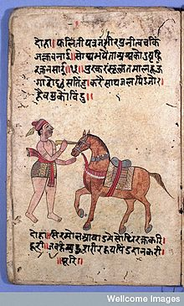
veheri -to draw, any animal that works with a yoke.
Verrius Flaccus, 14 A. D. in “Bestia Veterinus”
vieh- cattle, and terrin to be sick.
Other etymologists give a Celtic origin from

Slide 5
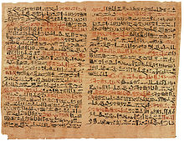
9000 BC -The first known veterinary practice came into being in in the Middle East.
4000 – 3000 BC in Egypt, medical treatment of animals became more common, but was still largely undeveloped.
1900 BC, first written accounts of veterinary medicine in four sacred Hindu texts.
1800 BC Kahun Gynaecological papyrus

Slide 6
1000 BC- Nakul-expert on horses and Sahdev- expert on cattle husbandry.
??? Shalihotra- expert on horse, Ashwachikitsa (Hayachikitsa)- father of veterinary medicine.
600 – 500 BC- Sushruta- Father of Indian medicine and father of plastic surgery. Pupil of Dhanvantari
Sushruta Samhita

Slide 7
460-375 BC- Hippocrates.
300 BC-Samrat Ashoka- erected first veterinary hospital.
____________
129-210 AD- Galen- Physician and philosopher studied animals’ body to know about human anatomy and no body dare antagonise him.
1514-1564 AD- Andreas Vesalius Physician- careful description of human anatomy dared to antagonise Galen

Slide 8
1510-1590 AD Ambroise Pare French barber-surgeon, haemostasis ligatures in lieu of cauterisation.
1761 AD-Claude Bourgelat erected first veterinary school at Lyons, France.
1771-1804 AD- Joseph Priestley- discovers nitrous oxide.
1818-1865 AD- Ignaz Semmelweis-Hungarian physician. Introduced antisepsis.

Slide 9
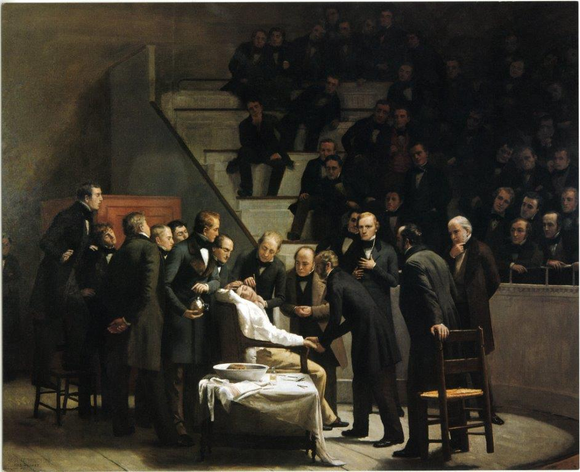
1846 AD William Morton- successfully demonstrated the use of ether anaesthesia for surgery.

Slide 10
1852-1922 AD William Stewart Halsted- aseptic surgery.
1856 AD- W.C. Roentgen- x-rays
1867 AD- Joseph Lister- Technique of antisepsis

Slide 11
Surgery
Chier /kheir- hand; ergon- work= Cheirurgia
That branch of medical science which deals with the treatment of diseases, injuries, or deformities by the physical removal, repair, or readjustment of organs and tissues, often involving cutting into the body, OR
That branch of medicine which is concerned with the treatment of injuries, diseases, and other disorders by manual and instrumental means.

Slide 12
Tenets of Halsted
  Gentle handling of tissue
  Careful haemostasis
  Preservation of blood supply
  Strict aseptic technique
  Minimum tension on tissues
  Accurate tissue apposition
  Obliteration of deadspace

Slide 13
THANK YOU
Very Much

