Slide 1
Antimicrobial drug
Dr Padma Nibash Panigrahi
Assistant Professor
Department of Veterinary Medicine
DUVASU, Mathura

Slide 2
Introduction
Anti bacterial
Antifungal
Antirickettsial
Antiviral
Factors –
  Age, sex, species
  Route
  Organ system affected
  Cost

Slide 3
Classification
Bacteriocidal
Bacteriostatic
Narrow-spectrum antimicrobial
Broad-spectrum antimicrobial: kill wide range of microorganisms:

Slide 4
Bactericidal Bacteriostatic
β-lactam agents Erythromycin
Aminoglycosides Tetracyclines
Quinolones Chloramphenicol
Vancomycin Sulfonamides
Trimethoprim

Slide 5
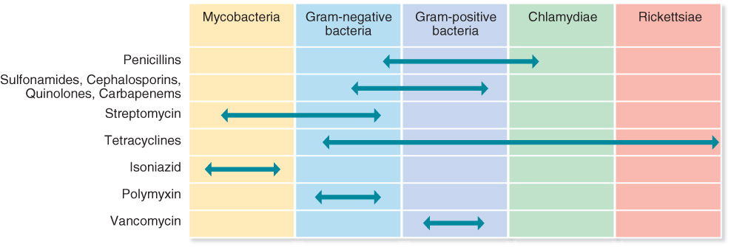

Slide 6
Classification-MOA
Inhibit cell wall synthesis
Inhibit protein synthesis
Inhibit nucleic acid synthesis
Injury to plasma membrane
Inhibit synthesis of essential metabolites

Slide 7
1. Inhibit cell wall synthesis
Eg- β-Lactam Drugs : penicillins and cephalosporins gr.
Irreversibly inhibit enzymes involved in the final steps of cell wall synthesis

Slide 8
Penicillin
Natural penicillin: penicillin G and V
Penicillinase-resistant penicillins: cloxacillin, dicloxacillin, oxacillin, and methicillin (narrow spetrum)
Aminopenicillins : ampicillin, amoxicillin, cyclacillin, hetacillin and bacampicillin
Extended-spectrum penicillin : carbenicillin, piperacillin
Potentiated penicillin : amoxicillin-potassium clavulanate, ampicillin-sulbactam, and ticarcillin-potassium clavulanate

Slide 9
Indicaion : aerobic and anaerobic G + bacilli - Bacillus anthracis, Clostridium sp. (not C. difficile), Fusobacterium and Actinomyces
Aminopenicillins: broad-spectrum- gram negative aerobes (E. coli, Klebsiella, and Haemophilus) + G+ve
Contraindicated- in patients having history of hypersensitivity
Adverse reaction- very low, If given orally may cause GI effects (anorexia, vomiting, diarrhea). Because may also alter gut flora, antibiotic-associated diarrhea
Safe in pregnancy

Slide 10
High doses or very prolonged use has been associated with neurotoxicity
Drug interaction:
Synergistic with aminoglycosides or cephalosporins, beta-lactamase inhibitors-clavulanic acid, sulbactam, tazobactam
Antagonistic: with bacteriostatic antibiotics (e.g., chloramphenicol, erythromycin, tetracyclines)
Ampicillin may cause false-positive urine glucose determinations when using cupric sulfate solution (Benedicts Solution)
Probenecid competitively blocks the tubular secretion of most penicillins

Slide 11
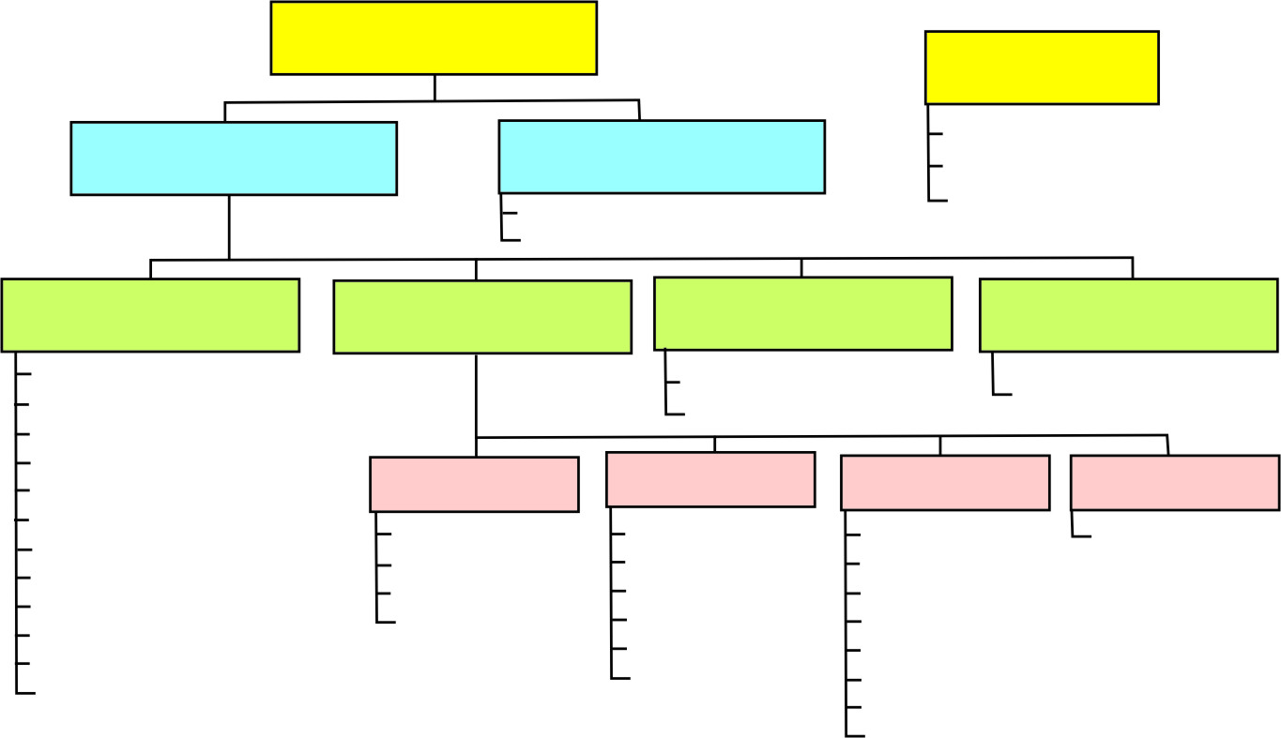
cephalosporins
INHIBITORS OF CELL
WALL SYNTHESIS
β-LASTAMASE
INHIBITORS
β-LASTAMASE
ANTIBIOTIC
OTHER
ANTIBIOTIC
Clavulanic acid
Sulbactam
Tazobactam
Bacitracin
Vancomycin
PENICILLINS
CEPHALOSPORINS
CARBAPENEMS
MONOBACTAMS
Amoxicillin
Ampicillin
Cloxacillin
Dicloxacillin
Indanyl carbenicillin
Methicillin
Nafcillin
Oxacillin
Penicillin G
Penicillin V
Piperacillin
Ticarcillin
Imipenem/cilastatin
Meropenem*
Ertapenem
Aztreonam
1st GENERATION
2nd GENERATION
3rd GENERATION
4th GENERATION
Cefadroxil
Cefazolin
Cephalexin
Cephalothin
Cefaclor
Cefamandole
Cefprozil
Cefuroxime
Cefotetan
Cefoxitin
Cefdinir
Cefixime
Cefoperazone
Cefotaxime
Ceftazidime
Ceftibuten
Ceftizoxime
Ceftriaxone
Cefepime
(according to Lippincott´s Pharmacology, 2009)

Slide 12
Cephalosporins
Indication: both G +ve and – ve
Contraindicated- in patients having history of hypersensitivity
Safe in pregnancy
Adverse reaction- very low, If given orally may cause GI effects (anorexia, vomiting, diarrhea). Because may also alter gut flora, antibiotic-associated diarrhea
Notes:
4th highest then 3rd…

Slide 13
Drug interaction:
Synergistic with aminoglycosides or cephalosporins, beta-lactamase inhibitors-clavulanic acid, sulbactam, tazobactam
Antagonistic: use of parenteral aminoglycosides or other nephrotoxic drugs (e.g., amphotericin B) with cephalosporins could cause additive nephrotoxicity

Slide 14
Ceftriazone- @ 5- 10 mg/kg- L A
  @ 15-25 mg/kg- dog, cat, (IM, IV, PO)
Cefotaxim @ 25-50 mg/kg- dog, cat
Caftiofur @ 1.1- 2.2 mg/kg- IM, SC
Cefadroxil @ 10-30 mg/kg- PO

Slide 15
2. Inhibit Protein Synthesis
Target ribosomes of bacteria
Aminoglycosides: bind to 30S subunit causing it to distort and malfunction; blocks initiation of translation
Tetracyclines: bind to 30S subunit blocking attachment of tRNA.
Macrolides: bind 50S subunit and prevents protein synthesis from continuing.

Slide 16
Aminoglyosides
Amikacin @ 10 mg/kg- dog, cat, tid, IM,IV,SC
Gentamicin @ 4 mg/kg- C/ S/G/D/C/P- IM,IV, poultry- 3-5 mg/kg
Neomycin
Netilmicin
Streptomycin- sreptopenicillin
Tobramycin
Contraindicated-in pregnancy and cow prone to milk fever

Slide 17
Indication
Bacterisidal
many aerobic G-ve and some aerobic gram positive bacteria, including most species of E. coli, Klebsiella, Proteus, Pseudomonas, Salmonella, Enterobacter, Serratia, and Shigella, Mycoplasma, and Staphylococcus.
Several strains of Pseudomonas aeruginosa, Proteus, and Serratia that are resistant to gentamicin will still be killed by amikacin.
Antimicrobial activity of the aminoglycosides are enhanced in an alkaline environment.
The aminoglycoside antibiotics are inactive against fungi, and most anaerobic bacteria

Slide 18
Toxicity- irreversible ototoxicity and nephrotoxic
caution in patients with neuromuscular disorders (e.g., myasthenia gravis) due to their neuromuscular blocking activity.
Contraindicated-
in pregnancy and cow prone to milk fever
in rabbits/hares as they adversely affect the GI flora balance in these animals
Drug Interactions - used with caution with other nephrotoxic, ototoxic, and neurotoxic drugs. These include amphotericin B, other aminoglycosides, acyclovir, bacitracin (parenteral use), cisplatin, methoxyflurane, polymyxin B, or vancomycin.

Slide 19
Tetracyclines
OTC @ 5- 10 mg/kg LA
@ 10-20 mg/kg dog, cat, IM,IV
Doxicycline @10 mg/kg dog, cat
@ 1-2 mg/kg cattle, S, G, PO
Bacteriostatic
Indication
G +ve, G –ve, Clamydia, Rickettsia, Mycoplasma

Slide 20
Contraindicated- young animal and pregnant
young animals can cause discoloration of bones and teeth to a yellow, brown, or gray colour.
Only used in the last trimester of pregnancy
Cats do not tolerate oral tetracycline
Toxicity
Nephrotoxic and hepatotoxic –long term use

Slide 21
Macrolides
erythromycin, roxithromycin, azithromycin, clarithromycin (methylated form of erythrom.)
telithromycin - derivative of erythromycin (a ketolide) , clindamycin
Indication- gram positive cocci (staphylococci, streptococci), gram positive bacilli, some strains of gram negative bacilli Actinomyces, Mycoplasma, Chlamydia, Ureaplasma, and Rickettsia are

Slide 22
Erythromycin
Erythromycin (base) capsules and tablets should be stored in tight containers at room temperature
protected from light.
To retain palatability, the oral suspensions should be refrigerated.
@ 2.2-4.4 mg/kg- LA, PO
@10-40 mg/ kg dog

Slide 23
Drug Interactions –
Because erythromycin, lincosamides (clindamycin, lincomycin), and chloramphenicol all bind to the 50S ribosomal subunit, competition for binding can occur and some clinicians state these drugs should not be used concurrently.
In vitro synergy with other antimicrobials (e.g., sulfonamides, rifampin) has been reported with erythromycin
Drug/Laboratory Interactions - Erythromycin may cause falsely elevated values of AST (SGOT), and ALT (SGPT) when using colorimetric assays.
Fluorometric determinations of urinary catecholamines can be altered by concomitant erythromycin administration.

Slide 24
Clindamycin
Lincosamide antibotics
50 s ribosome
@ 5.5 mg/ kg BID, PO/ 11 mg/kg OD
Avoid in rabbit, Guinea pig and hamster because of serious gastrointestinal effects that may occur, including death
Contraindicated during pregnancy and lactation- diarrhoea in newborn

Slide 25
Cloramphenicol
Broad-spectrum
  wide range of G+ and gram– organisms;
  also some intracellular - e.g. rickettsiae.
mostly bacteriostatic
Should be used with caution in neonatal animals, particularly in young kittens.
In neonates (humans), circulatory collapse (Gray-baby syndrome) has occurred probably due to toxic levels accumulating secondary to an inability to conjugate

Slide 26
given with caution to nursing bitches or queens, particularly within the first week after giving birth- excrete in milk
Serious side-effects: bone marrow aplasia, suppression of RBCs, WBCs, encephalopathy, optic neuritis

Slide 27
3. Inhibit Nucleic Acid Synthesis
Target enzymes required for nucleic acid synthesis
Fluoroquinolones: inhibit enzymes DNA gyrase that maintain the supercoiling of closed circular DNA, bacteriidal
Rifamycins: block prokaryotic DNA-dependent RNA polymerase from initiating transcription

Slide 28
Fluoroquinolones
Enrofloxacin@ 2.5-5 mg/kg, IM,IV,PO
Ciprofloxacin @ 5- 15 (Dog, Cat), 5 mg/kg LA,
Norfloxacin
Levofloxacin
Nalidixic acid @ 50 mg/ kg /day-divided dose- dog, PO (UTI)
Gatifloxacin- ointment (eye drop)

Slide 29
Enrofloxacin
Bactericidal
Mostly G –ve
Contraindications
young animals
Arthropathic effect
GI and CNS defect
Rashes in skin
Not recommended in horse
Quinolones are also contraindicated in patients hypersensitive to them.

Slide 30
Ciprofloxacin
ciprofloxacin has occasionally been reported to cause crystalluria, animals should not be allowed to become dehydrated during therapy with either ciprofloxacin or enrofloxacin.
In humans, ciprofloxacin has been associated with CNS stimulation and should be used with caution in patients with seizure disorders.
Patients with severe renal or hepatic impairment may require dosage adjustments to prevent drug accumulation.

Slide 31
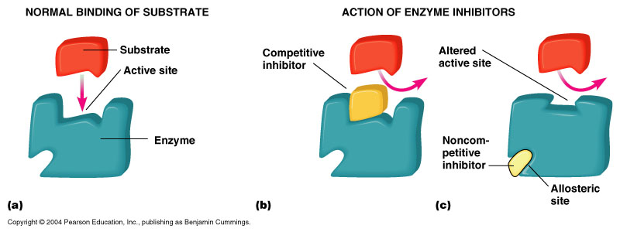
4. Sulphonamides
  Sulfonamides (Sulfa drugs)
    Inhibit folic acid synthesis
    Broad spectrum
    Bacteriostatic

Slide 32
Contraindications
patients hypersensitive to them, thiazides, or sulfonylurea agents.
patients with severe renal or hepatic impairment and should be used with caution in patients with diminished renal or hepatic function, or urinary obstruction.
Oral sulfonamides can depress the normal cellulytic function of the ruminoreticulum, but this effect is generally temporary and the animal adapts.
Sulfas cross the placenta and teratogenicity has been reported in some laboratory animals when given at very high doses.
They should be used in pregnant animals only when the benefits clearly outweigh the risks of therapy.

Slide 33
Drug Interactions - Sulfonamides may displace other highly bound drugs, such
  phenylbutazone, thiazide diuretics, salicylates, probenicid and phenytoin
Synergestic
Trimethoprim

Slide 34
5. Injure Plasma Membrane
Polymyxin B: binds to membrane of G- ve bacteria
Alters permeability of cell membrane
leads to leakage of cellular contents and cell death
These drugs also bind to eukaryotic cells to some extent, which limits their use to topical applications
@2.2 mg (10000 unit)/kg/day-divided dose
Nephrotoxic-prolonged use

Slide 35
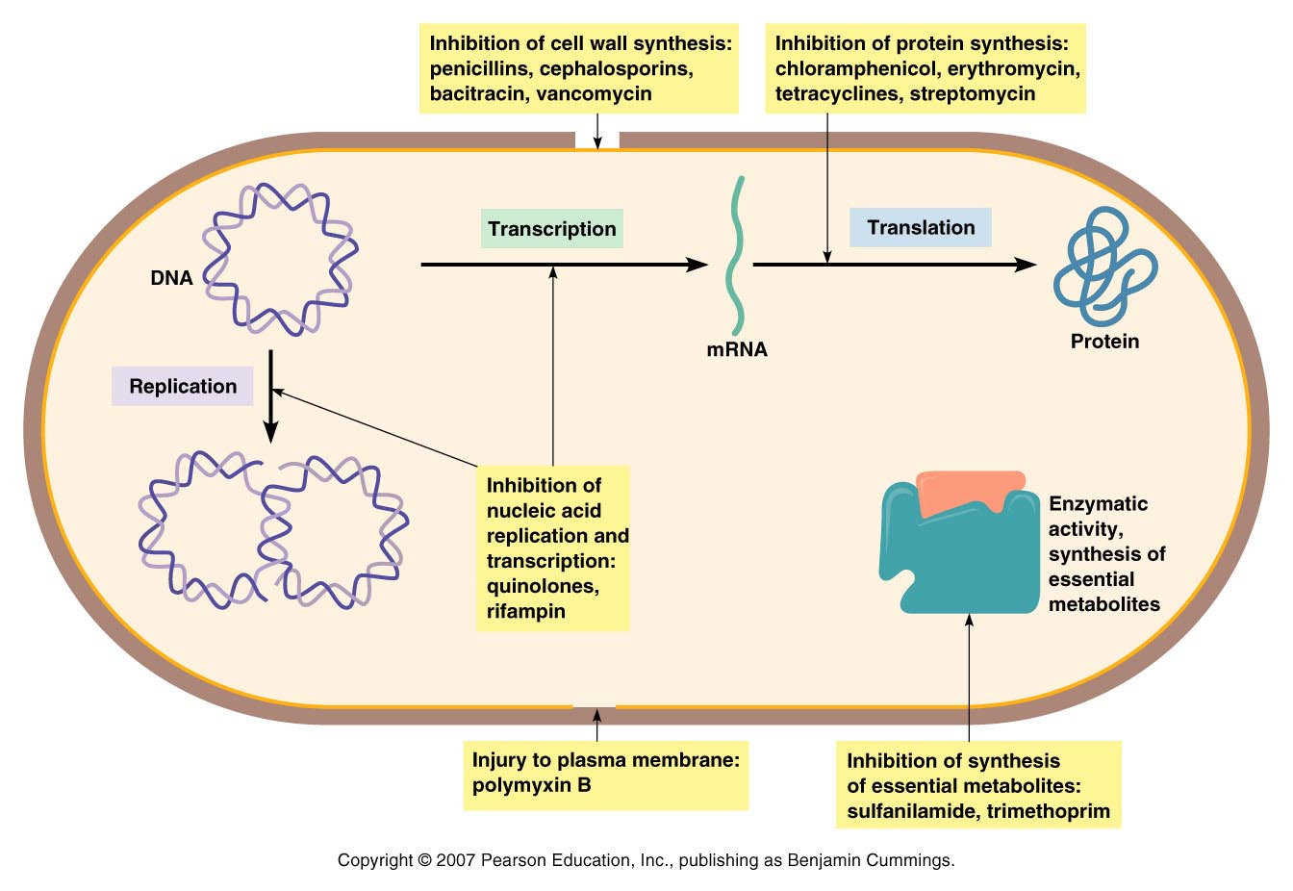

Slide 36

Thank you

