Slide 1
OPTIMUM TIME FOR ARTIFICIAL INSEMINATION
&
UPKEEPMENT OF AI EQUIPMENTS AND SEMEN AT AI CENTRES
Dr. Vikas Sachan
Assisatant Professor
Dept of Vet Gyn & Obst

Slide 2
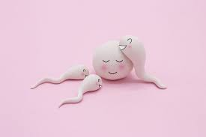
OPTIMUM TIME FOR ARTIFICIAL INSEMINATION

Slide 3
OPTIMUM TIME FOR ARTIFICIAL INSEMINATION
Artificial Insemination
- Fast genetic improvement
- Less/No transmission of veneral diseases
Successful conception
- Semen quality
- Inseminator efficiency
- Reproductive efficiency of female
- Heat detection
- Prediction the right time of insemination
- Optimum time of insemination - Time of ovulation

Slide 4
Dairy animals
- Estrous cycles throughout the year
- 21 days (may vary from 18 to 24 days)
Proestrous (3 days)
Oestrous (12 to 24 hrs)
Metestrous (3 to 5 days )
Diestrous (12 to 14 days)

Slide 5
Ovulation in dairy animals
- About 30-32 hrs after start of heat / estrous
- 12 to 14 hrs after end of oestrous
Intervals between
- Estrus and ovulation ...38 hr
- Estrus and the LH peak ....9 hr.
- LH peak and ovulation ....29 hr
Estrous……9 Hr……..LH peak…………….29 Hr……………………Ovulation

Slide 6
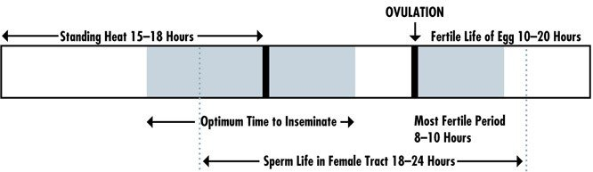
Optimum time of insemination
- 10 to 12 hrs after onset of estrous
- At mid to late estrous
- Maximum conception

Slide 7
The onset of behavioral estrous
- Under the influence of estrogen
- Changes in animal’s reproductive, circulatory and
nervous system
Very small window of opportunity
- For detection of the onset of standing heat
- Successful insemination
- Early estrous signs
Standing Estrous
- Late estrous

Slide 8
A score card is developed on the basis of observations
Scoring scale for visually observed symptoms of estrus:
Estrous symptoms Points
Mucous vulvular discharge 3
Cajoling (like flehmen) 3
Restlessness 5
Sniffing the vagina of another cow 10
Chin resting 15
Mounted but not stand Mounting 35
Mounting head side of other cow 45
Standing heat 100
sum of the points exceeds 50 during two consecutive observation periods (about 30 min twice a day), a cow was considered to be in estrous and ready to present for insemination.

Slide 9
- Optimum time of insemination
- microscopic examination of the dry smear of
estrous mucous discharge
- Typical fern / arborisation pattern
(Crystalization of NaCl under estrogenic effect)

Slide 10
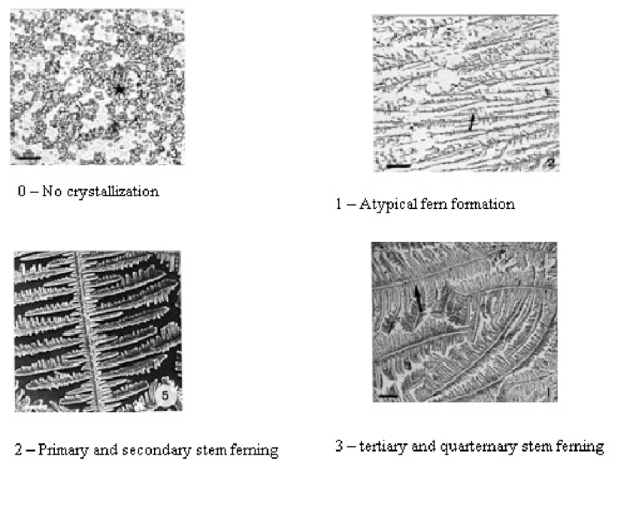

Slide 11
Progesterone assay
- RIA or ELSA
- 1 ng/ml at estrous in dairy animals
Per rectal examination
- Hyperemia of vaginal mucus membrane
- Relax and open external os
- Tonic uterus
- Mature follicle on either ovary
Ultrasonography examination
- 13 to 15 mm follicle on either ovary

Slide 12
UPKEEPMENT OF AI EQUIPMENTS AND SEMEN AT AI CENTRES
Artificial insemination (AI) –
- First generation reproductive biotechnology
- Rapid genetic improvement
- Less risk of transmission of venereal diseases
- No harmful recessive traits transmission
- Enhances the breeding value of a bull

Slide 13
Genetic merit of bulls
Quality of semen used
AI technique
Upkeepment and handling of the LN₂ cryocans
- AI equipments and semen handling
BETTER CONCEPTION RATE

Slide 14
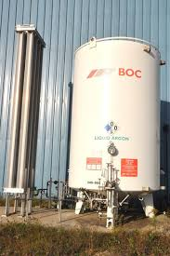
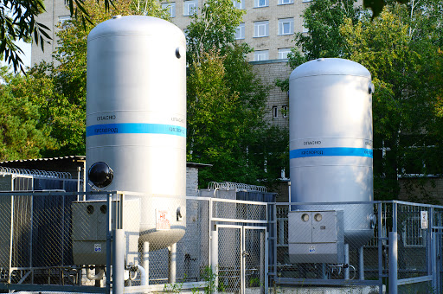
Liquid Nitrogen (LN₂)
- LN₂ provider/supplier
- Bulk Liquid Nitrogen storage and delivery facility

Slide 15
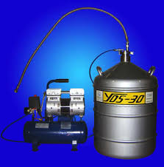
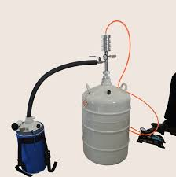
Liquid Nitrogen (LN₂)
- LN₂ provider/supplier
- LN₂ Tanks with gravitational flow facility
- LN₂ Pump delivery system / manual system
- Log book for LN₂ distribution schedule

Slide 16
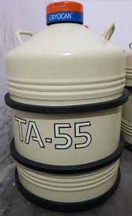
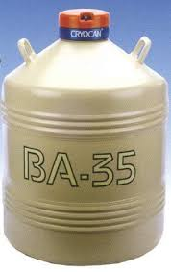
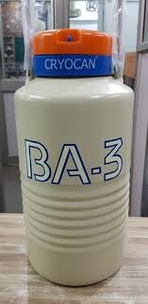
Liquid Nitrogen (LN₂)
- AI center
- container for LN₂ for storage (52 liter)
- frozen semen straws storage cryocan (35 litre)
- Small portable LN2 container (3-5 litre)

Slide 17
Liquid nitrogen
- BP -196⁰C and FP -212⁰C
- In special container : LN₂ cylinder or cryocan
- Double-walled metal/aluminium vacuum vessel
- Efficient insulation system
- Inner chamber, outer chamber and a bad heat
conductor non-metallic neck
- A high quality insulator material (No heat
exchange) with maintained vacuum system
: Between inner and outer chamber

Slide 18
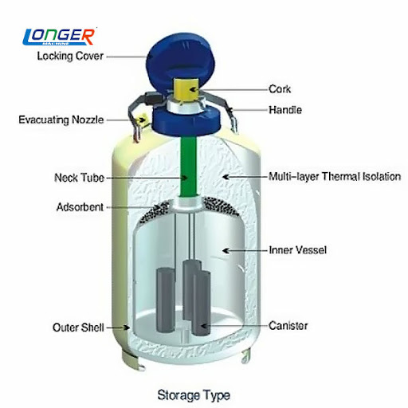

Slide 19
Failure of vacuum system
- Loss of the gas
Frost line (top of container) - increased evaporation
(due to damaged container)
Neck tube - delicate part
(hold weight of inner chamber)

Slide 20
LN₂ cylinder
-Kept on rubber, jute or wooden carpet
- No Wet floor, hard cement or chemicals
- corrosion - Loss of vacuum system
- Always in vertical position
- Never be tilted or rolled to avoid any damage
- No piling one cylinder above other

Slide 21
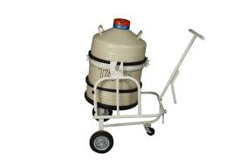
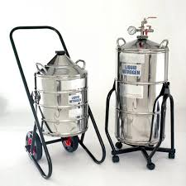
LN₂ cylinder
- Shifting with platform base trolley
- Place in cool place with no direct sunlight
- LN₂ holding capacity : reduced

Slide 22
- Arrangement of extra cryocan
(in case of appearance of frost line)
Careful handling to avoid damage to vacuum knob
No jerk or shock/vibration during lifting/carrying
- Damage to the neck tube: loss of vacuum system
No Punching or drilling on the container wall

Slide 23
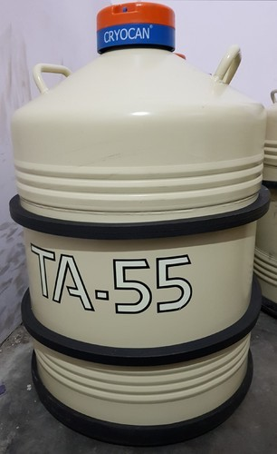
LN₂ cylinder - Secured with rubber band rings
(As shock absorbent)
- Careful while transporting filled cryocans in bus or train
(sudden evaporation : Panic situation)

Slide 24
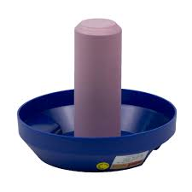
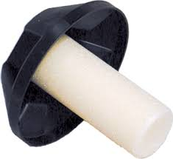
Neck : dry with cloth or tissue paper time to time
(to avoid jamming of the neck plug)
Lid should : vertical position
Lids or canisters : never be exchanged
(damage due to tight fitting)
(frost formation due to loose fitting)

Slide 25
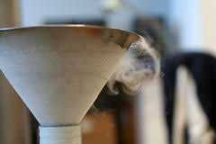
No Frequent opening, closing or shifting
: to keep evaporation rate minimum.
Charging and filling : Slowly
Non-splashing manner
Use funnel
Avoid overfilling of gas.

Slide 26
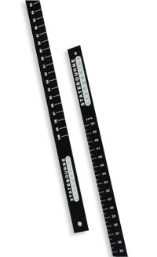
Metal or wooden dipstick :measure the LN₂ level
(No Plastic or any hollow rod)

Slide 27
Filling new container : Wait for 24 hr for charging
Refilled to its full capacity
Frost appearance on first filling
(Vanishes by its own within one or two hours)
First noting of the LN₂ level : After 10 days
(Normal time taken for thermal balance by the new
container)

Slide 28

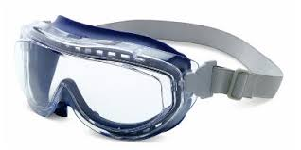
- Use of protective clothing and eye glasses
- To avoid any direct contact of the LN₂
- LN₂ : Non-toxic and Non-inflammable gas
- But direct contact : tissue damage (frost bite)
- Water should be used immediately
- Poorly ventilated room : Suffocation

Slide 29
- Frozen semen doses - in a well-ventilated room
(all weather safe storage area)
Identification marking and mapping of semen storage
Frozen semen : No exposure above liquid nitrogen
(thermal shock)
Canister : Not exposed over and above the neck
Transferring the semen straws : Use thermocole box
(Fast transferring : 5 seconds exposure of straw in air)
Maintain proper level of liquid nitrogen
Details of semen dose and AI centre
: Updated after every supply

Slide 30
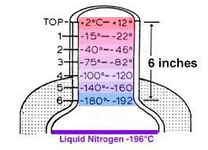
- LN₂ level below the canister
- Lost cold chain
- whole of the semen stored spoiled
- Discard all the semen doses
- Replenish the LN₂
At the time of AI , Semen straw
- No exposure above LN₂ : more than 10 seconds

Slide 31
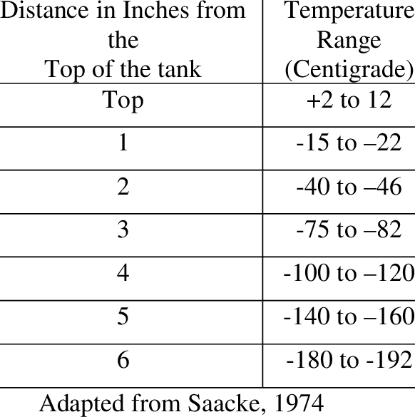

Slide 32
- AI kit - Scissors, Thermometer/thaw monitor, Thawing Tray, Forceps, Sheaths with sheath container, AI Gun with container, Plastic gloves, Lubricant, Isopropyl alcohol/ surgical spirit, Tissue papers, Clean towel, Thermos-flask with hot water, apron, Tags, pins and tag applicator etc.
Stainless steel AI guns and AI sheath
: Approved by BIS (Bureau of Indian Standard)

Slide 33
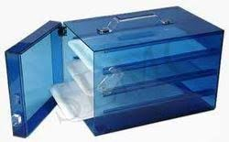
- Clean AI gun, scissors and other accessories
: When soiled
: Once a week with hot water and air dry
- Sanitize the AI gun and the scissor
: With Isopropyl alcohol after every insemination
- Surgical spirit and soaps : lethal to semen
- Aprons, towel etc : washed properly
- Cold fumigation in formaldehyde chambers (AI box)

Slide 34


