Slide 1

Infectious Bovine Rhinotracheitis (IBR)
Dr Padma Nibash Panigrahi
Assistant Professor
Department of Veterinary Medicine
DUVASU, Mathura

Slide 2

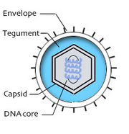
Etiology
Alfa herpesviridae
subtypes
  Bovine herpes virus-l
  BHV-l .l (respiratory)
  BHV-l.2a and 1.2b(genital)
  BHV- l.3 (BHV-5; encephalitic)

Slide 3
Epidemiology
Occurrence: Asia, Africa, Europe, North America, Australia, News Zealand
Host: cattle, buffaloes, small ruminant, wild ruminants
Endemic in white-tailed deer in certain parts of Canada, wild and farmed red deer in Britain
Buffaloes & wild ruminants may reservoir host

Slide 4
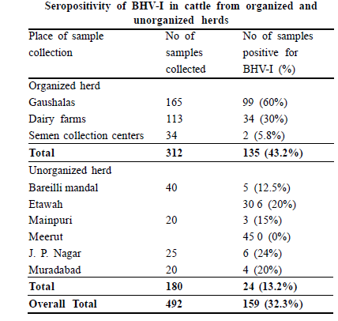
Singh et al., 2010

Slide 5
Morbidity & case fatality:
Uncomplicated form of the respiratory disease in cattle is not highly fatal
most losses being due mainly to secondary bacterial bronchopneumonia.
The morbidity and case fatality rates in dairy cattle are about 8% and 3%
feedlot cattle the morbidity rate is usually 20-30% in unvaccinated

Slide 6
Methods of transmission
Respiratory form: droplet, nasal secretion
Genital form: semen, genital fluid, foetal fluid, venereal
Risk factor
All ages and breeds of cattle are susceptible
most common- above 6 months of age (probably because of their greater exposure)
Unvaccinated herd -breeding cattle are highly susceptible to epidemics of respiratory disease and abortion

Slide 7
Clinical signs
Respiratory, Rhinitis (red nose)
Ocular form
Abortive form (IPV)
Systemic disease in newborn calves
Encephalitic form

Slide 8
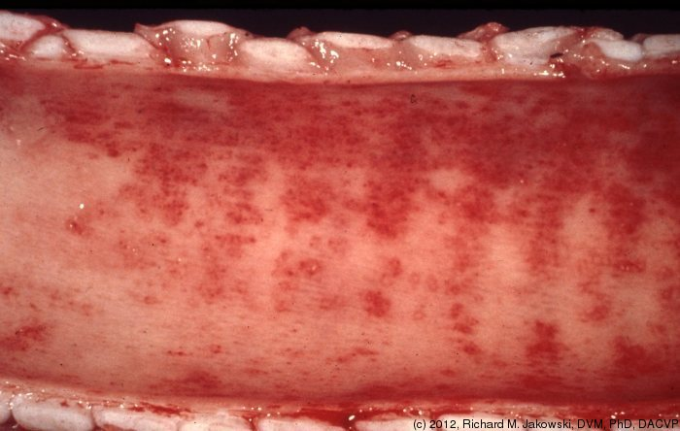
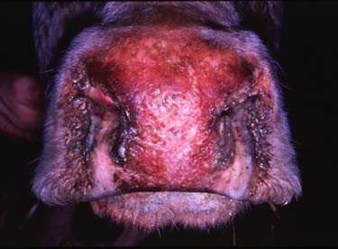
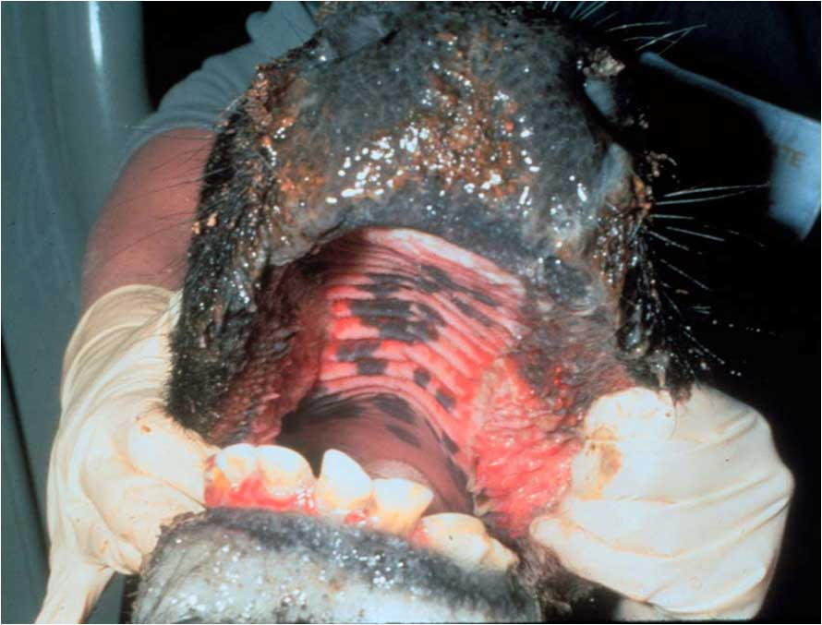
Rhinitis, tracheitis and conjunctivitis (red nose)
Anorexia, pyrexia (up to 42°C, 108°F)
Salivation
Nasal and ocular discharge
loud coughing
severe hyperemia of the nasal mucosa
Severe (viral or secondary bacterial) tracheitis, Inspiratory dyspnoea
abnormal tracheal breath sounds
Respiratory distress is evident on exercise

Slide 9
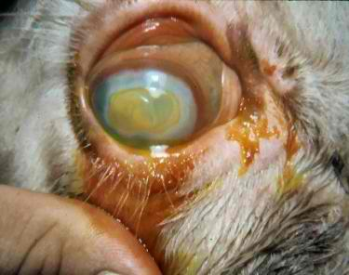
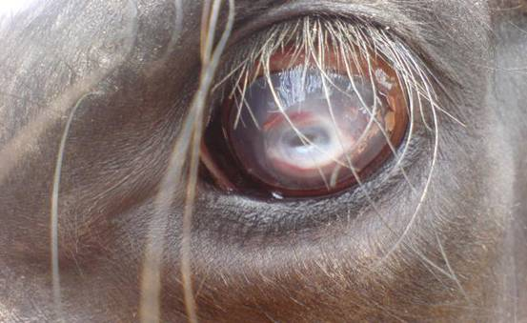
Ocular form
Conjunctivitis
Conjunctiva- reddened and edematous
Profuse serous ocular discharge
(DD: infectious keratoconjunctivitis (pink eye)
IBR lesions: confined to the conjunctiva and there are no lesions of the cornea except diffuse edema
Calves below 6 months of age may develop encephalitis, incoordination, Excitement, depression, Salivation, bellowing, convulsions and blindness
high mortality rate.
Notes:
Severe conjuctiviis and edema

Slide 10
Systemic disease in newborn calves
newborn calves under 10 days of age
highly fatal
Sudden anorexia, fever
excessive salivation
rhinitis
unilateral or bilateral conjunctivitis
Bronchopneumonia
loud breath sounds, crackles and wheezes
Outbreaks- unvaccinated herd (dams)

Slide 11
Abortion (IPV)
6-8 month of pregnancy
Retention of placenta
Endometritis
Infectious vulvo vaginitis
Short estrous
Infertility

Slide 12
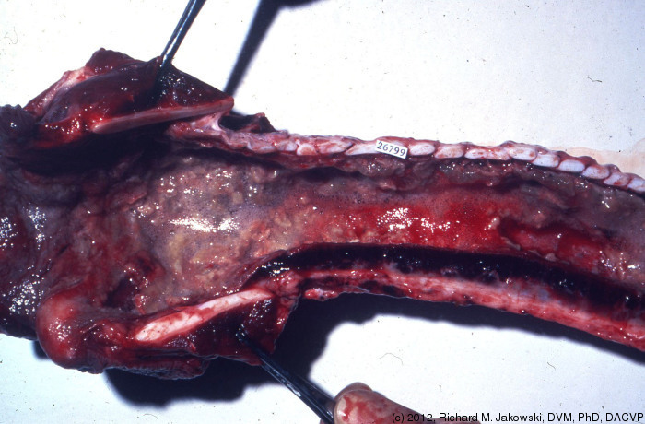
NECROPSY FINDINGS
Adult cattle- tracheitis, bronchitis
Pulmonary emphysema or bronchopneumonia,
Profuse and fibrinopurulent exudates
Lymph nodes: throat and neck region are usually swollen and edematous
Aborted fetuses: autolysis and focal necrotizing hepatitis

Slide 13
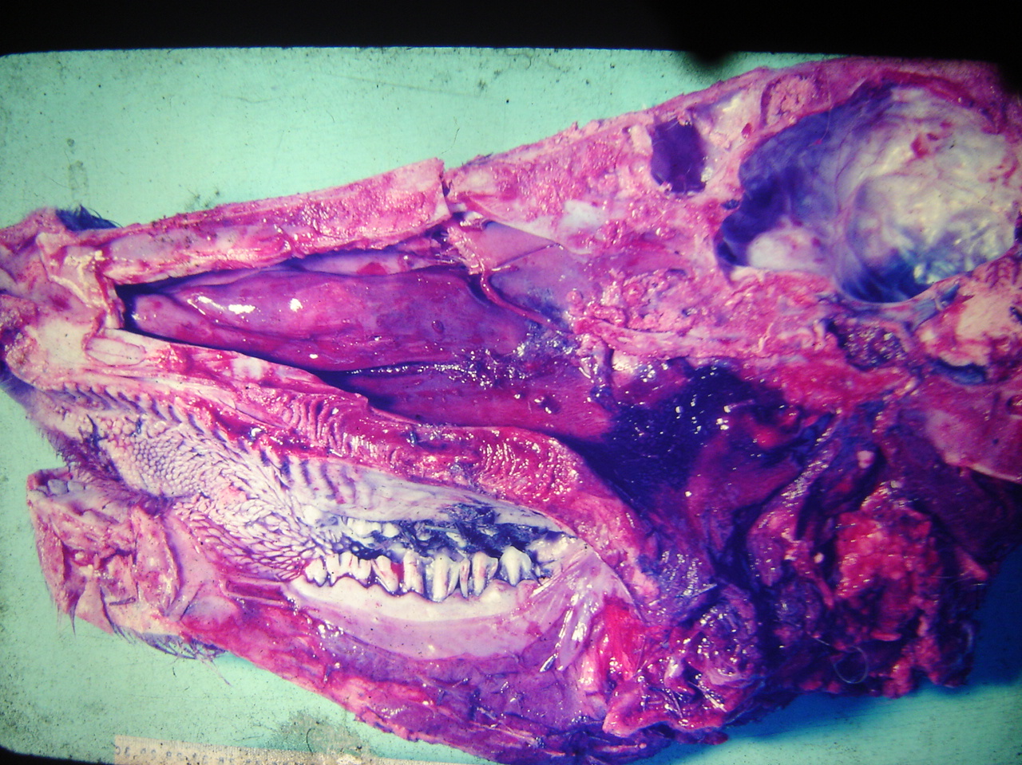
Rhinitis with congested nasal chambers

Slide 14
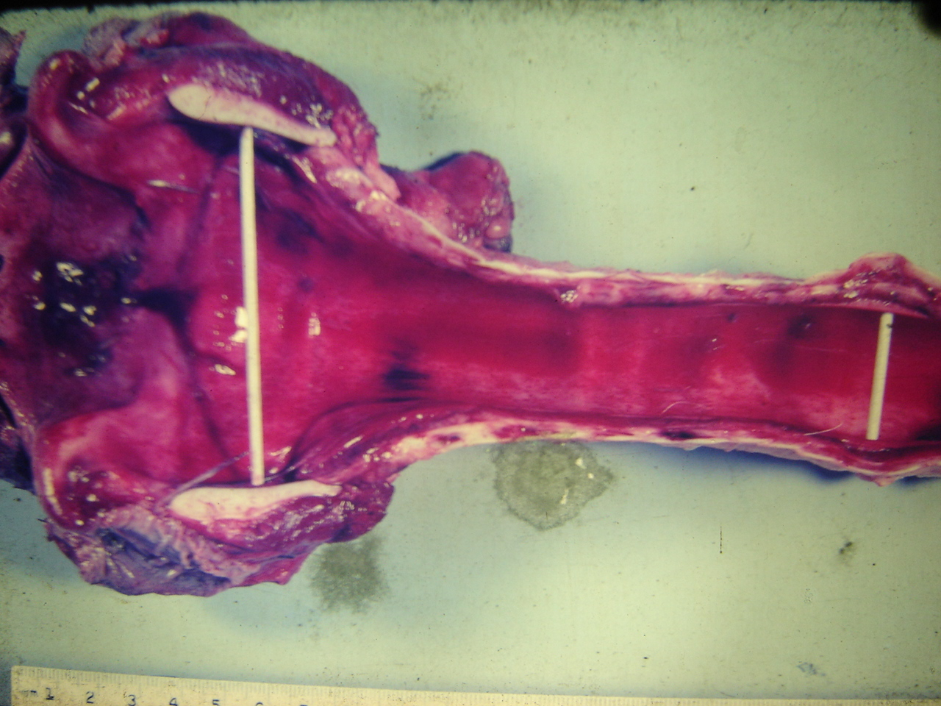
Tracheitis (IBR)

Slide 15
CLINICAL PATHOLOGY
Histology – formalin-fixed samples:
abortion/neonate: lung, liver, trachea, kidney, adrenal gland, rumen, esophagus, pharynx;
respiratory form: nasal turbinate, trachea, pharynx, lung
encephalitic form: half of mid sagittally sectioned brain
Virology - abortion/neonate: lung, liver, kidney, rumen
respiratory form: lung, trachea, nasal swab
Encephalitic form: half of midsagittally-sectioned brain (FAT, PCR)

Slide 16
Isolation of virus
Cell lines - Madin–Darby bovine kidney cell line (MDBK) uesd for BoHV-1 propagation
Virus isolation from semen (a prescribed test for international trade)
Nucleic acid detection
DNA–DNA hybridisation and the PCR
Real-time polymerase chain reaction (a prescribed test for international trade)

Slide 17
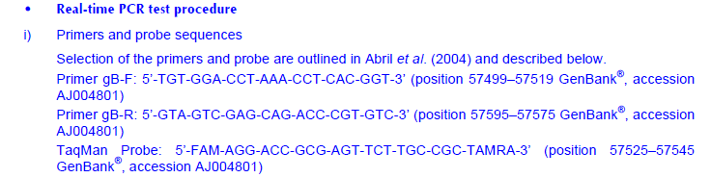

Slide 18
Viral antigen detection
Nasal, ocular or genital swabs can be directly smeared onto glass cover-slips
direct or indirect fluorescent antibody test
ELISA
VNT

Slide 19
Treatment
No specific anti viral drug
Broad-spectrum antimicrobials are indicated if secondary bacterial tracheitis and pneumonia are present
OTC, Ceftriazone, Ceftiofur, Enrofloxacin
Bronchodilator: Deriphylline
Inhailation
NSAID
Supportive therapy

Slide 20
Control
Vaccination
Biosecurity
Hygiene
Isolation and quarrantine

Slide 21
Vaccination
(6-12 months of age)
Modified live-virus vaccines (2 types)
  parenteral vaccine usually made with bovine foetal kidney tissue culture
  intranasal vaccine of rabbit tissue culture origin
  An intranasal vaccine of bovine tissue culture origin containing a temperature-sensitive mutant is also available
Protection from infection and disease has been observed within 40-96 hours following vaccination

Slide 22
2. Inactivated vaccine
require two doses of the vaccine
Booster- 10-14 days after the primary
But protection is observed after 7-10 days following the second dose of vaccine

Slide 23
.3. Subunit vaccines
contains only one or more of the antigens of the pathogen necessary to evoke protective immunity, and lacks the components that might cause unwanted side-effects.
Contain major surface glycoproteins of the BHV-1

Slide 24
Vaccination programs in herds
Beef breeding herds.
Beef calves -2-3 weeks before weaning
Heifer and bull -at least 2 weeks before breeding
Dairy cattle
heifer 2-3 weeks before breeding.

Slide 25

Thank you

