Slide 1
X-rays:
Interaction with matter
Dr Gulshan Kumar
MVSc PhD

Slide 2
X-rays are actually photons travelling with the speed of light.
Interaction.. How a photon interacts with matter on which it falls/impinges.
Matter may be tissue/cells/or non-biological material (here, we are considered with biological material only).
When the photon falls/strikes/impinges on the matter it encounters the atoms of that matter.
An atom comprises of a nucleus containing neutrons and protons around which are several orbits in which electrons are arranged (2n²)

Slide 3
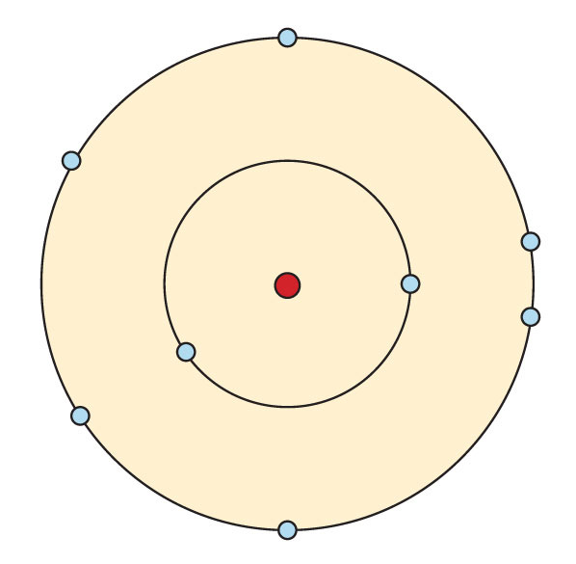
When x-ray photons enter the matter, they may:
  Penetrate the matter,
  Get absorbed in the matter, or
  May get deviated and attenuated.
So………

Slide 4
X-rays photons may interact with matter in five (05) ways:
  Coherent Scatter
  Compton Scatter
  Photoelectric effect/absorption
  Pair production
  Photodisintegration

Slide 5
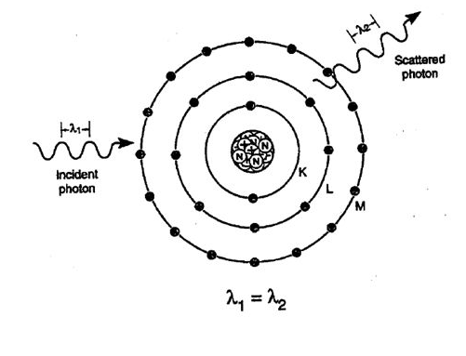
Coherent Scatter (photon energy<10 kev)
  The photon excites the whole of the atom
  There is no ionisation
  Electrons just vibrate in their orbits
  The atom returns to relax and the photon leaves the atom slightly deflected from its original direction
  Means it is scattered in different direction
  Wavelength of incident and scattered photon are same
  So no change in energy levels of photon
  Aka Classical scatter , very small %age, only contribute a little to image noise.

Slide 6
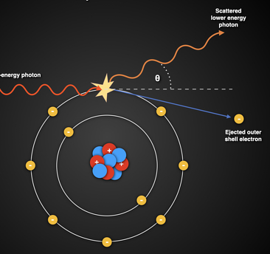
Compton Scatter (photon energy through out the
diagnostic energy range i.e. 10⁴ to 10 ^{5.5}kev))
  The photon removes an outer shell electron.
  Ionisation occurs. Some energy imparted to electron
  Called Compton Electrons
  The photon itself is deflected with increased λ and decreased energy
  Only contribute to fog on image, and absorbed dose of patient and attendant/technician… independent of atomic no. (Z)
  Liberate electron and scattered photon may cause further ionisations………
  Scatter can be in any direction….if backward….. “Back Scatter”

Slide 7
Photo-electric effect/absorption (also with photon energy through out the diagnostic energy range i.e. 10⁴ to 10 ^{5.5}kev))
  The photon removes an inner shell electron.
  Ionisation occurs. All energy imparted to electron the photo electron.
  Photon gets absorbed, the ejected electron may act to form characteristic x rays of low energy from adjacent atoms… and so on.
  Higher the Z, greater the absorption
  Contribute to image formation
  Increasing the photon energy decreases the probability of Photo-electric absorption. Even bone will be penetrated (darker).

Slide 8
Pair production (with photon energy > 1.02 mega ev)
  If the photon has higher energies then it will bye pass the electrons and interact with the nuclear field.
  The photon disappears and a pair of electron and positron appears.
  Does not occur in the diagnostic range of x rays.

Slide 9
Photo-disintegration (with photon energy > 10 mega ev)
  If the photon has higher energies then it will bye pass the electrons and interact with the nuclear field.
  The photon disappears and nucleus disintegrates to nucleons.
  Does not occur in the diagnostic range of x rays.

