Slide 1

Radiographic faults
Gulshan Kumar
MVSc, PhD

Slide 2
To be of any diagnostic value, these radiographs have to be of adequate quality.
Poor radiographic technique can lead to underdiagnosis of disease, due to missed lesions, but also to overdiagnosis, where the presence of a lesion is mimicked by inadequate positioning or artefacts.

Slide 3
FAULTY POSITIONING

Slide 4
CENTERING
COLLIMATION

Slide 5
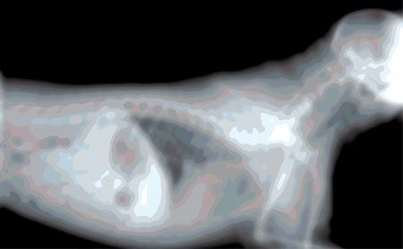
CONTROL OF MOVEMENT during exposure

Slide 6
EXPOSURE

Slide 7
EXPOSURE

Slide 8
EXPOSURE

Slide 9
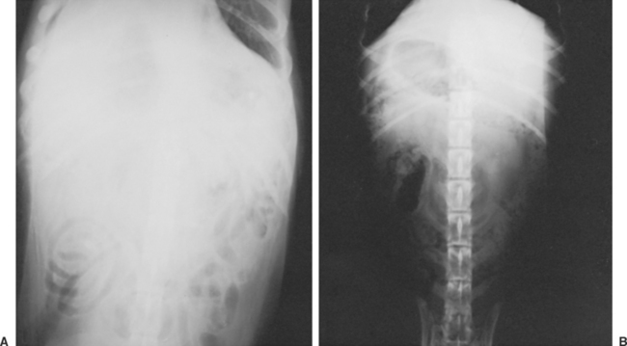
EXPOSURE

Slide 10
POOR RADIOGRAPHIC CONTRAST
  Underdevelopment
  Film fogging
  Exposure factors (Scale of contrast)

Slide 11
MARKS ON THE FILM

Slide 12
MARKS ON THE FILM

Slide 13
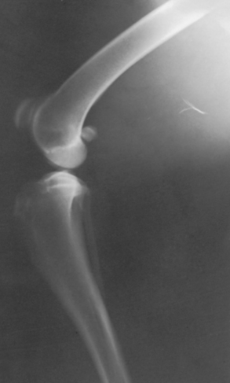
MARKS ON THE FILM

Slide 14
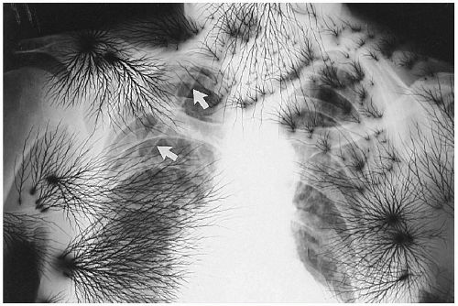
MARKS ON THE FILM

