Slide 1
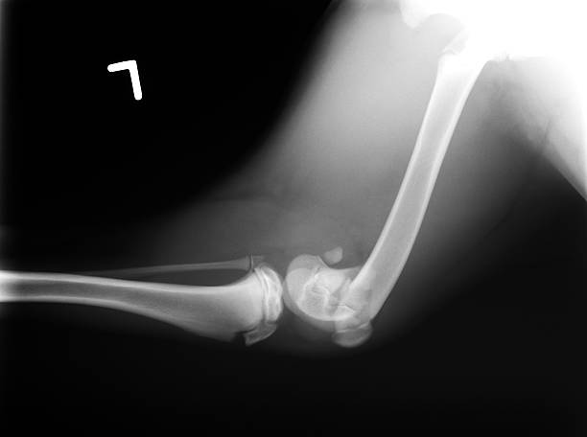

Slide 2
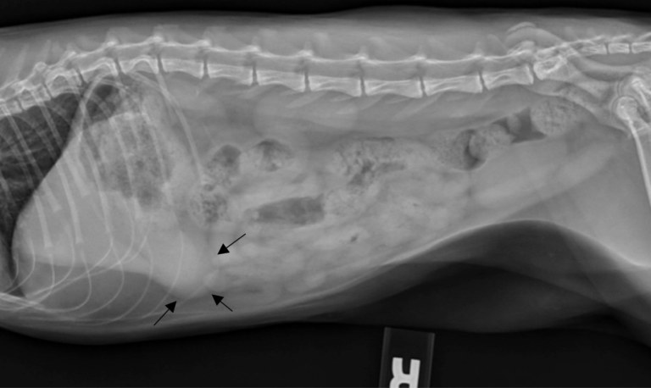

Slide 3
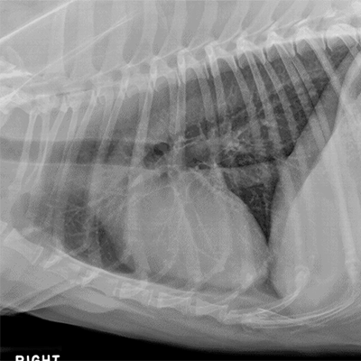

Slide 4
Contrast Radiography
Dr. Gulshan Kumar
MVSc, PhD

Slide 5
When­ the radio-density of the tissue itself or its surrounding structures is changed to obtain a radiograph with improved visualization and demarcation, it is called contrast radiography.
The substance used for the purpose is called contrast medium.
A contrast agent is a chemical substance of very high or very low atomic number or weight, which either increases or decreases the density of the organ under examination.

Slide 6
Positive contrast media - Materials which increases radio-density of the tissue under question in relation to surrounding tissue.
Negative contrast media- Materials which relatively decrease the radio-density.
When both contrast media are used together it is termed as double contrast radiography.

Slide 7
Advantages
Structures or organs can be evaluated more effectively for their size, shape and position.
Valuable information can be gained regarding serosal and mucosal surfaces of hollow organs or their contents which otherwise are not apparent on plain radiographs.
In some instances some idea of the function of the organ can be formed.

Slide 8
Positive contrast media
The atomic number of body part is generally positively correlated with the radio-density of a compound.
The highest atomic number in the body is that of the bone i.e. 138.
The atomic number of air filled lungs is 4.
For compounds to be used as positive contrast agents, the atomic number of the element has to be above 50 e.g. for barium it is 56 and that of iodine 53

Slide 9
Ideal qualities of positive contrast medium
It should have desired atomic number (Z) number.
It should be inert or its metabolic byproducts should not be toxic.
Uranium (Z = 92) could be the best positive contrast medium but it is radioactive
Similarly lead (Z= 82) compounds produce excellent contrast but are toxic to living beings.

Slide 10
Ideal qualities of positive contrast medium
Emulsion of lead oxide and soap in water is a cheap contrast agent used for angiography in experimental animals to be euthanised.
In general, high osmolar contrast media are more toxic than low osmolar contrast media.
It should be retained in the area of interest only for a desired period.
Agents used for outlining excretory organs must specifically be excreted through that route in sufficient concentration so as to produce radio-density of diagnostic value, e.g. barium sulphate for alimentary canal, meglumine iodipamide for biliary system

Slide 11
Adverse reactions
Chemo-toxic or local reactions and
Systemic or hypersensitivity reactions
Adverse reactions can be minimized by pre administration of corticosteroids.
Non ionic low osmolarity contrast media (iohexol, iopamidol) cause fewer side effects

Slide 12
Broad classification of positive contrast media
Barium sulfate preparations
Barium sulfate suspension, meal, swallow, paste | For outlining alimentary tract only Insoluble in water, non absorbable Not to be used in perforations of GIT On leakage it persists permanently and may provoke granuloma formation

Slide 13
Water soluble iodine preparations
Sodium and megluimine salts of iothalamic, diatrizoic or metrizoic acids | Are ionic and dissociate in solution This is the largest group of Contrast Agents Used for angio-, osteomedullo-, arthro-, cystourethro-, sialo-graphy, IVP and double contrast peritoneography

Slide 14
Cholecystopaques
Iopionic acid, sodium iopodate, iocitamic acid (oral), meglumine iodoxamate, iotroxate, iodipamide and ioglycamate (intravenous) | These are aqueous organic iodine preparations exclusively excreted via biliary system. i/v preparations are better than oral. Used for cholecystography

Slide 15
Viscous and oily agents
Iophendylate, iodized poppy seed oil, propyliodone | Used for broncho-, sialo-, dacro-, myelo-, hysterosalpingography. Newer low osmoslar non ionic water soluble agents (iohexol, iopamidol) are better for myelography.

Slide 16
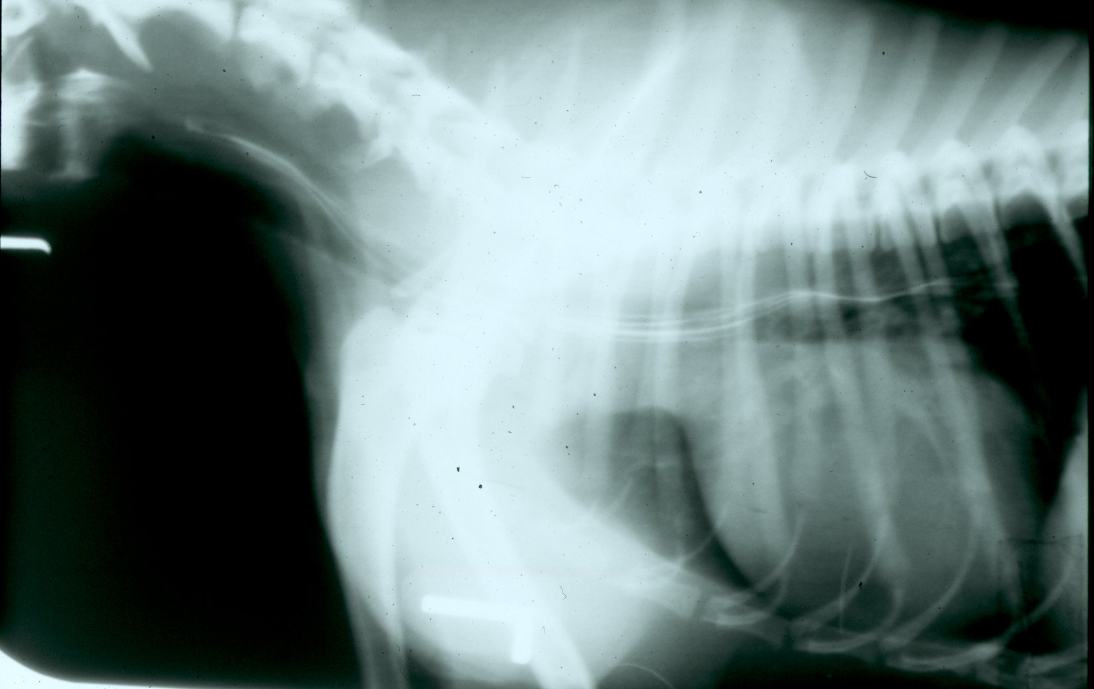
Positive Contrast - Enema

Slide 17
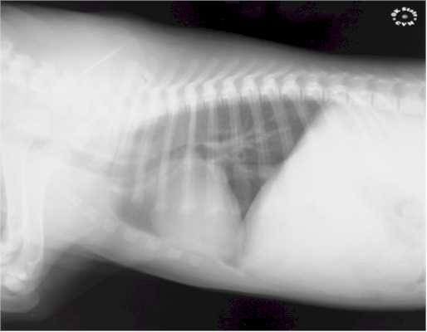
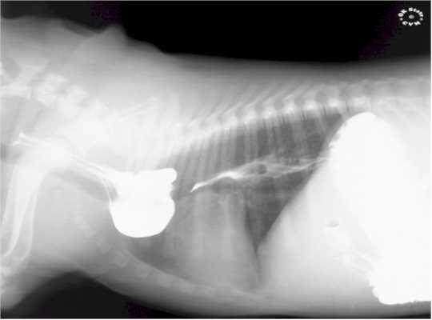

Slide 18
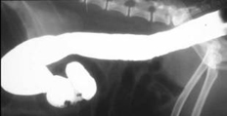
Positive Contrast - Enema

Slide 19
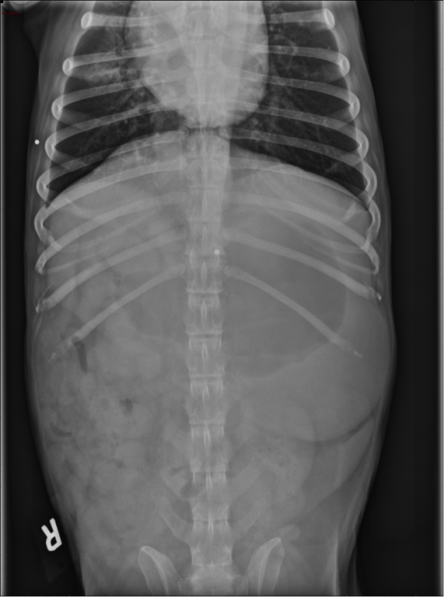
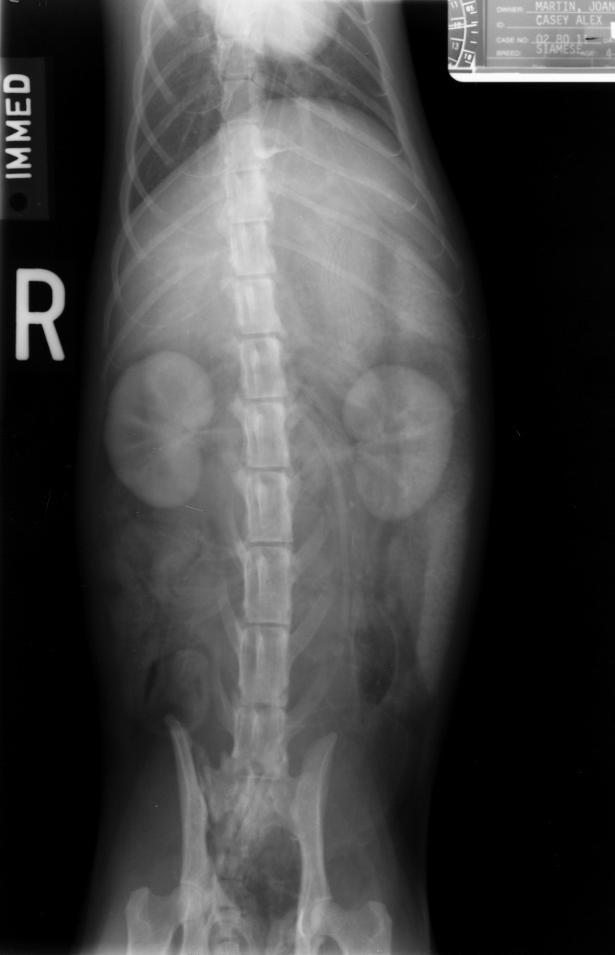

Slide 20
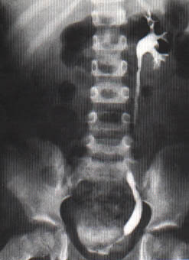
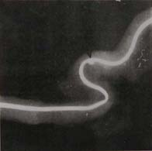
Positive Contrast
Ureter
Urethra

Slide 21
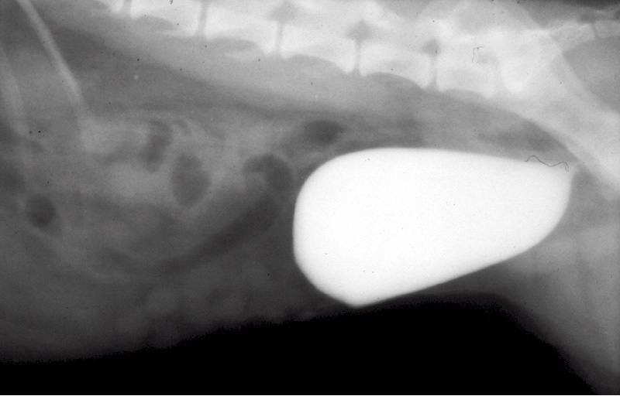

Slide 22
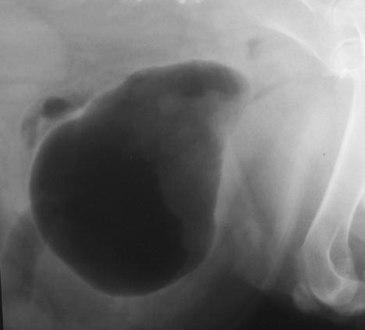
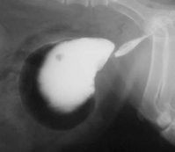

Slide 23
Negative contrast media
Room air, carbon dioxide and oxygen are most commonly used negative contrast media.
Nitrogen can also be used.
An ideal negative contrast media should be inert, quickly dissolved in the body fluids and quickly eliminated from the body.
Room air is cheapest, is safe but less readily absorbed.
After a gas has been infused into the tissues or a body cavity, it is eliminated.
………….

Slide 24
Negative contrast media
Since solubility of carbon dioxide in water is very high, it is eliminated quickly.
Gases provide poor contrast and are best used in double contrast studies.
Indications include arthrography, fasciagraphy, pneumo-peritoneography, pneumocystography etc.

Slide 25
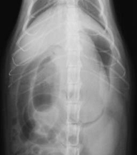
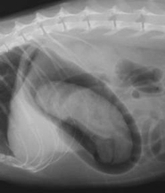
Negative contrast - Stomach

Slide 26
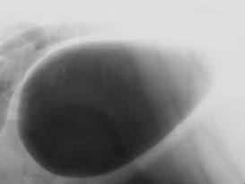
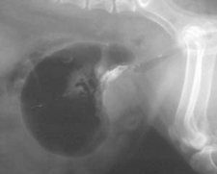
Negative Contrast – Urinary Bladder (UB)
Normal
With UB mass

Slide 27
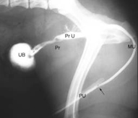
Double & Positive Contrast
Double contrast Cystography
Retrograde – Urethro-cystography

Slide 28
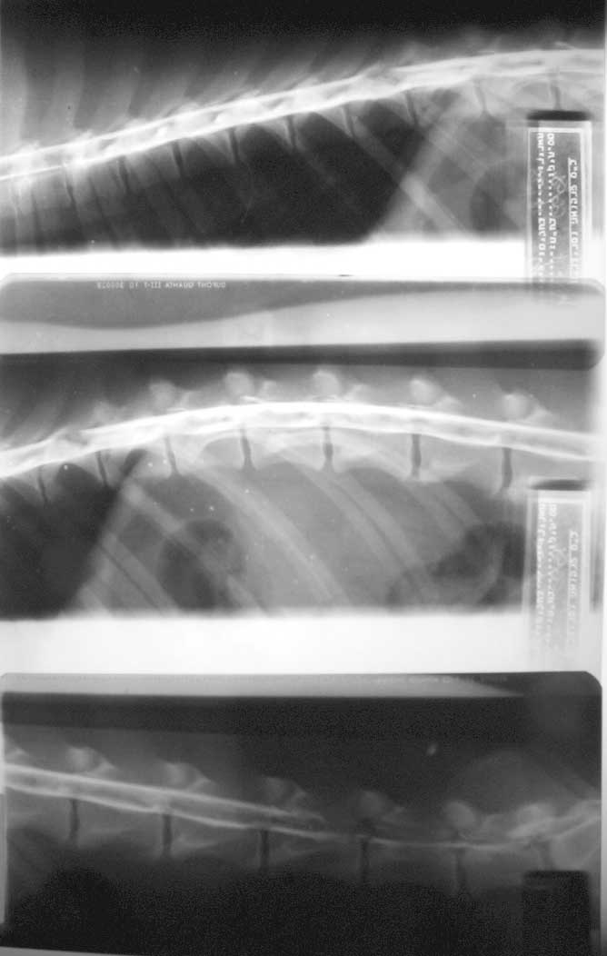
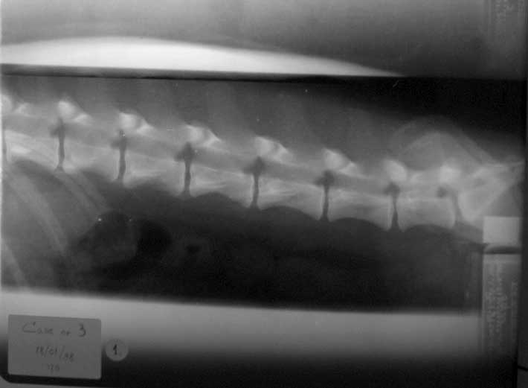
Myelography

Slide 29
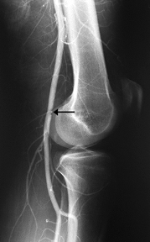
Angiogram

Slide 30
Dacrocystorhinography : Nasolacrymal duct
Sialography : Salivary gland
Bronchography : Bronchioles
Reticulography : Reticulum
Pneumocystography : Abdominal Cavity
Intravenous Pyelography : Urinary tract
Myelography : Spinal Cord
Arthrography : Joints
Fasciography : Tendon and associated structures
Osteomedullography : Channels of long bones.
Angiography : Arteries
Urethrography : Urethra
Cystography : Urinary Bladdergara

