Slide 1
MALIGNANT CATARRHAL FEVER
Dr Padma Nibash Panigrahi
Assistant Professor
Department of Veterinary Medicine
DUVASU, Mathura

Slide 2

MALIGNANT CATARRHAL FEVER (BOVINE MALIGNANT CATARRH, MALIGNANT HEAD CATARRH
Etiology :
Really two diseases (clinically and pathologically indistinguishable) associated with two different infectious agents with different ecologies
Alcelaphine herpesvirus-1 (AHV-l)
wildebeest-associated MCF virus, transmitted to cattle from blue wildebeest
Ovine herpesvirus- 2 (OvHV-2)
sheep-associated MCF virus transmitted to cattle from sheep
Neither agent transmit from cattle to cattle
neither of the viruses cause any disease in their principal host, the wildebeest and the sheep

Slide 3
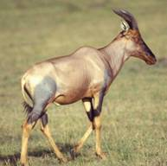
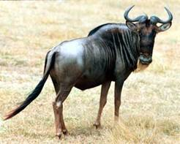
Geographic Distribution
AHV-1 primarily in Africa
  Carried by wildebeest, antelope
  Also in zoological and wild animal parks
OHV-2 worldwide
  Carried by domestic and wild sheep and goats
  Major cause of MCF worldwide

Slide 4
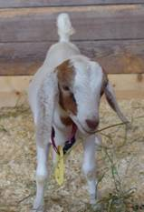
Species Affected
Susceptible species
  Cattle, bison, elk, reindeer, moose, domestic pigs, giraffe, antelope, red and white-tailed deer, nilgai
Carrier species
  Sheep, goats, wildebeest, antlope
  Morbidity- low
  Mortality- high (100%)

Slide 5
Transmission
AHV-1
Inutero
Contact with nasal and ocular secretions
Aerosols during close contact
OHV-2
  Respiratory (aerosol)
  Transplacental rare
  Contact with nasal secretions

Slide 6
Clinical Signs
Peracute form: sudden death
Head and eye form
  Majority of cattle cases
Intestinal form
  Initially like head and eye form, but death occurs from severe diarrhea
Mild form
  Inoculated animals; recovery expected

Slide 7
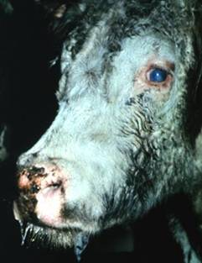
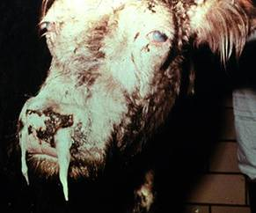
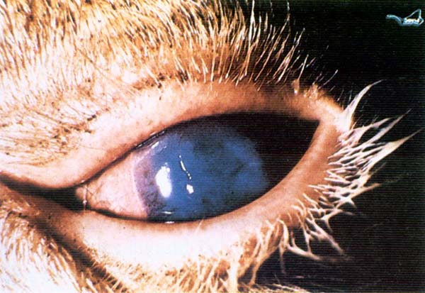
Head and Eye Form:
Early Stages
Reddened eyelids
Bilateral corneal opacity
Crusty muzzle, nares
Nasal discharge
Salivation

Slide 8
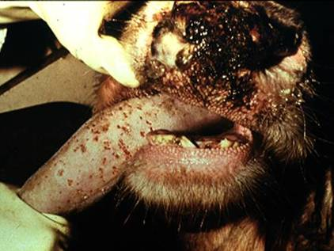
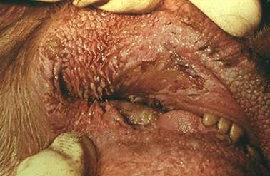
Head and Eye Form:
Later Stages
Erosions on the tongue, buccal mucosa, necrosis, ulcer in oral cavity
Erosions on the buccal mucosa

Slide 9
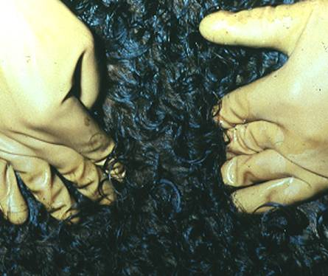
Clinical Signs in Bovidae
Swelling of Joints, superficial lymph nodes
Sloughing of Horn, hoof coverings
Nervous signs
  Incoordination, head pressing, nystagmus, hyperesthesia
Swollen pre-scapular lymph node

Slide 10
Peracute and alimentary tract forms
short course of 1-3 d
high fever
dyspnoea
acute gastroenteritis
resembles the 'head and eye' form except that there is marked diarrhoea
Mild form
transient fever
mild erosions -oral and nasal mucosa.
may be followed by complete recovery

Slide 11
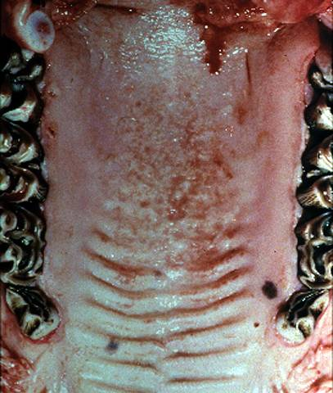
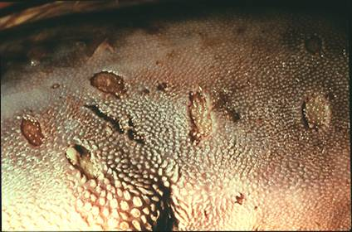
Post Mortem Lesions
Erosions on the tongue and soft and hard palate

Slide 12
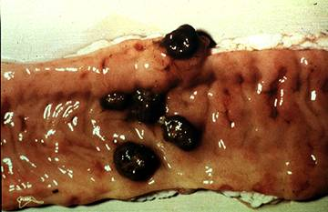
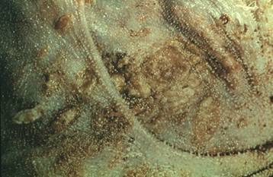
Post Mortem Lesions
Necrotic areas in the omasal epithelium
Multiple erosions of intestinal epithelium

Slide 13
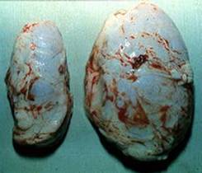
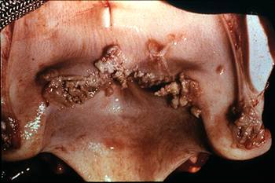
Post Mortem Lesions
Greatly enlarged lymph node compared to normal
Necrotic areas in the larynx
  Diptheritic membrane often present

Slide 14
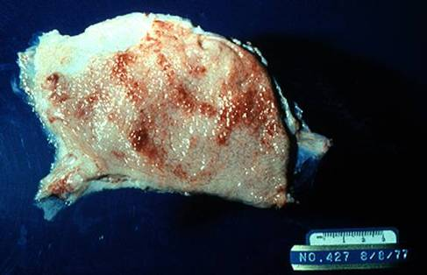
Post Mortem Lesions
Urinary bladder mucosa hyperemic and edematous
Kidney often has raised white foci on the cortex

Slide 15
Collection of Samples for diagnosis
Histology –
  Formaline fixed brain, lymph node, alimentary tract mucosa, pharynx, oesophagus, rumen, liver, adrenal gland, kidney, urinary bladder, salivary gland
Virology –
  lymph node, spleen, lung (PCR)

Slide 16
Differential Diagnosis
Salmonellosis
Pneumonia complex
Oral exposure to caustic materials
Mycotoxins
Poisonous plants
BVD mucosal disease
Bluetongue
Rinderpest
FMD
Vesicular stomatitis

Slide 17
Laboratory Diagnosis
Histopathology
PCR
Virus isolation (AHV-1)- Madin–Darby bovine kidney cell line (MDBK)
Serology
  AHV-1 antibodies in wildebeest
    Immunofluorescence, immunoblot, VN, ELISA, immunocytochemistry
  OHV-2 antibodies in sheep
    Immunofluorescence, immunoblot

Slide 18
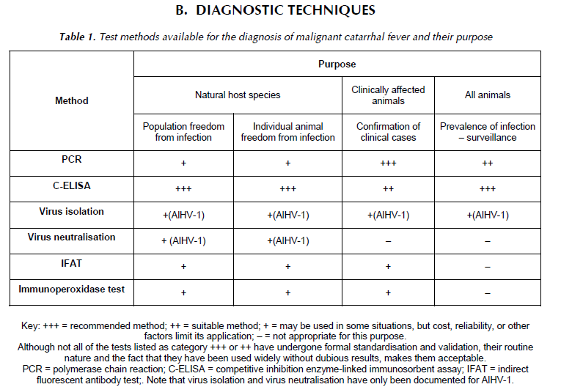

Slide 19
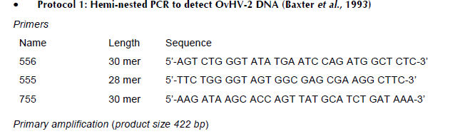
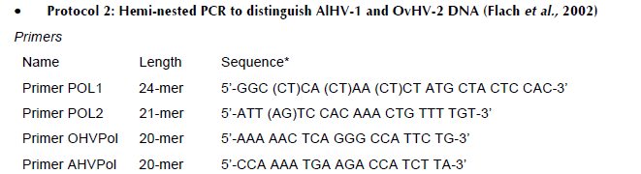
mcf

Slide 20
Treatment
Survival is rare if clinically ill
Mortality reaches 100%
No specific antiviral drug
Antibiotics for secondary bacterial infection
Supportive therapy
Recovered animals will remain virus carriers

Slide 21
Control
Isolation of affected animal
Separation of cattle from sheep in outbreak (sheep transmit diseases)
Wild life 1 KM distance from livestock
Quarantine
Hygiene
Vaccination ??? ( no specific immunity)

Slide 22

Thank you

Slide 23
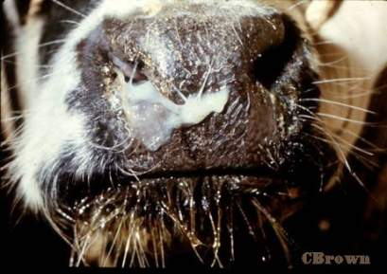
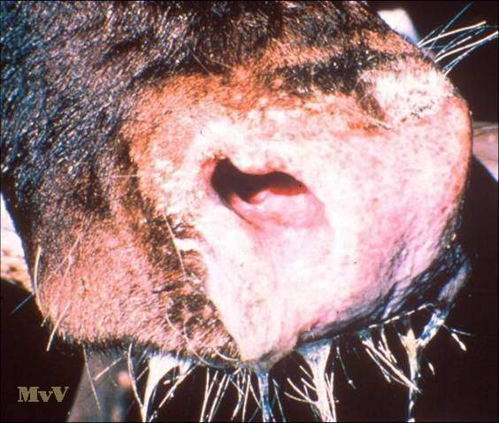

Slide 24
