Slide 1

Radiographic faults & artefacts
Gulshan Kumar
MVSc, PhD

Slide 2
Artefact: An artifact is an appearance that is not normally present on the radiograph and is produced by artificial means. They are radiographic errors and may be produced due to:
  Technical errors- errors in the technique of obtaining radiograph,
  Processing errors- errors committed during processing of film.
  Handling and storage errors.

Slide 3
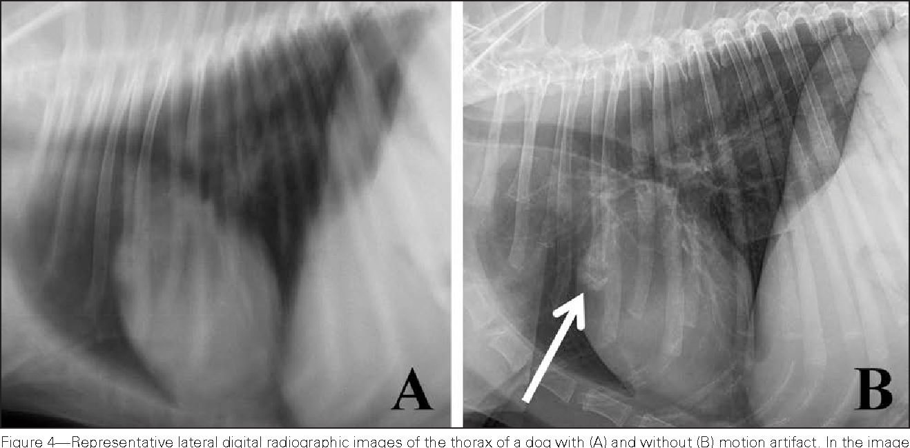
Technical errors:
  Motion artefact or blurring:
    Either the x-ray source has moved, or
    The animal subject, or
    The cassette has moved.
    There is un-sharpness
    Remedy-Immobilise or
    Reduce the exposure time

Slide 4
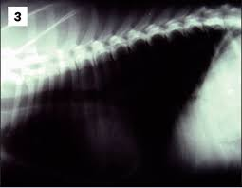
Technical errors:
  Dark or black radiograph:
    Too high kVp, or
    Too high mA, or
    Too much exposure time. Or
    Too short FFD

Slide 5
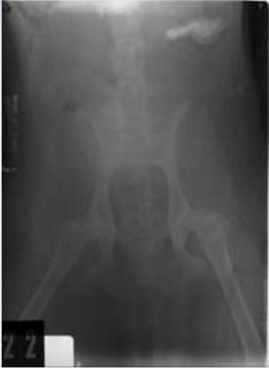
Technical errors:
  Gray non-contrast radiograph:
    Scatter radiation, or
    Under-development, or
    Exposure to light.

Slide 6
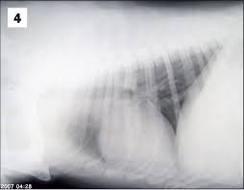
Technical errors:
  Light or white radiograph:
    Too low kVp, or
    Too low mA, or
    Too less exposure time. Or
    Too long FFD

Slide 7
Processing errors:
  Dark spots on the radiograph:
    Dust or water drop while viewing, or
    Developer on x ray prior to development

Slide 8
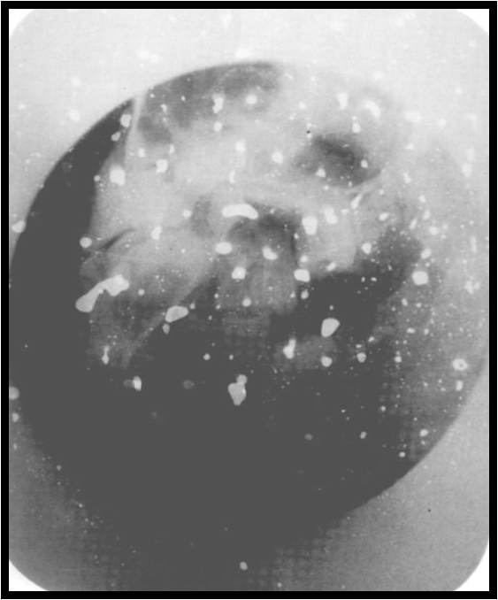
Processing errors:
  White or light spots on the radiograph:
    Dust or barium on the body of the subject, or
    Air bubbles trapped over the film during developing, preventing the developer from reaching the film
    fixer on x ray prior to development

Slide 9
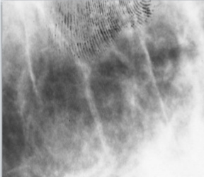
Processing errors:
  Black finger marks on the radiograph:
    Finger wet with developer on x ray prior to development

Slide 10
Processing errors:
  White finger marks on the radiograph:
    Finger wet with fixer on x ray prior to development

Slide 11
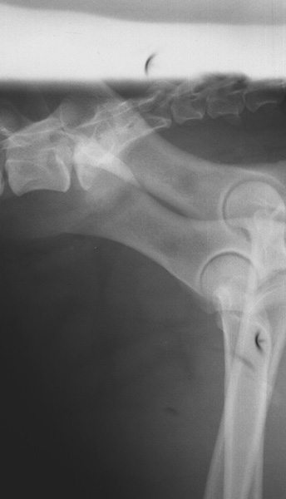
Storage and handling errors:
  Crescent marks on the radiograph:
    Kinking of the film while handling

Slide 12
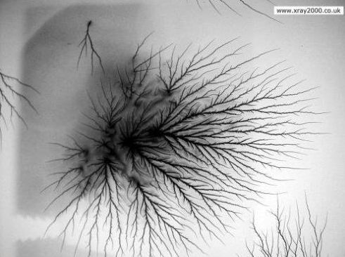
Storage and handling errors:
  Static current marks on the radiograph:
    Production of static electricity due friction in films

