Slide 1

Ultrasonography
Gulshan Kumar
MVSc, PhD
Dept. of VSR, College of Veterinary Science & Animal Husbandry, DUVASU, Mathura- 281 001

Slide 2
Noninvasive technique
Provides cross sectional anatomy of the organs
Based on differences in acoustic impedance of the tissue.
Image formed by directing high frequency sound waves into the body.
Sound waves either travel through the tissues or reflected back to the transducer.
Reflected sound waves (echoes) are analyzed by a computer and displayed on a monitor.
Dept. of VSR, College of Veterinary Science & Animal Husbandry, DUVASU, Mathura- 281 001

Slide 3
The human ear can process and perceive sound with frequencies ranging from 20 to 20000 Hertz (Hz).
Ultrasound- Sound with frequencies higher than 20 kHz
Bats use sound waves for navigation and hunting down their prey.
The first use of high frequency sound waves is reported to be a futile search of the ‘Titanic’ in 1912.
A similar technique known as sound navigation and ranging (SONAR)- researched massively and usd during the Second World War to detect the presence of underwater enemy vessels (Submarines).
Dept. of VSR, College of Veterinary Science & Animal Husbandry, DUVASU, Mathura- 281 001

Slide 4
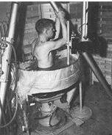
First used for diagnosis in 1942 for localizing brain tumours.
In the 1950’s 2D gray scale still images could be generated whereas real time imaging became possible around 1965.
The medical ultrasound uses ultrasound frequencies ranging from 2-10 mHz, more recently 1-13 mHz.
Dept. of VSR, College of Veterinary Science & Animal Husbandry, DUVASU, Mathura- 281 001

Slide 5
Ultrasound examination is a search.
Examination should provide 3D information about the area under investigation and all the neighbouring organs.
Hence requires multiple scans in different projections.
Rarely a single scan in one plane provides enough information to allow the correct diagnosis to be made
Dept. of VSR, College of Veterinary Science & Animal Husbandry, DUVASU, Mathura- 281 001

Slide 6
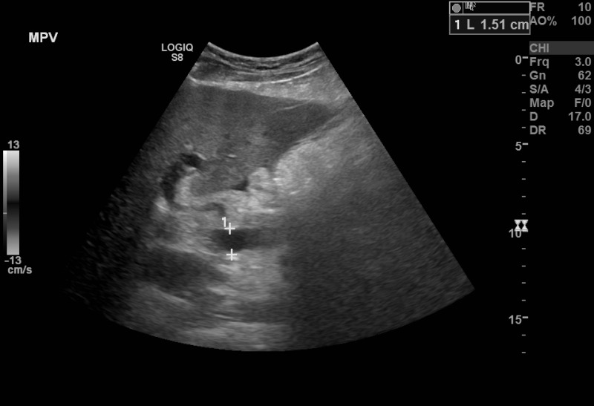
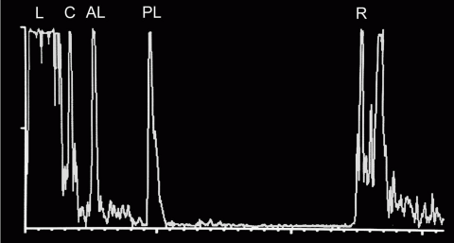
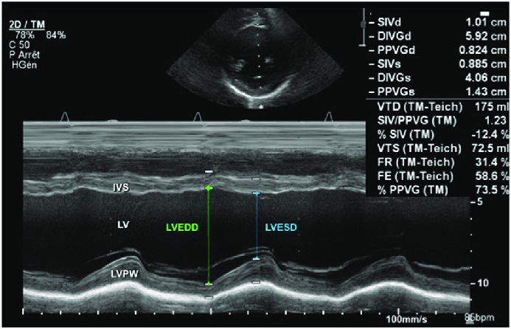
Modalities of ultrasound
Modes- A, B, M.
B-mode is commonly used for diagnosis (brightness mode).
Dept. of VSR, College of Veterinary Science & Animal Husbandry, DUVASU, Mathura- 281 001

Slide 7
Greater degree of reflection (stronger echoes), represented on the monitor as an area of white or light gray.
Lesser degree of reflection (weaker echoes) allows the more sound wave to pass through unimpeded, represented on the monitor as an area of black or dark gray.
Fluids, such as blood, water or urine, transmit sound waves readily. No echoes hence blackness.
Dept. of VSR, College of Veterinary Science & Animal Husbandry, DUVASU, Mathura- 281 001

Slide 8
Echoes very strong-complete,
Varying degrees of strength but not complete i.e. allows some degree to pass through,
No return of echoes i.e. complete transmission
Hyper, iso, hypo, an-
Dept. of VSR, College of Veterinary Science & Animal Husbandry, DUVASU, Mathura- 281 001

Slide 9
The image presented on the monitor is a distribution of black, grey and white dots, each of which represents return or non return of an echo from tissue interfaces.

Slide 10
Different echogenicities (shades of grey): from ‘hyper’ echoic to ‘an’ echoic
Dept. of VSR, College of Veterinary Science & Animal Husbandry, DUVASU, Mathura- 281 001

Slide 11
An ultrasonogram thus is essentially an ensemble of several dots varying from white, various shades of grey and black.
Experienced sonologists, therefore say, every dot says something.
Dept. of VSR, College of Veterinary Science & Animal Husbandry, DUVASU, Mathura- 281 001

Slide 12
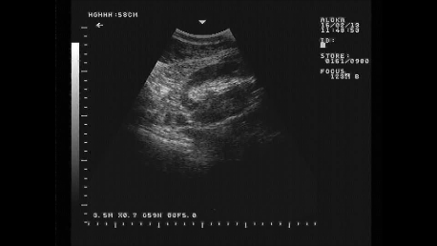
Dept. of VSR, College of Veterinary Science & Animal Husbandry, DUVASU, Mathura- 281 001

Slide 13
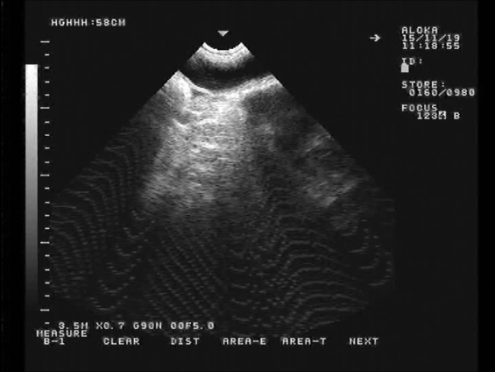
UB
BW
Dept. of VSR, College of Veterinary Science & Animal Husbandry, DUVASU, Mathura- 281 001

Slide 14
Contact???
The transducer needs to be in full contact with the skin or mucosa to obtain an informative image.
Hair?
Surface does not contact the skin adequately, a dark band originating at the near field surface between the skin and probe results
Dept. of VSR, College of Veterinary Science & Animal Husbandry, DUVASU, Mathura- 281 001

Slide 15
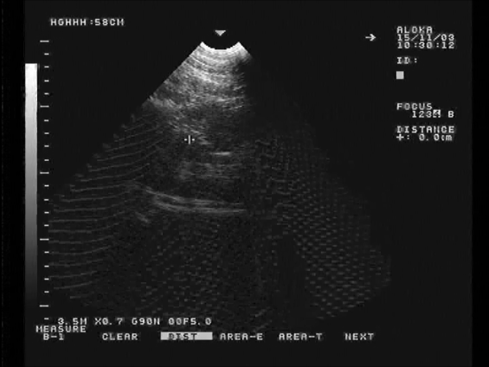
Dept. of VSR, College of Veterinary Science & Animal Husbandry, DUVASU, Mathura- 281 001

Slide 16
Move the transducer, or
apply more gel for better contact between the surface of the skin and transducer, absorption take place.
Mineral oil or vegetable oil also provides good contact, but they tend to weaken the rubber coating over the transducer.
Dept. of VSR, College of Veterinary Science & Animal Husbandry, DUVASU, Mathura- 281 001

Slide 17
Beam of ultrasound approximately 01 mm thick
Traverses through a very thin slice of the tissue/organ.
Image obtained is two dimensional- a section (cross/ longitudinal).
Orientation
Knob /ridge (marker)on the side of the transducer assists in orientation of the image appearing on the monitor.
Usually, the knob/ridge side of the transducer appears on the left side of the monitor.
General convention -knob/ridge should point in cranial direction(LS), to the right while scanning the midline (TS)and toward dorsal direction when scanning the lateral aspect of the animal (TS).
Dept. of VSR, College of Veterinary Science & Animal Husbandry, DUVASU, Mathura- 281 001

Slide 18
What to look for??
Abnormalities in the described size, shape, contours/margins, location/position, number and echotexture (regular or irregular, mottled, multifocal, heteroechoic etc.).
Sound knowledge of the anatomy of the area of the proposed site of examination.
Dept. of VSR, College of Veterinary Science & Animal Husbandry, DUVASU, Mathura- 281 001

Slide 19
The echogenicity of different organs varies.
Necessary to memorise the order of echogenicity of different organs.
The echogenicity of some important organs progressively increases in this order: fluid, medulla (kidney), cortex (kidney), liver, spleen, inflamed peritoneum.
Dept. of VSR, College of Veterinary Science & Animal Husbandry, DUVASU, Mathura- 281 001

Slide 20
Through tissue layers, the signal becomes attenuated (loses acoustic energy, resulting in a decreased number of ultrasound waves) as the depth of penetration increases.
Higher frequencies- lower penetration- higher resolution.
Lower frequencies- greater penetration- poor resolution.
Dept. of VSR, College of Veterinary Science & Animal Husbandry, DUVASU, Mathura- 281 001

Slide 21
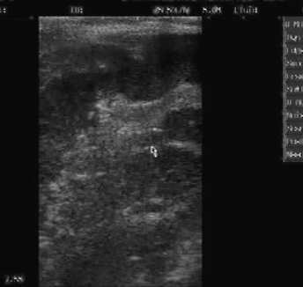
Dept. of VSR, College of Veterinary Science & Animal Husbandry, DUVASU, Mathura- 281 001

Slide 22
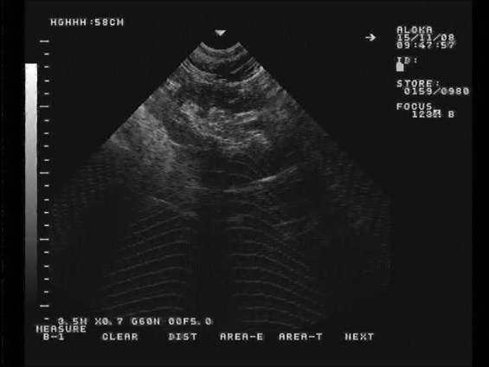
Dept. of VSR, College of Veterinary Science & Animal Husbandry, DUVASU, Mathura- 281 001

Slide 23
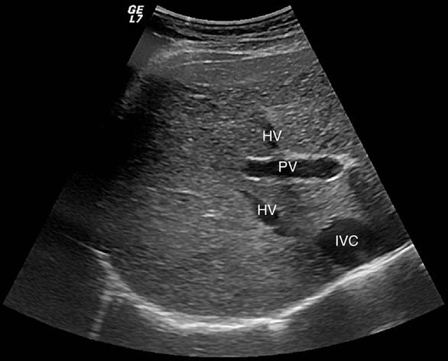
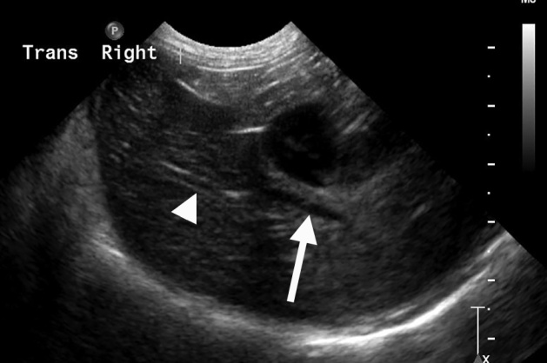
Fat in the tissue –hyperechoic -outlines of the kidney and the sinus brighter.
The vessels in the liver appear quite unique.
Portal veins have an outer hyperechoic wall due to the fibro-fatty connective tissue surrounding the wall and within the wall itself
The hepatic veins can be seen as hypoechoic, do not have hyperechoic walls
Dept. of VSR, College of Veterinary Science & Animal Husbandry, DUVASU, Mathura- 281 001

Slide 24
Artifacts

Slide 25
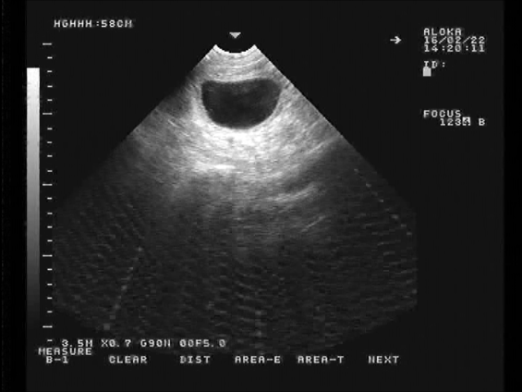
As discussed, the organs/cavities filled with fluid appear anechoic along with an increased echogenicity of the far margins of the cavity and is known as ‘acoustic enhancement’
Dept. of VSR, College of Veterinary Science & Animal Husbandry, DUVASU, Mathura- 281 001

Slide 26
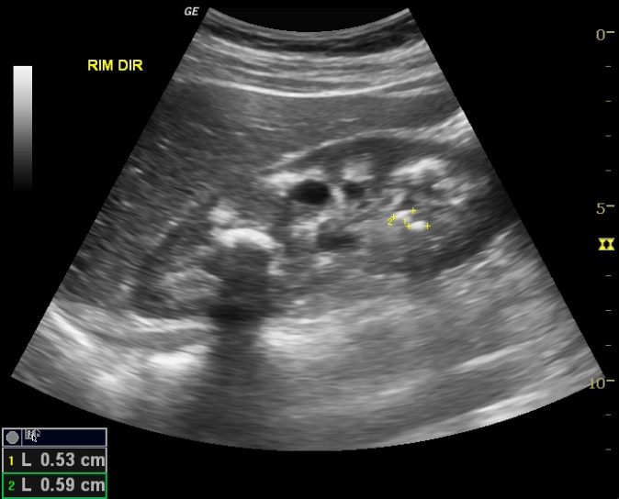
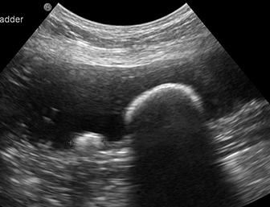
Another helpful artifact -total reflection of sound waves as seen in calculi in kidney, bladder or gall bladder.
‘Acoustic shadowing’ results when the sound waves are unable to penetrate the calculus interface and hence no image beyond the interface is formed.
Dept. of VSR, College of Veterinary Science & Animal Husbandry, DUVASU, Mathura- 281 001

Slide 27
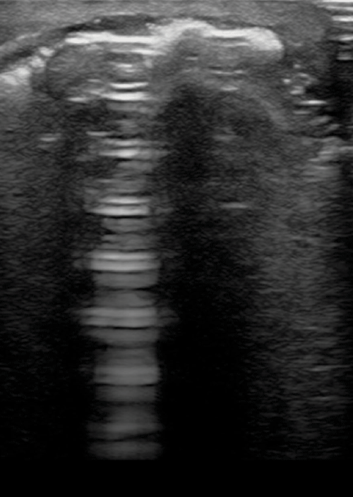
Another helpful artifact -Reverberation
Dept. of VSR, College of Veterinary Science & Animal Husbandry, DUVASU, Mathura- 281 001

Slide 28
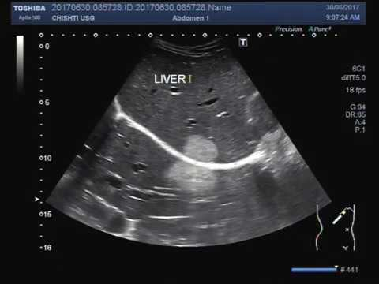

Slide 29
In a nutshell
Normal anatomy,
Observation of deviations from normal appearance in terms of size, shape, echogenicity, etc.
Sufficient knowledge of artifacts and the reasons for their appearance. Artifacts occur in all ultrasound images.
Also -be systematic about the examinations.
Remember, we are imaging differences in acoustic impedance, not anatomy, histology, or even pathology.
It so happens that most pathologic conditions in the abdomen correspond with differences in acoustic impedance, but there will be ultrasound misses.
Therefore, a negative scan does not always rule out disease.
Dept. of VSR, College of Veterinary Science & Animal Husbandry, DUVASU, Mathura- 281 001

Slide 30
Thanks

