Slide 1
ENDOCRINOLOGY
of
MALE REPRODUCTION
- Dr. Vikas Sachan

Slide 2
ENDOCRINOLOGY OF THE MALE REPRODUCTION
- Controlled by - Pituitary gonadotrophins
Gonadal androgens
- Only negative feedback mechanism
(Unlike in female)
i.e. Synchrony b/w pituitary gonadotrophins
with gonads in male is non cyclic
After castration – Retained pulse frequency of
LH and FSH

Slide 3
- Hypothalamus - Interface between
- Nervous and endocrine system
- GnRH synthesized in neurons in hypothalamus,
released at nerve endings (episodic)
transferred via hypophyseal portal system
……..Anterior pituitary
………Gonadotrophins

Slide 4
Sex Hormones are sex specific
e.g. Estrogen and progesterone - Female
Testosterone - Males
- Sex specificity is limited

Slide 5
LH receptors on leydig cells in bulls
(Upto 6-7 months of age)
- Less in no. and less sensitive
- No stimulus for testosterone
Growth hormone, Insulin, IGF-1
…stimulatory effect of LH on its receptors
LH receptors - leydig cells, germ cells
Testosterone receptors - On the leydig cells,
Sertoli cells
(but not on the germ cells) Myoid cells

Slide 6
Male reproduction is mainly controlled by
- Hypothalamic GnRH
- Pituitary Gn; LH & FSH
…LH in pulsatile fashion (15-30 ng/ml .. 2-4 hr)
LH receptors
Gonadal leydig cells ……
Androgens (Testosterone)
(After 30-60 minutes of LH …peak (10-20 ng/ml)
- Basal again after 40-80 minutes

Slide 7
In bulls
… LH ; 5 ng/ml to 15-30 ng/ml
… Testosterone 2-8 ng/ml to 10-20 ng/ml
In dogs
… LH ; 1.0-1.2 ng/ml to 3.8-10.0 ng/ml
… Testosterone 0.5-1.5 ng/ml to 3.5 -6.0 ng/ml
In tom
… LH ranges from 3 to 29 ng/ml
… Testosterone ranges from 0.1 to 3.3 ng/ml

Slide 8
- Acting on the Leydig cells
…..LH regulates steroidogenesis (leydig cells)
Cholesterol
rate limiting step
(Control by LH)
Pregnenolone
Progesterone
Testosterone (18 C)

Slide 9
Androgen (testosterone)
5α- reductase enzyme aromatase
sertoli cells
DHT estradiol
(5α - dihydrotestosterone)
Sertoli cell tumor - High level of blood estrogen
(mainly in canines)
Testosterone in the blood
…Bound α-globulin (Maximum)
…Free which is converted into DHT

Slide 10
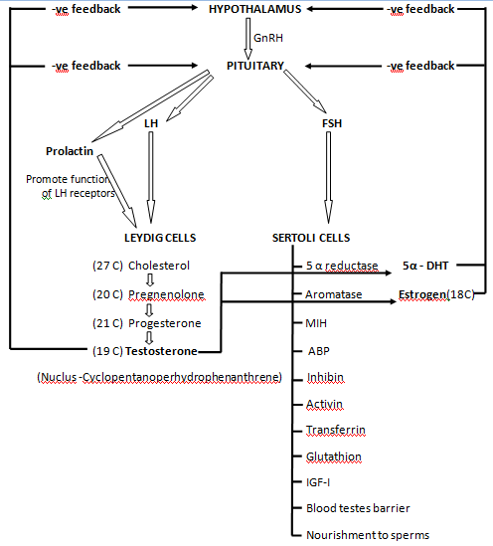

Slide 11
- Maximum estrogen….from testosterone
- Epididymis of stallion
DHT and estradiol … -ve feed back response
- at the level of hypothalamus and pituitary
DHT is more potent androgen than testosterone
DHT - controls accessory sex gland activity
Testosterone - spermatogenesis.

Slide 12
Androgen-binding protein (ABP)
- Bind testosterone and DHT
- High androgen concentrations in S.T. & Epid.
FSH - Non episodic pattern
- Proliferation i.e. determine the sertoli cell
numbers at puberty
.... Limit postpubertal spermatogenic yield

Slide 13
- FSH is - Initiation of spermatogenesis
FSH and testosterone - Maintain spermatogesis
- Spermiation
FSH – Functions / secretion of sertoli cells :
1. Androgen binding protein (ABP) –
Steroid binding protein - α-globulin
2. Activin – Development of leydig cells
- Delay growth of leyd. cells till puberty
- Secretion of FSH at pituitary level

Slide 14
3. Inhibin - Differentiating and growth factor
- Regulates leydig cell function
- Negative feedback effect on the FSH
- Inhibin B is more potent
4. Anti-mullerian hormone (AMH / MIH)
- Inhibit mullerian duct system
- Development of male fetus
5. Transferrin – Source of iron for sperm
6. Glutathion – Acts as anti-oxidant
7. Insulin like growth factor
8. Nursing / Sustentacular cells – Sperm nursing

Slide 15
Prolactin - Prolactin receptors - On leydig cells
- Promotes the functions of LH receptor
High level of prolactin, growth hormone (GH/STH) and melatonin - Negative feedback for Gn
- Delayed sexual characters
- Delayed sexual behavior
- Delayed puberty and libido

Slide 16
- Functions of androgen :
1. Testicular descend
2. Sexual differentiation of male reproductive
system
3. Regulation of structure and function of
accessory sex glands and ductus system
4. Spermatogenesis

Slide 17
5. Development of secondary sexual characters
and maleness (Body confirmation, hairs, hump,
broad shoulder, aggressiveness,
muscle growth etc)
6. Pronlongation of epididymal sperm life
7. Different sexual behavior pattern in diff sp.
8. Penile and prepucial growth
9. Degeneration of penile frenulum
10. Urinary pattern in dogs

Slide 18
Prepubertal castration
- No libido
- Underdeveloped genitalia
- No mating behavior
- Post pubertal castration
- leads to stoppage of ejaculation
- Mounting behavior
- Penile erection
High Testosterone - hypertrophy and hyperplasia
of prostate

Slide 19
- Thyroid stimulating hormone (TSH)
Growth hormone (STH)
Adrenocorticotrophic hormone
Melatonin
…. Maintenance of male reproduction
Over secretion - Negative feedback effect

Slide 20
- Oxytocin - Increasing tubal activity at ejaculation
- Increased seminal volume
- More sperm concentration
- β-endorphin (endogenous opioid peptides)
- Present in testicular interstitial fluid
- Leydig cell steroidogenesis.

Slide 21
- Stallions and rams - Seasonal breeders
- Stallion long day breeder
- Ram and camel - short day breeder
Stallion –
......More light (short night)
……Less melatonin (from pineal gland)
…..More gonadotrophins
…..More steroids (androgens)
- Long days after short days ….a rhythm
- Necessary for stallion reproduction

Slide 22
Reducing the day light hours in ram
- Increased melatonin
- Reduced prolactin production
- Increased gonadotrophins secretion
- Increased testosterone
- In non-breeding season
- Not azoospermic completely

Slide 23
THERMOREGULATION OF TESTES
- Optimim sperm production or spermatogenesis
…..requires 2⁰-5⁰ C less temperature
- Structures play role in thermoregulation -
Thermoreceptors - On scrotal skin
- Body sweating / panting
2. Adrenergic sweat glands - On scrotal skin

Slide 24
3. Absence of subcutaneous fat in scrotal skin
4. Contraction & relaxation of tunica dartos
5. Contraction & relaxation of Cremaster muscle
6. Testicular artery and vein (Pmpiniform plexus)
- Heat transfer

Slide 25
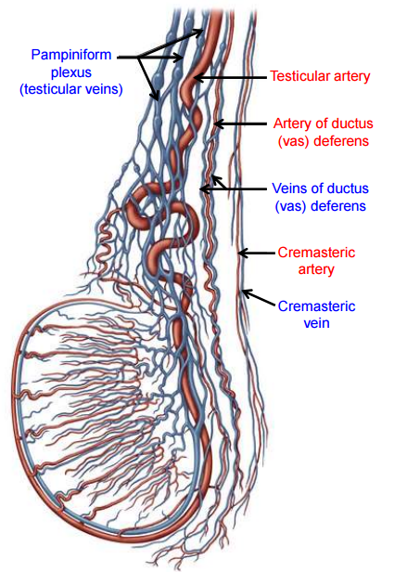

Slide 26
In boar - Less pendulous scrotum
- Less efficient sweating
- Difference of about 3.2⁰ C
- In ram - temperature difference between spermatic artery and vein is about 4⁰ C.

Slide 27


