Slide 1
Lateral ear canal resection
(Zepp’s Operation/procedure)
Dr Gulshan Kumar
MVSc, PhD

Slide 2
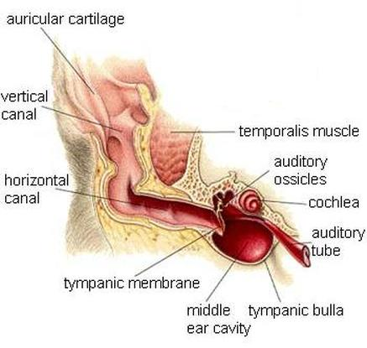

Slide 3
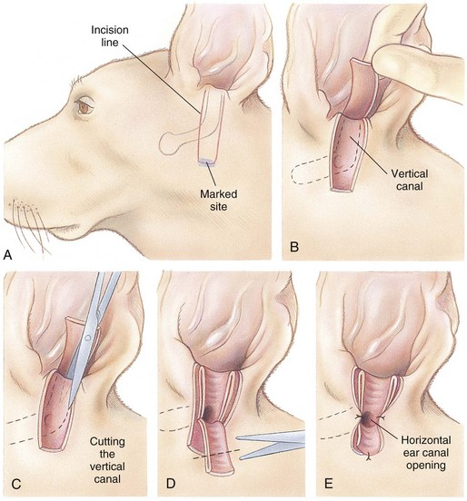

Slide 6
