Slide 1
Male reproductive system
(Anatomy)
- Dr. Vikas Sachan

Slide 2
- The male reproduction system
testes, scrotum, reproductive ducts,
accessory sex glands, prepuce and penis
Production of - Spermatozoas
Male sex hormone
Primary sex organs – Testicles
Secondary sex organs (ductus system)-
Epididymis, Vas deference, urethra, penis
- Accessory sex glands –
Seminal vesicles, prostate and
bulbo-urethral glands/cowpers gland

Slide 3
SCROTUM –
. Cutaneous pouch
. Encloses the testis
. Testes fix by scrotal ligament
. Scrotal hairs (except buck, ram, stallion
and tom)

Slide 4
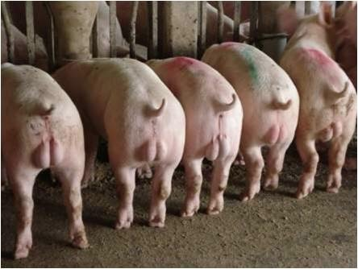
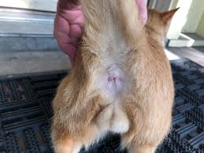
Scrotal position
Caudal to thighs – Boar and Tom
Between the thighs – All others
. Thermoregulation of testes
. Sebaceous and sweat glands (Stallion, dog)

Slide 5
SCROTUM LAYERS – (outward to inward)
1. Epidermis
2. Dermis
3. Tunica dartos
(fibroelastic CT & smooth muscles)
4. Tunica vaginalis communis/ reflexa
(Extension of parietal peritoneum)
5. Vaginal process/cavity (space in between)
6. Tunica vaginalis propria
(Extension of visceral peritoneum)
7. Tunica albuginea
(fibrous layer with some smooth muscles)
8. Tunica vasculosa
(layer with blood vessels)

Slide 6
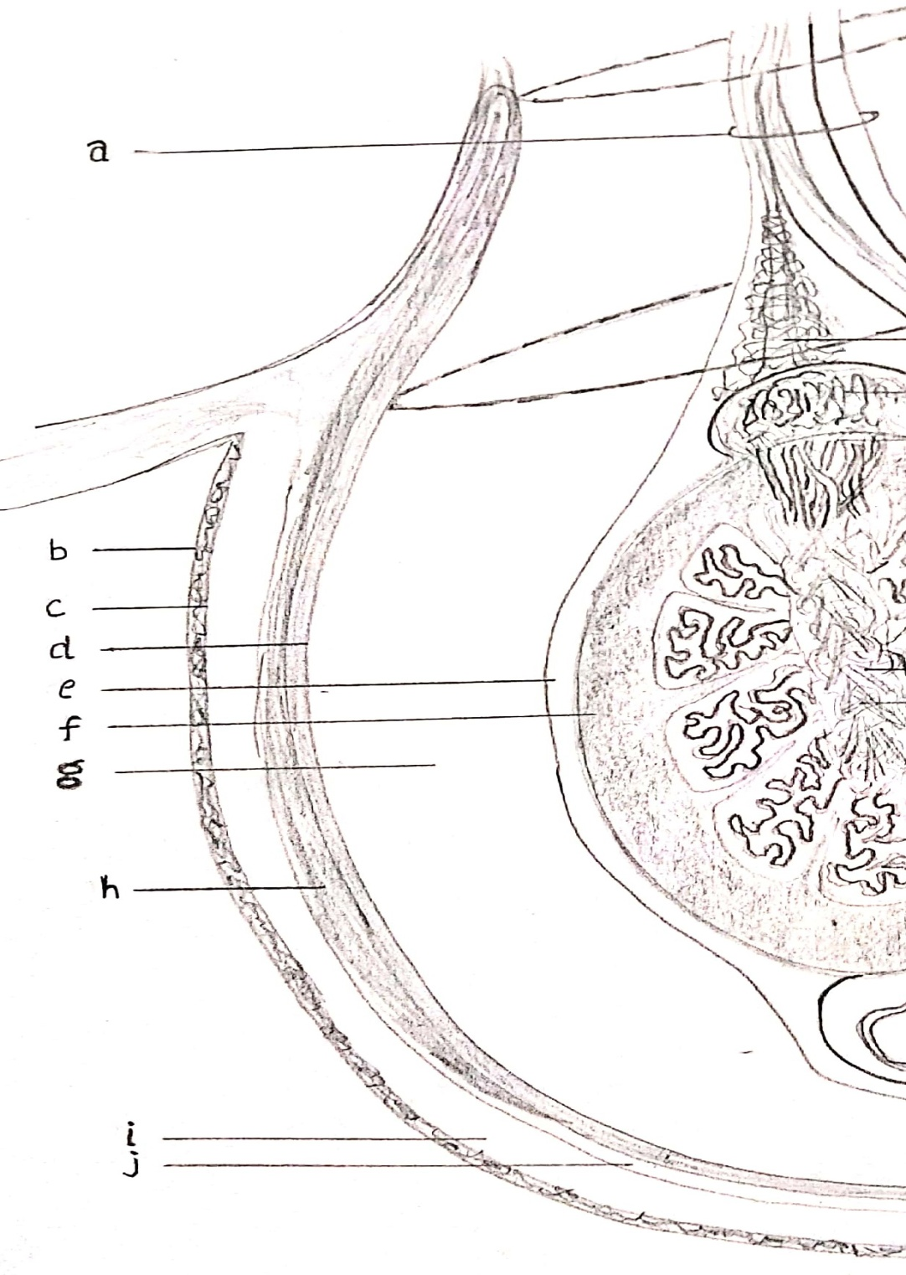

Slide 7
Tunica dartos
- Form intertesticular septum
Stallion scrotum - short and non-pendulous
Testes in camel - non pendulous scrotum
(in perineal region)

Slide 8
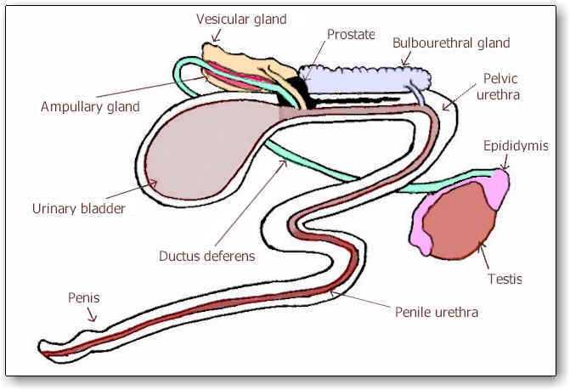
- The ductus system (in to out) :
Seminiferous tubules
Rete testes
Efferent duct
Caput epididymis
Corpus epididymis
Cauda epididymis
Vas deferense
Ampulla
Pelvic urethra
Penile urethra (in penis)
……. – Exit

Slide 9
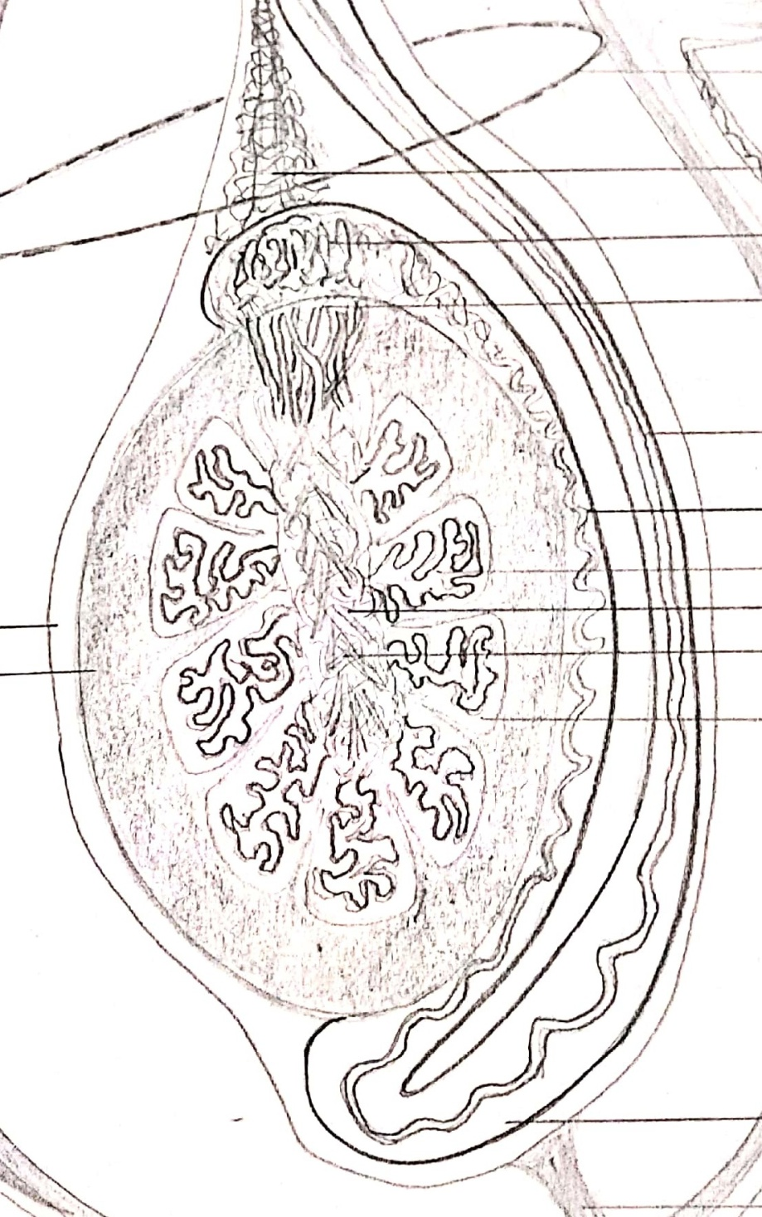

Slide 10
- SEMINIFEROUS TUBULES
Extension of tunica albuginea –
- Dividing testicular parenchyma into lobules
(encloses seminiferous tubules)
- Joins at mediastinum
Seminiferous tubules
- Highly convoluted & Unbranched
- Open at both ends
75% of total testicular mass
They Have
- Somatic sertoli cells/sustentacular/nurse
- Sperm producing germ cells
(spermatogonial germ cell line).

Slide 11
- The sertoli cells - Enrico Sertoli
- The leydig cells - Franz Leydig.
Sertoli cells secretes
mullerian inhibiting factor/hormone (MIH)
(inhibite paramesonephric or mullerian duct)
The number of sertoli cells doesn’t increase
after puberty i.e. it limits the spermiogenesis or
spermiogenic yield.
Sertoli cells form blood testes barrier just
before the puberty to separate differentiating
germ cells from blood circulation.

Slide 12
Interstitial space (out of Sem. tub.)
Leydig cells (interstitial cells)
Blood vessels & Lymphatics
In ram leydig cells are found in clusters around
blood vessels.
Length of seminiferous tubules :
Boar – 6 Km
Bull – 5 Km
Ram – 4 Km
Dog – 150 m
Tom – 25 m

Slide 13
- RETE TESTES – (in mediastinum)
Seminiferous tubules
Collecting tubules
Rete testes
Vas efferens
Lined by non secretory cuboidal epithelial cells

Slide 14
- TESTES (paired male gonads)
- In scrotum at inguinal region
- With help of tunics and spermatic cord
Covered with extra-abdominal tunic
- Tunica vaginalis…albugenia….vasculosa
Fluid in vaginal process
- Movement of testis within scrotum
- Plane of testes : Horizontal – Stallion
Vertical – Cattle, ram, buck
Oblique – Boar, Dog, Tom

Slide 15
Testicular diameter – Bull – 5-9 cm
Stallion – 4-8 cm
Ram and Buck – 4-7 cm
Boar – 5-9 cm
Dog – 1-3 cm
Tom – 0.7 – 1.5 cm
Shape of testes – Oval –stallion
Elliptical – boar
Elongates oval – bull, ram
Round to oval – Dog, Tom

Slide 16
Size of testes varies throughout the year in
seasonal breeder e.g. ram, stallion, camel
- Weight of testis –
Bull – 200-500 gm
Ram and buck – 200-400 gm
Stallion – 150-300 gm
Boar – 500-800 gm
Dog – 8-15 gm
In buffalo bull testes and scrotum are smaller
and the penile sheath is less pendulous than
cattle bull.

Slide 17
Testes –
Endocrine – Production of testosterone
(By leydig cells ….. LH/ICSH)
Exocrine – Spermatogenesis
(FSH & testosterone)
Body weight ….. positively correlated
with testicular weight, testicular volume,
total epididymal mass, total scrotal width
Castration (Removal of testicles)–
Reduces aggressive behavior of male animal
Rreduces the boar taint

Slide 18
Cremester muscle
-Internal abdominal oblique muscle to tunica
vaginalis propria
Loosening & Raising of testes
- In response to environmental temperature
any abnormal stimulus is the
- To maintain the testicular temperature
- Retracting the testes within abdomen
(Elephant, deer, and rabbit etc during their
non breeding season)

Slide 19
- Testes (in scrotum with help of spermatic cord)
Spermatic cord comprises of –
. Internal spermatic artery
. Spermatic veins (pampiniform plexus)
. Lymphatic vessels
. Autonomic nerves from renal and
mesenteric plexus
. Internal cremester muscle
. Tunica vaginalis propria
. Vas deferens
- Mesorchium & mesepididymis

Slide 20
- EFFERENT DUCTULES
(Vas efferens or ductus efferens)
- Connect rete testes to epididymis
- 13 to 20 in numbers in bull
- 13 to 15 in stallion
- Spermatophagy (also in epididymis)

Slide 21
EPIDIDYMIS –
- Highly convoluted tube
- Firmer than testes in consistency
- Head (caput), Body (corpus), tail (cauda)
- lined by circular muscle fibre layer
- Pseudosatrtified columnar cell layer
- Histologically …..three parts
- (not related to caput, corpus and cauda).
Large kinocilia & steriocelia…with widen lumen
Medusa cells in the semen
- Ciliated cells from caput epididymis.

Slide 22
In Stallion and dog caput epididymis situated cranially, corpus epididymis dorsally and cauda epididymis caudally to testicle while in ruminants caput, corpus and cauda epididymis is situated dorsally, caudally and ventrally to testicle respectively.
Length of epididymis
Bull – 30-36 m ……… 10 days
Ram – 50 m …….. 13 to 15 days
Boar – 50-54 m ……… 10 to 12 days
Stallion – 20 m ……… 8 to 11 days

Slide 23
1. Absorption
- In caput and cauda epididymis (90%)
- Increases sperm concentration.
2. Secretion –
- To maintain sperm viability during storage
- Max protein secretion occurs in caput
- Sperm flagellar activity, metabolic process,
motility and fertilization capacity
- Sialic acid, Carnitine, GPC
- Immobilin, Quescent factor (in bull)
- 5α reducatse in initial segment (T….DHT)

Slide 24
3. Storage (cauda epididymis) –
Stores matured sperms (extended viability)
50% of extragonadal sperm (66% in stallion)
75% of total epididymal sperms
Nearly 75000 million sperms
4. Maturation – (caput and corpus epididymis)
PCd into DCD
Motility and fertilizing capacity
Modification
- Surface glycoproteins (sperm pm)
- Reduce surface immunogenicity
- Enhance ability to bind with zona pellucida

Slide 25
- Luminal environment & cool temperature in the
cauda epididymis
- Sperms are maintained in a protected,
(quiescent state)
Fertility of sperms… More in cauda epididymis
5. Transportation –
- Capable to motile in cauda epididymis
- Passive (non motile in caput epididymis)
- Cilias and peristalsis of smooth muscles

Slide 26
Vas deferens –
- Lined with pseudostratified epithelium
- Lined with non ciliated cell
- Little secretion
- Joins epididymis to pelvic urethra
Temporary reservoir for sperm
Mesoductus deferens (running in the sp. cord)
Terminal swollen part – ampullae
(due to the abundance of ampullar glands)
- Ampullae …colliculus seminalis…pelvic urethra

Slide 27
AMPULLA
- temporary sperm reservoir
- Well developed in stallion
- Very small/absent in dog, tom and boar
Stallion - Ergotheionine (an antioxidant)
by ampulla and seminal vesicle
Uterus masculanis (utriculus prostaticus),
(Remnant of paramesonephric duct situated
between ampullae and vas deferens)

Slide 28
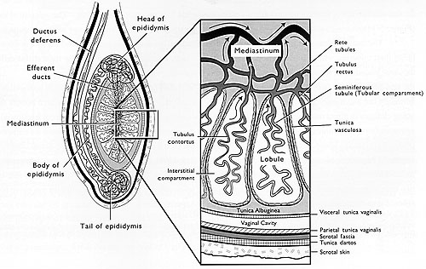

Slide 29
SEMINAL VESICLE –
- Predominant vesicular gland in bulls
- About 50% of total seminal plasma
- Situated near neck of urinary bladder
- . lobulated and paired – bull and ram
. Bag like – boar
. Smooth & pear/pyriform – stallion
. Absent – tom, dog and camel
In stallion ….more bladder like structure and
justified as seminal vesicle

Slide 30
Vesicular secretion in bull
Riboflavin (yellow coloration of semen)
Inositol (osmoregulator) in boar
Ergothionine (antioxidant) in boar
Gel portion of stallion semen
Seminal vesicle secretes citric acid, fructose,
ascorbic acid, inositol, ergothioneine,
riboflavin, KHCO3, Bovine seminal plasma
protein (BSP), prostaglandin etc.

Slide 31
- PROSTATE GLAND –
- Unpaired gland
- Around urethra (at neck of urinary bladder)
- Pars propria and pars disseminate in bull
- Joined by isthmus in stallion
- In ram prostate has no body (pars propria)
- Only gland in dog (very small in tom)
Size of this gland increases with age
(It pushes the freely movable urinary bladder
from the pelvis into the abdomen)
Castration - Atrophy of the prostate
(androgen dependent organ)

Slide 32
- Secretion of prostate gland
- Acidic secretion (pH 6.5)
- Lot of enzymes (proteinase, phosphatase,
glycosidase, nucleases, nucleotidase etc)
- anti-agglutinin
- Zn and Cl and citric acid (in canines)

Slide 33
- COWPERS GLAND (Bulbourethral gland) –
- Paired glands
- At both side of pelvic urethra
(at the level of ischiatic arc)
(embedded in bulbospongiosus muscle)
Shape –
Ovoid - bull, ram and stallion
Cylindrical - boar (most prominent gland)
Absent - dogs (prominent in tom)
“Driblings” - (urethra cleansing fluid)
Gel portion of boar semen
(Vaginal plug/seal after mating…Sialomucin)

Slide 34
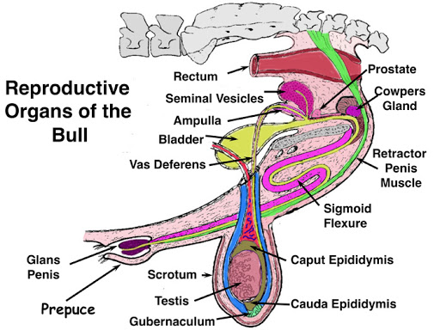

Slide 35
- URETHRA
- Pelvic (on pelvic floor)
- Bulb or urethral isthmus
(bending on ischiatic arc)
- Penile (in the penis)
Common passage for urine and semen
Urethral glands - Present in boar
Absent in bulls

Slide 36
- PENIS
- Muscular and cylindrical copulatory organ
- Two dorso lateral corpus cavernosum penis
(CCP) muscles
- One ventrally situated corpus spongiosum
(CSP) muscles
CCP ...
Tunica albuginea …
Ischiocavernosus (erector penis) muscle
- CSP surrounds the pelvic and penile urethra.
Covered by bulbospongiosus muscle
(emptying the penile urethra)

Slide 37
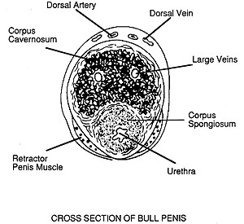

Slide 38
Spiral penis – Boar
Penis - Sigmoid flexure
(maintains the desired length of penis)
- Post scrotal in bull and ram
- Prescrotal in boar and camel
- Absent in stallion
Retractor penis muscles (paired)
- Smooth muscles (dorsal apical ligament of
penis to sacral or 1st/2nd coccygeal vertebra)
- Draw/retract back the penis in prepuce

Slide 39
- Penis may be :
1. Fibroelastic type
- Lesser erectile tissue
- More fibroelastic tissue
- Less blood accumulation
(small cavernous space)
- e.g. bull, ram, camel and boar.
2. Musculo vascular type
- More erectile tissue
- More blood accumulation
(bigger cavernous space)
- e.g. stallion, dog, tom.

Slide 40
- Length of penis – Bull – 36 inches
Ram – 30 cm
Stallion – 50 cm
Boar – 50-55 cm
Erectile tissue are more in stallion than bull
penis but retractor penis muscles are
stronger in bull than stallion.
Stallion penis - Urethral process in fossa glandis,
prepucial ring and urethral sinus/diverticulum
Smegma ….Infectious material in urethral sinus
Urethral process is also character of ram penis

Slide 41
Terminal / apical part of penis - Glans penis
- Absent in boar and tom
Glans penis in dog has two parts :
- Bulbus glandis and pars longa glandis
- Both have erectile tissues
- Cranial portion of dog penis
: a bone called as os penis/baculum
- Ventral groove of os penis – urethra
- Os penis - intromission before complete
penile erection

Slide 42
Tom penis
- Points posteriorly in the relaxed stage
- No bulbus glandis
- No glans penis
- No / short os penis.
Tom –
- Keratinized papillae/spines (100-120)
- Spines are developed fully at puberty
- Release of LH at coitus
- “Cat cry”

Slide 43
In dog, During penile erection –
- Pressure increases in CSP first then in CCP
- More arterial flow
(relax smooth muscles in CCP)
- Less venous flow
(compression by the ischiourethralis muscle)
Twisting at 180 degrees
- Venous occlusion
- Maintenance of erection
- Swollen bulbus glandis
- Copulatory lock
Normalization of the penis
- Reduced hydrostatic blood pressure

Slide 44
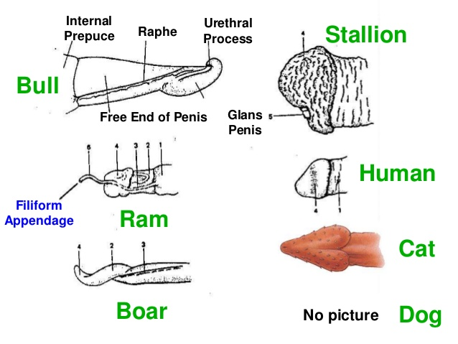

Slide 45
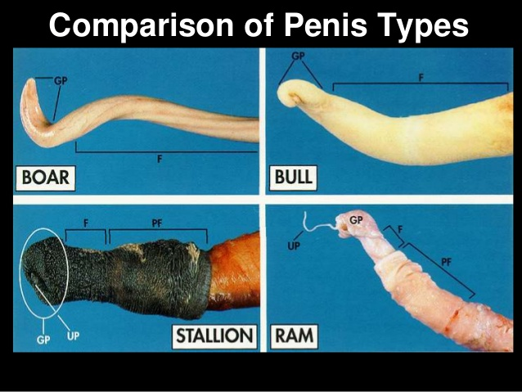

Slide 46
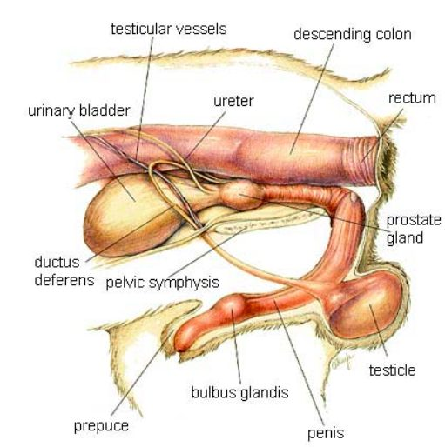
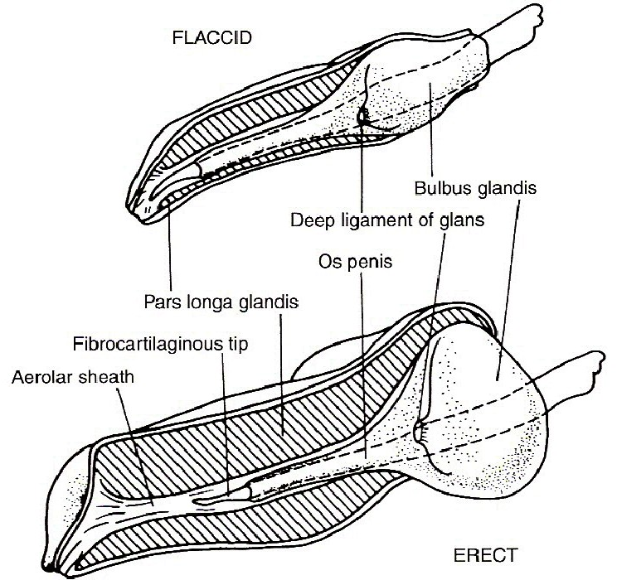

Slide 47
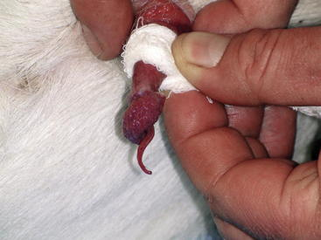
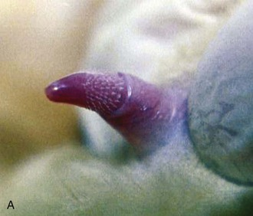

Slide 48
- PREPUCE –
- Penile integument (modified skin over penis)
- Invaginated fold of skin over penis
- Prepucial orifice or prepucial osteum
- Long and tough preputial hairs in bull
In bull, prepucial muscles
- Protractor and Retractor prepucial muscles
(drawing prepucial opening forward/backward)

Slide 49
Stallion - double folded prepuce
(wax like secretion “beans” at outer fold)
Boar - Preputial diverticulum (pouch)
(at dorsal to prepucial orifice..dead cells/debris)
(Pheromone…restricted sow movement at coitus
Swine and ruminants urinate inside the prepuce
Horses, dogs and tom urinate out of prepuce

Slide 50
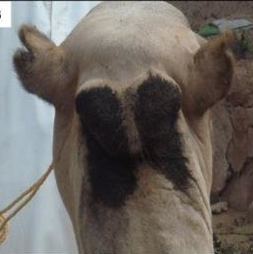
Peristaltic action of urethralis muscle
- Transport of urine or semen
Male camel –
- Poll glands
- At back of neck near the poll
- Activated after sexual maturity
- Dark brown secretion …. pheromones
- Attractive to female in breeding season

Slide 51
- Blood supply –
Testes – Internal spermatic artery
Scrotum – external pudendal artery
Penis – External and internal pudendal
artery with obturator artey
Acc. sex glands – Internal pudendal artery
Nerve supply –
Testes – Renal and mesenteric plexus
Scrotum – genital nerve
(from genito-femoral nerve)
Penis – pelvic plexus, pudendal &
hemorrhoidal nerve
Acc. sex gland – hypogastric nerve and
pelvic plexus

Slide 52


