Slide 1

The eye
Palpebrae
Gulshan Kumar
MVSc, PhD

Slide 2
Affections of
Palpebrae

Slide 3
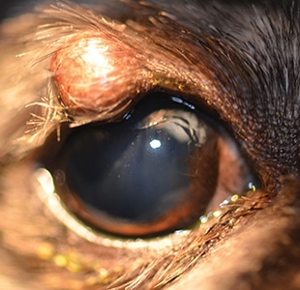
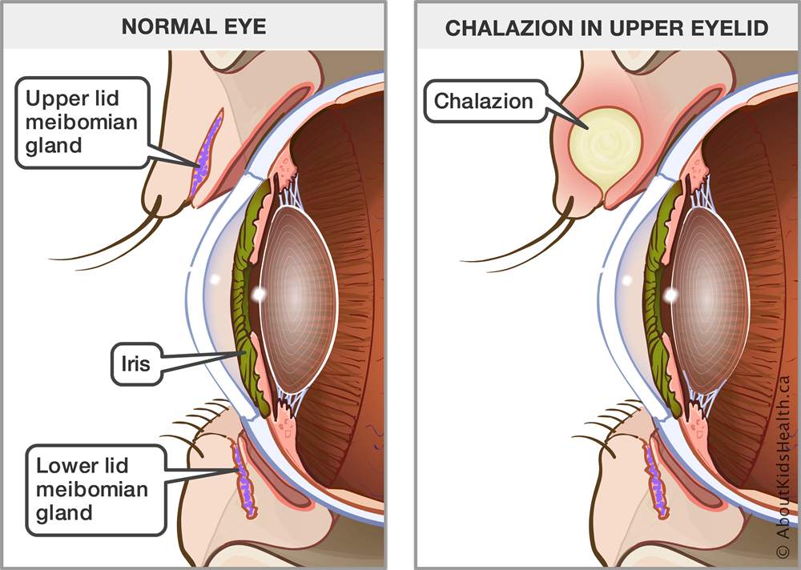
Chalazion/Tarsal cyst/Meibomian gland cyst

Slide 4
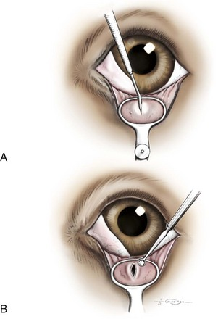
Chalazion/Tarsal cyst/Meibomian gland cyst

Slide 5
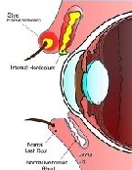
Hordeolum/Stye

Slide 6
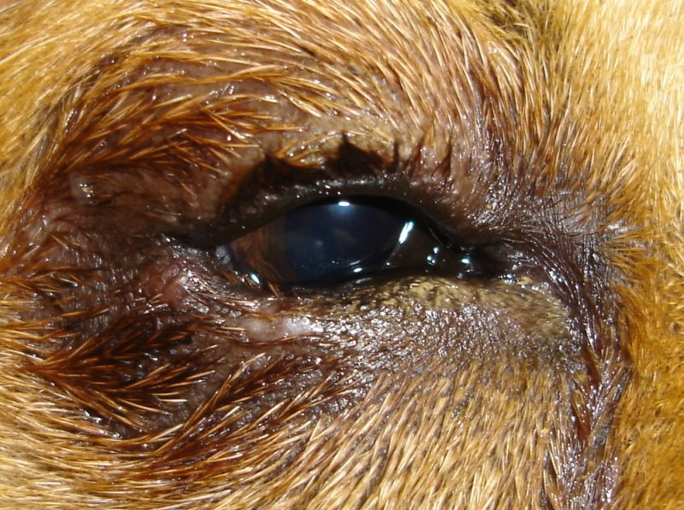
Entropion

Slide 7
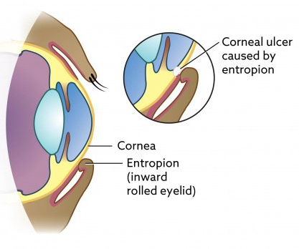
Entropion

Slide 8
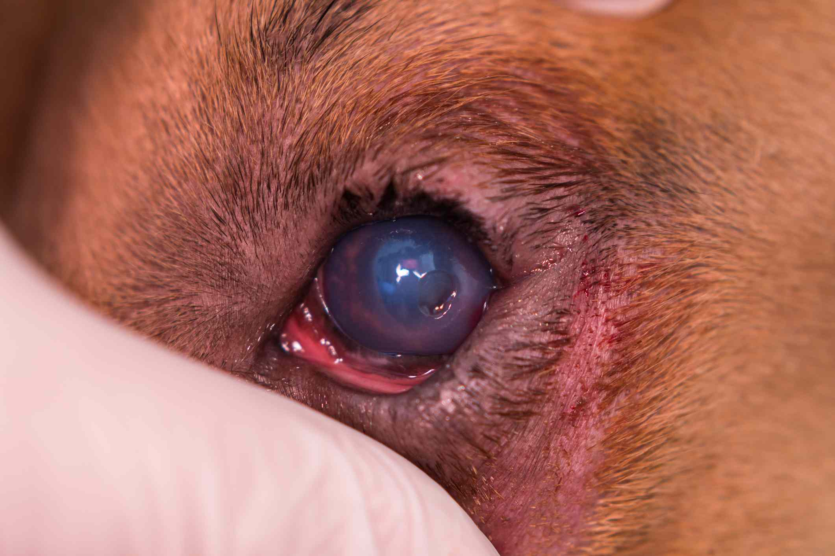
Entropion

Slide 9
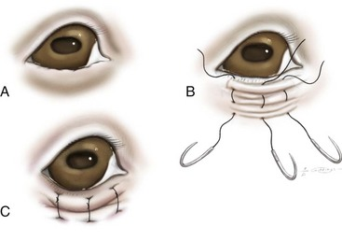
Entropion: in very young animals, temporary tacking of the palpebral skin until skull is fully formed. In many cases only this much is required and as the animal attains maturity the condition disappears.

Slide 10
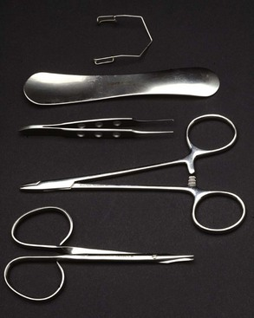
Wire Speculum
Ophthalmic instruments
Eyelid Plate
Fine toothed Forceps
Derf Needle Holders
Tenotomy Scissors

Slide 11
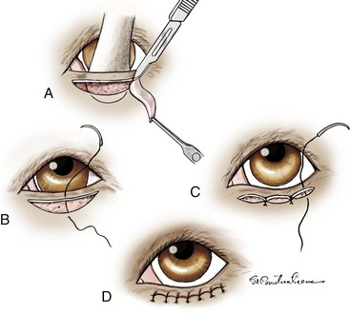
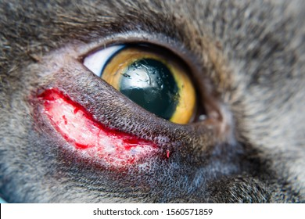
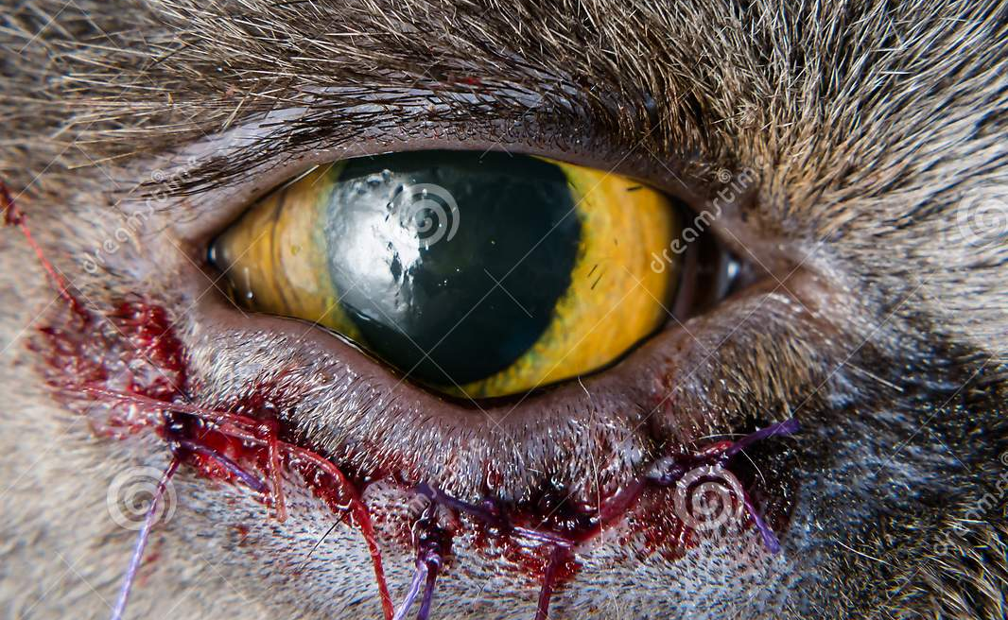
Entropion:
Permanent management (Hotz-Celsus technique).

Slide 12
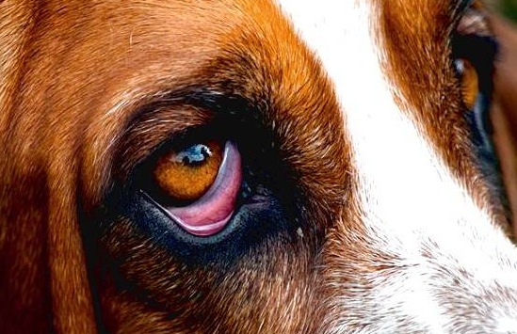
Ectropion: It congenital or acquired
Outward deviation or eversion of the eyelid

Slide 13
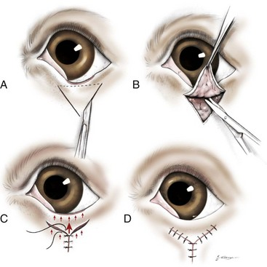
Ectropion:

Slide 14
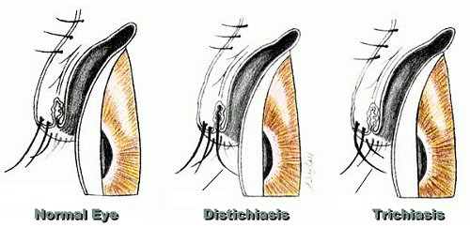
Trichiasis
Distichiasis

Slide 15
Trichiasis
Distichiasis

Slide 16
Trichiasis
Distichiasis

Slide 17
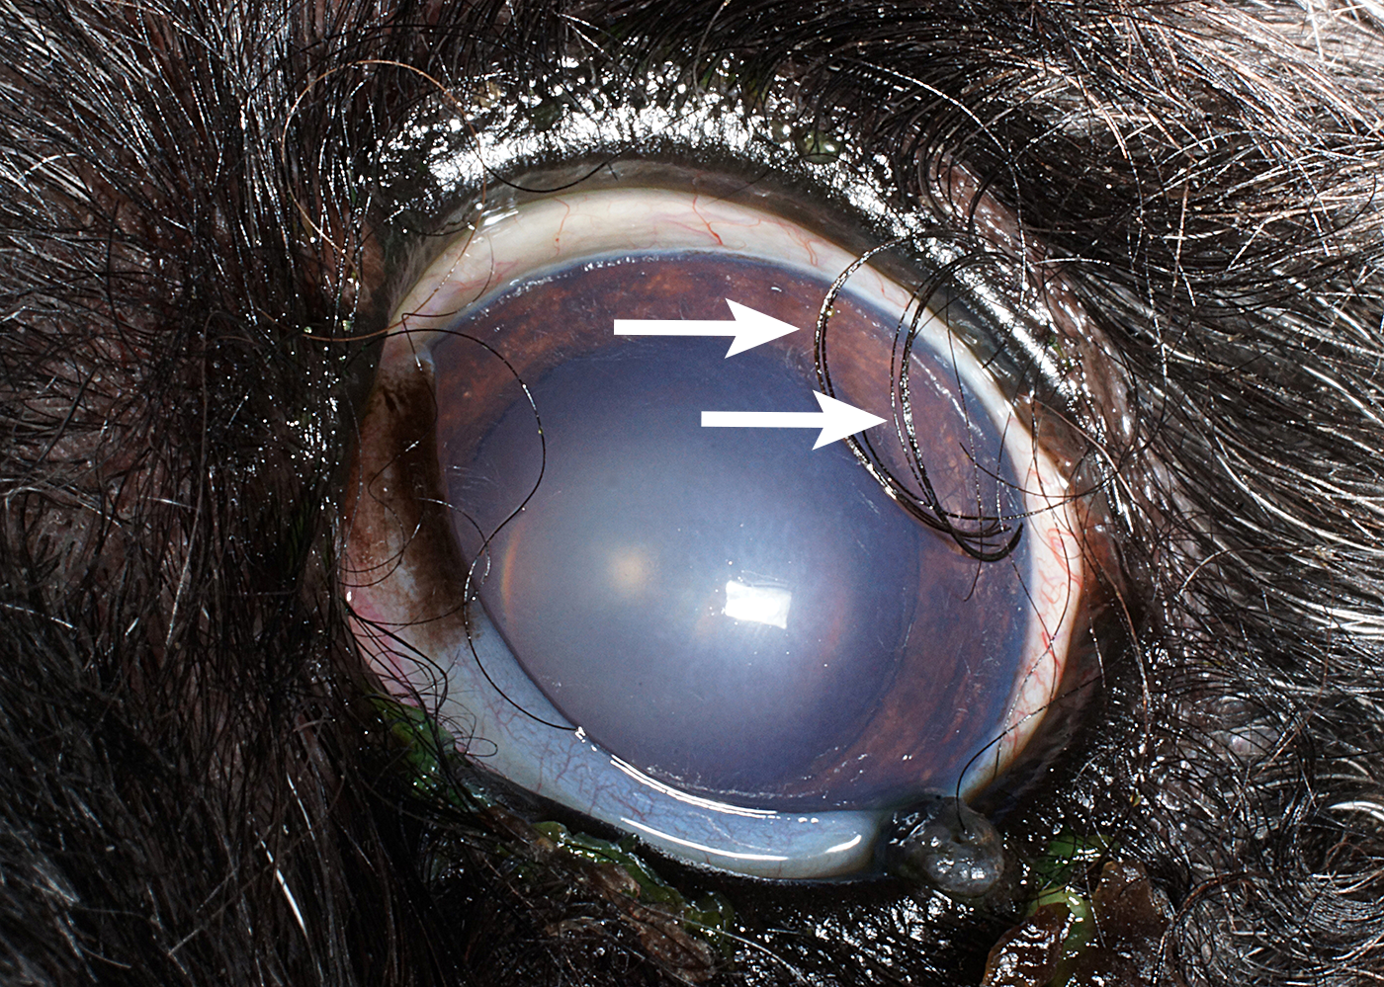
Trichiasis
Distichiasis

Slide 18
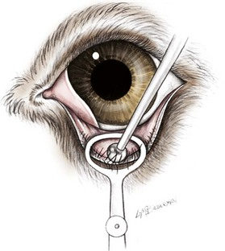

Slide 19
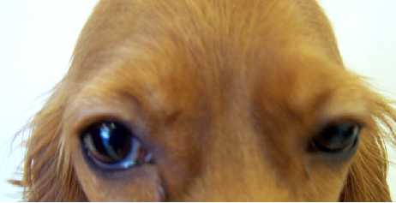
Blepharoptostis

Slide 20
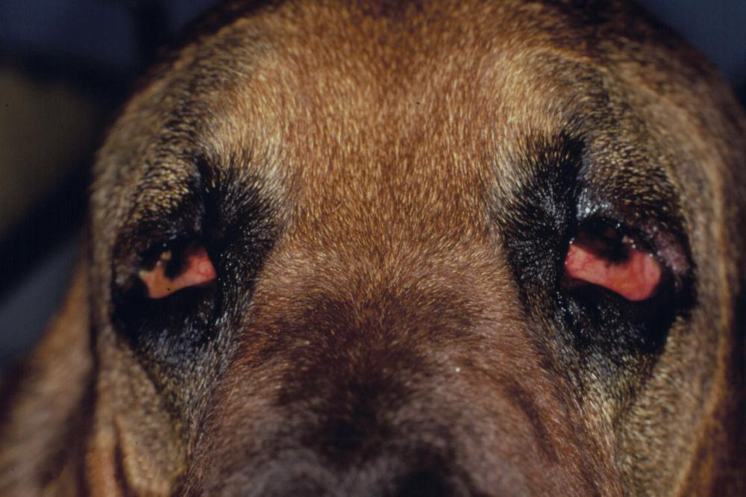
Laghthalmos

Slide 21
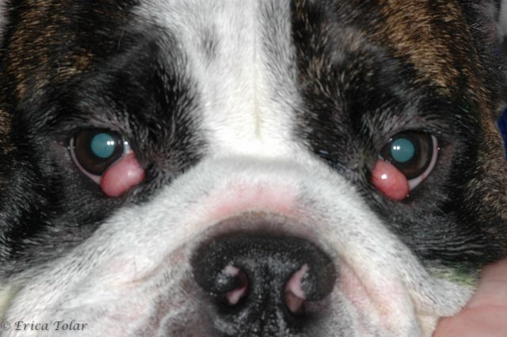
Prolapse of the gland of the third eyelid- the cherry eye
Marked breed predisposition, commonly seen in Maltese, Bassets, Rottweilers, Neapolitan Mastiffs and Shar Peis

Slide 22
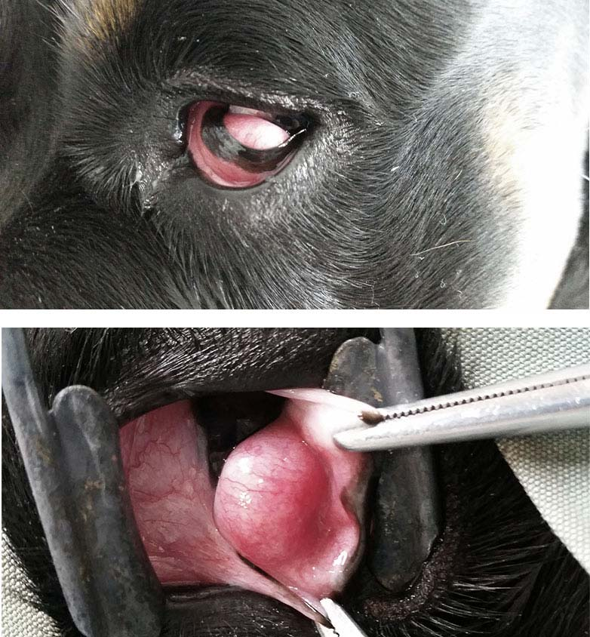
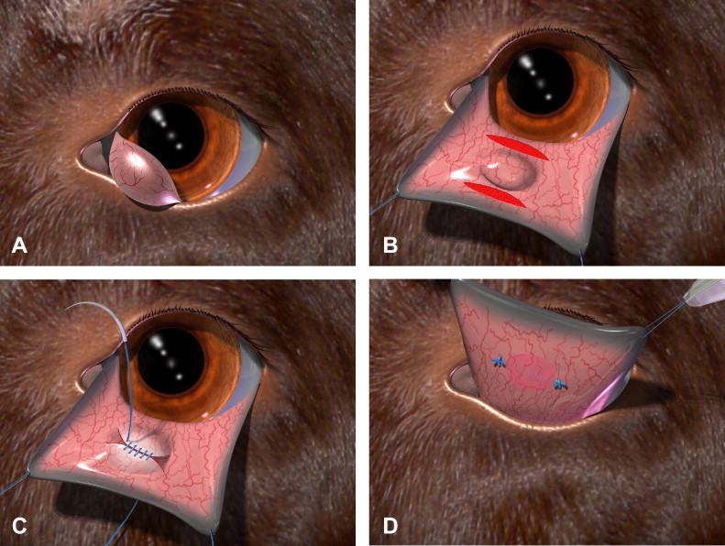
Prolapse of the gland of the third eyelid- the cherry eye
Excision
Morgan’s pocket technique
Modified Morgan’s pocket technique

Slide 23
Prolapse of the gland of the third eyelid- the cherry eye
Excision
Morgan’s pocket technique
Modified Morgan’s pocket technique

Slide 24
Prolapse of the gland of the third eyelid- the cherry eye
Excision
Morgan’s pocket technique
Modified Morgan’s pocket technique

Slide 25
Prolapse of the gland of the third eyelid- the cherry eye
Excision
Morgan’s pocket technique
Modified Morgan’s pocket technique
  Remove the conjunctiva also between the two incisions (dotted lines), followed by “tucking” the gland and suturing the edges

Slide 26
Dacryoadenitis
Blepharitis
Blepharospasm

