Slide 1

Fractures-3
Gulshan Kumar
MVSc, PhD
Dept. of VSR, College of Veterinary Science & Animal Husbandry, DUVASU, Mathura- 281 001

Slide 2
Principles of management
Dept. of VSR, College of Veterinary Science & Animal Husbandry, DUVASU, Mathura- 281 001

Slide 3
considerations
Primary consideration
Preservation of life:
  Treatment for shock, haemorrhage
Secondary considerations
Repair of tissue
Restoration of function
Dept. of VSR, College of Veterinary Science & Animal Husbandry, DUVASU, Mathura- 281 001

Slide 4
examiation
Primary consideration
Assessment of general health of the animal
Adjacent tissue damage and its extent
Precise evaluation of the fracture(s)
Dept. of VSR, College of Veterinary Science & Animal Husbandry, DUVASU, Mathura- 281 001

Slide 5
Clinical diagnosis of fracture
…history of trauma
…..signs and symptoms
  Pain & tenderness
  Swelling (may be immediate or appear several days later
  Deformity/change in angulation
  Crepitus
  Loss of function
Dept. of VSR, College of Veterinary Science & Animal Husbandry, DUVASU, Mathura- 281 001

Slide 6
Radiographic examination
Positioning
Two orthogonal views
To decide on best procedure for reduction and immobilization
Dept. of VSR, College of Veterinary Science & Animal Husbandry, DUVASU, Mathura- 281 001

Slide 7
Radiographic examination
Positioning
Two orthogonal views
To decide on best procedure for reduction and immobilization
Radiographs of the opposite limbs are useful (young animals)
Dept. of VSR, College of Veterinary Science & Animal Husbandry, DUVASU, Mathura- 281 001

Slide 8
Principles of fracture treatment
Anatomical reduction
Stable fixation
Preservation of blood supply
Early, active pain-free mobilization of muscles and adjacent joints
Dept. of VSR, College of Veterinary Science & Animal Husbandry, DUVASU, Mathura- 281 001

Slide 9
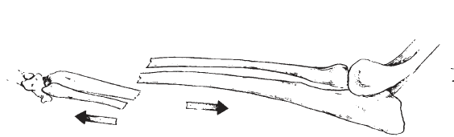
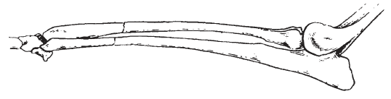
reduction
Closed reduction
  Most useful below the elbow and stifle, (less tissue, no hinderance of soft tissue
  Small and relatively long legged animals
  By traction and counter traction & manipulation
Dept. of VSR, College of Veterinary Science & Animal Husbandry, DUVASU, Mathura- 281 001

Slide 10
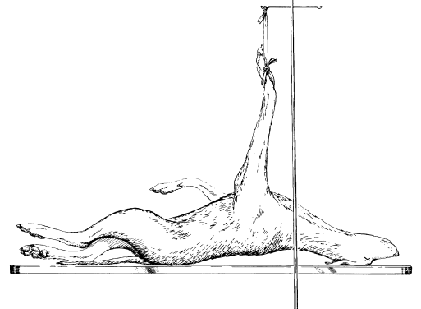
reduction
Closed reduction
  By traction and counter traction & toggling
  Skeletal traction (not common in veterinary practice)
  Use of gravity
Dept. of VSR, College of Veterinary Science & Animal Husbandry, DUVASU, Mathura- 281 001

Slide 11
reduction
Open reduction
  Method of choice in many Fractures
  Used in unstable fractures,
  Several day old fractures
  Those with joint involvement
Dept. of VSR, College of Veterinary Science & Animal Husbandry, DUVASU, Mathura- 281 001

Slide 12
reduction
Open reduction
  By levering
  By force using bone forceps,
  Combination of the two
Dept. of VSR, College of Veterinary Science & Animal Husbandry, DUVASU, Mathura- 281 001

Slide 13
The techniques
Closed reduction and immobilization
  Casts and splints
    POP, Fibre glass
    Thomas, Meta
Dept. of VSR, College of Veterinary Science & Animal Husbandry, DUVASU, Mathura- 281 001

Slide 14
The techniques
Closed reduction and internal fixation (CRIF)
Closed reduction and external fixation
Open reduction and internal fixation
  Intra-medullary
  extramedullary
Dept. of VSR, College of Veterinary Science & Animal Husbandry, DUVASU, Mathura- 281 001

Slide 15
Thanks

