Slide 1
INFERTILITY IN MALE ANIMALS
Dr. VIKAS SACHAN

Slide 2
INFERTILITY IN MALE ANIMALS
Complete lack of fertility - Sterility
Reduced fertility - Subfertility
Temporary loss of fertlity - Infertility.
Libido – no direct relation to male fertility i.e.
(Poor libido male may have excellent semen)
Infertility
1. Impotentia coeundi
2. Impotentia generandi

Slide 3
Impotentia coeundi –
- Reduced/no sexual drive
- Inability to copulate (no normal services)
Impotentia generandi –
- Failure of conception even after normal
services

Slide 4
IMPOTENTIA COEUNDI –
- Inability to complete the service
… due to Immaturity or poor experience
Unwillingness to mount
Inability for intromission
Failure of ejaculate successfully

Slide 5
Immaturity or poor/bad experience
- Mating at prepubertal or very young age
- Rearing in isolation like small confined room
(poor learning to copulate)
- Slippery floor, low roof
- Unpleasant environment
- Continuous exposure to estrous female
- Furious and improper size of dummy
- Abusive handling and unfriendly attendant
- Punishing or pain experience during mating
- Presence of old and senior/dominant male
- Experience of too cold and too hot AV

Slide 6
- Factors which reduce the sex desire
- Deficiency of energy, protein, vitamins, TDN
and minerals etc
- Over feeding : obese and lethargic
- Iodine deficiency/hypothyroidism : Obesity
- Over roughage feeding : Enlarged abdomen
- Over sexual use
- Over aged bull
- Climatic & psychological factors
- Poor exercise
- Joint, nerve and muscle pathologies
- Endocrine imbalance

Slide 7
Libido
- hCG & GnRH
…… increase the level of testosterone
(effect is temporary)
- Overdosing / frequent administration of hCG
….. Testicular oedema
….. Abnormal spermatogenesis
- Testosterone (@100-500 mg in bulls & stallion)
(Prolonged use….T. degeneration)
Good and gentle management
Exposure to estrous female
etc

Slide 8
- Unable and unwilling to mount (conditions) :
- Foot/limbs pathological
abnormal/over grown hooves, interdigital
growths, fibroma, sole penetration etc.
- Coxitis (hip joint inflammation) in dog
- Gonitis (stifle joint inflammation) in bull
- Tendonitis and tarsitis etc
- Abnormal limb confirmation
- Lesion in lower back trunk
e.g. honeymoon back
- Back pain : Ca deficiency
Pathologies of vertebrae
- Abnormal gait

Slide 9
Animals mount but dismount again and again
: Back pain during service test
Over Ca feeding
…… Exostosis of vertebrae
…… Degeneration of intervertebral joints
…… Stiffness, paraplegia & fracture tendency
- Poor exercise : Back pain
Neuro-musculo system
Limb confirmation & joint angles

Slide 10
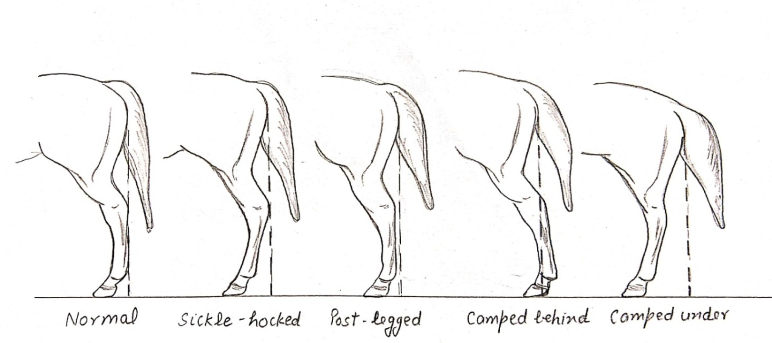

Slide 11
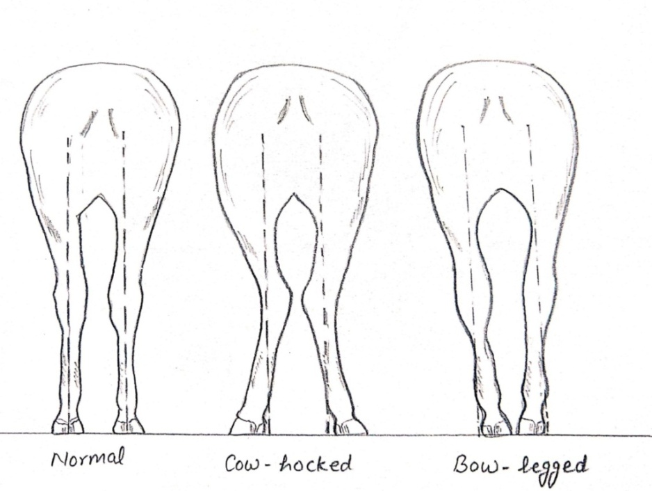

Slide 12
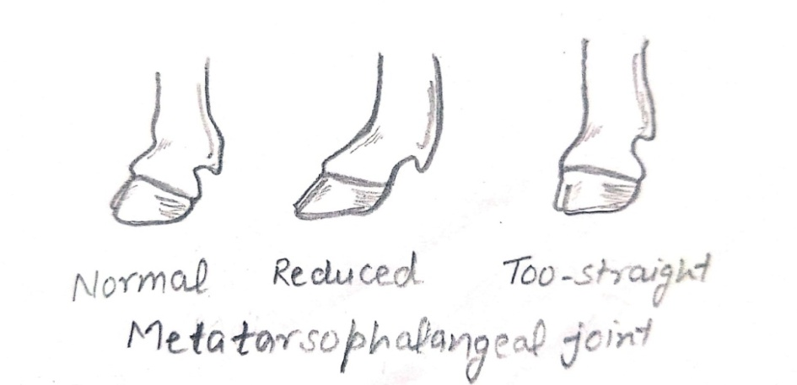

Slide 13
- Some neuromuscular abnormalities are –
- Progressive posterior paresis / crampy /
neuromuscular spasticity/spastic syndrome
- Spastic paresis (elso heel)
- Peroneal nerve or/and tibial nerve paralysis
- Honeymoon back
…. Rupture of lumbo-dorsal facia
…. Crepitation and swelling in muscles
…. Painful mounting

Slide 14
Failure of penile erection :
- Abnormal parasympathetic nervous system
- Improper blood flow in CCP
- Leakage of blood from CCP
- Presence of ectopic veins
- Rupture/broken penis
- Fracture of os penis (Dysuria & haematuria)
- Atrophy of retractor penis muscles
- Prepucial hair ring & biting abscess in tom

Slide 15
- Failure of penile protrusion and intromission :
- Short or undergrown penis
- Abnormal sigmoid flexure
- Abnormal retractor penis muscle
- Balanitis, posthitis, balanoposthitis
- Phimosis, paraphimosis, priapism
- Diphallus, phallocampsis
- Adhesion, necrosis, neoplasia in penis &
prepuce
- Hypospadias
- Penile necrosis
(Strangulation due to prepucial hairs / wool)
- Urolithiasis

Slide 16
- Some psychological : refusal of sexual arousal
or mating process
- New or aggressive partner
- Painful past experience
- Stressful environment/surroundings
In tom
- Exogenous drug administration (testosterone,
glucocoticoids, anti-androgens, ketoconazole,
cimetidine, anabolic steroids etc)
- Protruding intervertebral disc
- Degenerative myelopathy in tom

Slide 17
Ruptured/Broken/Fractured penis –
- Rupture of tunica albuginea
- Rupture at insertion of retractor penis M.
- Abnormal pressure in CCP
- Common in bull (young bulls)
- Poor experience and strong sex urge
- Strong thrust on hind region (Not in vagina)
- Aarched back, stiffness, pain and swelling
- Anormal stepping
- Hematoma, preucial edema / eversion
- Adhesion, abscess and hard fibrosis
- If damage of penile nerves : No erection

Slide 18
Treatment : Evacuation of hematoma by surg.
Suturing of T. albuginea
Sexual rest for 2-3 months
Antibiosis, anti-inflammatory drugs
Massaging
Penile trauma or trauma to os penis in dog
: No mating

Slide 19
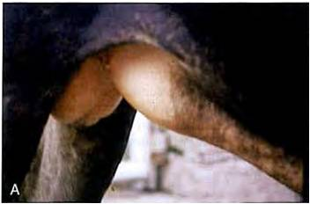

Slide 20
Phallocampsis (penile deviation) –
- Lateral or ventral deviation
- Due to
Congenital defect of t. albuginea
Poor development of dorsal apical Ligam.
Adhesion after trauma to penis / prepuce
- Ventral deviation of penis (rainbow penis)
- Due to
Persistent penile frenulum (> 11 yrs age)
Defect in tunica albuginea
Congenital defect
Adhesion and fibrosis of penile tissues

Slide 21
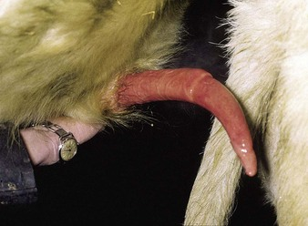
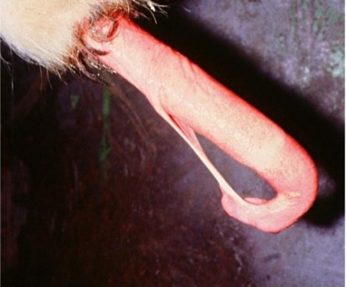

Slide 22
Bull in isolation
…. No riding behavior
….. Penile frenulum persistance
- Surgical transaction after ligation the vessels
- Fixing of dorsal apical ligament with tunica
albuginea …. with help of fascia lata
(taken from biceps femoris muscles)
….. prevent slipping or misplacing of ligament

Slide 23
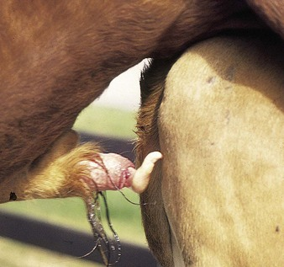
Cork screw penis – (premature spiral deviation
of penis; PSDPs)
…. Premature spiraling
- within prepuce or just after touching the
cow/dummy perineal region
Due to abnormal dorsal apical penile ligament
(inherited or acquired)
Some neural pathologies.

Slide 24
Balanoposthitis – infection and inflammation of
penis and prepuce
Infection and inflammation of penis – Balanitis
Infection and inflammation of prepuce – Posthitis
- Pain, adhesion and stenosis of prepucial orifice
- Laceration / ulceration on prepuce (dermatitis)
Common in bull, dog and ram
Less common in stallion, boar and tom

Slide 25
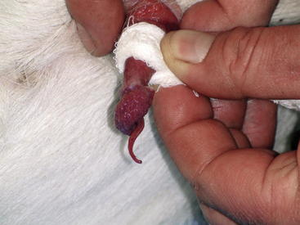
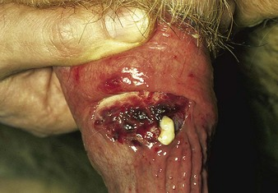

Slide 26
Ballanoposthitis – E. coli, streptococcus sp,
Staphylococcus, C. pyogens,
M. tuberculosis, aspergillus,
mucor, mycoplasma,
IBR-IPV virus and calcivirus
In canines - E. coli, canine herpes virus,
calcivirus etc
Orf (contagious pustular dermatitis/ecthyma
contagiosum/scabby mouth) : Ram & buck.

Slide 27
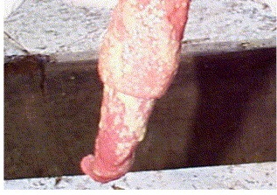
- BoHV-1 : Ulcerative & purulent balanoposthitis
in bulls
( painful urination & intromission)
- Ureaplasma : Granulomata formation on penis
In equines :
- Dourine (by Tyrpanosoma equiperdum),
- Habronemiasis (by Habronema musca larva)
- Equine coital exanthema/horse pox (by
equine herpes virus EHV-3)

Slide 28
- Pizzle rot / Sheath rot -
- Ulcerative balanoposthitis in ram
- Caused by Corynebacterium renal
- High protein diet
(ammonia scalds at prepucial region)
- Trauma due to faulty positioning of AV
- Hair drawn in prepuce
- Ulceration, necrosis and scab/crust
- Stenosed/blocked prepucial opening

Slide 29
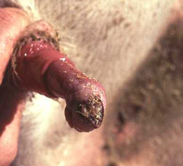

Slide 30
- Treatment :
- Broad spectrum antibiotics
(penicillin & cephalosporins)
- Anti-inflammatory drugs
- Antiseptic douching of prepuce
- Washing with KMnO₄ water /1% H₂O₂
- Bacitracin ointment application
- Sexual rest

Slide 31
Phimosis –
- Inability to protrude penis out of prepuce
- Due to
- Stenosed prepucial orifice (cong / injury)
- Small penis, penile neoplasia
- Balanoposthitis
- Prepucial adhesion

Slide 32
More common in dog and stallion
Premature swelling of penile erectile tissues
before protrusion in dogs due to over excite
Surgical removal of small piece of mucosa
from ventral side of prepuce
…. Enlarged prepucial orifice
- Antibiosis and anti-inflammatory drugs

Slide 33
Paraphimosis –
- Inability to retract back the penis in prepuce
Due to
- Abnormal / damaged retractor penis muscle
- Swelling/inflammation of penis & prepuce
- Local penile injury
- Stenosis of prepucial orifice
- Balanoposthitis
- Penile neoplasia
- Damaged pudendal nerve
- Penile paralysis due to spinal injury
More common in dog and stallion

Slide 34
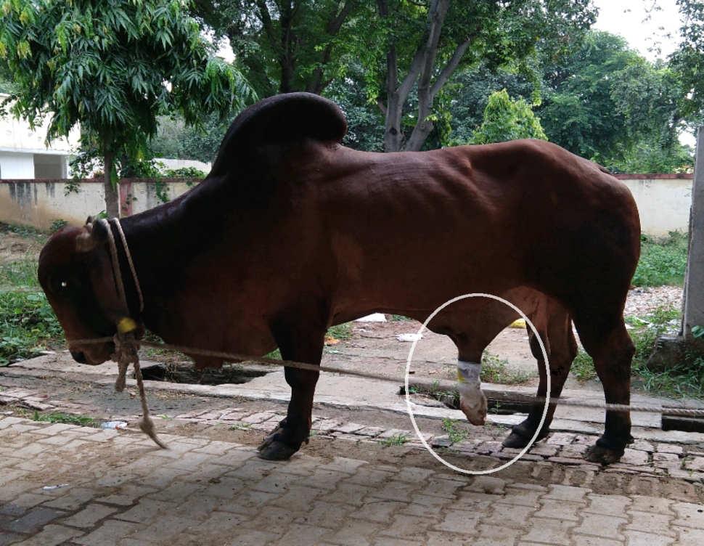
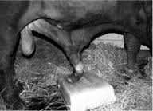

Slide 35
Prolonged protrusion of penis and prepuce
.. Impaired venous drainage due to prepucial
orifice ring….. Aggravates the condition
Treatment –
- Cold packs, lubrication
- Antiseptic ointments
- Diuretics
- Penile replacement in prepuce
(after compression gauzing or/and incising
prepucial orifice)
- Phallopexy
- Antibiotic and anti-inflammatory drugs
- Penectomy

Slide 36
Priapism –
- Persistent penile erection without sexual
stimulation (for > 4 hrs)
Due to
- Increased arterial blood flow (nonischaemic
or high flow priapism)
- Reduced/occluded venous blood flow
(ischaemic or low flow priapism) in penis or
- Abnormal neural control of erection
- More common in dog, stallion and tom
- Urine retention and painful urination

Slide 37
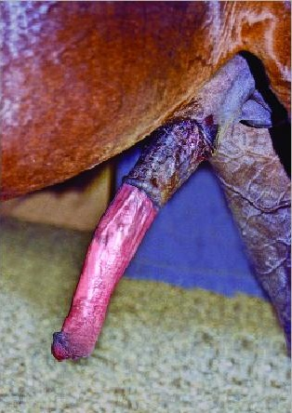
In chronic cases
- Edema and necrosis of penis
Treatment
- Cold pack & lubricants
- Antibiotics, anti-inflammatory
- Anticholinergics and diuretics
- Intravenous injections of benzatropin
mesylate and adrenaline into CCP
- Surgical drainage of CCP blood
- Penectomy

Slide 38
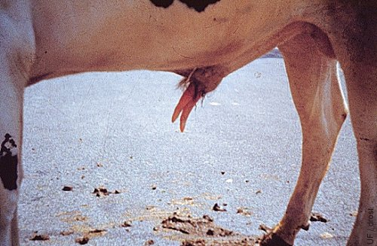
Diphallus –
- Presence of double penis
- Congenital anomaly
- Completely or partially duplicate
- Not able to complete normal copulatoion

Slide 39
Hypospadias –
- Abnormal extrapelvic urethral formation
- Urethra have abnormal opening
(at ventral aspect of penis)
Urethra opens at
- Penile/balanitic hypospadias – Ventral to penis
- Scrotal hypospadias – Scrotum
- Perineal hypospadias – Perineal region
- Epispadias – Urethra opens at dorsal of penis

Slide 40
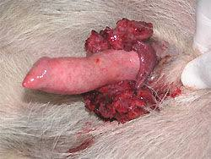
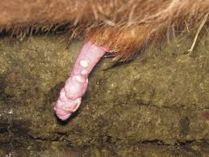
- Penile neoplasm –
- Fibropapilloma in bovines (papilloma virus)
- Squamous cell carcinoma in stallion
- Transmissible veneral tumor in dog (vineral
granuloma / lymphosarcoma / sticker tumor)

Slide 41
Topical application of fluorocil (in small tumors)
Surgical removal of tumor (laser / cryosurgery)
Anticancerous drugs
Penectomy

Slide 42
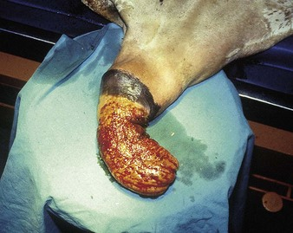
Preucial eversion – Prepucial mucosa is
protruded/everted out of sheath permanently

Slide 43
Intersex –
- True hermaphrodism (presence of both
testes & ovarian tissue along with both type
of externalia)
- Male pseudohermaphrodism
(Tetses with external clitoris)
- Female pseudohermaphrodism
(Ovary with male external genitalia)
Prepucial prolapse, fracture of os penis and
calcification of retractor penis muscle,
hemospermia (common in bull & stallion) etc

Slide 44
fail to ejaculate semen
- Congenital absence / abnormal penile
receptors on glans
- Damaged sensory dorsal nerve of penis
- Compression of spinal nerves
- Poor sympathetic nervous system
- Localized back pain
- Peritonitis in caudal abdomen

Slide 45
IMPOTENTIA GENERANDI –
- failure of fertilization even after normal
copulation
Abnormal semen
… (disease of testes/epid/sex glands)
- Abnormal seminal attributes as sperm
morphology, concentration, motility etc)
Normal semen
… Sperm defects (inherited sperm defects)

Slide 46
- IMPOTENTIA GENERANDI
(WITH ABNORMAL SEMEN)
- Testicular hypoplasia
- Testicular degeneration
- Orchitis
- Cryptorchidism
- Seminal vesiculitis
- Prostatitis
- Ampullitis

Slide 47
- TESTICULAR HYPOPLASIA –
- Incomplete development of germinal
epithelium of the seminiferous tubules
due to reduced germinal cells in testes
Reduced germ cells (spermatogonia) due to –
Failure of germ cells to develop in yolk sac
Failure of germ cells migration to genital ridge
Failure of germ cells to multiply in gonad
Degeneration of embryonic germ cells

Slide 48
Bilateral or unilateral
More common in left testicle
- Sterility in bilateral testicular hypoplacia
Congenital and hereditary
(controlled by recessive autosomal gene)
- Common in ram, bull and stallion
Klinefelter’s syndrome (extra X)
…Testicular hypoplasia
(in bulls, ram, boar & dogs)

Slide 49
Testes
- Small (scrotal circ. < 30 cm in bull)
- Flabby, Firm with shorter spermatic cord
- Freely movable in scrotal pouch
(Not in testicular atrophy)
- Spermiogram
- Aaspermia in bilateral & oligospermia in
unilateral condition)
- Low motility
- Abnormal morphology of sperm
- More sperms with PCD

Slide 50
Poor/no spermatogenesis
….. Poor gonadal sperm reserve
….(oligospermia or aspermia)
- No effect on leydig cells i.e. normal libido
Giant cells (multinucleate cell)
Medusa cells (ciliated cells from efferent
tubules)
Hereditary (diagnosed after two years age)
in bull or well grown other small animals
No treatment

Slide 51
TESTICULAR DEGENERATION –
- Degeneration of germinal layer of sem. epith.
(including spermatogonia and sertoli cells)
- Impaired spermatogenesis
Acute - Inflammation, heat & pain
- Testes …Enlarged & Tense
- C. epididymis…Soft and Smaller
Chronic
- Seminiferous epithelium … atrophy
(Testicles … small & softer)
- Calcification & fibrosis
(tetsicles …firm, hard & less resilient

Slide 52
Germinal epithelium … more susceptible
Leydig cells … most resistance
In germinal epithelium
….Sertoli cells & spermatogonial cells are
most resistive to degeneration i.e. once
they found degenerated along with blocked
lumen in affected testicle, regeneration will
not be there.
Sterility with maintained libido/sex drive

Slide 53
T. degeneration - reversible or irreversible
- Degeneration - Very fast (hrs to days)
Regeneration - Very slow (weeks to months)
Unilaterally (lesion is localized)
Bilaterally (lesions is generalized)

Slide 54
Low E₂ & high plasma FSH and LH in stallion
..Indicates ... Low fertility
(possibly due to t. degeneration)
- Degenerated testicle –
... Production of antisperm antibodies
… Affect the sperms produced by normal one

Slide 55
- Spermiogram –
Normal seminal volume
Oligozoospermia or azoospermia
Immature round spermatogenic cells
Reduced sperm motility
More abnormal sperms
(more PCD & detached head etc)
Diadem defect … temporarily
Necrozoospermia
Presence of giant (multinucleate cells)

Slide 56
Duration between
T. degeneration … & ... Abnormal spermiogram
Bull - 60-70 days
Ram - 60-70 days
Stallion - 40-45 days
Boar - 50-60 days
Dog - 60-70 days

Slide 57
Causes of testicular degeneration –
Temperature
Irradiation – (X-rays, Gamma rays etc.)
Hormonal imbalance
Age
Stress/Trauma/Disease
Systemic/localized diseases
Nutrition
Poisons
Autoimmunization
Testicular tumors
Vascular disturbance

Slide 58
Temperature –
- Summer & humidity
- Direct heating & frost bite (inflammation & necrosis)
- Unshorn or excessive wool over scrotum of ram
- Excess fat deposition over scrotum (no heat loss)
(due to high protein and high energy diet)
- Local Inflammation, scrotal dermatitis,
ectopic testes
- Scrotal mange (by chorioptes bovis) in ram
- Inguinal/scrotal hernia (poor thermoregulation)
- Testicular lesion/trauma

Slide 59
- Irradiation – (X-rays, Gamma rays etc.)
- Most susceptible – spermatocyte
- Most resistant – leydig cells & sertoli cells
- Sperm concentration reduced
- Increased abnormality

Slide 60
- Hormonal imbalance –
- Sertoli cell tumor (common in dog) – Excess E₂
- Leydig cell tumor – Excess testosterone production
- Adrenal tumor - Excess corticosteroid production.
- Tumors of pituitary & hypothalamus
(abnormal GnRH and gonadotrophin)
Excess estrogen or testosterone
… Negative feedback on hypothalamus and pituitary
… Reduced GnRH and gonadotrophins
… Testicular degeneration
Dystrophia adipogenitalis
…. Testicular neoplasia, atrophy and degeneration
along with obesity in dogs

Slide 61
Age –
- Over age…Poor management…Disease conditions
….Testicular degeneration
Dogs and bulls at > 10 years of age
In tom > 12 years of age
- Stress/Trauma/Disease –
- Shipping, heat, cold, severe fatigue
- Abscess, Arhritis, laminitis, Myiasis and foot rot etc
- Pneumonia, peritonitis, IBR, JD, FMD
Stress …Corticosteroid secretion
… Reduced gonadotrophins (e.g. LH)
… Testicular degeneration

Slide 62
- Systemic/localized diseases –
- Localized disease of testes
- Inflammation – heat, oedema and congestion
- Orchitis
- Trauma and abscess of testes & scrotum
- Brucella, M. tuberculosis, corynobacterium
pyogens, IBR-IPV, BEV (Bovine enterovirus), epivag,
canine distemper infection
Obstruction of efferent duct …continuous back pressure
… T. degeneration
Nutrition –
- Under feeding and poor nutrition (Deficiencies)
- Under nutrition ….. Gonadotrophins
- Vit. A and Zn deficiency …. Testicular degeneration

Slide 63
- Poisons –
- Dipping of ram in arsenical solution (ectoparasiticide)
- Antimony compound in dogs
(Treating heartworm disease; Dirofilaria immitis)
- Autoimmunization –
- Faulty or experimental injection of autologous
testicular material
- Damage of blood testes barrier due to any trauma

Slide 64
- Testicular tumors –
- Vascular disturbance -
- Varicocele of spermatic vein (abnormal heat exchange)
- Strongyle larva in testicular artery in stallion
- Vasculitis
- Granuloma formation
- Torsion of spermatic cord etc

Slide 65
Diagnosis -
- History of infertility & testicular trauma
- Testicular biopsy
- Testicular histology
- Giant cells
- Cytoplasmic vacuoles
- Thinning of germinal epithelium
- Lymphocytes & plasma cells in ST
- Fibrosis etc
- Trans-scrotal ultrasonography
- Spermiogram

Slide 66
Prognosis – Good
Seminiferous tubule
Intact basement mem. with spermatogonia
Prognosis – Poor
Chronic cases with abscess and bilateral tumor
- Treatment - according to cause
- Balance diet with minerals, vitamins & protein
- Supplementation of Vit A and Zn
- Cooling to avoid heat stress during summer
- Regular exercise, deworming and vaccination
- Sexual rest
- Antibiosis & anti-inflammatory (in orchitis)

Slide 67
- Orchidectomy in acute unilateral orchitis
- Removal of the testes with tumor
- Treatment of local and systemic diseases
- Hormonal therapies (testosterone, FSH,
Thyroxine) are of less value
Removal of degenerated testis
… Hypertrophy of the remaining testis
… Increase in sperm numbers

Slide 68
After treatment - Seminal quality is not
regained fully as previous
Testicular degeneration doesn’t progress once
the cause is removed
Sperm with less morphological abnormality
and increased motility indicates …. Recovery

Slide 69
ORCHITIS – “Infection & inflammation of testes”
- Continuous inflammation
…. Suppuration and necrosis
It may be cause due to-
Trauma/wound
Bovine enterovirus in bulls
B. abortus, B. canis, B. suis, B. melitensis
Tuberculosis in bulls (granulomatous orchitis)
Mycoplasam, Aranobacterium pyogens,
Histophilus somni
Ascending infection from urethra
Descending infection from acc. sex glands

Slide 70
    Canine distemper and mycoplasma in dog
    Autoimmune destruction of testes in dog
    Damage to blood-testes barrier
    Feline infectious peritonitis virus
    Epivag virus infection
- Unilateral orchitis …. more common
Acute condition – Hyperaemia
Swelling (2-3 times enlarge)
Pain with hotness
Chronic condition – Adhesion
Shrunken, fibrotic testes
Leaking abscess

Slide 71
- Semen is loaded with white blood cells
Treatment –
- Broad spectrum antibiotics
- Anti-inflammatory drugs
- Application of anticeptics and ice packs
- Glucocorticoids
- Sexual rest
- Removal of affected testes
- Castration
- Once treated….Not use for breeding purpose

Slide 72
CRYPTORCHIDISM
- No descend of testes (unilateral/bilateral)
- Incomplete cryptorchidism
(Epididymis / part of testicle in inguinal C.)
- Abnormal testicular thermoregulation
(Poor/no spermatogenesis)
Cryptorchid testicle - Spermatogonia A or B
Inguinal testicle - Primary spermatocyte
In foal - If gonad doesn’t come into scrotum
…Size of testicles increase
…Vaginal ring constricts
…. More chances of cryptorchidism

Slide 73
Due to –
- Mechanical defect
- Gubernaculums abnormality
- Inherited (genetic defect)
- Testicular chromosomal abnormality
- Poor testicular production of androgens
- Defective gonadotrophins production
- Unilateral cryptorchid … Animal is fertile
Bigger (compensatory) size of scrotal testes
Bilateral cryptorchidism …Infertility/sterility
…. Oligospermia or aspermia

Slide 74
Cryptorchid testes
- Smaller, soft and flaccid
- Unaffected leydig cells… Normal libido
More common in stallion, dog and boar
Inherited as sex limited autosomal recessive
trait
Cryptorchid testes … More prone to neoplasia
(Seminoma & sertoli cell tumor in dogs)
(Teratomas in stallion)

Slide 75
Diagnosis of monorchidism
- History, behavior, physical examination,
hormonal testing, and probably surgical
exploration
- Ultrasonography, low basal testosterone
level (e.g. <0.24 ng/ml in stallion) and
measurement of estrone sulphate in stallion
In Cryptorchid testicle (in stallion and boar)
- Destroyed sertoli cells - no inhibin
(i.e. no inhibition of FSH )… More estrogen
….but level of estrone sulphate…very low

Slide 76
High flanker - Testes in inguinal canal
Anorchia ….. No testes
Monorchia …. One testes
Polyorchia …. > 1 supernumerary testis

Slide 77
- TESTICULAR NEOPLASIA
- Commonly in cryptorchid testicle
- Common in dog
(Interstitial cell tumors > Sertoli cell tumors)
- Seminomas in dogs
- Seminoma & teratoma - Stallion
Interstitial cell tumors - Excess androgen
Sertoli cell tumor – More estrogen plasma
Teratoma, seminoma and teratocarcinomas are
germinal neoplasms - Stallion

Slide 78
Teratoma - Benign tumor with hairs, teeth,
bone, cartilage etc within
Seminoma - Germ cell tumor develops in
germinal layer of seminiferous tubules
…Malignant
Sertoli cell and leydig cell tumors
…. Nongerminal neoplasms (benign tumors)
Treatment
- Removal of tumor (cryosurgery etc)
- Removal of neoplastic testes

Slide 79
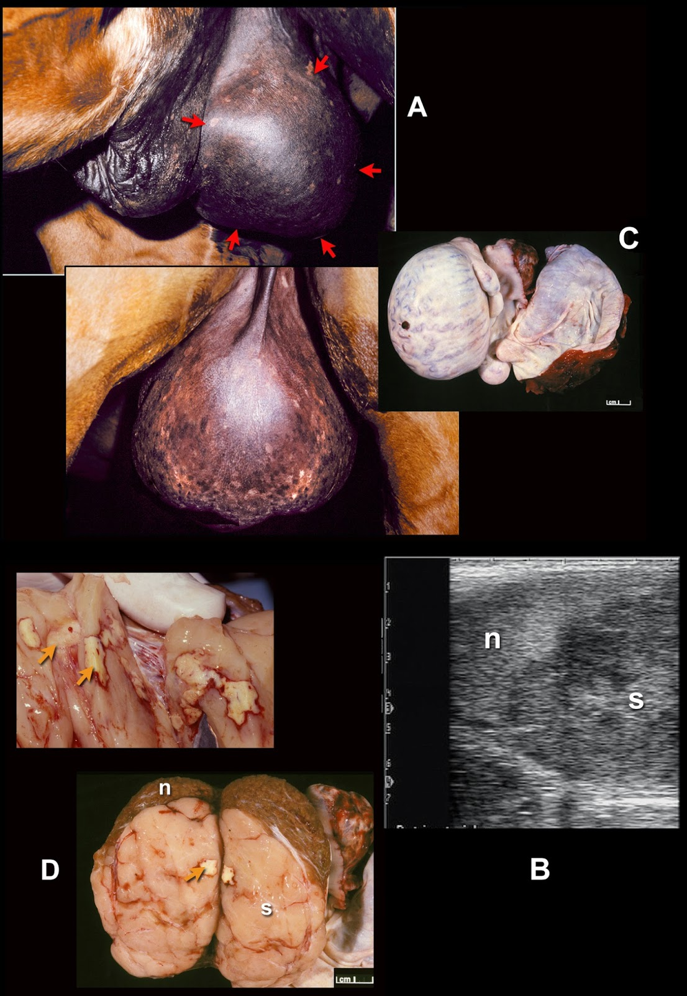

Slide 80
- SEMINAL VESICULITIS
- PROSTITIS
- AMPULLITIS
EPIDIDYMITIS
SPERMIOSTASIS
- No seminal flow
- Blind rudimentary mesonephric duct
- Defective efferent duct
FUNICULITIS – Infection and inflammation of
spermatic cord
TESTICULAR TORSION - Torsion of
spermatic cord) – Obstructed blood flow and
lymphatic

Slide 81
SPERM GRANULOMA –
- Duct obstruction pressure (back pressure)
- Faulty vasectomy
….. Rupture of epididymis
….. Sperm leakage (Foreign sperms)
(accumulates in surrounding stroma)
…. Antigenic inflammatory reaction
Degenerated sperms …. lipid and mycolic acid
Common in buck (Libido may be normal)
TESTICULAR HEMATOMA
TESTICULAR ABSCESS
TESTICULAR CYST

Slide 82
- IMPOTENTIA GENERANDI
(APPARENTLY NORMAL SEMEN OR
(ABNORMAL SPERMS)
- Seminal quality …. normal
- Sperm … not able to fertilize the ova
or early embryonic death / abortion
Disease conditions (Brucellosis,
Campylobacteriosis, Trichomoniasis, IBR-IPV)
Normal Seminal volume, color, pH, motility
Abnormal nuclear material / Nuclear shape
Abnormal sperm metabolism and abnormal
acrosome etc

Slide 83
Diadem defect –
- Invagination / pouching of nuclear material
- Beaded structure at anterior border of post
nuclear cap
- Single large vacuoles with distorted head
- Defect due abnormal spermatogenesis
- Diagnosed by fuelgen stain/wet mount
- Observe under phase contrast microscope
or differential interference microscopy
- Normal sperm motility and concentration
- Major and uncompensable defect

Slide 84
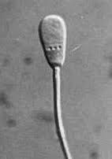

Diadem defect

Slide 85
- Knobbed acrosome sperm defect –
- Accentrically placed thickening of acrosome
- Defected spermiogenesis
(involving golgi complex)
- Inherited, autosomal, recessive and sex
linked sperm defect
- Common in bull, boar and dog
- Normal sperm motility and semen conc.
- Sperm is unable to penetrate ova
- Major and uncompensable sperm defect
- Diagnosed by eosine-nigrosine, eosine-B,
fast green stain (phase contrast microscopy)

Slide 86
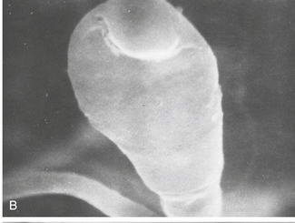
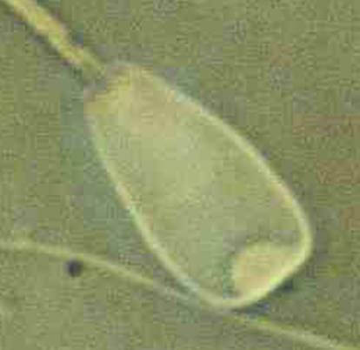
Knobbed acrosome sperm defect

Slide 87
Acrosomal crest
Acrosomal fold
Deatched or abnormal acrosome
Sperm chromosomal aberrations
Abnormal nuclear protein formation
Inheritance of disturbed enzymatic activity –
Sperm defects related to head, midpiece and tail due to abnormal spermatogenesis, maturation (protoplasmic droplets) etc also lead to infertility.

