Slide 1

Fractures-4
Gulshan Kumar
MVSc, PhD
Dept. of VSR, College of Veterinary Science & Animal Husbandry, DUVASU, Mathura- 281 001

Slide 2
methods of management
Dept. of VSR, College of Veterinary Science & Animal Husbandry, DUVASU, Mathura- 281 001

Slide 3
The METHODS
Closed reduction and immobilization
  Casts and splints
    POP, Fibre glass
    Thomas, Meta
Dept. of VSR, College of Veterinary Science & Animal Husbandry, DUVASU, Mathura- 281 001

Slide 4
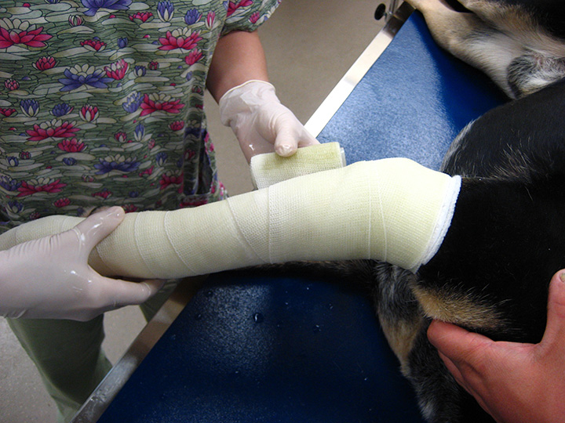
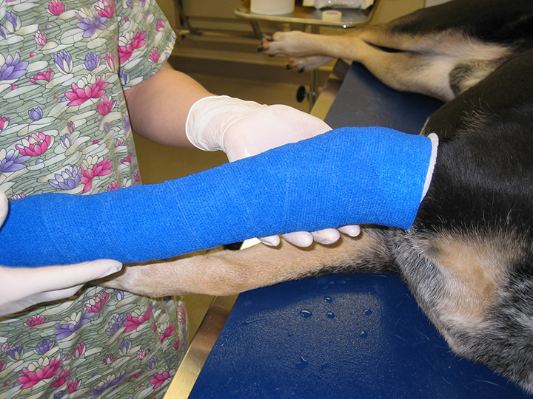
The METHODS
Closed reduction and external fixation (CREF)
Dept. of VSR, College of Veterinary Science & Animal Husbandry, DUVASU, Mathura- 281 001

Slide 5
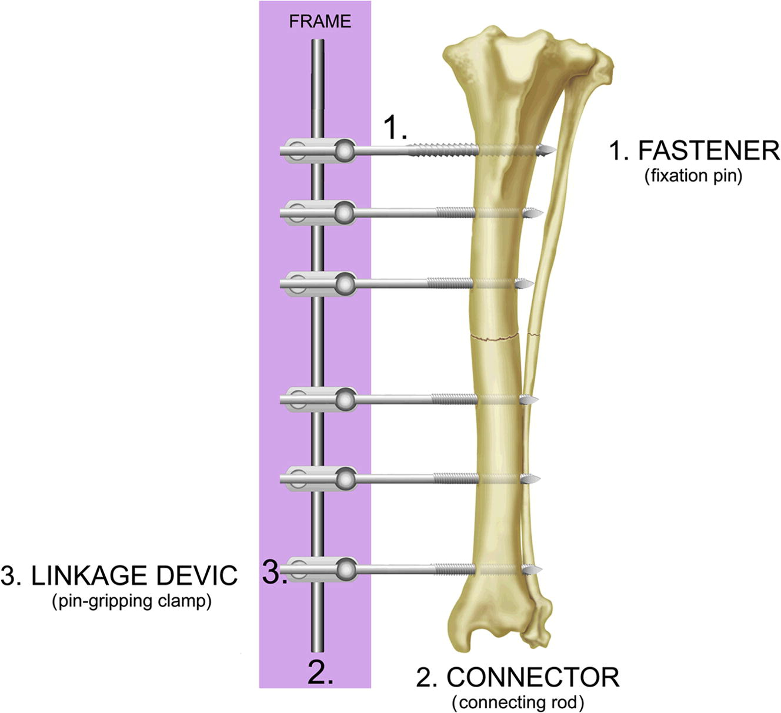
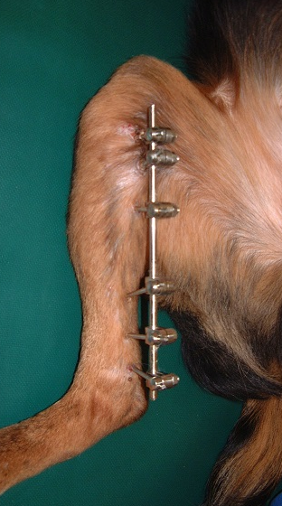
The METHODS
Open/close reduction external skeletal fixation
Dept. of VSR, College of Veterinary Science & Animal Husbandry, DUVASU, Mathura- 281 001

Slide 6
The METHODS
Open reduction without internal fixation
  Open reduction followed by casts
Dept. of VSR, College of Veterinary Science & Animal Husbandry, DUVASU, Mathura- 281 001

Slide 7
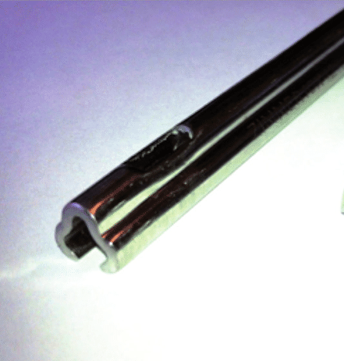
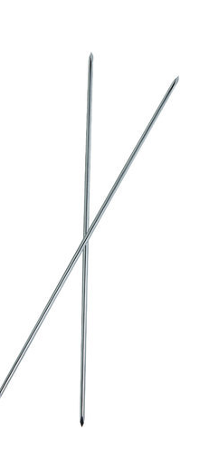
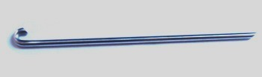
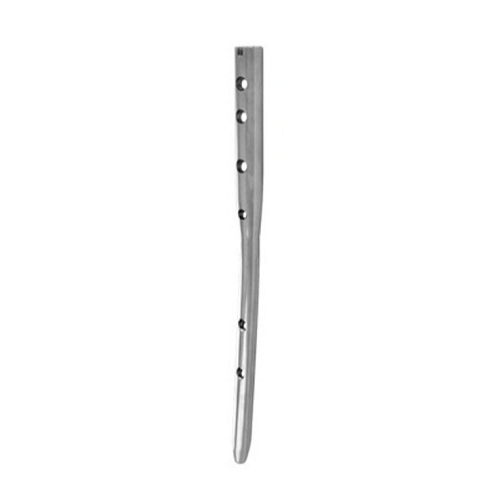
The METHODS
Open reduction and internal fixation (ORIF)
  Intra-medullary
    Pins: Steinmann, Kirschner-wire (K), Rush pins, Kuntscher nail Interlocking Nail
Dept. of VSR, College of Veterinary Science & Animal Husbandry, DUVASU, Mathura- 281 001

Slide 8
The METHODS
Open reduction and internal fixation (ORIF)
  Extramedullary
    Screws
      Cancellous & cortical
      Lag screws
      Cannulated
      Self tapping
Dept. of VSR, College of Veterinary Science & Animal Husbandry, DUVASU, Mathura- 281 001

Slide 9
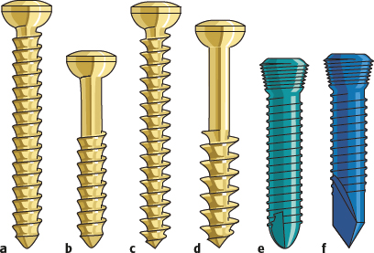
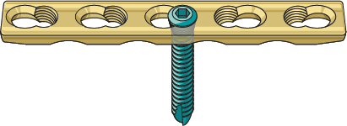
The METHODS
Open reduction and internal fixation (ORIF)
  Extramedullary
    Screws
      Cancellous & cortical
      Lag screws
      Cannulated
      Self tapping
      Locking
Dept. of VSR, College of Veterinary Science & Animal Husbandry, DUVASU, Mathura- 281 001

Slide 10
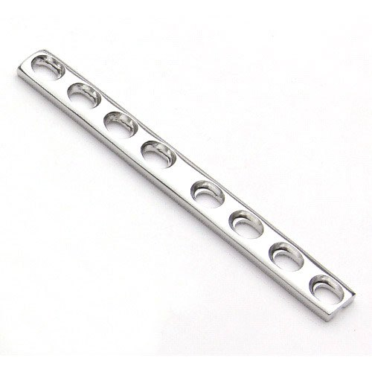
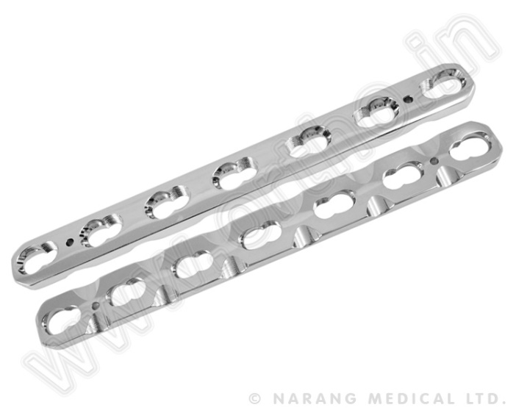
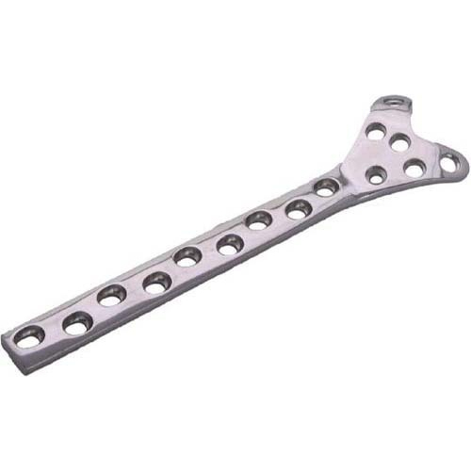
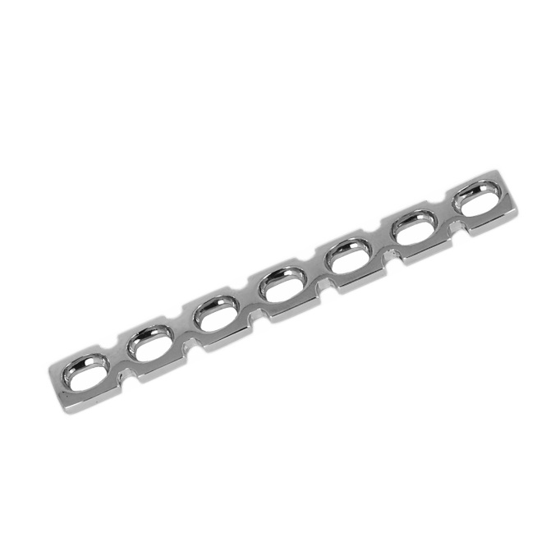
The METHODS
Open reduction and internal fixation (ORIF)
  Extramedullary
    Plate & Screws
      Neutrallization plate
      Dynamic compression plate-DCP
      Limited contact Dynamic compression plate-LC-DCP
      Buttress plates
      Reconstruction Plates
Dept. of VSR, College of Veterinary Science & Animal Husbandry, DUVASU, Mathura- 281 001

Slide 11
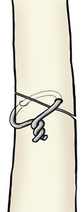
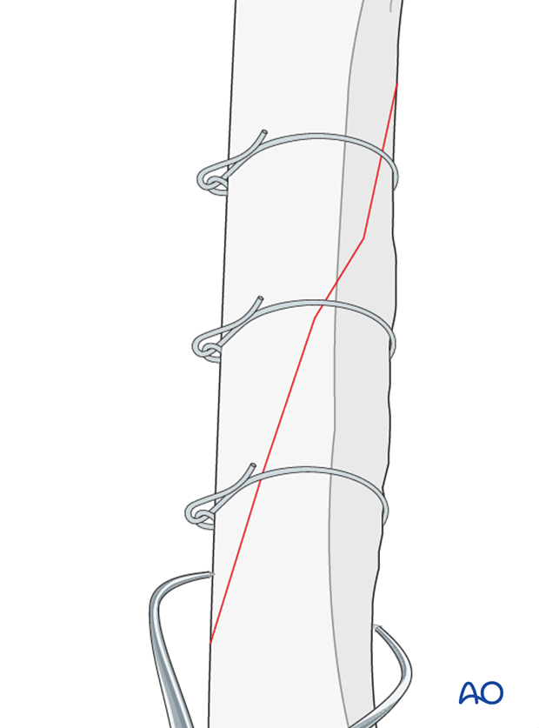
The METHODS
Open reduction and internal fixation (ORIF)
  Extramedullary
    Wire (cerclage, hemicerclage)
Dept. of VSR, College of Veterinary Science & Animal Husbandry, DUVASU, Mathura- 281 001

Slide 12
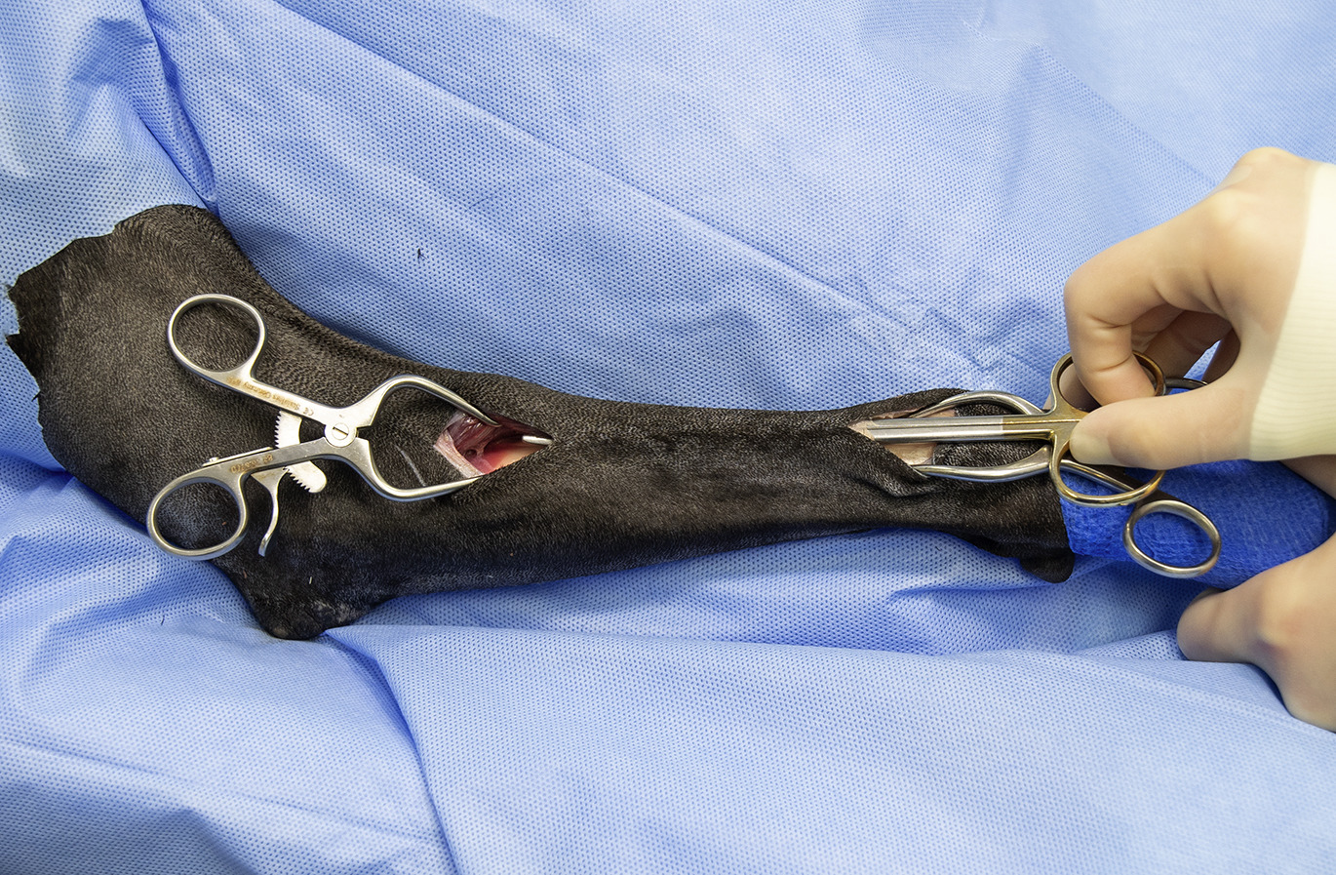
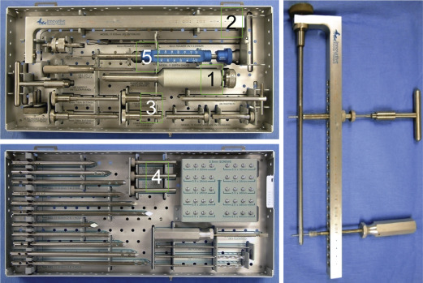
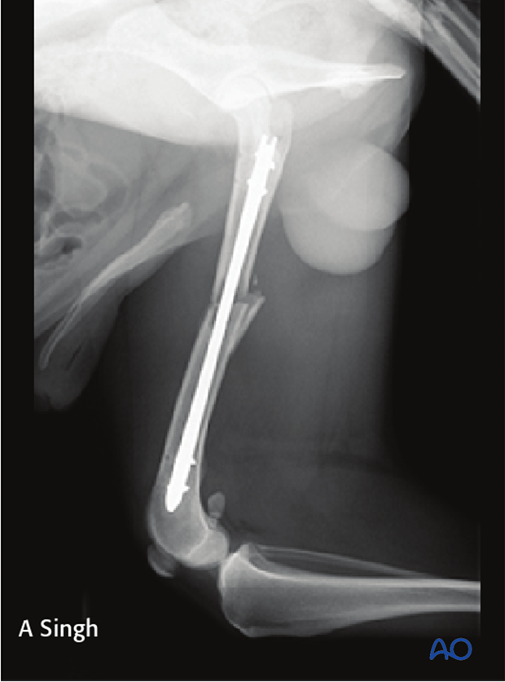
The METHODS
Closed reduction and internal fixation (CRIF)
  ILN
  MIPO
Dept. of VSR, College of Veterinary Science & Animal Husbandry, DUVASU, Mathura- 281 001

Slide 13
Thanks

