Slide 1

Fractures-5
Gulshan Kumar
MVSc, PhD
Dept. of VSR, College of Veterinary Science & Animal Husbandry, DUVASU, Mathura- 281 001

Slide 2
miscellaneous
Dept. of VSR, College of Veterinary Science & Animal Husbandry, DUVASU, Mathura- 281 001

Slide 3
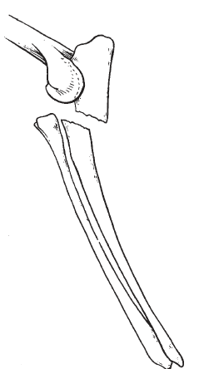
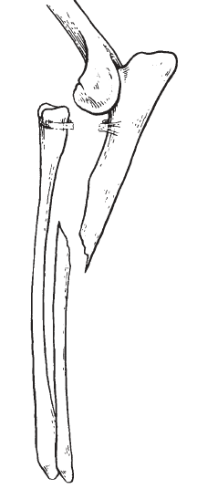
Normograde & retrograde
TBW
Monteggia
Slings
Dept. of VSR, College of Veterinary Science & Animal Husbandry, DUVASU, Mathura- 281 001

Slide 4
Dislocations
Signs & symptoms
Radiography
May accompany-
  Chips & soft tissue
  Neuronal involvement
Dept. of VSR, College of Veterinary Science & Animal Husbandry, DUVASU, Mathura- 281 001

Slide 5
Dislocations
Management
  Reduction
    Closed (immediate)
    Open
  Immobilization (for stability)
  Remobilization
Dept. of VSR, College of Veterinary Science & Animal Husbandry, DUVASU, Mathura- 281 001

Slide 6
Thanks

