Slide 1

lameness
Gulshan Kumar
MVSc, PhD
Dept. of VSR, College of Veterinary Science & Animal Husbandry, DUVASU, Mathura- 281 001

Slide 2
lameness
Lameness is an indication of a structural or functional disorder in one or more limbs or the back that is evident while the horse is standing or at movement.
  OR
  Lameness is a term used to describe a horse’s change in gait, usually in response to pain somewhere in a limb, but also possibly as a result of a mechanical restriction on movement.
Dept. of VSR, College of Veterinary Science & Animal Husbandry, DUVASU, Mathura- 281 001

Slide 3
lameness
Lameness may be caused by
  Trauma
  Congenital or acquired anomalies
  Infections
  Metabolic disturbances
  Circulatory or nervous disorders
Lameness due to pain is most common
Dept. of VSR, College of Veterinary Science & Animal Husbandry, DUVASU, Mathura- 281 001

Slide 4
Examination for lameness
Objectives of examination for lameness
  To know whether the horse is lame
  Which limb or limbs are involved
  The site or sites of the problem
  The specific cause of the problem
  The appropriate treatment
  The prognosis for recovery
Dept. of VSR, College of Veterinary Science & Animal Husbandry, DUVASU, Mathura- 281 001

Slide 5
Examination for lameness
Steps in examination for lameness
  Complete history including signalment and use
  Visual exam of the horse at rest
  Palpation of the musculoskeletal system including hoof tester examination of the feet
  Observation of the horse in motion (usually at a straight walk and trot/lope followed by circling) appropriate treatment
  Manipulative tests such as flexion tests
  Diagnostic anesthesia if necessary
  Diagnostic imaging
Dept. of VSR, College of Veterinary Science & Animal Husbandry, DUVASU, Mathura- 281 001

Slide 6
classification of lameness….
Supporting limb lameness
  Evident when supporting weight
Swinging limb lameness
  Evident when the limb is in motion
Mixed lameness
  Evident both when the limb is moving (swing phase) and when it is supporting weight (stance phase). Mixed lameness can involve any combination of structures affected in swinging or supporting-limb lameness.
Dept. of VSR, College of Veterinary Science & Animal Husbandry, DUVASU, Mathura- 281 001

Slide 7
….classification of lameness
Primary or baseline lameness
  To be examined before flexion tests
Compensatory/complementary lameness
  Evident when the limb is in motion
Dept. of VSR, College of Veterinary Science & Animal Husbandry, DUVASU, Mathura- 281 001

Slide 8
steps
History (Questions to be asked)
  How long has the horse been lame? (Acute/chronic???)
  Has the horse been rested or exercised during the lameness period?
  Has the lameness worsened/stayed the same/improved?
  Was the cause of lameness observed?
  Does the horse warm out of lameness?
  What treatment was given? Was it helpful?
  When was the horse last shod /trimmed?
Dept. of VSR, College of Veterinary Science & Animal Husbandry, DUVASU, Mathura- 281 001

Slide 9
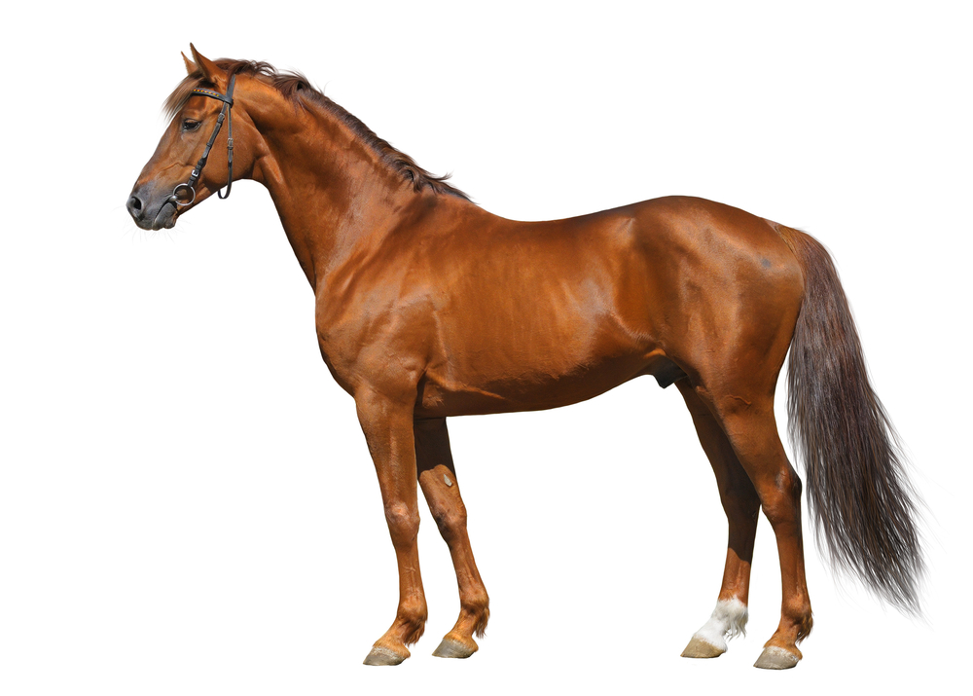

Slide 10
Suprascapular nerve injury
(Sweeny/shoulder slip)
Originally reported as a common affection in draft breeds (believed to be associated with repeated trauma to the shoulder region from poorly fitted harness collars.)
“Sweeny” : atrophy of the shoulder muscles in horses
Commonly used synonym for supra-scapular nerve paralysis.
Dept. of VSR, College of Veterinary Science & Animal Husbandry, DUVASU, Mathura- 281 001

Slide 11
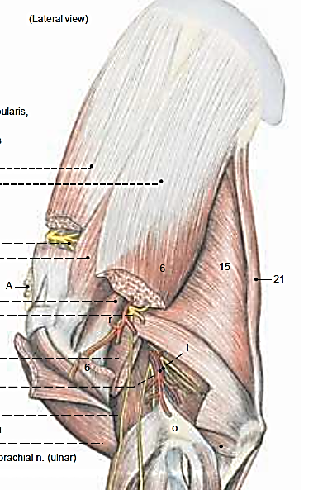
Suprascapular nerve injury
(Sweeny/shoulder slip)
Ætiology:
Trauma to the supra-scapular nerve as it passes over the cranial thin border of the scapula (arises from the 6th &7th cervical).
“ROPE ON THE EDGE”
Results in atrophy of the supra-spinatus & infra-spinatus muscles and,
Instability of the shoulder joint.
Dept. of VSR, College of Veterinary Science & Animal Husbandry, DUVASU, Mathura- 281 001

Slide 12
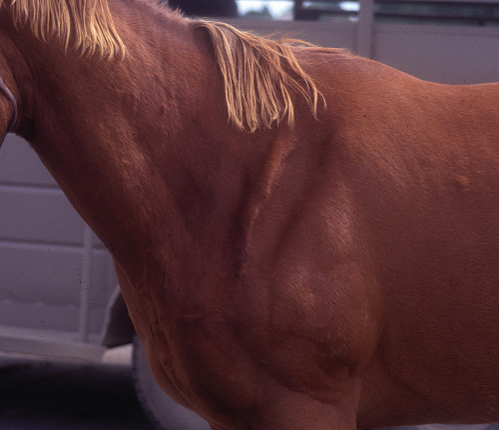
Suprascapular nerve injury
(Sweeny/shoulder slip)
Clinical Signs:
Depend on the extent of the nerve injury and the duration.
Pain immediately after injury leading to reluctance to bear wt. on the affected limb
When pain subsides, bears wt. “excursion of shoulder” because of instability
The scapular spine becomes prominent due to………
Dept. of VSR, College of Veterinary Science & Animal Husbandry, DUVASU, Mathura- 281 001

Slide 13
Suprascapular nerve injury
(Sweeny/shoulder slip)
Diagnosis:
Clinical signs and history.
Radiography rules out omarthritis or fracture of shoulder joint.
Dept. of VSR, College of Veterinary Science & Animal Husbandry, DUVASU, Mathura- 281 001

Slide 14
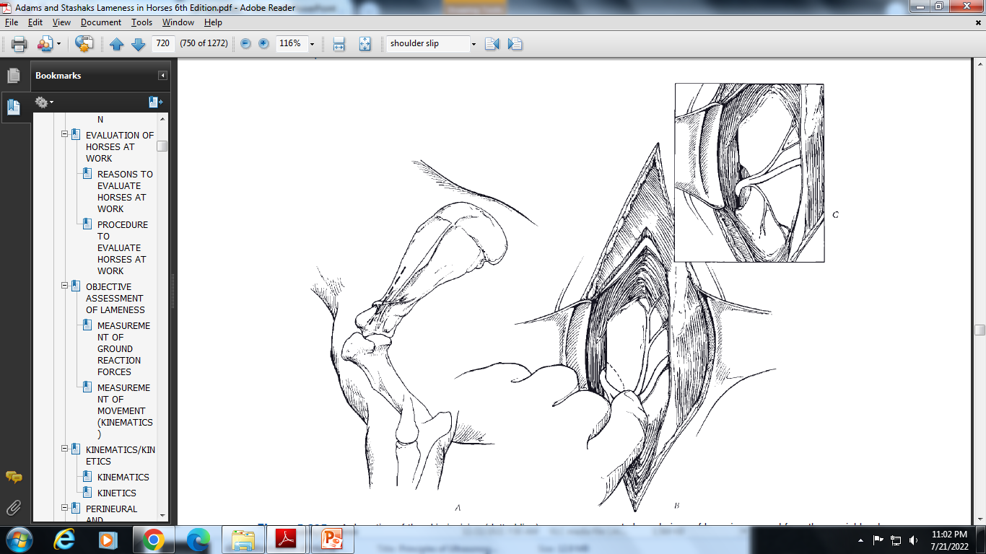
Suprascapular nerve injury
(Sweeny/shoulder slip)
Treatment:
Anti-inflammatories and cold applications and rest.
Conservative treatment:
  stall rest till shoulder stability returns.
  Corticosteroid injection –intra-articularly.
  Therapeutic ultrasound.
Surgical treatment:
Surgical decompression of scapular nerve.
Involves removing a small piece of bone from the cranial border of the scapula underlying the nerve.
Dept. of VSR, College of Veterinary Science & Animal Husbandry, DUVASU, Mathura- 281 001

Slide 15
bicipital bursitis
Inflammation of the bicipital bursa
The bicipital bursa is located between the bilobed tendon of the origin of biceps brachii muscle and the M-shaped tubercles at the cranio-proximal aspect of the humerus.
Dept. of VSR, College of Veterinary Science & Animal Husbandry, DUVASU, Mathura- 281 001

Slide 16
bicipital bursitis
Ætiology:
Trauma to the cranial surface of the shoulder region is believed to be the most common cause of a primary bursitis.
Stretching or tearing of the bursa or biceps tendon during the cranial phase of the stride with the limb in full extension or
Fall or slip that results in flexion of the shoulder with extension of the elbow. Or
Dislocation of the biceps brachii tendon associated with congenital abnormality of hypoplasia of the minor tubercle.
Infection, either from an open or penetrating wound or from hematogenous spread to the bursa has also been reported, e.g. Brucella
Dept. of VSR, College of Veterinary Science & Animal Husbandry, DUVASU, Mathura- 281 001

Slide 17
bicipital bursitis
Clinical signs:
Acute onset of lameness,
Swelling at the cranial aspect of the shoulder region, with or without a wound,
In chronic cases, generalised atrophy of pectoral muscle.
Reluctance to bear full weight on the affected limb while standing.
Dept. of VSR, College of Veterinary Science & Animal Husbandry, DUVASU, Mathura- 281 001

Slide 18
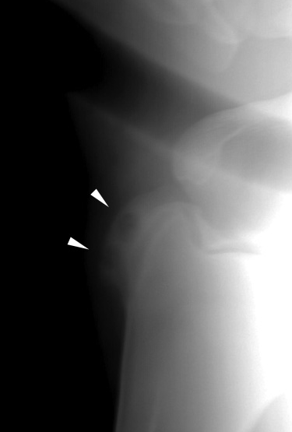
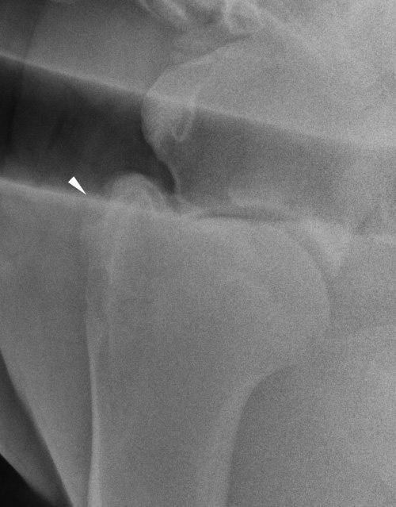
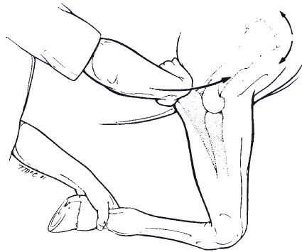
bicipital bursitis
Diagnosis:
Clinical signs,
Physical examination, (As the shoulder is flexed, tension is created in the tendon of the biceps brachii muscle. If the horse has bicipital bursitis or ossification of the tendon, a painful response is elicited).
Radiography of the affected joint.
Dept. of VSR, College of Veterinary Science & Animal Husbandry, DUVASU, Mathura- 281 001

Slide 19
Bicipital bursitis
Treatment:
Conservative treatment:
  Anti-inflammatories and cold applications and rest (up to 3 months). The animal will respond if the cause is non infectious.
  Extracorporeal Shock wave Therapy (ESWT) frequency is lower than Therapeutic ultrasound (upto 20MHz).
Surgical treatment:
Surgical removal of calcification or fractured fragments.
In case of infectious bursitis, drain, debride and lavage coupiously arthroscopically, followed by instillation of a broad spectrum antibiotic.
Dept. of VSR, College of Veterinary Science & Animal Husbandry, DUVASU, Mathura- 281 001

Slide 20
omarthritis
Osteoarthritis of the shoulder (scapulo-humeral) joint.
Ætiology:
Multiple causes-
  dysplasia of the glenoid cavity,
  Injury to the joint capsule (resulting in synovitis and capsulitis)
  Intra-articular fractures
Dept. of VSR, College of Veterinary Science & Animal Husbandry, DUVASU, Mathura- 281 001

Slide 21
omarthritis
Clinical signs:
Swelling in the shoulder joint
Disuse atrophy of extensor carpi radialis
Fixing of the joint (to avoid pain)
Abnormal toe wear
Foot flight and flexion of carpus is reduced, stride is shortened
As the lame limb is advanced a prominent lifting of the head and neck occurs on the affected side.
Dept. of VSR, College of Veterinary Science & Animal Husbandry, DUVASU, Mathura- 281 001

Slide 22
omarthritis
Diagnosis:
Radiography of the shoulder joint shows abnormalities of the glenoid and alterations in the humeral head.
Nuclear medicine- may be useful to diagnose a subtle shoulder lameness with focal intense uptake of the radioisotope, most commonly in the humeral head.
Dept. of VSR, College of Veterinary Science & Animal Husbandry, DUVASU, Mathura- 281 001

Slide 23
omarthritis
Treatment:
Conservative treatment in horses showing no radiographic lesions and that respond favorably to intra-synovial anesthesia.
Involves rest; controlled exercise; anti-inflammatory drugs; and relevant intra-articular therapy including corticosteroids, hyaluronic acid, etc.
Surgical:
  Those not responding with conservative therapy may be subjects for arthroscopic debridement of damaged cartilage and removal of osteo-chondral fragments.
  Arthrodesis of scapulo-humeral joint (especially in miniature ponies)
Dept. of VSR, College of Veterinary Science & Animal Husbandry, DUVASU, Mathura- 281 001

Slide 24
Thanks

