Slide 1
Diagnostic Imaging Modalities in Veterinary Practice
– An Introduction –
Dr Rudra Pratap Pandey
Prof. VSR

Slide 2
X-ray Imaging
Conventional radiography
Digital radiography (CR & DR)
A. Equipment details
B. Safety issues – Radiation
Advantages vs limitations
Analog vs HF

Slide 3
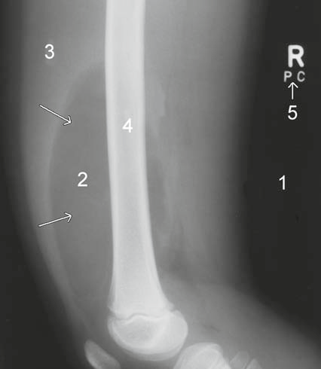
Radiographic Image
Air/gas: black, e.g. lungs, bowel and stomach
Fat: dark grey, e.g. subcutaneous tissue layer, retroperitoneal fat
Soft tissues/water: light grey, e.g. solid organs, heart, blood vessels, muscle and fluid-filled organs such as bladder
Bone: off-white
Contrast material/metal: bright white.

Slide 4
CR & DR
Computed radiography (CR) employs cassettes that are inserted into a laser reader following X-ray exposure. An analogue-digital converter (ADC) produces a digital image with the help of computer.
Direct digital radiography (DR) uses a detector screen containing silicon detectors that produce an electrical signal when exposed to X-rays. This signal is analysed to produce a digital image.
Digital images obtained by CR and DR are sent to viewing workstations for interpretation. Images may also be recorded on X-ray film for portability and remote viewing

Slide 5
Pros n Cons of Digital Radiography
Magnification of areas of interest (Fig. 1.2)
Alteration/optimization image attributes
Measurements of distances and angles
Integration with PACS (with US/CT/MR images)
Cost of establishment

Slide 6
Ultrasound Imaging
Types – as per need
A – mode
B – Mode
M – Mode
Doppler Ultrasound

Slide 7
Ultrasound Imaging – Machine details
Transducer or Probe…as generator + sensor
Arrangement of Piezoelectric crystals
Frequency
Footprint or aperture

Slide 8
Ultrasound Imaging – Machine details
A. Transducer or Probe…as generator + sensor
Arrangement of Piezoelectric crystals
Frequency
Footprint or aperture size
B. Computer for analyzing the US signals
C. Control Panel (Knobology?!)
D. Display unit CRT/TFT/LCD

Slide 9
Ultrasound Imaging – Tranducers
Convex or Curved (Regular or Microcovex)
Crystal arrangement is curvilinear
Available with fixed or variable frequency
Footprint is large convex
Image area is diverging convex of variable size
Of most versatile use

Slide 10
Ultrasound Imaging – Tranducers
B. Linear
Crystal arrangement is parallel
Available with high frequency
Footprint is small
Image area is rectangle or variable size
Mainly used for superficial structures, tendons, muscles, vessles

Slide 11
Ultrasound Imaging – Tranducers
C. Phased Array
Crystal arrangement is parallel – time delay effect allows steering
Available with 2-7.5 mHz frequency
Footprint is very small
Image area is almost a traingle of variable size – poor resolution in near field
Mainly used for cardiac (high frame rate) and brain examination

Slide 12
Ultrasound Imaging – Tranducers
Special types based on the shape:
Side firing – linear or convex
Pencil or front firing
Endocavity – side or front firing
Transesophageal
Endoscopic
Motorized 3D or Volume Probe

Slide 13
Ultrasound Imaging – Principles
Pulse echo
Amplitude vs brightness
Transmission / Reflection / enhancement / attenuation
Sojourn through tissue interfaces
Artifacts – acoustic enhancement / shadowing / reverberations

Slide 14
Doppler Ultrasound
Principles
Types – Pulse wave (Doppler gate in vessel…frequency shift displays as graph), Color (different color coding for blood flowing towards and away from probe)
Clinical applications (vessels….valves)

Slide 15
3D and 4D Ultrasound
Post acquisition 3D image reconstruction
Real time dynamic 3D image
Purpose specific applications

Slide 16
Advantages & Limitations
Use of non radiant energy
Non invasive
Purpose specific applications

Slide 17
Computed Tomography
The patient is passed through a rotating gantry that has an X-ray tube on one side and a set of detectors on the other.
Helical scanners… Multidetector row CT (MDCT)…8, 16, 32…256 n more allow good scanning speed, continuous data for 3D image reconstruction (CT angiography)
Cross-sectional (transverse / coronal / saggital) images of desired width (slices of part) are obtained.
Image reconstructed with computer. The relative density of an area of interest may be measured electronically.
Window setting – bone or brain n further e.g. Mediastinal (no lung parenchyma) or lung (good lung parenchyma)
Tissue density is measured in attenuation value (HU). Air to bone HU. Tissue density is measured in attenuation value (HU). Air to bone HU difference -1k to +1k

Slide 18
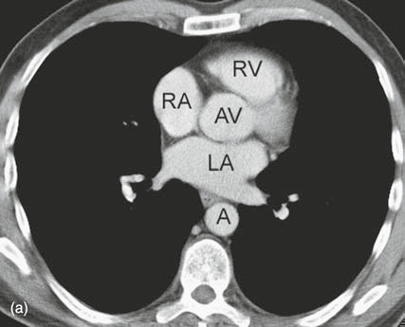
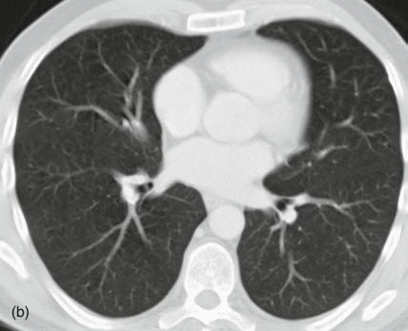
Computed Tomography
Mediastinal window (a) vs Lung window (b)

Slide 19
CT advantage vs disadvantages
Superior quality images of great diagnostic value, study of malignancies
High cost of equipment
High dose of ionizing radiation
Possible side effects of contrast agents if used
Equipment non portability

Slide 20
MRI
application of a strong, external magnetic field (0.3 tesla and above)
The hydrogen atoms within the patient align in a direction either parallel or antiparallel to the strong external field.
A greater proportion aligns in the parallel direction so that the net vector of their alignment, (net magnetic vector) will be in the direction of the external field. This is known as longitudinal magnetization.
A second magnetic field (radiofrequency pulse -RF pulse) is applied at right angles to the original external field.
The RF pulse causes the net magnetization vector of the hydrogen atoms to turn towards the transverse plane.

Slide 21
MRI Equipment
– Chamber: inside the main magnet generating the external magnetic filed B0 to align the magnetic moments of hydrogen atoms
– Correcting coils induce an additional magnetic field compensating for the non-uniformities of the B0 filed
– Gradient coils to produce the linear field change (gradient)
– Forcing and receiving coils

Slide 22
MRI Principles
Physical basis: some atomic nuclei have a spin and exhibit a magnetic moment
Mainly uses hydrogen analysis: the generation of electromagnetic radiation by hydrogen atom nuclei (protons) in the organism is analyzed
The natural atoms have to be appropriately excited
–Applies a strong magnetic field for imaging
– This field causes the nuclei of atoms to be aligned and spatially oriented
– When an external impulses comes to excite them, they respond with a harmonious tune, giving a clear and easily recordable signal revealing where they are abundant and where less.
– Magnetic field intensity: 0.1-3.0 Telsa

Slide 23
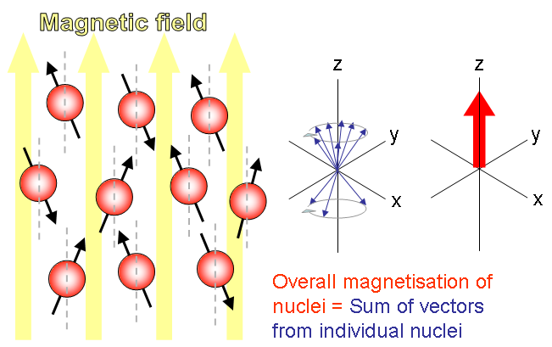
MRI

Slide 24
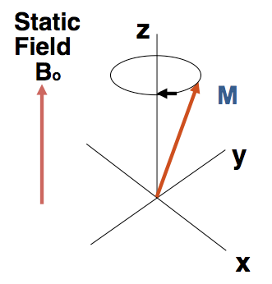
– External B0 field produces defined magnetization M
– Electromagentic impulse of a specific, defined frequency (Larmor frequency ω0) is applied with direction perpendicular to M and B0
– A nuclear resonance occurs: the M vector transits to the plane perpendiculr to B0
• All individual nuclei spin after the excitation, in the transverse plane, at the same frequency ω0 and in consistent phases
• The relationship between ω0 and the type of nucleus means that an impulse of the right frequency will excite only one type of nuclei
• The receiving coil (if placed at the vicinity of the excited tissue) will receive the current with ω0 (transverse component of M) as a signal that allows an image of the tissue to be examined

Slide 25
MRI
Principle of signal acquisition
• Before excitation: transverse M (Mt) = 0
• At the moment of excitation: longitudinal M (M1) = 0
• Relaxation:
Longitudinal M is restored (T1: time for M1 return 63%)
Transverse M decays to 0 (T2: time for Mt vanish 63%)

Slide 26
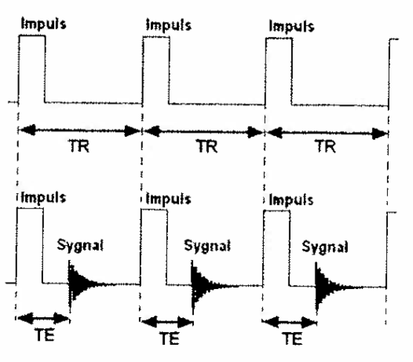
MRI Principles
MRI makes use of sequences of stimulating impulses
• TR (time of repetition)
• TE (time of echo)

Slide 27
MRI Principles
• T1 weighted images: difference of T1
– Tissue with shorter T1 has longer M magnetization length following the impulse, therefore brighter image
– TR is the key parameter: can not be too long
– Short TR and TE are used
• T2 weighted images: difference of T2
– Tissue with longer T2 gives relatively stronger signal after appropriate TE time
– TE is the key parameter: can not be short
– Long TR and TE are used
• Proton density weighing (PD)
– Based on differences in the density of protons in difference tissues, disregard the differences in T1 & T2
– Long TR & short TE

Slide 28
CT shows better anatomical details, MRI differentiates tissue of different biological functions better.

