Slide 1
The sTomach
Gulshan Kumar
Dept. of Veterinary Surgery & Radiology
College of Veterinary Science and Animal Husbandry
U.P. Pt. Deen Dayal Upadhyaya Pashuchikitsa Vigyan Vishwavidyalaya evam Go Anusandhan Sansthan, Mathura- 281 001

Slide 2
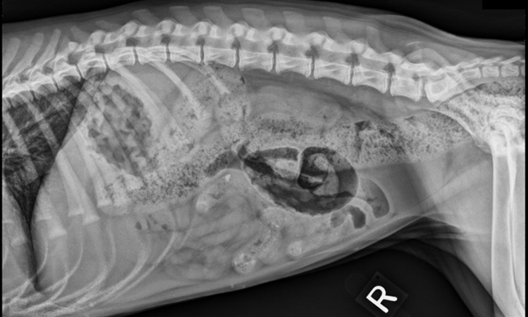

Slide 3
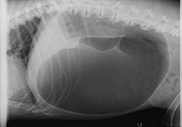

Slide 4
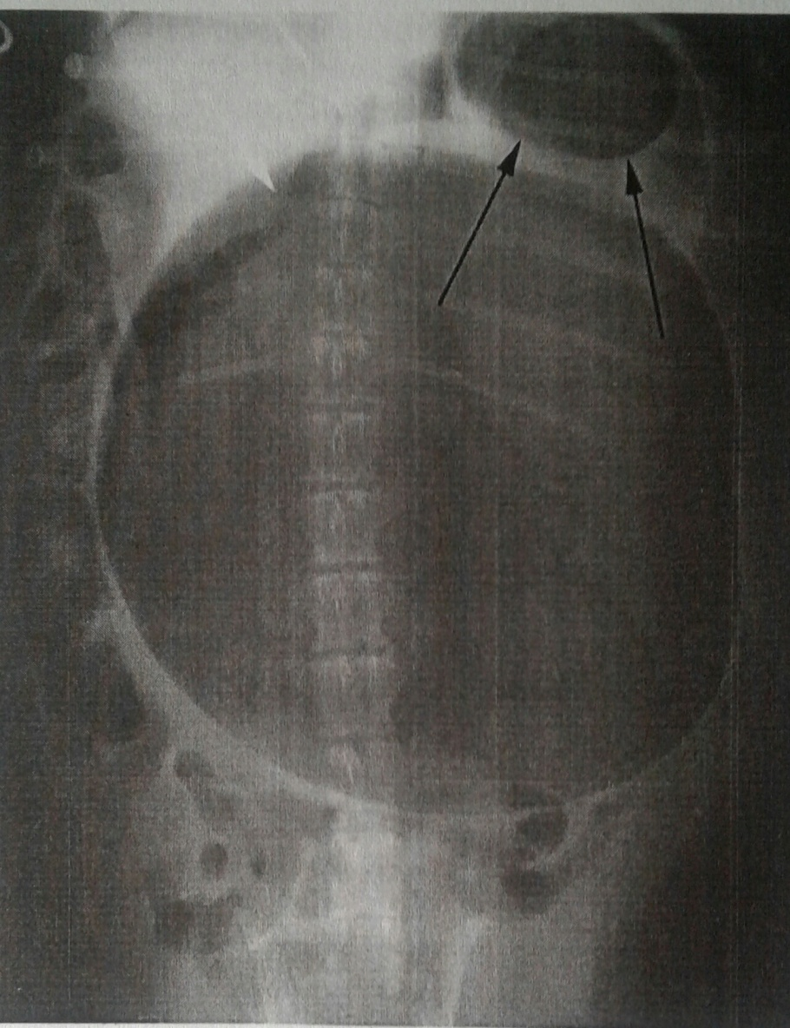
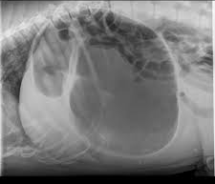

Slide 5
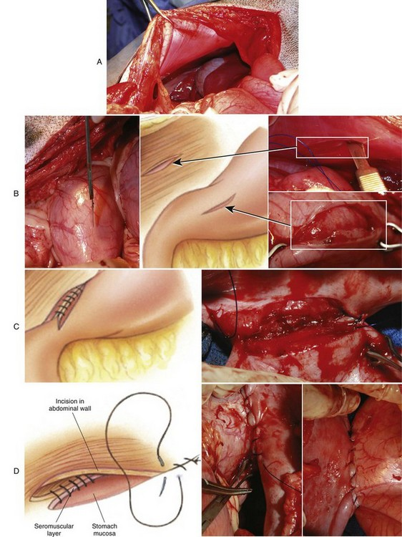

Slide 8
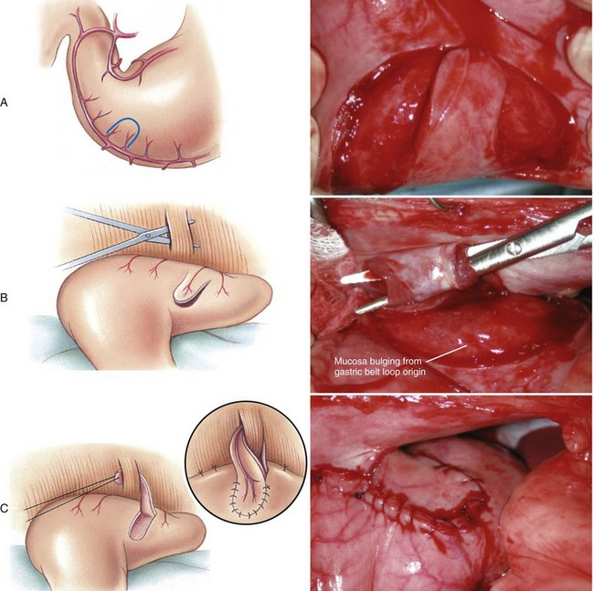

Slide 9
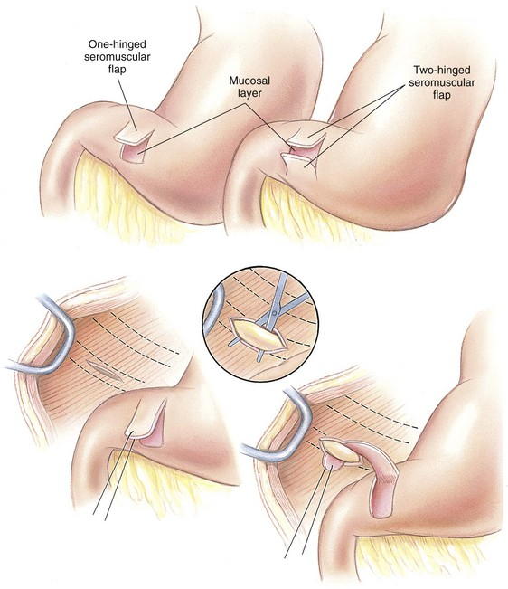

Slide 10
Thanks

