Slide 1
Inflammation
Dr Rudra Pratap Pandey

Slide 2
Definition
initial physiological response to tissue damage,
Causes – mechanical, thermal, electrical, irradiation, chemical, or microbial .
Can be acute (lasting for a few days) or
chronic (in response to an ongoing and unresolved insult).
Inflammation can develop into permanent tissue damage or fibrosis.

Slide 3
Cardinal signs
Rubor or redness
Calor or heat
Tunor or swelling
Dolor or pain
Functio lissa (?)

Slide 4
What happens after trauma
RESOLUTION
Bleeding….clotting….resolution
Inflammation
Epithelization
Granulation formation
Fibroblast secretion products…collagen laying
Wound contraction and remodelling
UNTOWARD OUTCOME…
Fibrosis
Abscess formation
Chronic inflammation

Slide 5
Mobilization of defense cells
Limiting the pathogen spread
Killing the pathogens
Initiation of tissue repair

Slide 6
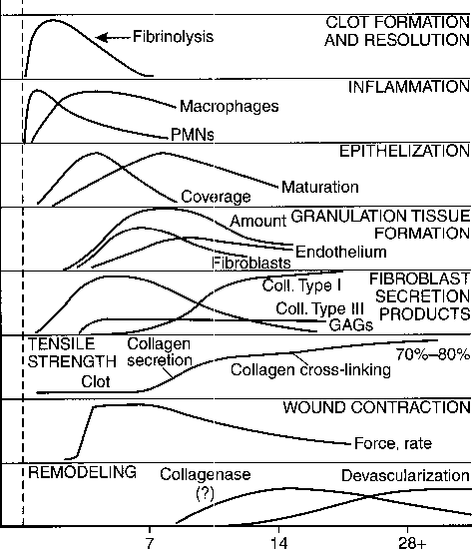
TRAUMA
RESPONSE
DAYS

