Slide 1
Instrument handling and various skills
Dr. Rudra Pratap Pandey

Slide 2
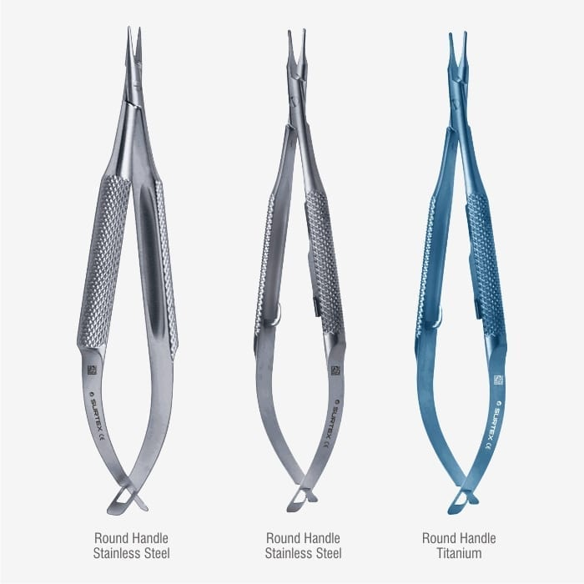
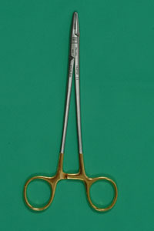
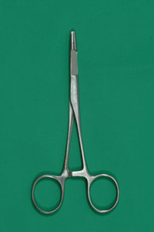
Needle holders
Mayo-Hegar
Olsen-Hegar
Micro-spring

Slide 3
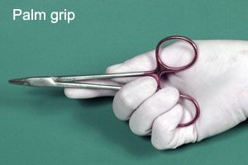
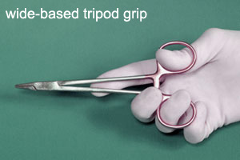
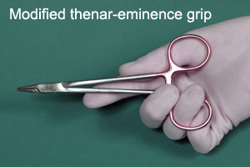
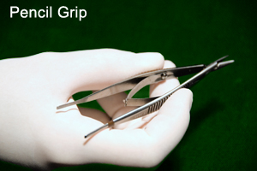
Needle holder grip
Needle grasped perpendicular to the jaws
Grasp near the center of the curve for most situations
Grasp near tip if penetrating tough tissue
Grasp near eye or swedged-on end for large amount of tissue
Rotating the wrist while the needle is penetrating the tissue uses the arc of needle so less force is needed

Slide 4
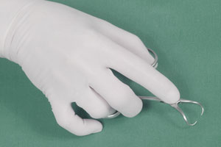
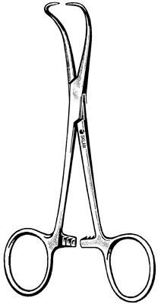
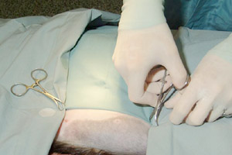
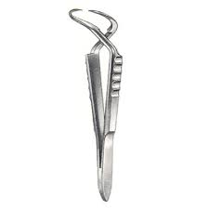
Towel clamps
Wide based tripod grip..concavity downward
Backhaus towel clamp
Cross action towel clamp
To fix the drape…drape to drape and skin grip

Slide 5
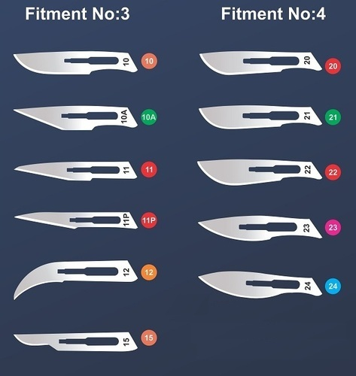
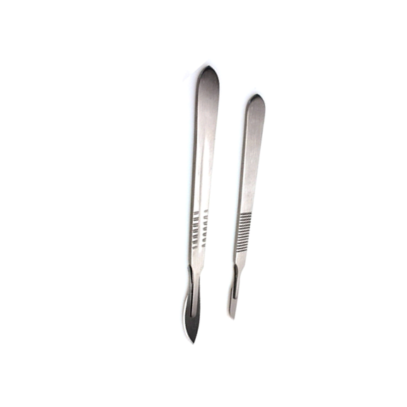
Scalpel…BP or Bard Parker blade and handle
3
4

Slide 6
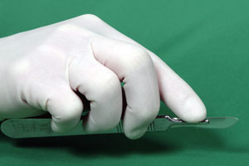
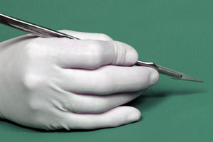
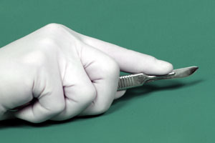
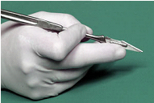
Scalpel handlig
Finger tip grip
Pencil grip
Palm grip
Reverse pencil grip

Slide 7
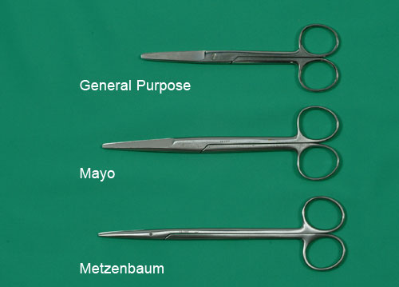
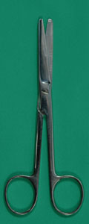
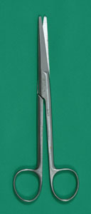
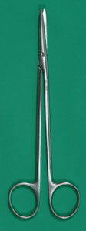
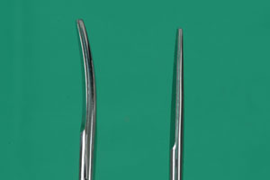
Scissors…Mayo’s
General
Mayo
Metzbaum
Curved vs Straight

Slide 8
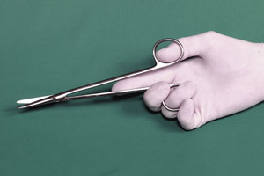
Wide base tripod grip..forward

Slide 9
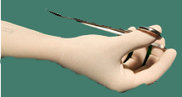
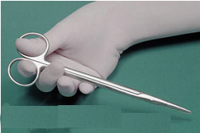
Backhand cutting

Slide 10
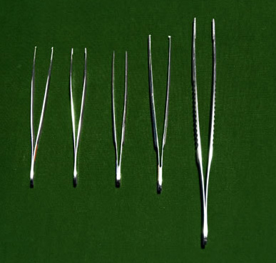
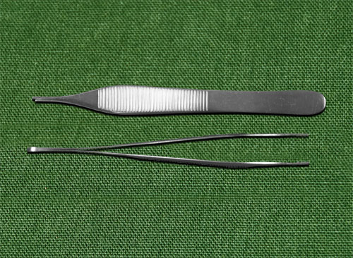
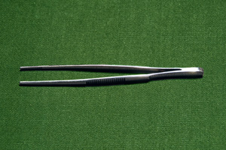
Thumb forceps vs rat tooth forceps
Good hold, less tissue strangulation
Poor hold, tissue strangulation
Brown-Adson
fine tips..broad handle for delicate secure grasp also for manipulating small needles during suturing

Slide 11
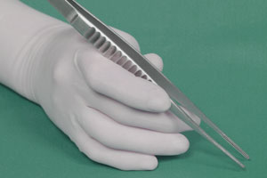
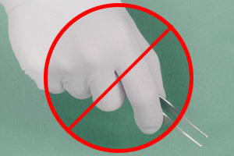
Forceps holding
Correct pencil grip
Poor control…

Slide 12
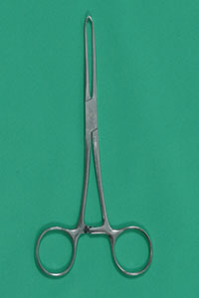
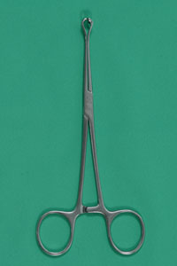
Tissue forceps…self holding
Consider replacing with stay sutures for prolonged grip
Allis tissue forceps
Babcock tissue forceps

Slide 13
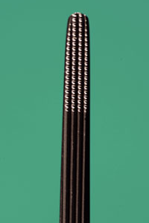
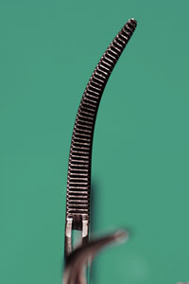
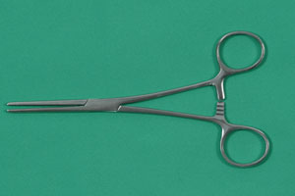
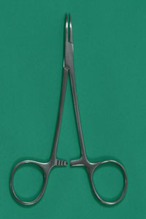
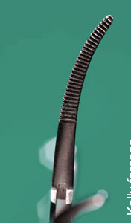
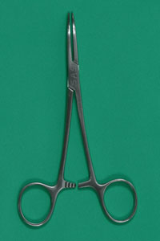
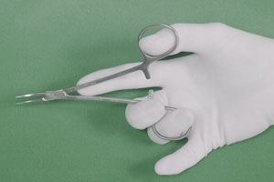
Hemostats
Mosquito straight n curved
Rochester Carmalt large crushing for pedicles
Crile curved stout large
Wide base tripod grip
Dunhill, Spencer Wells, Kocher’s, Ochsner’s are some other artery forceps

