Slide 1

Principles of Radiation Therapy
Dr SANJAY PUROHIT
Department of Surgery and Radiology
College of Veterinary Science and Animal Husbandry,
DUVASU, Mathura, U.P.
Prof. Sanjay Purohit – Educational & Confidential - contents – collected from different sources -not permitted for replication & commercial purposes

Slide 2
Radiation Physics
Basis – ionizing particles interact with cellular molecules
Relies on transfer of energy created by secondary charged particles (usually electrons)
Break chemical bonds
Teletherapy vs. Brachytherapy

Slide 3
Teletherapy
Radiation source—kept –distance from the lesion
4 types
1. Superficial X-ray therapy: Given through X-ray machine (60-100 keV)
2. Deep x-ray therapy: Given through X-ray machine 200-300 keV)
3. Super voltage therapy:
  Provided through
  X-ray machine having linear accelerator (1 -20 MeV) or Betatron (20-100 MeV) or cyclotron
  Isotopic X-ray machine with Cobalt and Cesium in a sealed form
  4. Particulate beam therapy: Electron, Proton and neutron used

Slide 4
Brachytherapy
Radioactive source in direct contact with tumor
3 types
  1.Interstitial brachytherapy: ¹⁹⁸Au, ⁶⁰CO
  2. Pliesotherapy (Surface brachytherapy): ⁹⁰Sr
  3. Systemic brachytherapy: ¹³¹I and ³²P
Greater deliverable dose
Continuous low dose rate
Advantage for hypoxic or slow proliferators
Shorter treatment times

Slide 5
Brachytherapy
Limitations
  Tumor must be accessible
  Well-demarcated
  Cannot be only modality for tumors with high risk of regional lymph node metastasis

Slide 6
Radiobiology
Ionizing radiation ejects an electron from a target molecule
Distributed randomly within cell
Double-strand DNA breaks – lethal
Cell death: no longer able to undergo unlimited cell division
Direct vs. Indirect injury (free radicals – O₂)
Inadequate cellular repair mechanisms implied

Slide 7
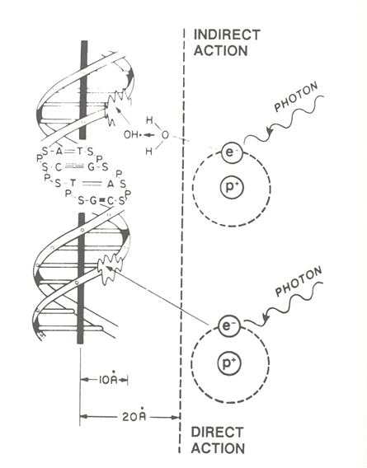
Radiobiology

Slide 8
Radiobiology
Random cell death
  Deposition of energy & injury is random event
  Same proportion of cells is damaged per dose
  100 to 10 cell reduction = 10⁶ to 10⁵ cell reduction
  Larger tumors require more radiation
  10⁵ cells = nonpalpable
  Applies to normal tissue also
Therapeutic advantage – 4 R’s of radiobiology

Slide 9
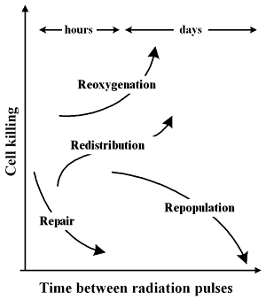
4 R’s of radiation biology
Repair of cellular damage
Reoxygenation of the tumor
Redistribution within the cell cycle
Repopulation of cells

Slide 10
Fractionation Schedules
Conventional
  1.8 to 2.0 Gy given 5 times/week
  Total of 6 to 8 weeks
  Effort to minimize late complications
Accelerated fractionation
  1.8 to 2.0 Gy given bid/tid
  Similar total dose (less treatment time)
  Minimize tumor repopulation (increase local control)
  Tolerable acute complications (increased)

Slide 11
Fractionation Schedules
Hyperfractionation
  1.0 to 1.2 Gy bid/tid, 5 times/week
  Similar total treatment time (increased total dose)
  Increases total dose
  Potentially increases local control
  Same rates of late complications
  Increased acute reactions

Slide 12
Thanks

