Slide 1
SHOCK
Dr. Gulshan Kumar

Slide 2
Shock
Can be defined as…
  An imbalance between oxygen delivery and oxygen consumption such that the delivery of oxygen does not meet the needs of the tissue.
  OR
  An acute clinical syndrome characterized by progressive circulatory failure that leads to inadequate capillary perfusion and cellular hypoxia.

Slide 3
Shock
Shock is a complex, multisystem disorder that may be caused by a variety of insults.

Slide 4
Shock: Classification
Hypovolaemic
  Haemorrhage
  Dehydration
    Diarrhoea & vomiting
    Hypoglycaemia
  Burns
  Third spacing
    Pleural /Peritoneal sac, (hydro-thorax/peritoneum)
    Fluid accumulation in GI proximal to obstruction

Slide 5
Shock: Classification
Cardiogenic
  Myocardial infarction
  Valvular dysfunction
  Dysrrhythmia
  Cardiomyopathy (myocarditis, etc.)

Slide 6
Shock: Classification
Obstructive
  Obstruction within the veins (Emboli etc.)
  Compression of the heart
  Pressure on the vessels

Slide 7
Shock: Classification
Distributive (Vasogenic)
  Septic-vasodilation-permeable vessels
    G -ve dead cell wall inflammatory Chemicals-vasodilation-septic shock
    G +ve live cell wall-exotoxins antigens + inflammation- vasodilation-toxic shock
  Allergic: allergen*-mass interaction with antibodies on mast cells release histamines
  *Allergens: vaccines, antibiotics, NSAIDS, latex, etc.
Hot/warm shock

Slide 8
Shock: Classification
Distributive (Vasogenic)
  Neurogenic-
    Equillibrium disturbed
    Decreased sympathetic (mainly thoraco-lumbar T1-L3 nerves) out flow
      OR
    Increased parasympathetic (mainly cranial nerves) out flow

Slide 9
Shock: Classification
Distributive (Vasogenic)
  Spinal
    Spinal injury mainly to thoracic spine
  Vasovagal syncope
    Vasodilatation + vagal outflow due to severe pain
  Systemic Inflammatory Response Syndrome

Slide 10
Shock: Pathophysiology

Slide 11
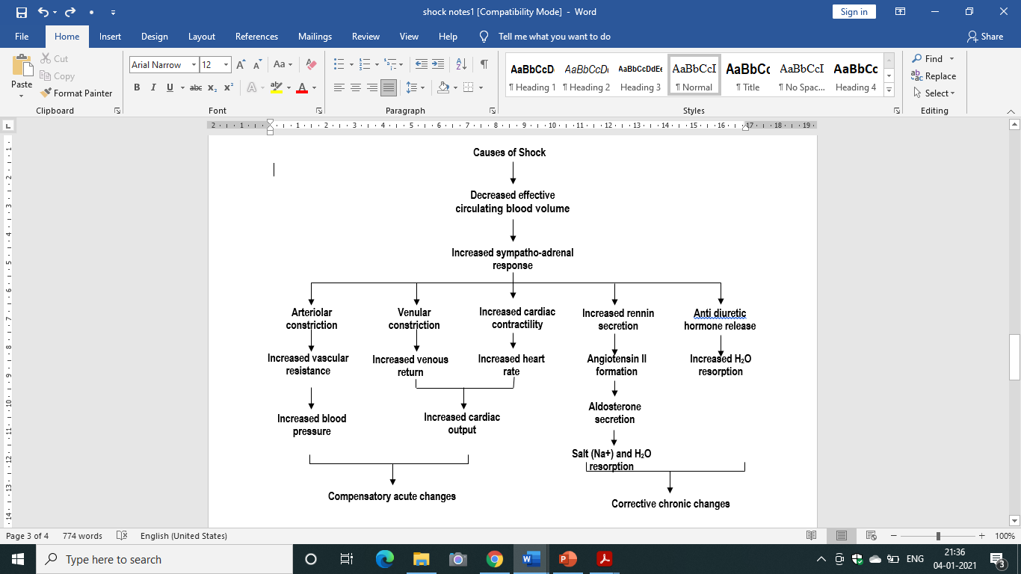

Slide 12
Shock: Stages
Compensated stage
Progressive stage
Irreversible stage

Slide 13
Shock: Stages
Compensated stage (non-progressive)
  Neurological response
  Endocrinal response
  (Neuro) Sympathetic Responses:
    Increased HR, peripheral vasoconstriction, increased CO and venous return

Slide 14
Shock: Stages
Compensated stage (non-progressive)
  (Neuro) Sympathetic Responses:
  Decreased BP and increased CO2 sensed by baroceptors in the carotid sinus and aorta- impulses to medulla oblongata
    More sympathetic impulses and less para-sympathetic impulses
    Increased HR, peripheral vasoconstriction, increased Cardiac Output and venous return
    More RENIN and Adrenalin and nor Adrenalin

Slide 15
Shock: Stages
Compensated stage (non-progressive)
  Endocrinal Responses-
    Adrenalin secretion just like sympathetic response
    JG complex in kidney sense falling BP-RENIN released
    Renin acts on circulating ANGIOTENSINOGEN (produced in liver) to form ANGIOTENSIN-I (10 amino acid protein)
    Some vasoconstriction + secretion of ALDOSTERONE from the adrenal cortex to retain Na++ in renal tubules.
    Retains water increases IV volume –increased venous return hence Cardiac Output

Slide 16
Shock: Stages
Compensated stage (non-progressive)
  Endocrinal Responses-
    Circulating ANGIOTENSIN-I reaches lungs where ACE (angiotensin converting enzyme )converts to ANGIOTENSIN-II by removing 2 amino acids
    ANGIOTENSIN-II –more profound vasoconstriction increased peripheral resistance, veinular constriction-increased venous return-increased preload
    Even more ALDOSTERONE it also stimulates osmoreceptors in the hypothalamus-- THIRST

Slide 17
Shock: Stages
Compensated stage (non-progressive)
  Endocrinal Responses-
    THIRST to drink more- increased fluid
    ADH (vasopressin) due to decreased B volume
    Increased reabsorption of water in kidneys +Vaso constriction

Slide 18
Shock: Stages
Progressiv (Decompensated) stage
Compensatory mechanisms are no longer working
    Progressive fall in BP
    Deleterious effects on vessels
    Overall condition deteriorates
    Increased hypoperfusion of the kidney, brain, GIT, myocardium, lungs, medulla oblongata
    Over some period of time the patient passes into stage of irreversible shock. Difficult to tell the difference
    Last window of opportunity to save the animal-aggressive therapy required- INTERVENE now

Slide 19
Shock: Stages
Irreversible stage
Irreversible changes in the animal’s body
    The animal is still alive but because of irreversible damage progresses towards death
    Treat before it progresses to irreversible
    Preferably within an hour……more likely to survive.
    The GOLDEN HOUR.

Slide 20
Shock: Management
The first hour is crucial hence called the GOLDEN HOUR
    The single most important factor in a successful resuscitation from shock is time……
    Rapid expeditious therapy in early therapy may lead to good results
    The basis of initial therapy is constituted by:
    A, B, C & D.

Slide 21
Shock: Management
“A”: establish a patent airway and maintain it at all times
    Check for any obstruction in the airway
    Ensure a patent airway
    Most post-op patients have ET in place….

Slide 22
Shock: Management
“B”: Check breathing
    Supplemental oxygen-@ 5L/minute by
      Facemask or a tube directed towards nostril/mouth
    If no ET try to place one so that Oxygen can be administered through anaesthesia machine.
    Administer respiratory stimulant if needed (Doxapram @ 1-2 mg/kg b.w.t., IV)

Slide 23
Shock: Management
“C”: Check circulation- the cardiovascular system
    Control of haemorrhage (internal and external)
    Compression if necessary. As in CPR
    Defibrillator etc.

Slide 24
Shock: Management
Vascular access
    Catheterise the peripheral veins namely the cephalic and saphenous (lateral in dog, medial in cat)
      In case of GDV never catheterise saphenous which is compromised Dilated stomach prevents adequate caudal venous return
    Catheterise more than one veins with large bore catheters.
    Try jugular …. Later
    Venous cutdown in those with collapsed veins

Slide 25
Shock: Management
Fluids
    Crystalloids replenish fluids effectively
    Eg. RL, Physiological saline, normosol, etc.
    Infusion rate of crystalloids: (50-100 mL/kg/hr)
      90 mL/kg/hr in dogs
      55 mL/kg/hr in cats
    The entire dose to be given in 10-15 minutes

Slide 26
Shock: Management
Fluids
    But in due course of time:…..
      Dilution of proteins hence decreased oncotic pressure
      Promotes extravasation of fluids
      Brain/Lungs…..catastrophic due to oedema
    Hence to maintain fluids in circulation colloids are required
    3 times more fluid is held by colloids as compared to crystalloids

Slide 27
Shock: Management
Fluids
    Colloids are required
    Maintain fluid balance between intravascular and interstitial compartments.
      Biological colloids: blood, albumin, plasma
      Synthetic colloids: Hetastarch, oxyglobin, etc.

Slide 28
Shock: Management
Fluids
    Whole blood not to exceed 22 mL/kg/hr
    Albumin 5% @ 10-20 mL/kg/hr
    Volume expansion and oncotic pr.
    Draw Na and water from interstitium
    Hetastarch @ 20 mL/kg in dog & 15 20 mL/kg in cat

Slide 29
Shock: Management
Drugs
  After adequate fluid replenishment:
    Antagonise anaesthetics and preanaesthetics
    Adrenaline in anaphylactic shock (remove cause of allergy)
    Antihistamines in anaphylactic shock
    Inotrops
      Dopamine (vasopressor) @ 3-10 μg/kg b.w.t., IV
      Calcium chloride soln. 10% @ 1ml/ 10 kg b.w.t., IV.

Slide 30
Shock: Management
Drugs
  After adequate fluid replenishment:
    Antibiotics and corticosteroids in septic shock
    Potent analgesics for pain
    Antiarrhythmics
      lidocaine @ 2-4 mg/kg IV
      Propranolol @ 0.05 mg/kg b.w.t., IV
    Counter acidosis: Sodium bicarbonate saline 5% @ 3-4 ml/kg b.w.t., IV (?????)

Slide 31
Shock: Management
Drugs
  Glucocorticoids?????????
    Potent anti inflammatory agents, so have role in septic shock and perfusion injury suspicion in which inflammatory mediators are released from traumatized cells.
    After normalization of CVP, dexamethasone may be given @ 4mg-6mg/ kg b.w.t.
    Not given in hypovolemic shock as they cause peripheral vascular relaxation causing hypotension

Slide 32
Shock: Management
Surgical removal of the cause (if any) eg. Bowel obstruction, abscess, gangrene or crushed extremity, decompression or radical surgery.

