Slide 1

Fluoroscopy
Dr SANJAY PUROHIT
Department of Surgery and Radiology
College of Veterinary Science and Animal Husbandry,
DUVASU, Mathura, U.P.
Prof. Sanjay Purohit – Educational & Confidential - contents – collected from different sources -not permitted for replication & commercial purposes

Slide 2
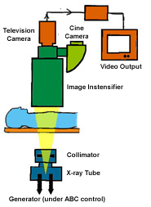

Slide 3
Introduction
Fluoro: is dynamic radiographic examination
Fluoroscopy is primarily domain of the radiologist
The role of radiographer to assist and routine post-fluoroscopic radiography
Fluoroscopy was discover 1896

Slide 4
Types of equipment
X-ray tube and image receptor are mounted to a C-arm to maintain their alignment at all times
C-arm permits the image receptor to be raised and lower to vary the beam geometry for maximum resolution while x-ray tube remains in position
C-arm can move all direction
2 Types of C-arm undercouch, and over couch
Carriage is the arm supports the equipment suspended over the table include II, x-ray tube, control power drive, spot film selection, tube shutters, spot filming, cine camera, video input tube etc.
Exposure cannot commence until the carriage is return to a full beam intercept position

Slide 5
X-ray tube
Similar to diagnostic tubes except:
  Designed to operate for longer periods of time at much lower mA i.e. fluoroscopic range 0.5-5 mA
  tube target must be fixed to prevent an SOD of less than 15 inch, cm?
  Fluoroscopic tube can operate by foot switch
  And equipped with electrically controlled shutter

Slide 6
Image Intensification Tubes
Was developed 1948
Is designed to amplify the brightness of an image
New II are capable of increasing image brightness 500-8000 times

Slide 7
78
Major components of an II are;
  input phosphor
  photocathode
  anode
  output phosphor
  electrostatic lenses

Slide 8
II
The primary x-ray beam exits the patient and strikes the input screen of the II, which is a vacuum tube with a cathode and an anode
Fluorescent screen is built into the image intensifier as input screen, which absorbs the x-ray photons and emits light photons
Photocathode is 2nd layer which prevent divergence of the light
The photocathode absorb the light and emits electrons

Slide 9
II
Then electrons accelerated from the cathode toward the anode and the output screen by 25 kV potential difference
Electrostatic lenses is used to accelerate and focus the electron beam
The output screen absorbs the electrons and emits light photons
II is encased in a lead lined housing that effectively absorbs the primary beam
A getter is ion pump is used to remove ions during operation and maintain the vacuum within the tube

Slide 10
Input screen and photocathode
It consists of 0.1-0.2 mm layer of CsI phosphors coated onto the concave surface of II
Surface made of glass, titanium, steel or Al and ranges from 15 cm to 23 cm in diameter
The screen is concave to maintain the same distance between each point in the output screen
What is the result when it is failed to maintain the distance?
CsI absorb 66% of the incident beam

Slide 11
Input screen and photocathode
The phosphor emit light photons vertically proportion to the absorption
25 keV photon will produce 1500 light photons
A thin protective coating is applied to the input screen to prevent a chemical interaction with the photocathode
Photocathode is made from 2 materials i.e. cesium and antimony compounds which applied to the protective coating
2 materials appear as single coating which absorb light to emits electrons that process called photoemission

Slide 12
Electrostatic lenses
Are a series of charged electrodes located inside the glass envelope of the tube
The main functions are to accelerates and focuses the electrons
The focal point reverses the image so the output screen image is reversed from the input screen

Slide 13
Magnification tubes
The greater the voltage supplied to the electrostatic lenses the greater the acceleration and the closer the focal point moves toward input screen
II design to magnify the image electronically by changing the voltage
They always called multi-field pr dual field
II capable to magnify 1.5-4×
Resolution can be increased from 4 lp/mm to 6 lp/mm when magnification mode is used

Slide 14
Anode and output screen
Anode is positively charged and supplied with about 25 kV
This charge cause attraction of the electrons from the photocathode
The anode is positioned inside the glass envelop in front of the output screen, it has a hole in the center which allow electrons to pass through to the output screen

Slide 15
Anode and output screen
The output screen glass fluorescent screen, it is a silver-activated zinc-cadmium sulfide phosphor
The electrons that strike the screen are converted into light photons exit the tube
Filter is used under the output phosphor layer in oblique direction to prevent in light returning to the input phosphor
Some new II use a fiber optic disc in place of the glass output screen to eliminate isotropic emission problem and transmit the image in some distance without loss of resolution

Slide 16
Total brightness gain
Is measurement of the increase in image intensity achieved by II tube is determine by:
Minification gain cause of image compression into a small output i.e. from 23 cm to 2.5 cm
Flux gain is number of light emitted in output screen, and not taking any account of conversion efficiency of the input screen
Flux gain causes a decrease in image quality exactly as II decrease resolution
Total brightness gain is minification gain × flux gain

Slide 17
Fluoroscopic generator
Same as conventional x-ray
ABC maintain the brightness of the image by automatically adjusting the exposure factors according to the density and contrast
Most ABC monitor flow of the current between cathode and anode of the II tube or the intensity of the output screen
Most ABC use variable kVp technique system (contrast) and mAs (density)

Slide 18
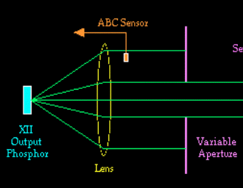
ABC FEEDBACK LOOP
Automatic
Brightness
Control Sensor
Light
Intensity
Generator
Exposure
Control
KVp
mA

Slide 19
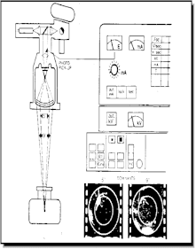
ABC
When the ABC mode is selected, the ABC circuitry controls the X-ray intensity measured at the I-I so that a proper image can be displayed on the monitor.
ABC mode was developed to provide a consistent image quality during dynamic imaging
The ABC compensates brightness loss caused by decreased I-I radiation reception by generating more X-rays (increasing mA) and/or producing more penetrating X-rays (increasing kVp). Conversely, when the image is too bright, the ABC compensates by reducing mA and decreasing kVp.

Slide 20
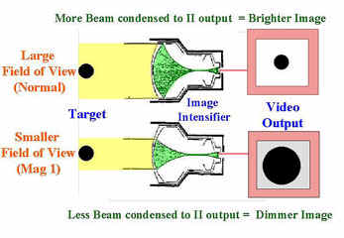
Magnification
Many fluoroscopy systems have one or several magnification modes
Magnification is achieved by electronically manipulating a smaller radiation I-I input area over the same I-I output area

Slide 21
Image Quality
Too many factors affecting image quality than static
Contrast:
  can be increasing amplitude of the video signal
  effected by penumbral light scatter in the input and output screens
  Affected by scatter radiation
  Back scatter effect from the output to the input screen→ background fog
  Edge of the image decreases image contrast

Slide 22
Resolution
The primary limitation is 525-line raster pattern of the video camera monitor
Spot film or direct optical viewing depend on geometrical factors, includes minification gain, electrostatic focal point, input and output screen diameter, viewing system resolution i.e. TV, OID, phosphor size and thickness
CsI II capable of 4 lp/mm, magnification or multifield image intensifiers capable of up to 6 lp/mm

Slide 23
Distortion
Size distortion is caused the same factors affect by static radiographic e.g. OID
Shape distortion is caused by geometric problems
Edge distortion problem (vignetting)

Slide 24
Quantum Mottle
Insufficient radiation which cos grainy appearance
Should be control by high mA and time setting
Can be also from video noise
Factors influence mottle are, total no. of photons arriving ratina which include radiation output, beam attenuation, conversion efficiency, minification gain, flux gain, total brightness gain, viewing system, distance of the eye from the viewing system

Slide 25
Fluoroscopic Image monitoring
Optical Coupling:
The light output from the II needs to directed to a video camera and then to a television screen.
There are two ways of coupling the output window to the input of a video camera;
- Lens coupling
- Fibre optic coupling

Slide 26
Lens coupling:
- uses a pair of optical lens and a “beam splitting mirror” (to enable other accessories like spot film camera or cine camera) and an aperture.
- loss of image brightness due to lens system and beam splitting.
- Aperture controls the amount of light passes through to the TV camera.

Slide 27
- A wide aperture will allow most light on to the video camera, thus reducing patient dose but the image will have high noise.
- A narrow aperture will allow only a fraction of the light on to the video camera, thus increasing patient dose but reducing the image noise.

Slide 28
Fibre optic coupling:
uses fibre optic cables thus reducing light loss from the II to video camera
prevents any additional accessories being used.
Preserves better spatial resolution

Slide 29
Viewing system
It is development of the image from output screen to the viewer these include video, cine and spot film systems
Video Viewing System
Most commonly used is video as close circuit through cables to avoid broadcast interference
System include video camera attached to II, 3 types are Vidicon or PlumbiconTM tube or CCD

Slide 30
Video camera Tubes
Vidicon and PlumbiconTM are similar in operation differing in target layers
PlumbiconTM has faster response time
Video camera;
  is a cylindrical glass tube of 15 mm diameter and 25 cm long
  contains a target assembly, a cathode & electron gun, electrostatic grids and electromagnetic coils for steering and focusing of electron beams
The target assembly contains 3 layers - the face plate, signal plate and photo-conductive layer.
Tube consist of cathode a series of electromagnetic focusing and electrostatic deflector coils, anode with face and signal plates and target

Slide 31
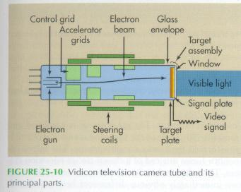
Cathode
Is an electron gun which emits electrons by heat (thermoionical) and shaped by the grid
Electron accelerated toward the target
Focusing coil bring the electron to a point to maintain resolution
Pair of deflecting coils serve to cause the electron beam to scan the target in a path as a raster pattern

Slide 32
Cathode
Commercial TV uses 525 horizontal line raster pattern
High resolution video system offer 1050 line
The electron beam scans across the screen nearly 1000,000 times per mints
To avoid flicker each scan divided into 2 halves first half scanning even no lined, 2nd half scan odd no lines
60 Hz 30 scans for each half to be projected/sec
Raster pattern reduces the resolution of the image

Slide 33
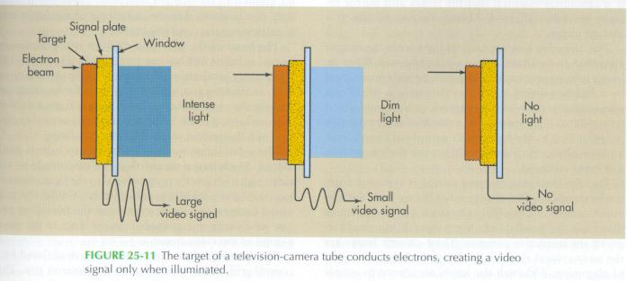
Anode
The light emitting from II is detected even by fiber optics or optical lens
Which permits light photon transmitted to the signal plate( thin graphite charge with positive voltage) and thick to conduct electronic signal out of the tube
This is the portion of the target assembly that send the signals to the TV monitor.

Slide 34
Anode
Vidicon tubes use antimony trisulfide (Sb₂S₃) (photo-conductive) while PlumbiconTM use lead oxide (PbO)
The globules are approx 0.025 mm in diameter
Each globule capable of absorbing light photons and releasing electrons equivalent to intensity of the absorbed light

Slide 35
Anode
The loss of e⁻ create + charge at the globule→ signal plates negative in charge
When the e⁻ gun’s beam scan the target it discharges the globules→ release the signals
The vidicon tube connected to the output screen of II

Slide 36
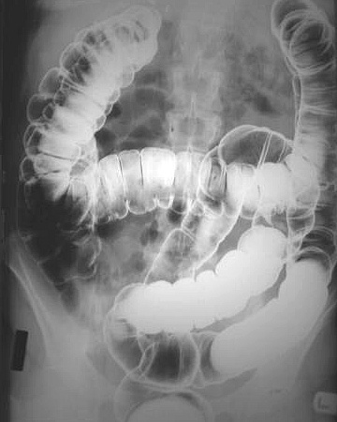
FLUOROSCOPIC VIEW OF COLON

Slide 37
Semiconductor Video Cameras
These cameras are based on the charged coupled device (CCD) technology
CCDs consist of a semiconductor chip which is sensitive to light.
The chip contains many thousands of electronic sensors which react to light and generate a signal that varies depending on the amount of light each receives.
When the light photon strikes the photoelectric cathode of CCD electrons are released

Slide 38
CCD has the ability to store released electron to P and N holes
Video signal is emitted in a raster scanning by moving the stored charge to the edge of the CCD where they are discharges as pulses into conductor
Adv. Fast discharge time, eliminate image lag, good for high speed imaging applications, more sensitive, operate at lower voltages, more life, acceptable resolution, hard enough from damages

Slide 39
CCDs have been developed primarily for the domestic video camera market
They are:
- compact
- lightweight
- possess improved camera qualities compared to photoconductive cameras.

Slide 40
A scanning electron beam in an evacuated environment is not required,
The image is read by electronic means.
CCD Chips are manufactured with different numbers of sensor arrays;
512 x 512
1024 x 1024
2048 x 2048

Slide 41
Image Monitor
The output of a video camera is a video signal which is fed via a coaxial cable to a video / TV monitor.
The video signal contains voltages representing image brightness as well as timing signals (sync pulses) associated with the raster scanning process.

Slide 42
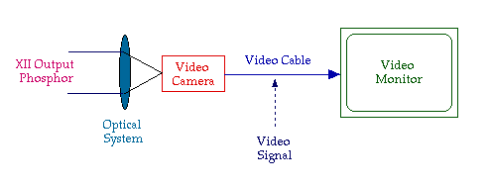

Slide 43
Video Monitor
A video monitor is used to display images acquired by the video camera of a fluoroscopy system.
- The image is described as a “softcopy”
- The video monitor is similar to an oscilloscope, ie, a scanning of the electron beam but in a raster fashion.

Slide 44
Video Monitor
It is an evacuated glass tube which contains an electron gun, a number of focussing & steering electrodes and a phosphor screen.
The electron gun forms the cathode and the electrons are accelerated by a high voltage towards the phosphor screen.
The impact of the electrons on the screen causes it to fluoresce and the resulting light forms the image.

Slide 45
Video Monitor
A 525 line monitor is capable to display 1-2 lp/mm
Magnification can increase the resolution
17” monitor has high resolution patterns i.e. 1050 lines

Slide 46
Video Monitor
Video monitors generally have two viewer adjustable controls;
contrast - controlled by the number of electrons in the electron beam
brightness - controlled by the acceleration of the electrons in the tube
These have a strong influence on the quality of displayed images.

Slide 47
Recording The fluoroscopic Image
Cine film:
  Consist of cine camera positioned behind output screen
  Required 90% of image intensity for proper exposure
  16 mm and 35 mm formats are currently use
  More pt dose
  Record series of static image at high speed
  Shutter and pulses of radiation should synchronize for the exposure
  Generator and fluoro x-ray tube must able to handle large heat loads
  ? Best generator for that study

Slide 48
Video tape recording
  VHS-S system requires
  High resolution camera
  Recorders tape and monitors
  Operate same as home video systems

Slide 49
Static Spot Filming
  Radiographic cassette or spot film sizes 105 mm chip or 70 mm roll
  Cassette stored in lead lined compartment in fluoroscopic carriage
  During exposure mA is boosted to level or radiograph i.e. 100-1200 mA and cassette move to primary beam
  Can be auto collimation and use 2-1 or 4-1

Slide 50
Digital fluoroscopy
Use CCD by sending analog signal to ADC microchip

Slide 51
THANK YOU

