Slide 1
Ruminant Stomach
Gulshan Kumar
Dept. of Veterinary Surgery & Radiology
College of Veterinary Science and Animal Husbandry
U.P. Pt. Deen Dayal Upadhyaya Pashuchikitsa Vigyan Vishwavidyalaya evam Go Anusandhan Sansthan, Mathura- 281 001

Slide 2
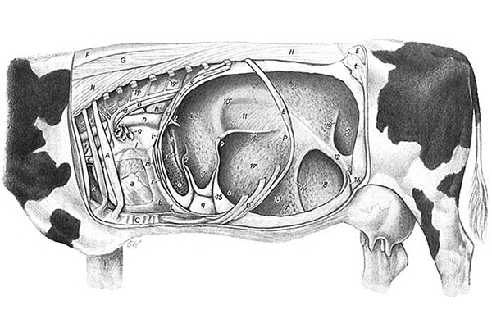

Slide 3
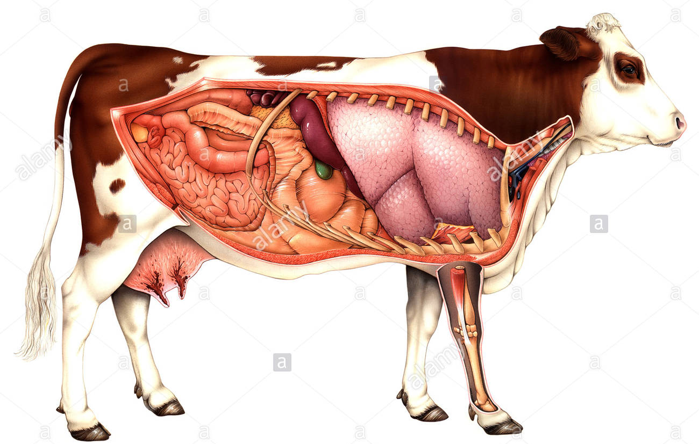

Slide 4
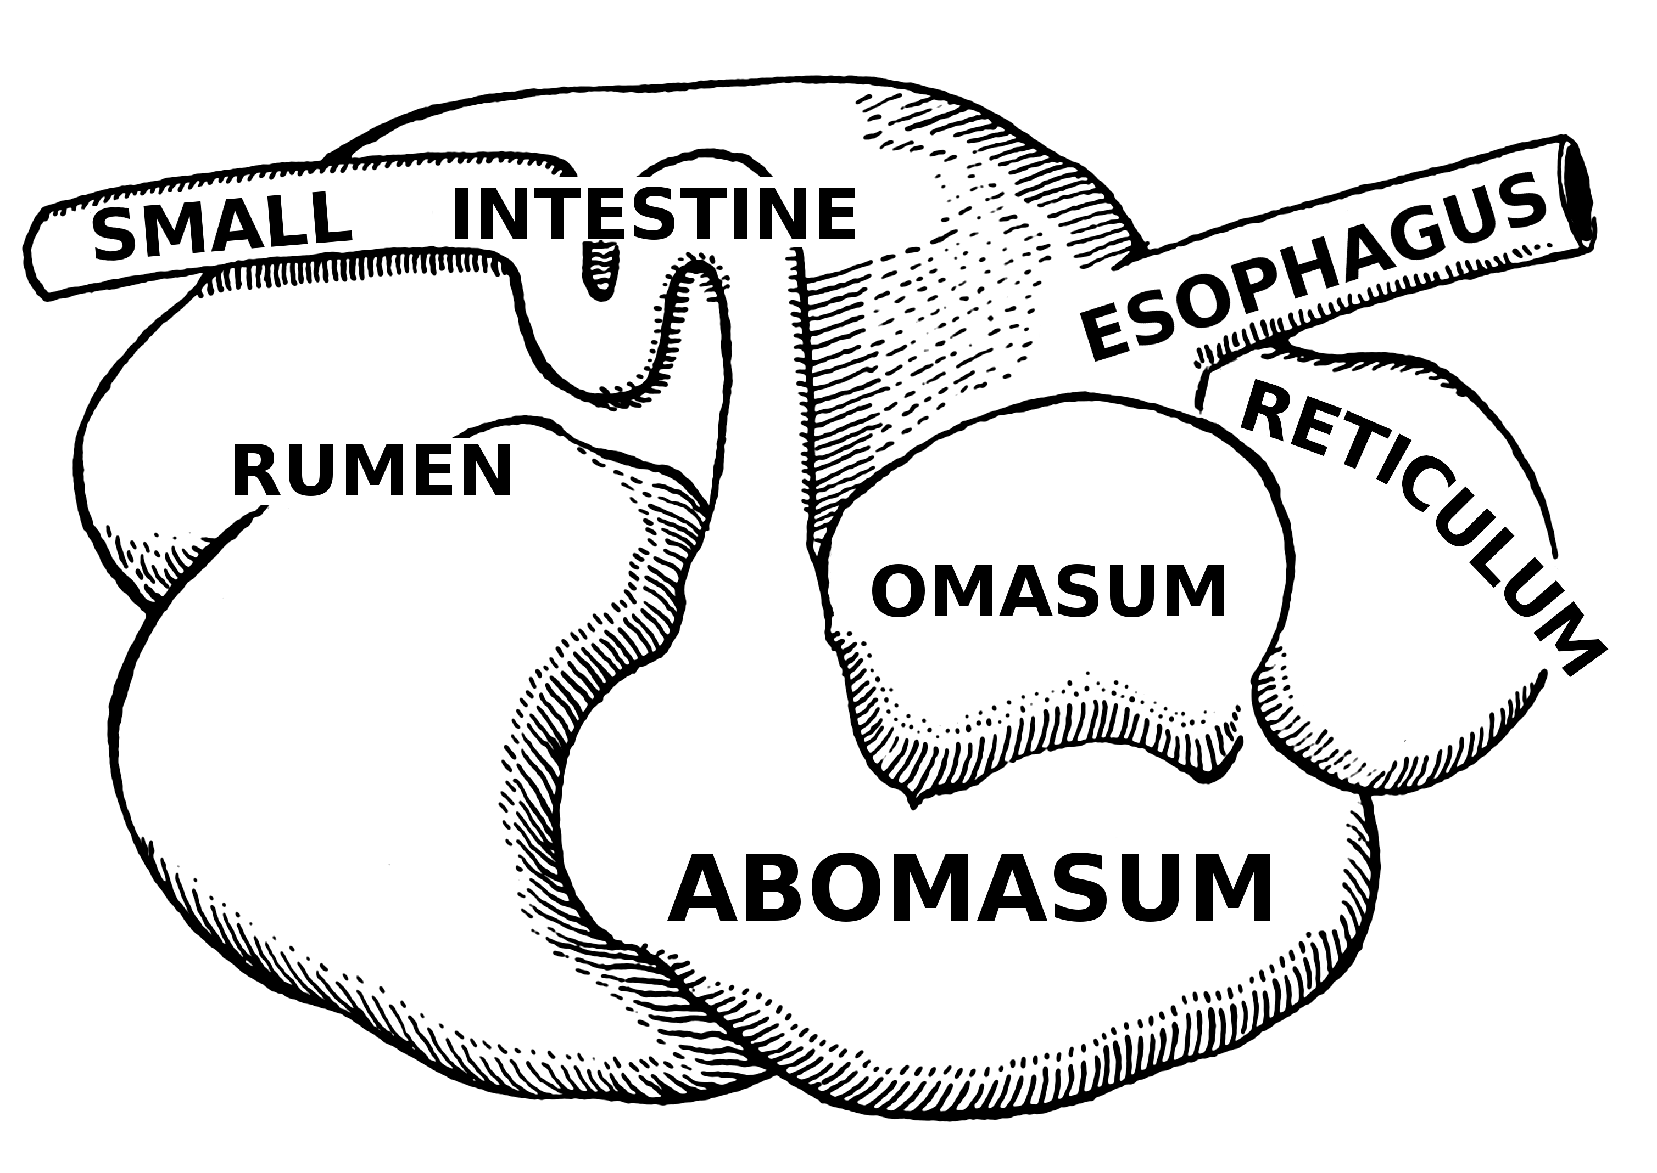

Slide 5
Anatomical considerations
In ruminants, the compound stomach occupies approximately ¾ of the abdominal cavity and almost fills the left half of it.
The first three, namely the rumen, the reticulum and the omasum could be considered as mere sacculation of the oesophagus, lined by stratified squamous epithelium.
The abomasum, with a glandular epithelium is the ‘true stomach’.
The rumen extends from the 7th/8th intercostal space to the pelvic inlet.
The ruminal mucosa is free from glands. The rumen papillae help to provide a grip over the ingesta during rumen contractions.

Slide 6
Anatomical considerations
The reticulum lies between the 6th to 8th/9th inter costal space and almost equal parts lie on either side of the median line.
The mucosal folds in reticulum form a typical honey comb pattern and acts like a sieve for foreign bodies.
The reticular groove connects the cardia with the abomasum and is about 15 to 20 cm in bovines and 7 to 10 cm in small ruminants.
The muscular lips of the groove encircle the cardia from dorsal aspect and pass steeply down the reticular wall in the direction of reticulo-omasal opening in young ruminants, the groove closes when the animal drinks milk so that it passes directly into the abomasum.

Slide 7
Anatomical considerations
Bovines- the omasum is on the right side of the median plane opposite the 7th to 11th intercostal spaces reaching up to a hand breadth below the costal arch.
Small ruminants- it lies at the position between 8th and 10th intercostals spaces and does not come in contact with the right body wall.
The omasum (many folds/plies) is related to the right abdominal wall in the ventral parts of the 7th to 9th intercostal spaces.
The abomasum lies on the abdominal floor in the xiphoid region.

Slide 8
Bloat/tympany/tympanites
Accumulation of gases of fermentation in the rumen, either in the form of persistent foam mixed with the ruminal contents, called primary or frothy bloat, or
in the form of free gas separated from the ingesta, called secondary or free-gas bloat.
It is predominantly a disorder of cattle but may also be seen in sheep.
The susceptibility of individual cattle to bloat varies and is genetically determined.

Slide 9
Bloat: Ætiology & pathogenesis
Frothy bloat or primary ruminal tympany:
  The cause is entrapment of the normal gases of fermentation in a stable foam.
  Soluble leaf proteins, saponins, and hemicelluloses are believed to be the primary foaming agents having its greatest stability at about pH 6.
  Bloat is most common in animals grazing legume or legume-dominant pastures, rich in easily digestible protein, hence common in feedlot cattle.
  The slimy nature helps forming bubbles which do not coalesce, hence the froth.

Slide 10
Bloat: Ætiology & pathogenesis
Free gas bloat or secondary ruminal tympany:
  The cause is physical obstruction of eructation (foreign body, stenosis, extraluminal lesions).
  Interference with oesophageal groove function in vagal indigestion and diaphragmatic hernia may cause chronic ruminal tympany. This also occurs in tetanus.
  Interference with the nerve pathways involved in the eructation reflex.
  It may be secondary to rumen atony occurring in anaphylaxis and grain overload causing decrease in pH, oesophagitis/rumenitis leading to interference in eructation.
  May also develop due to hypocalcaemia.

Slide 11
Bloat: Ætiology & pathogenesis
The increased intra-ruminal pressure due to accumulation of gases exerts pressure over the diaphragm and the ribs, which results in reduced respiratory movements. This results in hypoventilation and reduced venous return to heart.
The increased intra-ruminal pressure also causes absorption of gases, particularly poisonous methane which has a deleterious effect on the animal.
Bloat is a common cause of sudden death.

Slide 12
Bloat: clinical findings
Sudden obvious distension of the rumen.
Contour of the left paralumbar fossa changes to protrusion and the entire abdomen is enlarged.
The skin over the left flank becomes taut.
Marked dyspnoea and grunting, mouth breathing, protruded tongue, extended head and frequent urination.
If untreated the animal collapses and dies. Animal may die within an hour of being allowed to graze on a leguminous pasture.
In free gas bloat tympanic resonance is observed on the dorsal left flank.
Free gas produces a higher pitched ping on percussion than frothy bloat.

Slide 13
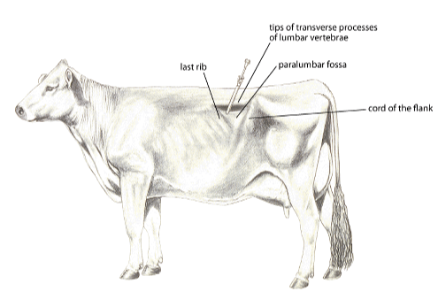
Bloat: treatment
A trocar and cannula may be used for emergency relief.
In the case of simple tympany, trocarisation alone may be enough to relieve the gas. But, in frothy bloat, administration of anti foaming drugs into the rumen is mandatory in order to free the gas either through a probang or trocar.

Slide 14
Bloat: treatment
Oral administration of 80 ml of turpentine mixed with 500 to 1000 ml of mustard oil is found to be very effective.
Anti-froth agents like dimethicone also can be used for this purpose.
After severe bloat, concentrates should be avoided for at least two days and the animal should be fed with non leguminous hay.
Rumen fistulation (Rumenostomy) may be done in chronic bloat, after which the treatment is purely medical and aimed at correction of primary disease and also the correction of fluid, acid-base and electrolyte imbalances.
Surgical intervention may be needed in cases of physical interference in eructation.

Slide 15
Thanks

