Slide 1

Major Credit seminar
SPERM SEXING
Advances and limitations
Presented by –
Vikas Sachan
Ph.D. 1st yr. (V-1815/17)
Department of Veterinary Gynecology & Obstetrics
DUVASU, Mathura

Slide 2
Content
Introduction
Techniques with their principle
Advantages and disadvantages
Sperm screening
Effect on fertility
Conclusion
Future prospects

Slide 3
INTRODUCTION
“Sexing” of mammalian sperm, i.e. separation of
sperm into X- and Y-chromosome bearing cells
Demand (meat, milk and dairy products)
..... Innovation & utilization of modern technologies
..... Promising breeding strategy (Sex preselection)
..... Meet the demand for food production
(Rath et al., 2013)

Slide 4
- Why sperm sexing?
Fastens the genetic progress
Selection of females for milk production
Male offspring for beef production
Minimize sex -linked genetic diseases
Gender balancing (Sureau, 1999)
Reduces the replacement cost (Seidel, 2007)
Economic and social benefits
Sperm separation : preferred method (over embryo
sexing) for sex preselection
: No need to embryo manipulation and exclusion

Slide 5
Early Greeks when Democritus,470-402 BC, right testis
produced males , whereas left testis produced females
Mono-orchydectomy, the position and timing of sexual
intercourse and diet affected the baby's sex
The first documented microscopic identfication of sex
chromosomes (Guyer, 1910)
First attempts to separate X and Y bearing sperms
by analytical flow cytometry (Gledhill et al., 1976)
First mammalian sperm separation in Microtus oregony
(9% DNA difference) at Lawrence Livermore National
Laboratory (Pinkel et al., 1982)

Slide 6
Potential Differences between X and Y spermatozoa
Parameter | X-Spermatozoa | Y-Spermatozoa |  | Method
DNA | More | Less |  | Flow cytometry
Size | Large | Small | Cui, 1997 | Percoll method
Motility | Swim slow | Swim fast | Shettles, 1960 | Swim up
Surface charge | Migrate to cathode | Migrate to anode | Kiddy and Hafs, 1971 | Free flow electrophoresis
Sperm surface determinants | No HY antigen | Yes antigen | Hoppe and Koo, 1984 | Immunological sexing

Slide 7
Determination and separation of X & Y chromosome
bearing spermatozoa
1) Physical Methods (on the basis of Mass and Motility)
- Albumin gradient method
- Percoll density gradient method
2) Predicting differences in surface charge
- Free-flow electrophoresis
- Counter current galvanic separation
3) Predicting differences in cell surface antigenic determinants
- Histocompatibility-Y antigen (H-Y)
- Sex specific proteins (SSps)
4) Predicting the difference in DNA content
- Flow cytometry

Slide 8
- Emerging methods for sperm selection:
Raman spectroscopy
Confocal light absorption and scattering spectroscopy
(CLASS)
Sperm chemotaxis (Resende et al., 2009)
- Sperm separation techniques:
Zeta potential method
Magnetic-activated cell sorting (MACS)
Hyaluronic acid sperm binding
Selection based on live sperm morphology

Slide 9
Possible to predetermine the sex of offspring from a
number of species before fertilization
: with an accuracy of 85–95%
(Seidel et al., 1999; Johnson, 2000)
The first commercial production of sexed sperm was
by the company Cogent in the United Kingdom
(Garner and Seidal, 2008)

Slide 10
albumin gradient method
- Based on sperm motility & size
- Ericsson and Coworkers in 1973 (Human sperms)
- 85% sperm having Y- chromosome at lowermost
portion (Ericsson and Ericsson, 1999)
Y-chromosome-bearing spermatozoa :
smaller in size and greater downward swimming
velocity
(within vertical columns of high density human serum
albumin i.e. HSA ) (Ericsson et al., 1973)
- More downward swimming velocity by Y-chromosome
(in increased density & viscous medium)

Slide 11

Higher wt. of X-chromosome
: Too small to influence the gravitational effect for
downward swimming
- No effect of Y sperm enrichment by albumin separation
(Brandriff et al., 1986)
Never been shown to sex spermatozoa accurately from
mammals other than humans (White et al., 1984)
Interesting aspect of the use of this method
: When women are treated with clomiphene citrate to
induce ovulation before insemination :
sex ratio is reversed (Ericsson and Ericsson, 1999)

Slide 12
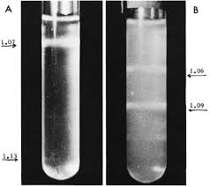
Percoll density gradient centrifugation
- On the basis of sedimentation density difference (Y < X)
: because of large size and more chromatin content
Percoll :colloidal silica particles (15-30 nm dia)
23% w/w in water
polyvinylpyrrolidone (PVP) coating
(Pertoft et al., 1978)
Low viscosity (Easy equilibrium sedimentation)
Low osmolarity
High levels of endotoxin
Damaging effect of PVP on sperm
(withdrawn from the market in 1996)

Slide 13
Centrifugation : minimize the effect of motility
maximize the difference in mass
: X- sperm : in the densest layer of the gradient
- Separation of X-Chromosome sperms (86% to 94%)
Difference between top and bottom layer for
Top : Y chromosome sperms : 1.6%
Bottom : X- chromosome sperms : 4.4%
(Van Kooij and van Oost, 1992)

Slide 14
Sucrose density gradient centrifugation
(Rhode et al., 1975)
Ficoll sodium metrizoate density gradient
(Shastry et al., 1977)
Nycodenz : iohexol (80% (w/v)
PureSperm 100
OptiPrep : 60% iodixanol in water (density of 1.32 g/ml)
low viscosity and low osmolality
sterile endotoxin, non-ionic, non-toxic to cells
metabolically inert (Sakkas et al., 2000)

Slide 15
VOLUMETRIC DIFFERENCES
X chromosome sperm : larger than Y chromosome sperm
(interference microscopy and image analysis)
(Van Munster et al., 1999)
: Demonstrate a difference in sperm head volume
Using interference microscopy optics with a flow
cytometer (van Munster, 2002)
Highly attractive alternative method
: No use of DNA-specific dyes
Success rate : <80% (Van Munster, 2002)

Slide 16
Centrifugal Countercurrent Distribution (CCCD)
- Difference in density between X and Y -bearing bovine
spermatozoa : 0.0007 g/cm3
(not suitable to be exploited as a characteristic to sex
sperm) (Meistrich, 1982)
A first attempt CCD to fractionate X and Y sperm
populations
: using a thin layer approach (Cartwright et al., 1993)
Enrichments of 80% in Y chromosome were reported
But … long time for CCD : nonviable sample

Slide 17
- Loss of viability (dilution and washing) during the
separation : Major technical problem for sperm cells
(Harrison et al, 1982)
- For phase separation
Long period : at unit gravity
: More cell death during the separation
(Albertsson, 1986)
Shorter period : centrifugation
: Speeds up the phase separation) (Akerlund, 1984)

Slide 18
Sex ram spermatozoa by CCCD : an aqueous two-phase
system (Ollero et al., 2000)
Based on the different affinities of cell surfaces for
inmiscible aqueous solutions of polymers
: Dextran – Stationary Lower phase
: Polyethylene glycol – Mobile Upper phase; more
hydrophobic
(Fisher and Sutherland, 1989)
Centrifugal Countercurrent Distribution (In Ram)
: Completed in 1 hr
Centrifugation : speed the partitioning process
(59 partitions was done in about 1 hr) (Ollero et al., 2000)

Slide 19
Sperms are added to the system
: Partition between the interface and the PEG-rich
upper phase (because of different surface properties)
: Dead sperms - affinity for the dextran-rich phase
: Reveals spermatozoa heterogeneity (Ollero et al., 1997)
Fractions of up to 75-80% Y-chromosome-bearing
spermatozoa (reasonable viability) (Ollero et al., 2000)
May not be as successful for species with less difference in DNA content between X- and Y-chromosome bearing spermatozoa than in ram (4.2%) (Johnson, 1995)

Slide 20
cell surface antigenic determinants
X and Y sperms : different surface charatcteristics
(at spermiation from germinal epithelium)
Histocompatibility-Y antigen (H-Y)
Molecule On both X- and Y- spermatozoa
possibly derived from Sertoli cells
(Hoppe and Koo, 1984)
Viable immunological sperm sexing procedure
: Isolation of sex-specific proteins (SSPs)
(Blecher et al., 1999)

Slide 21
- Different SCSPs on the surfaces of X and Y sperm
: Post-meiotic transcription and/or translation of
SSPs
: Don’t cross inter-spermatid cytoplasmic bridges
(Hendriksen et al., 1995)
SSPs are likely to be more conserved than non – SSPs.

Slide 22
Removal of Non-SSPs immunologically
Purification of SSPs by column chromatography
identification of purified SSPs by raising SSAbs using afinity chromatography
agglutination of approximately half of the bovine spermatozoa
unagglutinated free swimming spermatozoa (Y-chromosome) were separated by glass wool filtration
Produced > 90% male embryos

Slide 23
….. In Rabbit …. Use of anti-X & Anti-Y sera
(Blecher et al., 1999)
Constraint is that the method
: successful isolation of Y-bearing spermatozoa only
Attempts to isolate X bearing spermatozoa by
agglutinating Y bearing spermatozoa was not successful
(No agglutination of Y-spermatozoa) (Blecher et al., 1999)

Slide 24
Free-ﬂow electrophoresis
Based on difference of net electric charge on surface
…. X- and Y-bearing spermatozoa are separated
: Net electrical charges
: Difference in motility
Net negative charge on the cell surface of
X chromosome bearing spermatozoa is higher :
neuraminic acid containing glycoproteins (Okuno & Mohri, 1991)
Electronegativity on the sperm surface
: Associated with CD52 expression on sperm surface
(Schroter et al., 1999)
: Other glycoproteins (Ainsworth et al., 2011)

Slide 25
Uses an electric ﬁeld
….. (current of 75 mA and voltage (18-21 V)
: Separation of spermatozoa into the two major classes
(Kaneko et al., 1984)
X-bearing sperms : towards anode
X-chromosome-bearing fraction : relatively pure
(Kaneko et al., 1984)
- Difference in surface net electrical charges ???
both populations are in close contact with each other
and bathed in the same seminal fluid

Slide 26
Flow cytometry cell sorting
- Based on difference in DNA content (Garner et al., 1983)
Difference in DNA : 3.8% (3–4.5%)
(Johnson et al., 1987; Johnson, 2000)
first reported analysis of sperm on a flow cytometer
(Gledhill et al., 1976; Van Dilla et al., 1977)
The first fluorescence-based flow cytometry device
(ICP 11) : Wolfgang Göhde in 1968 from the University of
Münster
First commercialized in 1968/69 by German developer
and manufacturer Partec through Phywe AG in Göttingen

Slide 27
Flow cytometric sex-sorting of sperm is patented
(Johnson, 1991)
- Sub-licensed for non-human mammals to XY Inc.,
through Colorado State University
First demonstrated convincingly by Johnson et al. (1989)
resulted from integration of advances in many
fields including chromosomal karyotyping, AI,
invitro fertility, DNAspecific staining, flow
cytometry, computer science and high speed cell
sorting

Slide 28
Advances from these different disciplines were
integrated by
: A body of innovative scientists from
Lawrence Livermore National Laboratory
The United States Department of Agriculture Beltsville
Agricultural Research Center, Cambridge University,
Colorado State University
Atlantic Breeders Cooperative
XY, Inc. (Johnson and Seidel, 1999; Garner, 2001)

Slide 29
Species | Percentage of DNA (X > Y) | References
Cattle | 3.8% | Garner, 2001; 2006
Buffalo | 3.6% | Lu et al., 2006
Sheep | 4.2% | Johnson, 2000
Goat | 4.4% | Parilla et al., 2004
Horse | 3.7% | Johnson, 2000
Swine | 3.6% | Johnson, 2000
Human | 2.8% | Johnson, 2000
Rabbit | 3.0% | Johnson, 2000
Camel | 3.3% | Johnson, 2000
Bison | 3.6% | Johnson, 2000
Yak | 3.6% | Johnson, 2000

Slide 30
Breeds | Percentage of DNA (X > Y) | References
HF | 3.98% | Garner, 2001; 2006
Jersey | 4.24% | Garner, 2001; 2006
Angus | 4.05% | Garner, 2001; 2006
Hereford | 4.03% | Garner, 2001; 2006
Brahman | 3.73% | Garner, 2001; 2006
Murrah | 3.59% | Lu et al., 2006
Nili Ravi | 3.55% | Lu et al., 2006

Slide 31
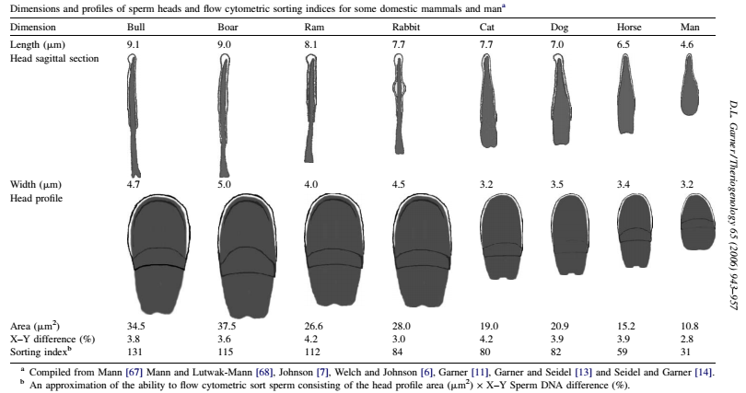
- Easiest sperm to separate in flow cytometer/ cell sorter
for bull : Resulting in the highest sorting index of 131 (Garner, 2006)

Slide 32
Hoest-3342
Bisbenzimidazole Hoechst 33342 (29-(4-ethoxyphenyl)-5- (4-methyl-1-piperazinyl)-29,59-bi-1H-benzimidazole 3 HCl)
- for staining intact spermatozoa
(fluorescence quantification of the DNA content)
(Johnson et al., 1987)
Hoechst 33342 (H33342)
- Yellow solid
- Formula weight of 561.9 (C27H28N6O?3HCl)
- Moderately water-soluble and relatively non-toxic
- Live cell stain : Permeates the cell membrane
Notes:
DAPI : (4,6-diamidino-2-phenylindole)….Can pass through cell membrane…Bind at A-T rich regions…non toxic, non/low mutagenic

Slide 33
- Useful in assessing precise amounts of DNA in cells
- Binds selectively to A–T base pairs along the minor
groove of dsDNA
Most DNA stains intercalate between the base pairs of
the DNA : mutagenicity
However, H33342 is not an intercalative dye: safer to use (Watkins et al., 1996)
Binding of H33342 to negatively charged DNA :
- Stabilized by a combination of
Hydrogen bonding
Van der Waals forces
Electrostatic interactions
- Multiple-binding interaction : putative radioprotective
properties (Young and Hill, 1989)

Slide 34
Fluorescence signals emitted from Hoechst 33342-
stained sperm - 351 and 364 nm lines of an
argon laser/mercury lamp
- Accurate measure of the DNA content
(Seidel and Garner, 2002)
- No significant damage to morphology and motility
(Johnson, 1990)
No genotoxic effects on sexed sperm (Parilla et al., 2004)
- Genetic damage : relatively small or nonexistent
(Garner and Seidel, 2008)
Disturbances of heat shock proteins HSP70
and capacitation like changes in boar sperms
(Spinaci et al., 2006)

Slide 35
Prolonged or repeated exposure to Hoechst 33342 :
: Potential skin, eye and respiratory irritant
: Might be harmful if inhaled or ingested
: No obvious DNA damage was observed (Garner et al., 2001)
What happens to Hoechst 33342
- Entering cells of the female tract ?
- Lymphocytes and macrophages ?
: phagocytize degenerating sperm ?
- Stain metabolized ?
- Simply diluted out to be expelled in urine or feces ?
(Fate of Hoechst 33342 in female tract : unknown)

Slide 36
- Fluids/Media : Affect sperm fertility (dilution)
Electrical & viscosity properties
No interference with staining & fluoroscence
Staining media – Tyrode’s albumin lactate pyruvate (TALP)
(Schenk et al., 1999)
Sorting media - TALP + EGG yolk
Sheath media - TRIS + Citric acid + Fructose
Catch media - 22% egg yolk –TRIS extender
(Schenk et al., 1999)
Sheath fluid surrounds the core of stream
(having sperms in sorting media)
: exciting fluid - 90% Sheath f. + 10% Sorting f.

Slide 37
Spermatozoon passes two fluorescence detectors at 90⁰
angles to each other
(each detector measures the intensity of fluorescence)
Main obstacle -Geometry of sperm head : paddle-shaped
Intensity of fluorescence
Lowest - Flat face of the paddle detector
Highest - Edge is so oriented
Forward fluorescence detector : measures DNA content
Side fluorescence detector : measures cell orientation

Slide 38
Proper orientation of sperm
Cylindrical geometry of sorting fluid (Rens et al., 1998, 1999)
......... considered appropriate orientation for sexing
Only About 10% of spermatozoa : well oriented
By modifying the cylindrical geometry of the fluid stream
: 70% of spermatozoa are oriented correctly
(Johnson and Welch, 1999)
- Modern flow cytometers
- flow rate past the detectors, which is over 20-25 m/s
(Over 180 000 measurements per detector / Sec)

Slide 39
Fluorescence signal depends on
- Wavelengths of light used
- Number of fluorescing molecules bound to DNA
- Laser intensity and pulse (Guthrie et al., 2002)
- Optical properties of the entire system
- Sensitivity of detectors and electronic noise
: As constant as possible to count the small differences
in DNA

Slide 40
Removal of dead sperms during the sorting process
- Propidium iodide (Johnson et al., 1994)
- Red food dye (FD & C40)
No potential mutagenic effects of propidium iodide
(Johnson and Welch, 1999; Schenk et al., 1999)
Mechanism of action :
Quench the H33342 of sperms with damaged
membranes
: Removed during the sorting process by dead-cell
gating

Slide 41
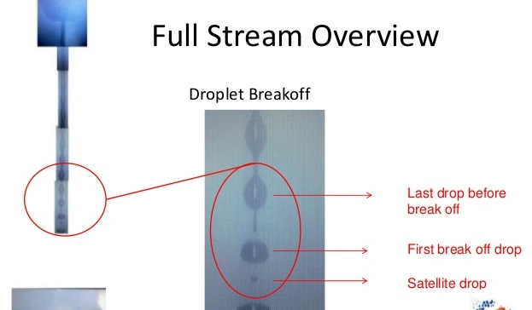
- Piezo crystal in Cytonozzle.
…….Frequency waves are applied to the crystal
…… Causes the fluid stream to break off into
droplets (80 000 drops / Sec)

Slide 42
Charge is applied to the stream
: Positive (for Y-chromosome-bearing spermatozoa)
Negative (for X-chromosome-bearing spermatozoa)
Drops then travel between high voltage fields
: Directed into respective collection tubes (catch media)
Droplets with no spermatozoa, dead spermatozoa,
Unsexable and double spermatozoa – Uncharged
……………… drop straight into the waste stream
Some spermatozoa are statistically ‘between droplets’
: Unclear in which droplet the spermatozoa will reside :
both drops are discarded

Slide 43
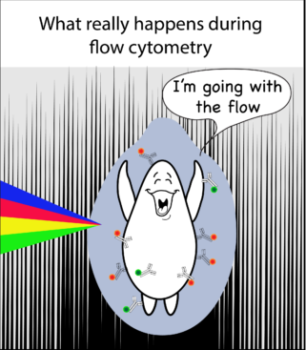
25% of droplets will contain a single spermatozoon
4-5 % of droplets will contain two or more spermatozoa
> 70% will not contain any spermatozoa
(Seidel and Garner, 2002)
25000 spermatozoa / sec .…. Event rate
Upper limit on sorter performance
: 80000 droplets per second at 50 psi
: sorting about 10000 live sperms each sex / Sec per
nozzle

Slide 44
- Event rate can be changed :
- Modifying the concentration of spermatozoa
- Changing the ratio of core stream to sheath fluid
- Increasing the pressure of the entire system
(80000 droplets per second at 50 psi)
: more than this leads to abortion & poor fertility
(Suh et al., 2005)
If the concentration of spermatozoa is increased
- Average space shortens
- More and more spermatozoa : relatively clumped
- Fluorescence signals : overlap
: Poor processing by the system them separately

Slide 45
- Addition of seminal plasma (10% v/v) in staining medium
- Improve the viability and motility
- Reduce capacitation like changes
in boar and ram spermatozoa (de Graaf et al., 2008)
- Addition of bovine sheath fluid in extender
(197mM tris, 55.4mM citric acid, 47.5mM fructose)
with addition of protamine before sorting
- Better sperm viability, motility with fertility
(Gosalvez et al., 2011)

Slide 46
Lowering the fluidic pressure during sorting
from 50 to 40 psi
- Maintaining resolution of the X- and Y-sperms
- Increased survivability with less damage
- Increases fertility (Schenk et al., 2009)
- BUT…. Improper orientation of gametes
(sperm with rounded or angular heads)
Optimizing sorting conditions may be necessary for
each species to achieve acceptable sexing efficiency
of mammalian species

Slide 47
- Sex-sorting of cattle sperm
- More sophisticated orienting nozzle (Rens et al., 1996)
- Improved ceramic version (Cytonozzle) of the SX
MoFlo system
(DakoCytomation, Fort Collins, USA) : commercial
- < one-third of the sperm passing through the
system can be sorted with the threshold set to achieve
90% accuracy
(Seidel and Garner, 2002)

Slide 48
Collection of Bull semen
Store for 20⁰C – 23⁰C (undiluted)(Schenk et al., 1999)
Dilution with staining media (200 mill / ml)
Staining with H33342 for 45 min / 340 C
Dlution with sorting media (100 mill / ml)
Addition food color agent
Repeat steps at every 90 min for 9 hr.
Centrifugation of sample at 850 g / 20 min and dilute
(0.8 mill / ml)
Sorting

Slide 49
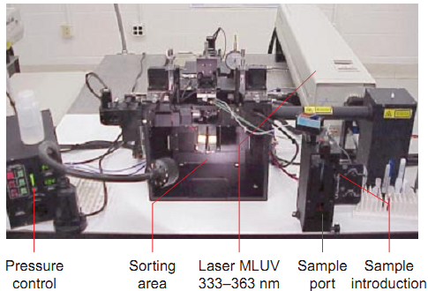
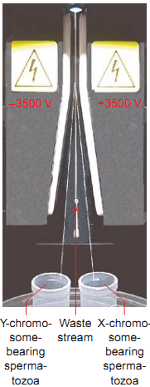
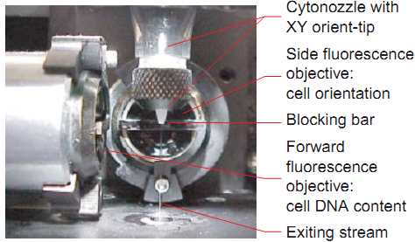

Slide 50
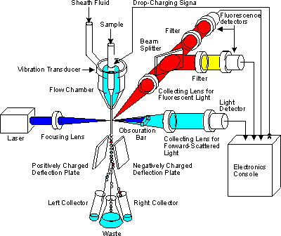

Slide 51
- Losses …. Aliquot of stained spermatozoa 100 %
- In staining tube 10%
- In sorter tubing correct plugged nozzles 12%
- Malorientation 30%
- Coincidence 15%
- Dead spermatozoa 10%
- Fluorescence overlap 12%
- Aneuploid spermatozoa 1%
- Both X- and Y-chromosome in one droplets 2 %
- Spraying 4%
- In the supernatant 15 %
(after centrifugation; concentration step)
- Filling and sealing 4%

Slide 52
- Spermatozoa that have been sorted 30%
- Sorted spermatozoa that are frozen 23%
- Spermatozoa available for insemination 22%
(11% of each sex )
(at 90 to 94 % accuracy)
(Garner and Seidel, 2003; Garner, 2006)

Slide 53
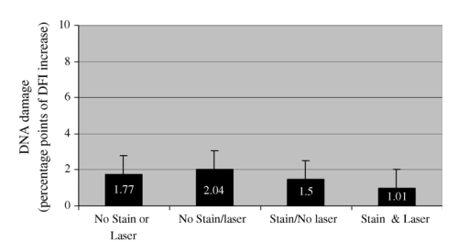
Examination of the integrity of the bovine sperm DNA
(Sperm Chromatin Structure Assay, SCSA)
: mechanical injury, exposure to Hoechst 33342
and/or 150 mW of laser illumination (Garner, 2001)
- Expressed as a DNA fragmentation index (%DFI)
(Evenson et al., 2002)

Slide 54
Flow cytometer/cell sorter for sexing sperm
: results in sexing about 10 X 10⁶ sperm/h of each sex
i.e. 5-6 doses of semen per hour (Seidel, 2002)
Two approaches to deal with problem of using low dose
(usually 2 X 10⁶ sperm)
1. Select animals with good fertility at low dose
(impractical)
2. Use low sexed sperm dose under good
management conditions in which normal fertility
(almost always used) (Schenk et al., 2005)

Slide 55
- Doubling or tripling sperm numbers : increase fertility
(Gain in pregnancy rate by 5-7%) (Schenk et al., 2009)
Timing of AI : breeding later after estrus onset in dairy
heifers : improves pregnancy
(later the start of AR more the life span of sperm) ( Sa Filho et al., 2010)
Better to use AI on heat (Not FTAI) with sexed semen
Insemination after 12 to 24 hr (18 hr.) improves fertility
Follicles ≥ 9mm at the time of FTAI with sexed semen
: Greater pregnancy (than cows with < 9mm)
(Sá Filho et al., 2012)

Slide 56
- Variation in pregnancy rates from bull to bull with
sexed semen (Meyer et al, 2012)
IVF : requires only 600-1500 sorted sperm to fertilize an
oocyte
: Pregnancy rates : 30% to 50%
…… Greatly increases the potential sexed offspring
from a sire (Xu et al., 2009)
- Calves produced : Phenotypically normal
: No/very low genetic damage
: No evidence of abnormalities
: No increased abortion rates (Siedel, 2007)

Slide 57
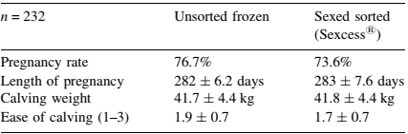
The new sperm sexing protocol….. ( Sexcess ^{R} )
Modified processing and preservation protocol
- Temporary inhibition of sperm with fluorides
- Supplementation with different radical scavengers
- Adapted three-step equilibration protocol to 4⁰ C
- Thawing at 37⁰C for 20 Sec
- Maintenance of motility, viability and AR
(Rath et al., 2008; 2009)

Slide 58
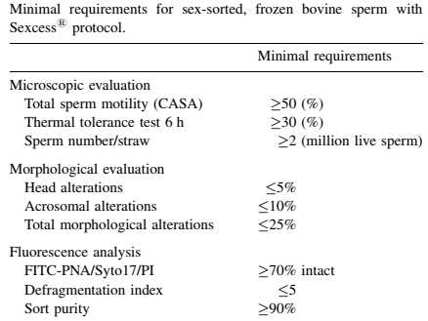

Slide 59
- Freshly collected semen is used for semen sexing -
- Storing the bull semen undiluted at 20–23⁰C for 0–8 h
- Storing the stallion semen in diluents at 5–15⁰C for 18 h
: excellent fertility (Seidel and Garner, 2002)
Successful cryopreservation of the sorted gametes (Schenk et al., 1999)
Enhanced cryopreservation methods :
Multi-Thermal Gradient freezing system
: Sorted sperm to survive cryopreservation and thawing
(Arav et al., 2002)
Notes:
Multi-Thermal Gradient freezing system : Hormony cryodevice
Based on thermodynamic principle
Modify ice crystal morphology by regulating sample velocity : Finger like projection space to reside the sperms
Less cryoprotectant required …. Less osmotic stress….less dmaged sample

Slide 60
- Limitations -
- Low sorting rate: 20 X 10⁶ spermatozoa / day
- Expensive: to purchase and maintain
- Skill is required
Mutagenic effects: DNA binding and Fluorochrome
dyes …Chromosomal aberrations
…Low embryo viability ……… low pregnancy rates
Physical trauma during sorting : low fertility
(Garner, 2006)
Low sperm viability/ motility/fertility (Carvalho et al., 2010)
Gene expression and organelle development : Impaired
(Rath et al., 2009)

Slide 61
SORTING PROCEDURES
- Changes in pH and osmolarity : Poor fertilizing ability
(Harrison and Gadella, 2005)
Removal of seminal plasma
Sorting pressure and speed
Electrical deviation and laser radiation
... Membrane alteration(depolarization)
... Pre – capacitation like changes (Schenk et al., 2009)
... Alteration of membrane proteinase
(de Graaf et al., 2008)
... Poor mitochondrial activity (Rath and Johnson, 2008)
Reduce the life span and motility of spermatozoa
Reduced fertility (Peippo et al., 2009)
- Reduce embryonic viability (Tesarik et al., 2004)

Slide 62
- Poor tolerance to cryopreservation (Schenk et al. (1999)
Faster sperm degeneration (Rath et al., 2003)
Rapid arosome reactions (23%) (Moce´ et al., 2006)
Gene expression in early embryos : delayed
(Lu et al., 1999)
Altered mRNA expression of embryos (Morton, 2007)
Inferior embryo with delayed development to
blastocysts (Wilson et al.(2005)
Reduction in embryo survival 21 days following
insemination of rabbits (McNutt and Johnson, 1996)

Slide 63
Conception rate with sexed semen
in heifers > in lactating cows
(Seidel, 2003; De Vries et al., 2008)
Low conception rate in lactating animals
... Low insemination dose & Large postpartum uterus
... Weak heat symptoms (Yoshida and Nakao, 2005)
Higher number of inseminations and insemination
doses are required for lactating cows (Peppio et al., 2009)
- No different between heifers and postpartum cows
(Rhinehart et al., 2011)
- Pregnancy rates with sexed spermatozoa
: 60–80% of unsexed spermatozoa (Doyle et al., 1999)
But reverse is documented in China (Lu et al., 2010)

Slide 64
- Pregnancy losses in cattle ( 1 to 2 months of gestation)
: 1–2% higher (Seidel et al., 1999)
No abnormality in the offspring with sex-sorted sperm
Cattle (Andersson et al.,. 2006)
Sheep (de Graaf et al., 2007)
Rabbits (Johnson et al., 1989)
Swine (Maxwell et al., 2004)
Horses (Lindsey et al.., 2002)
Cats (Holt et al., 2007)
Dolphins (O’Brien and Robeck, 2006)
Humans (Fugger, 1999)
Non-human primates (O’Brien et al., 2003)
Dogs (Meyers et al., 2008)
- Reliable and accurate method

Slide 65
Sperm screening
Banding techniques :
- Quinacrine (C₂₃H₂₈Cl₃N₃O)staining (Q-banding)
(F-body on Y chromosome) : (Barlow and Vosa, 1970)
- Only the AT-quinacrin-complex fluoresces (intense
yellow)
- Unreliable (Van Kooij and van Oost, 1992)
G – Banding :
Giemsa stain of trypsin digested of chromosomes
dark regions : heterochromatic (AT rich)
light regions : euchromatic (GC rich)

Slide 66
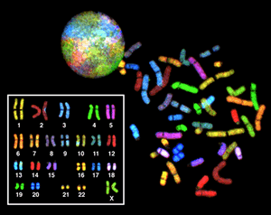
R- banding (Reverse banding to Giemsa)
Spectral karyotyping : molecular cytogenetic techniques
….. all the pairs of chromosomes in different colors
(Fluorescently labeled probes for each chromosome are made by labeling chromosome-specific DNA with different fluorophore)

Slide 67
Zeta potential method (Chan et al., 2006)
Confocal light absorption and scattering spectroscopic
microscopy (CLASS)
Raman spectroscopy (De Luca et al., 2014)
Sperm chemotaxis (Eisenbach & Giojalas, 2006)
Hyaluronic acid sperm binding (Jakab et al., 2005)
Notes:
CLASS : cancer cell studies, light-scattering spectroscopy (LSS) with confocal microscopy, properties of light elastically scattered by small particles to their
size, refractive index, and shape…. internal cell structures much smaller … approaches the accuracy of electron microscopy …. Non invasive,
nondestructive and does not require the contrast agents common to optical microscopy
Raman spectroscopy : based on a spectral classification model… Raman peaks acc. To the DNA content (nucleus) and sperm membrane proteins
- The results (>90% accuracy)….. non-invasive, and non-destructive tool for sperm sexing
Zeta potential : Differential potential between the sperm membrane and its surroundings……Mature sperm cell : negative zeta potential of -16 to -20 mV
- Washed sperm in serum-free medium.. introduced in a conical tube (positively charged by rubbing or rotating the tube on a latex glove)
Electronegatively charged sperm attach to the walls by electrostatic forces…. non-adherent sperm and other contaminants are removed
...... sperm cells : recovered by rinsing with serum-supplemented medium…. Inexpensive but not reliable
Sperm chemotaxis….. Chemical gradient (progesterone from cumulus of ova), Thermal gradient

Slide 68
Double fluorescence in-situ hybridization (FISH)
detect sex chromosomes in decondensed sperm nuclei
- X- and Y-chromosome probes are used
- Great efficiency of sperm screening
(Han et al., 1993b; Flaherty et al., 1996)
Questionable effectiveness
: Lab manipulation of sperm separation
(Claassens et al., 1995)
Molecular cytogenetic technique
: Uses fluorescent probes (bind to only those parts
of the chromosome with a high degree of sequence
complementarity)
: Presence or absence of specific DNA sequence
Notes:
Fluorophore for probes : spectrum orange fluorophore for X-chromosome
spectrum green fluorophore for Y-chromosome

Slide 69
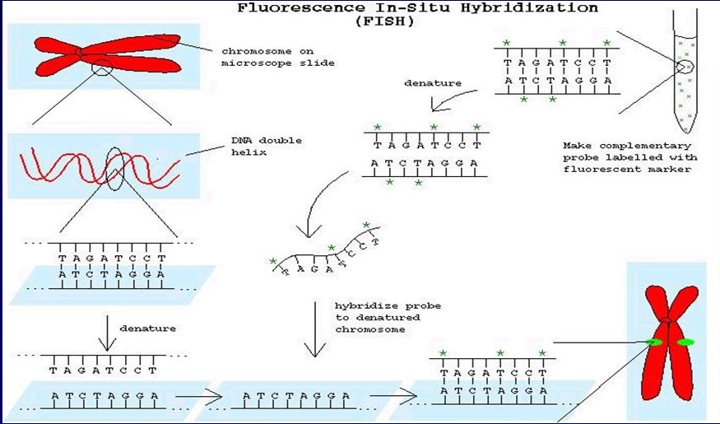
Notes:
Final examination : Counter stain : DAPI
x1000 microscope with epifluorescence and DAPI-Texas red-FITC triple filter
Cell with single orange domain : X
Cell with single green domain : Y

Slide 70
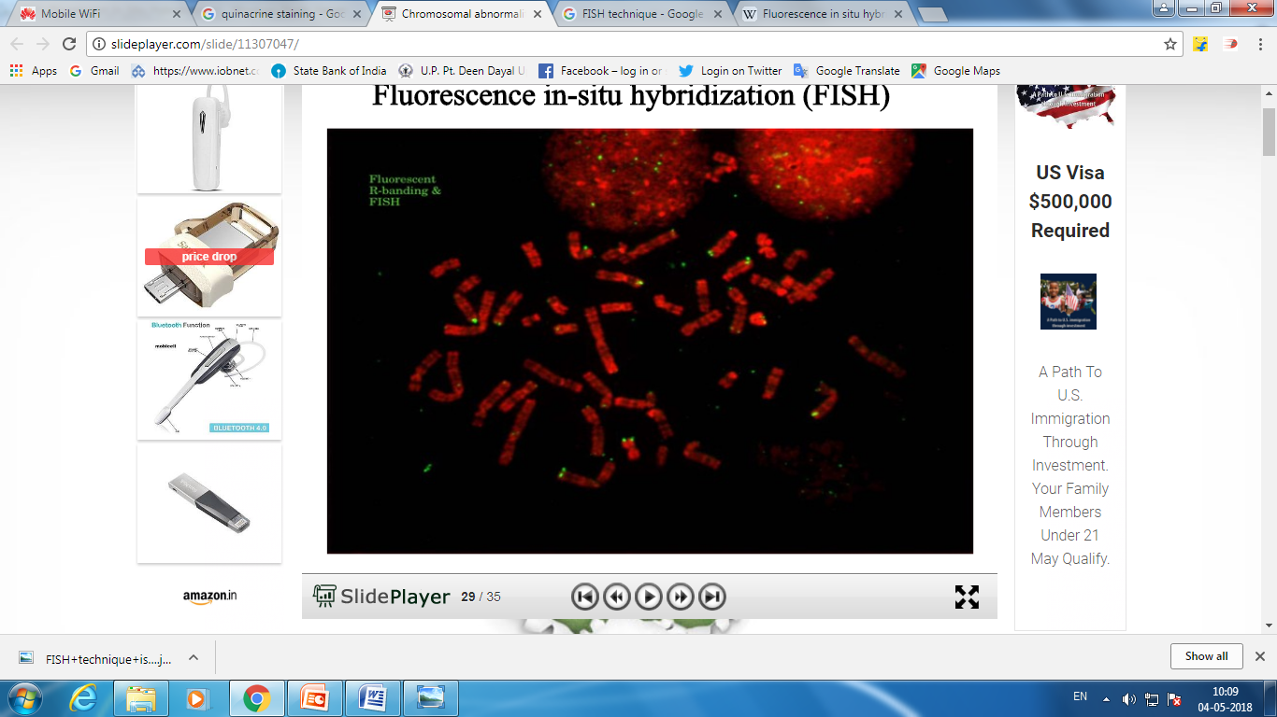
Double-labeled FISH
: more accurate and reliable than single-labeled FISH
and quinacrine staining (Han, 1993)

Slide 71
Sexed Semen Products Offered by Major A.I. Organizations
Organization | Product Label/Name | Stated % Females
ABS | ABS Sexation TM | 90
Accelerated Genetics | ACC-SS® (ACCESS Sexed Semen) | 90
Alta Genetics | Alta511 | 90
Genex /CRI | GenChoice 90TM GenChoice 75TM | 90 75
Select Sires | gender SELECTed TM | 90
Semex Alliance | Semexx TM | 90

Slide 72
- (ABS India) is part of Genus PLC –provider of bovine genetics and reproduction
- PUNE, India (April 28, 2016)— Genus ABS India
: Joint Venture (JV) collaboration with B G Chitale,
Bhilwadi
- new bull stud facility BRAHMA (Brahmanand
Nagar, District Sangli)
ABS India offers Sexcel™ (Sexed Semen)
Holstein, Jersey, Cross Breed, Murrah, Sahiwal, GIR
& Red Sindhi.
ABS India : represented in Bihar, Gujarat, Haryana, Punjab, Rajasthan, Tamilnadu, Uttar Pradesh (West), Uttar Pradesh (East), Uttar Pradesh (Central), Uttarakhand through authorised business associates and distributors

Slide 73
Uttar Pradesh
Indian’s Pharmacare Pvt. Ltd., Meerut
Kaamdhenu Cattle Breeder, Modi Nagar
Krishna Dairy, Azamgarh
V.K. Traders, Varanasi

Slide 74
Conclusion
Most ideal route for preselection of sex : Semen sexing
Variable accuracy and efficiency
- Flow cytometry is best till date
(relatively slow, and requires specialized, expensive
and immobile equipment and skilled operators)
Predetermine of sex of offspring from : 85–95%

Slide 75
Future prospects
Need to develop newer technique or modification in
flow cytometry method
With point of view as :
Lower cost
more Number of sperm sexed in less time
Less damaging effect
More accurate and more efficient
Need to evaluate more acceptable and effective
methods with better accuracy and low costs
- Can be applied in both humans and livestock

Slide 76
- Need to work on more advance techniques :
- CLASS
- Raman spectroscopy
- Zeta potential method
- Sperm chemotaxis
- Hyialuronic-acid sperm binding
- Real-time motile sperm organelle morphology
examination (MSOME)

Slide 77


