Slide 1

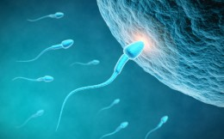
Major Credit seminar
Regulation of Male fertility by protein players on sperm membrane
Presented by -
Vikas Sachan
Ph.D. 1st yr.
Dept of Vet Gyn & Obst
DUVASU, Mathura

Slide 2
Overview
Introduction
What are the proteins on spermatozoa to regulate
its function
How they interact to each other
Their regulatory role on fertility
Conclusion

Slide 3
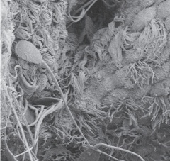
INTRODUCTION
Mammalian fertilization –
- Coordinated events like sperm deposition
- Anterior vagina in cow, sheep, dog
- Cervix in sow
- Uterus in horse and rodents
Complex interactions between the spermatozoa and
the female reproductive tract (sperm migration)
(adhesion/binding and release from oviduct)
(“ sperm race” is no longer a tenable hypothesis)
(Holt and Fazeli, 2016)
ZP binding and penetration and the fusion of sperm
with oocyte

Slide 4
Very less no. of sperm can cross the uterotubal junction
(UTJ) and reach to ampullary-isthmus junction (= 10%)
(Tokuhiro et al., 2012; Suarez, 2014)
Crossing/ migration through UTJ is a critical step
- Verified by using modified mice models
(Tokuhiro et al., 2012)
Passage through the oviduct - selective processes
- Eliminate poor quality sperms
- Regulate the numbers of sperm
- Reducing polyspermic fertilization
(Suarez, 2014)

Slide 5
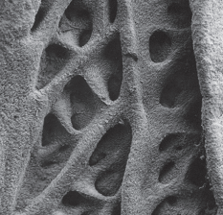
Uterotubal junction
- Tortuous and narrow – cattle / mice (Wrobel et al., 1993)
- Mucosal folds : cul-de-sac in cow (Yaniz et al., 2006)
- Sigmoid shape – bovine (Hafez & Black, 1969)
- Interdigitation of microvilli
- Smooth muscle contraction
- Wall fluid engorgement
- Mucus in cattle (Suarez et al., 1997)
Restricted entry of infectious agents and leukocytes
& Regulation of sperm entry

Slide 6
Sperm Factors for successful fertilization –
- Gene targeting studies in mice
Different sperm proteins (biochemical analyses)
- Migration, ZP binding and fusion
(Yamaguchi et al., 2006)
Certain proteins on sperm head plasma membrane
- Transit through uterotubal junction (UTJ)/ reach the
oviduct (Shen et al. , 2013; Fujihara et al., 2014)

Slide 7
In mice (Nakanishi et al. 2004, Yamaguchi et al., 2009)
In cattle (VanDemark & Moeller, 1951)
In sheep (Mattner & Braden, 1963)
In humans (Kunz et al., 1996)
In rabbits (Overstreet & Cooper, 1978)

Slide 8
The null mice models presenting
Adam 1 (Nishimura et al., 2004)
Adam 2 (Cho et al., 1998)
Adam 3 (Shamsadin et al., 1999)
Calmegin (CLGN ) (Yamagata et al., 2002)
Calreticulin (Ikawa et al., 2001)
Calsperin (CALR 3) (Holt and Fazeli, 2016)
Tpst2 (Marcello et al., 2011)
Pdilt (Tokuhiro et al., 2012)
tACE (Hagaman et al., 1998)
All are : Male infertility phenotypes (Marcello et al., 2011)

Slide 9
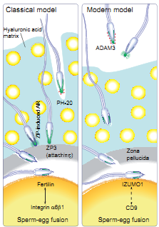
(Okabe, 2013)

Slide 10
The ADAMs (fertilin) – (sperm membrane proteins)
(zinc protease superfamily)
- Contain a disintegrin and metalloproteases domain
- 40 members of this family
- Distributed in a variety of tissues
- Testis/sperm-specific members
3 are predominantly expressed in the testis
ADAM1 (fertilin α / PH-30 α )
a disintegrin and metalloproteases domain 1
ADAM2 (fertilin β / PH-30 β)
a disintegrin and metalloproteases domain 2
ADAM3 (cyritestin)

Slide 11
All members of ADAM family –
- Membrane anchored
- Possess domains : pro, metalloprotease-like,
disintegrin, cysteine-rich, EGF repeat,
transmembrane, and cytoplasmic tail
In mice – Isoforms of ADAM1 - ADAM1a and ADAM1b
(Nishimura et al., 2002)
ADAM1a and 1b - resides in the endoplasmic reticulum
of TGCs (Kim et al., 2003)
ADAM2 - located on the plasma membrane overlying
the acrosome on mature sperm (Cho et al., 1998)

Slide 12
Bovine fertilin (complex of 2 membrane bound
sub units α and β)
α subunit is mapped to Adam1 (17th chromosome)
β subunit to Adam2 (27th chromosome)
Role for the disintegrin domain of fertilin β (removes
the pro- and metalloprotease domains, leaving N-
terminal disintegrin domains in processed form in
matured sperm surface in the epididymis)
… to the egg plasma membrane via an integrin (α6β1)
(Immunofluoroscence and immunoblotting)
(Almeida et al., 1995)

Slide 13
Both ADAM1a and ADAM1b - form a heterodimer with
ADAM2 (CLGN mediated)
ADAM1a/ADAM2 (t-fertilin)…. found (only in ER) in
testis / TGCs (Kim et al., 2006)
ADAM1b/ADAM2 (s-fertilin)…. on cauda epididymal
sperm surface (in ER & cell surface) (Kim et al., 2003)
ADAM3 - Sperm-surface protein
- Post-translational modification during the
epididymal transit (Kim et al., 2006)
- Bind directly to solubilized ZP
(as a biologically significant ZP ligand) (Kim et al., 2005)

Slide 14
t-fertilin (ADAM1a / ADAM2) disrupted mouse -
- Disappearance of ADAM3 (Nishimura et al., 2004 )
(no maturation of ADAM 3/no transfer from ER to
sperm surface) (Yamaguchi et al., 2006)
- Normal spermatogenesis in the testis
- Defects in migration Through UTJ
- Could not bind to zona pellucida (Stein et al., 2005)
ADAM2 - deficient mice
- Reduced levels of ADAM1b in TGC
- Reduced level of ADAM3 (cyritestin) in sperm
- No formation of ADAM1a/ADAM2 or
ADAM1b/ADAM2 (Nishimura et al., 2007)

Slide 15
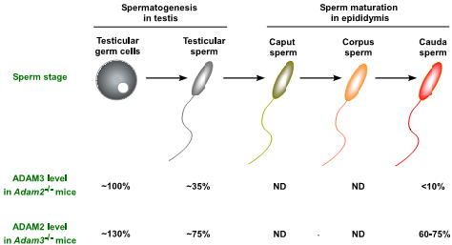
(Nishimura et al., 2007)

Slide 16
ADAM3 remained the same on ADAM1b/ADAM2
(s-fertilin) disrupted sperm (But not on t-fertilin
disrupted sperm)
t-fertilin is the crucial factor for sperm to acquire the
zona-binding ability (s-fertilin is not)
(Nishimura et al., 2004 )
Disruption of Adam3 - loss of zona-binding ability i.e.
ADAM3 is the most close factor involved in sperm
zona binding (Nishimura et al., 2004 )

Slide 17
Loss of ADAM3 from Adam2-null TGCs
- Occur in a post-Golgi compartment or
- By proteolytic release or
- Degradation
..…immediately upon arrival at the plasma membrane
(i.e. ADAM3 is present at normal levels on Adam2-null
TGCs but not in mature sperm)
ADAM2-ADAM3 complex - ZP ligand which bind to
directly to solublized ZP.
(By immunoblotting and immunoprecipitation)
(Nishimura et al., 2007)

Slide 18
Adam3 ^{−/−} spermatozoa (also Adam1a ^{−/ −} ) –
- Can fertilize ZP-intact eggs in vitro if they were
surrounded in cumulus oophorus cells
(Nishimura et al., 2004)
Spermatozoa lacking ADAM3 -
- Fertilize eggs effectively in vivo when capacitated
sperms were directly deposited into the oviduct (Tokuhiro et al., 2012)

Slide 19
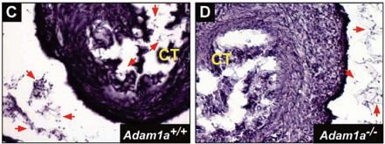
Adam1a and Adam2 knockout sperm (not Adam3 –null)
- Impaired in migration from the uterus to the oviduct

Slide 20
However, in Adam3-disrupted mouse line
- Normal Sperm migration into the oviduct
- No zona binding (Kim et al., 2005)
(observation by tagging sperm with transgenically
expressed green fluorescent protein (GFP) in sperm
acrosome, visualization of sperm in the oviduct by
fluorescence dissection microscopy)
(Nakanishi et al., 1999)

Slide 21
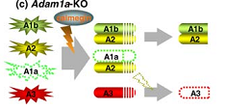
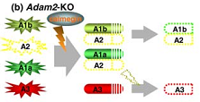
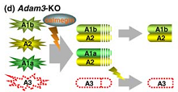

Slide 22
All these models converge in the lack of ADAM3 from
mature sperm surface
(cysteine-rich, glycosylated membrane protein)
(No uterotubal transport, no zona binding - infertility)
(Keizo et al., 2012)
Above phenotype may be compensated by tansgenically
expressed ADAM3 (Yamaguchi et al., 2009)

Slide 23
Both sperm–ZP binding and sperm–oviductal epithelium
binding consist of carbohydrate-mediate interactions
Endoglycosidase studies –
- Presence of sugars on bovine fertilin
(Waters and White, 1997)
While fertilin β-no potential carbohydrate-binding
domain
…… Possible that multiple proteins act in concert with
fertilin β to bind the oligosaccharide chain of ZP3 and
oviductal epithelium) (Nakanishi et al., 1999)

Slide 24
On surface fractions of TGCs -
- A complex of ADAM2 / ADAM3 / calnexin
(Nishimura et al., 2007)
Absence of Clgn, Adam1a, Adam2, Adam3,or Ace genes
- Might affect the binding of BSP to sperm
(Okabe, 2013)

Slide 25
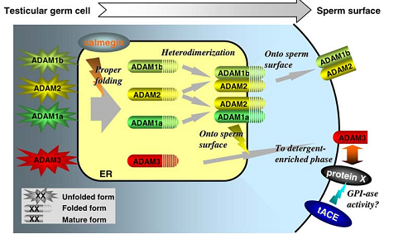
(Yamaguchi et al., 2006)

Slide 26
ADAM2 and ADAM3 regulates - protein expression or
integrity of the two sperm surface ADAMs
(ADAM5 and ADAM7) (Kim et al., 2006)
May have critical roles in the process of fertilization.

Slide 27
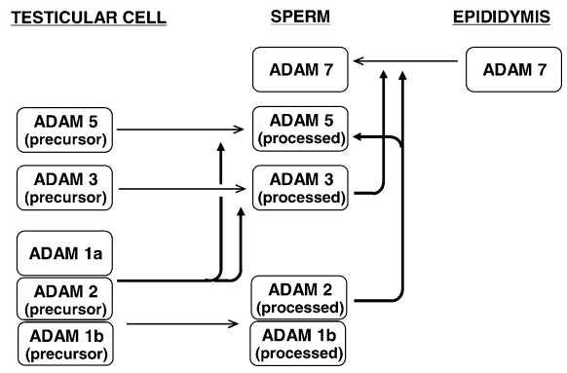
(Kim et al., 2006)

Slide 28
Calmegin (CLGN)
Calmegin (CLGN) testis-specific molecular chaperone
(= 95% to calnexin)
- Lies in the lumen/surface of rough ER
- Encoding gene on chromosome 17 in bovines (Hagaman et al., 1998)
- Expressed during spermatogenesis i.e. active in
testicular spermatogenic cells
- Absent in mature sperm (Yoshinaga et al., 1999)
Specifically interacts with ADAM1a, ADAM1b, ADAM2
(responsible for fertilin α and β expression)
(Ikawa et al., 2001)

Slide 29
Clgn - Deficient Mouse –
- ADAMs are Present in Testes But Not in Sperm
- No ADAM1a/ ADAM2 and ADAM1b/ ADAM2
heterodimer
(direct involvement : immunoprecipitation)
- No ADAM 3 expression on sperm surface
(Yamaguchi et al., 2006)
- No UTJ transit with No ZP binding (Nakanishi et al., 2004)

Slide 30
Calmegin-knockout sperm - May result in failure to
acquire such proteins required for oviduct epithelium
attachment may lead to failure of sperm entry
(Nakanishi et al., 2004)
Clgn-Deficient Mouse – normal tACE presence i.e. no
effect on tACE (Yamaguchi et al., 2006)
CLgn and CALR 3 (Calsperin)
- Maturation of ADAM 3 (Nishimura et al., 2007)

Slide 31
CLGN ^{-/-} sperms –
- unable to pass through the UTJ
(even with presence of wild-type sperm from the
same ejaculate)
…… Sperm must be individually responsible for their
passage into the oviduct (Nakanishi et al., 2004)
Transgenic GFP-tagged ‘‘green sperm’’ Clgn-knockout
mice (to trace the migration in oviduct) (Yamaguchi et al., 2009)

Slide 32
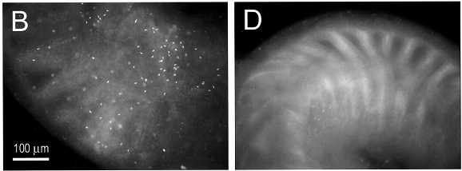
Clgn ^{+ / +} Clgn ^{- / -}
Sperms in oviduct; fluorescence;
(Nakanishi et al., 2004)

Slide 33
Clgn, Adam1a, Adam2, and tAce disrupted mouse line
- Normal morphology and motility (Ikawa et al., 2001)
- Failure of sperm migration into the oviduct
- Poor/no zona binding
- No fusion with oocytes (Yamagata et al., 2002)
INFERTILTY

Slide 34
PDILT
An ubiquitous PDIs (Protein disufide isomerase)
- Testis specfic PDI-like protein (PDILT)
(expressed in germ cells)
- Interact with CLGN and CALR 3 in TGC
- Role in maturation of spermatid protein
- Disulfide formation in the ADAM3
….… male fertility in vivo (van Lith et al., 2006)

Slide 35
PDILT knockout mice sperms
No Interaction with CLGN and CALR 3 in TGC
No PDILT/CALR3 complex
Lacking/ no maturation of ADAM3
No transportation to sperm surface
Can not migrate through the UTJ
(Sperm tagged with Acr3-EGFP & CAG/ su9-DsRed2)
Can not bind to the ZP
INFERTILE MALES (Tokuhiro et al., 2012)

Slide 36
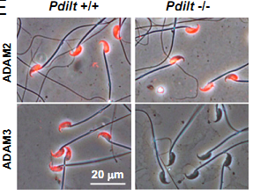
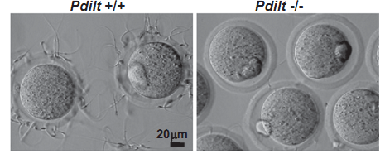
(Immunofluorescence staining; Tokuhiro et al., 2012)

Slide 37
Prss37
- Putative trypsin-like serine protease
- Exclusively expressed in the testis of adult mice
(immunohistochemistry, immunofluoresce)
- Especially in the elongating spermatids
i.e. during spermiogenesis
- Absent in mature sperms
- Regulate post-translational modification of ADAM 3
(Shen et al., 2013)

Slide 38
Mice deficient for Prss37 -
- Undisturbed testis development
- Normal mating activity,
- Normal spermatogenesis,
- Normal sperm morphology, and motility
BUT
- No expression of ADAM 3 on sperm surface
- Defect in sperm migration through oviduct
- Impaired zona binding
INFERTILITY
(Shen et al., 2013)

Slide 39
tACE / gACE
(testicular/germinal Angiotensin-converting enzyme)
Renin–angiotensin system (RAS)
- Regulates blood pressure (De Gasparo et al., 2000)
- Pancreas (Leung & Carlsson, 2001)
- Female & male reproductive systems
(Speth et al., 1999)

Slide 40
Location of RAS components as
- Angiotensinogen on Testis (Leydig cells); epididymis;
prostate
- Renin on Leydig cells; epididymis; prostate
- ACE on Leydig cells; seminiferous tubules;
epididymis; prostate; spermatozoa; seminal plasma
- Angiotensin II on Testis; epididymis; prostate;
seminal plasma
- Angiotensin receptors: AT1a, AT1b on Testis (Leydig
cells); epididymis; vas deferens; prostate; sperm

Slide 41
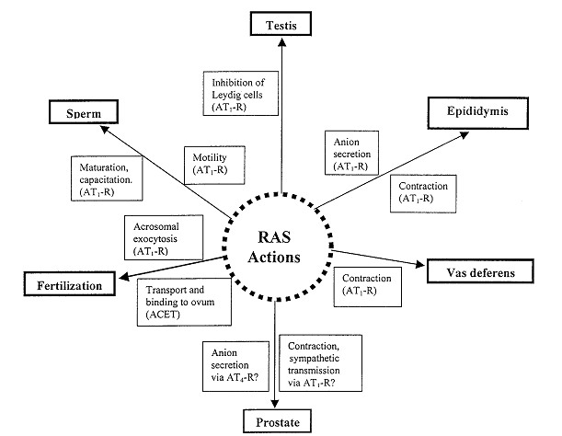

Slide 42
RAS system - isolated from the plasmatic RAS by the
blood testicular barrier
(which protects fertility from - AT1 blockers
- ACE inhibitors.
(Anthony et al., 2017)
Angiotensin I
(central action)
Angiotensin II
- Sperm survival
- In the bovine oviduct - local immunological
response against allogeneic sperms
(Modulating the phagocytic activity of neutrophils) (Marey et al., 2016)

Slide 43
ANG II
Physiomorphological alterations in the infundibulum, ampulla, and isthmus
Ideal micro-environment for
- Oocyte transport and maturation
- Sperm capacitation and transport
- Fertilization
- Early embryonic development
(Marey et al., 2016)

Slide 44
Study of ACE - Anti-ACE antibodies, radiolabeled ACE
inhibitors, simplified ACE assay
(Das and Soffer, 1976)
Affect many physiologic processes –
blood pres sure control, hematopoiesis,
reproduction, renal function , and
immune response (Kenneth et al., 2013)

Slide 45
Same gene encodes :
Two isozymes - sACE and tACE/gACE (Corvol et al., 2004)
Somatic ACE (sACE) - Vascular endothelium,
Epididymal epithelium,
Proximal tubules of the kidney,
Small intestinal epithelium,
Alveolar macrophages ,
Neuronal cells
In body fluids in a soluble form
(CSF/serum/semen etc)
…….Involvement in multiple biologic processes
(Metzger, 1999)

Slide 46
tACE/gACE (Testicular or Germinal ACE) –
Immunodetection (Zn peptidase)
MW 105 -110 kDa (mice)
MW 60-70 (Horse and Dog) (Me´tayer et al., 2002)
Peptidyl-dipeptidase A or kininase II or
CD143, or EC 3.5.15.1.
Immunologic approaches – catalytic domains
testis ACE (single domain)…… in male germ cells
somatic ACE (double domain) ….. in the epididymal
epithelium, cells of the vas deferens, seminal fluid (Kondoh et al., 2005)

Slide 47
tACE / gACE
- In developing (late pachytene) and mature sperms
- Seminal plasma, residual bodies, cytoplasmic
droplets of epididymal sperm (Köhn et al., 1998)
- Express in postmeiotic developing male germ cells
(found in round and elongated spermatids)
- no other tissue (Corvol et al., 2004)
Immunolocalization in spermatozoa
- Entire acrosome, except equatorial segment (Sabeur et al., 2001)
Evaluation of the enzymatic activity in the semen
of Holstein bulls (Deiler and Jacob, 2012)

Slide 48
Human spermatozoa - Acrosome or entire sperm head,
post-acrosomal region,
mid-piece, flagellum, equatorial
segment, and post-acrosomal
(Köhn et al., 1998)
Rat and mouse - Middle piece of testicular sperm
and principal piece of the flagella
(Metayer et al., 2002)
Rabbit - Around the heads of spermatids
and spermatozoa
(Brentjens et al., 1986)

Slide 49
Swine - Spermatids and cytoplasmic
droplets of epididymal sperms
(Yotsumoto et al., 1984)
Horse and dog - Periacrosomal region (Sabeur et al., 2001)
Bull - Periacrosomal region (Deiler and Jacob, 2012)

Slide 50
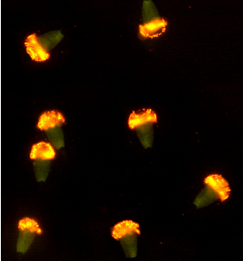
Immunolocalization of tACE on bovine sperm
(Mouse monoclonal antibody anti-ACE)
(Costa et al., 2012)

Slide 51
tACE -
- Potential ACE secretion in the seminal fluid (van Sande et al., 1985)
- ANG II, AT1 receptors are predominant in the
prostate, in vas deferens, but with low activity (Dinh et al., 2001)
- Role in fertilization
(since its levels increase during sperm capacitation)
(Köhn et al., 1995)

Slide 52
Highest ACE enzyme activity (rat)
- Epididymis and testes
(increased when mature sperms are first present) (Cushman and Cheung, 1971)
tACE - Absent in prepubertal animals
- Increase in pubertal
(i.e. expression of tACE...high testosterone)
(Deiler and Jacob, 2012)

Slide 53
tACE in fertilization –
- By GPI activity (not by dipeptidase) (Kondoh et al., 2005)
- By dipeptidase activity (not by GPI) (Deguchi et al., 2007)
Release of the extracellular portion of
glucose phosphate isomerase
glycosylphosphatidyl-inositol-anchored proteins(GPI)-
anchored proteins from membrane (Kondoh et al., 2005)
tACE exposes a ZP-binding factor by shedding GPI-
anchored proteins that block binding)
(Yamaguchi et al., 2006)

Slide 54
Transgenic tACE knockout mice with expressed sACE
- Normal sperm conc., motility & morphology
- Normal capacitation, AR
- Aberrant ADAM 3 modification during epididymal
maturation on sperm surface (Keizo et al., 2012)
- Impaired uterotubular migration (Deiler and Jacob, 2012)
- Reduced no. of sperms in oviduct (only 15%)
(Kessler et al., 2000)
- Reduced binding to the zona pellucida (4%)
(Yamaguchi et al., 2009)
- Severely compromised in ability to reproduce
(Esther et al.,1996)

Slide 55
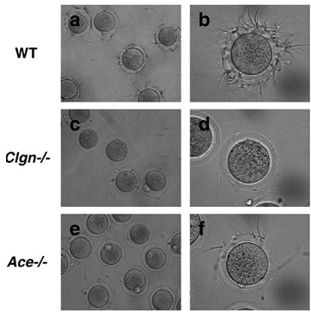
(Yamaguchi et al., 2006)

Slide 56
tACE – Important for release of sperm from oviduct
epithelium at capacitation (Hagaman et al., 1998)
Defects were rescued by introducing tACE (not sACE)
to the germ cells
…. Implicating tACE as crucial for male fertility (Kessler et al., 2000)

Slide 57
tACE release from sperm in the caput epididymis is
due to a serine protease (Sperm modification)
(Thimon et al., 2005)
Portion of tACE is released from spermatozoa during
- Passage up the female reproductive tract
- Capacitation
…. Increase its binding capacity to the ZP (Kamata et al., 2001)
… Contributing to fertilization in a dual mode
(Using immunoblotting, dipeptidase and GPIase assay)
(Deguchi et al., 2007)

Slide 58
AT1 receptors
- In primary spermatogonia and spermatid tails
- In the tail of non-capacitated sperm
- Head to tail distribution in capacitated sperm
(Vinson et al., 1995)
AngII (via an AT1 receptor-mediated mechanism )
- Induces AR only in capacitated sperm
- Maintain sperm motility (Vinson et al.,1996)
- Normal fertility (Tempfer et al., 2000)

Slide 59
Captopril ……. Inhibition of ACE
Reduced the production of angiotensin II
No activation of AT1 receptors
No stimulation of AR in capacitated sperms
in cattle (Gur et al., 1998)
in horses (Sabeur et al., 2000)
……..lower % progressive motility (Kaneko et al., 1984)
INFERTILE MALE

Slide 60
IZUMO1 - Only sperm protein which is proven to be
essential for sperm-egg fusion
- but has no ‘‘fusogenic peptide’’ domain
Testis specific tACE3 - identified as an IZUMO1-
interacting protein in sperm
May not interact with IZUMO1 because of their locations
localizations (Immunoprecipitation)
- Plasma membrane for tACE and acrosomal membrane
for IZUMO1
Interact after AR ……….. Sperm-Egg fusion
(Inoue et al., 2010)

Slide 61
Conclusion
Fertilization - very critical and interacting process
Sperm motility, concentration, morphology etc are not
last attributes to define the potential spermatozoa
Certain proteins on spermatozoa – interact and regulate
each other
Critical role in sperm passage through UTJ as well as
zona binding
Diagnosis of similar proteins on bovine spermatozoa
Actual molecular pathway – how they regulate the
fertility

Slide 62




