Slide 1
Pharmacology
of
Digestive System

Slide 2
Physiology and Anatomy of GI Tract
The anatomic structures: Oral cavity, Pharynx, Oesophagus, Stomach, Small intestine and Large intestine.
The digestive tract plays a role of bringing life-sustaining elements into the body, and taking waste products out of it.
Accessory organs (e.g., liver, gall bladder, salivary glands, and pancreas)

Slide 3
In addition to its main function of digestion and absorption of food, the gastrointestinal tract is one of the major endocrine systems in the body and has its own integrative neuronal network, the enteric nervous system.
Contains almost the same number of neurons as the spinal cord.

Slide 4
Control of GI Tract functions
The blood vessels and the glands (exocrine, endocrine and paracrine)
Neuronal Control
(Autonomic Nervous System)
Hormonal Control
Endocrine secretions (Peptides e.g. Gastrin, Cholecystokinin etc.) from endocrine cells in mucosa released in to blood stream
Paracrine secretions
(From special cells throughout the wall of tract)
Sympathetic
(Fight-or-flight response)
Parasympathetic
(Homeostatic response)
-
Cholinergic drugs
Anti-Cholinergic drugs
Intestinal motility
GI secretions
Relaxes sphincters
+
+
-
Intestinal motility
GI secretions
Relaxes sphincters

Slide 5
Neuronal Control
Two principal intramural plexuses in the tract:
Myenteric plexus (Auerbach’s plexus): between the outer, longitudinal and the
middle circular muscle layers (major nerve supply to the gastrointestinal tract and control the motility)
2) Submucous plexus (Meissner’s plexus): on the lumenal side of the circular
muscle layer
Plexuses are interconnected, and their ganglion cells receive preganglionic parasympathetic fibres from the vagus, which are mostly cholinergic and excitatory, although a few are inhibitory
Incoming sympathetic fibres are largely postganglionic.
In addition to innervating blood vessels, smooth muscle and some glandular cells directly, some sympathetic fibres may terminate in these plexuses, where they inhibit acetylcholine secretion.

Slide 6
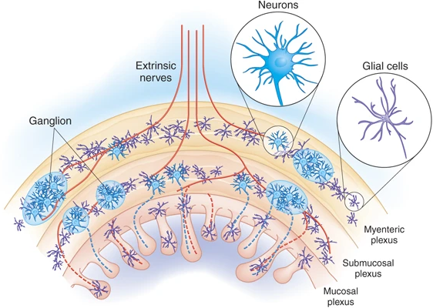
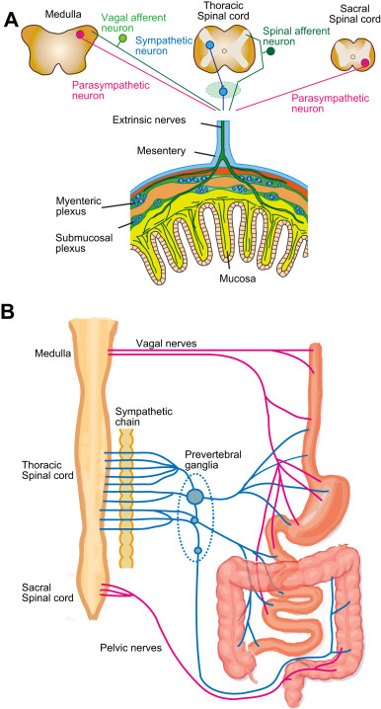
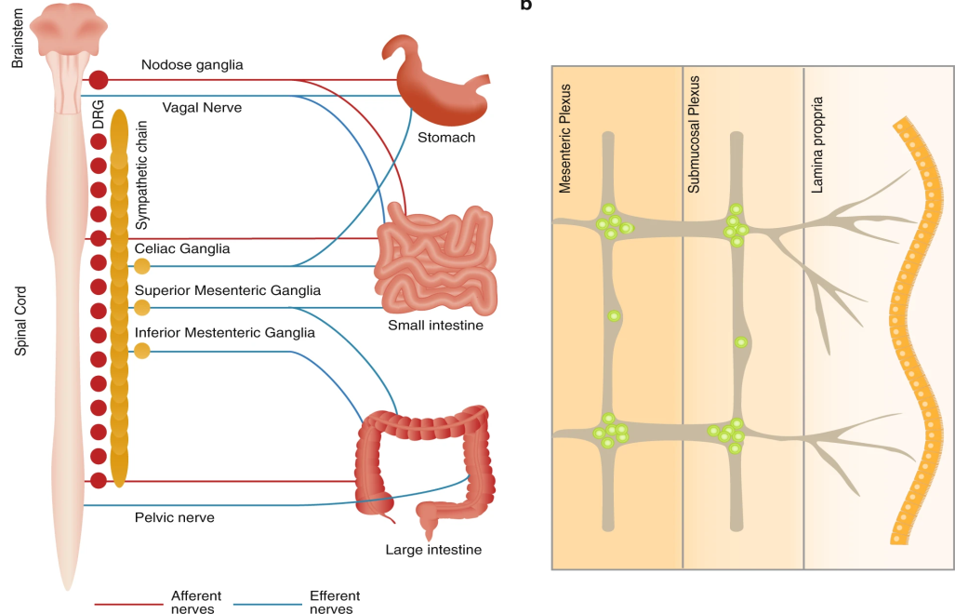

Slide 7
The neurons within the plexuses constitute the Enteric Nervous System and secrete
  Acetylcholine
  Noradrenaline
  5-hydroxytryptamine,
  Purines,
  Nitric oxide
  Other pharmacologically active peptides
The enteric plexus also contains sensory neurons, which respond to mechanical and chemical stimuli.

Slide 8
Gastrointestinal Drugs
Stomachics 6. Antacids and Antiulcers
Carminatives 7. Antizymotics
Emetics and Anti-emetics 8. Laxatives and Purgatives
Antidiarrhoeals
Cholorectics and Cholagogues

Slide 9
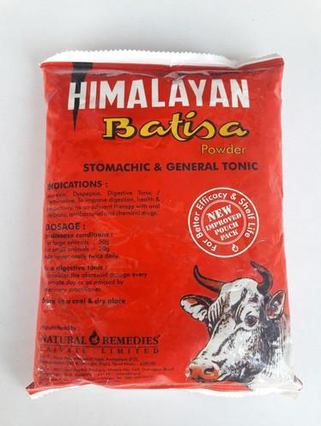
Stomachics
Promote the functional activity of stomach by increasing secretions and motility of GI Tract
Stomachic is a historic term for a medicine that serves to tone the stomach, improving its function and increase appetite. While many herbal remedies claim stomachic effects, modern pharmacology does not have an equivalent term for this type of action.
Herbs with stomachic effects:
Cannabis – गांजा
Anise – सौंफ़
Barberry – दारुहल्दी
Dandelion – ससांहपर्णी
Cleome – चतुर
Aloe – मुसब्बर

Slide 10
Veterinary stomachic powder available in market
1.Himalayn Batisa powder (IH)
2.Herminsa Powder (BBB)
3.Ruchamx Powder (Dabur)
Indications
For prevention and treatment of digestive disorders: Anorexia, Dyspepsia, (Indigestion, also known as dyspepsia) Constipation etc.
As an adjuvant therapy along with oral antibiotics, antibacterials, anthelmintics and other chemical drugs.
To improve ruminal digestion and farm productivity.
  **Administer orally twice daily with jaggery or sugary syrup

Slide 11
Drugs affecting Secretion
Salivary Secretion
Gastric Secretion
Saliva: Watery and frothy, continuous secretion in oral cavity from salivary glands
Water, electrolytes, mucus and enzymes (amylase – starch breakdown;
salivary lipase-fat digestion)
Moisten and formation of food bolus for easy swallowing
Salivary nuclei (brain) : regulate secretion
    Watery saliva: Parasympathetic NS
    Viscous: Sympathetic NS

Slide 12
Drugs affecting Salivary Secretion
Sialics (Salivary Stimulants)
(Sialogogues/Sialagogues / ptysmagogue/ptyalagogue)
Incresaes volume and fluidity of saliva
Antisialics (Salivary Inhibitors)
(Saliv. Suppressants/Antisialogogues)
Anticholinergics – Atropine (Glycopyrronium)/hyoscine
Antihistaminics - Diphenhydramine
Neuroleptics - Thioridazone
Appetite and digestibility
℞ Hypoptyalism/xerostomia
Gentian: Bitter in nature (Glycosides: Amarogentin, gentiopicrin, Gentisin, gentiopicroside and gentiamarin)
Stomachic, appetizer
Nux Vomica: Alkaloids (Strychnine, brucine)
Stimulate salivary and gastric secretion
Quassia: Terpenoid (Amaroid) i.e. Quassin
Large dose (vomition/irritation)
1. Indirect acting Sialics : e.g. Gentian, Nux vomica, Quassia
2. Direct acting Sialics : e.g. Carbachol, Arecoline
Cholinergic sialics: directly stimulate glands through Muscarinic receptors (No/little therapeutic effects)

Slide 13
Physiology of Gastric Acid Secretion
Gastric acid secretion is a complex and continuous process which regulates secretion of H⁺ from parietal (acid secreting) cells by three factors:
  Neuronal (Ach (M₃ receptors), GRP (BB₂ receptors)
  Paracrine (Histamine: H₂ receptors)
  Endocrine (Gastrin: CCK₂ receptors)

Slide 14
Physiology of Gastric Acid Secretion
The principal mediators that directly or indirectly control parietal cell acid output are:

Slide 15
HISTAMINE
Neuroendocrine cells abound in the stomach and the dominant type are the ECL cells (enterochromaffin-like cells; histamine-containing cells similar to mast cells) which lie close to the parietal cells.
Basal release of histamine ---- further increased by gastrin and acetylcholine.
Histamine acts in a paracrine fashion on parietal cell H₁ receptors, increasing intracellular cAMP.
These cells are responsive to histamine concentrations that are below the threshold required for vascular H₂ receptor activation.

Slide 16
GASTRIN
Synthesised by G cells in the gastric antrum and secreted into the portal blood (i.e. it acts in an endocrine fashion).
Stimulate acid secretion by ECL cells through its action at gastrin/cholecystokinin (CCK)₂ receptors, which elevate intracellular Ca₂₊ gastrin receptors.
CCK2 receptors are blocked by the experimental drug Proglumide weakly inhibits gastrin action.
Gastrin also stimulates histamine synthesis by ECL cells and indirectly increases pepsinogen secretion, stimulates blood flow and increases gastric motility.
Release controlled by both neuronal transmitters and blood-borne mediators, as well as by the chemistry of the stomach contents.
Amino acids and small peptides directly stimulate the gastrin-secreting cells, as do milk and solutions of calcium salts, explaining why it is inappropriate to use calcium-containing salts as antacids.

Slide 17
ACETYLCHOLINE
Acetylcholine (together with a battery of other neurotransmitters and peptides), released from postganglionic cholinergic neurons, stimulates specific muscarinic M₃ receptors on the surface of the parietal cells.
Elevates intracellular Ca²⁺ and stimulate the release of protons.
It also has complex effects on other cell types; by inhibiting somatostatin release from D cells,
It potentiates its action on parietal cell acid secretion.

Slide 18
PROSTAGLANDINS
Most cells of the gastrointestinal tract produce prostaglandins
The most important being PGE₂ and I₂.
Prostaglandins exert ‘cytoprotective’ effects on many aspects of gastric function including increasing bicarbonate secretion (EP1/2 receptors),
Increases the release of protective mucin (EP₄ receptor), reducing gastric acid output probably by acting on EP2/3 receptors on ECL cells and prevent the vasoconstriction (and thus damage to the mucosa) that follows injury or insult.
Action mediated through EP2/4 receptors.
Misoprostol is a synthetic prostaglandin that probably exploits many of these effects to bring about its therapeutic action.

Slide 19
SOMATOSTATIN
This hormone is released from D cells at several locations within the stomach. By
acting at its somatostatin (SST)₂ receptor, it exerts paracrine inhibitory actions on
gastrin release from G cells, histamine release from ECL cells, as well as directly
on parietal cell acid output.

Slide 20
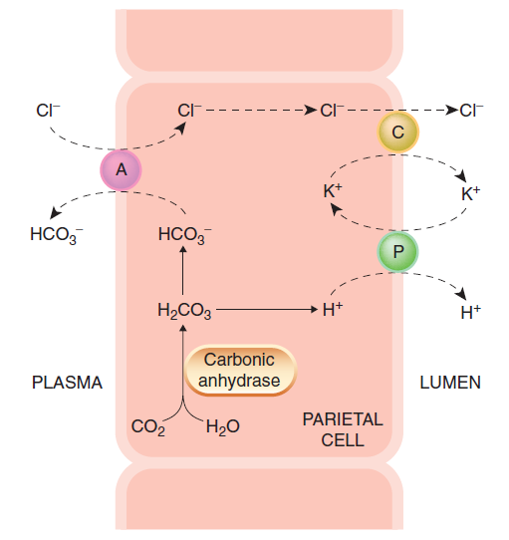
REGULATION OF ACID SECRETION BY PARIETAL CELLS
A schematic illustration of the secretion of hydrochloric acid by the gastric parietal cell. Secretion involves a proton pump (P), which is an H⁺-K⁺-ATPase, a symport carrier (C) for K⁺ and Cl⁻, and an antiport (A), which exchanges Cl⁻ and HCO₃⁻. An additional Na⁺/H⁺ antiport situated at the interface with the plasma may also have a role

Slide 21
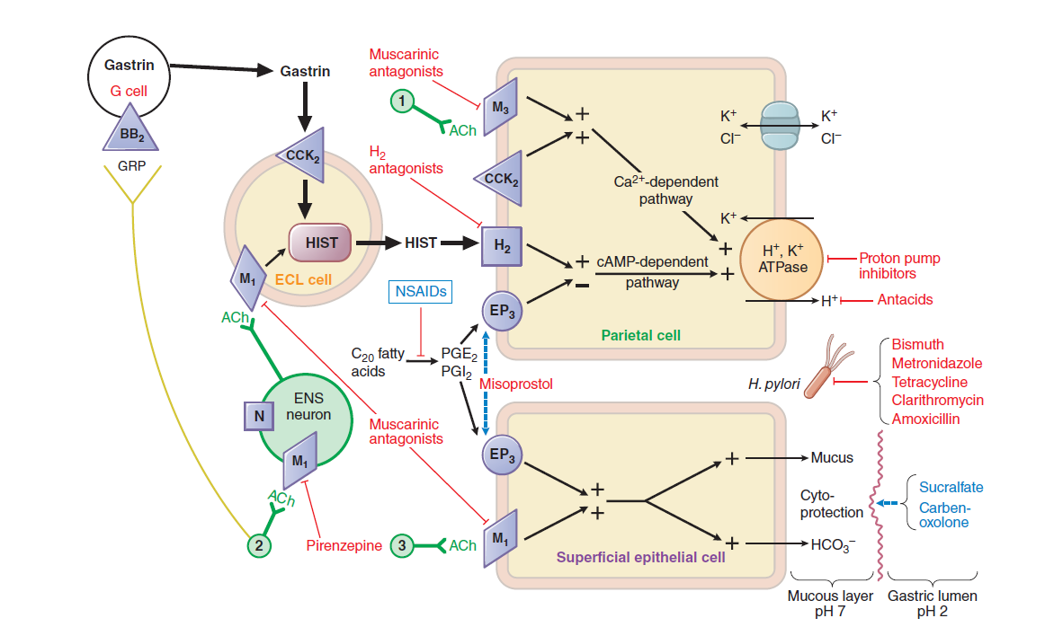
Physiology of Gastric Acid Secretion

Slide 22
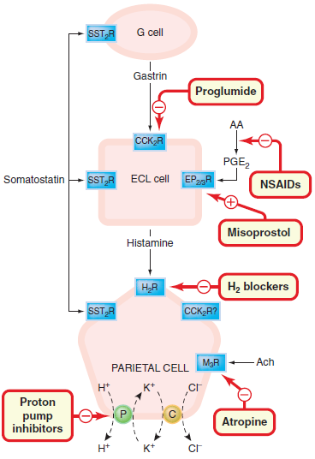
Schematic diagram showing the regulation of the acid-secreting gastric parietal cell, illustrating the site of action of drugs influencing acid secretion. The initial step in controlling physiological secretion is the release of gastrin from G cells. This acts through its CCK2 receptor on ECL cells to release histamine and may also have a secondary direct effect on parietal cells themselves, although this is not entirely clear. Histamine acts on parietal cell H2 receptors to elevate cAMP that activates the secretion of acid by the proton pump. Direct vagal stimulation also provokes acid secretion and released acetylcholine directly stimulates M3 receptors on parietal cells. Somatostatin probably exerts a tonic inhibitory influence on G cells, ECL cells and parietal cells, while local (or therapeutically administered) prostaglandins exert inhibitory effects
predominately on ECL cell function.

Slide 23
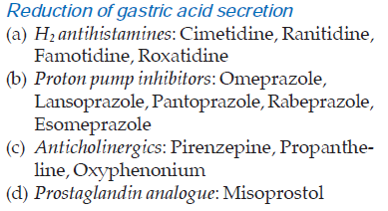
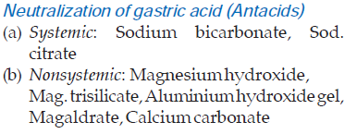

Approaches for Treatment of Acidity

Slide 24
Zollinger-Ellison Syndrome
It is a gastric hypersecretory state due to a rare tumour secreting gastrin.
Zollinger-Ellison syndrome develop pancreatic or duodenal gastrinomas that stimulate the secretion of very large amounts of acid, sometimes in the setting of multiple endocrine neoplasia, type I
This can lead to severe gastroduodenal ulceration and other consequences of uncontrolled hyperchlorhydria.
PPIs are the drugs of choice, usually given at about twice the routine dosage for peptic ulcers (omeprazole, esomeprazole, lansoprazole, rabeprazole, or pantoprazole
If PPIs are unable to control gastric acid secretion, the long-acting somatostatin
analogue octreotide (off-label indication) can be given to inhibit secretion of gastrin.

Slide 25
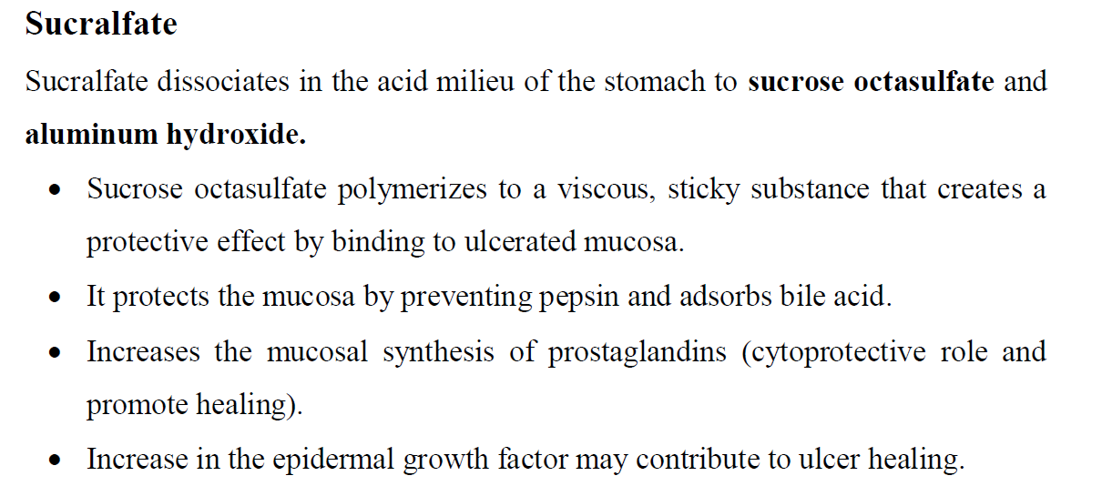
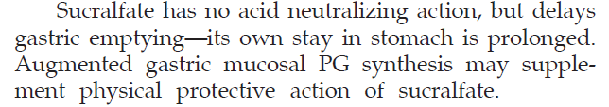
Ulcer Protectives

Slide 26
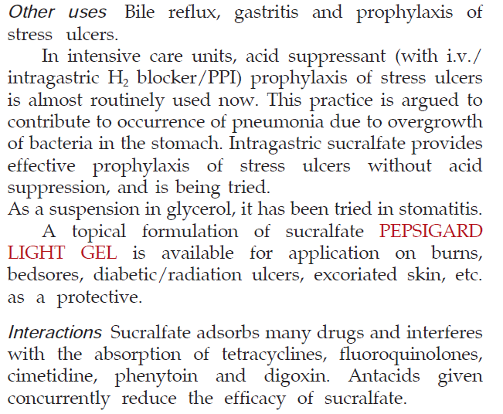
Ulcer Protectives

Slide 27
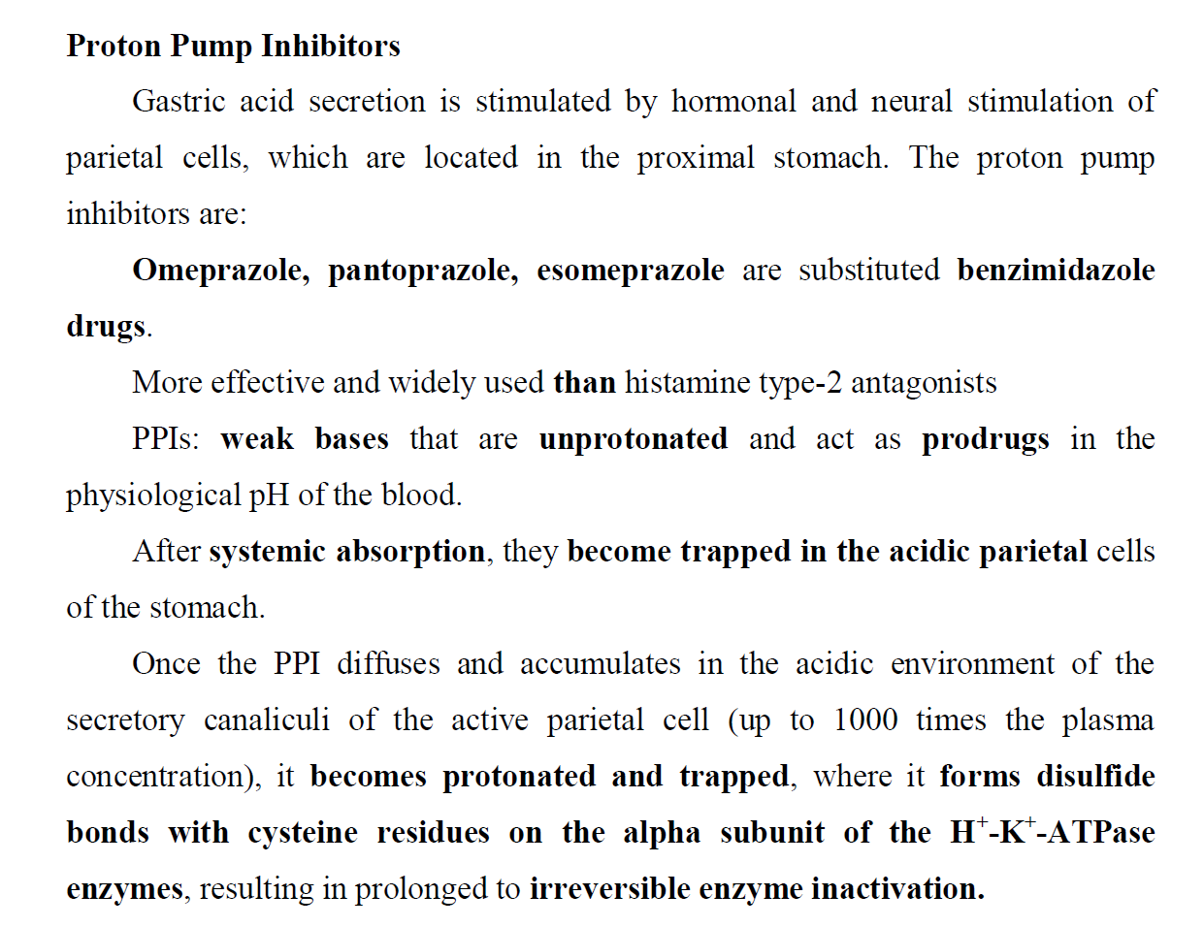

Slide 28
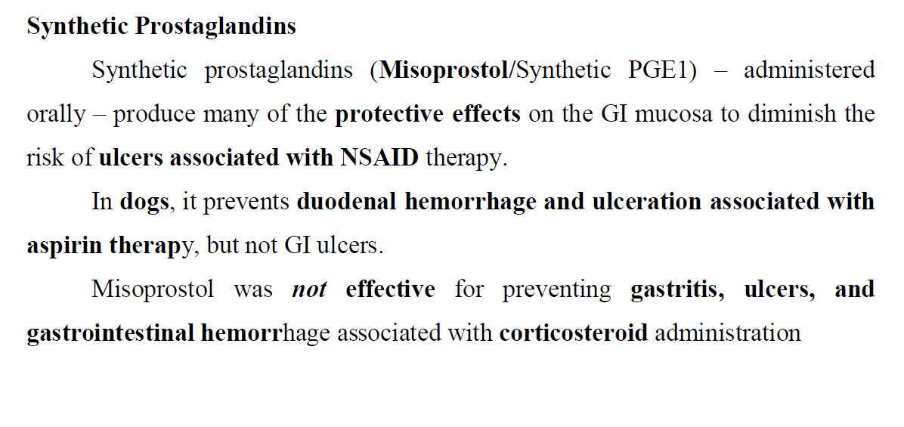

Slide 29
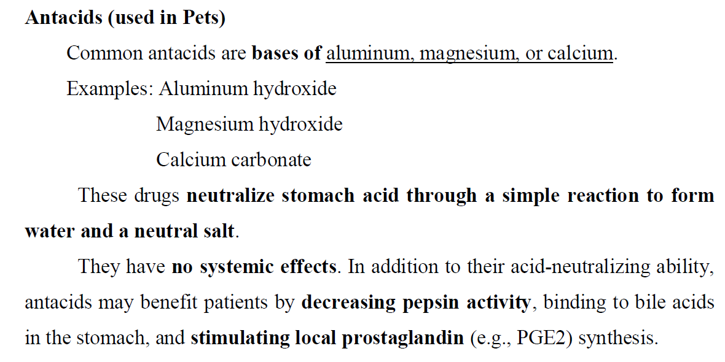

Slide 30
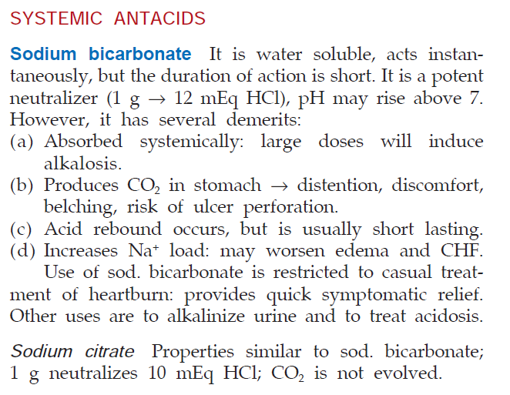

Slide 31
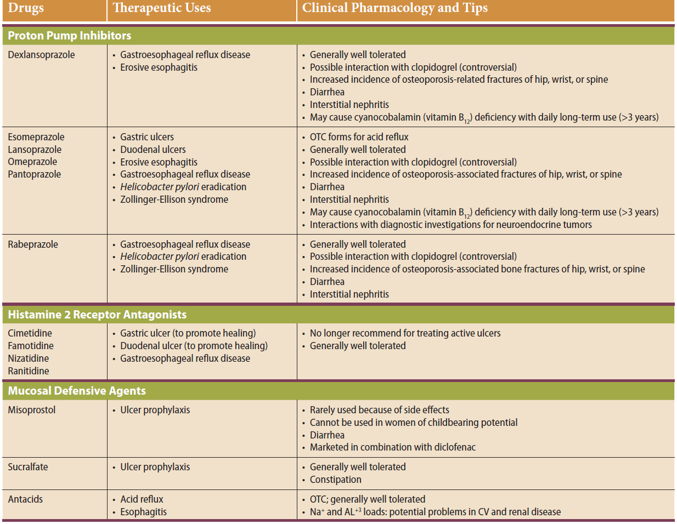

Slide 32
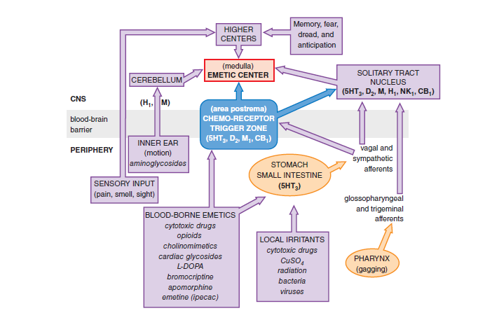
Emetics and Anti-emetics

Slide 33
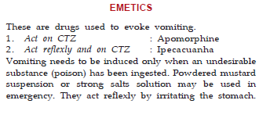
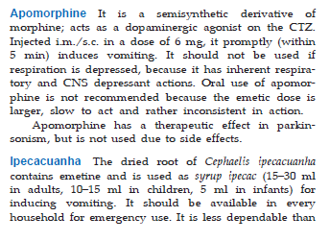


Slide 34
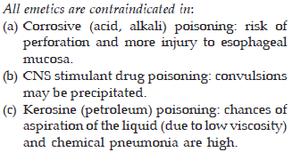
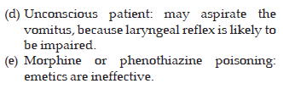

Slide 35
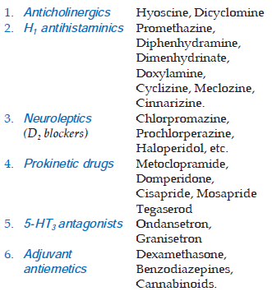
Anti-emetics

Slide 36
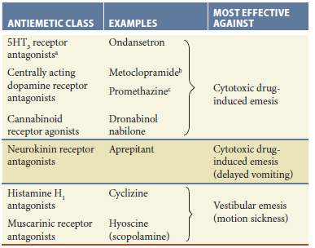

Slide 37
Classification of Anti-Emetics
Locally/Peripherally acting
Demulscents and protectants: Kaolin, pectin and bismuth salts
Gastric antacids and local anesthetics: Mg(OH)₂, Al(OH)₃, Benzocaine
Anticholinergics: Glycopyrronium, methscopolamine, propatheline
Prokinetics: Domperidone, Cisapride
(D₂ receptor antagonists)
Centrally acting
1) H₁-receptor antagonists: Meclozine, cyclizine, cinnarizine, diphenhydrinate, promethazine
2) D₂-receptor antagonists:
  Phenothiazine derivatives: Chlorpromazine, prochlorperazine, acepromazine
  Butyrophenones: Droperidol, haloperidol
  Benzamides: Metoclopramide, trimethobenzamide, alizapride
3) 5HT₃-receptor antagonists: Ondansetron, granisetron, tropidetron, dolasetron, palonosetron, cyproheptadine
4) Muscarinic receptor antagonists: Hyoscine, dicycloverine, aminopentamide
5) NK₁ receptor antgonists: Aprepitant, maropitant, casopitant
6) Miscellaneous:
  Glucocorticoids: Dexamethasone, methylprednisolone
  Benzodiazepines: Diazepam, Lorazepam, midazolam
  Cannabinoids: Dronabinol, nabilone

Slide 38
Locally/Peripherally acting
Demulscents and protectants:
  Limited therapeutic action
Coat, protect, lubricate and sooth the irritated mucosa.
Suppress emetic stimuli originating from gastric mucosa.
2) Gastric antacids and local anesthetics:
Indicated when gastric acidity contributes vomition.
Desensitize gastric mucosa from irritating gastric acid
Anticholinergics:
    Used which do not cross BBB
    Inhibit afferent vagal impulses
    Inhibit GIT secretion
    Relief from GIT smooth muscle spasm
    (Delays gastric emptying, should not be used more than 3 days)

Slide 39
Prokinetics:
Promotes gastroduodenal peristalsis and accelerate gastric emptying
Domperidone: Prokinetic and antiemetic (IV, IM, PO and Rectal)
Inhibit D₂ receptors
Stimulate gastric motility of stomach and CTZ (not protected by
BBB)
  Antiemetic effect Lower than Metoclopramide (Acts both central and peripheral)
  Used in combination with Metoclopramide and cyclizine and Granisetron (5HT₃ receptor antagonists)
Cisapride: Structurally related to procainamide
Effect similar to domperidone and metoclopramide
Antidopaminergic but does not act on CTZ
Stimulate 5HT₄ of stomach

Slide 40
Centrally acting
(Block impulses at higher centres and/or emetic centre)
H₁-receptor antagonists: Prevention and treatment of Motion sickness and Emesis
Central antihistaminic, anticholinergic and CNS depressant activity
Depress labyrinth excitability and vestibular stimulation and affect CTZ
D₂ receptor antagonists: Block D2 receptors on CTZ and antagonize apomorphine-
induced vomition
Used in nausea and vomition induced by Drugs, General anesthesia, malignancy, cancer chemotherapy, radiation sickness and systemic diseases
Not useful in motion sickness, labyrinthitis and vestibular pathways
mediated vomition (these pathways do not involve dopaminergic neurons)

Slide 41
5HT₃-receptor antagonists:
Used in chemotherapy induced nausea and vomiting
Ondansetron: Prototype of this class
Used in emesis induced by asplastin (Potent emetogen),
chemotheray induced and radiation induced emesis
Acts on serotonin receptors found on terminals of Vagus nerve and certain areas of brain like CTZ and solitary tract nucleus
NK1 receptor antagonists: Antidepressants, anxiolytic and antiemetic (acute and motion sickness)
Nk1 are tachykinin receptors
Found in both CNS and PNS
Substance P associated with NK1 leads to pain, stress, emesis,
contraction of SM and inflammation

Slide 42
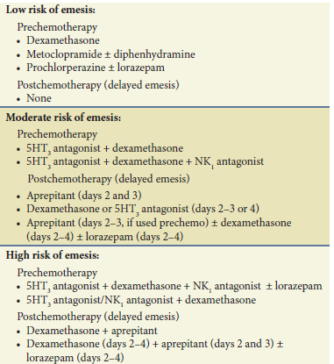
Antiemetic agents in Cancer chemotherapy

Slide 43
DRUGS AFFECTING APPETITE
Appetite is regulated by Hunger and Satiety centres in Hypothalemic nuclei and other components of limbic system.
Neurotransmitters involved in control of appetite:
Nor-epinephrine (alpha 2 receptors)
Dopamine (D1 receptor)
Serotonin
GABA
Neuropeptides involved to increase appetite
Endocannabinoids
Endogenous opioid peptides
Pancreatic peptides
Neuropeptides involved to inhibit appetite
Calcitonin
CCK
Corticotropin releasing factor

Slide 44
Appetite stimulants: K/a Orexigenics/appetisers
In monogastric animals: Short term stimulation of appetite
e.g. Benzodiazepines: Oxazepam (PO: Cats, Dogs, Horses, Goats),
Diazepam (PO and Parenteral: Cats and Dogs)
(Alleviate anxiety/inhibit satiety centre)
Cyproheptadine: H1 blocker with antiserotonin action (inhibit serotonergic
receptors)
Glucocorticoids (Prednisone, prednisolone, dexamethasone) fast onset
Anabolic steroids (Synthetic analogue of testosterone): Protein anabolic activity, Stanozolol, Boldenone undecylenate
Vitamin B, Fish oil (Eicosapentaenoic acid), Mirtazapine (tetracyclic
antidepressants), Dronabinol (Synthetic cannabinoid)

Slide 45
Appetite Suppressants:
Anorexiants, Anorectic or anorexigenic agents
Stimulate satiety centre in medial hypothalamus and block impulse reaching the eating centre in lateral hypothalamus
Increase plasma free fatty acids which depresses eating centre
Not used in veterinary practice
e.g. Amphetamine

Slide 46
DRUGS AFFECTING GI MOTILITY
Prokinetics
Antispasmodics/spasmolytics
Laxatives and Purgatives
Antidiarrhoeal Drugs

Slide 47
Prokinetics
Stimulate contractions in gastropyloroduodenal area of GIT
Accelerate gastric emptying
Used in gastric/gatroduodenal motility disorders
a) vomiting not associated with feeding
b) Anorexia, indigestion, belching, post-prandial
discomfort, gastro-esophageal reflux (associated with
oesophagitis and ulcers)

Slide 48
Prokinetics increases-
Tone of lower oesophageal sphincter (Inhibit GIT reflux)
Gastric emptying (improve gastroparesis and functional dyspepsia)
Intestinal motility (increased peristalsis)

Slide 49
Gastric motility influenced by
Neurons
Cholinergic neurons (Stimulate)
Adrenergic neurons (Inhibit)
Enteric Nervous system (Dopamine and Serotonin)
2) Neurotransmitters and modulators
Dopamine (D₂ receptors)
Inhibit fundus movement
Reduces amplitude of contractions
Delays gastric emptying
Inhibit ACh release which mediates gastric dilatation/lower
oesophageal sphincter relaxation
Serotonin (5-HT₄ receptors)
  Enhances ACh release from myenteric plexus
  Motilin (Motilin receptors) a GIT peptide
  Stimulate gastric emptying and post prandial gastric contraction in antrum and duodenum

Slide 50
Classification of Prokinetics
D2 receptor antagonists
Metoclopramide, domperidone, bromopride, alizapride, clebopride
2) 5-HT4 receptor agonists
Cisapride, tegaserod, prucalopride, mosapride, cinitapride
3) Motilin like drugs
Erythromycin
4) H2 receptor antagonists
Ranitidine, nizatidine
5) Prostanoids
Misoprostol

Slide 51
Antispasmodics/spasmolytics
Relieve spasms of smooth muscles in GIT
Two Main group of drugs
Drugs affecting autonomic innervations (Anticholinergics/parasympatholytics)
Drugs directly affecting smooth muscle function
Indications and therapeutic uses
- Irritable bowel syndrome
- flatulence, distension of the abdomen (meteorism)
- Smooth muscle spasms
Analgo-spasmolytics: in painful smooth muscle spasms like biliary, renal and intestinal colics (also in spastic dysmenorrhoea)

Slide 52
Anticholinergics/parasympatholytics
Anticholinergics:
Antagonists on both M and N receptors
Spasmolytic effects on both smooth muscle and sphincters
Quarternary amines: low/slow absorption
e.g. Otilonium and fenpiverine
Parasympatholytics (Antimuscarinics)
M receptor antagonists
Spasmolytic on smooth muscle but opposite effect on sphincters
e.g. Atropine, trospium, tolterodine

Slide 53
Drugs directly affecting smooth muscles
Calcium channel inhibitors
Potassium channel activators
Stimulation of NO synthesis
e.g. Papaverine
Drotaverine
Mebeverine
Alverine

Slide 54
Laxatives and Purgatives
Classification
1. Bulk laxatives: dietary fiber- bran, methgylcellulose, isapagula.
2. Stool softeners: docusates, liquid paraffin
3. Stimulants (irritant): bisacodyl, sodium picosulphate, phenophthelein
Anthraquinone derivatives- senna, cascara sagrada.
4. Osmotic laxatives: MgSO₄⁻, MgOH, NaPO4⁻, NaSO₄, sodium potasium tartarate, lactulose, PEG.
5. 5-HT4 agonist: Prucalopride

Slide 55
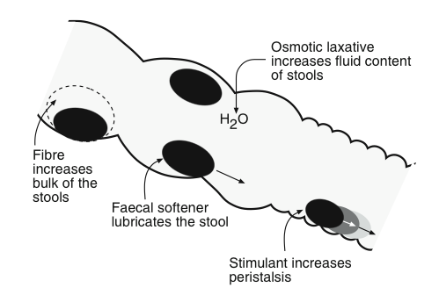
Laxatives and Purgatives

Slide 56
Bulk forming laxatives
Indigestible, hydrophilic substances like bran, agar, methylcellulose, ispaghula etc.
Absorb water, swell up and increase the bulk of stools.
Cause mechanical distension so stimulate peristalsis and promote defaecation.
Large amount of water should be taken with bulk laxatives to avoid intestinal obstruction.

Slide 57
Stool softeners
Docusates: dioctyl sodium sulphosuccinate, dioctyl calcium sulphosuccinate and dioctyl potassium sulphosuccinate.
Anionic detergents, lower surface tension of stool, accumulates fluids and fatty substance thus softening the stool.
Administered orally or as retention enema.
Should not be given with liquid paraffin, because increase absorption of it.

Slide 58
Liquid paraffin is a mineral oil, administered orally.
Soften stools.
Has lubricant effects.
Useful in patients with cardiac disease, because it prevent straining.
Adverse effects: lipid pneumonia, so avoided at bed time and in laying position.
Long term use cause malabsorption of vitamins.

Slide 59
Stimulant laxatives
Phenophtaelein, bisacodyl, sodium picosulfate, anthraquinone derivatives,
These agents have direct action on enteric neurons and GI mucosa.
Increase prostaglandin and cAMP levels, inhibit Na⁺, K⁺-ATPase activity in intestinal mucosa.
Increase secretion of water and electrolytes by intestinal (colon) mucosa thus stimulating peristalsis.
Contraindicated in pregnancy.

Slide 60
Stimulant laxatives
-Increases intestinal motility
-Irritate the GI mucosa and pull water into the lumen
-Indicated for severe constipation where more rapid effect is required (6-8 hours)
Castor Oil - From the Castor Bean
Senna - Plant derivative
Bisacodyl
Lubiprostone -PGE1 derivative that stimulates chloride channels, producing chloride rich secretions

Slide 61
Osmotic/saline laxatives
Most powerful and rapid acting laxatives.
Salts of magnesium, sodium or potassium.
Given orally, not absorbed from gut, remain in lumen and exert osmotic effect, draw water in lumen, distend the bowel, stimulates peristalsis.
Sodium phosphate used in enema before surgery.
Should be avoided in cardiac patients.

Slide 62
Osmotic/saline laxatives
Effective in 1-3 hours
Used to purge intestine (e.g. surgery, poisoning)
Fluid is drawn into the bowel by osmotic force, increasing volume and triggering peristalsis
Nondigestible sugars and alcohols
        Lactulose (broken down by bacteria to acetic and lactic acid, which causes the osmotic effect)
Salts
        Milk of Magnesia (Mg(OH)2)
        Epsom Salt (MgSO4)
        Glauber’s Salt (Na2SO4)
        Sodium Phosphates (used as enema)
        Sodium Citrate (used as enema)
Polyethylene glycol

Slide 63
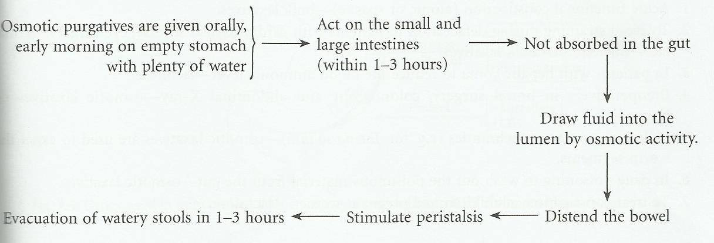
Osmotic laxatives/purgatives mechanism

Slide 64
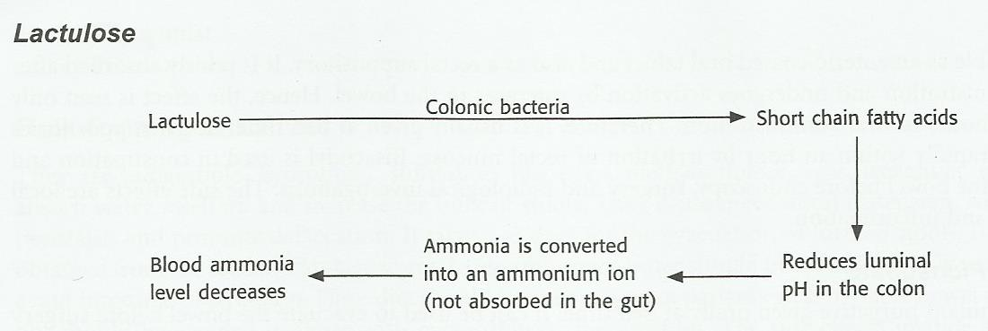
Mechanism of lactulose

Slide 65
Uses of laxatives
Acute functional constipation-bulk laxatives
To avoid straining during defecation-bulk laxatives
Hepatic comma, to reduce NH₃ levels-lactulose
Surgery/x-ray, colonoscopy-osmotic laxatives
Anthelmintics-osmotic laxatives
Drug poisoning-osmotic laxatives
Pregnant women/ children-lactulose.

Slide 66
Constipation, surgery, hernia.
Hepatic coma
Preoperatively in bowel surgery, colonoscopy, abdominal x-ray
Drug poisoning

Slide 67
Laxative Abuse
Most common cause of constipation!
Longer interval needed to refill colon is misinterpreted as constipation
    => repeated use
Enteral loss of water and salts causes release of aldosterone
    => stimulates reabsorption in intestine, but increases renal excretion of K+
      => double loss of K+ causes hypokalemia, which in turn reduces peristalsis.
        =>This is then often misinterpreted as constipation
        => repeated laxative use

Slide 68
Anti-diarrhoeal agents
Diarrhoea: frequent passage of liquid or semisolid stools is called diarrhoea.
OR
Abnormal frequent passage of loose stools
or
Abnormal passage of stools with increased frequency, fluidity, and weight, or with increased stool water excretion

Slide 69
Causes: enteric infection, food toxins, malnutrition, inflammation, drugs like reserpine, prostaglandins, metoclopramide, domperidome, cholinergic drugs, quinidine and purgatives.
Dysentery: abdominal pain and passage of bloody stools and mucous due to infection or inflammation.

Slide 70
Agents can cause diarrhoea
Non specific agents:
Fear
Anxiety or apprehension
Ingestion
Traveling
Acute diarrhoea
Chronic diarrhoea

Slide 71
Acute Diarrhea
Sudden onset in a previously healthy person
Lasts from 3 days to 2 weeks
Self-limiting
Resolves without sequelae
Chronic Diarrhea
Lasts for over 3 to 4 weeks
Associated with recurring passage of diarrheal stools, fever, loss of appetite, nausea, vomiting, weight loss, and chronic weakness

Slide 72
Acute Diarrhea Chronic Diarrhea
Bacteria Tumors
Viral Diabetes
Drug-induced Addison’s disease
hyperthyroidism
Nutritional Irritable bowel syndrome
Protozoal

Slide 73
Management of diarrhoea
1. Non-specific therapy:
a) Oral and parenteral rehydration
b) Anti-motility and anti-secretory agents:
i) Opioids: codeine, diphenoxylate, loperaminde
ii) α-adrenergic receptor agonist: clonidine
iii) Octreotide.
2. Specific therapy: Antimicrobial agents
3. Antispasmodics: Atropine & oxyphenonium (antrenyl)
4. Adsorbants: Kaolin, pectin and chalk, bismuth subsalicylate

Slide 74
Non-specific therapy
Oral rehydration solution (ORS):
2.6 g NaCl, 1.5 g KCl, 2.9 g sodium citrate, 13.5 g glucose dissolved in 1 liter of water.
Super ORS:
(boiled rice powder used instead of glucose)-also decreases frequency of diarrhoea along with rehydration.

Slide 75
Antimotility and antisecretory agents
Codeine: opium alkaloid, reduces GI motility, also have antisecretory effects.
Diphenoxylate: structurally related to pethidine, combined with small doses with atropine, side effects are constipation, paralytic ileus, banned in many countries.
Loperamide: opiate analogue and importantant antidiarroeal than morphine.
Interact with µ-receptor in the gut, reduces GI motility and increase anal sphincter tone.

Slide 76
Opiates
Decrease bowel motility and relieve rectal spasms
Decrease transit time through the bowel, allowing more time for water and electrolytes to be absorbed
Examples: paregoric, opium tincture, codeine, loperamide, diphenoxylate

Slide 77
Antimotility and antisecretory….
loperamide poorly penetrates BBB and has no abuse potential. Can use in acute and chronic and traveller’s diarrhoea.
Adverse reactions:
Skin rashes, headache, and paralytic ileus, should not be used in children <4 years of age. Should be avoided in infectious diarrhoeas, avoided in IBD.

Slide 78
Antimotility and antisecretory…
Clonidine: it has antimotility and antisecretory activities, used in diabetics with autonomic neuropathy,
Octreotide: analogue of somatostatin, inhibits 5-HT & VIP, gastrin, used in refractory diarrhoea in patients with AIDS.
Racecadotril: inhibits degradation of enkephalins, used in acute secretory diarrhoeas.
Side effects: nausea, vomiting, drowsiness.

Slide 79
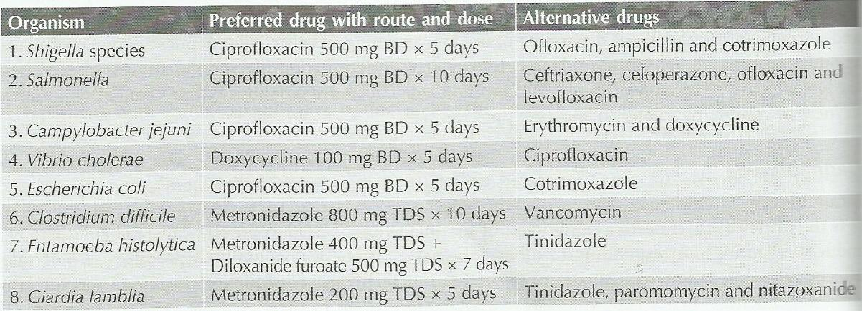
Infective antidiarrhoeal drugs

Slide 80
Adsorbents
Coat the walls of the GI tract
Bind to the causative bacteria or toxin, which
are then eliminated through the stool
Examples: bismuth subsalicylate (Pepto-Bismol), kaolin-pectin, activated charcoal, attapulgite (Kaopectate)

Slide 81
Anticholinergics
Decrease intestinal muscle tone and peristalsis of GI tract
Result: slowing the movement of fecal matter through the GI tract
Examples: belladonna alkaloids (Donnatal), atropine, hyoscyamine

Slide 82
Intestinal Flora Modifiers
Bacterial cultures of Lactobacillus organisms
work by:
  Supplying missing bacteria to the GI tract
  Suppressing the growth of diarrhea-causing bacteria
  Examples: Lactobacillus acidophilus (Lactinex)

Slide 83
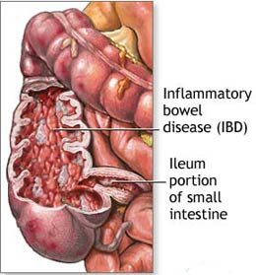
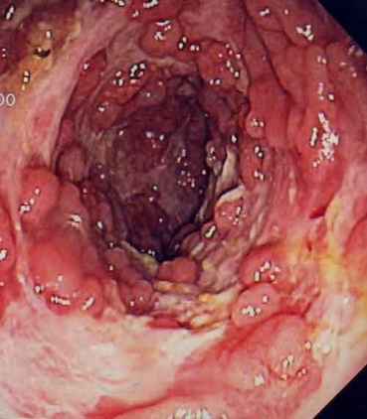
Inflammatory Bowel Disease
Ulcerative colitis
  Diffuse mucosal inflammation limited to the colon
  Bloody diarrhea, colicky pain, urgency,tenesmus
Crohn’s Disease
  Patchy transmural inflammation
  May affect any part of GI tract
  Abdominal pain, diarrhea, weight loss, intestinal obstruction

Slide 84
Treatment = Resolve acute episodes and prolong remission
Therapeutics:
  Aminosalicylates - for mild symptoms
  Corticosteroids - for moderate symptoms
  Thiopurines - for active and chronic symptoms
  Methotrexate - for active and chronic symptoms
  Cyclosporin - for active and chronic symptoms refractory to corticorsteroids- (significant side effects)
  Infliximab - antibody infusion

Slide 85
Pharmacotherapy of IBD
IBD includes crohn’s disease and ulcerative colitis , characterized by diarrhoea, bleeding, abdominal discomfort, anaemia and weight loss.
Aminosalicylates: sulphasalazine, mesalamine, olsalazine, balsalazide.
Antibiotics: metronidazole, ciprofloxacin, clarithromycin.
Glucocorticoids: prednisolone, methylprednisolone, hydrocortisone, budesonide.
Immunomodulators: azathioprine, 6-mercaptopurine, methotrexate.
Biological response modifiers: infliximab.

Slide 86
Aminosalicylates
Sulfasalazine (5-aminosalicylic acid and sulfapyridine as carrier substance)
Mesalazine (5-ASA), eg Asacol, Pentasa
Balsalazide (prodrug of 5-ASA)
Olsalazine (5-ASA dimer cleaves in colon)
Oral, rectal preparation
Use
    Maintaining remission
    Active disease
    May reduce risk of colorectal cancer
Adverse effects
    10-45%
    Nausea, headache, epigastric pain, diarrhoea, hypersensitivity, pancreatitis, blood disorders, lung disorders, myo/pericarditis
    Caution in renal impairment, pregnancy, breast feeding

Slide 87
Sulphasalazine: prodrug composed of sulphapyridine and 5- aminosalicylic acid (5-ASA), acts locally by inhibiting production of inflammatory mediators.
Sulphapyridine get absorbed and causes side effects like nausea, vomiting, skin rashes, headache, fever, pancreatitis, pneumonitis, etc.

Slide 88
Pharmacotherapy of IBD…
Mesalamine: 5-ASA, can administered as suppository and enema.
Osalazine: 2 molecule of 5-ASA with azo linkage, poorly absorbed after oral administration; in colon it cleaved into 2 molecules of 5-ASA by colonic bacteria.
Basalazide: split into 5-ASA and metabolized in colon.

Slide 89
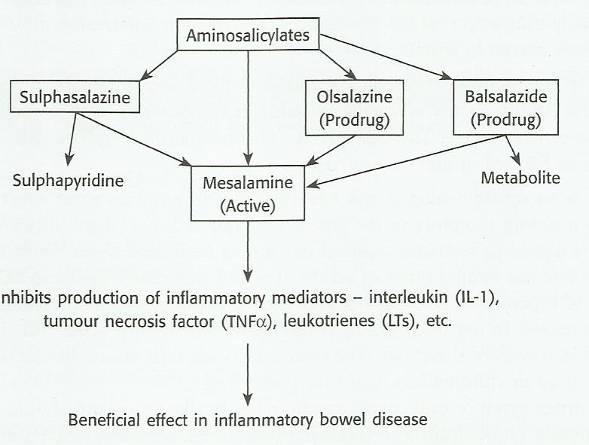
Mechanism of Drugs for IBD

Slide 90
Corticosteroids
Anti-inflammatory agents for moderate to severe relapses
eg 40mg Prednisolone
Inhibition of inflammatory pathways (↓IL transcription, suppression of arachidonic acid metabolism, lymphocyte apoptosis)
Side effects
  Acne, moon face
  Sleep, mode disturbance
  Dyspepsia, glucose intolerance
  Cataracts, osteoporosis, myopathy…

Slide 91
Thiopurines
Azathioprine, mercaptopurine
Inhibit ribonucleotide synthesis
Inducing T cell apoptosis by modulating cell signalling
Azathioprine metabolised to mercaptopurine and 6-thioguanine nucleotides
Use
  Active and chronic disease
  Steroid sparing
Side effects
  Leucopaenia (myelotoxic)
  Monitor for signs of infection, sore throat
  Flu like symptoms after 2 to 3 weeks, liver, pancreas toxicity

Slide 92
Methotrexate
Inhibits dihydrofolate reductase
Probably inhibition of cytokine and eicosanoid synthesis
Use
  Relapsing or active CD refractory or intolerant to AZA or thiopurine
Side effects
  GI
  Hepatotoxicity, pneumonitis

Slide 93
Cyclosporin
Inhibitor of calcineurin, preventing clonal expansion of T cell subsets
Use
  Active and chronic disease
  Steroid sparing
  Bridging therapy
Side effects
  Tremor, paraesthesiae, malaise, headache, abnormal LFT
  Gingival hyperplasia, hirsutism
  Major: renal impairment, infections, neurotoxicity
Monitor
  Blood pressure, FBC, renal function

Slide 94
Infliximab
Anti TNF-α monoclonal antibody
Potent anti inflammatory effects
Use
Fistulizing CD
Severe active CD refractory/intolerant of steroids or immunosuppression
iv infusion
Side effects
Infusion reactions
Sepsis
Reactivation of Tb, increased risk of Tb

Slide 95
Carminatives
Anti-fermentive and Antifoaming agents
Ruminotorics
Digestants

Slide 96
Carminatives
(Anise, Asafoetida, Camphor, Caraway, Cardamom, Cinnamon, Clove, Coriander, Ginger, Menthol, Peppermint, Spearmint)
Used in mild cases of simple bloat
Mild irritation of GI mucosa & relaxation of Oesophageal sphincter
Eructation of entrapped gases
Promotes expulsion of gases from GIT
Relieve discomfort and distension of stomach
Distension leads to:
Respiratory and cardiovascular compromises
Epigastric pain
Agents: Volatile inhalant anaesthetics Low therapeutic uses (Inconsistent action)
Alcohol

Slide 97
Anti-fermentive and Antifoaming agents
Cellulose fermentation in rumen
Production of gases (periodical eruction)
Excess gas production
Free form of gas Stable foam form of gas
Ruminal Tympany or Bloat
Management: Antifermentive agents Antifoaming agents
+
Ruminal Intubation
or
Trocharisation

Slide 98
Antifermentive (Antizymotic) agents: By Stomach tube or as Drench
                Directly in Rumen by Trochar and Cannula
Formalin: 40% soln. in water (highly irritant diluted with water. NSS)
      Antizymotic and intestinal antiseptic
E.g.: Turpentine oil, Formalin
Turpentine Oil: Act as reflex sialogogue, carminative, antizymotic and
antifoaming
For internal use (Rectified T.T. oil)
Irritant, mixed with demulscents
Used in combination with linseed Oil, Not with fish oil

Slide 99
2) Antifoaming agents: Surfactants (decrease the stability of foam in rumen)
Organic silicones: Polydimethylsiloxane/Dimeticone, Simethicone, Poloxalene
Dimeticone: Widely used in Vety. Practice
Unabsorbed in GIT
Higher doses: Constipation/diarrhoea
Vegetable oils: Arachis oil (peanut oil, groundnut oil) extracted from Arachis
hypogaea
Antizymotic, antifoaming, laxative and demulscent
Volatile oils: Turpentine oil
Other Drugs: Sod. Bicarbonate,
Serotonin antagonists (Ketanserin, ritanserin),
Monensin

Slide 100
Ruminotorics/Ruminatoriums
(Modulators of Ruminoreticular activity)
Helps in Fermentation, absorption, passage of ingesta to omasum and abomasum and removal of free gas by eructation by increasing normal contractile activity
Used in ruminal stasis
Agents: Cholinergic agonists (Neostigmine: increases frequency
(Carbachol: M and N
Prokinetics (Metoclopramide)
Benzodiazepines (Diazepam: Appetite enhancer) Plant alkaloids (Arecoline, Pilocarpine, Strychnine, Lobeline)
Bitters (Gentian, nux vomica, ginger)
Mineral supplements (Co, Cu, Mn, Fe, Zn, Ca, Mg, P, S, I)
Ruminal acidifying agents (Vinegar, acetic acid 5%)
Ruminal alkalinising agents (Mg(OH)_{2,} MgO, MgCO₃, Al(OH)₂, CaCo₃)
Other agents: Opioid antagonists, Potassium antimony
tartarate, Liquid paraffin

Slide 101
DIGESTANTS
(Drugs affecting Digestive Functions)
Pancreatic Digestants: Pancreatin,
          Pancrealipase
          Diastase
          Taka-diastase
Gastric digestants: Pepsin
            Papain
            HCl
Hepatic digestants:
  Cholagogues: Magnesium sulphate, ceruletide, aloes, ammonium chloride, ipecacuanha
  Cholerectics: Ursodeoxycholic acid, chenodeoxycholic acid, dehydrocholic acid, glycocholate, taurocholate, florantyrone, tocamphyl, clanobutin, ox bile extract

