Slide 1


Lecture 1. | Introduction to feed technology
Unit-1
Dr. Muneendra Kumar
Assistant Professor
Department of Animal Nutrition
muneendra82@gmail.com
College of Veterinary Science & Animal Husbandry
U.P. Pt. Deen Dayal Upadhyaya Pashu Chikitsa Vigyan
Vishwavidyalaya Evam Go-Anusandhan Sansthan
(DUVASU), Mathura - 281001 (U.P.)

Slide 2
Animal Feed Market
World compound feed production has reached over 1 billion tonnes annually (generates an estimated annual turnover of over US $400 billion; INR 32,908 Billion).
The Indian animal feed market reached a value of INR 873.7 Billion in 2021.
The animal feed market in India is classified into three broad categories: Poultry Feed, Cattle Feed and Aqua Feed, .
The poultry feed market has mostly been dominating in terms of its share in the animal feed market with almost 44% share globally.

Slide 3
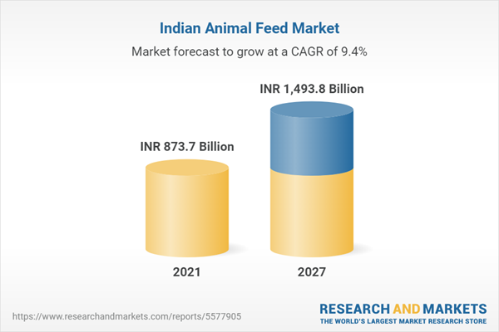

Slide 4
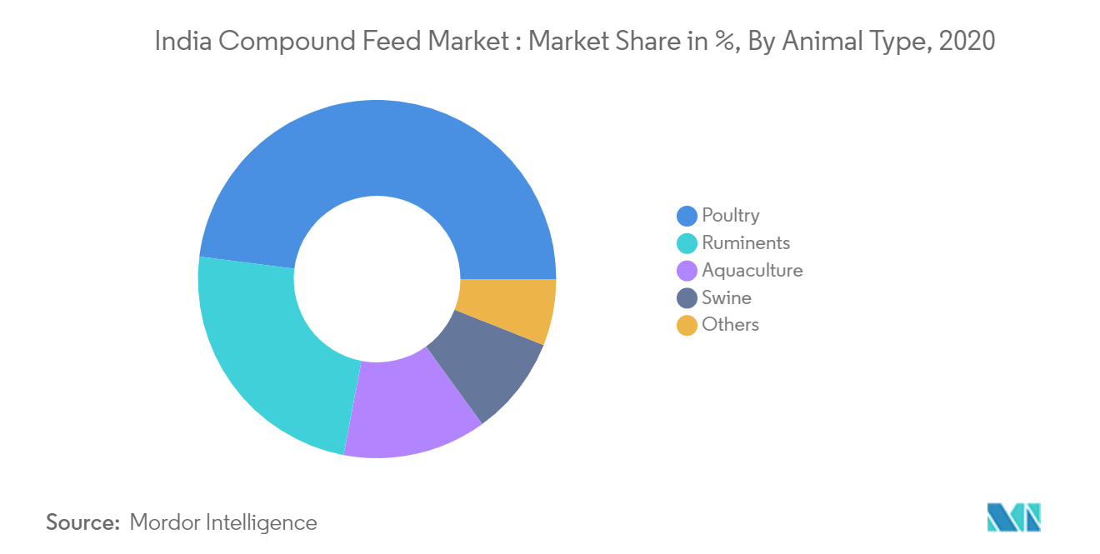

Slide 5

Development of feed market

Slide 6
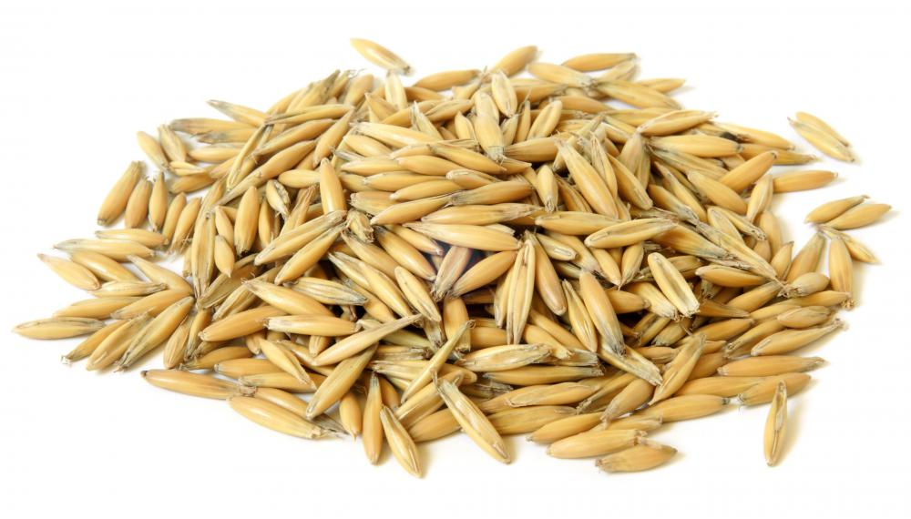
The first use of ground grain for animal feed was recorded as early as in year 1813.
Oats were traditionally used for animals feeds (equine), as they are cheap to grow and has much less use in human food compare to wheat.
The concurrent increase in the milling waste that was being dumped into water sources quickly gained negative attention.
There was an immediate need to redirect by-products from human food production to avoid waste build-up.
When chemical analysis of such grain by-products proved their nutritional value, the commercialization of the modern feed industry was initiated.

Slide 7
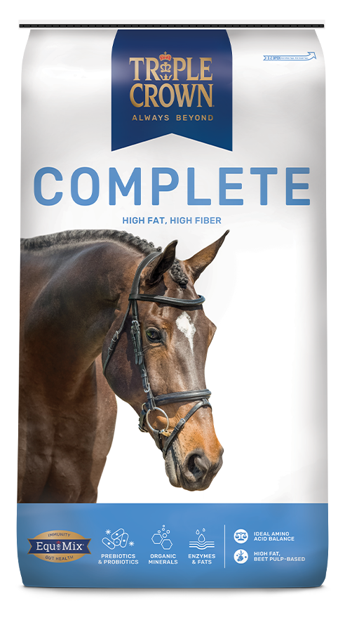
The first commercial formulated feeds arose in the early 1800s when horse and mules supplied the main form of transportation and energy to drive agricultural equipments.
Manufacturing formulated feeds based on the first feed standards started in the late 1800s (1870, first batch mixed feed, Massachusetts, USA).
In 1875, Mr. John Barwell initiated the production of a calf meal at Blatchford of Waukegan, Illinois, USA.
In 1900 the first hammer mill was used, followed by horizontal batch mixer in 1909.

Slide 8
Association of American Feed Control Officials (AAFCO) and American Feed Manufacturers Association (AFMA) were established in 1909.
Name of AFMA was changed into American Feed Industry Association (AFIA) in 1985.
Linear programming (least-cost feed formulation, a mathematical procedure) was developed by George B. Dantzig in 1947 at USDA.
Feed Production School (FPS) was established in 1950 in USA to work up definitions of feed terminology used by manufacturers.

Slide 9

Feed industry come into existence in India in 1961 with the establishment of a feed plant in Ludhiana, Punjab.
Compound Livestock Feed Manufacturers Association (CLFMA) was established on 8th June 1967 (with head quarters at Mumbai).
It is the sole national representative body of compound animal feed manufacturers in India (with more than 250 members in the public, private and cooperative sectors).
CLFMA has been publishing a bi-monthly “LIVESTOCK & FEED TRENDS”.
Presently there are >31,000 feed mills globally and >800 in India

Slide 10
Compound cattle-feed producers
Home-mixers (Unorganized)- 33% (>20000 feed manufactures)
Dairy cooperatives -42%
Private sector manufacturers of compound cattle feed- 25% (832 feed manufacturers)
The Organized animal feed manufacturers are producing around 30 million tonnes of commercial feed.
Out of total production, commercial production of cattle feed is about 8 million tonnes.

Slide 11


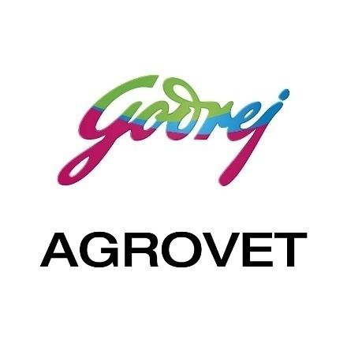
Competitive Landscape
Suguna Foods Private Limited.
Japfa Comfeeds India Pvt. Ltd.
Venkateshwara Hatcheries Pvt. Ltd.
Anmol Feeds Pvt. Ltd.
Godrej Agrovet Limited (GAVL).
SKM Animal Feeds and Foods (India) Ltd.
Cargill, Incorporated.
Kapila Krishi Udyog Ltd.
Amrit Group, KSE Ltd.
Avanti Feeds Ltd.
Uno Feeds.
Growel Feeds Pvt. Ltd.
C P Aquaculture India Pvt. Ltd.
Mulpuri Foods and Feeds Pvt. Ltd.
The Waterbase Ltd.
Grobest Feeds Corporation India Ltd.

Slide 12
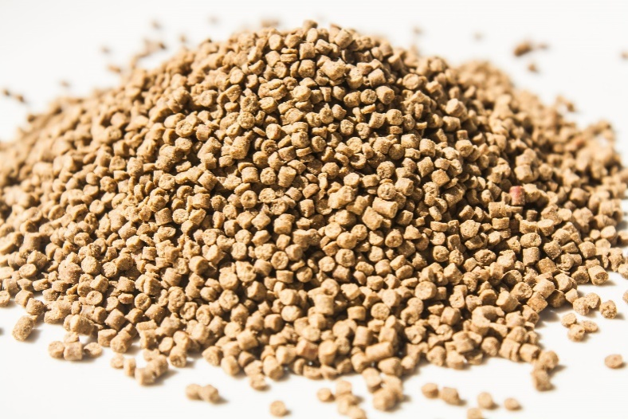
Feed Technology
“Application of physical, chemical, biochemical, biological and engineering techniques to increase the nutrient utilization of feed and fodders in the animal system”

Slide 13
The Association of American Feed Control Officials (AAFCO) definitions
Complete feed: Nutritionally adequate feed for animals formulated using specific formula compounded to be fed as the sole ration and is capable of maintaining life and promoting production without any additional substance, except water.
Concentrate: A feed used with another component to improve the nutritive balance of the total feed.
Supplement: A feed used with another to improve the nutritive balance or performance of the total.
Premix: A uniform mixture of one or more micro ingredients with diluent and /carrier. Premixes are used to facilitate uniform dispersion of the micro ingredients in a large mix.

Slide 14
Processing of feeds and forages
To make more profit
To alter particle size
To change moisture content
To change density of feed
To change palatability
To increase nutrient content
To increase nutrient availability
To detoxify or remove undesirable material
To improve keeping quality
To reduce microbial load and other harmful substances

Slide 15
Particle size reduction procedure
1. Cutting: Reduction of particle size by pushing or forcing a thin sharp knife through the material (chaffing of green fodder and straw).
2. Crushing: reduction of particle size by applying a compressive force to the particle to be reduce (ball mills, percussion mills and jaw crushers work on the principle of crushing).
3. Shearing: It is a combination of cutting and crushing (rotary type knife and stationary bar cutter work on the principle of shearing).
4. Impact grindings: It is most commonly used procedure for particle size reduction in the feed industry (hammer mills, jet mills and centrifugal input mills work on this principle).

Slide 16
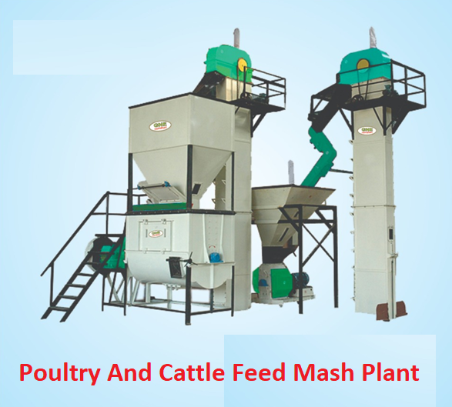
Feed plant/mill/unit

Slide 17
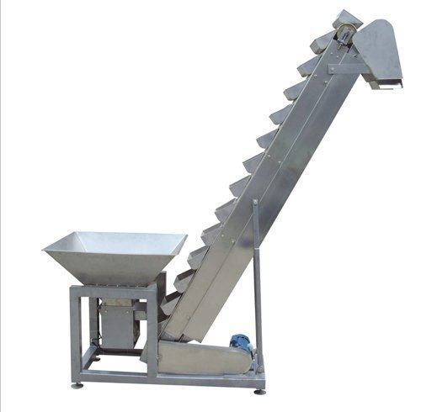
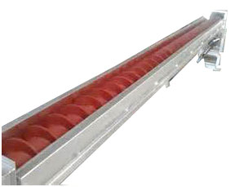
Conveyor

Slide 18
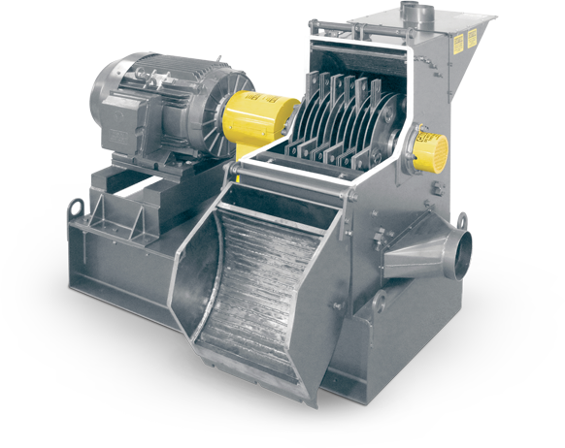
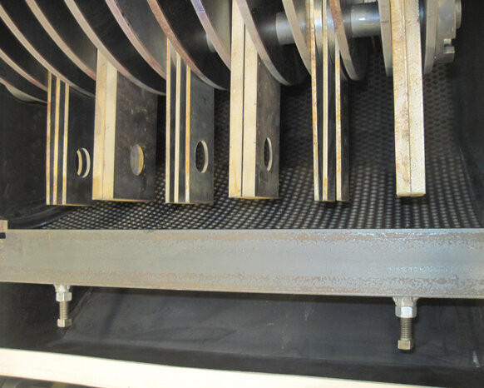
Hammer mill

Slide 19
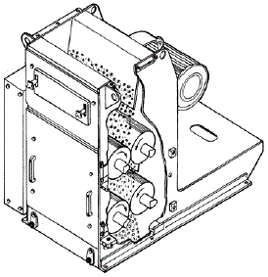
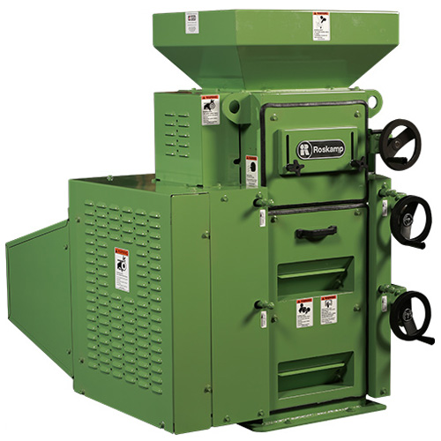
Roller mill

Slide 20
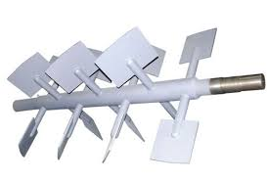
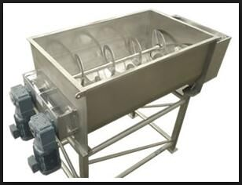
Horizontal mixer

Slide 21
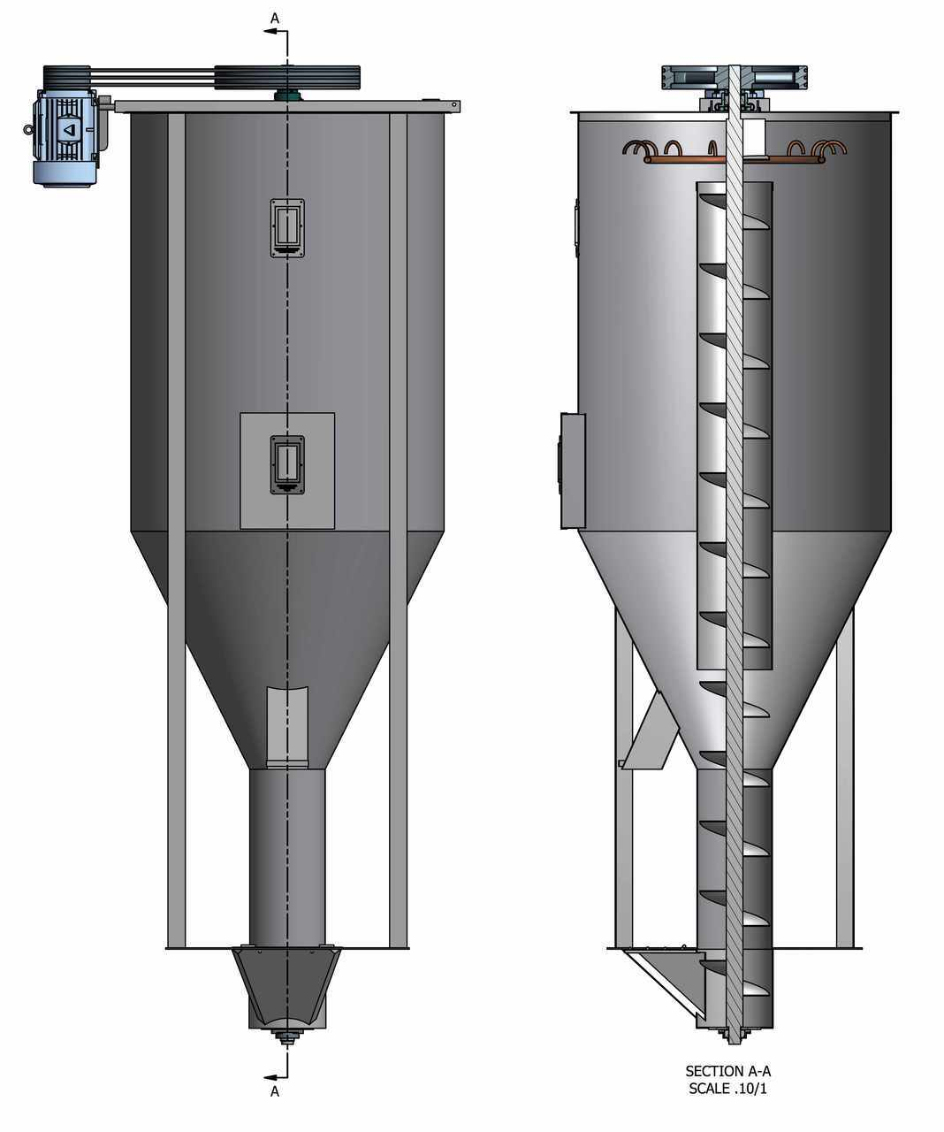
Vertical mixer

Slide 22
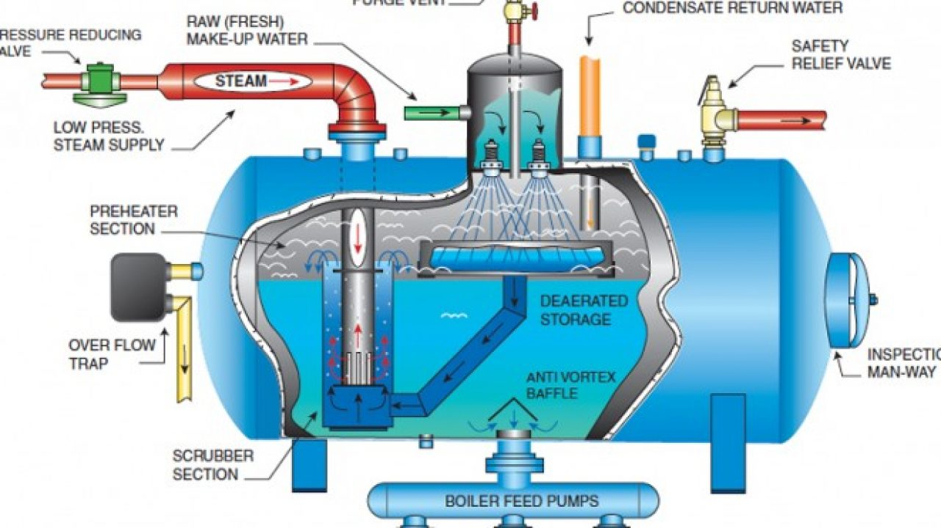
Boiler-steam producing unit

Slide 23
Processing methods of grains
A- Dry processing methods
B- Wet processing methods
Soaking, steam rolling, steam processing and flaking, pressure cooking, exploding, pelleting, reconstitution
Grinding, dry rolling, popping, extruding, micronizing and roasting

Slide 24
A. Dry processing methods
1. Grinding
It is a simplest and least expensive method for grain processing.
It is prerequisite for various other processing methods like mixing, pelleting, extruding, etc.
It is accomplished by means of a hammer mill.
The grinding may vary from fine to coarse depending upon mesh size of the sieve/screen.
Very fine grinding makes feeds dusty and less palatable resulting reduced animal performance due to lower feed intake

Slide 25
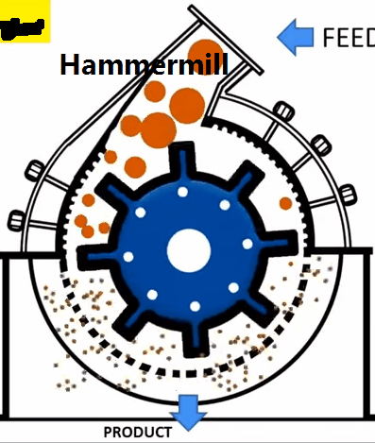
Hammer mill

Slide 26
Expressing particle size of grounded material
Grounded feed is expressed in terms of modulus of uniformity and modulus of fineness.
Modulus of uniformity is expressed as ratio of coarse: medium: fine particle with suitable ratio will be 1:6:3.
Modulus of fineness varied fro 1 to 7 and decreased with decrease of particle size of grounded material.

Slide 27
Advantages
Grinding increased surface area thereby improved digestibility.
Improved performance of animals by increasing nutrient utilization.
Grinding makes mixing uniform and more efficient.
Using grounded material makes pelleting and extruding easy, more effective, and efficient.
Grinding reduced risk of particle segregation.
Selective feeding and risk of wastage by livestock will be minimized/avoided by the grinding of grains.

Slide 28
Grinding improves palatability.
Grinding reduce energy loss occurs during mastication.

Slide 29
Disadvantages
Fine grinding reduce digestibility due to increase passage rate in gut.
Grinding reduce ruminal production of propionic acid which results into milk fat depression/low milk fat.
Fine grounded particle goes waste.
Fine grinding reduced feed intake due to dusty ambience.
Grounded material is difficult to handle.

Slide 30
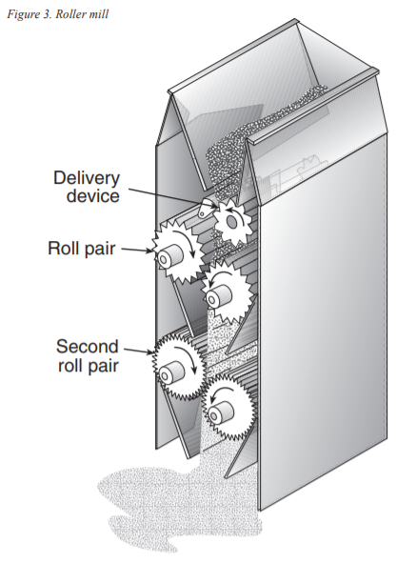
2-Dry rolling
Rolled grains are prepared by passing the grain through a roller mill.
The physical properties of rolled grains are very similar to the of grains coarsely grounded in hammer mills.
There is less issue of variation in the size of grounded material in rolling (material is uniformly grounded).

Slide 31
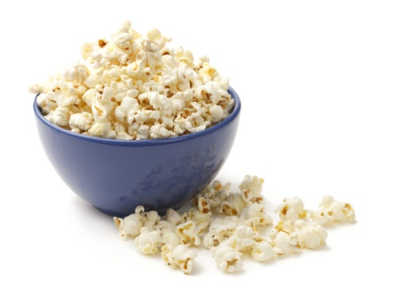
3-Popping or puffing
Popping is produced by the action of dry heat (370-425 degree celsius) for 15-30 sec.
Popping caused sudden expansion of grains which rupture the endosperm and this is responsible for the rupture of starch granules and makes starch more available for the digestion.
Popped grains are less in moisture and are bulky in nature.
Popping improved palatability, feed intake and digestibility.
Puffed grains are good carrier of molasses.

Slide 32
4-Micronizing
Micronizing is similar to popping except that heat generated is in the form of infra-red energy.
Micro waves with 3 x 10⁸ to 3 x 10¹¹ cycles/sec are emitted from infra-red burner.
Generally micronized grains are rolled to produce a uniform dense product.

Slide 33
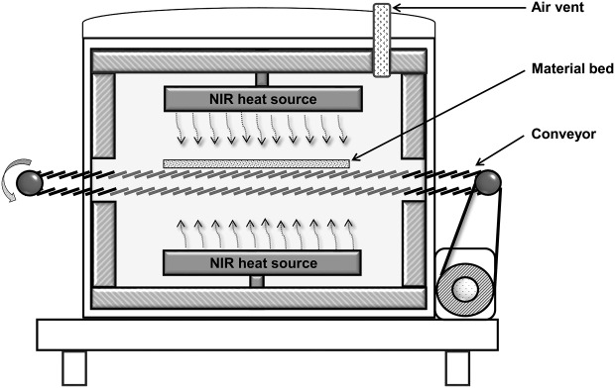

Slide 34
5-Roasting
It occurs by passing the grains through flame resulting in heating to about 300 degree Fahrenheit or 148.9 degree Celsius.
Roasting results into the expansion of grain starch to a certain extent which produce a palatable product.
Moisture content of the roasted grain is around 3-5%.

Slide 35
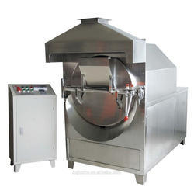
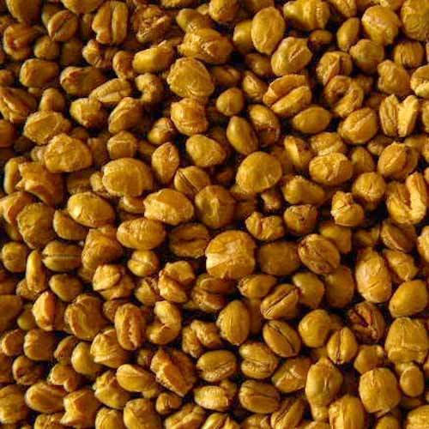
Drum type grain roaster

Slide 36
6-Extruding
Extrusion is used by the feed industry in the production pet feeds, fish feeds, laboratory animal feeds, etc.
Extrusion results in the gelatinization of starch in variety of cereal grains and also cooking of soybean and pulses for the control antinutritional factor.
It also used in the cooking of meat, fish, and feather meals for the control of pathogenic agents (salmonella).
Gelatinization of starch results into the improved digestibility, feed conversion efficiency and performance of the animal.

Slide 37
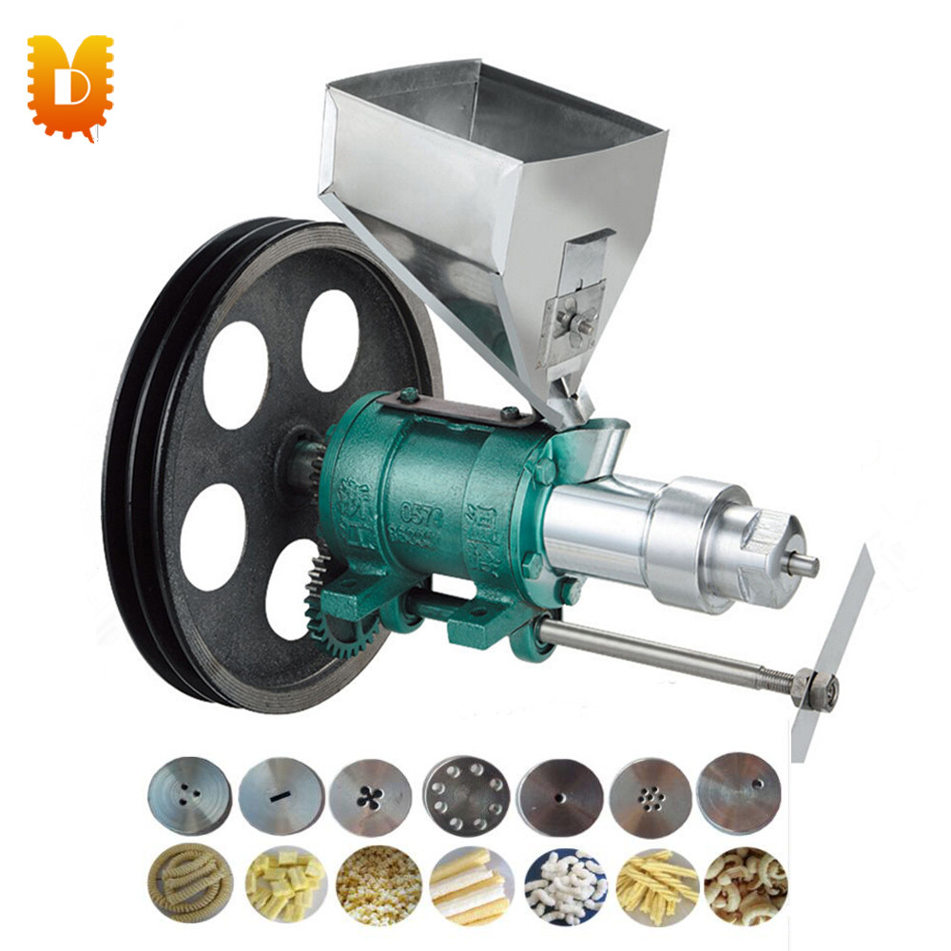

Slide 38
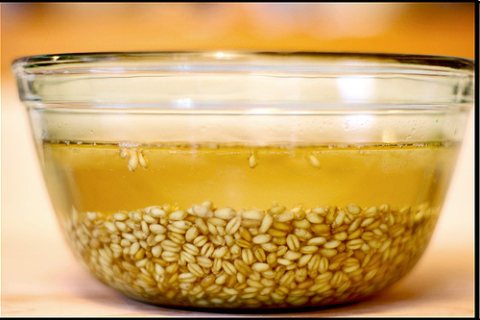
B-Wet processing method
1-Soaking
Soaking of grains for 12-24 hours in water improved palatability and intake of soaked grain.
Soaked concentrate mixture feeding is popular in swine feeding.
Soaking of MOC, till cake and other feedstuffs remove certain antinutritional factors.

Slide 39
2-Steam rolling
The grain is subjected to steam for different time period depending upon the pressure used prior to rolling.
In case of steam pre conditioning at atm pressure, grains are subjected steam for 8-20 minutes with 210-215 degree Fahrenheit or 100 degree Celsius and 16-20% moisture.
In case of pressure (20-60 psi), preconditioning of grain is done by subjecting for 50 sec-2 min (temperature 250-300 degree Fahrenheit or 121-148.9 degree Celsius and 18-25% moisture, respectively.
Steam rolled grains are less fine and less dusty than grounded and dry rolled grains.

Slide 40
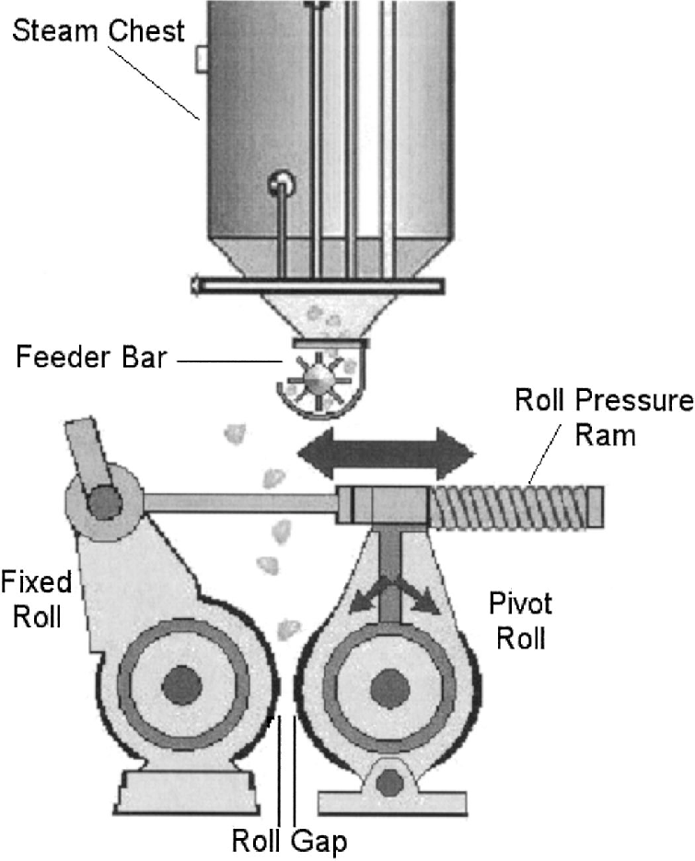
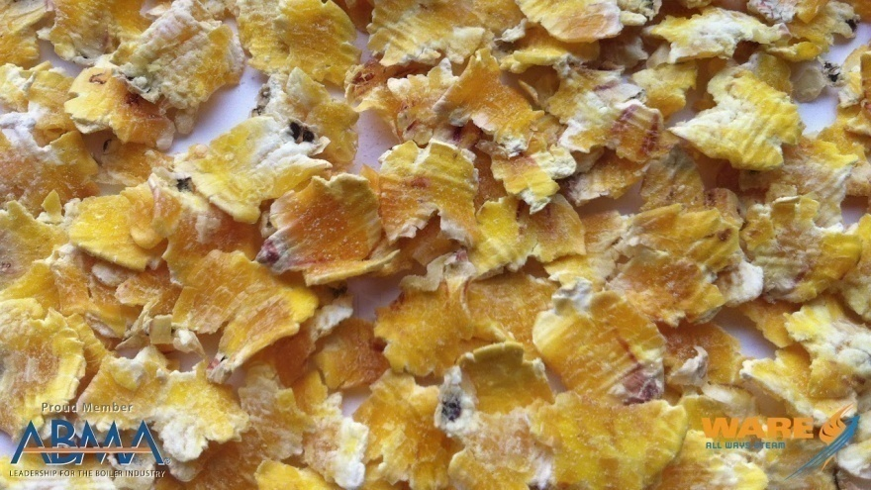

Slide 41
3-Steam processing and flaking
Somehow similar to the steam rolling. After steam treatment, grains are passed through the roller mill.
The tolerance set between the rollers depends upon the flatness of the flake desired.
Drying is required while storing the steam processed and flaked grains.

Slide 42
4-Pressure cooking
Pressure cooking is similar to the steam rolling or steam processing and flaking.
Grains are pressure cooked at 50 psi for 1.5 min in air tight pressure chambers at temperature 300 degree Fahrenheit.
The temperature is reduced to below 200 degree Fahrenheit and the moisture to 20% by passing them through cooling and drying tower prior to flaking.
Pressure cooked grains are difficult to flake to the same degree of flatness due to spongy nature of the pressure cooked grain.
Pressure cooked flakes are less brittle and therefore not break.

Slide 43
5-Exploding
It is done by subjecting grains to high pressure steam (250 psi) for very short time (20 sec) followed by sudden decrease to atm pressure.
This results into rapid expansion of grain kernels and produced a low density product (similar to popping).

Slide 44
6-Reconstitution
Reconstituted grains are matured grain (10% moisture) to which water is added to raise the moisture level to 25-30% and wet grains are stored in an oxygen-limited silo of 14-21 days prior to feeding.
Reconstitution of grain increases the solubility of the grain protein.

Slide 45
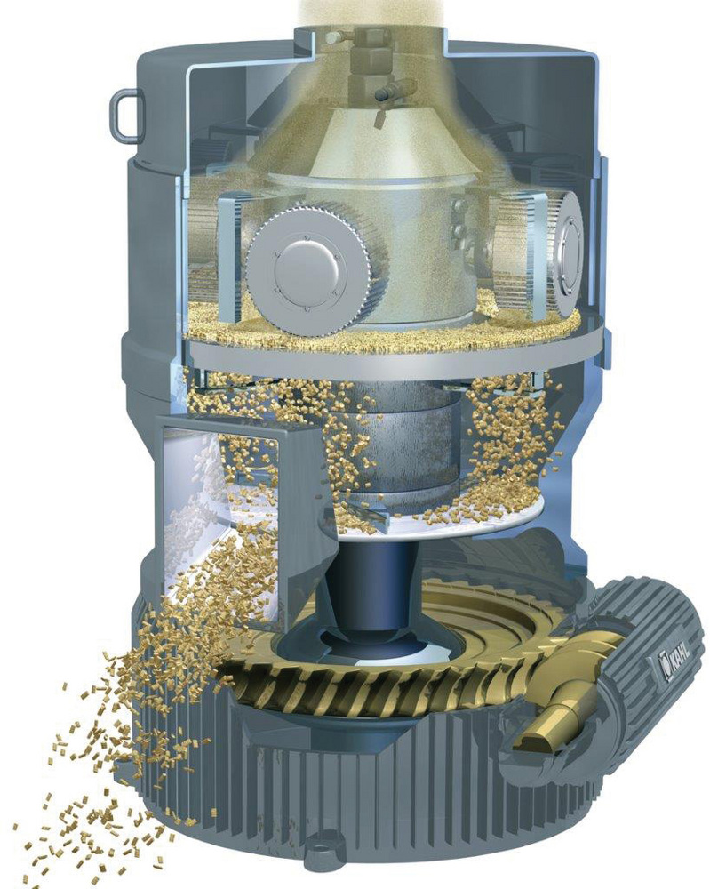
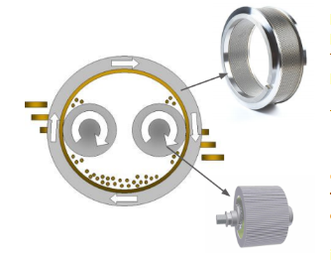
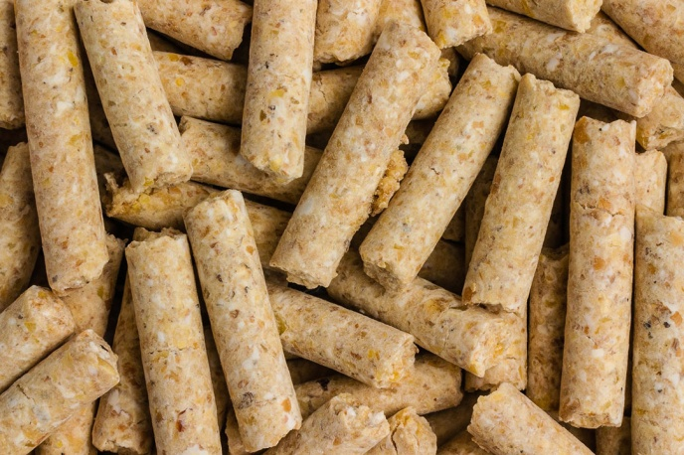
7-Pelleting

Slide 46
Pelleted feeds are agglomerated feeds formed by extruding feed/grain by forcing and compacting and forcing through die openings by any mechanical process.
The purpose of pelleting is to change dusty and unpalatable feed material into more palatable, easy to handle large particles by application of optimum amounts of heat, moisture and pressure.
The normal size of the pellets is 3.9-19 mm with most optimum particle size of pellets are 6.25-9.4 mm.

Slide 47
Advantages of pelleting
Increase the palatability and therefore increase feed intake.
Increase the density of feed and thereby reduce the storage space required.
The segregation of ingredients in a mixing, handling or feeding process is prevented.
Waste during the eating process is minimized.
Requires less labour (easy to handle) in pelleted feed handling as pelleted material is free flowin.
Heat labile inhibitors are destroyed , gelatinization of starch occurs.
Feeding pelleted feed improved performance of the animals.
Bulk density is increased, which enhances storage capabilities of most bulk facilities. Shipping facilities are also increased, thereby reducing transportation costs.
Feed in pellets forms reduces natural losses because it reduces the formation of dust.

Slide 48
Disadvantages of pelleting
Increase the cost of the feed due to the pelleting process.
Decrease eating time, creating more boredom.
Decrease the amount of fiber a animal receives.
Poor-quality feed ingredients can be hidden in a pellet.
Excessive heat during the pelleting process may decrease the availability of amino acids such as lysine and may destroy some Vitamins.
Greedy eaters may be more prone to choke, colic, or other digestive disorders.

Slide 49
Roughage processing methods
divided into two groups: based on the addition or deduction of water content of roughages.
Dry processing method
Wet processing method

Slide 50
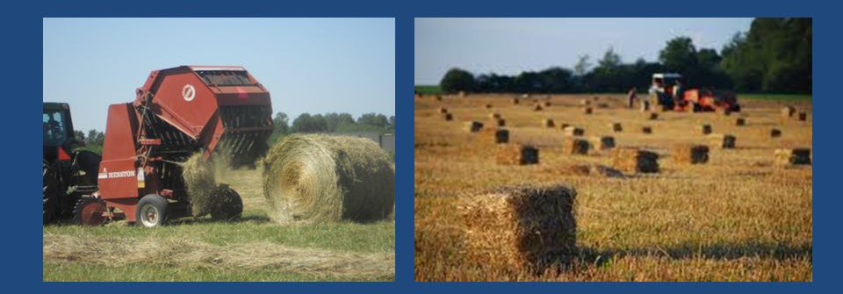
A-Dry processing methods
In these methods water content is reduced to a desired level.
Baling
The forage is cut and dried in the field condition.
Dried forage is then baled or bundled with Baler
By this method we make storage and handling of forage easy and convenient.

Slide 51
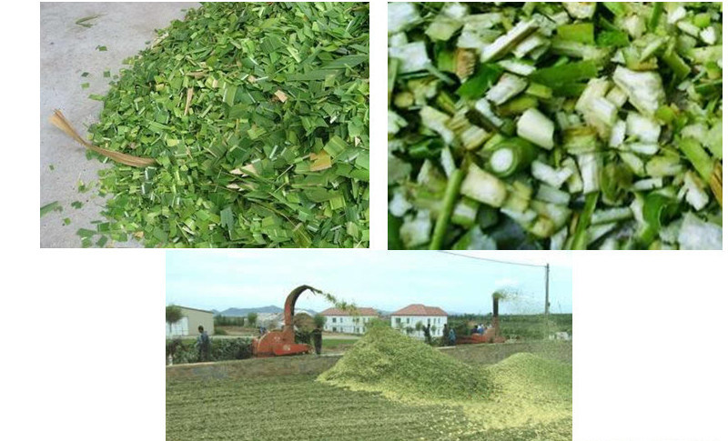
Chopping (Chaffing)
The forages are chopped into small pieces as fine or coarse particles.
Chopping avoids the selective feeding thus wastage of plant material is reduced.
The machine used for the intended purpose is called chaff cutter.
Chopping facilitates easy handling due to increased bulk density.
Also improves digestion due to exposure of relatively large surface roughages for microbial digesting.

Slide 52
Grinding
It is a process of particle size reduction.
Course grinding: roughages improves the feed consumption and growth rate
Fine grinding: reduce the digestibility of CF: due to faster rate of feed particles in GIT (reduce milk fat content).
High cost: grinding of roughages is not economical.

Slide 53
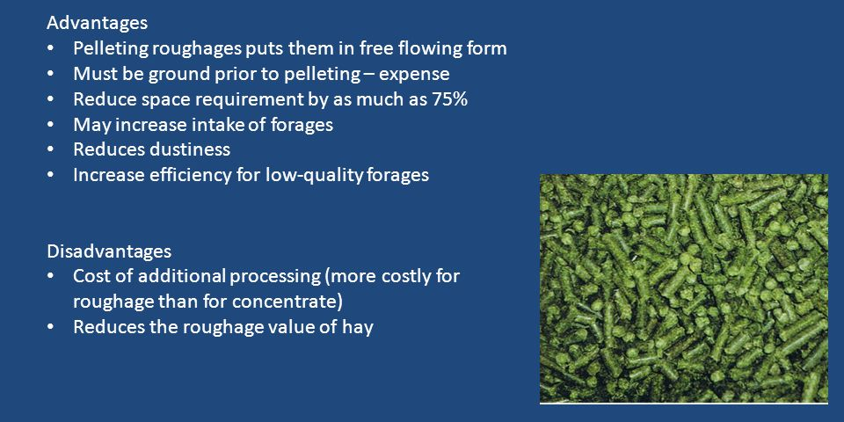
Roughage-Pelleting
The ground roughages are pelleted and fed to animals.
Improves the consumption of poor quality roughages.
The size of pellets is 12/64” to 48/64” and has a density of 40 lb/ cft.

Slide 54
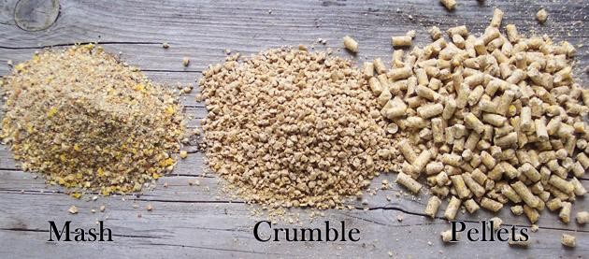

Slide 55
Dehydration
It is a process of reduction of moisture content in a dehydrator using a temp. 600-1500⁰F for a short time period of 3-5 minutes.
dehydrated forage: retains: lot of DM and CP
No loss of leaves, but carotene content is reduced.

Slide 56
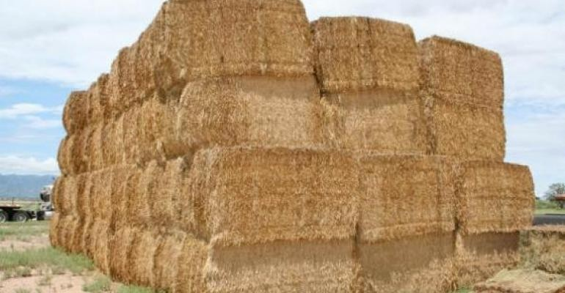
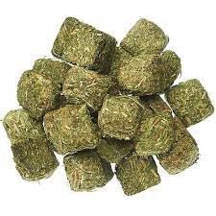
Cubing
It increases the density of roughages upto 30lb/cft.
good quality hay is sprayed with water to increase the moisture content upto 14%.
broken down rather than to ground the roughage, so that there is minimum of fine particles in the cube.
Cubing: Alfa- alfa hay is done: Developing country.

Slide 57
B: Wet processing methods:
1. Soaking is a process of mixing or spraying water on roughages so that stems become soft and mixing of
concentrates improves the roughages.
with
feed
roughage intake
is uniform which and digestibility of
2. Green chopping: When green roughages are chaffed, there is no need of soaking and fed as such or mixed with dry roughage or concentrate mixture.

