Slide 1


Lecture 1. | Feeding of Cattle and Buffalo
Unit-3
Dr. Muneendra Kumar
Assistant Professor
Department of Animal Nutrition
muneendra82@gmail.com
College of Veterinary Science & Animal Husbandry
U.P. Pt. Deen Dayal Upadhyaya Pashu Chikitsa Vigyan
Vishwavidyalaya Evam Go-Anusandhan Sansthan
(DUVASU), Mathura - 281001 (U.P.)
www.upvetuniv.edu.in

Slide 2
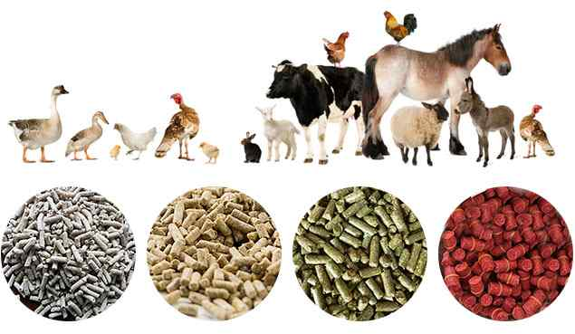
A ration is the feedstuff offered for a given animal during a time period of 24 hours. The feedstuffs are give at a time or in proportions at intervals (diet)
A balanced ration is one that furnishes nutrients in such proportions and amount that it will properly nourish a given animal for 24 hours
Ration

Slide 3
Maintenance
Balance
Ration
Production
Gestation
Ideal

Slide 4

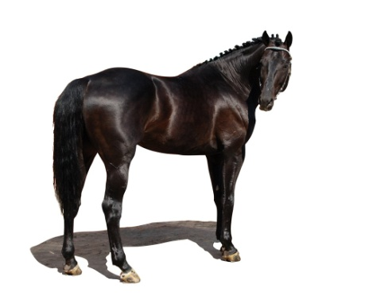
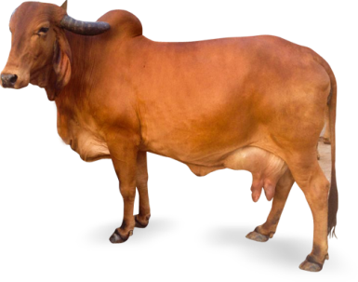
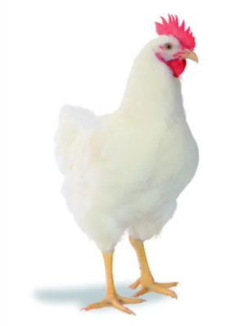
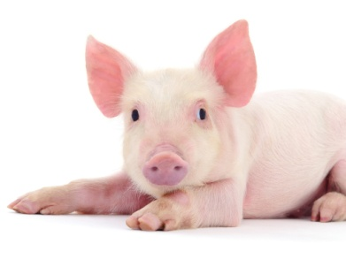
Difference
Concentrate mixture/compounded concentrate/feed
Concentrate mixture +
Roughage

Slide 5
Concentrate mixture
1. Cereal grains-energy source-maize, jowar, bajra, rice, wheat, etc.
2. Cakes-meals/animal origin-protein source-MOC, CSK, TK, SBM, GNC/M, etc./fish meal, meat meal, bone-cum meat meal, feather meal, etc.
3. Cereal grain milling by-products-laxative and bulky-wheat bran, rice bran, rice polish, maize gluten, gram/dal chuni, etc.
4. Mineral and vitamin supplements.

Slide 6
Characteristics of ration
Lecture 2
Ration should be well balanced in terms of energy, protein, minerals and vitamins.
Ration should be highly digestible.
The ration should be fairly laxative to stimulate the walls of digestive track for maximum secretion and action of digestive juices.
Ration should be fairly bulky to satisfy the hunger of animal.
The ingredients composing the ration should be good and sound enough.

Slide 7
6. Ration should be free from harmful constituents.
7. A variety of feeds should be used to formulate the ration for better balance of nutrients as well as palatability.
8. Ration should be cost effective and economic. The feed ingredients used in ration formulation should be easily available and cost effective.
9. Always avoid sudden change in the diet as it upsets whole stomach resulting in digestive disturbances and reduction in productive performance.

Slide 8
10 Ration should be given to the animal at regular intervals.
11 Ration must be properly prepared. Hard grains like maize, barley, sorghum etc. should must be grounded before feeding.
12 The average particle size of diet should be 800 microns for poultry and between 650 to 750 microns for swine for better utilization of feeds.
13 In the ration formulation the crude fibre (CF) contents of diet should be adjusted between 6 to 8 %.
14 Ration must contain all limiting amino acids in balanced amount.

Slide 9
15 If feed contains antibacterial compound, the withdrawal period of that compound must be kept in mind. This is the period of time that medicated feed must be removed from pig / poultry diets before you slaughter them.
16 The ration should be formulated and fed according to the requirement of the animals. Feeding less or in excess, both are detrimental to health.
17 For better digestibility the animals should get ad libitum the clean and fresh supply of drinking water.

Slide 10
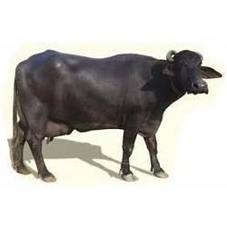
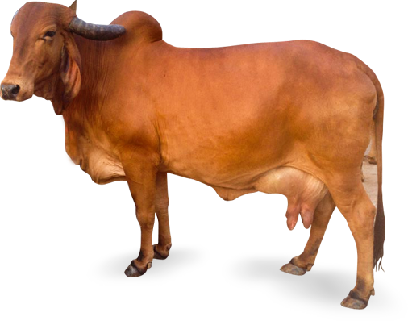
Why ?
How ?
balance Feeding

Slide 11

1. To explore the genetic potential of the animal by feeding a balanced ration to meet the daily nutrient requirements of the animal to perform in terms of weight gain, milk or wool production.
2. A judicious use of available feed resources is possible only through scientific feeding

Slide 12

Lecture 3
An understanding of the different nutrients required by livestock for different physiological functions (maintenance, growth, reproduction, milk production, wool production, etc.).
An understanding of the nutrient composition of different feed and fodder resources and how efficiently they are utilized by the animals.
Formulating balanced rations by combination of different feed and fodder resources to supply the nutrients to livestock for different physiological functions.
Cost
ANF
Availability
An understanding the inclusion level of different
feeds and fodders.

Slide 13
1. Determining nutrient requirement
Nutrient requirements of animals are calculated by following feeding standard guidelines.
Feedings standards are the tables, which indicate the quantities of nutrients to be fed to the various classes of livestock for different physiological functions like growth, maintenance, lactation, egg production and wool growth.
The nutrient requirements are generally expressed in quantities of nutrients required per day or as a percentage of diet.
For dairy animals, nutrient requirements are generally expressed as separate body functions but in case of poultry and pigs, combined requirements of maintenance and other body functions are given.

Slide 14
Classification of feeding standards
Comparative type
Hay Equivalent standard Scandinavian “feed Unit” Standard
Digestible-Nutrient system
Grouven’s
Wolff’s
Wolff’s Lehmann
Haeckers’s
Savage
Morrison
National Research Council
Indian
Production-value type
Kellner Armsby
Agricultural and Food
Research Council

Slide 15
Basis of expression of nutrients in different feeding standards
Feeding standard (Country) | Protein | Energy
NRC (USA) | CP, DCP | TDN, DE, NE
ARC (UK) | DCP, AP | DE, ME
SCANDINAVIA | DTP | FEED UNIT
GERMAN | DCP | SE
ICAR (India) | DCP, CP | TDN, ME
CP = Crude Protein, DCP = Digestible Crude Protein, DTP = Digestible True Protein, AP = Available Protein, TDN = Total Digestible Nutrient, SE = Starch Equivalent, DE = Digestible Energy, ME = Metabolizable Energy, NE = Net Energy

Slide 16
Daily nutrient requirement calculation of cattle and buffalo
(as per ICAR feeding standard-2013)
First Indian feeding standard for dairy cattle is designed by Sen and Ray (1946).
Sen and Ray feeding standard is based on Mid-Morrion feeding standard (1954)
First revised edition of Indian feeding standard was brought by Ray and Ranjhan in year 1978.
Second revised Indian feeding standard was brought by Ranjhan in year 1998.
Recent ICAR feeding standard is “ICAR feeding standard-2013”.

Slide 17
Maintenance
Nutrient requirement
“Nutrient requirements of cattle and buffalo”
(ICAR-2013)
Production
Maintenance Requirement of cattle and buffalo
Body weight (kg) | DM (kg/day) | TDN (kg/day) | ME (Mcal) | CP (g/day) | Ca (g/day) | P (g/d)
400 | 8.64 | 3.27 | 11.82 | 436 | 18 | 8
450 | 9.72 | 3.58 | 12.94 | 476 | 20 | 9
500 | 10.8 | 3.88 | 14.04 | 515 | 23 | 10
550 | 11.88 | 4.18 | 15.10 | 553 | 25 | 11
600 | 12.96 | 4.47 | 16.15 | 591 | 27 | 12

Slide 18
Milk Production Requirement
Fat% | DM (kg/day) | TDN (kg/day) | ME (Mcal) | CP (g/day) | Ca (g/day) | P (g/d)
Cow
4 | 0.510 | 0.330 | 1.20 | 96 | 3.2 | 1.8
Buffalo
6 | 0.670 | 0.440 | 1.58 | 124 | 4.8 | 1.8

Slide 19
Calculate nutrients requirement of a Sahiwal cow with 450 kg body weight and yielding 10 kg of milk having 4% milk fat?
Maintenance nutrients requirement of a Sahiwal cow with 450 kg body weight
Body weight (kg) | DM (kg/day) | TDN (kg/day) | ME (Mcal) | CP (g/day) | Ca (g/day) | P (g/d)
450 | 9.72 | 3.58 | 12.94 | 476 | 20 | 9
Nutrients requirement for milk production (4% milk fat)
Fat% | DM (kg/day) | TDN (kg/day) | ME (Mcal) | CP (g/day) | Ca (g/day) | P (g/d)
Cow
4 | 0.510 | 0.330 | 1.20 | 96 | 3.2 | 1.8

Slide 20

Body weight (kg)/fat % | DM (kg/day) | DM (kg/day) |  | TDN (kg/day) | ME (Mcal) | CP (g/day) | Ca (g/day) | P (g/d)
Maintenance requirement
450 | 9.72 | 9.72 |  | 3.58 | 12.94 | 476 | 20 | 9
Milk production
For 1 kg milk with 4% fat | 0.510 | 0.510 |  | 0.330 | 1.20 | 96 | 3.2 | 1.8
For 10 kg milk with 4% fat |  | 5.10 |  | 3.30 | 12.0 | 960 | 32 | 18
Total
 | 14.82 | 6.88 |  | 6.88 | 24.94 | 1436 | 52 | 27

Slide 21
Lecture 4
Maintenance
Nutrient requirement
for pregnancy
“Nutrient requirements of cattle and buffalo”
(ICAR-2013)
Foetal growth
Cow-Foetal growth
Month of gestation | DM (kg/day) | TDN (kg/day) | ME (Mcal) | CP (g/day)
6-7 | 0.85 | 0.64 | 2.30 | 169
7-8 | 0.99 | 0.74 | 2.67 | 216
8-9 | 1.13 | 0.84 | 3.05 | 263
Ca (upto 190 days=1 g/day; 190 days onwards=10 g/day)
P (upto 190 days=1.5 g/day; 190 days onwards=6 g/day)

Slide 22
Buffalo-Foetal growth
Month of gestation | DM (kg/day) | TDN (kg/day) | ME (Mcal) | CP (g/day)
6-7 | 1.0 | 0.80 | 2.76 | 203
7-8 | 1.2 | 0.90 | 3.21 | 259
8-9 | 1.4 | 1.0 | 3.66 | 316
9-10 | 1.5 | 1.1 | 4.11 | 373
Ca (upto 190 days=1 g/day; 190 days onwards=10 g/day)
P (upto 190 days=1.5 g/day; 190 days onwards=6 g/day)

Slide 23
Question: Calculate the nutrient requirements of 7.5 month pregnant Hariana cow having 450 kg body weight
1. Nutrient requirement for maintenance of 450 kg cow
Body weight (kg) | DM (kg/day) | TDN (kg/day) | ME (Mcal) | CP (g/day) | Ca (g/day) | P (g/d)
450 | 9.72 | 3.58 | 12.94 | 476 | 20 | 9

Slide 24
2. Nutrient requirement for 7.5 months pregnancy
Month of gestation | DM (kg/day) | TDN (kg/day) | ME (Mcal) | CP (g/day)
7-8 | 0.99 | 0.74 | 2.67 | 216
Ca (190 days onwards=10 g/day)
P (190 days onwards=6 g/day)
DM (kg/day) | TDN (kg/day) | ME (Mcal) | CP (g/day) | Ca (g/day) | P (g/day)
10.71 | 4.32 | 15.61 | 6.92 | 29 | 15

Slide 25
Nutrient requirement
for growth
“Nutrient requirements of cattle and buffalo”
(ICAR-2013)
BW (kg) | Weight gain (kg/day) | DM (kg/day) | TDN (kg/day) | ME (Mcal) | CP (g/day) | Ca (g/day) | P (g/day)
70 | 0.2 | 1.6 | 1.04 | 3.76 | 263 | <200 kg BW = 17 | Young = 9
70 | 0.3 | 1.8 | 1.16 | 4.19 | 335
70 | 0.4 | 1.8 | 1.28 | 4.63 | 406 | 200-300 kg BW =13
100 | 0.2 | 2.9 | 1.33 | 4.78 | 288
100 | 0.3 | 2.9 | 1.46 | 5.28 | 357 |  | Adult=6
100 | 0.4 | 3.0 | 1.61 | 5.80 | 423 | >400 kg BW = 8
100 | 0.5 | 3.1 | 1.75 | 6.32 | 487
100 | 0.6 | 3.1 | 1.90 | 6.84 | 549

Slide 26
Question: Calculate the nutrient requirements of 100 kg calf with average daily gain (ADG) 400 g/day
BW (kg) | Weight gain (kg/day) | DM (kg/day) | TDN (kg/day) | ME (Mcal) | CP (g/day) | Ca (g/day) | P (g/day)
100 | 0.4 | 3.0 | 1.61 | 5.80 | 423 | <200 kg BW = 17 | Young = 9

Slide 27
2. Nutrient composition of feedstuffs
Feedstuffs are subjected to different protocols of laboratory analyses like proximate analysis, detergent method of fibre analysis, Talpatra method for Ca determination, etc. for nutrient profiling.
These analytical procedures are specific for a given element, compound, or group of compounds.

Slide 28
NUTRIENT COMPOSITION OF COMMON FEEDSTUFFS
Ingredient | ME (Kcal/kg) | CP (%) | CF (%) | EE (%) | Ca (%) | P (%)
Maize | 3309 | 9.2 | 3.0 | 3.8 | 0.25 | 0.40
Bajra | 2950 | 12.7 | 4.0 | 3.0 | 0.13 | 0.72
Rice polish | 2837 | 12.7 | 12.0 | 16.0 | 0.27 | 1.37
Wheat bran | 1286 | 17.2 | 10.9 | 3.0 | 0.19 | 1.12
Soybean meal | 2300 | 45.0 | 6.0 | 1.0 | 0.36 | 0.90
Groundnut ext. | 2128 | 40-42 | 11.2 | 1.0 | 0.31 | 0.67
Fish meal | 1834 | 43.1 | 2.5 | 6.0 | 7.16 | 2.5

Slide 29
3. Formulation of balanced rations
a. Partitioning of DM
Partitioning of Ration DM
DM requirement in indigenous cattle is 2-2.5 kg/100 kg BW (2-2.5 %).
DM requirement in buffalo/crossbred cattle/exotic cattle is 2.5-3.0 kg/100 kg BW (2.5-3.0%).
2/3 as roughage
1/3 as concentrate
2/3 as dry
roughage
1/3 as green roughage
3/4 as dry
roughage
1/4 as green leguminous roughage

Slide 30
Question: Calculate DM from different components of ration for a 400 kg Gir cow?
10 kg DM
(2.5 %)
DM requirement in indigenous cattle is 2-2.5 kg/100 kg BW (2-2.5 %).
2/3 as roughage=6.7 kg DM
1/3 as concentrate
=3.3 kg DM
2/3 as dry
Roughage=4.5 kg DM
1/3 as green roughage=2.2 kg DM
3/4 as dry
Roughage=5.0 kg DM
1/4 as green leguminous roughage=1.7 kg DM

Slide 31
b. Formulation/computation of concentrate mixture/
compounded concentrate/feed
Different methods of feed formulation
Pearson Square Method (Single and double Pearson Square Method)
Algebraic Method
Thumb Rule Method
Linear Programming or Least-cost Feed Formulation or Computer Method
Hit and Trial Method

Slide 32
Steps in Pearson Square Method
i. Draw a square on left side of the page.
ii. Insert the percentage of required crude protein in the middle of the square.
iii. Place the basal feed with its CP% on the upper left corner and supplement feed with CP% on the lower left corner of the square.
iv. Subtract the CP% in the basal feed. From CP% desired in the mixture and place the difference on the corner of the square diagonally opposite to the basal feed. This is the amount of supplement in the mixture.

Slide 33
v. Subtract the CP% desired in the mixture from the CP% in the supplement and place the difference on the corner of the square diagonally opposite to the supplement.
vi. The above remainders represent the amount of two feeds in a mixture weighing equal to the sum of two remainders having a desired percentage of CP. The amounts are then converted into percent to simplify mixing.

Slide 34
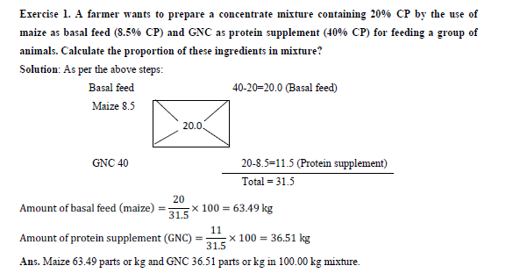

Slide 35
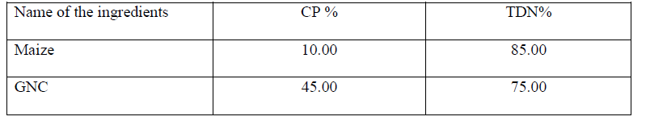
Lecture 5
2. Algebraic or simultaneous equation method
The equation of ingredients are used for determining the level of any one nutrient.
Simple equation like A + B = 100 or A + B + C = 100 can be used for calculation of concentrate mixture.
Exercise 2. Compute a concentrate mixture of 20% CP content with help of simultaneous equation from two ingredients i.e. maize grain and GNC.

Slide 36
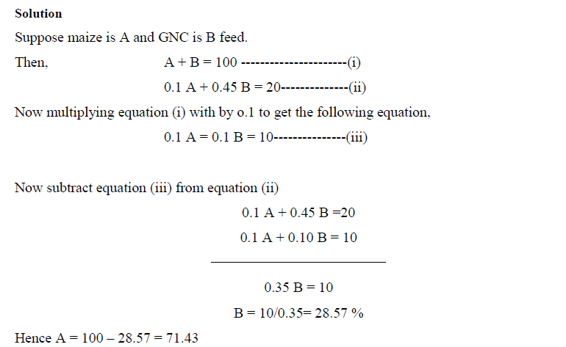

Slide 37
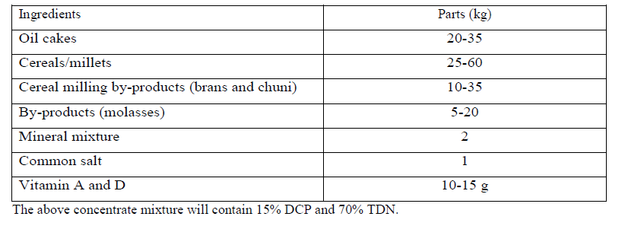
3. Thumb Rule Method
The concentrate mixture can be prepared by mixing one-third of each of cereals, oil cakes and byproducts.
Broadly according to this cereal or pulse method, the concentrate mixture may also be prepared as per the following flexible formula.

Slide 38
4. Linear Programming or Least-cost Feed Formulation or Computer Method
The method employed to calculate least-cost and profit maximizing rations is known as linear programming.
Computer programme/software/app has been developed that allowed the calculation of optimum and least-cost rations in a matter of seconds.
With the use of linear programming models, the prices of available feed ingredients as well as their nutrient contents can be considered while formulating rations.
Accuracy and speed of calculation are the major advantages of computer based ration formulation.

Slide 39
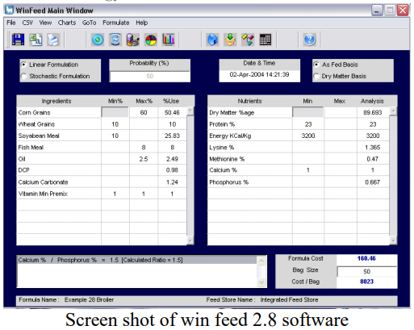
Feed formulation software’s/Least Cost/Linear Programming
There are number of feed formulating software's some important are:
Eco-Mix, AFOS, Adifo, Win feed, Brill, etc.

Slide 40
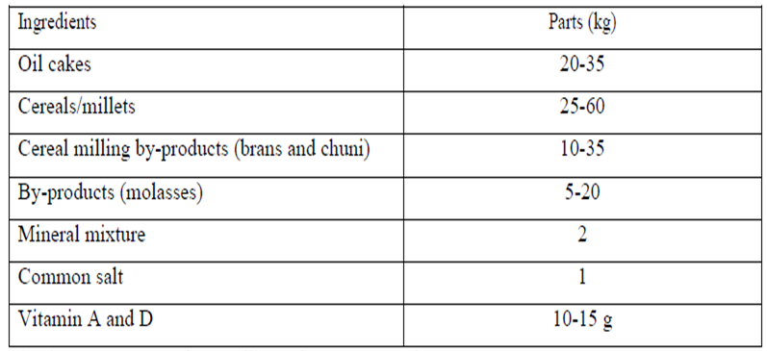
5. Hit and Trial or Trial and Error Method
CP content (kg)
30 x 0.40 = 12
50 x 0.9 =4.5
20 x 0.125 = 2.5
15 x 0.04 = 0.6
0
0
0
Total = 19.5 %

Slide 41
BIS SPECIFICATIONS FOR COMPOUNDED FEEDS FOR CATTLE
S.No. | Characteristic Requirement | Type 1 | Type 2
1 | Moisture (max) | 11 | 11
2 | Crude protein (min) | 22 | 20
3 | Crude fat (min) | 3.0 | 2.5
4 | Crude fibre (max) | 7 | 12
5 | Acid insoluble ash (max) | 3.0 | 4.0
BIS SPECIFICATIONS FOR COMPOUNDED FEEDS FOR CATTLE

Slide 42
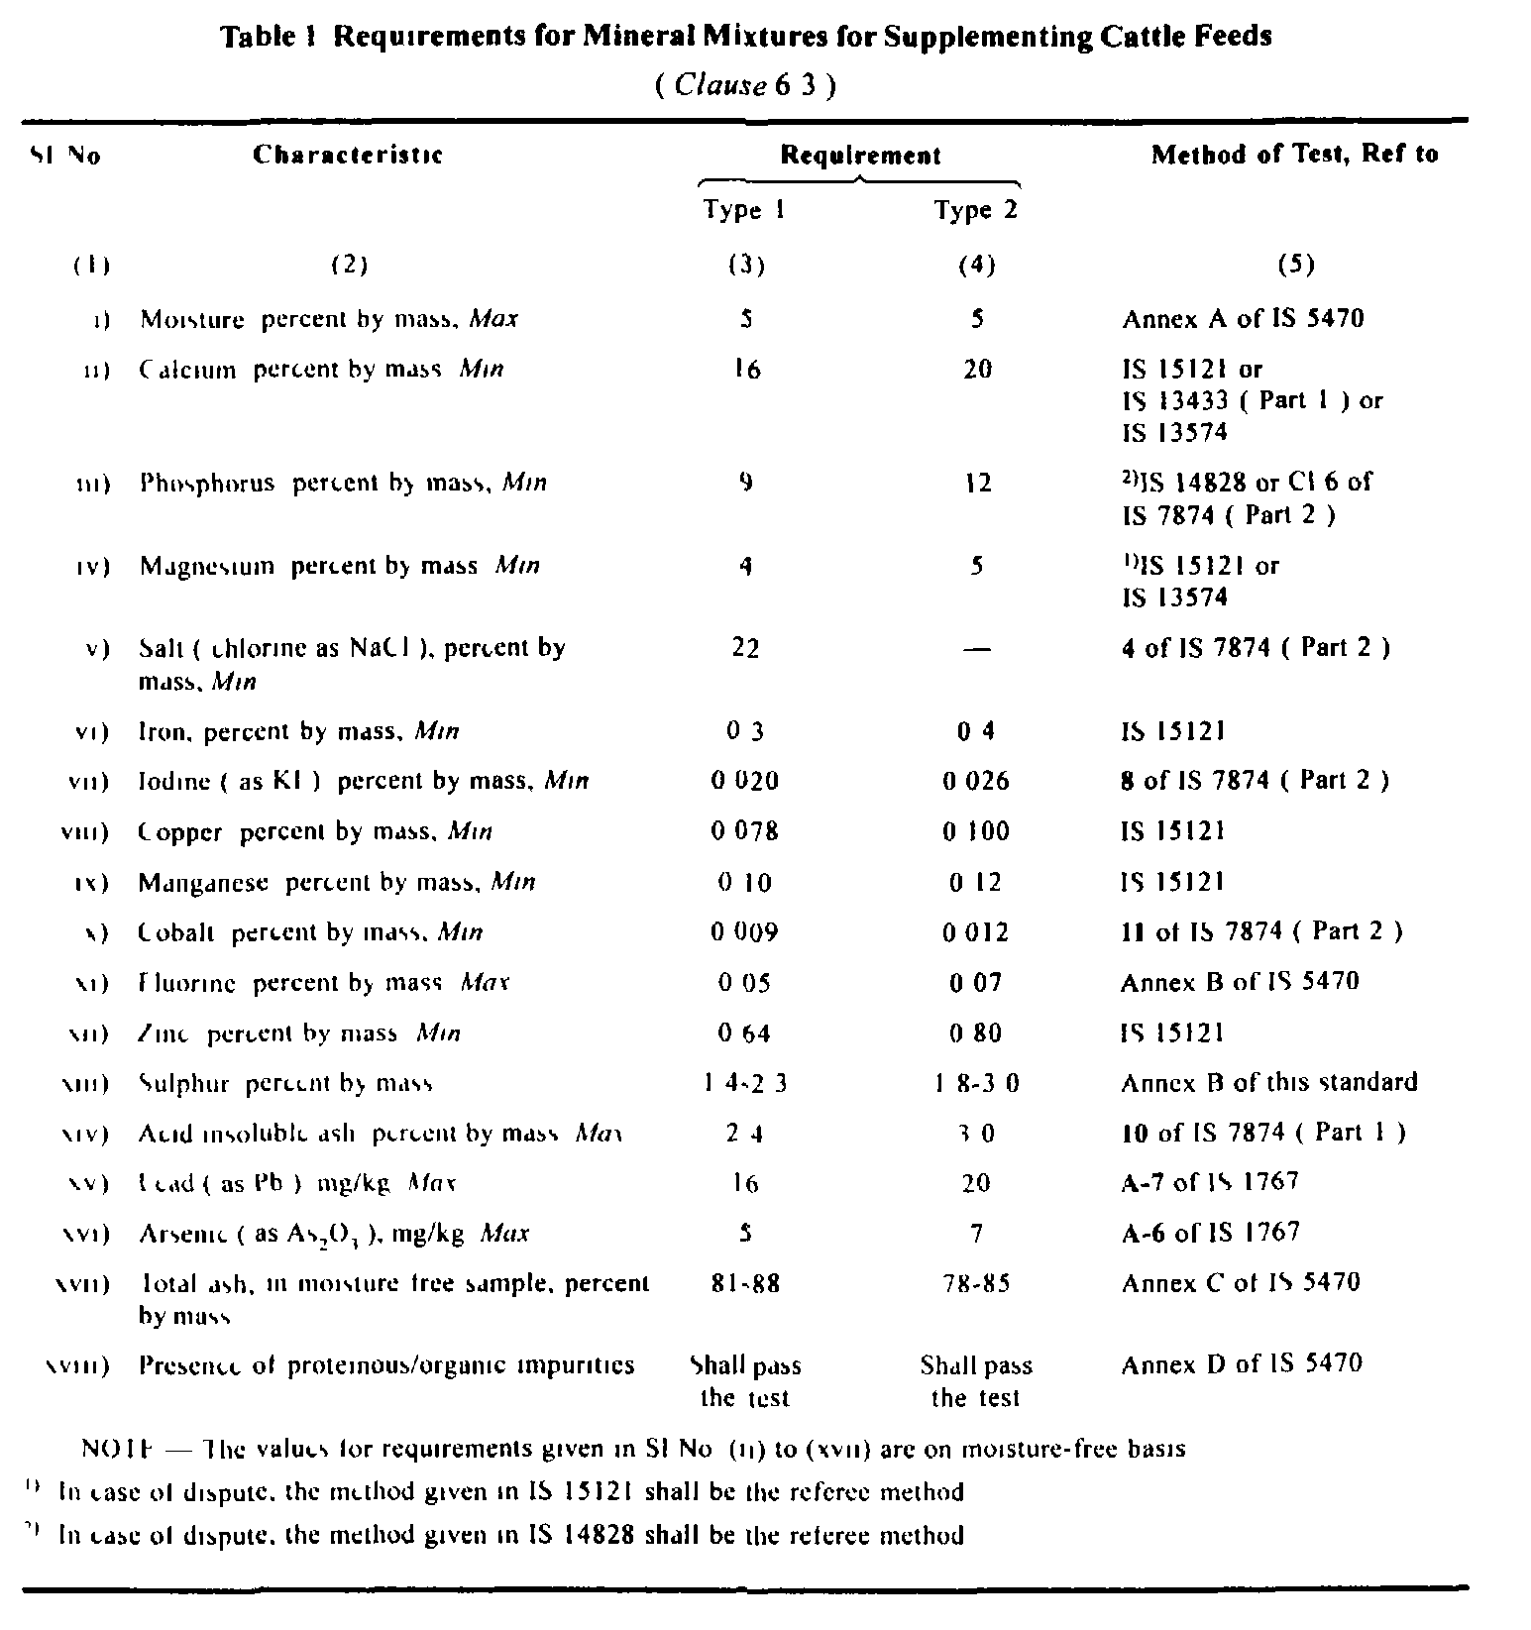

Slide 43
Feeding of concentrate by thumb rule method
The livestock owner finds difficult to follow the computation on body weight basis.
The following thumb rule may guide them to feed their livestock satisfactory.
Thumb rule is based on practical experience rather than scientific basis.
In maintenance type of indigenous and crossbred cow/buffalo, 1.5 and 2.0 kg, respectively concentrate mixture is recommended.
Over and above maintenance requirement, additional 1 kg concentrate mixture is required for every 2.5 kg (40%) of milk in indigenous cow and per 2.0 kg (50%) of milk in case of buffaloes
During the last trimester of pregnancy, a further quantity of 1.25 kg and 1.75 kg concentrate mixture is recommended for indigenous and crossbred cow/buffalo, respectively.

Slide 44

Feeding of calf
Lecture 6
A. Colostrum or beestings, bisnings or first milk
Passive Immunity in cattle is the short term immunity transfer from mother to offspring by way of colostrum or beestings, bisnings or first milk.
This is very important in cattle because during pregnancy there is no transport of antibodies across the placenta. Therefore, calves have no active immune system of their own.
Colostrum contains antibodies, technically called immunoglobulins (Ig), for priming the calf’s immune system; in addition it has a high content of fat to provide energy to the calf.

Slide 45
Newborn calf’s small intestine is permeable or “open” and is able to absorb the Ig contained in colostrum by the process of pinocytosis however, it can also absorb environmental pathogens that can cause diseases.
For this reason, it is important that newborn calves receive colostrum as soon as possible (with 2 hours of birth) not later than 3 hours of birth.
During the first 3 days of its life the calf should receive colostrum.
The protein content of colostrum is 17% as against only 3.5% in normal milk.

Slide 46
The content of vitamins (A, D and E) and minerals (Ca, Mg, Fe and P) is very high in colostrum.
The laxative action of colostrum helps the calf in evacuating the accumulated first faecal matter (muconium) from its intestine.
Colostrum should not be warmed as due to the presence of large amount of protein. It will coagulate/clot during heating.

Slide 47
Evaluation of colostrum quality
Colostrum quality depends on the content of immunoglobulins which are the proteins that convey protection against disease.
Visual Assessment:
Colostrum should have a thick consistency and color should be yellowish, avoid feeding any colostrum that looks brown or has blood in it.
Watery colostrum is of low quality and should not be fed to newborn calves if possible. If the colostrum has high content of proteins, it will be very thick. The thicker the better!
Practical, but not very reliable.

Slide 48

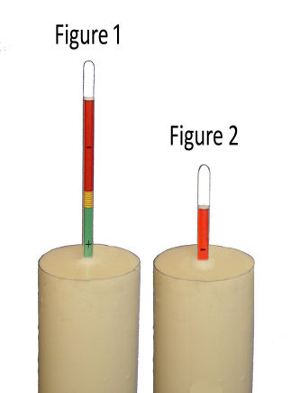
2. Colostrometer:
The colostrometer is a large thermometer-like glass instrument that measures the specific gravity of colostrum.
It measures how thick a sample is, and this correlates to the Ig content of the colostrum.
When the instrument floats in the green zone area, it indicates high quality colostrum, medium quality is within the yellow are and very low quality is in the red area.
Practical and reliable method.
High quality | Medium quality | Low Quality
>50 mg Ig/ml | Between 20-50 mg Ig/ml | <20 mg Ig/ml

Slide 49

3. Brix Refractometer:
The Brix refractometer is an instrument that measures sugar content in a variety of solutions and has been adapted to correlate this measurement with the content of Ig in colostrum.
The reference value for high quality colostrum is 22% Brix or higher.
Practical and reliable method.

Slide 50
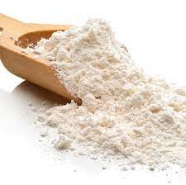
Artificial colostrum
If colostrum is not available artificial colostrum can be made as follows:
Sr. No. | Ingredients | Amount
1 | Warm water | 275 ml
2 | Raw egg (1 ) | 55 g
3 | Castor oil | 3 ml
4 | Vitamin A | 10, 000 IU
5 | Warm whole milk | 525 ml
6 | Antibiotic | 80 mg
Mix well and feed at 40 degree celsius

Slide 51
B. Milk replacer
Calves cannot process the higher fiber feed that adult cows eat and must slowly begin their transition from colostrum to milk to feed.
After the first two or three days of feeding from colostrum, the calves will need a high quality milk replacer.
Milk replacer is a formula that replaces the mother cow’s milk and is an economical choice for feeding calves versus whole milk.
Quality milk replacers have a minimum of 20% fat and 20% protein to give the calf what it needs to grow strong and healthy.
It should have good quality ingredients. The milk replacer is usually fed in gruel form.

Slide 52
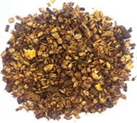
C. Calf starter
The purpose of calf starter is to transition the calf from the milk–feeding period to the dry feeding period and fed calf upto 70-80 kg BW attained.
Calf starter is very important to healthy rumen development, good body growth and successful weaning of the calf.
It is solid feed consisted of ground grains, oil cakes,, animal protein, and brans fortified with vitamins, minerals and antibiotic feed supplements.
Calf starter should contains 23-26% CP, 18.8-19.5% DCP and 75% TDN.

Slide 53
D. Feeding schedule
Age of calf | Colostrum/Whole milk | Calf starter | Hay
1-3 days | Colostrum @ 1/10th BW | - | -
4-7 days | Whole milk @ 1/10th BW | - | -
8-14 days | Whole milk @ 1/10th BW | - | -
15-21 days | Whole milk @ 1/10th BW | Little (50 g/day) | Little
22-35 days | Whole milk @ 1/15th BW | 100 g/day | Ad lib
Upto 2 months | Whole milk @ 1/20th BW | 250 g/day | Ad lib
2-3 months | Milk is gradually reduced | 500 g/day | Ad lib

Slide 54
Challenge feeding/steaming up
Feeding/supplying extra nutrient in high yielding animals to challenging them to produce at their maximum potential is known as challenge feeding.
Challenge feeding starts 2 weeks prior to the expected date of calving.
Feeding of extra concentrate at 500 g/day and increase it gradually to a level of 500-1000 g/day/100 kg BW.
Challenge feeding will condition digestive system for the increased quantity of feed to provide sufficient nutrients to initiate lactation on a higher plane.

Slide 55
Milk fever or parturient paresis
Milk fever is characterized by low blood Ca and paralysis. It is usually observed within 40 hours post-calving.
Milch animal do not develop fever on the contrary body temperature may be decreased.
It seems probably PTH fail to mobilize the body Ca rapidly to meet the drain at parturition which results from the onset of active milk secretion.
High dietary supply of Ca for prolonged period is responsible for less activity of PTH.

Slide 56
Feeding of negative dietary cation anion balance (DCAB) or dietary cation anion difference (DCAD) (-100 to -150 meq/kg DM) during pre-partum period helps in improving responsiveness of PTH which results into mobilization of bone Ca post-partum.
However, positive DCAD (+250 to +300 meq/kg DM) is provided during post-partum (buffering capacity).
DCAD (mEq/kg DM) = [(sodium x 435)+(potassium x 256)] - [(chloride x 282)+(sulfur x 624)]

Slide 57
Bypass nutrient technology
Bypass nutrients [(bypass protein, bypass fat and rumen resistant starch (RRS)] is also called rumen escape or undegradable nutrients. It is the portion of the dietary nutrients that escapes from being broken down or digested in the rumen by microbes (bacteria, protozoa, etc.).
Bypass nutrient technology is used in high yielding animals in which microbial origin end products not able to fulfill the requirement of host animals.

Slide 58


