Slide 1

Welcome

Slide 2


Lecture 1. | Fodder Conservation: Silage and Hay Making
Dr. Muneendra Kumar
Assistant Professor
Department of Animal Nutrition
muneendra82@gmail.com
College of Veterinary Science & Animal Husbandry
U.P. Pt. Deen Dayal Upadhyaya Pashu Chikitsa Vigyan
Vishwavidyalaya Evam Go-Anusandhan Sansthan
(DUVASU), Mathura - 281001 (U.P.)
www.upvetuniv.edu.in

Slide 3
Significance of fodder conservation/preservation
Climatic factors play an important role in acute scarcity of green fodders on one hand and surplus green fodder availability on the other.
The surplus green fodder is available during July-October and December-April followed by an acute scarcity period between mid October to mid December and mid April to mid July.
Thus, it becomes imperative to conserve the surplus green fodder at appropriate time so that they can be used during lean periods.
Unless such measures are taken, it is not feasible to sustain and economize livestock production during the lean periods.
Preservation of fodder without much loss of nutrients is the main aim of conservation.
Fodder is cut before maturity ensuring optimum availability of nutrients.
Fodder could be preserved in airtight chambers by anaerobic fermentation (Silage making) and by drying (Hay making).

Slide 4
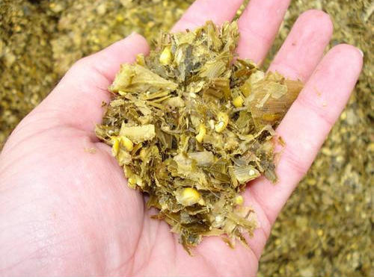
SILAGE MAKING OR PICKLE GRASS ?
Silage is the material produced by the controlled anaerobic fermentation of a crop of high moisture content.
Silage is the green succulent roughage preserved more or less in its original condition, with a minimum deterioration and minimum loss in respect of various nutritive constituents of fodder. ”

Slide 5
Terminology
1. Silo: Silo is the air tight container in which silage is made.
2. Ensiling/ensilage: The process of conserving green fodder as silage is called ensilage.
1. Type of silo
A very large number of different types of silos are in existence.
These vary from massive concrete structures with complete equipment to simple plastic bags.

Slide 6
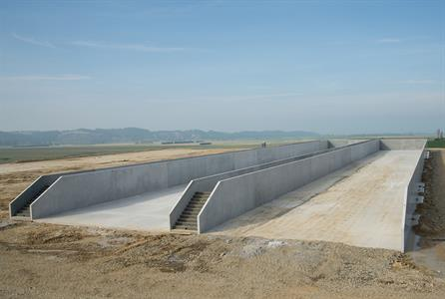
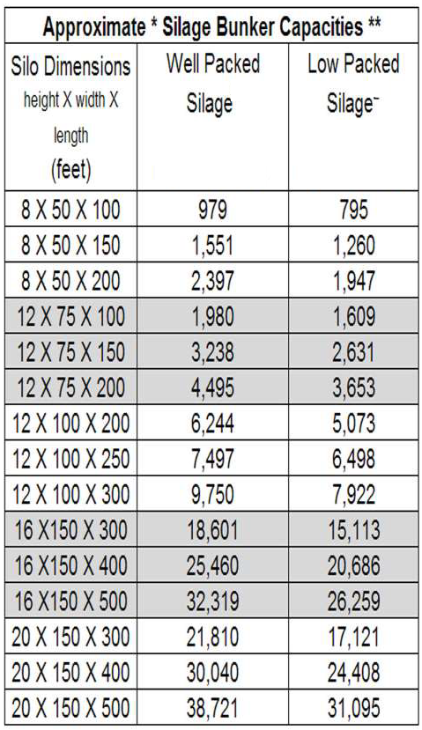
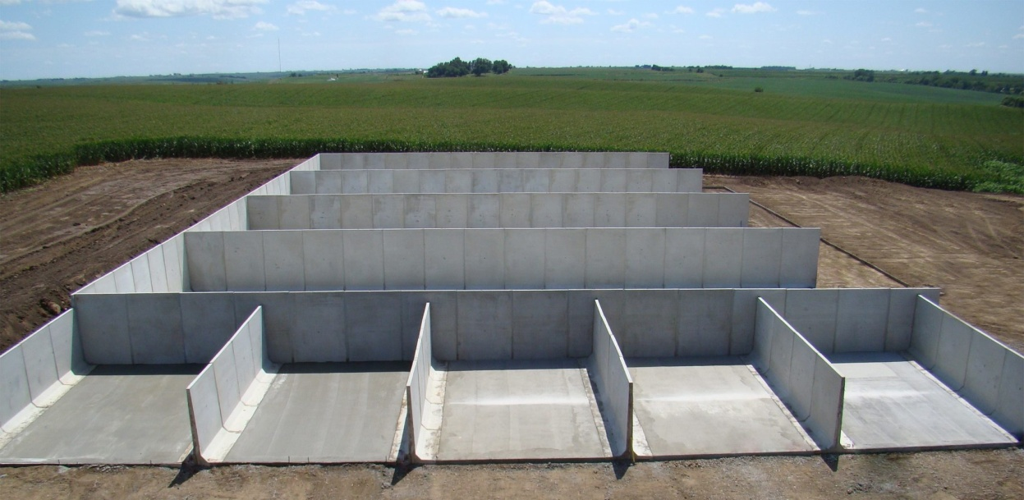
Bunker silo
Tones
Tones

Slide 7
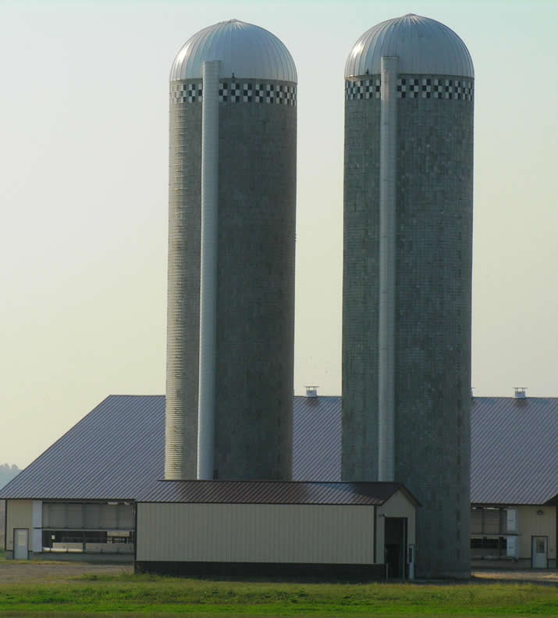
Tower silo

Slide 8
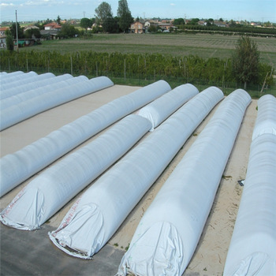
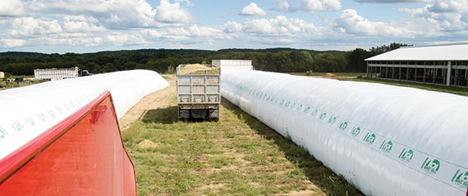
Tube silo

Slide 9
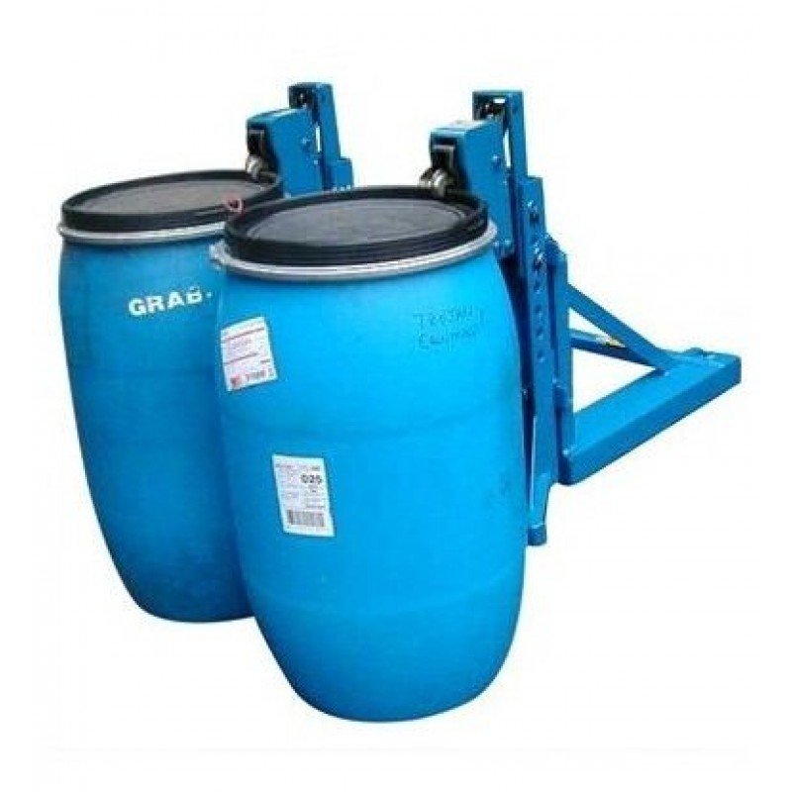
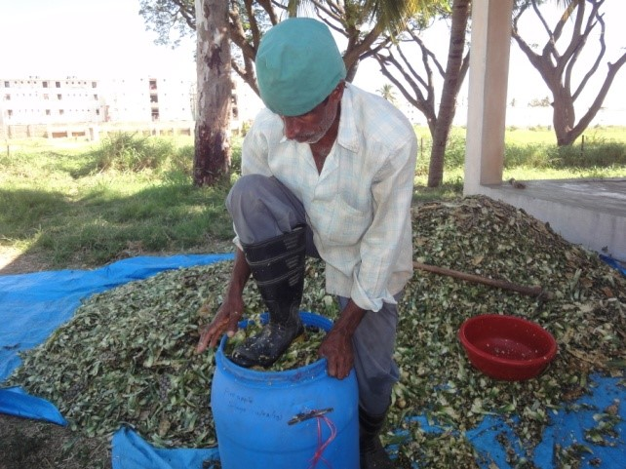
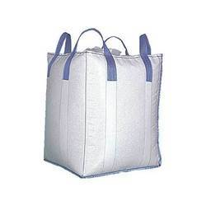
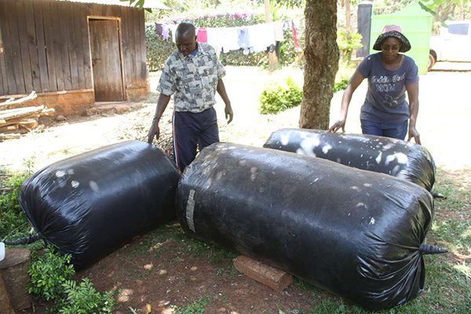
Drum silo
Bag silo

Slide 10
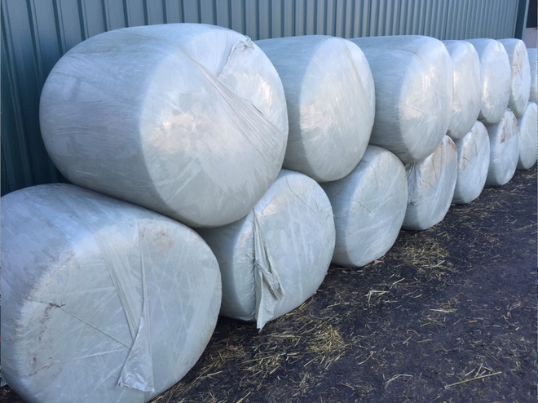
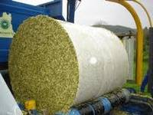
Silage bale

Slide 11
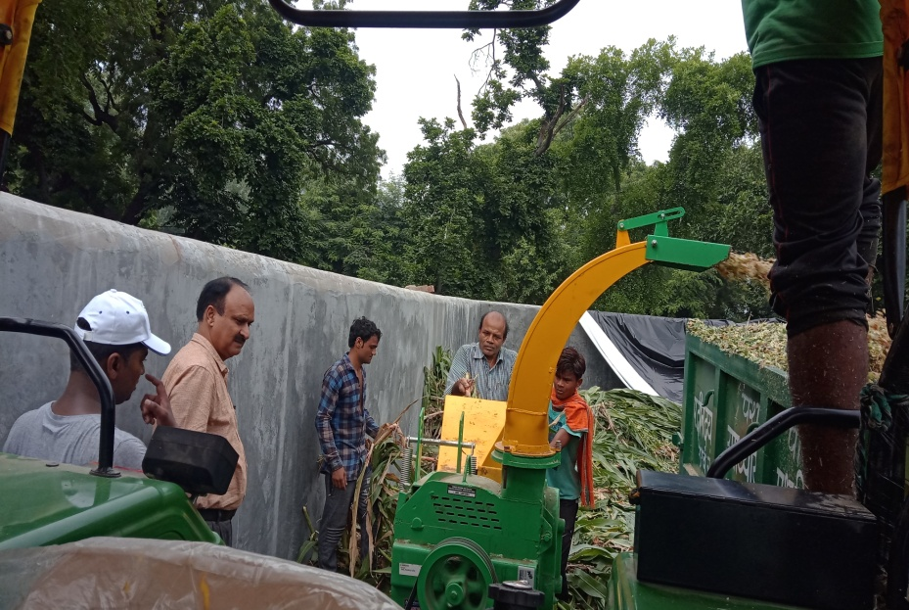
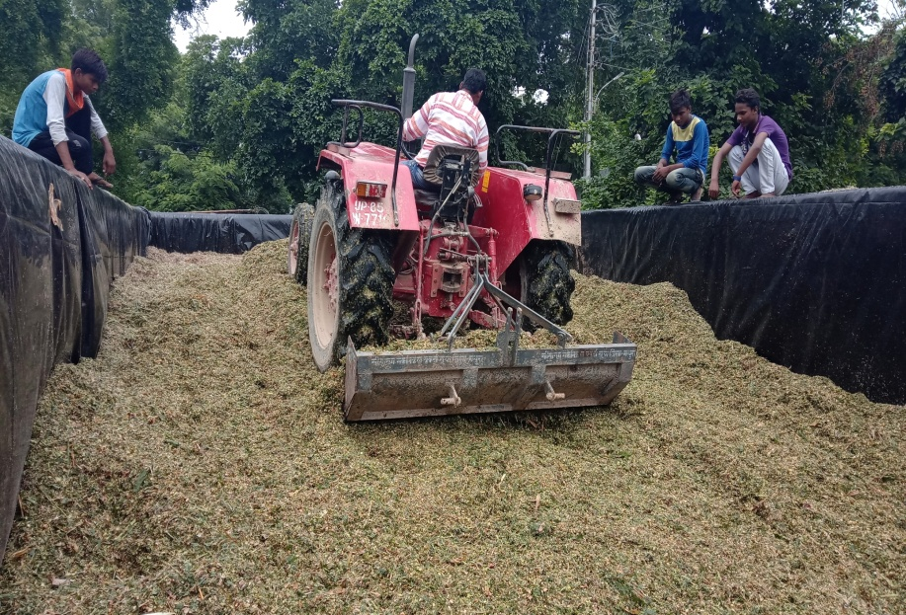
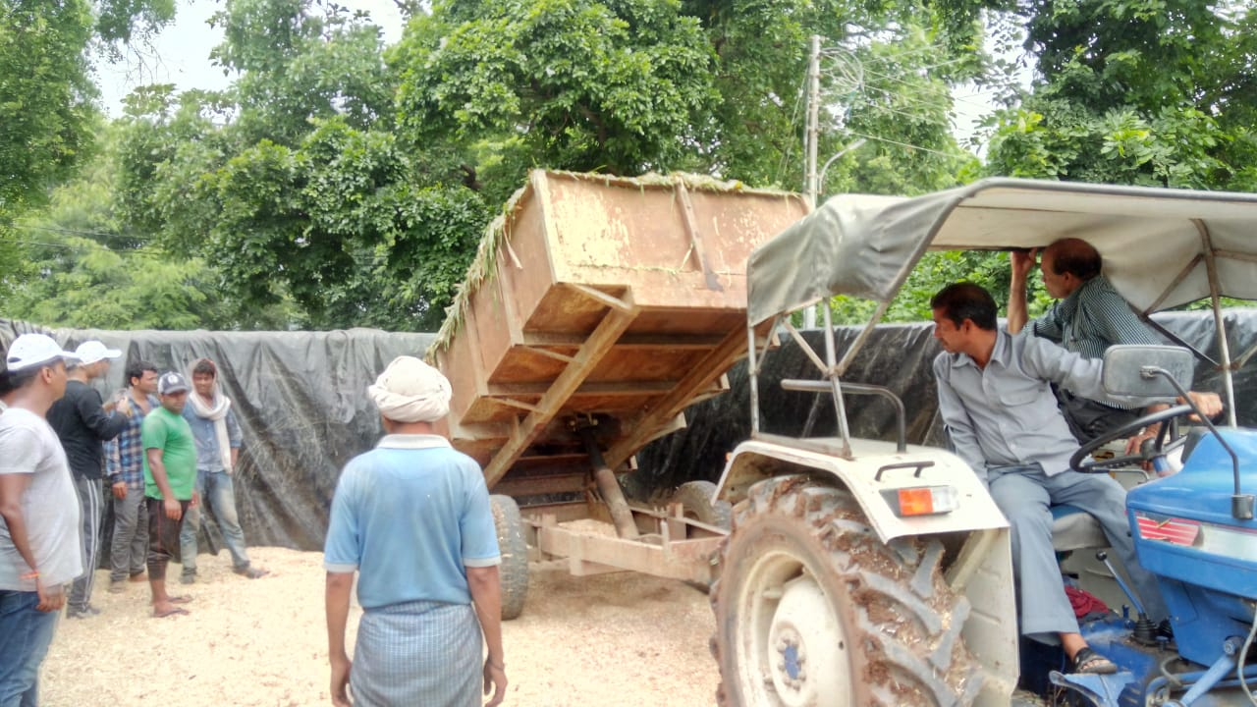
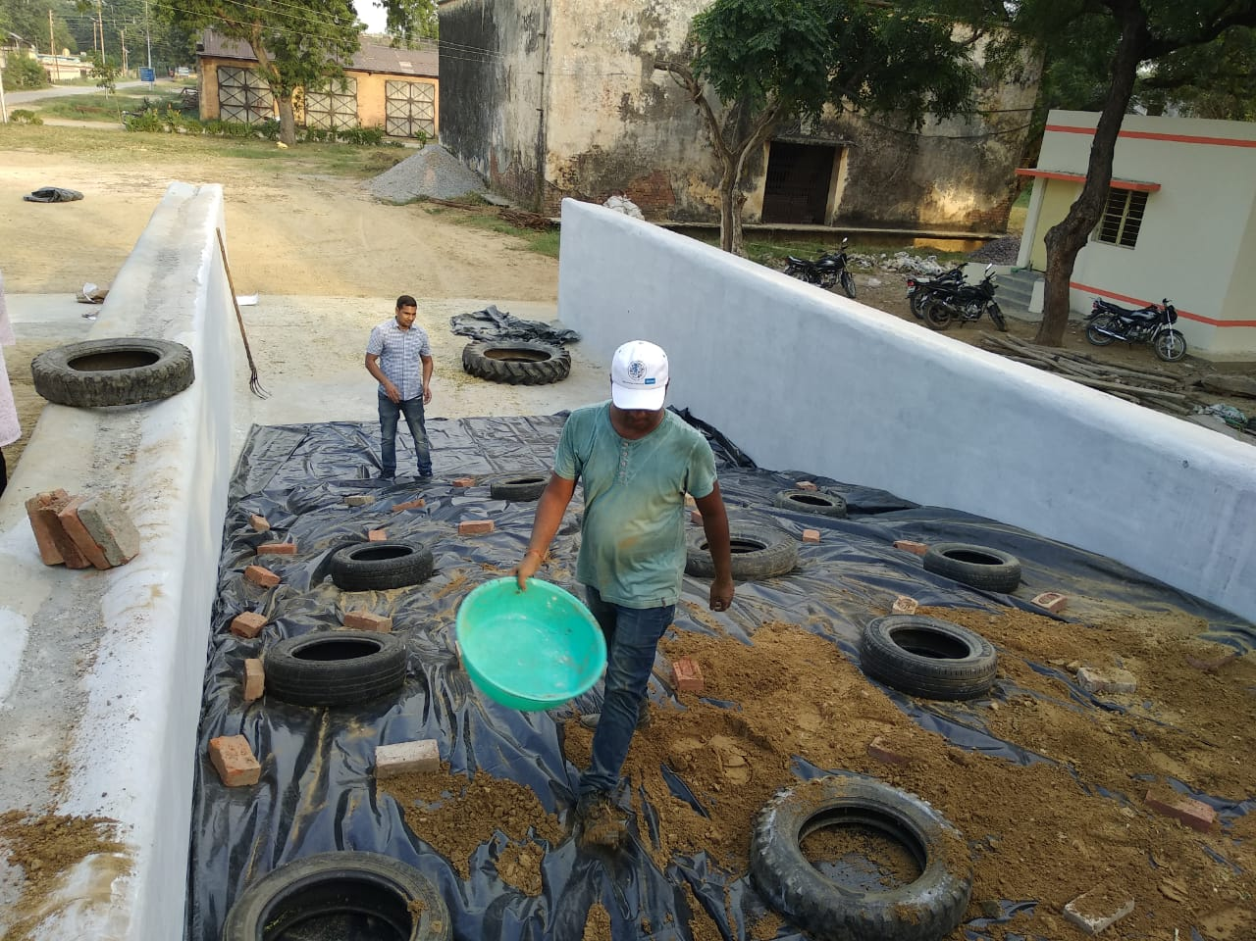
Silage preparation at LFC, DUVASU, Mathura

Slide 12
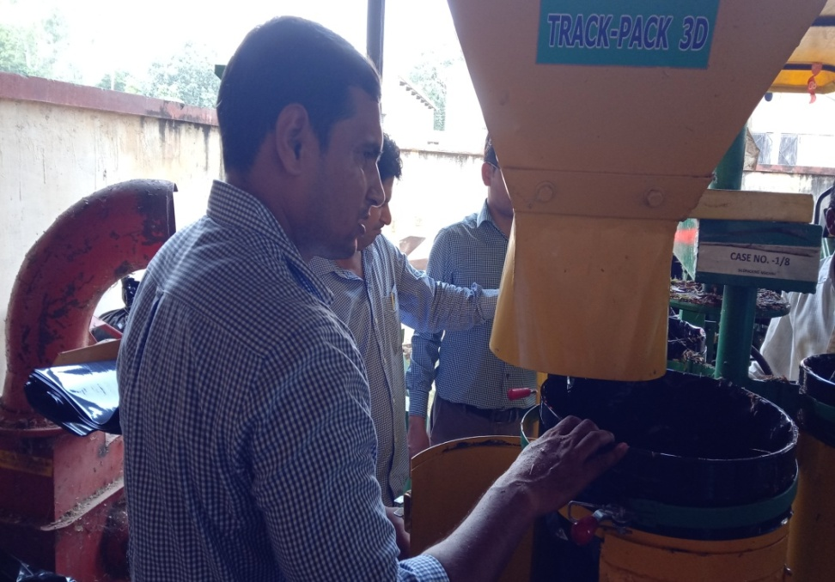
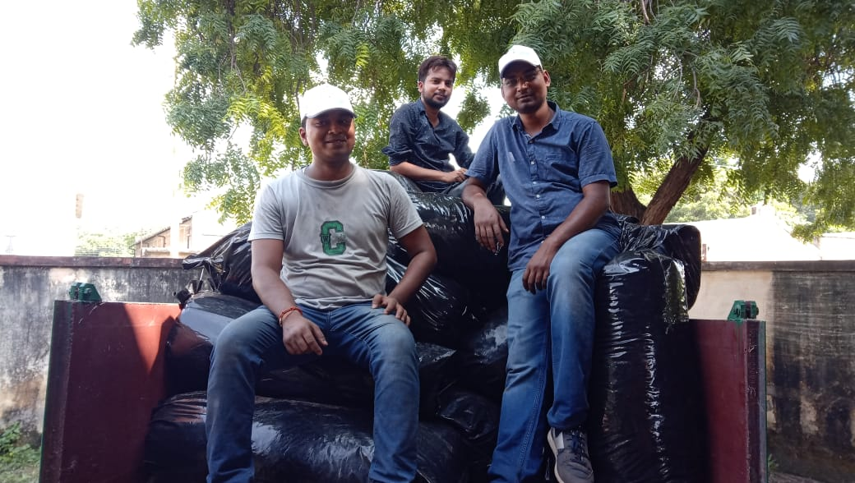
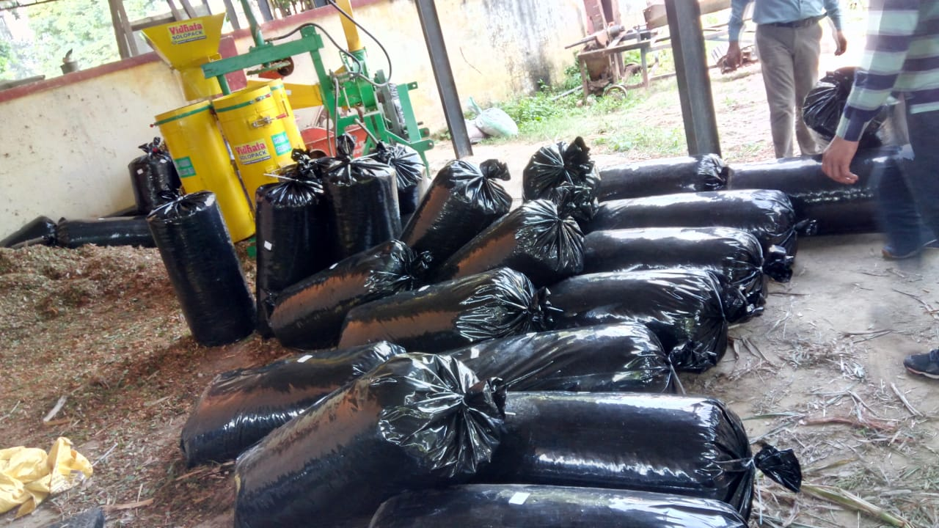

Slide 13
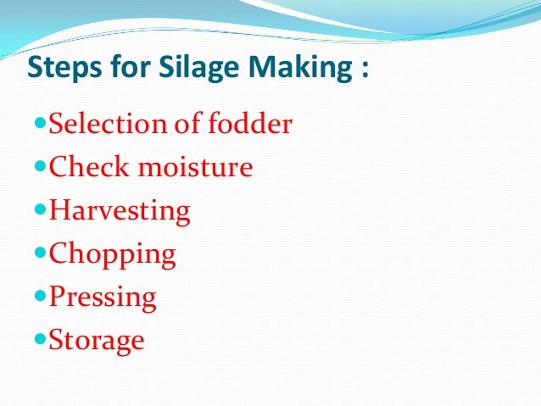
2. Ensiling

Slide 14
Crop suitable for silage making
Crops rich in soluble sugars/ carbohydrates content like maize, Sorghum (Jowar) and Pearl millet (Bajra) are most suitable for silage making.
Crop used for silage making should have dry matter 30-35% (moisture > 65%).
Crops having less soluble sugars can also be used for ensilage by addition of 3-3.5% soluble sugar like molasses.
Avoid legumes having low sugar and high protein contents, which favours the growth of the undesirable bacteria. Otherwise, mixed grasses or cereal fodder and legumes in ratio of 3:1.
Do not cut immature crops for silage making as they have high protein and’ low sugar contents.

Slide 15
Crops may be cut late in the day as sugar content increases during hours of sunlight.
For crops deficient in sugar, add molasses as uniformly as possible before ensiling.
Avoid cutting crops when soaked in rain or dew. If necessary, wilt the crop in the field before transporting to the silo.
Consolidate and rapidly seal the silo as the oxidation of sugars can produce water.
Prevent seepage of rain water inside the silos.

Slide 16
Fodder harvesting stage
The silage quality is influenced by dry matter (30-35%) and soluble sugar content (8-10%). All these factors are responsible for the development of lactic acid and other organic acids, which act as preservative.
Harvesting the crop at 50% flowering to milk or dough stage can make good quality silage of crops like maize, sorghum and pearl millet.

Slide 17
Process of silage making (Ensiling)
The fodder crops to be used for silage making should be harvested or wilted in field to attain a moisture level of 65-70% (30-35% DM).
Harvested fodder can be ensiled as such or chopped. But the silage crops are usually chopped into fairly small pieces (2.5-5 cm). Chopping facilitates good packaging of fodder and handling of silage thereafter.
The chopped fodder are compactly packed inside the silo and sealed off from the outer atmosphere.
Ensure even distribution of chopped fodder in the silo. Press (trample) the chopped material either by feet or with a tractor or bullocks as per the size of silo to exclude air as much as possible.
Pack the fodder up to 1 meter (3-4 fts) at the top of silo or above ground level of pit. Every half meter thick layer of chaffed fodder is to be regularly pressed.

Slide 18
6. Cover the fodder with 14-15 cm thick layer of wheat straw/paddy straw from all sides. Put mud on it and finally plaster it to seal the material preventing the entry of air and water. See that the silo is completely air tight.
7. Alternatively, a plastic sheet may also be used to cover the packed fodder. Edge of the sheet may be sealed by mud plastering.
8. Keep occasional watch and if there is any crack or hole plug it immediately. Silage would be ready within 4-6 weeks/45 days/2 months.
9. Ground shelled corn, cane molasses, limestone, urea and various commercial preparations are sometimes added to reduce fermentation losses.
10. Salt and urea are added @ 0.5 and 1%, respectively to cereals and grasses to improve their palatability and nitrogen content. In grass silage, molasses are added at 3.0-3.5% to improve the sugar content.
11. Open the silo pit from one end only and take out the required quantity, while the remaining silage is kept covered.

Slide 19
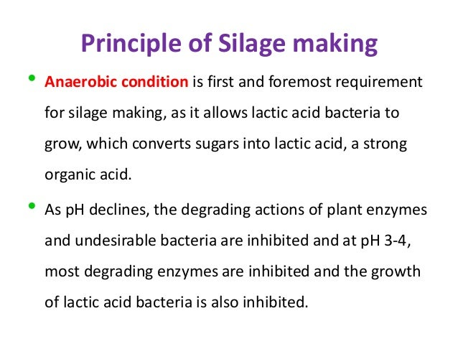
Lecture 2.
February 1, 2022

Slide 20
Chopped fodder (30-35% DM)
Silo
CHO
Temp.
(27-38 ⁰C)
CO₂
Activate lactic acid bacteria
Plant
Respiration
Aerobic bacteria
Enzymes, yeast and moulds
Lactic acid
pH= 4.0
O₂
Inhibit butyric acid
producing bacteria
Changes during ensiling

Slide 21
Colour of silage
The colour of good silage tend to yellowish or brownish green or golden in colour.
This is due to conversion of chlorophyll into brown magnesium free phaeophytin pigment.
High temp. during fermentation produced brown or black colour or dark brown colour silage.

Slide 22
A.I.V. method of silage making
This method was developed by Professor A.I. Virtanen in 1925 in Finland. In this method he recommended to add equal amount of (2N) H₂SO₄ and HCL which acts as preservative.

Slide 23
Classification of silage on the basis of their quality (Shephered et al., 1948)
Very good silage: pH = 3.5-4.2, ammoniacal nitrogen less than 10% of total nitrogen, lactic acid content= 1-2%, having acidic taste and free from butyric acid, moulds and sliminess.
Good silage: pH = 4.2-4.5, ammoniacal nitrogen= 10-15% of total nitrogen, butyric acid less than 0.2% with acidic taste.
Fair Silage: pH= 4.8 or more, ammoniacal nitrogen= 20% of total nitrogen with some butyric acid and moulds.

Slide 24
Losses during silage making
Silage can greatly influence losses of oxidizable vitamins like carotene, vitamin C or ascorbic acid. A part of minerals also leached out and lost.

Slide 25
Haylage
When the grasses and legumes meant for hay are ensiled, the term haylage is used. The DM content of haylage is 40-45%.
In this method 1 kg urea and 1.5 kg min. mix. Dissolved in 20 kg of water and mixed with 97.5 kg chaffed material.
Wastelage
Anaerobically fermented animal waste containing other feed ingredients (poultry dropping, poultry letter, swine excreta and bovine dung) with the help of lactic acid producing bacteria.

Slide 26
Important points
Lecture 3.
The best silage is moist to the touch, soft but not slimy and cut at right stage with dry matter 30 to 35%.
Low pH of silage discourages the activities of undesirable microorganism such as clostridia, enterobacteria, which produced objectionable fermentation products.
Legumes are difficult to ensiled due to high buffering capacity.
Lactic acid producing bacteria are facultative anaerobes (able to grow in the presence or absence of oxygen).
Lactic acid producing bacteria are classified into homofermentative (Lactobacillus plantarum, Pediococcus pentosacus, E. faecalis) and heterofermentative bacteria (L. brevis, Leuconostoc mesenteroides).
February 2, 2022

Slide 27
Increased clostridial number in silage indicates contamination of silage by soil and polluted water.
Clostridia produced acetic acid, butyric acids, amines and ammonia and grow best at 7.0-7.4 pH, where as enterobacteria produced acetic acid, ethanol and hydrogen and grow best at 7.0 pH.
DM losses 1-2% when wilting is for 24 hour. 6% after 5 days and 10% after 8 days of wilting.
Nutritive value of silage depends upon species and stage of harvested crop and changes during ensiling process.
The pits are dug 2.4 to 3.0 meter deep and one cubic meter of space of silo is required for 400 kg fodder.

Slide 28
Silo-fillers disease is an illness of farm workers that is caused by inhalation of the nitrogen dioxide (NO2).
Silage disease (sheep) in animal caused due to excess feeding of silage contaminated with Listeria monocytogene.
Should not feed silage at the time of milking.
Feed silage @ 4kg/100 kg body weight.

Slide 29
Advantages of Silage Making
The ensiling process is the only means by which the entire forage plant can be preserved in a succulent form.
The crops can be harvested and stored at the time of its development when it has the maximum nutritive value.
Silage retains higher proportions of nutrients than hay because losses due to shattering and leaching! bleaching are minimized.
Silage preserves 85% of feed energy. Hay under best conditions preserves only 80% and under poor conditions 50-60%.
Silage can be made from thick stem crops those are not suitable for hay making.
Silage can be made in almost any kind of weather.

Slide 30
7. Silage crops have more yield than other hay-crop.
8. Silage requires less storage space than hay.
9. Silage is more palatable, digestible and slightly laxative.
10. No wastage in feeding, as cobs, shucks and coarser stems are eaten.
11. Silage is a better source of protein and carotene.
12. Weeds can also be utilized along with main fodder crop.
13. Nutritive value of ensiled forage could be increased by adding suitable additive.
14. Less fire hazard with silage compared to hay and other dry crops.

Slide 31
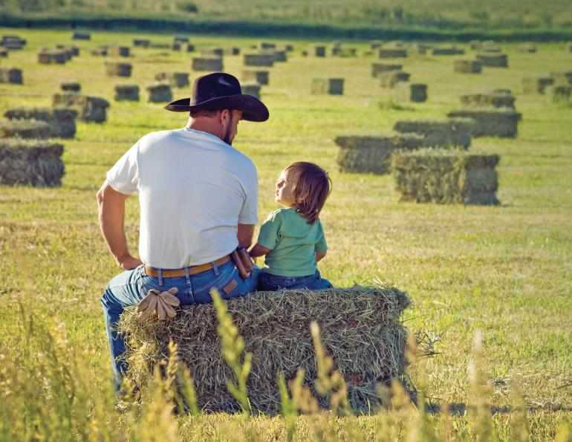
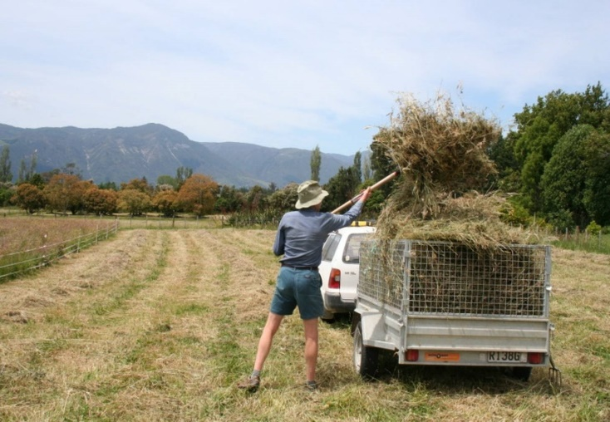
Hay making
“Hay making is the process of turning green, perishable forage into a product that can be safely stored and easily transported without danger of spoilage, while keeping nutrient loss to a minimum’
Crops with thin stems and more leaves are better suited for hay making as they dry faster than those with thick stem and small leaves. These may include: oats, berseem, lucerne , cow pea, etc.

Slide 32
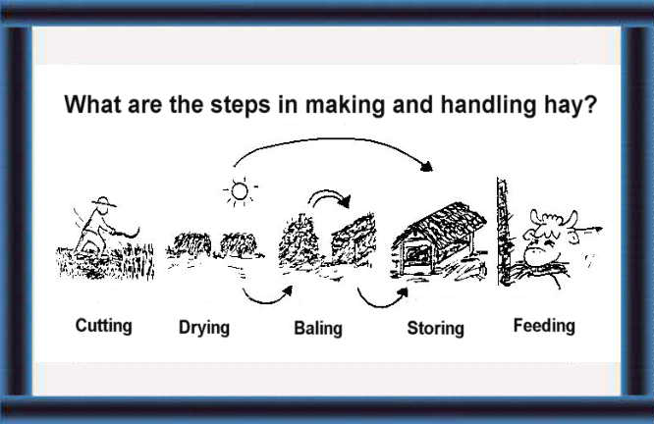

Slide 33
The aim of hay making is to reduce the moisture content of green crop to a level low enough to inhibit the action of plant and microbial enzymes.
The moisture content of hay should not be more than 12-14%.
Thin stemmed grasses, leguminous and hollow stemmed crops are suitable for hay making (like- Cowpea, Berseem, Lucerne, Oats etc).
Leguminous fodder crops (e.g. Cow pea, Lucerne, etc) should be harvested at the flower initiation stage or when crown buds start to grow, while grasses and similar fodder crops should be harvested at the pre-flowering stage. At this stage, the crop has maximum nutrients and green matter.
Best time of fodder harvesting in case of cereal fodder in the milk stage while in legumes at the time of tender pod formation.

Slide 34
Methods of hay making
Field curing
2. Mow curing (barn drying)
3. Artificial drying

Slide 35
1. Field curing
Steps in field curing
Cutting the crop: Preferably cut crops in the same direction.
Swath curing:
Hay is dried very fast in the swath than windrow.
After certain degree of drying there is shattering and bleaching of leaves.
Forage left to cure in swath until it is wilted sufficiently (upto 40% moisture content remaining) to avoid shattering and bleaching.
3. Raking:
After wilting of fodder as swath, it is rolled into small loose fluffy cylindrical bundles known as windrow.
It is better to do raking in the morning as dew make hay a little more tough and prevent shattering of leaves.

Slide 36
4. Cocking:
This is the process of making bigger heaps after hay has been cured partially in windrow.
Cocks were protected with rain caps where rain is expected.
5. Bailing and storing:
Bale hay with the help of automatic baler.

Slide 37
2. Mow curing or barn drying
This refers to the practice of curing partially dried hay inside the barn in mows.
Heated or unheated air is blow to the mows until moisture is reduced to 20-25%.
Swath curing is completed in the field itself until moisture content reach to 40%.
It taken to the barn and placed on the mows.
It takes 7-14 days on the mows with unheated air while less time with heated air to cure the hay fully.
Hay produced by mow curing will be greener and leafier and of a higher quality than field cured hay.

Slide 38
3. Artificial drying
In this method, freshly cut or wilted chopped fodder will be dried in artificial driers (600-1500 degree Fahrenheit for 3-5 min.).
This is limited to large commercial operations where alfalfa leaf meal us mainly as vitamin supplement in poultry and swine are produced.
Such hay is consistently of superior quality but costly.

Slide 39
Losses of nutrients during hay making
1. Shattering of leaves:
The leaves are much richer in digestible nutrients than stem hence losses by shattering decreased nutritive value of hay.
Hay should newer be over dried or handled during warm period of the day (preferably done in morning hours).
2. Losses due to bleaching (oxidation):
Much of the greener colour containing carotene is bleached.
Sun cured hays are rich in vitamin D2.
3. Losses due to leaching:
If cured hay is exposed to heavy and prolonged rain, sever nutrients losses may occur due to leaching.
Leaching causes loss of protein, soluble carbohydrate and other soluble nutrients and minerals.
4. Losses due to fermentation:
Protein is hydrolyzed to amino acids which will lost if there is heavy rain.

Slide 40
Total losses in hay making
Sl. No. | Nutrient losses | % of total losses
1. | DM | 20-30% (legumes) 10-15% (grasses/non-legumes)
2. | Protein | 28%
3. | Carotene | 90%
4. | Energy | 25%

Slide 41
Sun dried hays are rich in Vitamin D (ergocalciferol, Vit. D₂) content than original crop.
Drying during bad weather conditions leads to bacterial fermentation and such hay may also contains actinomycetes which leads to farmer’s lung disease.
Storage of high moisture legumes for hay making results into excess fermentation and heat production which leads to browning of material and such type of hay is known as brown hay or mow burnt hay.
Brown colour or dark brown colour of hay is attributed mainly due to Maillard type reactions.
The amino acid lysine is particularly susceptible to Maillard type reactions.
Nutritive value of hay is generally lower as compare to silage and losses during conservation is high in hay making.

Slide 42
Problems with hay making
If hay is dried in a moist environment (during heavy rains season), mould may grow on the hay. These moulds can be extremely toxic to animals as well as the people handling it.
In such cases it is advisable to wait till the end of the rainy season before cutting the forage. This may lead to lower nutritional content in the hay, but this is better than toxic hay.
On the other hand, drying the hay too fast may lead to shattering of the delicate parts of the plant, causing a subsequent loss of nutrients.
Although artificial drying produces hay of good quality, it is expensive, but can be attempted on a community basis in areas where there is a need.

Slide 43
Thank you

