Slide 1
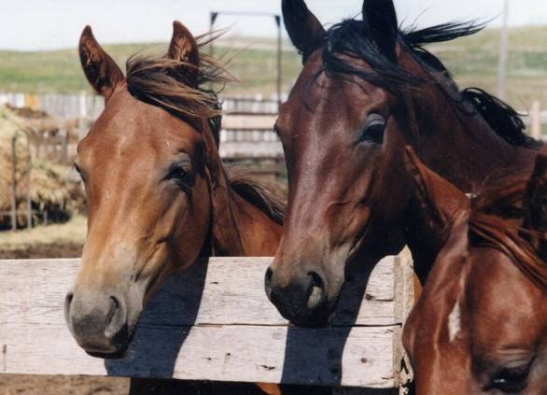
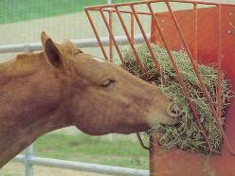
Feeding Management of Horse
Dr. Mamta
Assistant Professor

Slide 2
Feeding Management
Plan!
System of feeding in India- stall feeding, grazing and feeding bags
Horse’s condition score and fitness level
Feeding - at the same time each day and on individual basis
At least twice daily
Diet should be changed gradually

Slide 3
Body Condition Score
Based upon how much fat the horse is carrying
The scoring system uses a scale of 1 to 9
1-2 Poor
3 Thin
4 Ribs visible, vertebral ridge evident
5 Back flat, Ribs can be felt
6 Crease down back, fat deposits
7-9 Fleshy - Extremely fat
Useful to group horses for feeding management

Slide 4
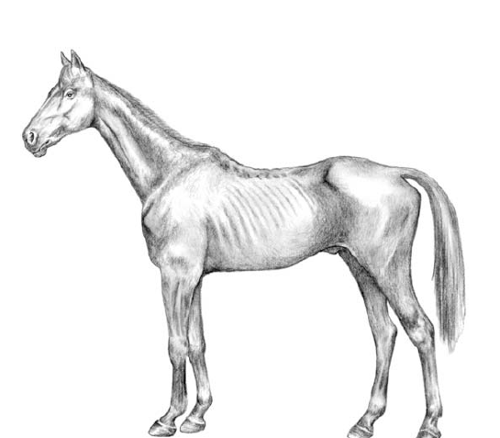
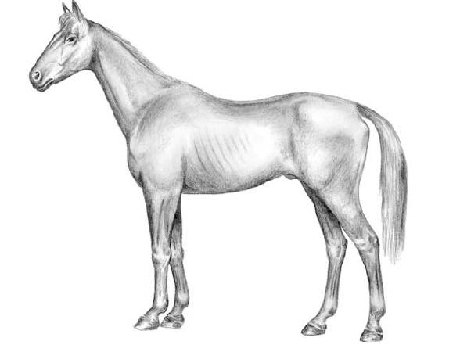
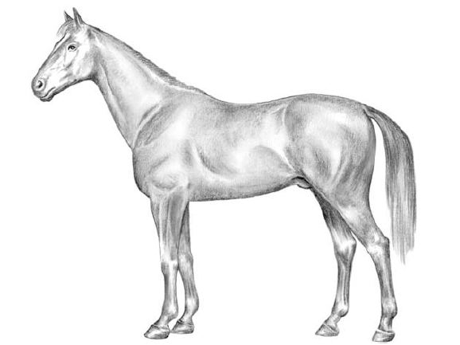
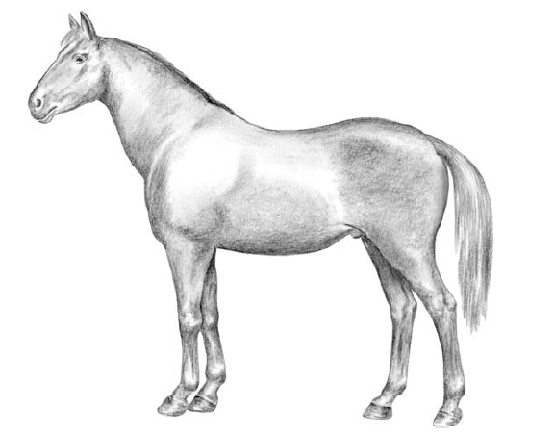
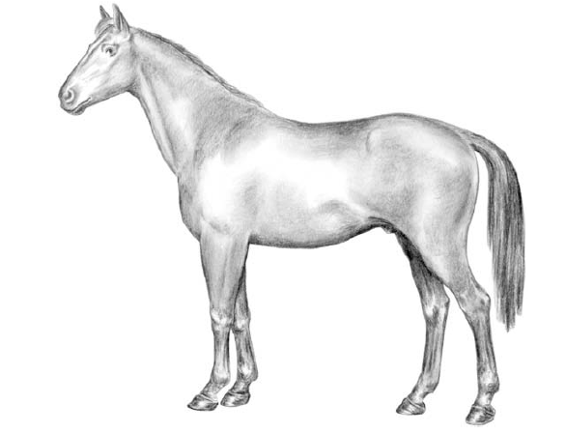
1
2
3
4
5
Illustration of body condition score of 1/9, 2/9, 5/9, 6/9 and 9/9 respectively
Reference: Becvarova et al., 2009

Slide 5
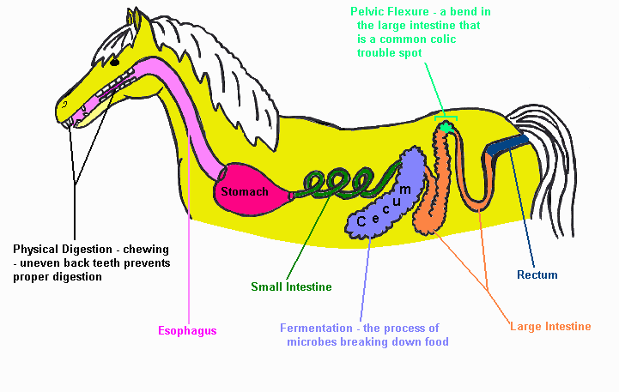
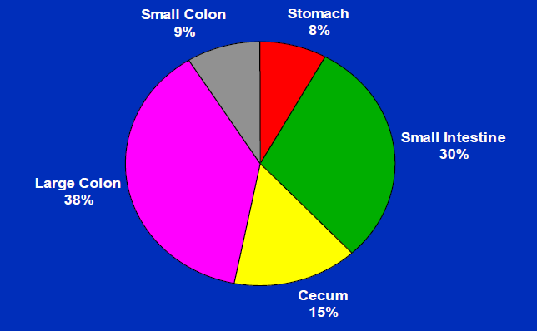
Horse Digestive System
One way system
Hindgut fermenter - digestion of fiber in LI
Digestion and absorption of non-fibrous feed ingredients in stomach and SI
Fibrous feed ingredients in ceacum and large colon by bacteria and absorption of VFA, water, ammonia, minerals, vitamins
Pelvic flexure – Bend in the large intestine that is a common colic trouble spot

Slide 6
Essential Nutrients
Water
Protein
Energy
Vitamins
Minerals
Carbohydrates and Fats

Slide 7
Water
Digestion and nutrient absorption
Temperature regulation
Consumption varies according to need
2 to 4 litres water per kg of dry matter intake
Free access to water

Slide 8
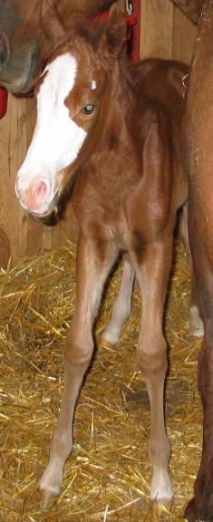
Protein
Feed - 5 to 20%
Greater amount for young and growing animals
Lysine - first limiting amino acid in young growing animals
Methionine and tryptophan - milk production

Slide 9
Source of protein
Source | Crude Protein (%)
Oats | 13.6
Linseed meal | 40.0
Barley | 13.9
Wheat bran | 17.0
Gram | 20.0
Soyabean meal | 43.2
Brewer’s yeast | 1.00
Pelleting the ration and adding 5% molasses, improves the palatability.
Source: Handbook of Animal Husbandry, 2008

Slide 10
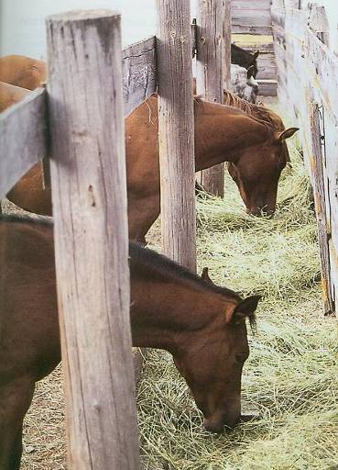
Energy
Roughages
Foundation for every feeding program
Main diet for growing, pregnant and lactating horses
4 to 6 kg per 100 kg body weight

Slide 11
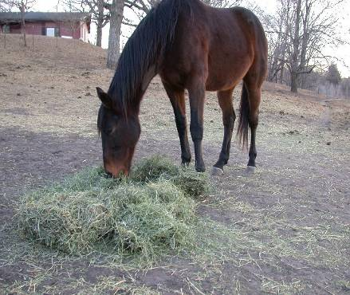
HAY OR SILAGE OR PASTURE
Hay, dub grass (Cynodon), anjan grass, angola grass from pasture, legumes like lucern, berseem
Silage – storage, transportation and palatability
Pasture – Hilly regions

Slide 12
Vitamins
Needed in small amounts for growth, repair and digestion
Factors and/or co-factors for chemical reactions in the body
Vitamin | Functions | Present
A | Essential for vision | High-quality leafy forages or through grazing
D | Ca absorption and bone growth | Obtained through sunlight
E | Antioxidant properties, reproduction, prevention of diseases like white muscle disease, EDM and EMND | Found in high quality hays and grains
K | Important for blood clotting | Found in high quality forages and intestinal bacteria can also synthesize
B complex | Absorption of feed, synthesized in hind gut | Good quality feeds

Slide 13
Minerals
Required in very small amounts (ppm)
For chemical reactions and structure/foundation
Minerals | Function | Present
Calcium and Phosphorus | Important in bones and teeth plus metabolic functions (i.e. muscle contraction) | Ca is present in hays/forages and P in grains
Sodium and Chloride | Important in osmotic balance | Supplementation- 0.5% to 1% to horses diet or free-choice
Magnesium | Bones and metabolism | Normal feedstuffs
Sulfur | Hoof growth | S-containing amino acids
Potassium | Intracellular action | Relatively higher in forages

Slide 14
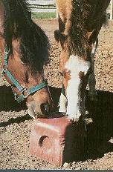
Minerals | Functions | Present
Copper and Zinc | Important for connective tissue | Too much Zn can cause Cu deficiency
Iodine | Essential for T3 and T4 that control basal metabolism and skin integrity | Iodized salt
Iron | Component of hemoglobin | Adequate in feedstuffs
Selenium | Detoxification of substances that are toxic to cell membranes | Toxic in soils in some areas, can also be deficient
TMS containing high levels of Cu (0.25%), Zinc (0.75%) and/or selenium (0.0025%) should be provided.

Slide 15
Feeding of Horses
Toxic factors, odour, taste, laxative properties and physical characteristics of feed such as hardness and bulkiness
Roughage requirement
Digestible Energy and Crude Protein provided
Concentrate to be fed
Double checking!

Slide 16
Feeding of neo-natal foals
Minimal energy store – Glycogen < 20 mg/g
Mare’s colostrums - 19% protein (ɤ-globulin), 0.7% fat and 5% lactose
500 ml of colostrum
Milk contains 480 kcal/kg DE, fed from 5th day onwards, meets all the nutrient requirements up to first 2 to 3 week

Slide 17
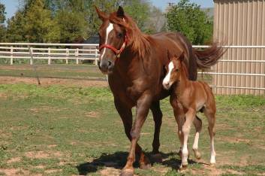
Feeding of foals
Upto 1 year- proper balanced ration
5 to 6 kg of good hay
16% CP, 0.8% Ca and 0.6% P along with 6000 IU per kg Vit A and trace minerals
Major problems – contracted tendons, epiphysitis and several deficiencies

Slide 18
Feeding of yearlings
Good pasture
Concentrates 0.25% to 1.0% of body weight
14% to 18% protein
Consume 2% to 3% of their body weight dry matter per day

Slide 19
Daily Nutrient Requirement Of Mature Horses
Body weight (kg) | Daily feed (kg) | Digestible energy (Mcal) | Crude Protein (kg)
Maintenance
200 | 3.75 | 8.24 | 0.32
400 | 6.30 | 13.86 | 0.54
500 | 7.45 | 16.39 | 0.63
Mature horse at light work (2 hr daily)
200 | 4.20 | 10.44 | 0.38
400 | 7.40 | 18.36 | 0.67
500 | 8.80 | 21.89 | 0.80
Mature horse at medium work (2 hr daily)
200 | 5.30 | 13.16 | 0.48
400 | 9.60 | 23.80 | 0.87
500 | 11.60 | 28.69 | 1.05
Source: Handbook of Animal Husbandry, 2008

Slide 20
Daily nutrient requirement of pregnant and lactating mare
Body weight (kg) | Daily feed (kg) | Digestible energy (Mcal) | Crude Protein (kg)
Pregnancy (last 90 days of gestation)
200 | 3.70 | 9.23 | 0.39
400 | 6.20 | 15.52 | 0.64
500 | 7.35 | 18.36 | 0.75
Lactation (first 3 months of age)
200 | 5.20 | 14.58 | 0.71
400 | 8.35 | 23.36 | 1.12
500 | 10.10 | 28.27 | 1.36
Source: Handbook of Animal Husbandry, 2008

Slide 21
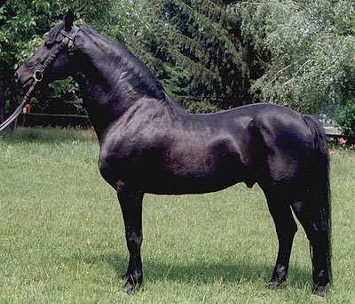
Feeding of stallion
Non-breeding season
High quality pasture is sufficient
Green and leafy hay provided with small amount of concentrate feed
Breeding season
25% more energy, protein, minerals and vitamin
0.75 to 1 kg per 100 kg b.wt. concentrate feed having 12-14% CP with good quality hay

Slide 22
Feeding of geriatric horses
More than 20 years of age
Higher CP (12%–16%) – high quality protein sources, such as soybean meal
Grain or grain by- products are mechanically (ground) or thermally (popped or heat-extruded)treated to improve prececal starch digestibility
4 to7% crude fat
12% crude fiber
Feeding rate - 2% of body weight
Minimum of four feedings
Ca:P ratio maintained at between 1.5:1 and 2:1

Slide 23
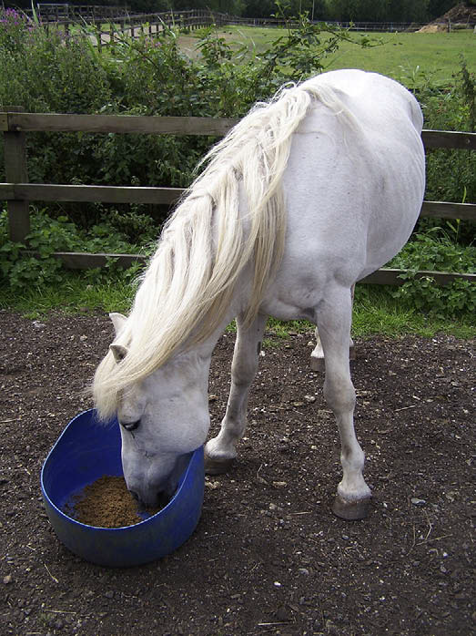
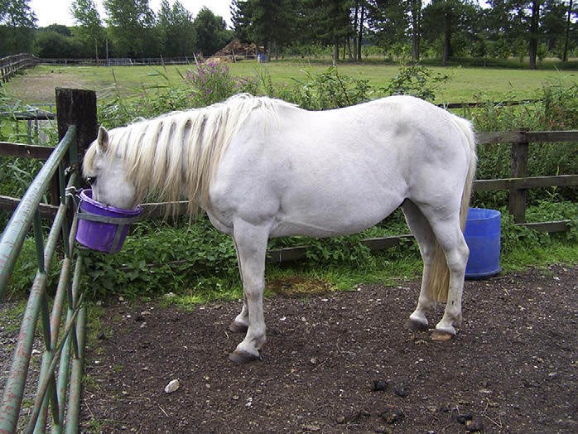
Feeding from a raised bucket improves comfort and can lead to increased feed intake and weight gain
Feeding from the floor can prove difficult for a horse with osteoarthritis of the neck or
forelimbs

Slide 24
Feeding of sick horses
Nutritional support should be offered within the first 48 to 72 hours
Intravenous route
Enteral therapy (administration of nutrients through a nasogastric tube) - field conditions
Horses recovering from an acute illness - therapeutic ration, that is formulated to support the animal’s metabolic and nutritional needs

Slide 25
Feed additives
Probiotics - increased feed efficiency
Yeast culture - increased fiber and protein digestion
Organic/chelated/proteinated minerals- greater absorption for faster growth rate and faster hoof growth
Vegetable oil - source of EFA, improved coat condition, greater hoof flexibility and less cracking
Digestive enzymes

Slide 26
