Slide 1
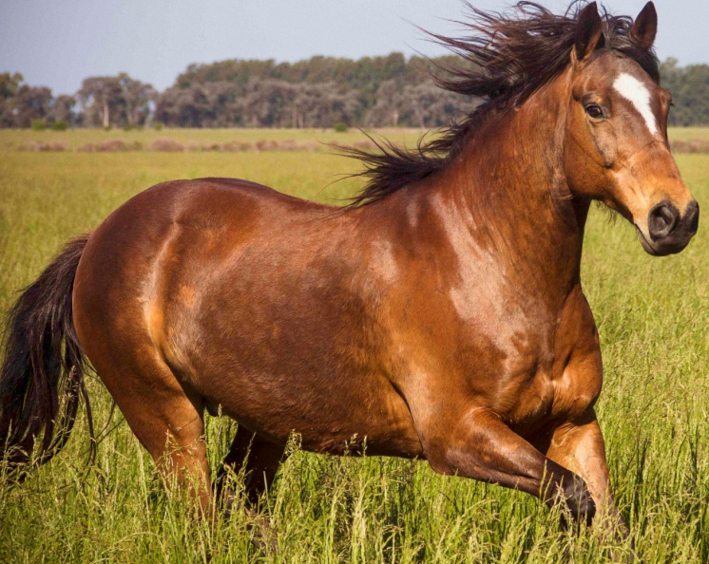
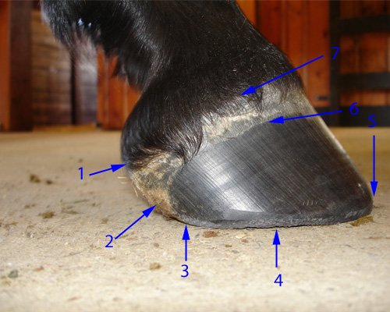
No Hoof, No Horse
Structure of Hoof and its importance
By
Dr. Abhinov
Asst. Professor

Slide 2
No Hoof, No Horse
It may sound cliché to quote the age old saying, “no hoof, no horse,” but it is entirely too true.
Although horses are no longer used as a primary mode of transportation, their main use is still for riding or other athletic endeavors, and a riding horse must have sound, healthy hooves in order to function properly and be of any use to its owner.

Slide 3
The equine hoof is a great example of Mother Nature’s engineering capabilities.
Consider the size and weight of a horse relative to the size of a hoof, and how fast horses can run or how high they can jump; it’s amazing how so much is supported by so little.
A horse’s hooves play a key role in its ability to survive and function.
Horse’s hooves can require more maintenance than dairy hooves, or the hooves of any other animal for that matter, depending on their athletic use.

Slide 4
As mentioned previously, horse’s hooves not only require daily cleaning, but some horses benefit from shoeing as well.
Horse’s hooves are subjected to many insults either out in the pasture or while they are being ridden or driven.
Stone bruises, punctures, and abscesses are all common problems in equine hooves.
Horses also suffer from diseases similar to those in cattle, sheep, and goats

Slide 5
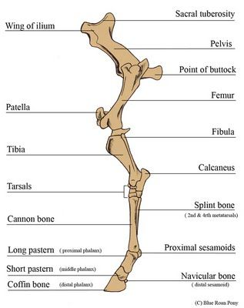
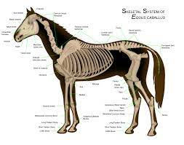
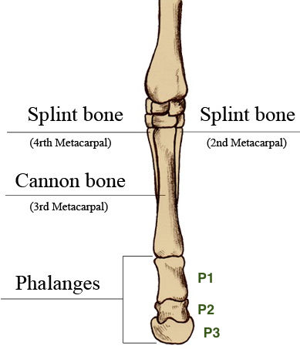

Slide 6
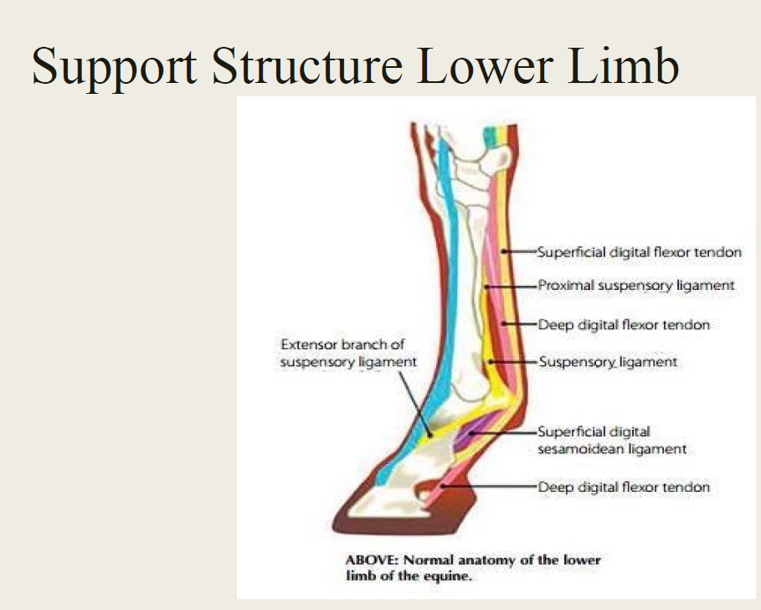

Slide 7
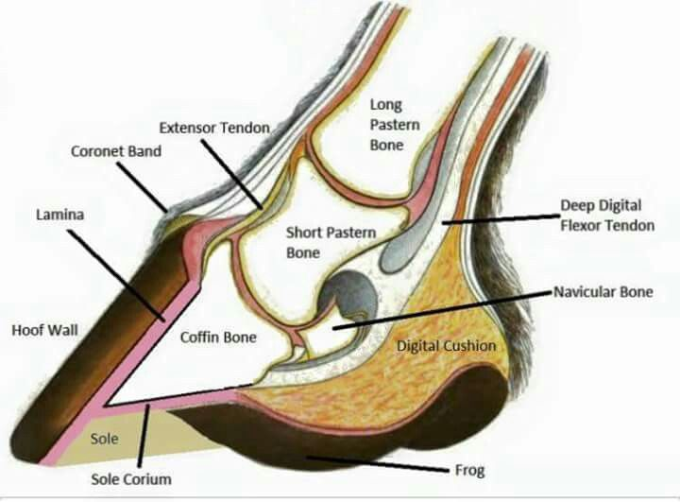

Slide 8
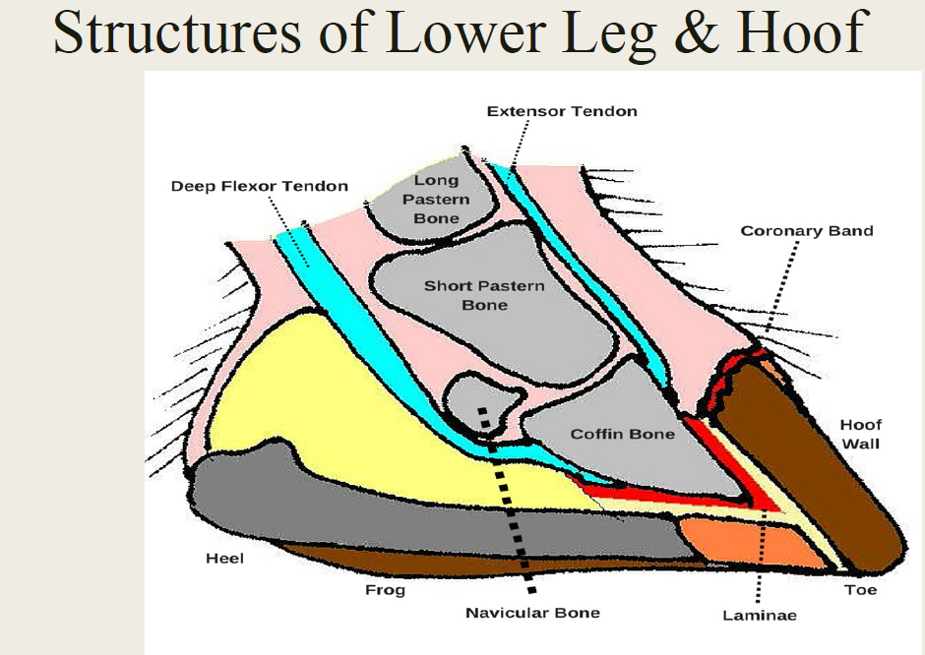

Slide 9
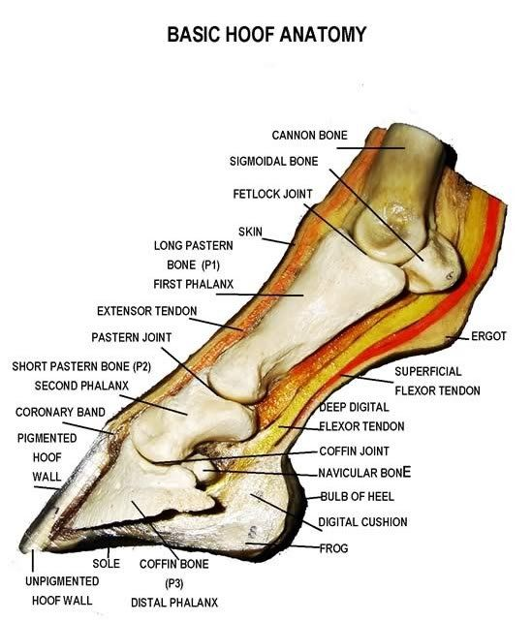

Slide 10
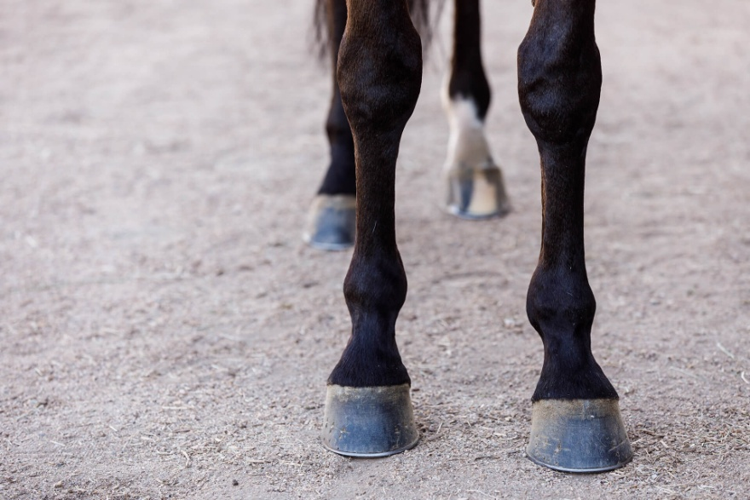
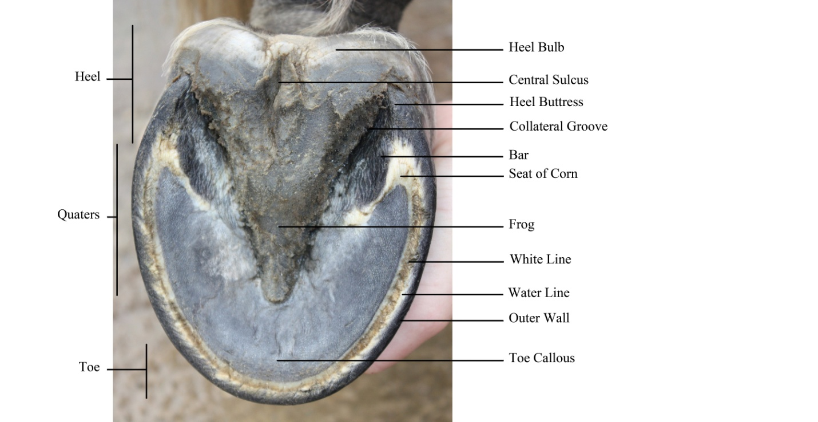
Frog
Wall
Sole
Hoof is the horny covering of the distal end of the digit. For description it is divided into three parts.
Wall
Sole
Frog

Slide 11
1. Wall
hard, horny outer covering that houses and protects the more delicate structures within, supports the weight of the horse and absorbs shock as the horse moves.
hoof wall does not have nerves or blood vessels; it’s a continually growing, keratinous material that needs to be trimmed or naturally worn off.
A healthy hoof wall grows about 3/8 of an inch per month.
hoof wall can either be black or white. If a horse damages the internal structures of the hoof, it can cause a lameness.
Healthy hooves should not have any cracks or rings.
Cracks can make the internal structures vulnerable to potentially damaging substances, like gravel or germs.
Rings on the hoof can indicate that the horse may have some additional health problems that are affecting his hooves.

Slide 12
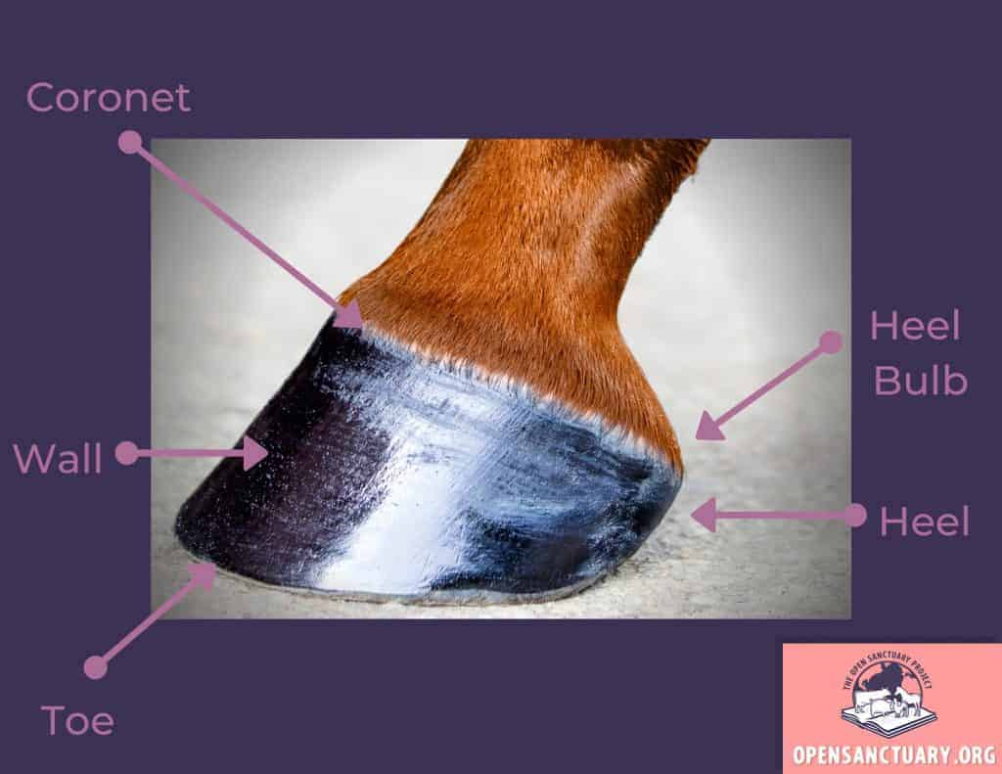
Wall:
It is the part of hoof which is visible when the foot is placed on the ground.
It covers the front and sides of the foot, and is reflected posteriorly at an acute angle to form the bars.
Sole

Slide 13
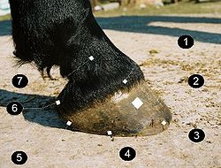
Parts of wall
Toe: The most anterior part of the wall.
Quarter: Medial and lateral parts of the wall.
Heel (angle)
Coronary Band
Wall
Toe
Quarter
Heel
Bulb
Pastern Joint
Wall

Slide 14
Wall has 2 surfaces and 2borders
External surface: It is convex from side to side and slopes obliquely from edge to edge.
Angle of inclination to the ground on the front of the hoof
In fore limb- 50 degree
In hind limb- 55 degree
Angle of inclination to the ground on the heel is
100 degree
1. Heel bulb
2. Periople at the heel
3. Heel
4. Quarter
5. Toe
6. Periople
7. Coronary band
External surface

Slide 15
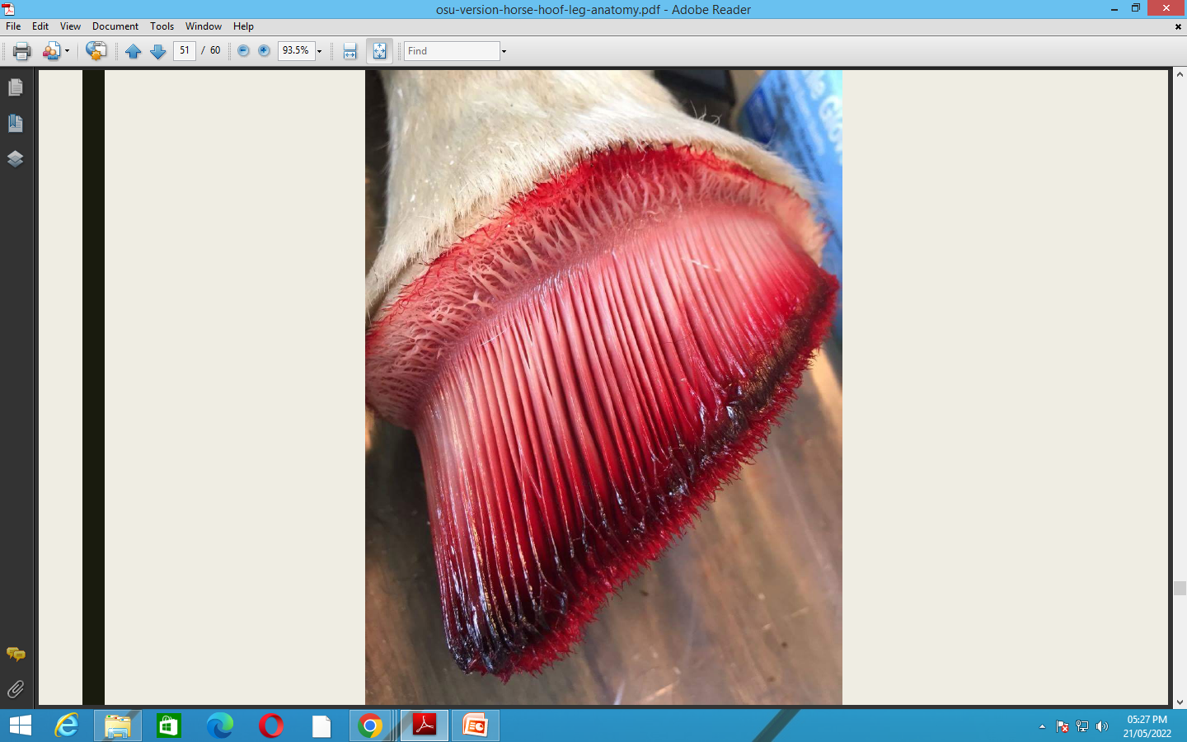
Coronary Band
The coronary band is at the top of the hoof wall where the hairline meets the hoof. This band encircles the top of the hoof wall and is usually light in color.
It is the primary growth and nutritional source for the hoof wall. Although its structure is tough, it also contains a large blood supply. Injury to the coronary band can result in damage to the hoof wall or disrupt proper hoof growth to the point where the horse may no longer be rideable.

Slide 16
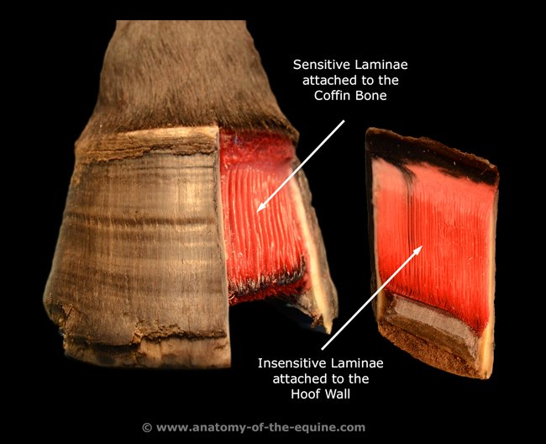
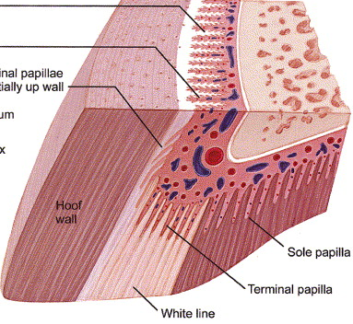
Internal surface: It is concave from side to side and bears about six hundred thin primary laminae which extends from coronary groove to the basal border of the wall. Each primary laminae bears a more than hundred secondary laminae, so that the arrangement is pinnate on cross section. Laminae are continued on the inner surface of the bars and dovetail with corresponding laminae of the corium
Primary epidemal papillae
Secondary epidemal papillae

Slide 17
BORDERS
Coronary border
Periople
Coronary border: Coronary border is thin in a horse.
Periople : Outer aspect of this border covers with a layer of soft, light-colored horn, the periople. The periople covers the soft area just below the coronary band and helps protect the hoof wall. The soft area is made up of newly formed hoof wall tissue, and the periople helps give it time to harden.

Slide 18
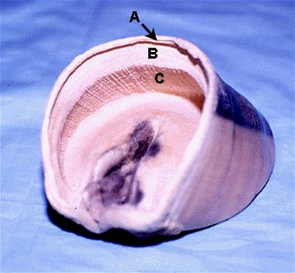
Periople: It appears as a ring like prominence above and gradually fades out below . At the angle it forms a wide cap/bulb and blends centrally with frog.
Coronary groove: The inner aspect of coronary border is excavated to form the coronary groove. It contains the thick coronary corium.
Perioplic groove: above the thin border of wall proper there is small perioplic groove which contains the corium of the perople
Coronary groove
Perioplic groove
Epidermal laminae
Bulb

Slide 19
Basal border/ Ground border: It comes in contact with the ground. Its thickness is greatest in front and decreases considerably with on before backward on either sides. But there is slight increase at the angles. Its inner surface is united with the periphery of the sole by horn of light color and softer texture which appears on the ground surface of the hoof called as white line

Slide 20
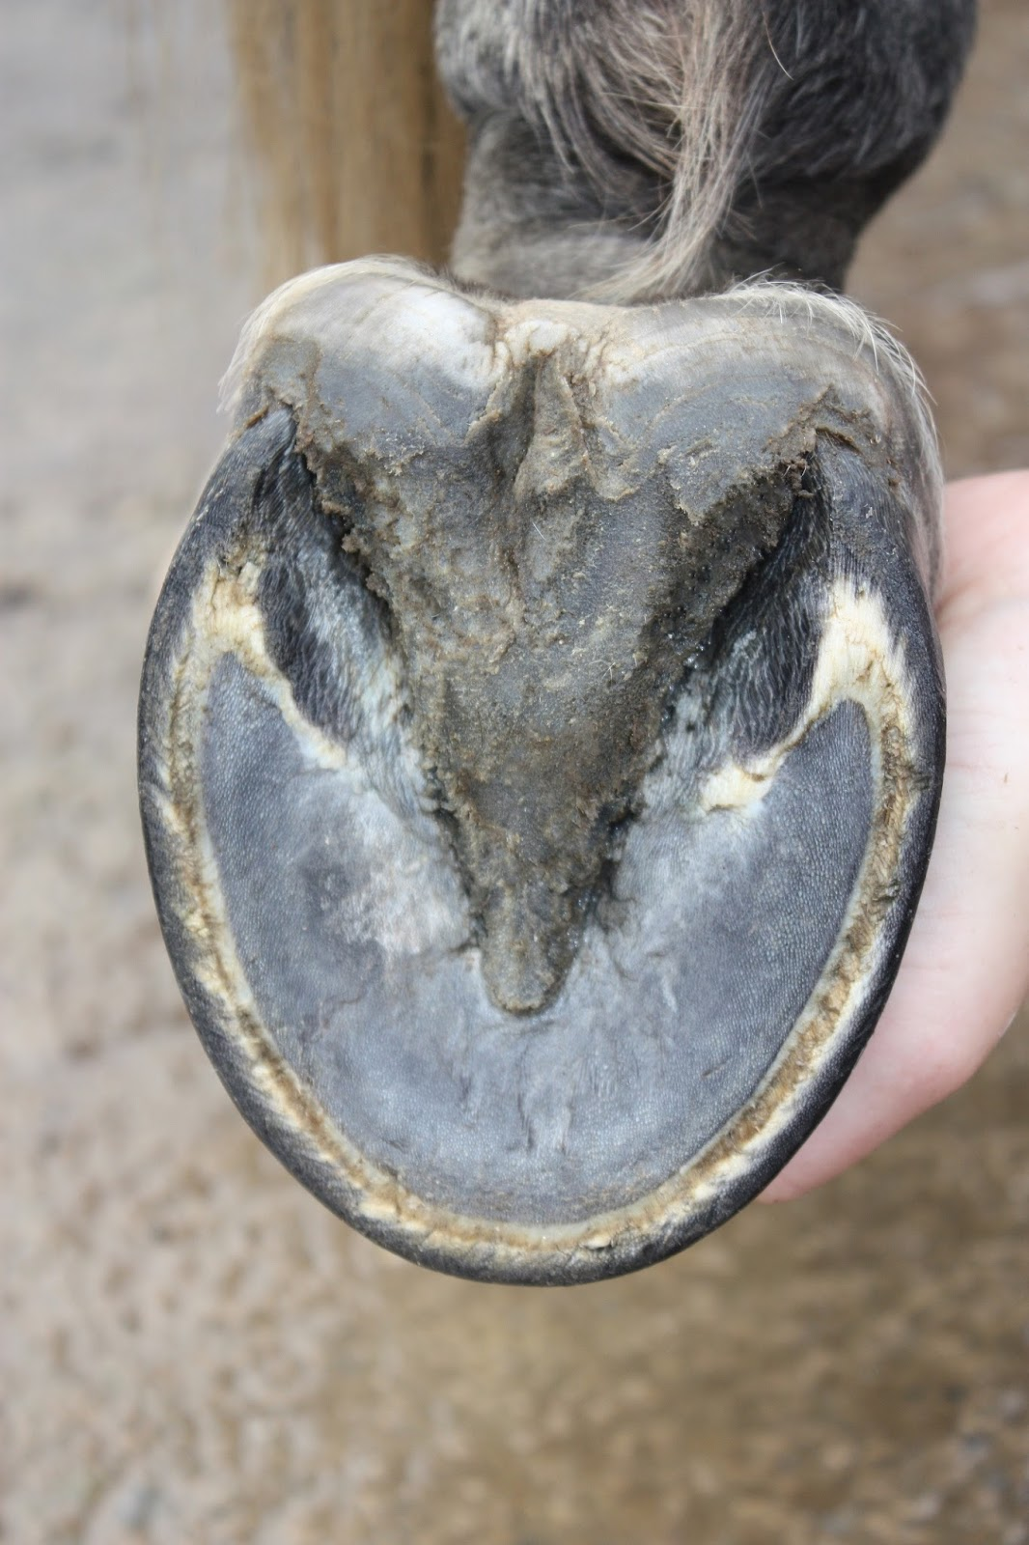
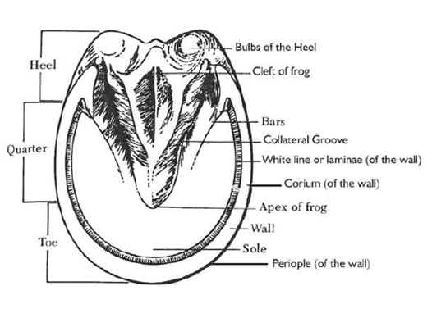

Slide 21
2. Sole
The structure of the sole is similar to that of the hoof wall; however, the keratin found in the sole is more easily rubbed or worn down than that found in the hoof wall.
The sole also helps to protect the inner workings of the hoof, and is designed to bear internal weight transferred through the border of the sole rather than weight from the ground.

Slide 22

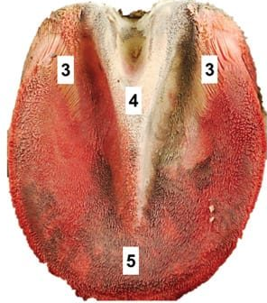
2. Sole:
Forms the greater part of the ground surface of the hoof.
Internal surface is convex and slopes obliquely downward to the convex border. It presents numerous small funnel like openings which contain numerous papillae of the sole corium in the natural state.
External surface : is concave , normally archeds more strongly in the hind than the fore foot.
External surface
Internal surface

Slide 23
Convex border: it is joined to the wall by relatively soft horn called white line on the ground surface of hoof.
Concave border : it is in the form of deep angle, which is occupied by the bars and the apex of the bars. The parts of the sole between the wall and bars are called angles.

Slide 24
One important area of the sole is the “white line,” which may actually be somewhat yellow in color.
white line is the junction between the hoof wall and the sole.
Tissues of the white line area contribute to sole protection and help attach the sole to the inner wall of the hoof.
When the white line area becomes impaired, it allows germs to enter and separate the layers of the hoof wall.
Once this happens, it can spread throughout the hoof and make the horse lame.

Slide 25
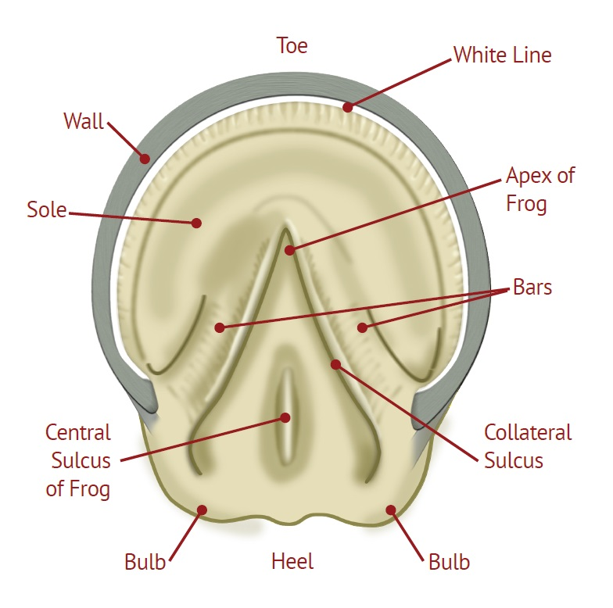

Slide 26

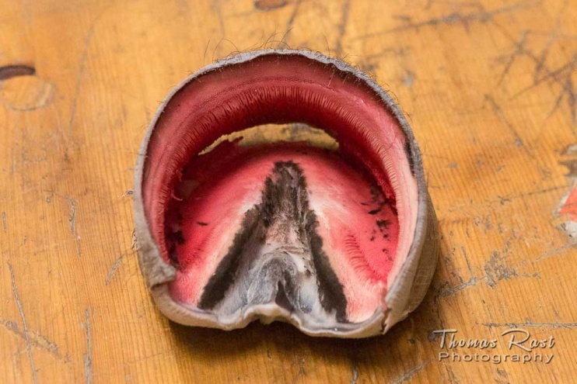
3. Frog

Slide 27
3. Frog:
When you pick up the horse’s hoof, the frog is immediately obvious – it’s the tough, thick, V-shaped structure pointing down from the heels.
It protects the digital cushion beneath it, aids in traction and circulation in the hoof, and partly acts as a shock absorber when the horse moves.
The sensitive nerves in the frog communicate to your horse where his feet are and help him feel the surface on which he is standing.

Slide 28
3. Frog:
it is wedged shaped mass which occupied the angle bounded by bars and sole,and extends considerably below these on the ground surface of foot.
Description- 04 surface,a base, and an apex
1. Internal surface bears central ridge called frog stay, which is high posteriorly but subsides abruptly in front. On either side of this there is depression, bounded outwardly by the rounded ridge formed by the junction of the frog with the bar and sole. The surface presents fine stria and openings for the papillae of corium

Slide 29
External surface / ground surface presents central sulcus, bounded by two ridges called crura. The medial and lateral surfaces are united at the upper part with the bars and sole.
The base is depressed centrally and prominent at the sides where it unites with angles of the wall . The junction here is covered by the expanded periople and constitute the bulb of the hoof.
The apex occupies the central angle of the concave border of the sole and form blunt rounded prominence.

Slide 30
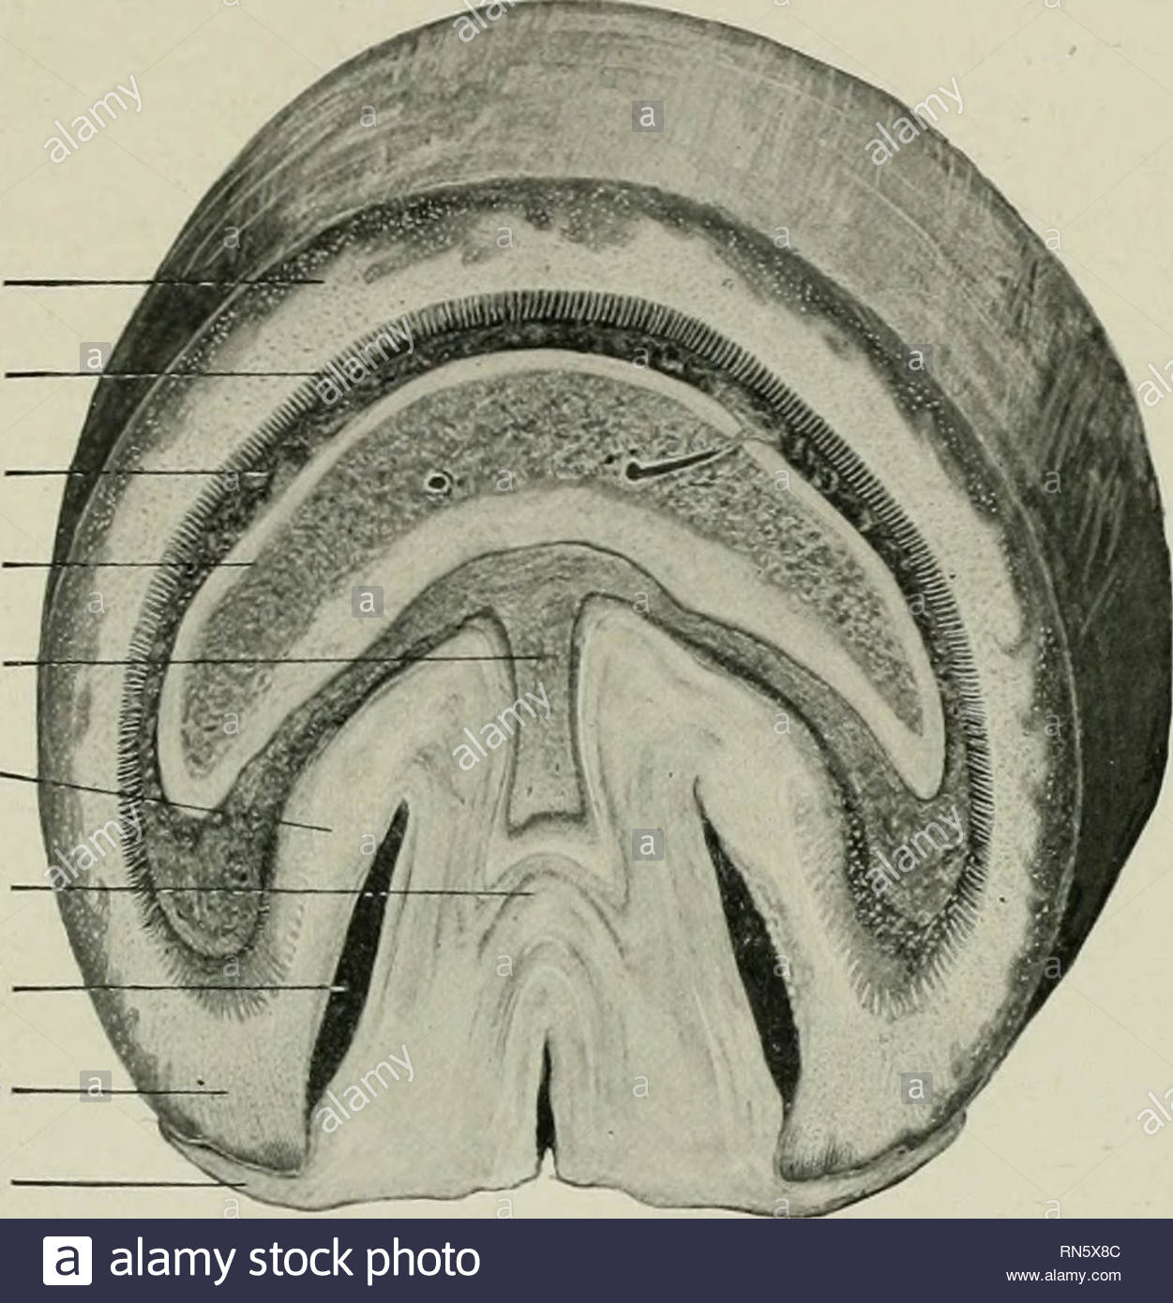
Cross Section of Hoof of Horse
Wall
Lamina of wall
Laminar corium
Third Phalanx
Digital cushion
Bar
Frog
Space b/w bar & frog
Angle of wall
Periople of heel

Slide 31
Bars :are extensions of the hoof wall that turn-in at the heel and run partway along the frog. The bars strengthen the heel area and control overexpansion of the heels. This area also contributes to building the sole of the hoof and helps support the horse’s weight.
Digital Cushion
The digital cushion is the area below the coffin bone towards the back of the hoof. It does exactly what the name implies: it is a cushion of cartilaginous material with some “give,” acting as one of the main shock absorbers in the hoof.

Slide 32
The corium of the foot
The hoof is nonvascular and receives nutrition from corium. It is also destitute of nerves.
The corium of the foot (pododerm is specially modified and highly vascular part of the corium of the common integument which furnishes nutrition to the to the hoof.
Perioplic corium
Coronary corium
Laminar Corium
Corium of sole
Digital cushion

Slide 33
Corium of periople
Coronary corium
Laminar corium
Lateral view of foot of horse after removal of hoof wall and part of skin

Slide 34
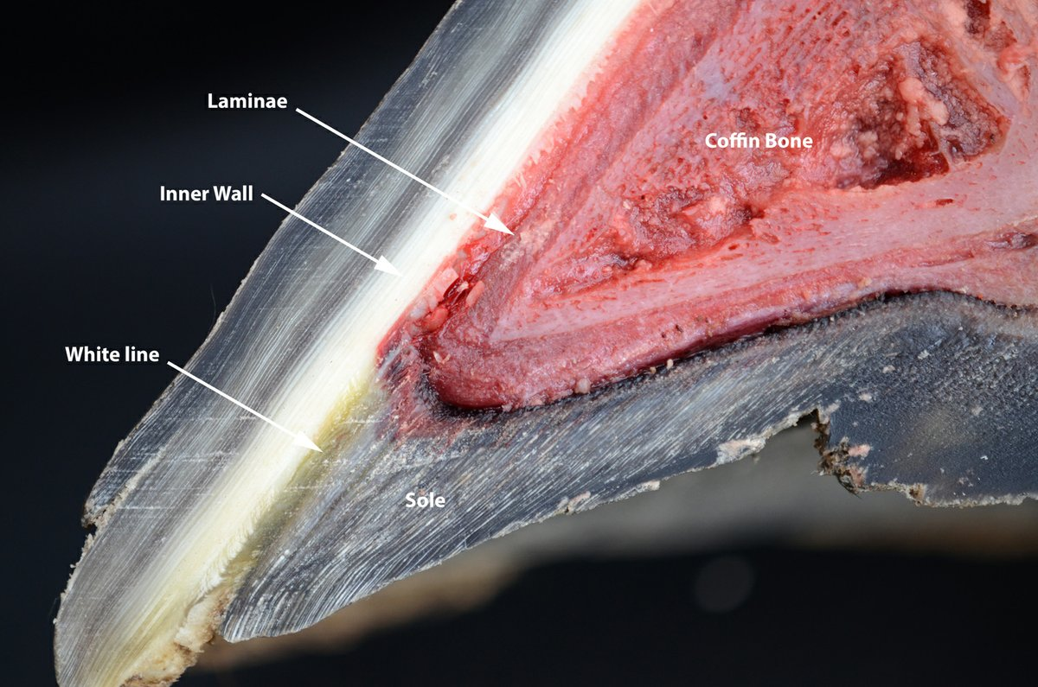
Half of hoof of horse (Internal Surface)

Slide 35
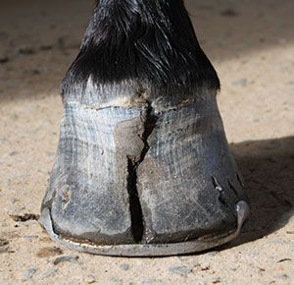
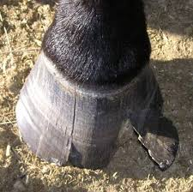
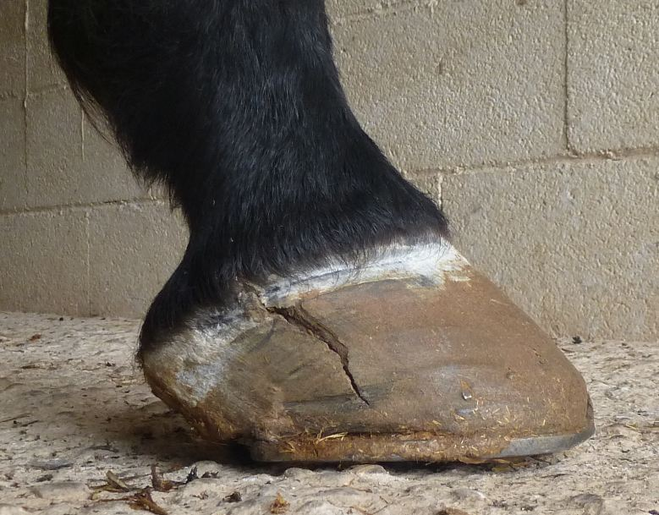
Cracks in hoof

Slide 36
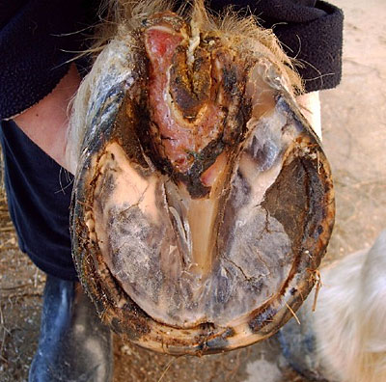
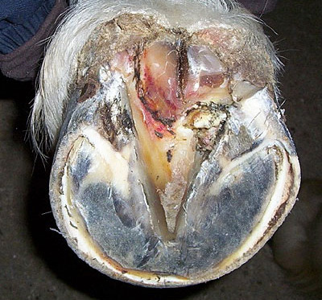
Hoof Cancer

Slide 37
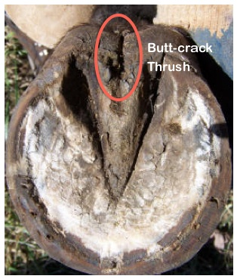
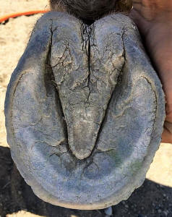
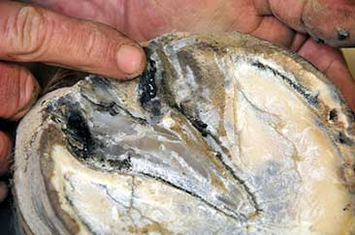
Thrush

Slide 38
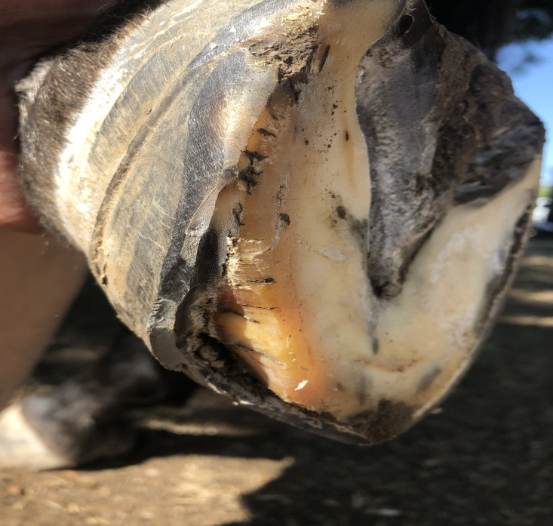
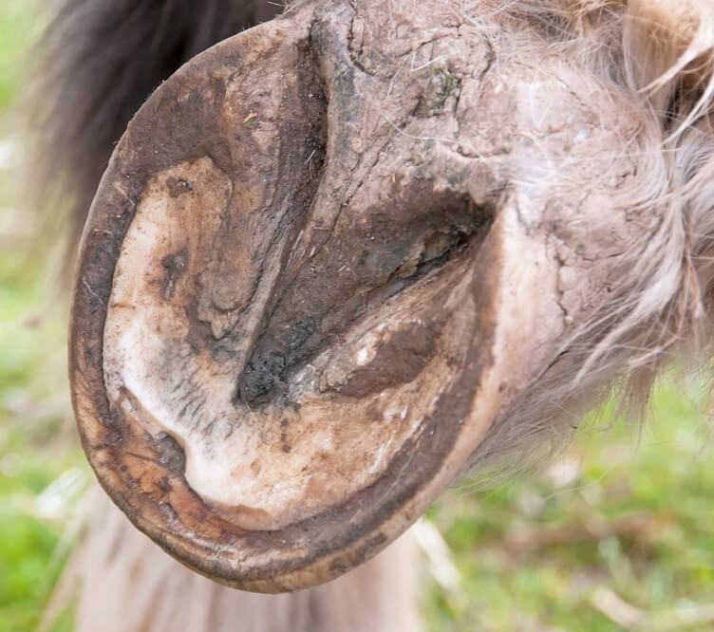
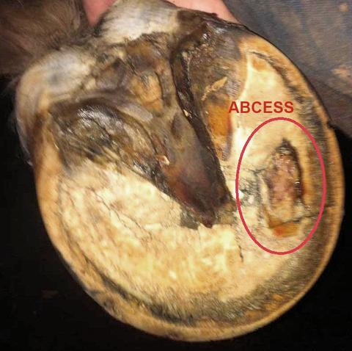
Hoof Abscess

Slide 39
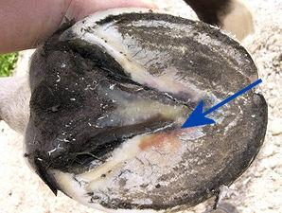
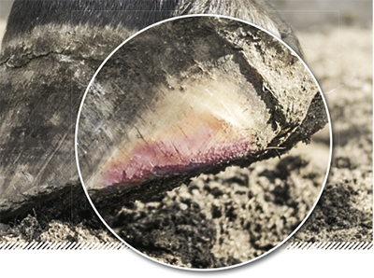
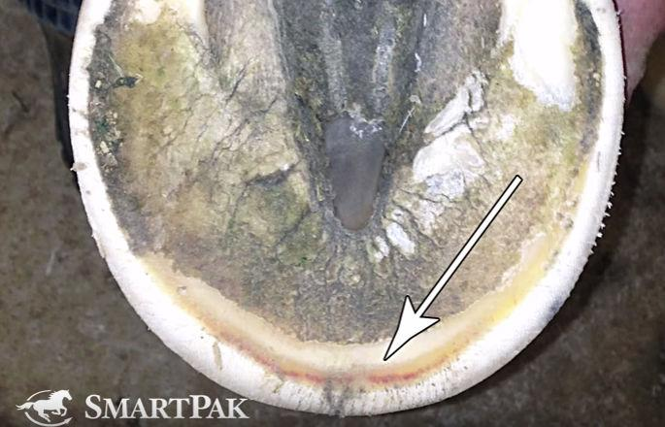
Bruised sole

Slide 40
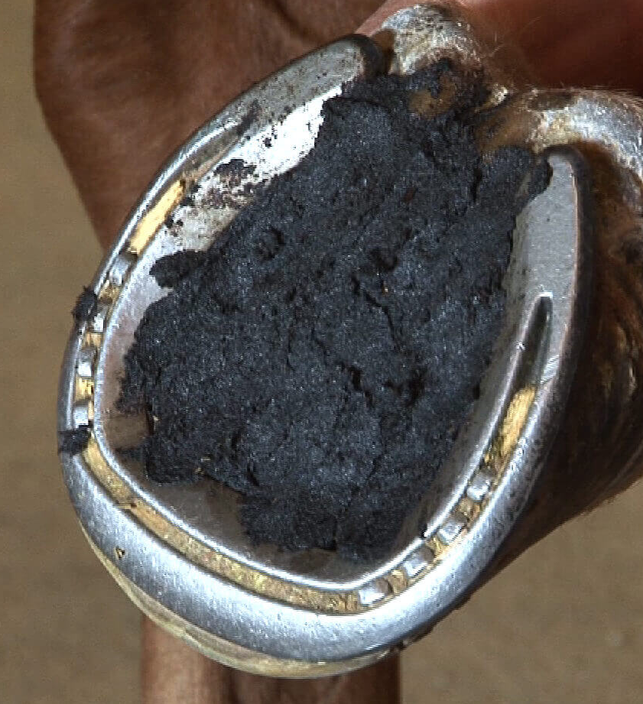
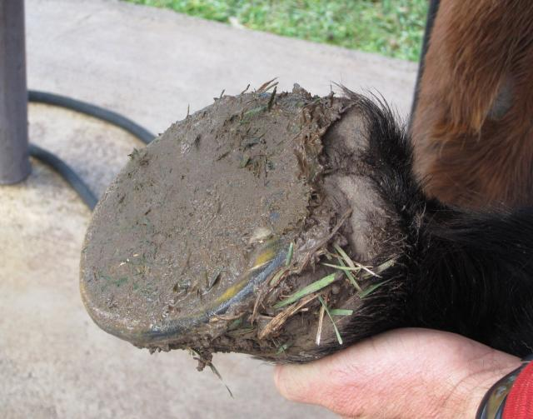

Slide 41
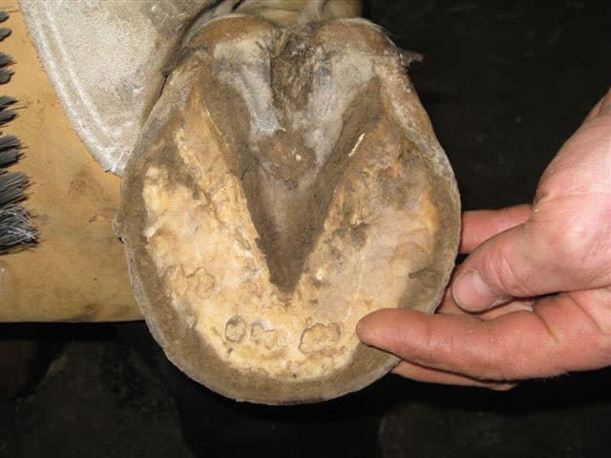
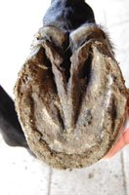
Fungal infection in Hoof

Slide 42
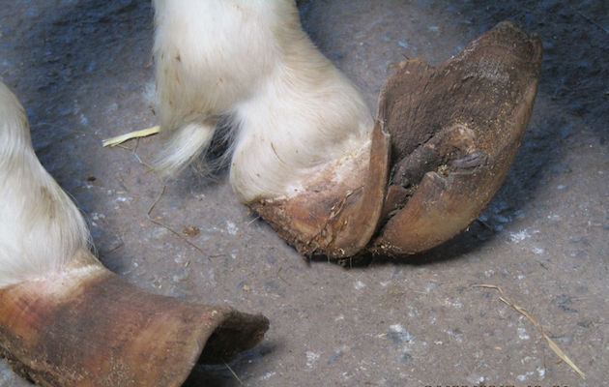
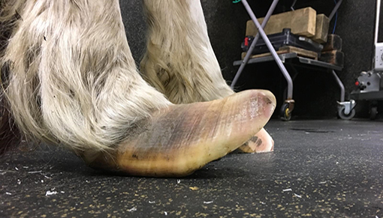
Overgrown Hoof

Slide 43
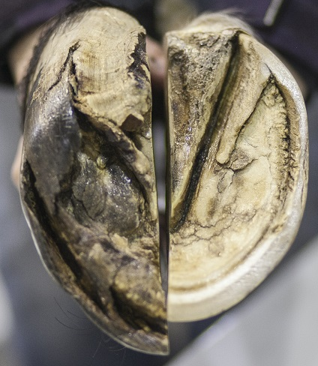
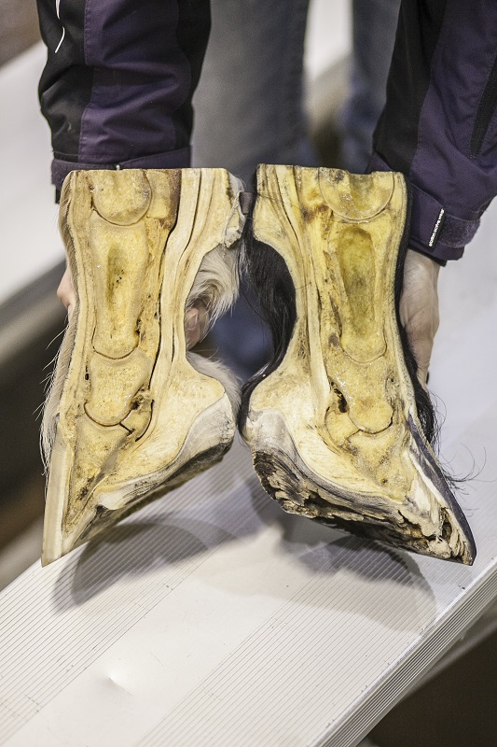
Difference between a well-trimmed hoof (right) in comparison to a hoof with excess hoof growth and other issues.
Healthy foot and hoof (left) in comparison to a laminitic foot where the coffin bone has rotated, causing permanent damage.

Slide 44
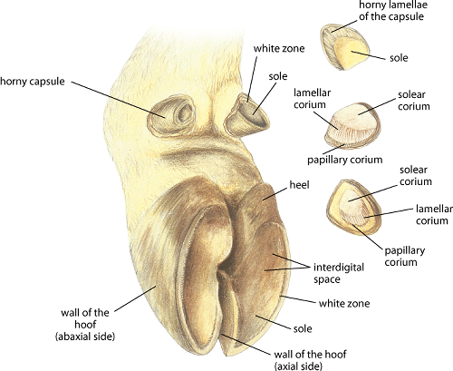
Hoof of ox
Consist of:
Periople
Wall
Sole

Slide 45
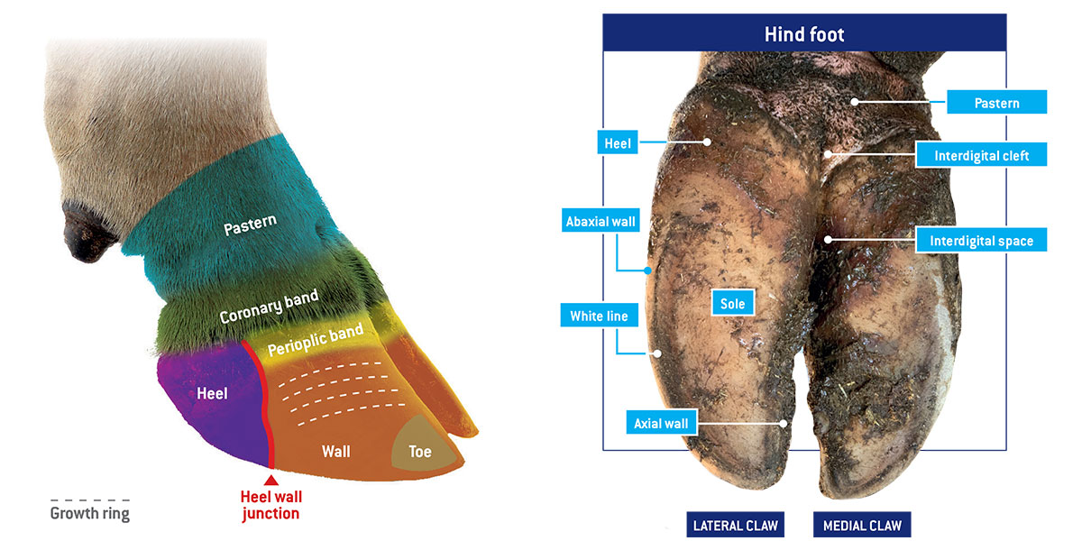

Slide 46
Coronary corium much less developed than horse.
Wall lamelllae are much narrower and more numerous than horse.
Secondary lamellae not present
Accessory digits bear short conical horn capsule which resemble in general way those of chief digit.

Slide 47
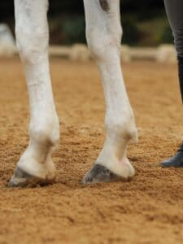
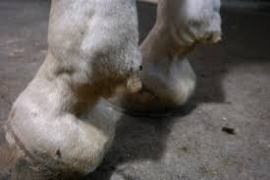
Ergot- is a small callosity on the underside of the fetlock of a horse or other equine. Some equines have them on all four fetlocks; others have few.
an even smaller pea-sized callosity type growth on the underside of the back of the fetlocks of a horse.
Again, not all horses have all four. Some breeds tend to display more prominent ergots while others have barely any ergot growth at all. They seem more prevalent on horses with feathers.

Slide 48

Chestnut- those patches of rough tissue on the inside surfaces of the front legs just above the knees—are structures that remind us of the horse's origin as a creature with more than one toe on each foot. Horses also have chestnuts on the insides of the hind legs; these are found just below the hocks.
Mane/Juba- the mane is the hair that grows from the top of the neck of a horse or other equine, reaching from the poll to the withers, and includes the ...

