Slide 1
Isolation and identification of bacteria from clinical cases of
Mastitis, Abortion, Enteric, respiratory and pyogenic infections

Slide 2
Idenfying sick animals: History and Clinical symptom
Specimen collection
Preservation and transportation of specimen
Microscopic examination of sample
Various methods used for isolation of bacteria

Slide 3
Idenfying sick animals: History and Clinical symptom

Slide 4
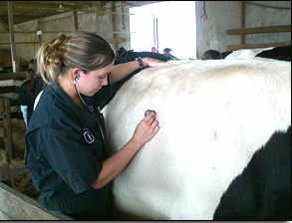
Physical ExamINATION of ANIMAL
Notes:
Frequently a staff member, trained by the herd veterinarian, identifies cows that appear abnormal and conducts a basic exam.

Slide 5
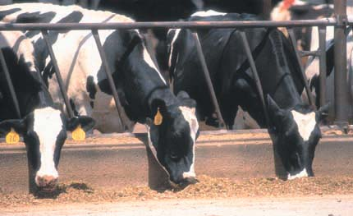
Potential Disease conditions
Mastitis
Metritis and endometritis
Lameness – feet and legs
Lesions – mouth, feet, teats
Enteric infection
Respiratory infections
Abortion
Pyogenic infections
Notes:
Once you determine that a cow is “abnormal”, use your powers of observation to determine what the problem is. Some potential disorders include: ketosis (urine or milk analysis), displaced abomasum (DA), mastitis, metritis and endometritis, lameness (feet and legs), lesions (mouth, feet, or teats), other common diseases (IBR, BVD, leptosporosis, PI₃, etc.), and unusual symptoms that could indicate foreign or new diseases.

Slide 6

Systematic Approach
Attitude
  eyes and ears
Appetite
Hydration
Temperature
Feet and Legs
Udder
Uterus
Heart Rate
Lungs
Rumen
Manure
Notes:
Develop a systematic approach to check the cow from one end to the other. Develop your own routine. Observe attitude, appetite, hydration, and temperature. Systematically check eyes and ears, feet and legs, udder, uterus, heart rate, lungs, rumen and manure. By using one order consistently you will be less likely to miss something.

Slide 7
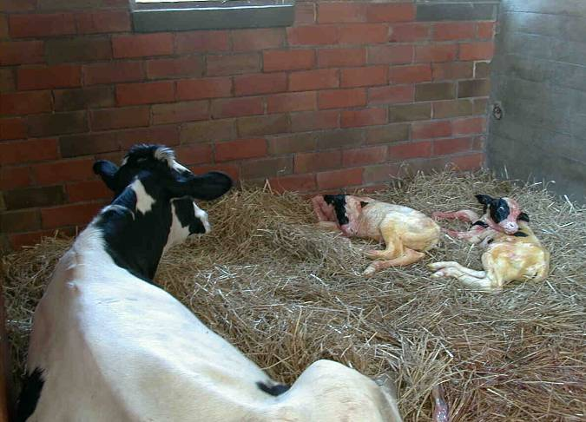
Retained Placenta (RP)
Abortion
Notes:
Even normal looking cows must be monitored to catch early symptoms. When cows retain their placenta or the fetal membranes, abort, twin or have difficulty calving they are more likely to have problems later. Spending a little extra time checking those cows that had problems earlier can lead to early identification of other problems. Cows with low calcium levels or milk fever may not be able to get up. These cows need extra attention as well.

Slide 8
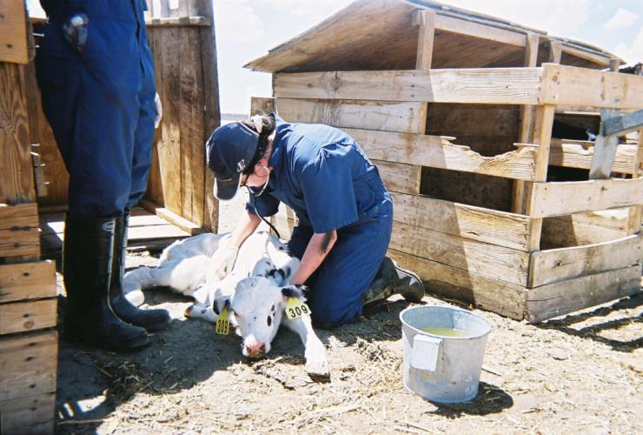
Check the Lungs
Listen to:
Lung sounds
Respiration rate
Observe for:
Nasal discharges
Congestion
Coughing
Notes:
Check the lungs. Determine the respiration rate and listen for signs of congestion that might indicate the cow has pneumonia. Observe for nasal discharges, congestion, or coughing. Associate the finding with other clinical signs such as fever, dehydration, lack of appetite, etc. to determine if the cow has an illness or disorder.

Slide 9
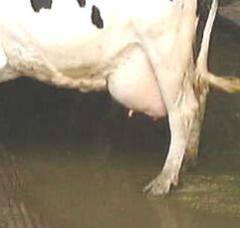
Visual Evaluation of Udder and Teats
Notes:
We must always look for signs of disease in our animals. When you are out in the herd visually evaluating an udder, consider whether the abnormal signs are mastitis, from trauma, or something you don’t recognize. If there are unusual lesions on the teat, is it frost bite or something you don’t recognize? Early identification is the key to preventing the spread of any disease, whether it is an unusual foreign animal disease such as foot and mouth disease or a more common disease like BVD. Whenever there are unusual symptoms report them to the owner, manager, or veterinarian.

Slide 10
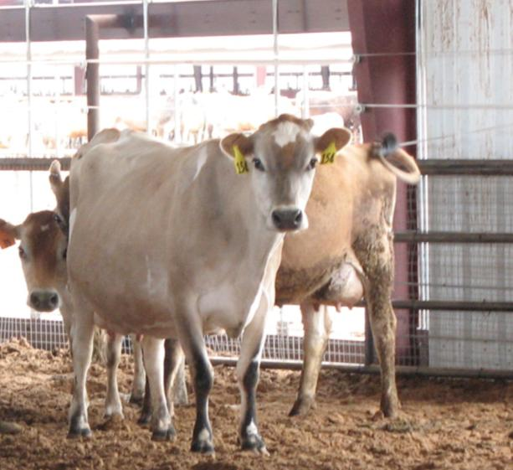
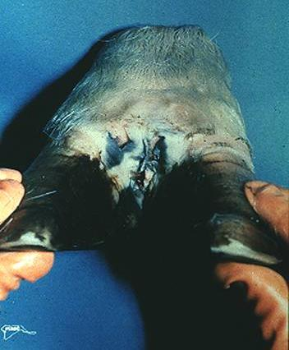
Check the Feet and Legs
Notes:
Whether working with the herd in the parlor or in pens, check the feet and legs. Are the cows walking and standing normally or have a number of cows gotten “lame” and you see some lesions between the toes. Whenever you see something you don’t recognize or have a lot of animals come down with something at once, report it at once to the farm manager, owner, or veterinarian.

Slide 11
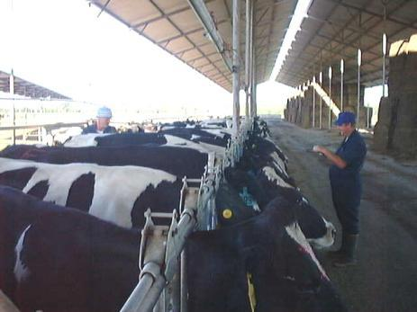
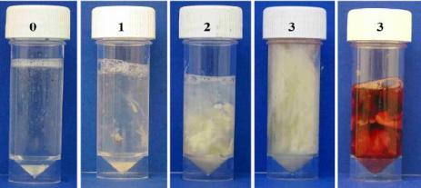
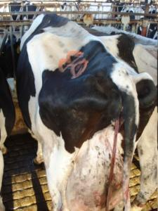
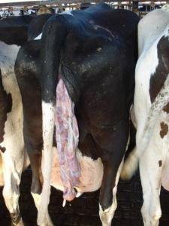
Check the Uterus
Note normal or abnormal discharge
Varies by day after calving
Type of uterine discharges
Palpation of the uterus per rectum is a tool to evaluate uterine discharge and retained placenta
Notes:
Particularly for fresh cows, check to see if there are visible signs of discharge. Some discharge, called lochia, is common immediately after calving. Clear mucus is what is desirable. A cloudy mucus is an abnormal discharge and may require further action. When palpating the uterus through the rectum, observe the discharge color and odor as an aid in determining whether a cow has metritis. Investigate the cause of any foul smelling discharge which may indicate a problem. Follow standard protocols for cows with abnormal discharge.

Slide 12
Collection of Samples
Choice of sample
Methods of collection
Precautions to be followed before collection

Slide 13
Choice of sample
Depend upon the type of symptom
Abortion: whole foetus, placenta, vaginal discharge
Metritis: Uterine discharge
Respiratory infection: sputum, bronchial lavage, nasal and pharyngeal swab
Eye infection: Eye swab
Enteric infection : stool or faecal sample, vomiting,
Systemic infection: blood
CNS: CSF

Slide 14
From dead animals:
Heart blood
Liver,
Spleen
Visceral lymph node,
Intestinal content
Brain and meninges

Slide 15
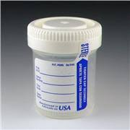
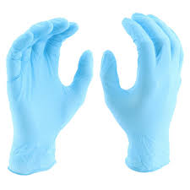
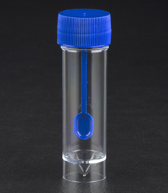
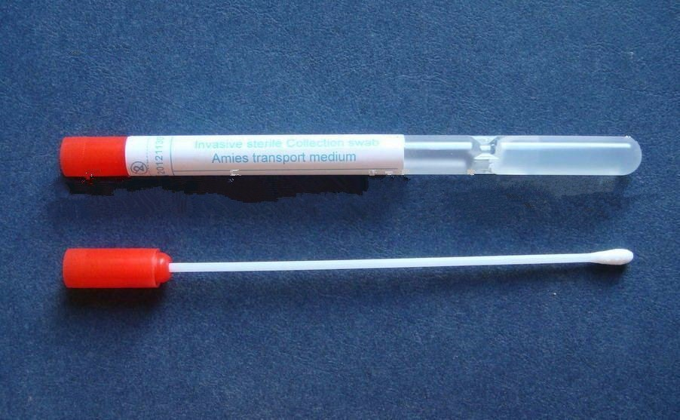
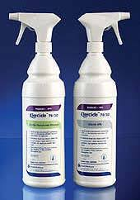
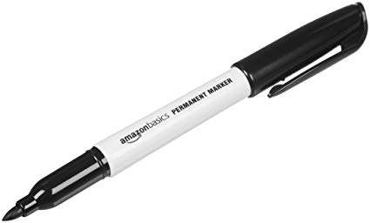
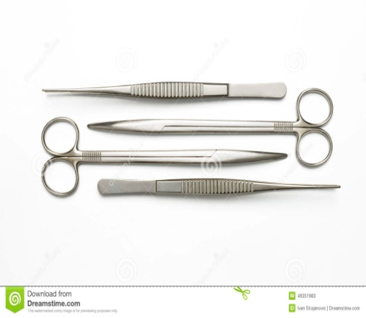
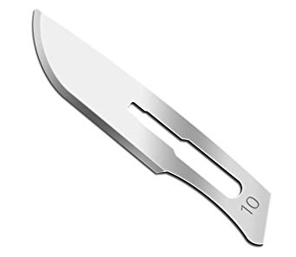
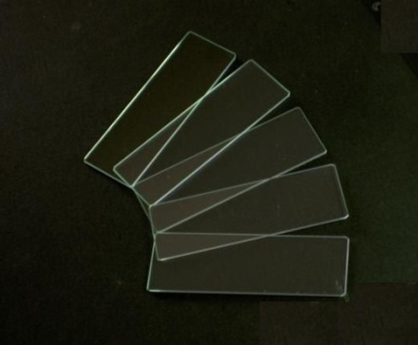

Slide 16
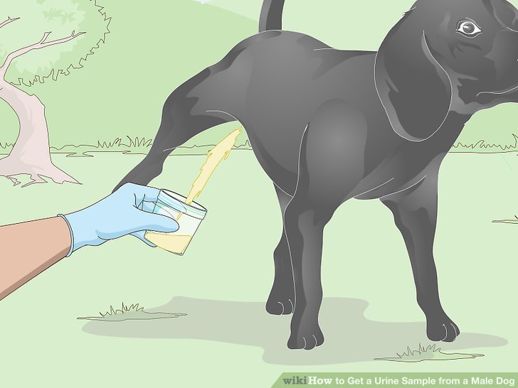
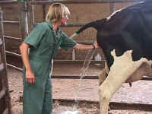
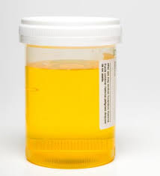
Urine sample

Slide 17
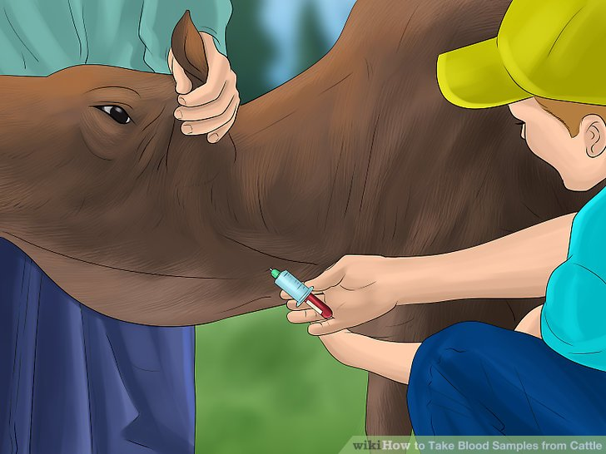
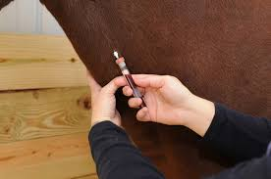
Blood sample
JUGULAR VEIN

Slide 18
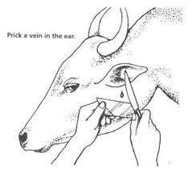
Ear tip

Slide 19
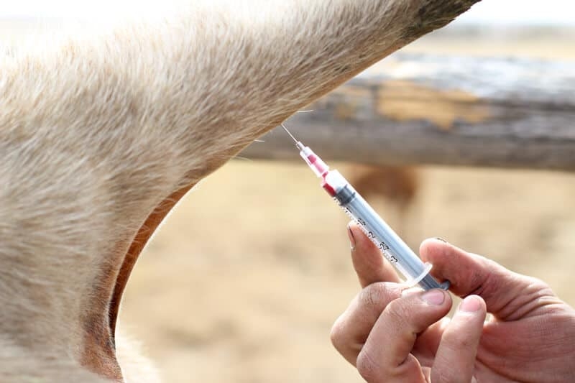
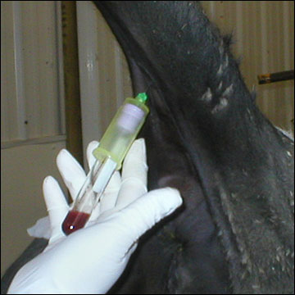
Coccygeal vein

Slide 20
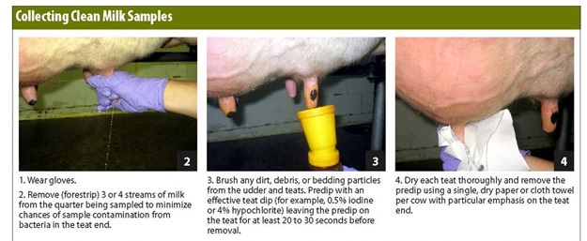
Milk Sample

Slide 21
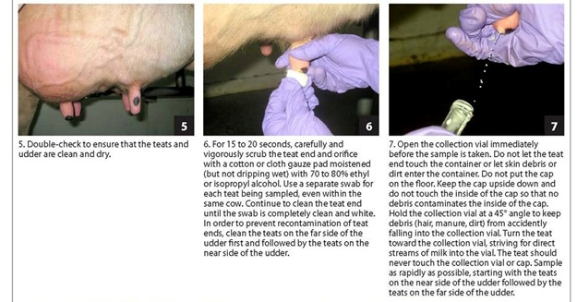

Slide 22
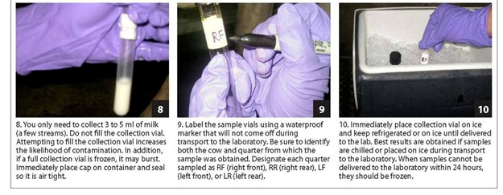

Slide 23

Faecal sample

Slide 24
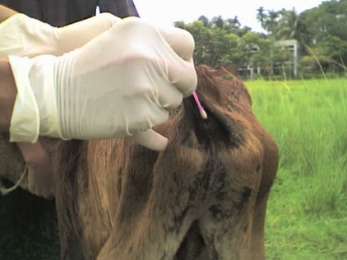

Slide 25
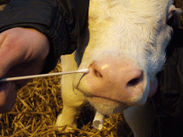
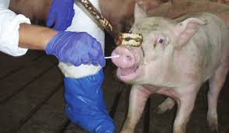
NASAL SWAB

Slide 26
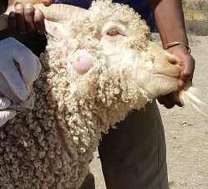
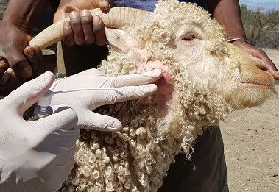
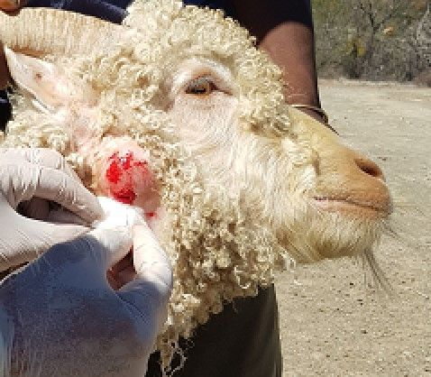
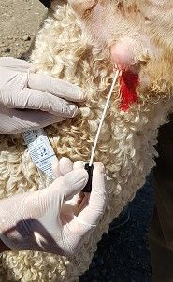
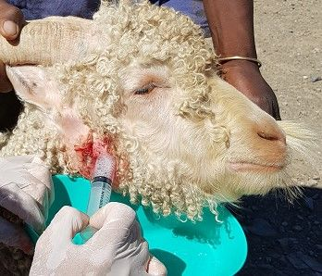
PUS Sample

Slide 27
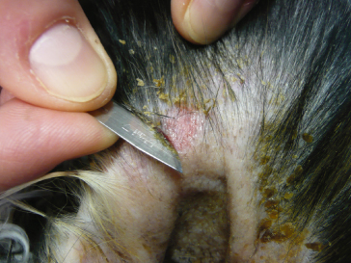
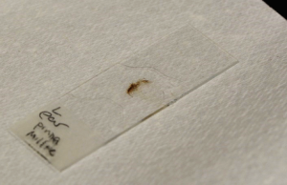
Skin Scrapping

Slide 28
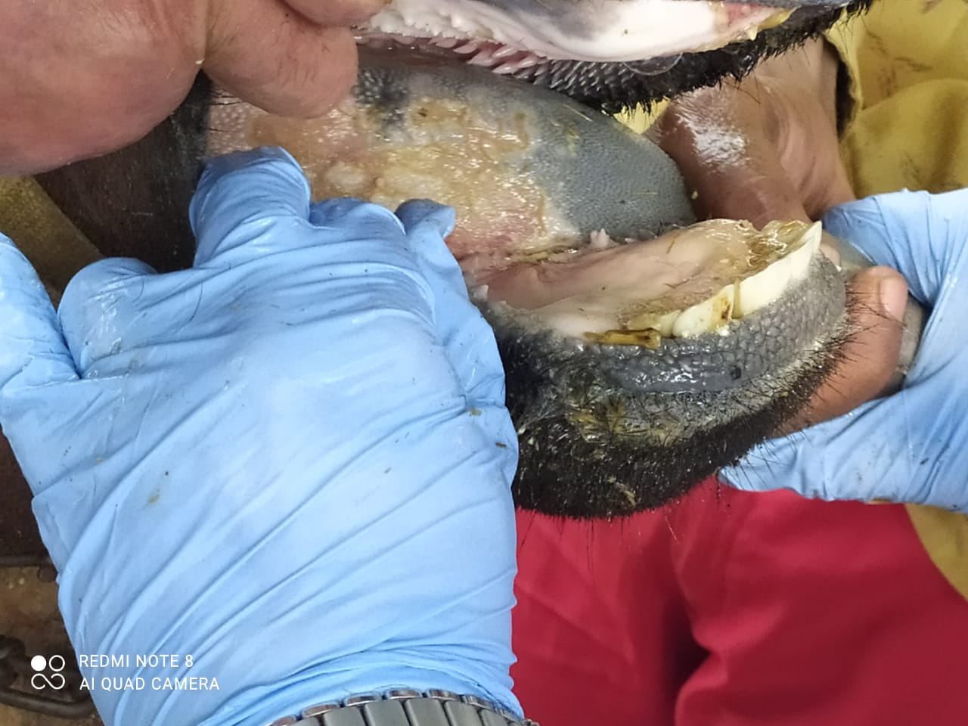
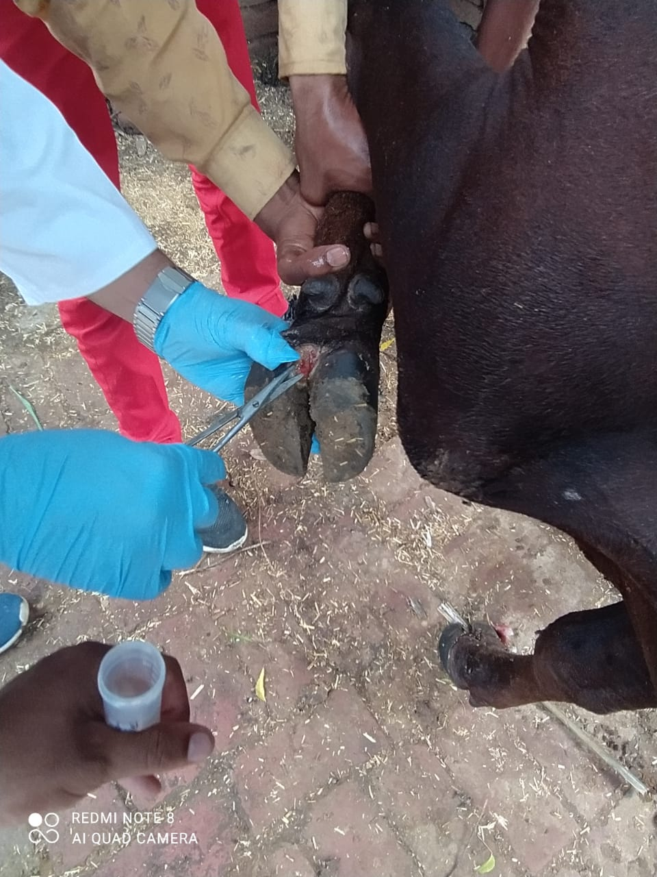
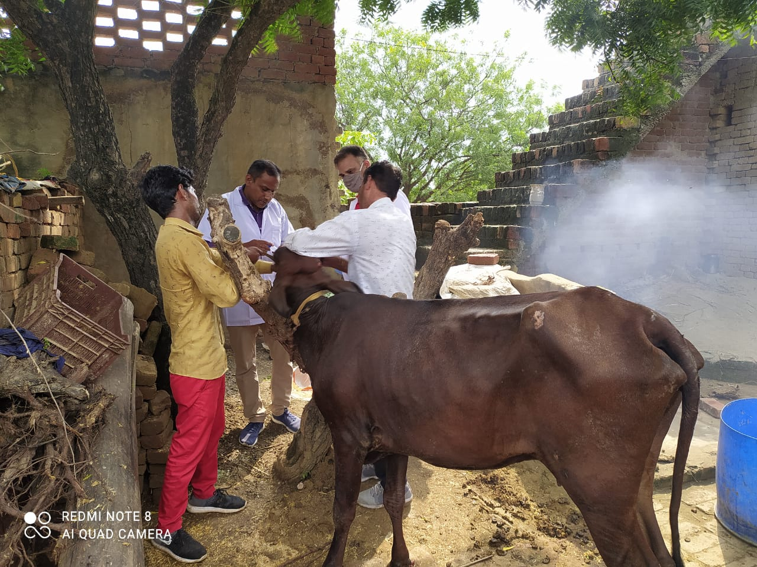

Slide 29
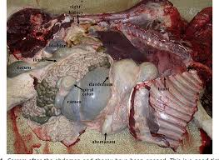
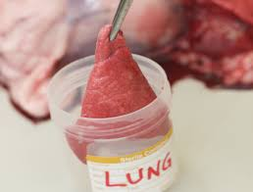
Tissue sample

Slide 30
Preservation and Transport of specimen
Most specimens are sent to the laboratory in sterile universal containers.
Swabs are placed in a suitable transport medium (eg. charcoal medium) otherwise it leads to false negative reporting.
Specimens should be transported as soon as possible to the laboratory. In case a delay is anticipated the specimen should be stored at 4° C.

Slide 31
Immediate transport is necessary in order to:
(i) Preserve the viability of the ‘delicate’ bacteria delays in processing can cause false-negative culture results
(ii) Minimize the multiplication of bacteria (e.g. coliforms) within specimens before they reach the laboratory

Slide 32
Transport material as quickly to lab as possible
If delay is expected, use suitable transport media
Transport samples at 4ºC

Slide 33
To transport all infectious substances, the basic triple packaging system must be used. This transport system comprises three layers:
1.Primary container. It is the primary leak-proof and watertight container that contains the sample. This container should be wrapped in absorbent material with the capacity to absorb all the fluid in case of breakage or leakage.
2.Secondary container. Resistant, watertight, leak-proof container that encloses and protects the primary container.
3.Outer container. The secondary containers are placed in outer transport packages provided with a suitable cushioning material. The outer containers protect the contents from the external elements, such as physical damage, while the package is in transit.

Slide 34
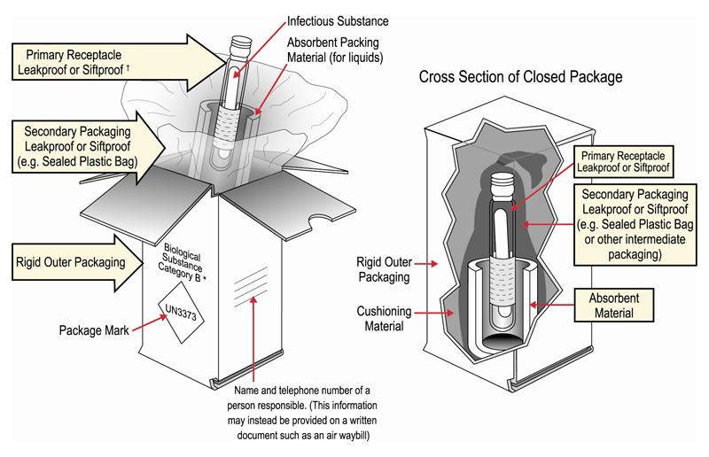

Slide 35
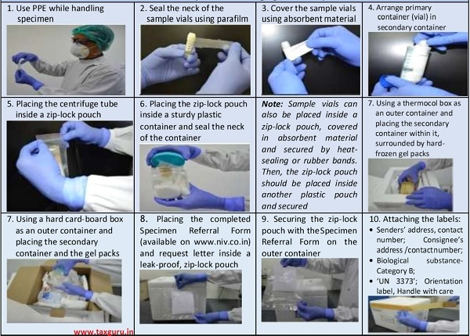

Slide 36
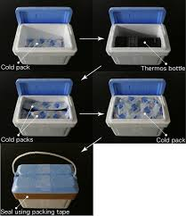

Slide 37
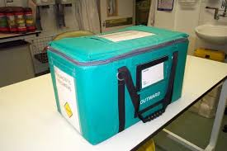

Slide 38
Processing of sample
1.Pre-treatment phase:
Centrifugation (CSF, Synovial fluid, Urine)
Homogenisation (biopsies and tissues)
Decontamination: Sputum

Slide 39
2.Inoculation of culture media:
Pre-enrichment: Highly contaminated samples like faecal sample for Salmonella, Sample with low bacterial load
First process the samples for anaerobes
First inoculate the less selective media to avoid carrying any inhibitory substance to another medium.
The media will be selected according to the type of sample and the diagnostic suspicion of the possible causal agent to be detected

Slide 40
3.Observing colony morphology and performing staining of bacterial smear: Gram staining, ZN staining, etc.
4. Biochemical test: depending on type of organism suspected
5. Serological identification: Agglutination, precipitation , ELISA, CFT, Immunofluroescence, Immunohistochemistry

Slide 41

6. Detection of nucleic acid: by PCR, RT-PCR,

