Slide 1


Lecture 1. | Metabolic Diseases/Disorder in Dairy Cattle
Unit-3
Dr. Muneendra Kumar
Assistant Professor
Department of Animal Nutrition
muneendra82@gmail.com
College of Veterinary Science & Animal Husbandry
U.P. Pt. Deen Dayal Upadhyaya Pashu Chikitsa Vigyan
Vishwavidyalaya Evam Go-Anusandhan Sansthan
(DUVASU), Mathura - 281001 (U.P.)
Class link: meet.google.com/gbf-rehf-gtb

Slide 2
Metabolism is the sum of all physical, chemical, and metabolic processes occurring in a living cell or organism related to absorbance, breakdown or synthesis of necessary organic molecules in the body.
Metabolic processes are associated with the release of a variety of metabolites that are either used as building blocks or degraded and excreted from the body as waste.
Disturbance of one or multiple metabolic processes, related to regulation of a certain metabolite in the body, is known as metabolic disease or disorder.
Different synonymous terms have been used to describe metabolic disturbances in animals such as metabolic diseases, metabolic disorders, or production diseases.

Slide 3
Metabolic diseases or disorders indicate a group of diseases characterized by disturbance of one or more plasma metabolites such as ketone bodies, calcium, or acids (NEFA).
The term production disease is focused more on non-esterified fatty acid on the human imposed nature of these diseases.
Metabolic disorders of cattle are a group of diseases that affect dairy cows immediately after parturition.

Slide 4
There are several metabolic disorders identified in dairy cows during the first month after parturition and the most frequent ones are the following:
Ruminal acidosis [Subacute and acute ruminal acidosis (SARA and ARA)]
Milk fever
Laminitis
Ketosis
Fatty liver
Left displaced abomasum (LDA)
Downer cow
Retained placenta (ROP)
Liver abscesses
Metritis
Mastitis
Udder edema
Bloat/Tympany

Slide 5
The reason that these diseases are called metabolic disorders is related to the fact that they are associated with the disturbance of one or more blood metabolites in sick cows.
Ketosis is associated with enhanced ketone bodies (i.e. beta-hydroxybutyric acid - BHBA) in the blood.
Fatty liver is associated with enhanced NEFA and their accumulation in the liver.
Acidosis is associated with increased production of acids (like lactic acid, acetic, propionic, and butyric acids) in the rumen and low rumen pH.
Milk fever is associated with decreased blood Ca level.
There is not yet a blood metabolite identified for some of the metabolic disorders such as downer cow, LDA, metritis, mastitis, laminitis, retained placenta or bloat.

Slide 6
The most interesting observation with regards to the occurrence of metabolic disorders is that they are highly associated with each other.
Cows affected by milk fever are more prone to mastitis, retained placenta, metritis, LDA, distocia, udder edema, and ketosis.
Cows affected by acidosis are more prone to laminitis, LDA, milk fever, mastitis, and fatty liver.
Those animals affected by retained placenta are more prone to metritis, LDA, and ketosis.
Ketosis and fatty liver are common findings in cows affected by milk fever, mastitis, laminitis, LDA, metritis, retained placenta and udder edema.

Slide 7
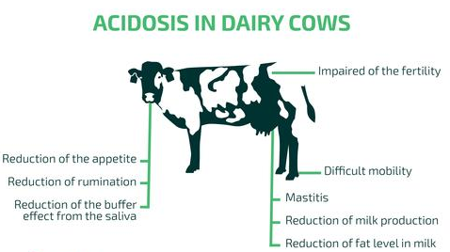
Lecture 2

Slide 8
Subacute and acute rumen acidosis (SARA and ARA) are very prevalent disorders of dairy herds.
Two groups of cows at special risk for acidosis are early lactation cows and cows with high intake of grain in their diets.
Excessive intake of readily fermented starch often occurs immediately after calving when cows are first being adapted to a high-grain diet.
For optimum ruminal fermentation and fiber digestion, ruminal pH should range between 6.0-6.5.

Slide 9
The most typical clinical manifestation of subclinical acidosis is reduced or inconsistent feed intake.
Other associated signs include decreased appetite, milk production, lowered fat content in the milk, poor body condition score, diarrhea, accelerated respiration, salivation, lethargy and laminitis.
Subclinical acidosis occurs very often even in well managed and in high producing dairy herds.
Acute acidosis results in very sick cows: physiological functions may be significantly impaired and death may occur. Acute acidosis is characterized by a significant decrease in ruminal pH (<5.0).

Slide 10
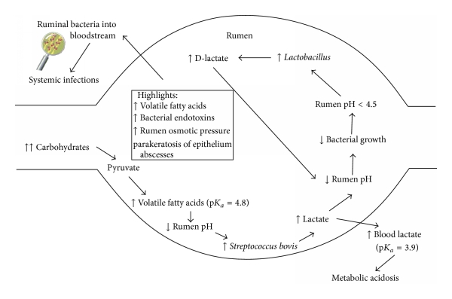
Cascade of events in ruminal acidosis

Slide 11
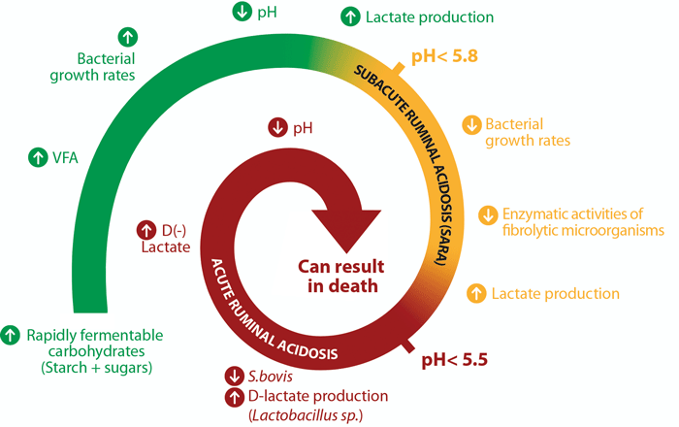

Slide 12
Main differences between the two different clinical forms of ruminal acidosis
 | Ruminal acidosis
 | Acute | Subacute
Presence of clinical signs | Yes | Maybe
Mortality | Yes | No
Ruminal changes
(1) Rumen pH | Below 5 | 5.0–5.4
(2) Lactic acid | Increase (50–120 mM) | Normal (0–5 Mm)
(3) Volatile fatty acids (VFA) | Decrease (<100 mM) | Increase (150–225 mM)
(4) Gram negative bacteria | Decrease | Normal
(5) Gram positive bacteria | Increase | Normal
(6) Streptococcus bovis | Increase | Normal
(7) Lactobacillus spp. | Increase | Normal
(8) Lactic acid producers | Increase | Increase
(9) Lactic acid consumers | Decrease | Increase
Blood parameters
(1) Blood pH | Low | Borderline
(2) Bicarbonate | Low | Borderline
(3) Lactate | Increase | Normal

Slide 13
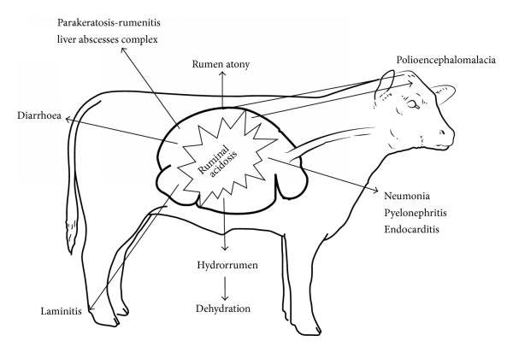
Clinical picture of the disease

Slide 14
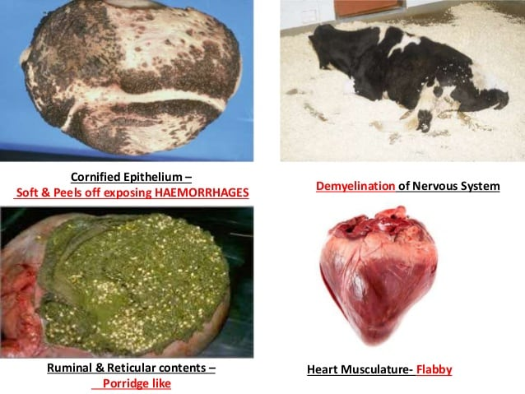

Slide 15

Treatment
Cows show mild signs of acidosis such as diarrhea, they should be fed a diet with smaller proportion of grain or increased amount of roughage.
Cows with more severe signs such as severe diarrhea, off feed, and in a depressed state should be removed from the grain diet and fed roughage only.
Cows should be given orally about 120 g of sodium bicarbonate dissolved in 4-5 liters of water. This treatment should be repeated three times per day if possible and the cows need to be encouraged to walk around.

Slide 16

There are two commonly used management practices for prevention of ruminal acidosis:
Increasing the proportion of roughage in the diet, and
Decreasing the intake of starch (i.e. cereal grains such as corn, wheat, or barley).
The reason for increasing the amount of roughage is that it lowers the frequency of eating as well as the size of a meal. In addition, by increasing the proportion of roughage in the diet the time of chewing and the amount of saliva produced will be increased

Slide 17
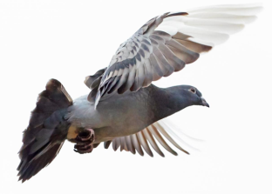
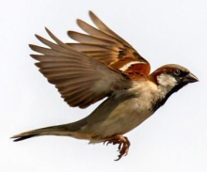
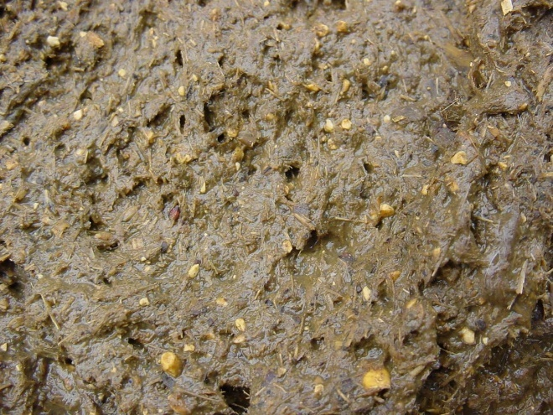

Slide 18
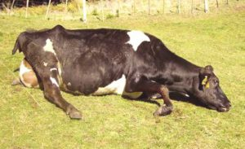
Lecture 2
Milk Fever/ Hypocalcemia/Parturient Paresis/ Downer Cow Syndrome

Slide 19
Possible Causes ?
Just before calving, large amounts of Ca are removed from the blood and are utilized in colostrum synthesis (Ca in colostrum may be 8-10 times higher than milk).
The rapid decreased of Ca prior to parturition, and the failure of Ca absorption to increase fast enough after the onset of lactation, can predispose animals to milk fever.
There are other probable causes that have been associated with inducing milk fever:
Excessive bone formation due to elevated levels of gonadal hormones
Rations containing excessive dietary levels of cations, especially K.
Other metabolic disorders like ruminal stasis, displaced abomasum, retained placenta, prolapsed uterus, metritis, and ketosis can also lead to clinical and subclinical hypocalcemia.

Slide 20
Milk fever generally occurs within the first 72 hours post-calving, but can still occur 2-3 days post-calving.
The most notable changes occurring in the blood are a decrease in blood Ca and blood P levels and an increase in blood Mg levels.
Mature and old cow is more susceptible (3rd lactation onward).

Slide 21

Types | Terminology used | Condition
1 | Typical milk fever | Occurs within a few days after parturition, but it sometimes occurs in late lactation or the dry period. Typical milk fevers respond well to treatment.
2 | Refractory or atypical milk fever | An acute form with little or no response to treatment. The cow may remain alert, eat, and milk but cannot regain her feet. She may become a creeping downer cow with flexed pasterns and posterior paralysis. Rupture of the large muscle or group of muscles in one or both hind legs may complicate the problem.
3 | Tremors or sub-acute | Cows are easily excited with muscle twitching and tremors occurring. Several cows are involved. Many of these animals may be in late lactation, dry, or recently fresh.

Slide 22
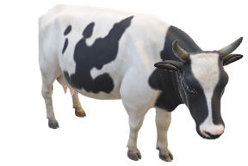
3 stages
on clinical signs basis
Loss of appetite, excitability, nervousness, hypersensitivity, weakness, weight shifting, and shuffling of the hind feet
Stage I (< 1 hour)
Turn its head into its flank, cold ears and a dry nose, incoordination when walking, muscles trembling and quivering. Other signs are an inactive digestive tract and constipation. A decrease in body temperature is common, usually ranging from 96°F to 100°F. The heart rate will be rapid exceeding 100 beats per minute.
Stage II (1 to 12 hours)
Inability to stand, loss of consciousness leading to a coma. Heart sounds become nearly inaudible and the heart rate increases to 120 beats per minute or more. Cows in stage III will not survive for more than a few hours without treatment.
Stage III
Symptoms and Problem Situations

Slide 23
Blood serum concentration of minerals in dairy cows in various metabolic states
State | Blood serum (mg/dl) Ca | Blood serum (mg/dl) P | Blood serum (mg/dl) Mg
Normal lactating cow | 8.4 to 10.2 | 4.6 to 7.4 | 1.9 to 2.6
Normal parturition | 6.8 to 8.6 | 3.2 to 5.5 | 2.5 to 3.5
Milk fever, Stage I | 4.9 to 7.5 | 1.0 to 3.8 | 2.5 to 3.9
Milk fever, Stage II | 4.2 to 6.8 | 0.6 to 3.0 | 2.3 to 3.9
Milk fever, Stage III | 3.5 to 5.7 | 0.6 to 2.6 | 2.5 to 4.1

Slide 24

Ensure that the Ca intake during the dry period is below 50 g/day.
Ensure that adequate dietary Ca is available over the risk period (just prior to and after calving).
Try to avoid diets high in strong cations, such as Na and K.
Prevent animals from becoming over fat (BCS 2.5-3) and ensure they get plenty of exercises.
Make sure that the diet is sufficient in Mg for cows in late pregnancy.
Do not breed from cows or sires with a history of recurrent milk fever.
Avoid stress in cows.
Feed adequate long fiber to transition cows.

Slide 25

Treatment
Treat cases of milk fever as soon as possible with a slow I/V infusion of 8-12 g of Ca. Ensure the solution is warmed to body temperature in cold weather.
Inject I/M 10 million units of vitamin D3 within 24 to 48 hours of expected freshening.
Sit the cow up in a sternal recumbency position and turn her so that she is lying on the side opposite to the one on which she was found and turn every 2 hours
Feed 100 g of ammonium chloride/head/day beginning not less than two days before and continuing at least two days after freshening.
Give a drench of two pounds of Epsom salts in one gallon of water. This will sometimes remove toxins in the lower gastrointestinal tract and enable cows to stand within 2-3 hours.

Slide 26
Dietary Cation-Anion Balance (DCAB) or Dietary Cation-Anion (DCAD)
Very useful method of preventing and controlling milk fever is by balancing dry cow rations for anions (negatively charged molecules) and cations (positively charged molecules).
Na and K are the cations and Cl and S are the anions of interest in formulating anionic diets.
The DCAB equation most often used to determine milliequivalents (mEq)/100 grams of DM:
DCAB (mEq/100g diet DM) = mEq (Na + K) - mEq (Cl + S)

Slide 27
Balancing rations for anions affects the cow's acid-base status, activating PTH and raising the amount of Ca in the blood by mobilizing it from bones.
The range of DCAB that achieves the lowest incidence of milk fever is -10 to -15 mEq/100g DM or -100 to -150 mEq/kg DM.
-DCAD diet is not offered in lactating cow as it increases chance of ruminal acidosis (+DCAD diet with 200-300 mEq/kg DM is optimum diet for lactating animal).
It is difficult to calculate -/+ DCAD diet. Therefore, ammonium chloride is added to achieve –DCAD diet and sodium bicarbonate is added in diet to achieve + DCAD diet.
Urinary pH is good indicator about effectiveness of DCAD diet.

Slide 28
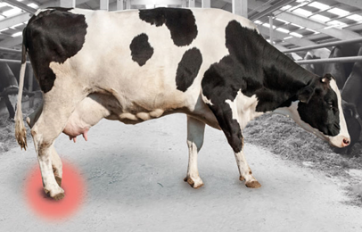
Laminitis/Pododermatitis aseptica diffussa/Founder

Slide 29
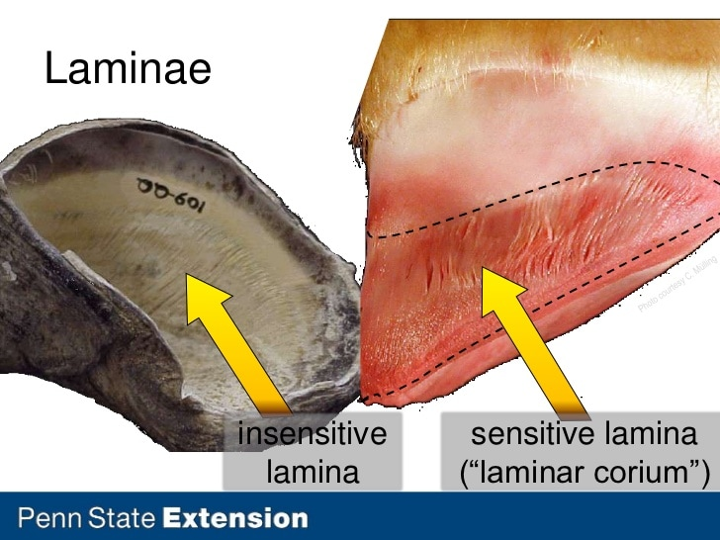
Laminitis is an inflammation of the laminar corium of the hoof wall. Laminitis has been described in many species, but is most common in equine and bovine.
The pathogenesis of laminitis is associated with a disturbance in the micro-circulation of blood in the corium (the dermis or horn producing tissue of the claw).
This circulatory disturbance leads to breakdown of the dermal-epidermal junction between the claw wall, and the bone with in the claw.

Slide 30
Rumen acidosis is considered to be a major predisposing cause of laminitis and presumably mediates its destructive effects through various vasoactive substances that are released into the blood stream.
These vasoactive substances initiate a cascade of events in the blood vessels of the corium including thrombosis (clotting), ischemia (restricted blood flow), hypoxia (lack of oxygen). The end result is swelling (edema), bleeding (hemorrhage), and death (necrosis) of corium tissues.
Sole ulcers are very common claw lesions in dairy cattle and constitute one of the most costly of lameness conditions.
Areas of hemorrhage are often most noticeable and severe in the white line region of the sole. This is a primary weight-bearing region of the claw (white line disease).

Slide 31
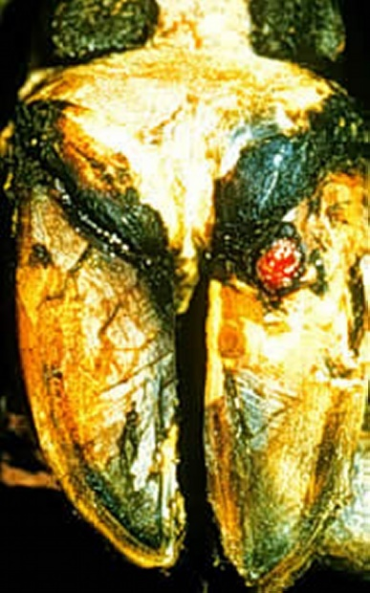
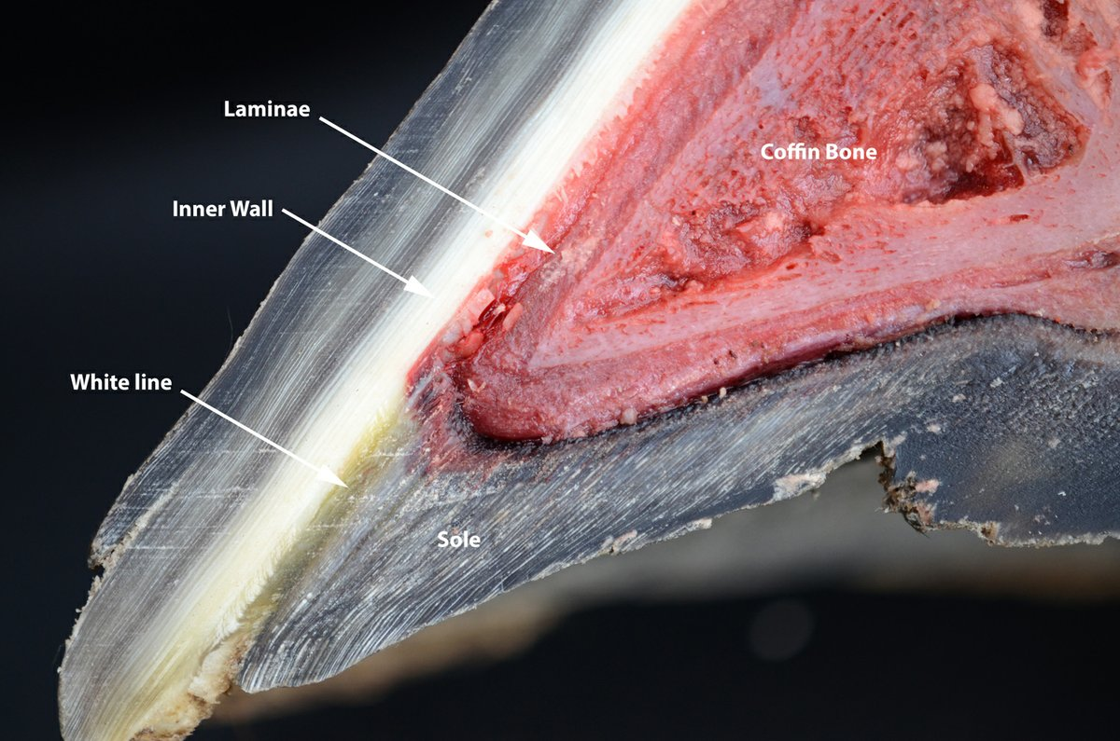
Sole ulcer

Slide 32


Diet and feeding management: All measures to increase optimal rumination and reduce the risk for acidosis should be made.
Housing and cow comfort: Primary advice is to provide a long enough adjustment period, especially if moving animals from pasture or deep bedding to harder floors.
Treatment
Surgical removal
Footbaths
Topical treatment with various disinfectants, caustic chemicals, and antibiotics
Cryosurgery (freezing), and electrocautery (burning)
Systemic antibiotic therapy.

Slide 33
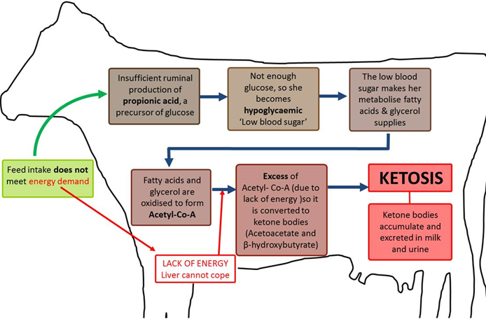
Ketosis
Acetonaemia, Fat Cow Syndrome, Hypoglycaemia and Pregnancy Toxaemia
Insufficient feed intake

Slide 34
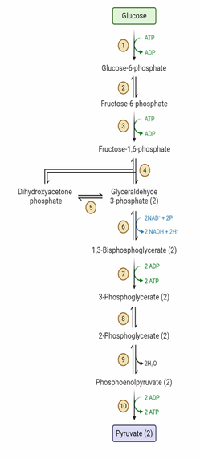
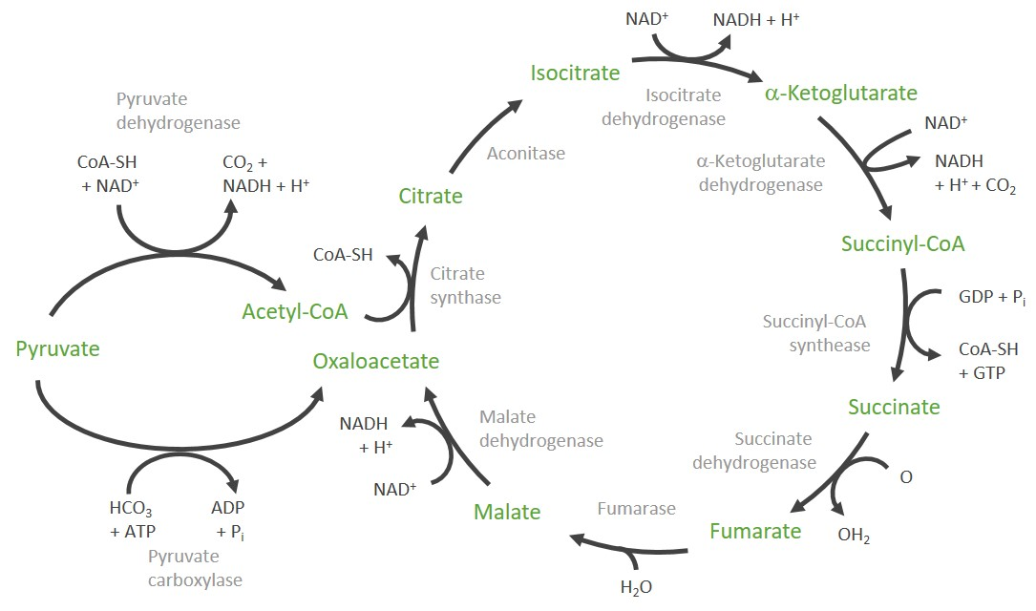
Body reserve
Krebs cycle
Acetone
Acetyle Co A + Acetyle Co A Acetoacetate
Glycolysis
BHBA

Slide 35
Ketosis is a metabolic disorder that occurs in cattle when energy demands (high milk production) exceed energy intake and result in a negative energy balance (NEB).
When large amounts of body fat are utilized as an energy source to support production, fat is sometimes mobilized faster than the liver can properly metabolize it. If this situation occurs, ketone production exceeds ketone utilization by the cow, and ketosis results.
The mismatch between input and output usually occurs in the first few weeks of lactation, because the cow is not able to eat enough to match the energy lost in the milk.

Slide 36
Symptoms: Reduced milk yield, weight loss, reduced appetite, dull coat, acetone (sweet/pear drop/fruity) smell of breath/ or milk, fever.
Treatment:
The initial aim of treatment is to restore the lack of glucose in the body. I/V administration of a dextrose solution is quick option while drenching with propylene glycol or glycerine has longer term effects.
Corticosteroids have the ability to break down protein in muscles to produce glucose, which immediately replenishes the depressed blood glucose levels.

Slide 37

Prevention
Cows should not be too fat at calving, as this depresses their feed intakes (BCS 2.5-3.0).
Concentrates fed during lactation should be introduced in small amounts (2 weeks before calving) to allow adjustments of the rumen microflora.
Efforts should be made to ease the transition from gestation to lactation by offering highly palatable forage at calving.
Roughage high in butyric acid should be avoided in early lactation.
The heritability for ketosis is relatively high, and this trait should be used to advantage.
Higher proportion of herds with tie stalls experienced ketosis compared to those with free stall herds (muscles can utilize ketone bodies).

Slide 38
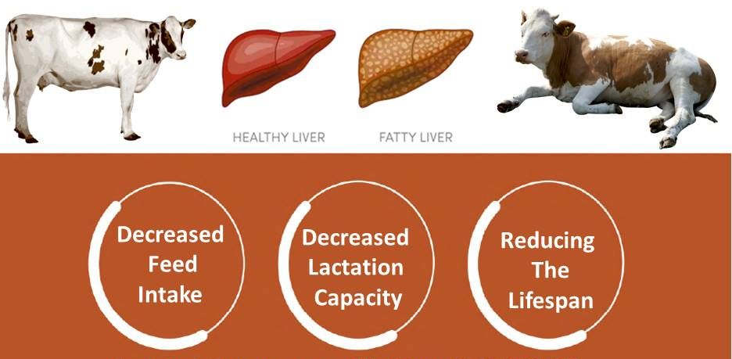
Fatty liver

Slide 39
Mobilization of body fat reserves in states of NEB results in the release of NEFAs from adipose tissue.
The liver retains 15%–20% of the NEFAs circulating in blood and thus accumulates increased amounts during periods when blood NEFA concentrations are increased.
NEFAs taken up by the liver can either be oxidized or esterified. The primary esterification product is triglyceride, which can either be exported as part of a VLDL or be stored in liver cells.
In ruminants, export occurs at a very slow rate relative to many other species because of impaired VLDL synthesis. Therefore, under conditions of increased hepatic NEFA uptake, triglycerides accumulate.
The condition is often associated with feed intake depression, decreased milk production, and ketosis.

Slide 40
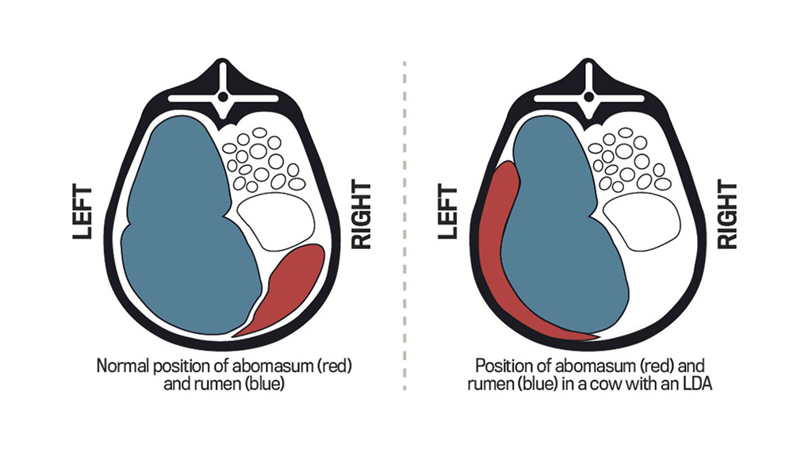
Left displaced abomasum (LDA)

Slide 41
Because the abomasum is suspended loosely by the greater omentum and lesser omentum, it can be moved from its normal position on the right ventral part of the abdomen to the left side.
Important contributing factors include
Abomasal hypomotility associated with hypocalcemia
Concurrent diseases (mastitis, metritis) associated with endotoxemia
Decreased rumen fill
Periparturient changes in the position of intra-abdominal organs.
Treatment: Rolling a cow through a 180° arc after casting her on her right side corrects most LDAs (recurrence is very likely).
Prevention: Incidence of LDA is decreased by ensuring a rapid increase in rumen volume after calving (avoid “slug feeding”), avoiding rapid dietary changes, avoiding postparturient hypocalcemia.

Slide 42
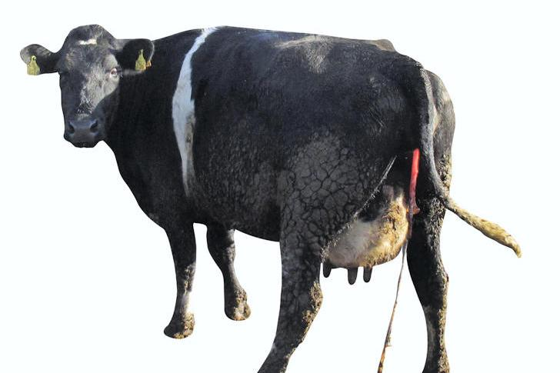
Retained placenta (ROP/RFM)
Retention of fetal membranes (RFM), or retained placenta (ROP), usually is defined as failure to expel fetal membranes within 8 hours after calving.
The incidence is increased by hypocalcemia, abortion, dystocia, stillbirth, advancing age of the cow or induction of parturition and nutritional disturbances.
Cows with RFM are at increased risk of metritis, displaced abomasum, and mastitis.

Slide 43
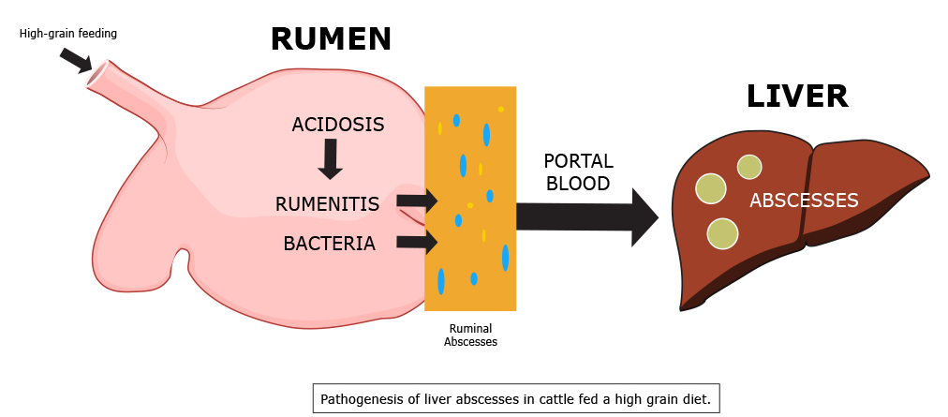
Liver abscesses

Slide 44
Liver abscess is usually the result of rapid intraruminal fermentation of dietary carbohydrate with subsequent production of lactic acid and increased acidity of the ruminal fluid ("grain overload").
Rations with high levels of carbohydrate are the principal cause in both dairy and feedlot cattle.
Fusobacterium necrophorum, alone or with other bacteria, colonizes through the area of superficial necrosis produced by the acid rumen contents. Leukotoxin may facilitate resistance to phagocytosis.
Bacterial emboli from the lesions invade the hepatic portal venous system and are transported to the liver, where they can establish infectious foci of necrobacillosis that eventually develop into abscesses.

Slide 45
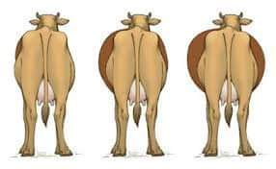
Ruminal Tympany/Bloat

Slide 46
Bloat is a disease of ruminant animals, characterized by an excessive volume of gas in the rumen.
Ruminal tympany may be primary, known as frothy bloat, or secondary, known as free-gas bloat.
The cause of frothy bloat is entrapment of the gases of fermentation in a stable foam. Coalescence of the small gas bubbles is inhibited, and intraruminal pressure increases because eructation cannot occur.
Soluble leaf proteins, saponins, and hemicelluloses are believed to be the primary foaming agents and to form a monomolecular layer around gas bubbles.
Bloat is most common in animals grazing legume or legume-dominant pastures, particularly alfalfa, ladino, and red and white clovers, but also is seen with grazing of young green cereal crops, rape, kale, turnips, and legume vegetable crops.

Slide 47
Free-gas bloat occurs due to physical obstruction of eructation by esophageal obstruction due to a foreign body (potatoes, apples, turnips, kiwifruit), stenosis, or pressure from enlargement outside the esophagus (as from lymphadenopathy or sporadic juvenile thymic lymphoma).
In bloat, the rumen becomes obviously distended suddenly, and the left flank may be so distended.
Dyspnea and grunting are marked and are accompanied by mouth breathing, protrusion of the tongue, extension of the head, and frequent urination. If the tympany continues to worsen, the animal will collapse and die.

Slide 48
Treatment
In life-threatening cases, an emergency rumenotomy may be necessary; it is accompanied by an explosive release of ruminal contents and, thus, marked relief for the cow.
A trocar and cannula may be used for emergency relief, although the standard-sized instrument is not large enough to allow the viscous, stable foam in frothy bloat cases to escape quickly enough.
A variety of antifoaming agents including vegetable oils (peanut, corn, soybean) and mineral oils (paraffins) at doses of 250–500 ml are effective, .
Surfactant (dioctyl sodium sulfosuccinate), is commonly incorporated along with one of the above oils.

Slide 49
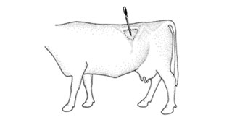
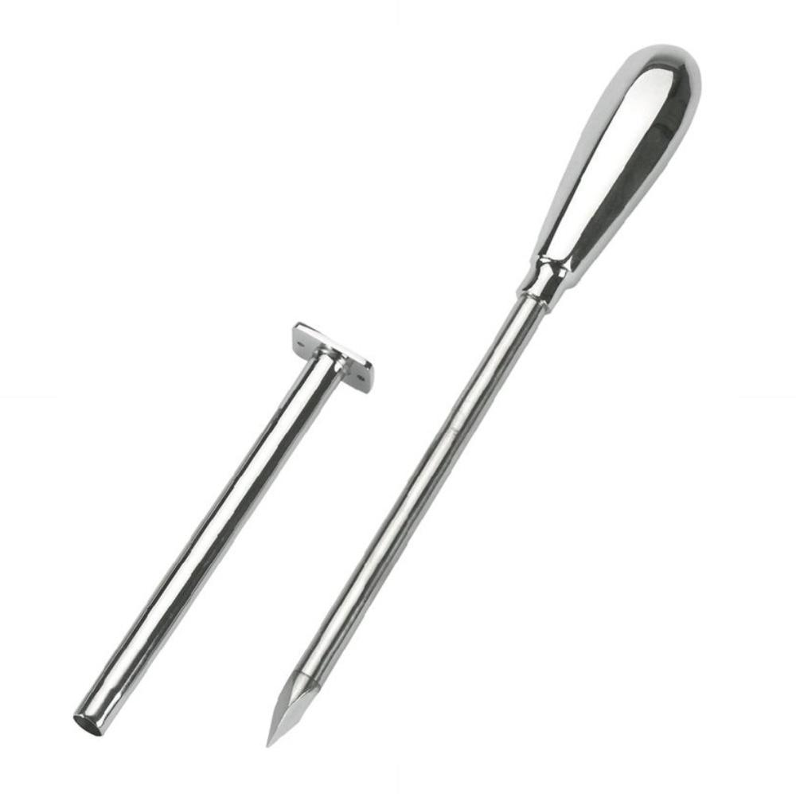
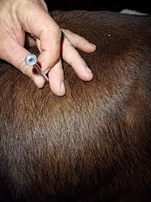
Trocar and cannula
Cannula and Trocar

Slide 50
Control and Prevention
Management practices used to reduce the risk of bloat include
Feeding hay, before turning cattle on pasture
Maintaining grass dominance in the sward, or using strip grazing to restrict intake, with movement of animals to a new strip in the afternoon, not the early morning.
The satisfactory method available to prevent pasture bloating is continual administration of an antifoaming agent during the risk period.

Slide 51


