Slide 1
Plants Producing Photosensitization
Photosensitization: Abnormal sensitivity of the light pigmented areas of skin to sunlight due to presence of photodynamic agent(s) in the peripheral circulation and skin.
Primary Photosensitization
Secondary (Hepatogenous) Photosensitization
Most Frequent
Photodynamic agents/Photodynamic metabolite
Polyphenolic pigments
“Phylloerythrin” bacterial breakdown product of chlorophyll
Absorbed from GIT Under skin through circulation and reacts with UV light
Hypericum perforatum (Saint John’s wort)
Fagopyrum esculentum (Buckweed)
Ammi majus (Bishop’s Weed)
Trifolium spp. , Medicago spp., Erosium spp., Brassica spp.
Accumulate in peripheral blood: Photosensitization
Microcystis spp. (Blue green algae )
Tetradymia glabrata (Horse brush)
Lantana camara (Lantana)
Sporidesmin (Moulds)-Icterogenic
Dermatitis/Photosensitization

Slide 2
Secondary (Hepatogenous) Photosensitization
Plants causing Liver damage
(Pyrrolizidine alkaloids)
Plants causing biliary occlusion
Tribulus terrestris (Puncture vine)
Panicum colaratum (Klein grass)
Agave lecheguilla (Agave)
Lantana camara (Lantana)
Senecio spp., Crotolaria spp., Heliotropium spp.
Saponins (form crystals): Inflammation and obstruction of bile duct
Phylloerythrin: Accumulate in blood stream leads to photosensitization
Bioactivated to “Pyrroles” by Mono-oxygenase system
Alkylate DNA, impairs cell division in hepatocytes
Hepatocellular necrosis/Hepatomegaly/karyomegaly: Death
Pigs are most susceptible
Pyrrolizidine alkaloids: Carcinogen/mutagen/teratogen/abortifacient

Slide 3
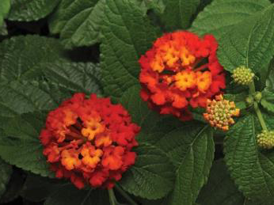
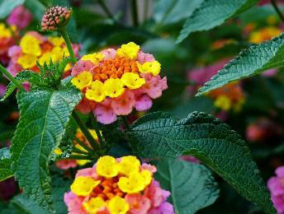
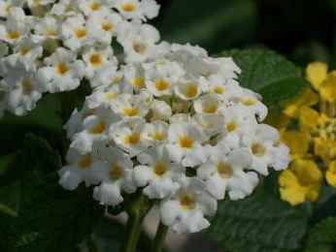
Lantana camara poisoning
(Shrub once grown as garden ornamentals, major weed across all states and territories of Australia); Alien weed
Another variety, Lantana montevidensis
Treated as poisonous to stock
Red flowered varieties most toxic
White and pink flowered can also be highly toxic
Red-yellow, orange-pink and white depending on the location and plant maturity. Lantana is mostly seen in coastal and sub-tropical areas however it can survive in dry areas as well

Slide 4
Susceptible Species
Cattle, sheep, goats and camelids are affected by the plants.
Lantana is not toxic to humans unless berries are ingested.
Lantana poisoning occur when animals are introduced to an area where toxic forms of lantana grows or during droughts when other feed sources are scarce

Slide 5
Toxic principles of Lantana camara
Lantadenes (Polycyclic triterpenes)
(Sheep is most susceptible)
Major lantadenes
Lantadene A
Lantadene B
Lantadene C
Lantadene D
Minor lantadenes
Reduced lantadene A
Reduced lantadene B
Icterogenins
Olenonic acid
Oleanolic acid
Carmarinic acid
Trans fused cyclic lactones

Slide 6
Mechanism of Toxicity of Lantana camara
Ingestion of plant
Photodynamic substance after absorption from GIT enters circulation
Energised by certain wavelength of UV light and molecule attain high energy state
Photodynamic agents return to lower energy state and releases energy- transferred to receptor molecules and initiate chemical reaction in skin
Tissue injury (by production of ROS)
Damage cell membrane and alters cell membrane permeability
Release of histamine (mast cells)
Inflammatory reactions: Erythema, edema, vesicles, pruritis, cellular necrosis, sloughing off of affected skin
Three factors:
Photodynamic substance
UV light
Light pigmented skin

Slide 7
CLINICAL SIGNS and SYMPTOMS OF LANTANA POISONING
Signs of lantana poisoning depend on the type of lantana consumed, how much of it and the intensity of sunlight. Acute signs appear with in 24 hours. Signs include:
Depression, loss of appetite , Photophobia
Constipation, frequent urination
Jaundice (yellow discolouration) of the insides of the eyes, mouth and vulva
Drooling and weeping eyes (Conjunctivitis), Skin Sensitivity to sunlight
Reddening and inflammation of unpigmented (white) skin; muzzle may become inflamed, moist, ulcerated and very painful (pink nose) and slough (fall off)
Severely affected animals may have a short period of diarrhea with black strong smelling faeces
Death may take between 2d-3wks depending on the severity

Slide 8
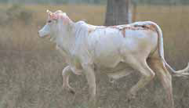
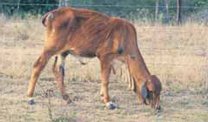
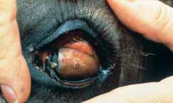
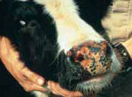
DIAGNOSIS
Diagnosis is based on the animal’s access to lantana and clinical signs shown (e.g. jaundice).
Cattle may become sun sensitive and their skin may blister after eating lantana
Calves poisoned by lantana stop eating and become weak and depressed
Jaundice (yellow discolouration) of eye
Photo-sensitisation

Slide 9
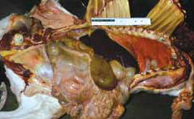
POST MORTEM FINDINGS
Yellow discolouration of tissues (jaundice)
Hard, dry, mucus-covered faecal masses in large intestine
Dry, undigested plant material in the rumen
Swollen and discoloured (yellow to orange) liver
Swollen gall bladder
Swollen and pale kidneys that turn green when exposed to air and cutting
Ulcerated cheeks, muzzle, nostrils, tongue and gums (in severe cases in cattle)
Post-mortem changes—enlarged gall bladder and yellowing of all tissues

Slide 10
TREATMENT
Unless treated quickly and effectively, animals may die within a week of ingesting the plant.
Move animal to a lantana free area
Place in the shade at all times due to sun sensitivity
Early diagnosed animals may be drenched with activated charcoal to reduce toxin
absorption
Provide fresh water and good quality hay at all times
Give oral electrolytes or intravenous fluids if animal is severely dehydrated
- Antibiotics and anti-inflammatories

Slide 11
Effective treatment may include:
Intravenous fluids and encouraging the animal to eat
Treating skin damage with antibiotics and sunscreens; other drugs can provide relief but are available only on veterinary prescription
Drenching with a slurry (2.5 kg activated charcoal in 20 litres of electrolyte replacement solution for cattle; 500 g in 4 litres for sheep and goats)

Slide 12
HOW TO PREVENT LANTANA POISONING
Follow these key points to prevent your animals from being poisoned by lantana.
Treat all lantana as being poisonous
Keep your property lantana free – weed control is paramount
Ensure stock have adequate feed at all times
Never put new/young stock in areas where lantana is present
- Act quickly if poisoning is suspected

