Slide 1

Welcome

Slide 2


Lecture 1. | Improving the nutritive value of poor quality roughages
Dr. Muneendra Kumar
Assistant Professor
Department of Animal Nutrition
muneendra82@gmail.com
College of Veterinary Science & Animal Husbandry
U.P. Pt. Deen Dayal Upadhyaya Pashu Chikitsa Vigyan
Vishwavidyalaya Evam Go-Anusandhan Sansthan
(DUVASU), Mathura - 281001 (U.P.)
www.upvetuniv.edu.in

Slide 3
Characteristics of poor quality roughages
-
1. Large content of structural carbohydrate
2. Low level of storage carbohydrate
-
3. Low nitrogen/protein content
4. Low mineral content
-
5. Presence of antinutritional factors
6. Poor/slow digestibility due to delayed microbial colonization

Slide 4
Methods of improving poor quality roughages
A-Supplementation with deficient nutrients
Supplement with green fodder
Supplement with urea-molasses liquid supplements
Ensiled with animal waste
B-Treatments
The main aim of the treatment of poor quality roughage with different methods is to increase voluntary intake or increase its digestibility or both.

Slide 5
B-Treatment methods
1. Physical methods | 2. Chemical methods | 3. Physico-chemical methods | 4. Biological methods
Soaking Chopping Grinding Pelleting Wafering Stream under pressure Irradiation | Alkali treatment [NaOH, Ca(OH)2, KOH, NH4OH] Ammonia treatment (gaseous, aqueous, urea-ammonia) Acid treatment (H2SO4, HNO3) Salt treatment (Na2CO3, NaCl) Gaseous treatment (Chlorine and SO2) Oxidizing agents (H2O2, O3) | Combination of physical-chemical treatments e.g. NaOH-pelleting, Urea-pelleting, Chopping-alkali, etc. | Enzymes Rot fungi Mushrooms

Slide 6
1. Physical treatments i-Soaking
This implies short –term soaking for about 12 to 24 hrs.
The paddy straw is rich in oxalate and the major portion of it is present in the form of soluble K⁺ and Na⁺ and small fraction is present in the insoluble form of calcium oxalate.
Soaking of paddy straw reduces some of the oxalates and may improve the nutritive value of the straw especially the calcium nutrition.

Slide 7
ii-Chopping or chaffing
Chaffing reduce the risk of selective feeding and thus wastage of fodder can be avoided.
Fodder is chopped uniformly into fine (0.5 cm) or coarse (1-2 cm) particles.
Chopping can be done either with the help of hand operated or power operated chaff cutter.

Slide 8
Advantages of chopping
It avoid selectivity and wastage.
It facilitate uniform mixing of roughage and concentrate in TMR.
Green fodder chopping facilitates good silage making.
It facilitates easy handling as increased bulk density.
It improve digestibility due to exposure of relatively large surface area of roughages for microbial digestion.
It increase the density of feed thus effectively increase the intake capacity of animal.

Slide 9
iii-Grinding
Grinding a lignocellulosic material affects its behavior in the digestive tract of a ruminant in three ways.
It greatly the time and effort made by the animal to break down the materials into particles, which are small enough to pass through the rumen into the lower digestive tract.
It increase the surface area of the material thereby providing more sites for cellulolytic enzyme action.
It increase the density of feed thus effectively increase the intake capacity of animal.

Slide 10
iv-Pelleting
Pelleting extruding individual or mixture of feed ingredients by compacting and forcing through die opening by any mechanical process.
The application of optimum amounts of heat, moisture and pressure is required.
Roughages are usually grounded before they are pelleted, size of pellets range from 12/6’’. Pelleted roughage weigh about 40lb/cft as compared to 5-6 lb/cft of long hay.

Slide 11
v-Boiling under pressure
This method has great effect on improvement of feeding quality of poor quality roughage.
This process breaks the ligno-cellulosic bonds through steaming at high pressure which increased digestibility of the product.
The increase in digestibility is reported due to combination of the direct physical influence of steam (7- 42.2 kg/cm2), heat and pressure on lignin and separating cell wall components and from auto-hydrolysis by the acid released.

Slide 12
vi-Irradiation
The use of ionizing radiations to increase the digestibility of ligno-cellulosic material is based on the observation that when wood is irradiated the cellulose chain length decreases and insoluble carbohydrate become more available to rumen bacteria.
The quantum of irradiation needed (25-75 mrad) to break the digestion ceiling and to release substantial amount of additional energy in a lignocellulosic material is quite high and therefore, this method is too expensive for commercial application.

Slide 13
2- Chemical treatments
Lecture 2
The aim of chemical treatment is to increase lignin solubility or decrease the bonds between lignin and other cell wall constituents
Increase voluntary feed intake and digestibility of ligno-cellulosic material.
Several chemicals used to improve the quality and nutritional value of poor quality roughages.

Slide 14
i. Alkali treatment
Treatment with alkali like NaOH, Ca(OH)2, KOH, NH4OH.
This process was first used on straw in Germany (1919) during first world war to fulfill the shortage of quality fodder.
Treated straw was termed as “fodder cellulose”.
NaOH treatment of straw is of two types:
NaOH treatment
A. Wet method
1. Beckmann method
2. Modified Beckmann method
3. Torgrimsby method
4. Dip method
2-Dry method

Slide 15
A. Wet method
1-Beckmann method (developed in 1921): treated chopped straw in 8-10 times its weight of cold 1.2 -1.5% (w/v) solution of NaOH for at least 4 hrs.
The treated straw is drained and washed with large quantity of water until free from alkali.
As NaOH is caustic and corrosive for animal tissues, it should be thoroughly washed with water.
The quantity of water used to wash the treated straw varies from 40 -50 % of the added NaOH.
Results into the environment (water pollution).
2-Modified Beckmann method: It utilizes less NaOH therefore requires less water and also DM losses are less.

Slide 16
B. Dry method
3-Dip method: To eliminate the limitations of Beckmann methods, Sundstol et al. (1981) developed dip method of alkali treatment.
After draining the excess alkali solution, the straw is allowed to ripen for 3-6 days which improved digestibility of finished product.
To eliminate the limitations of wet methods, Wilson and Pigden (1964) develop a dry alkali treatment method.
Here the straw is spayed or sprinkled with small amount of concentrated solution of NaOH.
4-6 kg of NaOH dissolved in 200 lt of water is adequate for 100 kg straw.
Intake of treated material is increased by 30-40% and digestibility by 10-15%.

Slide 17
Treatment with calcium hydroxide
It is cheaper, safer to use and easily available but low soluble in water and weak alkali.
Require long reaction time.
4kg Ca(OH)2/100 kg straw with enough water to give 50% moisture in treated material and incubate for 90-150 days.
Combination of NaOH and Ca(OH)2 gives better results than either of the alkali alone.
4% NaOH produced better results than 4% Ca(OH)2 treatment.
High cost of chemicals, pollution problem, corrosive nature of alkali limits their use.

Slide 18
ii-Ammonia treatment
Ammonia serve as alkali to improve the digestion of poor quality roughage.
Also, it serves as an sources of nitrogen for microbial protein synthesis.
1. Stack/anhydrous method of ammonia treatment: This method was developed by Sundstol et al., (1970-75).
Stacks of straw was wrapped with polyethylene cover and injected with 3% anhydrous ammonia.
When material with a high sugar content when treated with anhydrous ammonia at high temperature (>70 ℃) a poisonous compound 4-methyl imidasol can be formed which may cause crazy cow or angry cow or bovine bonker (hyperexcitability) in dairy cow.

Slide 19
2-Aqueous ammonia: It is also used at the concentration of 20-30% for straw treatment.
3-Ammonia through urea hydrolysis: Anhydrous or aqueous ammonia are costly, not easily available and difficult to transport due to corrosive nature.
Fertilizer urea can be use to generate ammonia and over come the limitation of associated with aqueous and anhydrous ammonia.
Simple and low cost method.
Create no pollution
Act as preservative.
Treated straw is pliable and palatable.
Urine can also be used for the treatment of poor quality roughage.

Slide 20
1. Take 100 kg wheat or chopped paddy straw and spread in a 6-9 inches layer over a impervious cemented floor or on a polythene sheet.
2. Dissolve 4 kg urea solution in 60 liters of water.
3. Spray and mix urea solution thoroughly with straw.
4. Pile up the mixed material in round shape and cover with polythene sheet.
5. Roll the ground level sheet with bricks to make it stay air tight.
6. After 4 weeks, open from side, aerate for 12 hrs and offer gradually to animals.
7.This treatments improves the voluntary intake of straw and increases its TDN and CP value.
Ammonia treatment enhance the rate of rumen degradability of wheat straw by more than 60%.
Ammonia treatment increase CP content decrease NDF and cell wall phenolic compounds.

Slide 21
Treatments using oxidizing agents
Oxidizing agents like H₂O_{2,} O₃ sodium peroxide etc. can be used for the treatment of wheat straw.
Unlike alkali, which does not disrupt the lignin molecule, peroxides are know to oxidize lignin and disrupt its complex with cellulose and hemicellulose.

Slide 22
Biological treatments
This treatment involve the use of microorganisms such as Phanerochaete chrysosporium, Streptomyces viridosporus, Coprinus fimetarius etc. or their enzymes for depolymerization of complex structures present in highly fibrous feed materials.
It based on the principle that lignolytic fungi will selectively degrade lignin and may leave behind better digestible cell- wall carbohydrates for further by the ruminants.
Spraying of cellulase solution on poor quality roughage @ 25 mg/100 kg material

Slide 23
1. Zadrazil process: Poor quality roughage was treated with Pleurotus sp. The process involved huge loss OM.
2. Karnal process: It is essentially a biological treatment of lignocellulosic material in a solid state fermentation (SSF).
In the first stage, the wheat or paddy straw is treated with 4 % urea, keeping moisture level at 40% and then ensiled for 30 days.
In the second stage, treated straw is mixed with 1% single superphosphate and 0.1% calcium oxide and then moisture to 60-65% before inoculation with 3% inoculum of Coprinus fimentarius culture grown on millet seeds.

Slide 24
Urea treatment in first stage break ligno-cellulosic bonds, create conducive environment, increase CP content and act as chemical sterile in preventing the growth of unwanted organism.
In second stage, fungus trap the free ammonia and convert it into amino acids. Considerable DM losses were there (upto 35%).

Slide 25
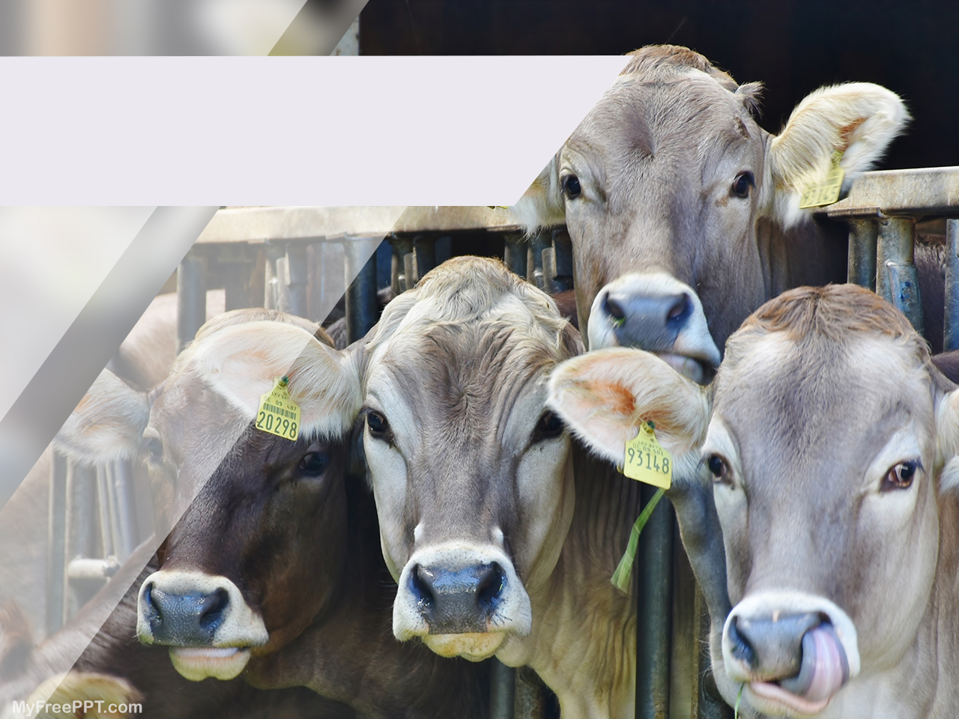
Thank you

