Slide 1


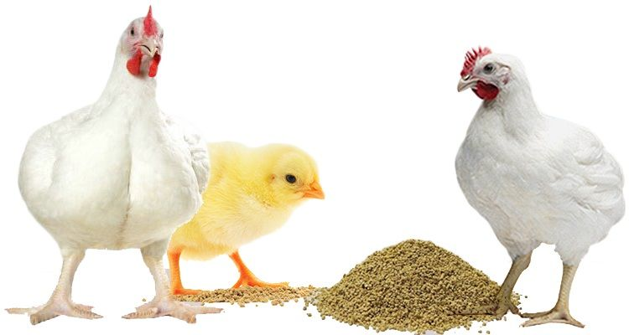
Lecture 1. | SCIENTIC FEEDING OF BROILERS, LAYER AND OTHER BIRDS
Unit-4
Dr. Muneendra Kumar
Assistant Professor
Department of Animal Nutrition
muneendra82@gmail.com
College of Veterinary Science & Animal Husbandry
U.P. Pt. Deen Dayal Upadhyaya Pashu Chikitsa Vigyan
Vishwavidyalaya Evam Go-Anusandhan Sansthan
(DUVASU), Mathura - 281001 (U.P.)
www.upvetuniv.edu.in

Slide 2
6 Major Classes of Nutrients
Carbohydrates
Protein
Fats
Vitamins
Minerals
Water

Slide 3
Water
The water requirement is dependent on
Age
Functional status
Environmental temperature
Water is given to the birds ad libitum.
Birds drink water double the quantity of feed (2:1). In summer (3-4:1), this can be more than three times the quantity of feed.
Water is not restricted to the birds, except under special circumstances, i.e. for initiation of molt in certain programmes.

Slide 4
Energy
The intake of energy by a chicken is governed by
Energy content of the diet
Productive state
Nutritional adequacy
Other factors

Slide 5
Protein
Some amino acids have to be provided in diet as the chicken cannot synthesize them or they do so inadequately. Such amino acids are called essential amino acids.
Amino acids required but synthesized in the body adequately are known as non-essential amino acids.
Among the essential amino acids, certain amino acids are likely to be low in practical feeds and these are known as critical amino acids.
Among the critical amino acids, lysine and methionine are the most deficient amino acids and are known as limiting amino acids.

Slide 6
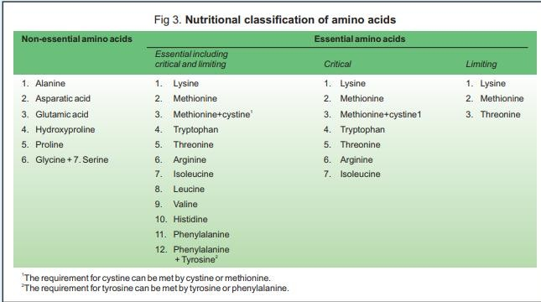

Slide 7
Minerals
Several factors influence the requirements of minerals. These are:
Breed of the chicken
Animal adaptation
Chemical form
Age of the chicken
Level of production
Interrelation with other elements

Slide 8
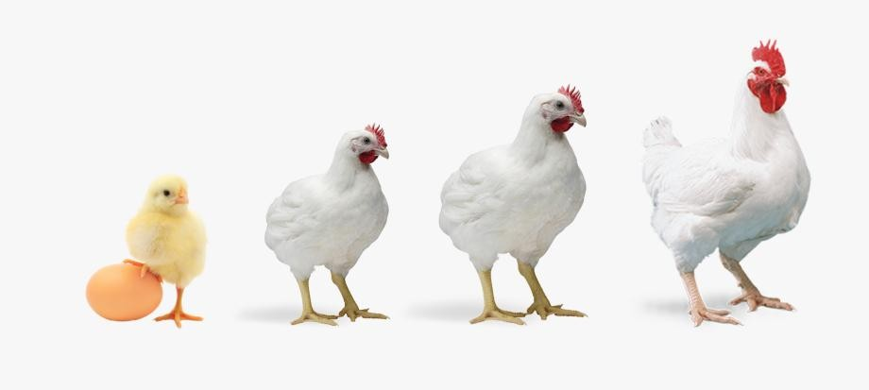
Feeding of Broilers
A broiler is any chicken that is bred and raised specifically for meat production.
Most commercial broilers reach slaughter weight between four and six weeks of age.

Slide 9

Phases (BIS, 2007)
Commercial White broilers reared under three phases,
are generally
Pre-starter phase (0-14 days of age)
Starter phase (14-21 days of age)
Finisher phase (21-42 days of age)
To achieve 2 to 2.5 kg market body weight.

Slide 10
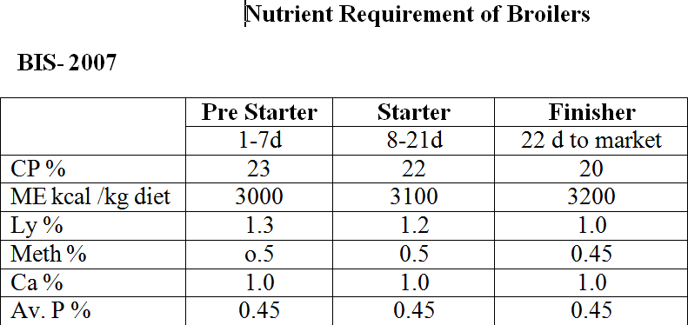

Slide 11
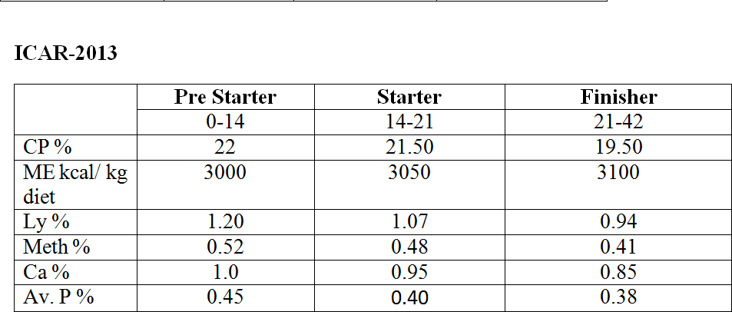

Slide 12
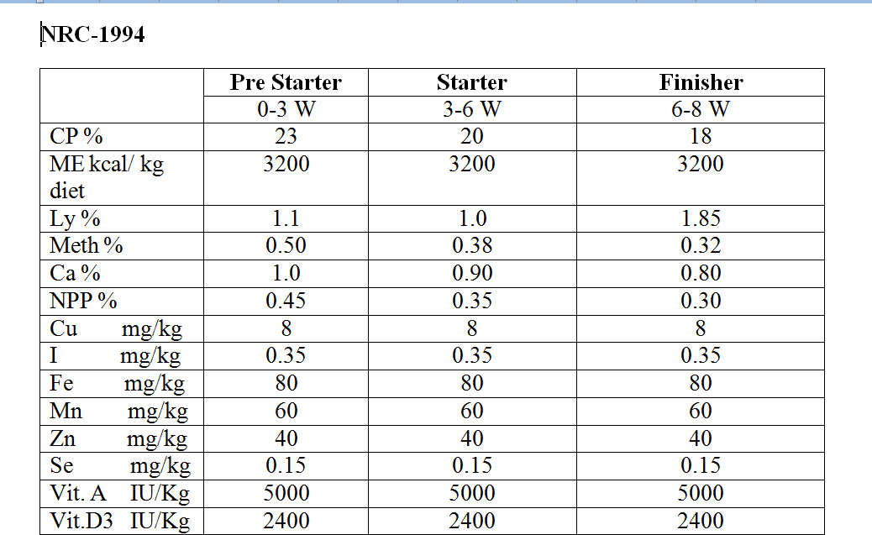

Slide 13
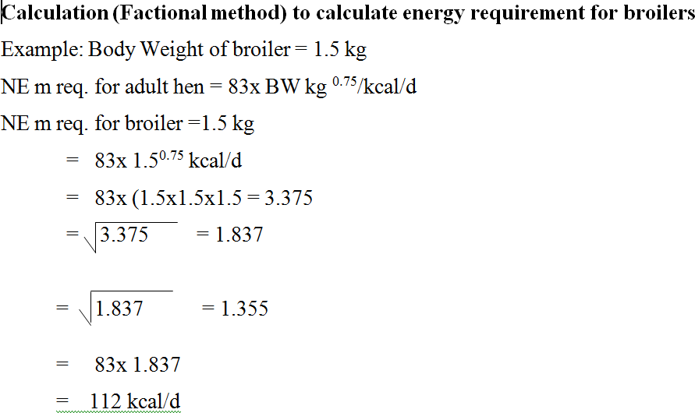

Slide 14
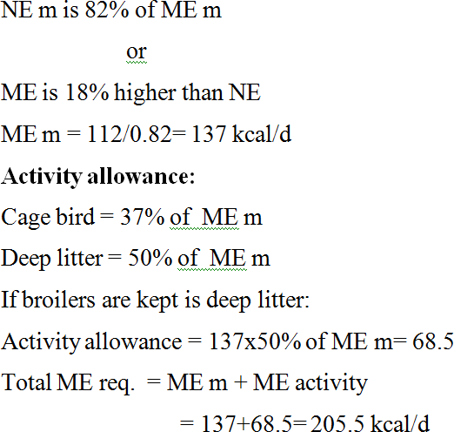

Slide 15
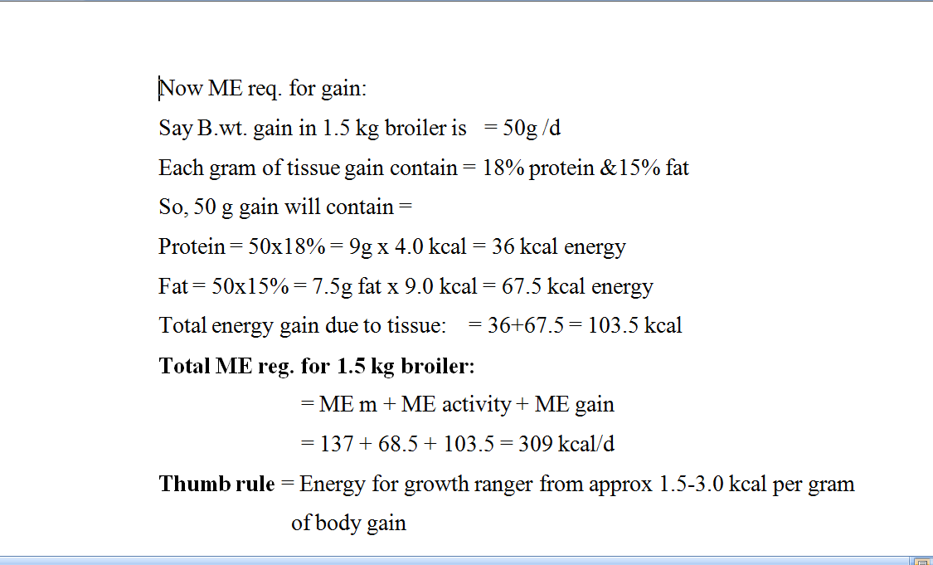

Slide 16
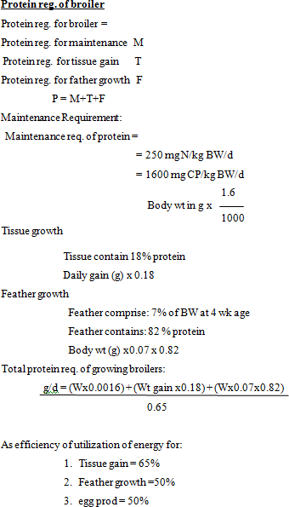

Slide 17


Efficiency parameters
Feed Coversion Ratio
Feed Efficiency Ratio
Performance Index

Slide 18
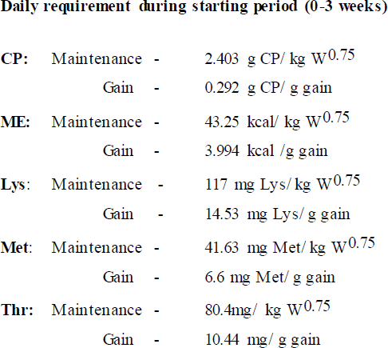

Slide 19
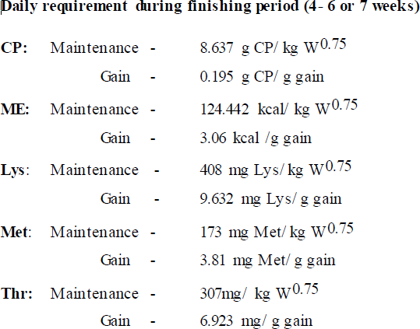

Slide 20
The requirement of other amino acids were calculated as proportion of Lys requirement:
Arg 110-114
Ile 73
Leu 109
Val 82
Phe 65
His 32
Trp 18%.
Requirement of digestible amino acid was calculated based on the digestibility coefficients:
for Lys 0.90; Met 0.90; Thr 0.84; Arg 00.92; Ile 0.88
Leu 0.93; Val 0.87; Phe 0.89; His 0.88 and Trp 0.91%.

Slide 21
Egg Type Pullets
Hens may be typed for production of:
Table eggs (laying hens)
Settable eggs (breeding hens)
Replacement pullets are generally reared in three phases:
Starter (0-8 weeks of age)
Grower (8-20 weeks of age)
Layer (20 weeks or above).
For meeting the nutrient requirement, particularly that of calcium at onset of lay, pre-lay phase (17/18 – 20 weeks) is recommended.
Laying phase is often divided into Phase I (20-30 weeks)
Phase II (>30 weeks).
In certain countries, a five-phase feeding system is followed viz. starter (0-6 weeks of age), grower I (6-12 weeks of age), grower II (12-18 weeks of age), grower III (18-to 1st egg) and layer (20 weeks or above).
Nutrition and feeding in early part of life influence subsequent laying performance

Slide 22
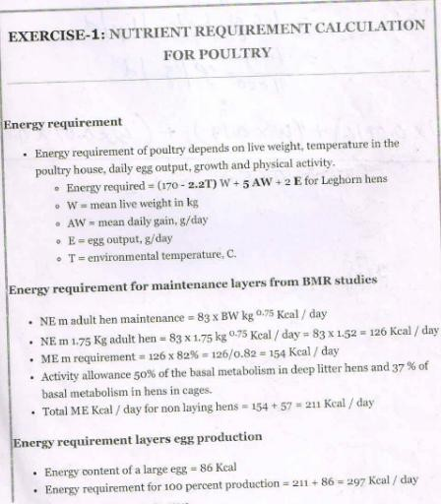

Slide 23
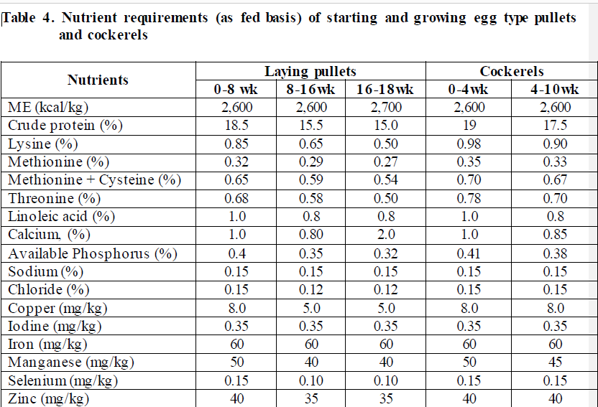
ICAR-2013

Slide 24
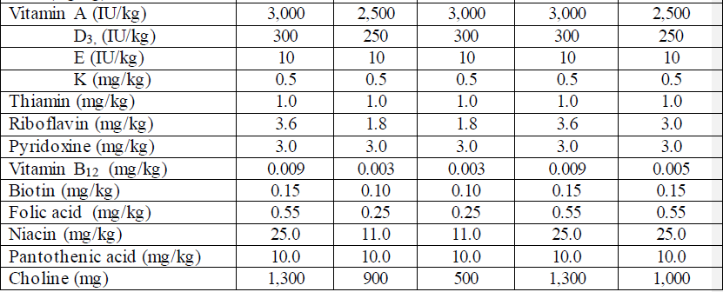
ICAR-2013 Cont…….

Slide 25
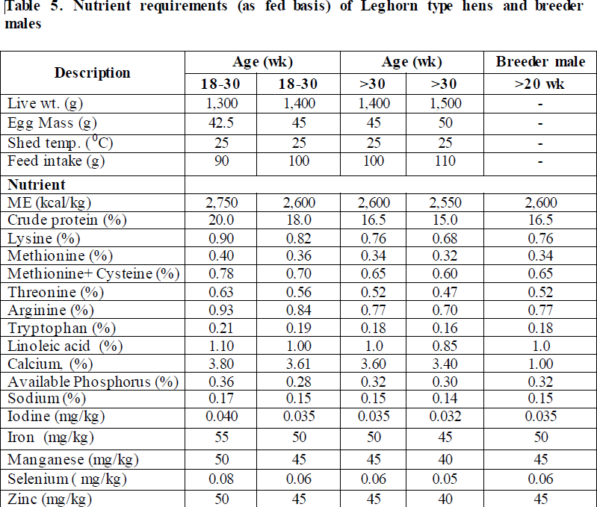
ICAR-2013

Slide 26
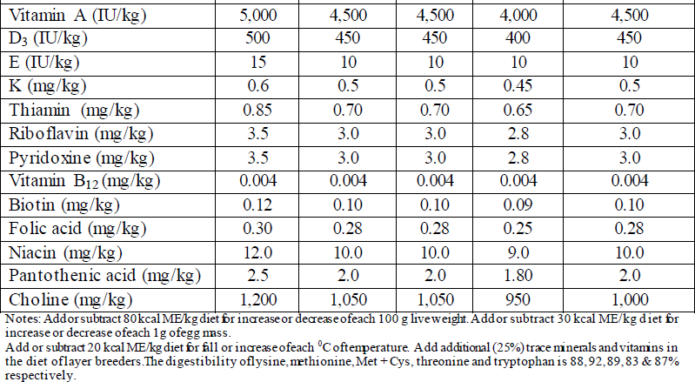
Cont……
ICAR-2013

Slide 27
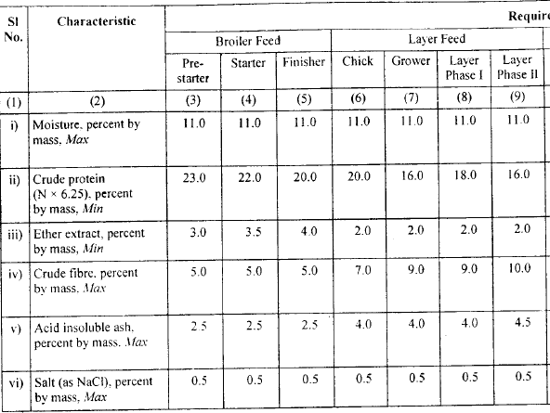
BIS-2007
Broilers: | Pre-Starter: 1-7 d; | Starter 8-21d; | Finisher: 22d-market
Layers: | Starter: 0-8 wks; | Grower: 9-20 wks; | Layer: Phase I: 21-45 wks; Phase I I: 46-72wks

Slide 28
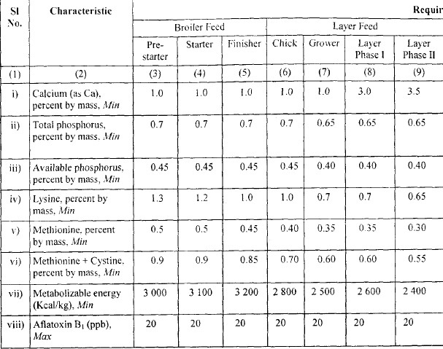
cont….
BIS-2007

Slide 29
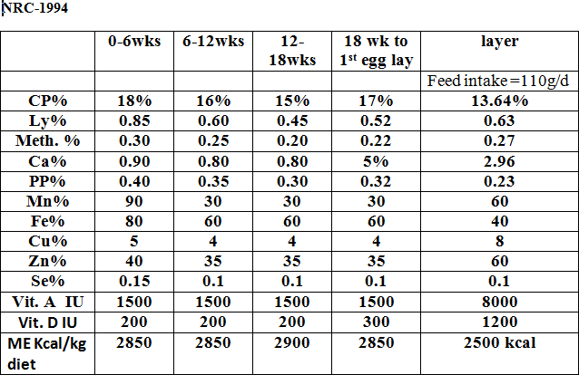

Slide 30
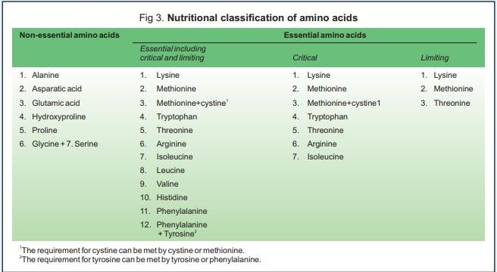

Slide 31
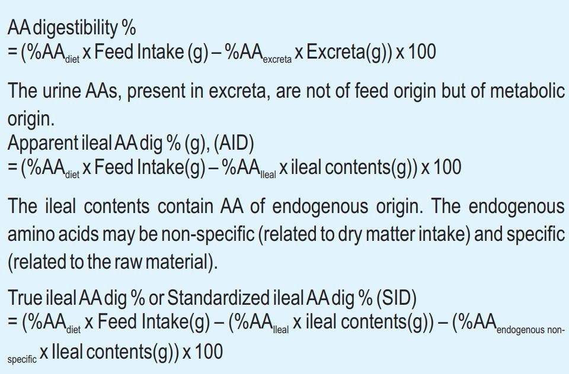

Slide 32
The critical nutrients required for optimum laying performance are energy and protein (amino acids).
Birds satisfy energy intake by adjusting their daily feed intake; unable to meet their AA needs by adjusting FI.
The daily requirement for all the AAS changes as the
amount of egg mass changes.
It also increases from 25 to 40 weeks of age, and then gradually decreases as egg mass decreases.
As the laying house temperature and energy content of the
diet influence the feed intake, the AA content in the feed must be adjusted to compensate those changes.
The prediction formula developed by Harms (2001): Critical amino acids requirements are 13.42, 5.45, 8.54, 2.91,
11.82 and 12.73 mg/g of egg mass for lysine, methionine,
threonine, tryptophan, isoleucine and valine, respectively.

Slide 33
Amino acids can be calculated from the equation:
mg of AA / g egg mass X kcal ME consumed per day
% of amino acid in diet =
kcal ME / g egg mass X Feed consumption in mg

Slide 34
NRC (1994) recommendations provide much energy (2,800- 2,900 kcal ME/kg).
It becomes difficult to provide such an amount of energy under Indian conditions.
The dietary energy level is kept in between 2,500 and 2,750
kcal ME/kg during growth period.
Moreover, being tropical country, the maintenance requirement is also slightly lower.
Lower energy level is associated with higher feed
conversion ratio, higher gut volume and subsequent higher feed intake.
In laying hens the dietary energy concentration ranges from 2,550 to 2,700 kcal ME/kg.
On an average one laying hen showing 90% egg production
requires 16-18 g of protein and 285 to 290 kcal ME per day.

Slide 35
Meeting calcium requirement is important during overall growth (0.9 to 0.7%), but most crucial during laying phase.
Just prior to initiation of egg production, huge amount of calcium is stored in bones, which is sufficient for 6 to 30 eggs.
Therefore, calcium concentration is increased to about 2%
of diet a week before onset of egg production.
Once egg laying starts birds meet their calcium requirements from dietary intake and body reserve.
The specific gravity of egg-hell increases with increased
calcium concentration in diets.
White Leghorn hens producing 90% eggs require daily about 3.8 to 4.2 g of calcium.
Half of the calcium in diet should be supplied through LSP and remaining half as grit so that the needy hens may select and consume calcium as per need and palatability of feed is
maintained.

Slide 36
Therefore, in addition to dietary calcium (3 to 3.5%), there should be continuous access to shell grit.
Shell grits improve digestion and utilization of other
nutrients by helping in the grinding of feed materials in the gizzard.
Addition of grit of appropriate sizes in mash at an interval
of every two to four weeks may be beneficial.
Retention of calcium during the first 40 weeks is about 55% and decreases thereafter with age.
Thus, requirement of calcium increases with age.
Heavy birds consume more feed, hence dietary concentration of calcium should be less.
Any factor that affects feed intake like ME content of diet, and environmental temperature, will affect calcium concentration in the diets.

Slide 37
The available P requirements are 0.4% in starting, 0.35% during growing and 0.25 to 0.3% in laying phase.
Egg content can be manipulated by nutrition. The major
changes that
can be brought through nutritional are egg size, egg shell
manipulation
quality, yolk
pigmentation, egg cholesterol content, and concentration of certain vitamins, minerals and desired fatty acids (enrichment of eggs).

Slide 38
Chick Mash
Chick mash should be fed to the birds from its arrival until the average
body weight of the birds reaches 580 gms. This is a feed-to-weight program rather than feed-to-age program. Body weight gains are better with pelleted/ crumbled feed compared to mash feed. Therefore it is recommended to use pelleted/crumbled chick feed.
Grower Mash
The grower feed should be fed till flock reaches an average body weight of 1100 gms. Do not administer prelay feed to the birds weighing below 1100 gms.
Prelay Feed
Care should be taken to ensure prelay feed is introduced after the flock attains an average body weight of 1100 gms and usually for 2 to 3 weeks Layer Feed
Layer feed offered to the laying birds should be formulated according to the age of the birds and egg production. Accordingly, layer feed can be divided into three groups i.e. Phase I , Phase II and Phase III. Phase I feed should be given upto the age of 40 weeks and later Phase II ration may be given. Phase III feed should be given after the age of 60 weeks.

Slide 39
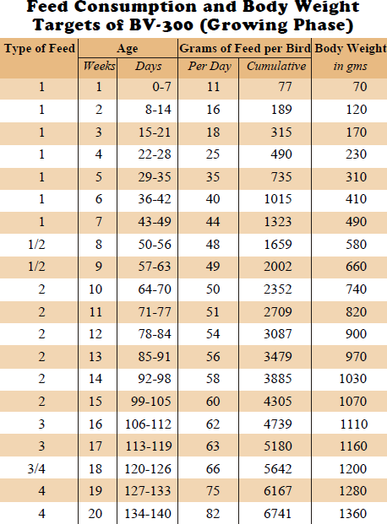

Slide 40
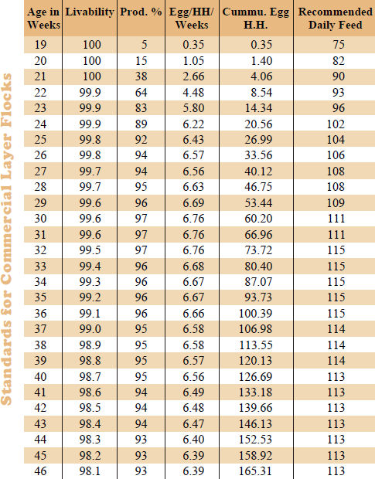

Slide 41
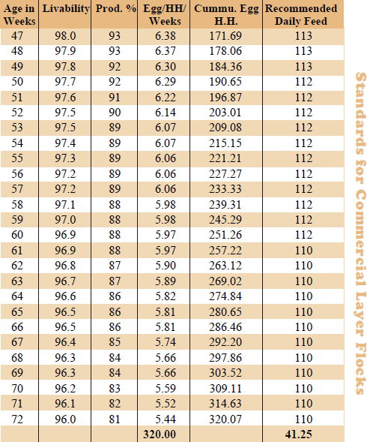

Slide 42
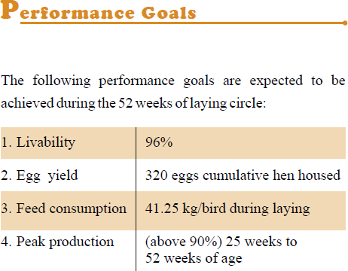

Slide 43
Calorie protein ratio
Calorie-protein ratio is defined as the metabolizable energy (kcal) per kilogram divided by the percentage of crude protein in the ration.
Calorie-protein ratio is maintained for effective utilization of protein as well as amino acids.
Faster growth is achieved when the protein level is increased (at lower calorie to protein ratio).
Calorie-protein ratio = kcal M.E. per kg feed
Protein percentage

Slide 44
Cont….
Types | Calorie -Protein ratio
 | BIS (1992) | BIS (2007)
Broiler starter feed | 122 | 141
Broiler finisher feed | 145 | 160
Layer Chick feed | 130 | 140
Layer Growing chicken feed | 156 | 156
Laying chicken feed | 144 | 144 to 150

Slide 45
Phase feeding in poultry
Definition- Phase feeding is a nutritional management strategy in which the ingredient and chemical composition of the diet is modified over time so that the nutrient composition of the diet more closely meets the nutrient requirements of the poultry bird
or
Phase feeding refers to change in the protein level of laying diet during normal production cycle.
Followed during laying phase.

Slide 46
Cont….
Such changes are designed to regulate the intake of dietary protein to meet more closely the hen’s requirement at various stages of egg production.
Production cycle of layers may be divided in to 3 phase:
  Phase I - up to 36 weeks age
  Phase II - 37 to 56 weeks age
  Phase III – from 57 weeks age ( till the spent out birds are discarded)

Slide 47
Phase feeding in poultry
Phase (Age) | Egg production | Egg weight | Body weight
Phase I - up to 36 weeks age | Rises and reaches the maximum | Gradually increases | Gradually increases
Phase II - 37 to 56 weeks age | Production maintained | Gradually increases | Gradually increases
Phase III – from 57 weeks age | Production declines | Gradually increases | Slightly increases

Slide 48
Cont….
Phase-I: During the first phase of 18-20 weeks period the birds are expected to reach from zero to peak egg Production of 85 percent or so.
This further accompanied into increase in body weight by 500 g and increase in size of eggs from 40 to 60 g.
Therefore, this phase of reproduction is critical for maximum egg production and tissue development.

Slide 49
Cont….
Thus energy content of poultry rations should be adjusted to supply required quantity of protein.
Daily protein requirement is about 10.2 g

Slide 50
Cont….
Phase-II: It is the period when hens have attained mature body weight and egg production has not gone below 60 % level.
Average egg production is 72% (all are large egg).
The efficiency of protein utilization is approximately 56 % during this phase.
Daily protein requirement is 16.9 g

Slide 51
Cont….
Phase-III: During this phase egg production is less than 60 percent.
Protein intake of about 15 g or less would be enough in this phase.

Slide 52
Restricted feeding in poultry
Definition- Offering the animals limited amounts of feed, normally lower than the amount that they are able to eat
Restricted feeding during the growing period (particularly in the age group of 12 to 20 weeks)
means an actual reduction of nutrient intake below minimum requirement of birds

Slide 53
Restricted feeding in poultry
Feed intake is reduced either by limiting feed offered to 85-90% of normal fed intake or
by diluting the conventional feed with fibrous material of low nutrient density or
following skip a day feeding.

Slide 54
Cont….
In skip a day feeding
  feed is provided on the first day at 85-90% level of the two days ration,
  on the second day birds are not given any feed and some whole grain may be spread on litter.
Feed restriction is recommended until 21 or 22 weeks of age or up to 5% egg production level.
It is reported that low protein or low lysine diets are able to produce slightly more delay in sexual maturity than quantitative feed restriction.

Slide 55
Cont….
Pullet birds on restricted feeding requires 5-10 days longer to reach sexual maturity.
There is a reduction in the number of small eggs laid at the commencement of production.
Restricted feeding is also practiced in broiler, since excess weight of breeders affect fertility and egg production.

Slide 56
Cage layer fatigue
Caged layer fatigue (CLF) seems to be an extreme consequence of loss of structural bone in the vertebrae that leads to spinal cord collapse and paralysis.
Due to the deficiencies or poor utilization of calcium and phosphorus, lot of calcium is depleted from the long bones and muscles.
High producing laying hens maintained in cages, around the time of peak egg production are more prone to CLF.
Predisposing factor is reduced activity/exercise

Slide 57
Cont….
The fracture of the vertebrae is due to an impaired calcium flux related to the high output of calcium in the egg shell.
A high incidence of CLF can be prevented by ensuring the normal weight-for-age of pullets at sexual maturity.
Such pullets receive a high-calcium diet (minimum 3.5% Ca) at least 14 days prior to first ovi-position.
The condition is rarely seen in deep litter.

Slide 58
Cannibalism and feather picking
Cannibalism is a condition in which birds of a flock attack their pen mate and eat its flesh, which may impose deep wounds and heavy mortality.
It occurs in flocks fed fibre free diets.
Its considered that chicken diets should contain 3-4% crude fibre.
This condition is more likely with pelleted or crumbled diet.
Deficiency of arginine, methionine, common salt and mineral are some cause responsible for cannibalism.
A methionine deficiency may leads to feather picking.

Slide 59
Fatty liver haemorrhagic syndrome (FLHS)
Fatty liver hemorrhagic syndrome is a metabolic disorder of chickens (increased accumulation of fat in liver).
It is common occurrence in laying hens and breeders (pullets are more prone).
Cause are:
  Low protein, high energy ration
  Ration with amino acid imbalance or deficiency
  Diets low in lipotropic factors (choline, methionine, vit-B₁₂)
  Certain moulds or mould toxins
  High level of glucosinolate in laying hens feed

Slide 60
Fatty liver kidney syndrome (FLKS)
Diet deficient or marginal in biotin can leads to FLKS in young broilers.
This condition is most commonly seen in 2-4 weeks old birds fed wheat-based diets.
Death is caused by hypoglycaemia due to failure of hepatic gluconeogenesis (triggered by inadequate level of pyruvate carboxylase enzyme).

Slide 61
Cont….
Pyruvate carboxylase enzyme is biotin dependent.
Stress is a major contributor to the severity of FLKS.
Stress likely induces an epinephrine-induced catabolism of the already low glycogen reserve.

Slide 62
Diet and Egg size
Egg size is largely dependent upon the level of dietary protein and level of linoleic acid.
Higher intake of balanced protein produce larger eggs.
Feeding of higher levels of proteins at the onset of production will help to increase egg size more rapidly.
A level of 1% linoleic acid in the diet is considered adequate for maximum egg size.

Slide 63
Forced moulting
Moult: seasonal decline in egg production occurs when birds go into a condition known as the “moult”.
Moulting: Moulting is the normal process of shedding and renewing feathers of chickens.
The objective is to give the laying hen rest or to rejuvenate her lost vigour during laying period, and make her lay eggs again after the rest.

Slide 64
Cont….
Forced moulting : It refers to moult which has been induced in laying hen by introducing planned stress.
Minor stresses such as temporary fed or water shortage and diseases, can also initiate a partial or premature moulting.
Decrease in day length is normal trigger for moulting.
Forced moulting of flock is suggested whenever the egg production is less and egg prices are less.

Slide 65
Amino acid interaction
Amino acid imbalance- may be caused in diets formulated with feed ingredients without supplemental amino acids
  In such diet, protein content is high with excess levels of some amino acids.
  Amino acid in excess compete with the dietary limiting amino acid for transport to the brain using reduced feed intake and consequent reduced performance.

Slide 66
Cont….
Cont….
2) Amino acid antagonism-
Lysine-arginine antagonism- The increased level of arginine to lysine-rich diet relieves the depressant effect caused by this antagonism
excess lysine stimulates arginase activity
increased renal catabolism of arginine in the body
causing symptoms of deficiency of this amino acid
which can cause a decrease in productive responses

Slide 67
Cont….
Cont….
b) Leucine, isoleucine and valine antagonism-
High dietary level of leucine or valine reduced the utilization of Isoleucine and exacerbating its deficiency.
The result is high dietary level of one amino acid increases the requirement for the other two.

Slide 68
Cont….
Cont….
3) Amino acid Toxicity-
Amino acid toxicity is due to an individual amino acid.
Methionine is most toxic amino acid depressing the growth and feed intake at a level of about 3 to 4 time the requirement.

Slide 69
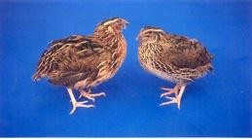
JAPANESE QUAILS
Japanese quails (Coturnix coturnix japonica) are reared intensively for commercial meat and egg production.
Quails are also important laboratory birds because of their small size and short life span.
Quail possess characteristics of fast growth, early sexual maturity and high rate of egg production.
They are prolific breeders and have the ability to produce 4 generations in a year.
Quails are immunologically more potent than chicken ,need no vaccination, little or no medication ,tough to environmental constraints due to inherent ability to grow under natural conditions
Quils meat and eggs contain less fat and cholesterol and thus are more healthy and friendly to cardiac patients.

Slide 70
Broiler quail chicks
Biphasic rearing system (0-3 and 3-5 weeks)
Quail broilers achieve body weight of about 180- 240 g at 35 days.
The growth rate is very high during the first three weeks of age and decreases thereafter at 4th and 5th weeks of age.

Slide 71
Layer quail chicks
Females grow faster than males and at 5th week of age, the difference is about 10-20 g.
They start to lay at about 6th week of age and about 50% egg production is achieved at 42 to 49 days of age; 9-30 weeks =80% egg production
Their live weight at hatch is about 6-8 g
Egg mass output as per the body weight is more than of chicken, thus, the requirements of energy, protein and amino acids in layer/breeder ration are higher.
Egg weight of egg line quails is about 10 g.
The 10 g egg contains 7.46 g water, 1.31 g protein, 1.12 g fat and
0.11 g of total ash.
The average daily feed intake is about 25 g.
The minimum daily protein requirement is less than 4.7 g and energy is 60 kcal ME per layer.

Slide 72
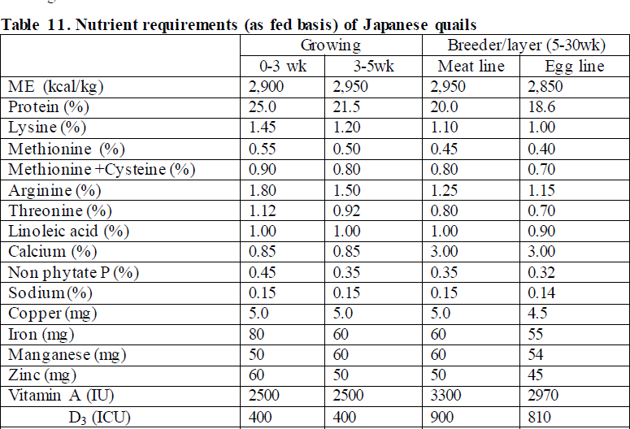
ICAR 2013

Slide 73
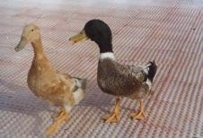
DUCKS
They are raised for both meat and eggs.
Duck rearing is more common in entire coastal belt in India. White Pekin is the most preferred meat type duck breed. Among egg-laying breeds, Khaki Campbell is the best: 300 eggs per year and egg weight 65 to 75 g.
They thrive well in scavenging conditions. Ducks supplement their feed intake by foraging.
They eat fallen grains in paddy fields, insects, snails, earthworms, small fishes and other aquatic materials.
They do not require any elaborate houses like chicken.
Ducks are quite hardy, more easily brooded and more resistant to common avian diseases.
Marshy river side, wet land and barren moors are excellent quarters for duck farming.

Slide 74
 | Poultry | Duck
Egg Production | 60-80 eggs Year/B Back yard | 130-140/D/Year So 40-50 eggs more
Duration of egg production | 1 year Commercially viable | 2-3 years Commercially viable
Egg wt. | 50-60 g | 65-70 g Protein content more
Egg shell | Thin | Thick Less transportation loss
Management | More | Less
 | Immunity poor | Immunity higher
 | Mortality high | Less mortality

Slide 75
Eggs | Poultry | Duck
Av. wt | 52.0 g | 67.0 g
Albumin % | 55.8 g | 52.6 g
York % | 31.9 | 35.4
Shell thickness | 0.31 mm | 0.33 mm
CP % | 12.9 % | 13. 5%
Energy kcal /100g | 148 | 150
Colesterol mg/g | 12.0 | 6.50
Ca mg/g | 0.60 | 0.70
P mg/g | 2.0 | 2.60

Slide 76
Ducks are suitable for integrated farming systems such as duck-cum- fish farming and duck farming with rice cultivation.
In duck-cum-fish farming droppings of ducks serve as feed for fishes and no other feed or manuring of the pond is necessary for fishes (200-300 ducks per hectare of waste area).
Under integrated duck farming with rice cultivation, ducks perform four essential functions viz. inter tillage as they search for food, their bills loosen up the soil around the rice plants, weeding, insect control and manuring.
Ducks also reduce the incidences of schistosomiasis, amphistomiasis and fascioliasis.
Though duck is a water fowl and very fond of water, water for swimming is not essential at any stage of duck rearing.

Slide 77
Nutrient requirements of Broiler Duck ( NRC, 1994)
Nutrients | Starter | Grower
 | 0-2 weeks | 3-7weeks
ME(Kcal/kg) | 2900 | 2900
CP% | 22 | 16
Ly% | 1.1 | 0.9
Meth.% | 0.4 | 0.3
Ca% | 0.65 | 0.60
P% | 0.40 | 0.35

Slide 78
Production performance of White pecking duck (Straight run)
Age | B.wt kg | Feed Consumption kg | FCR
1wk | 0.19 | 0.21 | 1.14
2wk | 0.60 | 0.97 | 1.61
3wk | 1.11 | 2.25 | 2.02
4wk | 1.68 | 3.79 | 2.26
5wk | 2.18 | 5.42 | 2.48
6wk | 2.58 | 7.17 | 2.78
7wk | 2.95 | 9.09 | 3.08
8wk | 3.29 | 11.11 | 3.38

Slide 79
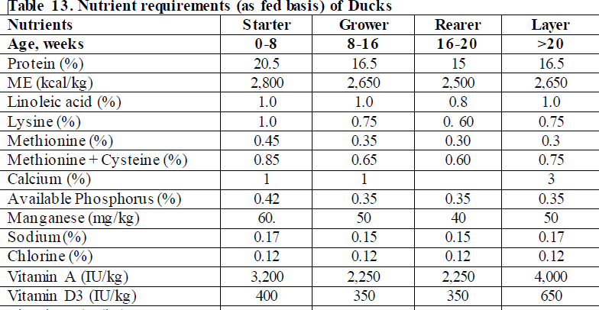
Nutrient Requirement of Layer duck (ICAR 2013)

Slide 80
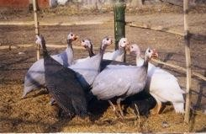
GUINEA FOWL
It is superior as free range bird.
Three major varieties of guinea fowl: Pearl, Lavender and White.
Guinea fowls are reared primarily for meat purpose.
The CARI has developed improved guinea
fowl:
Kadambari, Chitambari and Swetambari.
They are resistant to many common diseases of chicken, do not need elaborate and expensive housing, have
excellent foraging capabilities, are more tolerant to mycotoxins and have meat low in cholesterol.
They weigh 500-550 g at 8 weeks and 900-1000 g at 12
weeks of age
They start laying when 230-250 days of age.
Average egg weight ranges from 38 to 40 g.
.

Slide 81
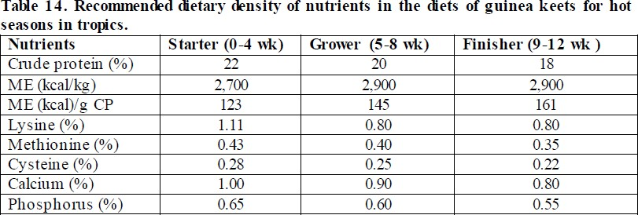
ICAR-2013

Slide 82
TURKEY
Turkeys are native of the North America.
They were first domesticated in Europe.
They are now important source of meat in many parts of the world.
The bird is suitable for free range, semi-intensive and
intensive systems of rearing.
Turkey birds are less sensitive to dietary energy level but they require more protein (28% CP) and amino acids during earlier part of life (NRC, 1994).
They have special requirements for lysine and methionine.
Lysine has special role in feathering, as lysine-deficient
Bronze poults show a characteristic white barring of the primary and secondary feathers of the wings.

Slide 83
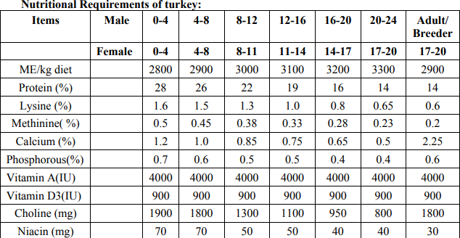

Slide 84
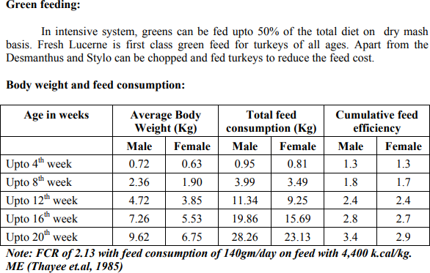

Slide 85
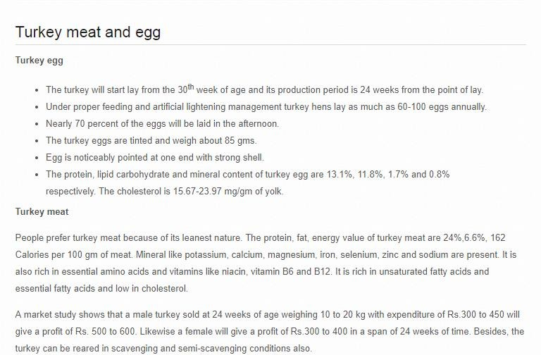

Slide 86
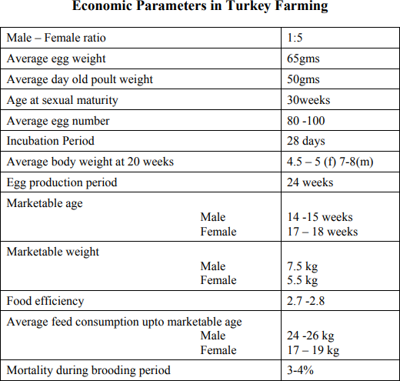

Slide 87
FEEDING OF TURKEYS
The general principles of feeding turkeys are similar to those for feeding broilers.
Major differences are in the protein levels required and the importance of the vitamins biotin & pyridoxine in turkey diets
• Poults must be fed & watered as soon as possible after hatching & if feeding delayed beyond 36h after hatching ⇒difficulty learning to eat & drink.
• Vits. & minerals suppl. of the diet essential for good hatchability of turkey eggs.
• At 10-12W of age separate hens from toms

Slide 88
FEEDING OF TURKEYS (NRC 1994)
ME (Kcal/Kg diet) | Protein (%) | Period
2900 | 28 | 0-3 W (starter)
3300 | 14 | After 17-20 W (grower)
2900 | 15 | Breeding

Slide 89
ME (Kcal/kg) | Protein (%) | Period
2930-3000 | 30-33 | First 3 weeks
2930-3000 | 28 | 0-4 W
2900 | 26 | 4-8W
3100 | 20-22 | 8-12W
3200 | 19 | 13-16W
3275 | 16 | 17-20 W
3350 | 13-14 | 21 W-market
2925 | 15-18 | Laying hen
2755 | 19 | Peak production

Slide 90
FEEDING OF TURKEYS
Nutritional disorders of turkey:
1-Leg weakness disorders:
Cause: def. of Ca, P, vit.D, choline, biotine, folic acid, Mn & zinc.
2-Enlargment of hock joint:
Cause: def. Of niacin, biotin, vit.E & zinc.
3-Footpad dermatitis:
Cause: biotin deficiency
Symptoms: sticky droppings adhere to the feet & cause dermatitis

Slide 91
FEEDING OF TURKEYS
4-Pendulous crop:
Cause: yeast proliferation in crop
Symptoms:gas production from fermentation of carbohydrate ⇒interfere with passage of ingesta from crops to proventriculus ⇒pendulous crop
Treatment: fungal inhibiting antibiotics
5-Ascitis:
Cause: high salt intake ⇒fluid accumulation in body cavities

Slide 92
FEEDING OF TURKEYS
6-Exudative diathesis:
Cause: Selenium deficiency
7-Aflatoxicosis:
• Aflatoxin affect the immune system ⇒increase susceptibility to disease
• Mycotoxin ⇒hemorrhage may bluish the carcass

Slide 93
FEEDING OF DUCKS & GEESE

Slide 94
FEEDING OF DUCKS & GEESE
Commercial feeds in mash, pelleted or crumbles form available for ducks & geese
If a commercial feed for ducks & geese is not available, chicken feed may be used (not contain coccidiostat)
Geese are largely herbivorous.
Geese will start to eat pasture when they are only few days old & feed additional grain if pasture is not of good quality.

Slide 95
 | Poultry | Duck
Egg Production | 60-80 eggs Year/B Back yard | 130-140/D/Year So 40-50 eggs more
Duration of egg production | 1 year Commercially viable | 2-3 years Commercially viable
Egg wt. | 50-60 g | 65-70 g Protein content more
Egg shell | Thin | Thick Less transportation loss
Management | More | Less
 | Immunity poor | Immunity higher
 | Mortality high | Less mortality

Slide 96
FEEDING OF WHITE PEKIN DUCK (NRC 1994)
ME (Kcal/Kg diet) | Protein (%) | Period
2900 | 22 | 0-2 W (starter)
3000 | 16 | 2-7 W (grower)
2900 | 15 | Breeding

Slide 97
FEEDING OF GEESE (NRC 1994)
ME (Kcal/Kg diet) | Protein (%) | Period
2900 | 20 | 0-4 W (starter)
3000 | 15 | After 4 W (grower)
2900 | 15 | Breeding

Slide 98
Practical level of nutrients in duck ration
 |  | Grower
Nutrients | Starter (0-2weeks) | Ist phase (3-8 week) | 2nd phase (9-20 weeks) | Layer | Breeder
ME K cal/kg | 2750 | 2750 | 2700 | 2650 | 2650
CP (%) | 20 | 18 | 15 | 18 | 18
Calcium (%) | 0.9 | 0.8 | 0.8 | 2.5 | 2.5
Phosphorus % (available) | 0.45 | 0.45 | 0.45 | 0.45 | 0.45
Niacin (mg/kg diet) | 60 | 60 | 60 | 60 | 60
Riboflavin (mg/kg diet | 5 | 5 | 5 | 5 | 5
Vit A (IU/ kg diet) | 400 | 400 | 400 | 600 | 800
Vit D₃ (IU/kg diet) | 600 | 600 | 600 | 100 | 100

Slide 99
JAPANESE QUAILS
Japanese quails (Coturnix coturnix japonica) are reared intensively for commercial meat and egg production.
Quails are also important laboratory birds because of their small size and short life span.
Quail possess characteristics of fast growth, early sexual maturity and high rate of egg production.
They are prolific breeders and have the ability to produce 4 generations in a year.
Quails are immunologically more potent than chicken ,need no vaccination, little or no medication ,tough to environmental constraints due to inherent ability to grow under natural conditions
Quails meat and eggs contain less fat and cholesterol and thus are more healthy and friendly to cardiac patients.

Slide 100
Broiler quail chicks
Biphasic rearing system (0-3 and 3-5 weeks)
Quail broilers achieve body weight of about 180- 240 g at 35 days.
The growth rate is very high during the first three weeks of age and decreases thereafter at 4th and 5th weeks of age.

Slide 101
Layer quail chicks
Females grow faster than males and at 5th week of age, the difference is about 10-20 g.
They start to lay at about 6th week of age and about 50% egg production is achieved at 42 to 49 days of age; 9-30 weeks =80% egg production
Their live weight at hatch is about 6-8 g
Egg mass output as per the body weight is more than of chicken, thus, the requirements of energy, protein and amino acids in layer/breeder ration are higher.
Egg weight of egg line quails is about 10 g.
The 10 g egg contains 7.46 g water, 1.31 g protein, 1.12 g fat and
0.11 g of total ash.
The average daily feed intake is about 25 g.
The minimum daily protein requirement is less than 4.7 g and energy is 60 kcal ME per layer.

Slide 102
ICAR 2013

