Slide 1
Family: Poxviridae

Slide 2
'POC' meaning a vesicular skin disease.
The members of this family are largest of all viruses
Viruses of veterinary and medical importance.
All poxviruses have complex, enveloped virions

Slide 3
Classification
Poxviridae
Orthopoxvirus
Capripoxvirus
Entomopoxvirinae (poxviruses of insects)
Chordopoxvirinae (poxviruses of vertebrates)
Suipoxvirus
Leporipoxvirus
Molluscipoxvirus
Yatapoxvirus
Avipoxvirus
Parapoxvirus

Slide 4
Genus: Orthopoxvirus
Variola (smallpox) | Humans
Vaccinia virus | humans, cattlebuffalo, swine, rabbits
Cowpox virus | cattle, humans, rats, cats, gerbils, large felids, elephants, rhinoceros
Camelpox virus | Camels
Ectromelia virus | Mice, voles
Monkeypox virus | Monkeys. great apes, humangs
Genus: Capripoxvirus
Sheeppox virus | Sheep, Goat
Goatpox virus | Goats, sheep
Lumpyskin disease | Cattle, African buffalo
Suipoxvirus | Swinepox virus
Leporipoxvirus | Myxoma virus rabbit
Molluscipoxvirus | Molluscum contagiosum virus (human)
Yatapoxvirus | Yabapox virus and tanapox virus (Monkeys, Humans)
Avipoxvirus | Fowlpox virus
Parapoxvirus | Orf virus, Pseudocowpox virus, Bovine papularstomatitis virus

Slide 5
Members of the same genus are closely related genetically and have a similar morphology and host range

Slide 6
Virion Properties
large compared to most other animal viruses with an oval or brick-shaped morphology
Complex structure
Composed of an outer layer of tubular structures, arranged rather irregularly, giving them a characteristic appearance;
outer layer encloses a dumbbell shaped core and two lateral bodies
The core contains the viral DNA together with several proteins.
Virions that are released from cells by budding have an extra envelope that contains cellular lipids and several virus-specified proteins

Slide 7
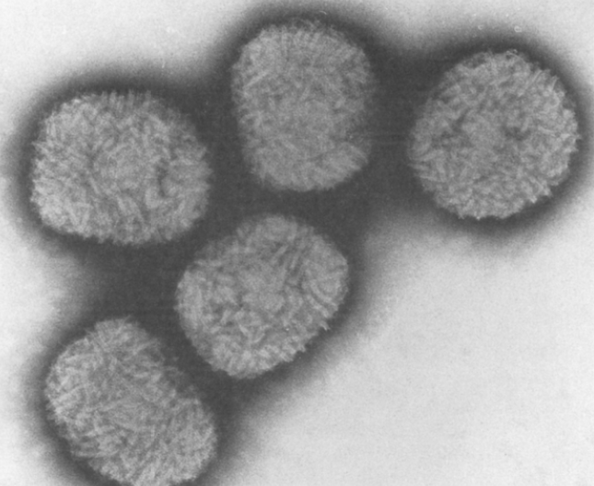
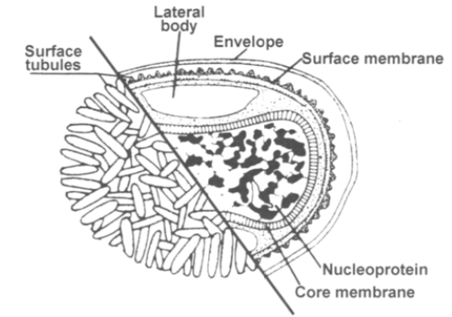

Slide 8
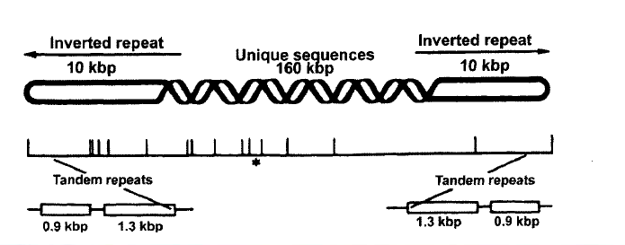
Virus Genome
Single molecule of linear double-stranded DNA
Genomes have the capacity to encode about 200 proteins

Slide 9
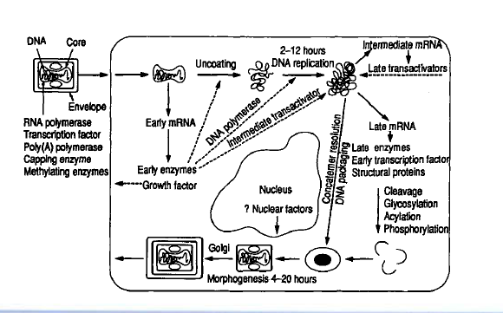
Replication

Slide 10
The multiplication takes place in the cytoplasm in special viroplasm factories and produce B type inclusion bodies.
The cytoplasmic accumulations produce A type inclusion bodies.

Slide 11
Transmission
by introduction of virus into small skin abrasions or directly or indirectly from a contaminated environment.
respiratory route via droplets from infected animals: eg. orf virus
mechanically by biting arthropods: eg. Sheeppox, swinepox, fowlpox, and myxomatosis

Slide 12
Immunity to virus
Both CMI and HMI critical
CMI facilitate destruction of virus infected cells
Neutralizing antibody are important in recovery from infection

Slide 13
Virus Antigen
The virus particles are built from more than 30 structural proteins and several viral enzymes, to be used with the nucleic acid synthesis and processing which includes a DNA dependent transcriptase.
There are about ten major antigens in the virus particle, one antigen cross reacts with most pox viruses of vertebrates.

Slide 14
Resistance
Poxviruses are resistant in the environment under ambient temperatures
may survive for many years in dried scabs or other virus-laden material.
The pox viruses withstand drying for months and even storage at room temperatures.
They are destroyed by moist heat at 60°C within 10 minutes.
They are also resistant to many common disinfectants.

Slide 15
Virus Cultivation
Most of the pox viruses grow readily in embryonated eggs and produce pocks on the chorioallantoic membrane.
They can also be cultivated in cell culture like chicken embryo fibroblasts, bovine kidney, rabbit kidney and HeLa cells.

Slide 16
Cow Pox Virus

Slide 17
Cow Pox Virus
The cowpox is a benign contagious disease of cattle which is distinct form the viruses of vaccinia and milkers nodule.
The disease occurs mostly is milking cows and the lesions restricted to particular areas of animal body like muzzle, udder, testes or scrotum on the one hand and systemic disease with pock covering the whole body on the other hand.
The disease is transmitted from affected animals to human beings.

Slide 18
Epidemiology
Cow pox is mostly transmitted by direct contact.
Passes into the environment through dried pustules from skin and mucous membranes, secretions from eyes, respiratory tract and digestive tract.
Enters the body through broken skin or via the mucous membranes of upper respiratory and digestive tract.
Indirectly transmitted during milking.
Also transmitted to humans, where it causes local affections in the form of pocks on hands, arms and face.
Systemic disease with fever, lymphangitis, lymphadenitis, conjuncti-vitis and disseminated pox exanthema may also develop

Slide 19
Clinical Disease
Incubation period is 3-7 days.
The cattle may show slight fever and anorexia followed by appearance of lesions on teats and udder which pass through all stages of pox infection.
lesions are 1-2 cm in diameter and are thick, tenacious and yellow brown to red in colour.
Mostly confined to teats and lower parts of udder. In severe cases the lesions may spread to inside of the thighs and rarely to perineum, vulva and mouth.
In bulls, the lesions usually appear on the scrotum.

Slide 20
Diagnosis:
Based on the appearance of firm dark red circular lesions with raised edges and depressed centres on the teats and udder.
Isolation of the virus from lesion
serological tests for identification of virus.
haemorrhagic pock lesions on the CAM of embryonated eggs is of diagnositc value.

Slide 21
Control:
Attenuated strains of cow pox or attenuated vaccinia virus strains is used

Slide 22
Genus: Capripox

Slide 23
Capripox
The genome of sheep pox, goatpox and lumpy skin disease of cattle are very closely related. The term
'capripox' is proposed to include the viruses of these pox diseases of ruminants.

Slide 24
Sheep Pox Virus
highly contagious and often fatal disease of sheep
lesions in generalized cases are associated with haemorrhagic inflammation of respiratory and gastrointestinal mucosa and high mortality

Slide 25
Cultivation:
Cultivated in various cell cultures of sheep origin like testes, embryonic kidney and thyroid as well as in goat testes and kidney and bovine testes
Produces inclusion bodies in the cytoplasm of cells

Slide 26
Epidemiology:
The disease spreads by contact with infected sheep, their aerosals, nasal secretions, saliva or dried scabs.
The air borne infection spreads to 20-25 yards.
The virus may remain viable in wool for 2 months and on contaminated pens upto 6 months.
Mechanical transmission by biting insects may play a part.

Slide 27
Clinical Symptom
Incubation period varies from 4-7 days
Disease usually causes systemic reaction, with high temperature and eruptions on the cheeks, nostrils, lips, ears, groins, udder and lips of vulva.
The lesions begin as macules with slight oedema of surrouding skin.
The macules - papules –pustules.
Pustules mayor may not become vesicles.
In more severe cases, lesions in buccal, digestive and respiratory mucosa also develop. The mortality rate may reach upto 80%.

Slide 28
Diagnosis
History and the symptoms.
confirmation is based on the isolation of virus in susceptible sheep or cell cultures.
Detection of antibodies in the serum of recovered animals by neutralization, complement fIxation, gel diffusion and fluorescent antibody tests

Slide 29
Control
Ovination: Infected scabs powder in glycerine saline
A chinese strain of sheep pox adapted to CAM of chicken embryos
In Russia an avirulent strain (K) grown on CAM of chicken embryos is reported to produce immunity upto 5 months

Slide 30
Goat Pox Virus
Epizootic disease resembling sheep pox
Characterised by fever, mucopurulent nasa! discharge and generalized cutaneous eruptions.
In India the disease is of economic significance causing significant losses in goat producing regions.
Naturally the virus affects the goats but there are reports that some strains may produce disease among sheep also

Slide 31
Cultivation:
The goat pox virus grows readily in cell cultures of
lamb kidney,
kid kidney, and
testis
produce CPE similar to sheep pox.

Slide 32
Epidemiology:
host specific but some strains are believed to infect sheep as well.
The disease spreads by contact with the infected animals or infected fomites.
The disease may also be spread by insects mechanically.

Slide 33
Clinical symptom
Incubation period of 5-14 days.
Small papules appear mostly on the hairless parts of the body like nose, mouth, around the eyes, udder, testes, scrotum, inner aspect of thighs.
The lesions develop into vesicles and crusts and subsequently heal in 3-4 weeks.
The disease is more common in young animals or in lactating animals. The mortality rate varies from 0 to 50%

Slide 34
Diagnosis and Control
Same as Sheep Pox virus
Chicken embryo adapted strains are being used in certain countries.
Goat pox strains attenuated in cell culture

Slide 35
Lumpy Skin Disease
Acute febrile disease of cattle
Characterized by eruption of skin nodules of varying sizes.
Drop in milk yield and abortions occur among pregnant animals.

Slide 36
Ecthyma (Orf) Virus
Orf or
Contagious pustular dermatitis or
Contagious ecthyma (CE)
highly infectious disease of sheep and goats characterised by development of pustular and scabby lesions on muzzle and lips.
Incidence among kids and lambs of 4-6 months is very high

Slide 37
Epidemiology
Orf is highly contagious among sheep and goats.
The transmission is by contact, aerogenic, or virus remaining infectious in the ground in the dried scabs.
The virus is indireclty transmitted by way of carcasses or processed meat from latently infected animals or slaughtered during viraemic phase.
The virus can also be transmitted to lambs by infected ewes at birth or later. Latently infected sheep and goats are virus reservoirs.

Slide 38
Clinical Symptom
Lesions mostly occur on hairless parts of the body, lips, mouth and sometimes udder and interdigital region of the feet.
Lesions like papules, pustules and ulcers develop in 34 days.
The course of the disease is 3-4 weeks. Cytoplasmic inclusion bodies occur in the affected cells.

Slide 39
Diagnosis and Control
Same as other pox viruses
live virus vaccine
Lambs and kids are vaccinated at 1 month of age and again revaccinated 2-3 months later.

Slide 40
Fowl Pox Virus
also known as Avian diphteria
disease mainly affects chicken but other poultry like turkeys, guinea fowl, peacocks, pigeons, water fowl, pheasants, canaries and sparrows may be affected
avian pox viruses are not related to other mammalian pox viruses
cross neutralization among avian pox viruses

Slide 41
Cultivation:
The virus grows readily on CAM of developing chicken embryos and produces pock lesions.
The virus also grows on chicken embryos fibroblasts and produces intracytoplasmic inclusions (Borrel bodies).

Slide 42
Epidemiology:
Affects all ages but is mostly seen in 5-12 months old chickens.
Virus is very stable and survives in dried scabs and exudates for many months.
Infection occurs through mechanical transmission of the virus to injured skin.
Blood sucking arthropods like mosquitoes, ticks or flies may also take part in transmission.
Virus may also enter through minor abrasions in the mouth caused by rough feed or through feather follicles and also through injuries to comb, wattles or skin as a result of fighting, pecking, scratching etc.

Slide 43
Clinical Symptom
incubation period is 4-10 days.
Cutaneous form and Diptheretic form
Cutaneous form: mostly found on the comb, wattles, legs, feet, vent and around the eyes.
Lesions first appear as white foci which develop rapidly into nodules. The lesions may coalesce and become rough and dark brown.
Diptheritic form:
Slightly elevated white opaque nodules develop into mucous membranes of pharynx and larynx resulting respiratory distress

Slide 44
Diagnosis
Same as other pox viruses
Fowl pox vaccine: contains live attenuated virus of chicken embryos or tissue culture origin
can be given to birds by feather follicle or wing web method.
The age at vaccination by cutaneous method is 4 to 8 weeks.

