Slide 1
Preparation of Media for Virus Cultivation

Slide 2
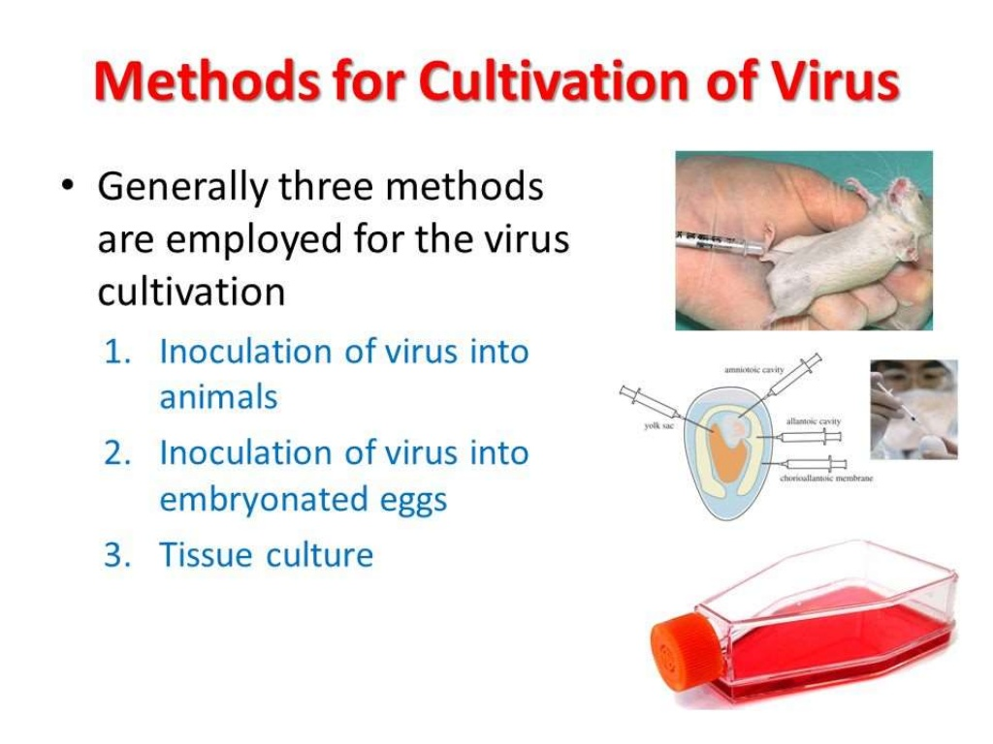

Slide 3
Cultivation of Virus in Tissue culture system
Cell culture is the process by which cells are grown under controlled conditions.
Cells are grown in vitro on glass or a treated plastic surface in a suitable growth medium
On incubation the cell divide and spread out on the glass surface to form a confluent monolayer.

Slide 4
Nutritional Requirement of mammalian cells

Slide 5
Basic Requirement
1. Amino acid
Amino acid is the raw material for the cell to synthesize protein. All the cells need twelve essential amino-acids
arginine, cystine, isoleucine, leucine, lysine, methionine, phenylalanine, threonine, tryptophan, histidine, tyrosine and valine, which are L-amino acids.
The nitrogen contained in glutamine is not only the source of purine and pyrimidine of nucleic acid,

Slide 6
2. Monosaccharide
Cultured cells use aerobic glycolysis and anaerobic glycolysis of hexose as main energysource.
In addition, hexose is used for the synthesis of some amino acid, fat and nucleic acid.

Slide 7
3. Vitamin
Vitamins mainly act as coenzymes or prothetic groups in cell metabolism processes.
Biotin, folate, nicotinamide, pantothenic acid, pyridoxine, riboflavin, thiamine and vitamin B12 are common component in culture medium.

Slide 8
4. Inorganic ion and trace element
Besides some basic elements (including sodium, potassium, calcium, magnesium, nitrogen and phosphorus)
cell growth needs some trace elements, such as molybdenum, vanadium, iron, zinc and selenium, copper, manganese.

Slide 9
5. Somatomedin and hormones
Cells grown in vivo are always regulated by somatomedin and hormones.
Very important to maintain cell function and status (differentiated or undifferentiated). Some hormones have promoting growth effects on different cell typs.
Some hormones are cell-type specific, as hydrocortisone that can promote the growth of epidermal cells and prolaction that induces the proliferation of mammary epithelial cell.

Slide 10
Physicochemical requirement

Slide 11
1. Osmotic pressure
Cells need an isotonic environment
human plasma osmotic pressure is about 290 mOsm/kg, which is thought to be ideal osmotic pressure to culture human cells.
Mouse plasma osmotic pressure is about 320 mOsm/kg.
Osmotic pressure of 260-320 mOsm/kg fits for most mammalian cells.

Slide 12
2. pH
The suitable pH for most cells is 7.2-7.4
The culture medium should have some buffer capacity.
The main substance causing pH changes is CO2 produced in cell metabolism process.
CO2 can combine H2O2 to produce carbonic acid and thus reduce the pH value of the medium.

Slide 13
3. Osmolality
4. Temperature
5. Viscosity
8. Surface tension and foaming

Slide 14
Growth medium for the in vitro cultivation of Cells
A growth medium or culture medium is a liquid or gel designed to support the growth of microorganisms, cells, or small plants.
Cell culture media generally comprise an appropriate source of energy and compounds which regulate the cell cycle.
A typical culture medium is composed of a complement of amino acids, vitamins, inorganic salts, glucose, and serum as a source of growth factors, hormones, and attachment factors.
In addition to nutrients, the medium also helps maintain pH and osmolality.

Slide 15
Types of Cell culture media
Media Type | Examples | Uses
Natural media | Biological Fluids | plasma, serum, lymph, human placental cord serum, amniotic fluid
 | Tissue Extracts | Extract of liver, spleen, tumors, leucocytes and bone marrow, extract of bovine embryo and chick embryo
 | Clots | coagulants or plasma clots
Artificial media | Balanced salt solutions | PBS, DPBS, HBSS, EBSS
 | Basal media | MEM DMEM
 | Complex media | RPMI-1640, IMDM

Slide 16
Preparation of Media
Culture medium is available in three forms from commercial suppliers:
Powdered form: it needs to be prepared and sterilized by the investigator.
Concentrated form: to be diluted by the investigator.
Working solution: to be used directly without further manipulation.
Powdered medium is the least expensive but needs to be sterilized.

Slide 17
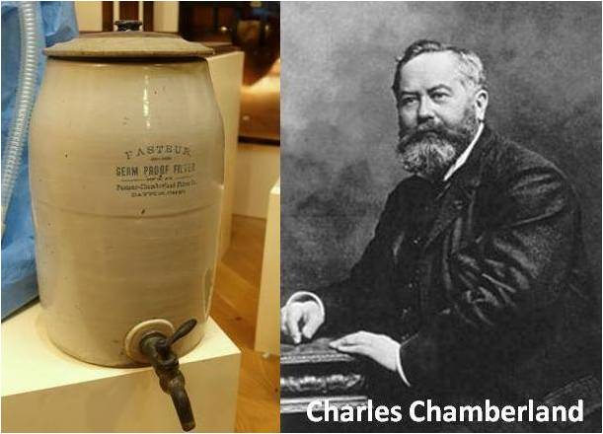
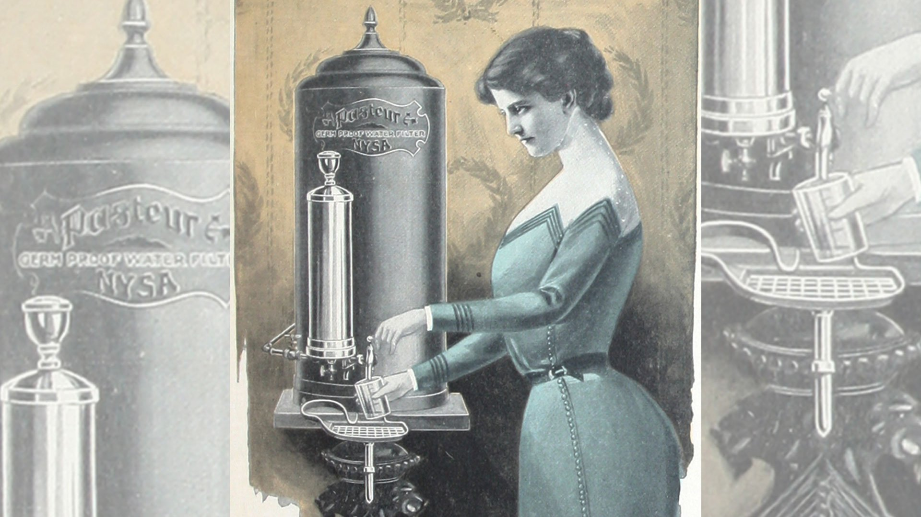
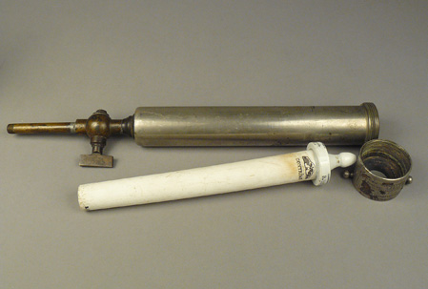
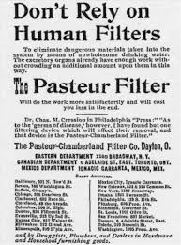
Porcelain filter

Slide 18
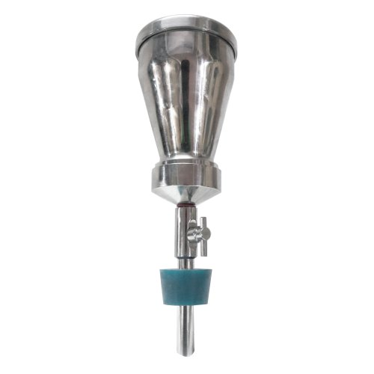
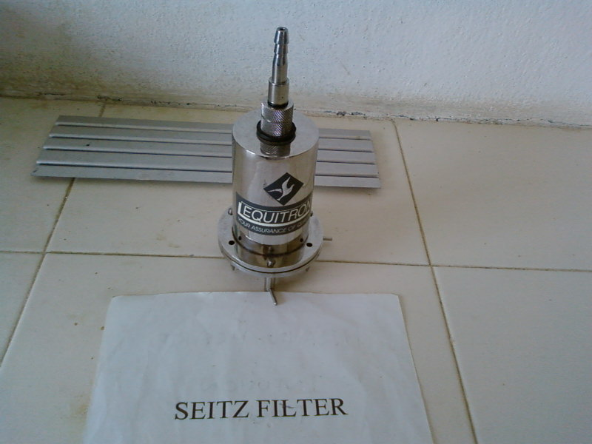
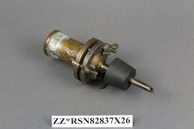

Slide 19
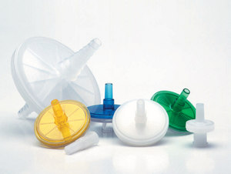
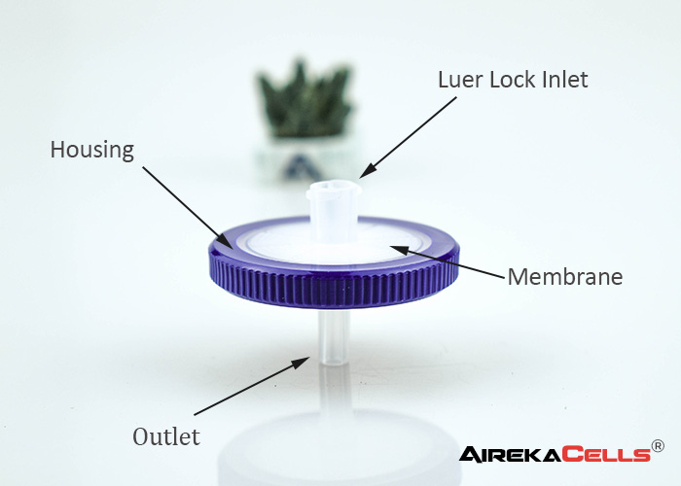
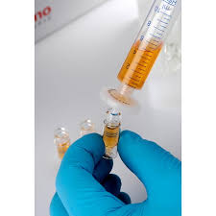
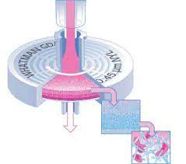
Syringe Filter

Slide 20
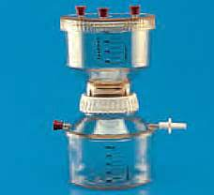
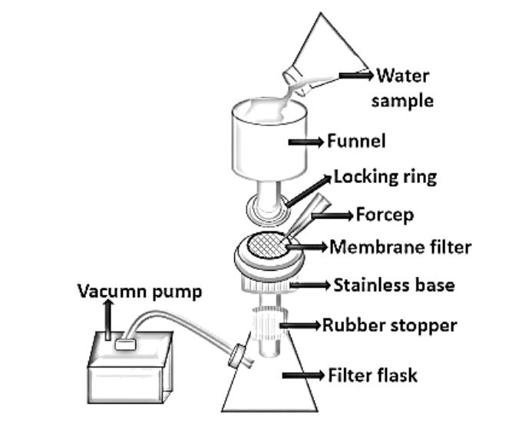
Membrane filter
https://www.youtube.com/watch?v=Haw14QOFxL8

Slide 21
Common Cell Culture Media
Eagle’s Minimum Essential Medium (EMEM): contains balanced salt solution, nonessential amino acids, and sodium pyruvate
Dulbecco’s Modified Eagle’s Medium (DMEM): twice the concentration of amino acids and four times the amount of vitamins as EMEM, as well as ferric nitrate, sodium pyruvate, and some supplementary amino acids
RPMI-1640: hematopoietic cells
Ham’s Nutrient Mixtures

Slide 22
