Slide 1
Respiratory System
What is Respiration?
Respiration defined as the osmotic and chemical process by which an animal absorbs oxygen and gives off the product (CO²) formed by the oxidative activities of the tissues.
The respiratory system/apparatus consists 06 components-
1. Nasal cavity
2. Pharynx
3. Larynx
4.Trachea
5. Bronchi
6. Lungs – Central organs in which exchange of gases between blood and air takes
place (exchange of gases here others are air passages)
System also include sense of smell and organ of voice
03 ductless glands also included in this system due to their topographical location
Thyroid
Parathyroid
Thymus

Slide 2
Questions
Difference between right and left lung?
Difference in lungs of ox, horse and dog?
Difference in larynx of ox,horse and dog?
Short note on nasal cavity
Short note on fowl respiratory system salient features?

Slide 3
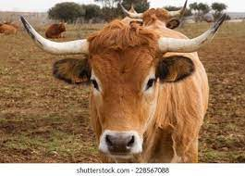
Cut through
Median plane

Slide 4
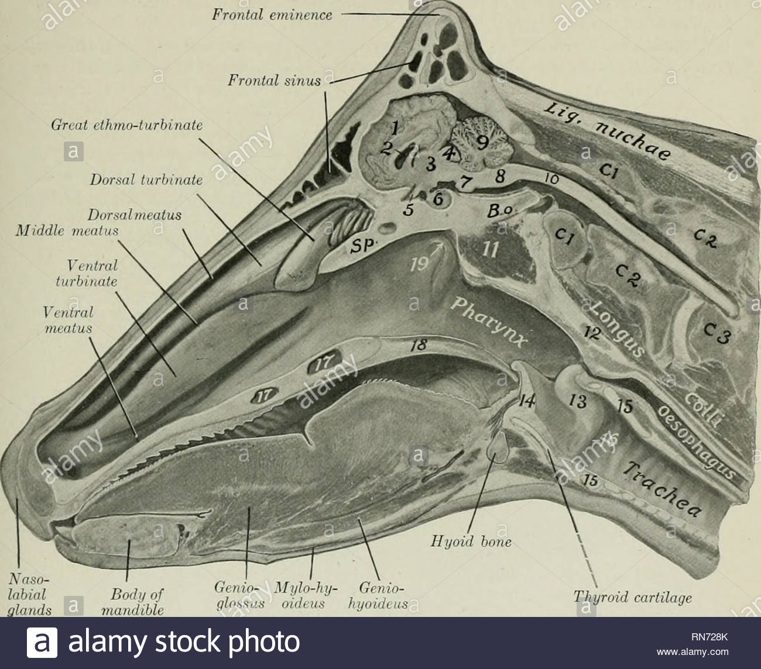

Slide 5
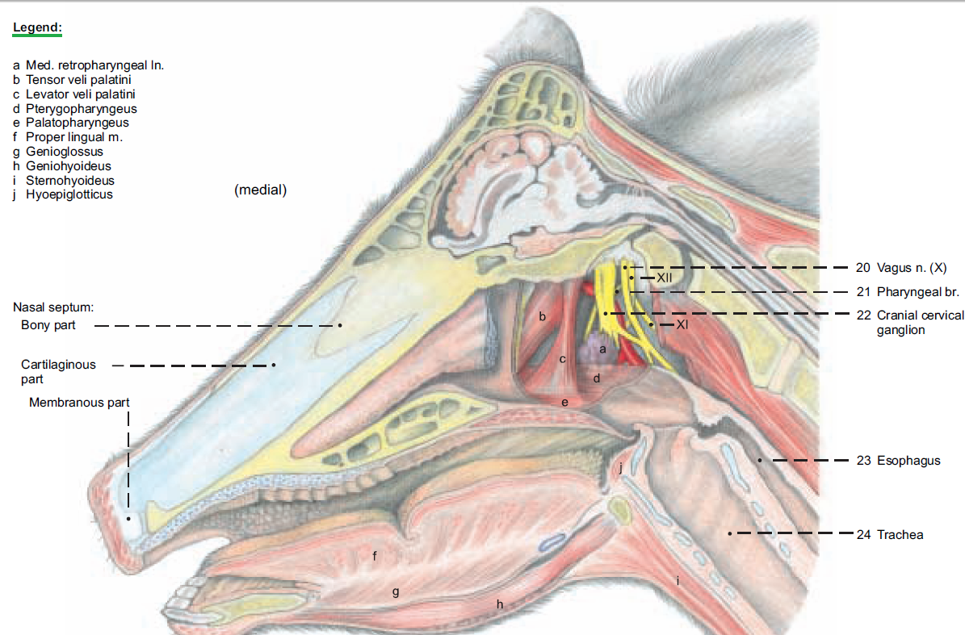

Slide 6
The Nasal Cavity
Nostrils lead into the nasal cavity.
occupies upper half of the face and is bounded by all of the facial bones except the mandible and hyoid.
Cavity is somewhat cone shaped with large end posteriorly. It is flattened on the ventral side where it is separated from the mouth cavity by the palate.
Cavity has Respiratory and Olfactory part- is smaller postero-dorsal part(have olfactory receptor cells) and is continuous with respiratory part.

Slide 7
Parts of nasal cavity-8
1. Anterior nares (nostrils)
Muzzle
Nasal septum
Turbinate bodies/Bones
Olfactory area
Nasal meatus
Posterior nares or choana
8. Vomeronasal organs

Slide 8
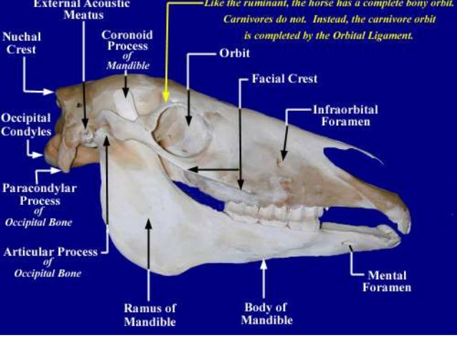
Skull
Cranial bones
Facial
bones

Slide 9
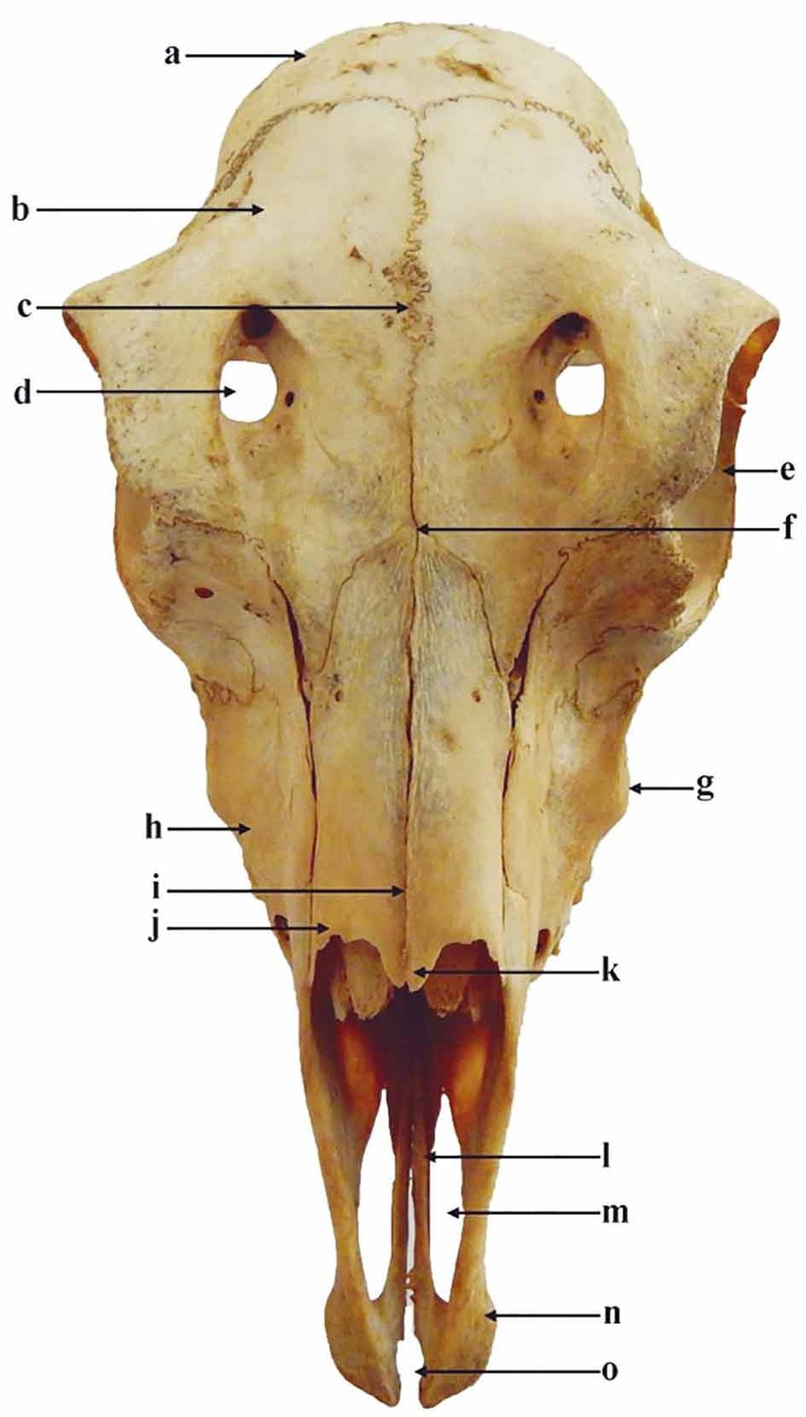
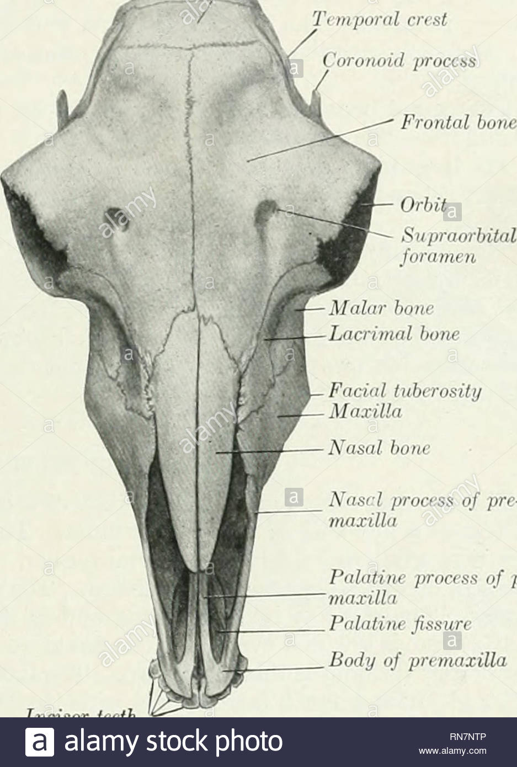
Skull bones

Slide 10
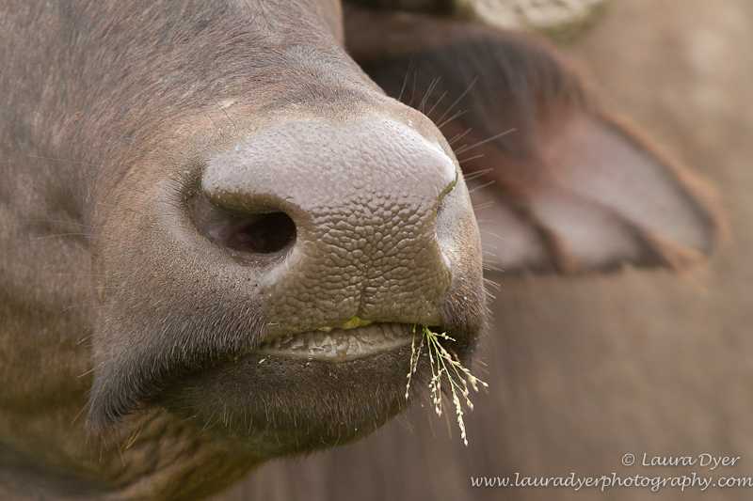
Anterior Nares (nostrils)
Oval anterior openings of cavity, separated by muzzle
Rounded ends of oval shape are the- commisures and connecting borders are wings or alae
Commisures- 02 are laterally present
wings or alae- 02 dorsal wing is thin,slightly convex and joined on its ventral surface by alar fold of ventral turbinate bone
ventral wing is thicker, concave and rounded

Slide 11
Wing/Alae
Commisure
Alar fold
Muzzle

Slide 12
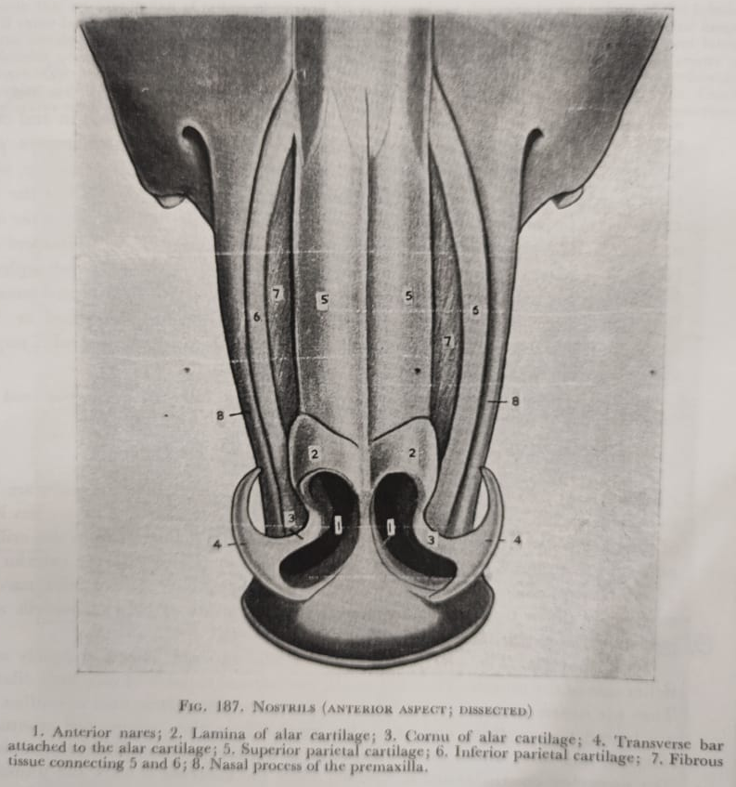
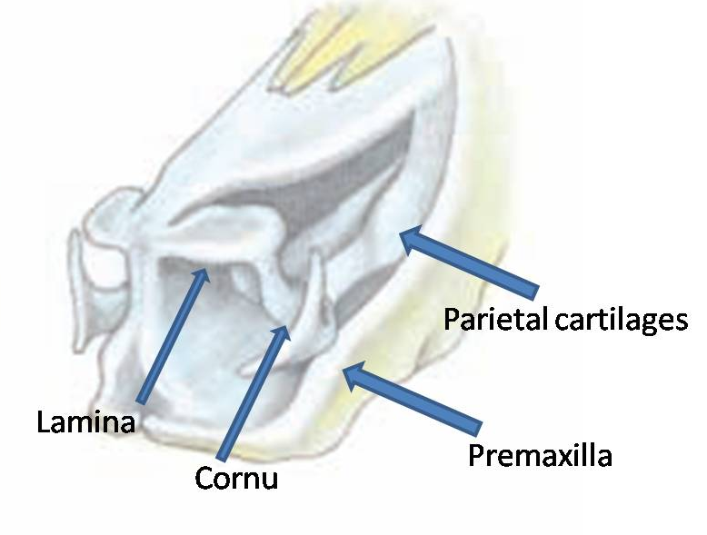
Skeleton of nostril
Cartilaginous
Formed by
1. Anterior end of nasal septum and its parietal cartilages medially and ventrally
2. Alar cartilages- dorsally and laterally Have lamina and cornu
Lamina-
Oval plate in dorsal part nostril and continuous with dorsal parietal cartilage.
Alar fold of the ventral turbinate body joins its ventral surface.
Cornu-
Irregular S-shaped, in lateral part of the nostrils.

Slide 13
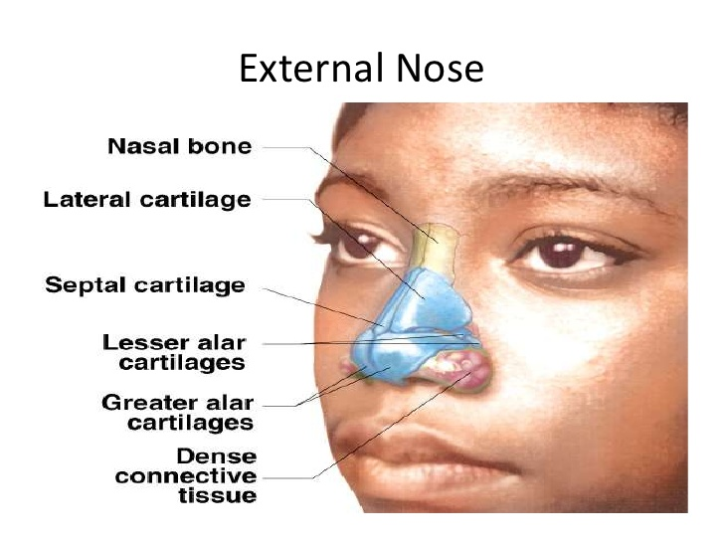

Slide 14
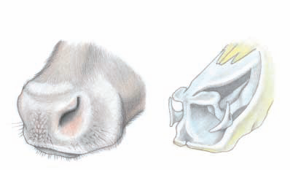
Parietal cartilages
Lamina
Premaxilla
Cornu

Slide 17
Muzzle: is hairless area between the nostrils and includes the central part of upper lip.
epidermis is cornified and marked by shallow grooves separating irregular areas.
Numerous ducts of nasolabial glands (modified cutaneous glands)opens on the surface of the muzzle.
Nasal septum: is a median partition dividing nasal cavity into left and right part or major part is cartilage.
Parts- posterior part is osseous (ethmoid bone, vomer bone).
remainder - hyaline cartilage.
Borders- dorsal, ventral and lateral

Slide 18
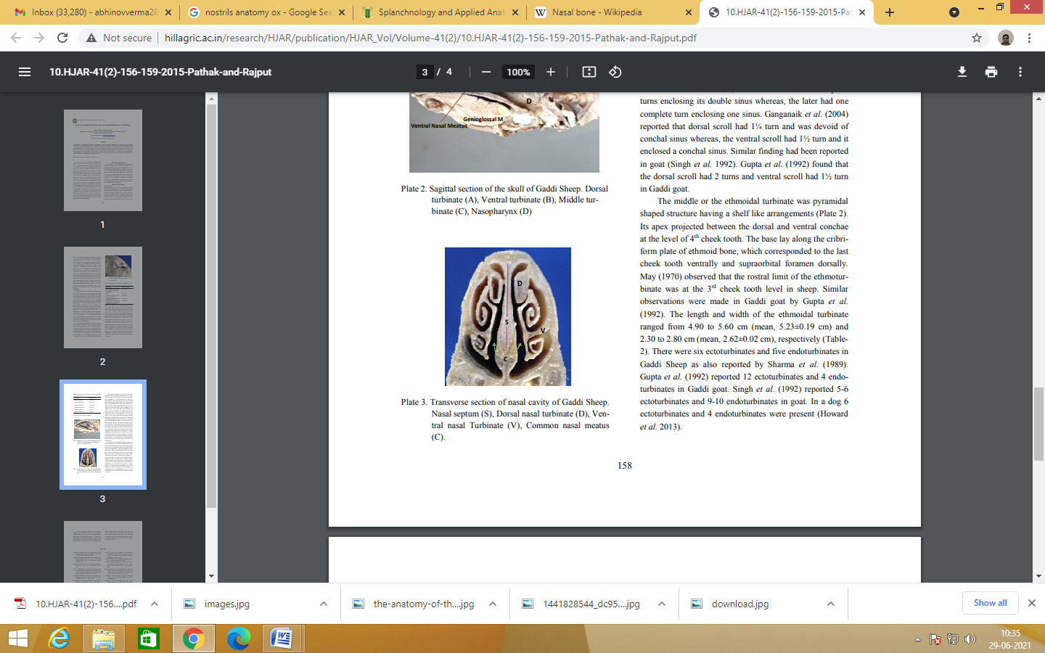
NASAL CONCHES/ Turbinate bodies
Turbinate bodies and lateral mass of ethmoid bone occupy much of space in each half of nasal cavity.
Turbinate bodies-04 in number scroll like, have skeleton of bone posteriorly and cartilage anteriorly and are covered by mucous membrane.
To increase the area of mucous membrane in limited space of nasal cavity
1. Dorsal nasal concha or dorsal turbinate bone :
Small and Triangular/cylindrical in outline
extends from the cribriform plate of the ethmodial bone to the level of the first cheeck tooth.
1
2
2

Slide 19
2. ventral turbinate bone : much broader than the dorsal nasal concha.
Posterior half has dorsal and ventral coiled portions. The anterior end of body is alar fold. The nasal opening of nasolacrimal duct (Tears)is on ventral surface of alar fold of ventral turbinate bone and can be seen through nostril.
It extends from the level of last check tooth to the naso-incisive notch.
*Great ethmoturbinate bone : part of the lateral mass of ethmoid bone occupies the caudal part of middle nasal meatus just ventral to the dorsal concha. It is also called as the middle nasal concha.
The mucosa covering ethmoturbinates contains receptors of olfactory nerves.

Slide 21
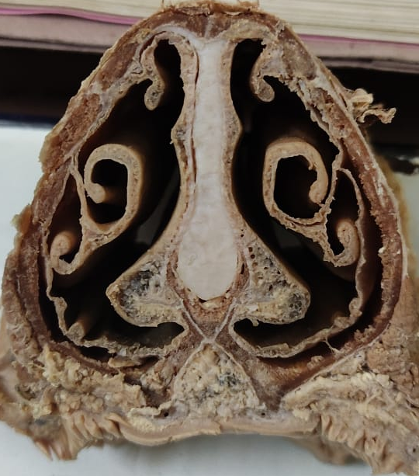
Dorsal meatus
Dorsal turbinate
Middle meatus
Septum
Common meatus
Ventral turbinate
Ventral meatus
VMO

Slide 22
Nasal Meatus
Spaces associated with turbinate bodies and nasal septum.
Common meatus is between septum and turbinate bodies,extend into olfactory area
Dorsal,middle and ventral meati extends laterally from common meatus
1. Dorsal nasal meatus is a narrow passage between the roof of the cavity and the dorsal nasal concha.
2. Middle nasal meatus is situated between the dorsal and ventral nasal conchae. Caudally the middle meatus is divided into dorsal and ventral passages by the middle nasal concha.

Slide 23
3. Ventral nasal meatus is largest. It lies between the ventral nasal concha and floor of the nasal cavity.
the two ventral nasal meatuses form common passage which leads into the naso-pharyngeal meatus.
Olfactory area- is the posterodorsal part of the cavity above and largely posterior to posterior nares. It is occupied by lateral masses of the ethmoid bone. Mucous membrane thicker, yellowish contain olfactory nerve endings in a special non ciliated epithelium. In it are numerous olfactory glands (Glandulse olfactorise),these are long, tubular, and often branched.
Posterior Nares (Choanae)
Is the posterior opening of nasal cavity.
These are two wide oval openings which open behind into the pharynx and are partly separated from each other by vomer bone.

Slide 24
Vomero-nasal Organ (Organ of Jacobson)
two bilateral blind tubes or diverticula, lined with mucous membrane.
lie one on either side of the ventral border of the nasal septum surrounded by thin layer of cartilage.
Also have glands
Each tube opens into the oral cavity at the incisive papilla.
have chemo-receptors that detect specific organic compounds
Flehmen response in bulls- important parameters to adjudicate the time of estrus detection and therefore it can be used as an olfactory test for detecting estrus in bovine.
VN organ
Transverse Section

Slide 25
LARYNX
Complex valvular apparatus which regulates the volume of air in respiration tends to prevent foreign substances from entering the trachea and is the chief organ of voice.
It is located ventral to the axis vertebra and posterior to the rami of the mandible and projects into the floor of the pharynx.
.
Cartilages of Larynx -04
Unpaired- cricoid, thyroid and epiglottis cartilages
Paired-arytenoid
Epiglottis cartilages -elastic cartilages (AC) remainder -hyaline cartilage

Slide 26
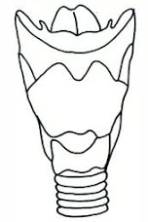
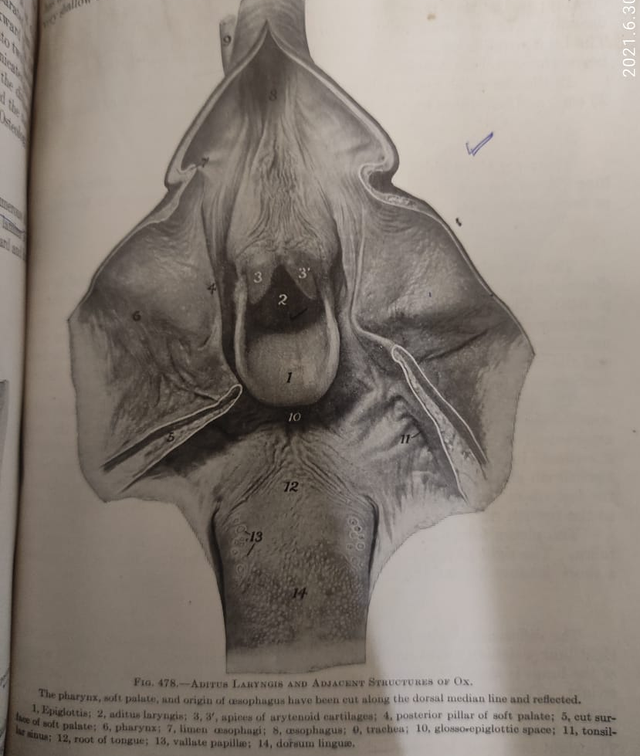

Slide 27
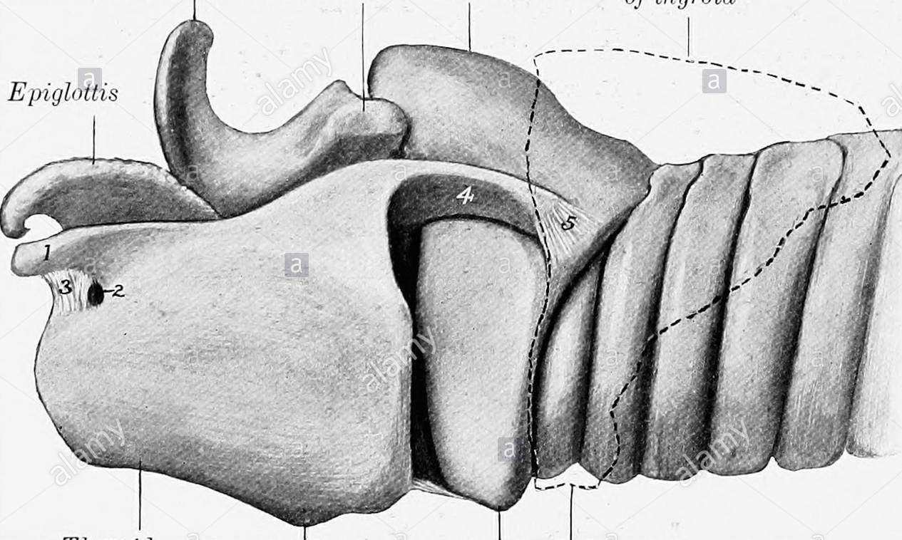
Cricoid
Arytenoid
Epiglottis
Trachea
Cricoid
Thyroid
Laryngeal prominance

Slide 28
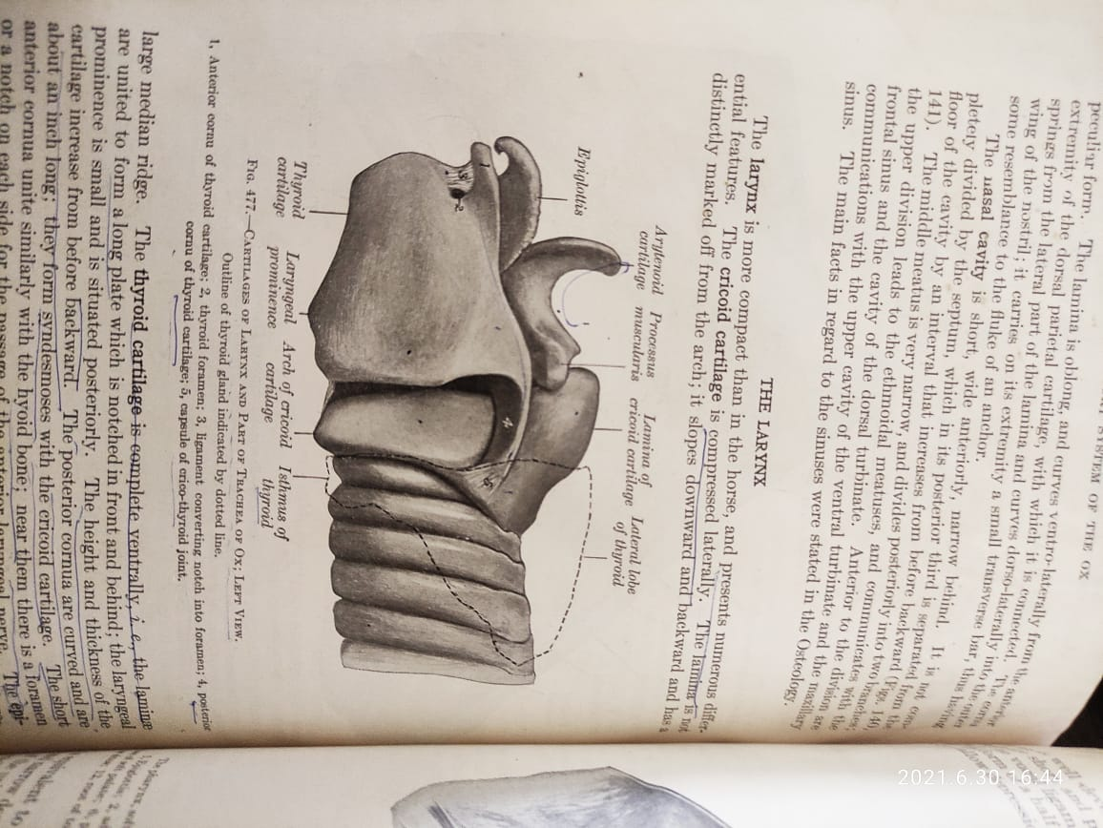

Slide 29
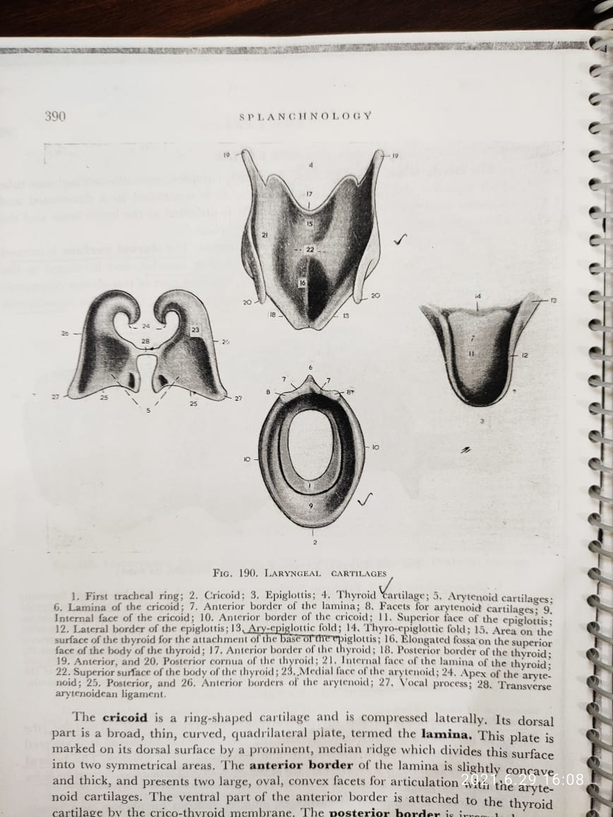
Thyroid
Arytenoid
Epiglottis
Cricoid

Slide 30
Thyroid cartilage
largest of the laryngeal cartilages,
forms the lateral and ventral walls.
terms “thyroid” means shield
It consists of thick median part -body and two laminae or wings.
The body is formed by the union of the two laminae.
Ventrally at the posterior part it bears an eminence known as laryngeal prominence. (It is known as Adam’s apple in human being). Dorsally thyroid cartilage is related to epiglottis.
Body

Slide 31
The laminae are two irregularly quadrilateral plates,
Borders 04
1. Dorsal border is prolonged beyond the anterior and posterior borders, forming cornu.
Rostral cornu is short and is attached with the thyroid cornu of hyoid bone. Below presents a thyroid notch which is converted into a thyroid foramen by thyroid ligament and gives passage to anterior laryngeal nerve.
Caudal cornu is about one inch long, curved and it articulates with the cricoid cartilage.
1- rostral cornu
2- thyroid foramen
3.Thyroid ligament
4-caudal cornu

Slide 32
2. Anterior border- slightly convex
3. Posterior- longer than anterior and adjacent to arch of cricoids
4. Ventral- straight and fuse with opposite lamina

Slide 33
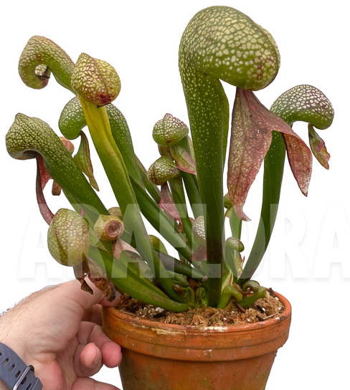
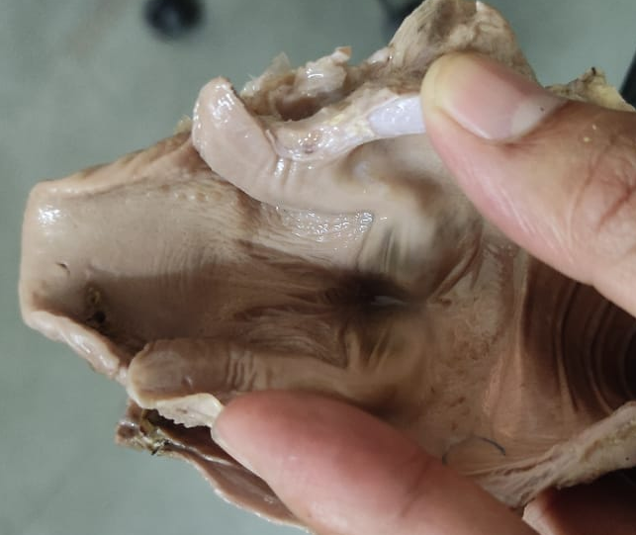
Arytenoid cartilage
from a latin word “Aryteina” which means pitcher i.e. cartilage is pitcher shape (surahi)
situated on either side infront of cricoid cartilage and medial to the laminae of thyroid cartilage except their apexes.
For description-
1.A body
2.A vocal process
3. An apex
Apex
Body
Process

Slide 34
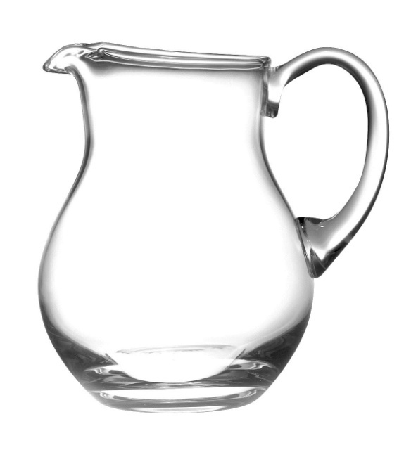
1.Body
Triangular
2. Vocal process
Projects downward from body attached with vocal ligament(elastic band extend from ventral end of vocal process to posterior part of fusion line of thyroid laminae)
3. Apex
Curve upward and backward
Form highest point of larynx
Apex
Body
Process
28-Arytenoidean ligament

Slide 35
Cricoid
located just rostral to the first tracheal ring.
shaped like a signet ring
presents a dorsal lamina and lateral and ventral arch.
lamina –
quadrilateral plate with a convex dorsal surface and concave ventral surface.
Its dorsal surface -well marked medial ridge called muscular process.

Slide 36
Arch is wide at its junction with the lamina but narrow ventrally.
Upper part of the lateral surface of arch is concave and on the posterior margin of the concavity is an oval facet for articulation with the posterior thyroid cornu

Slide 37
Epiglottic cartilage
Anterior cartilage of larynx
Shape resembles –Pitcher spout with lip directed forward
Ventral part of cartilage is attached to thyrohyoid ligament and thyroid ligament

Slide 38
Vestibule/anterior
GLOTTIS
/Middle
Posterior
compartment

Slide 39
ARYTENOID
Vocal cord
EPIGLOTTIS
Vocal cord

Slide 40
According to Ghosh 466
Ox-(total-4) Unpaired- cricoid, thyroid and epiglottis
Paired-arytenoid
Horse (total-6) –3 unpaired (cricoid, thyroid and
epiglottis ) and 3 paired (arytenoid,corniculate (hyaline)and cunieform(elastic))
Dog – (total-6) as horse

Slide 41
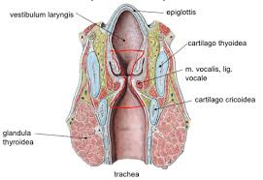
Lumen of larynx
Cavum Laryngis
1.Anterior Compartment or Vestibule
2. Middle Compartment/ Rima glottidis or glottis/
3.Posterior Compartment
1.Vestibule/Ant. Compartment: extends from the pharyngeal opening to the glottis.
Aditus laryngis- entrance to the cavity or upward facing oval opening from pharynx into vestibule.
Lateral Ventricle : is oval, shallow depression in the lateral wall of the vestibule just above the vocal fold

Slide 42
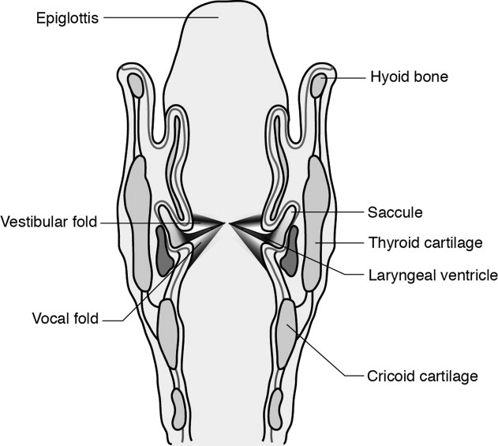
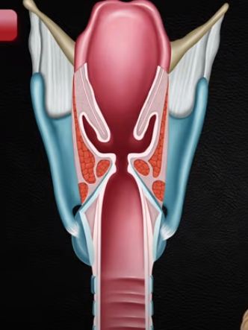
2.Rima glottidis or glottis:
narrow, vertical space of cavity between the vocal folds(vocal cords) and vocal process of the arytenoid cartilages. (wiki-The rima glottidis is the opening between the true vocal cords and the arytenoid cartilages of the larynx).
it has cartilaginous and membranous parts.
Cartilaginous part- bounded by vocal process(arytenoid )
Membranous part- bounded by vocal fold/cord

Slide 43
Vocal fold/cord- are slight elevations where mucosa crosses the vocal ligament (strong elastic lig. Extends from vocal process of arytenoid cartilage to dorsal surface of body of thyroid cartilage) and underlying parts of the thyro-arytenoideus Muscle.
Acc to getty- neither vestibular fold nor lateral ventricles are present in ruminants
Caudal Compartment :
Is continuous with trachea
It extends from the rima glottidis to the laryngeal outlet which is formed by the caudal border of the cricoid cartilage.
Enclosed by the cricoid cartilage and cricothyroid membrane and is much longer dorsal than it is ventrally.
Larynx supply by
Anterior and posterior laryngeal arteries and internal branch of anterior laryngeal nerve (branch of vagus)

Slide 44
ARYTENOID
Vocal cord
EPIGLOTTIS
Vocal cord

Slide 45
Vestibule/anterior
GLOTTIS
/Middle
Posterior
compartment

Slide 46
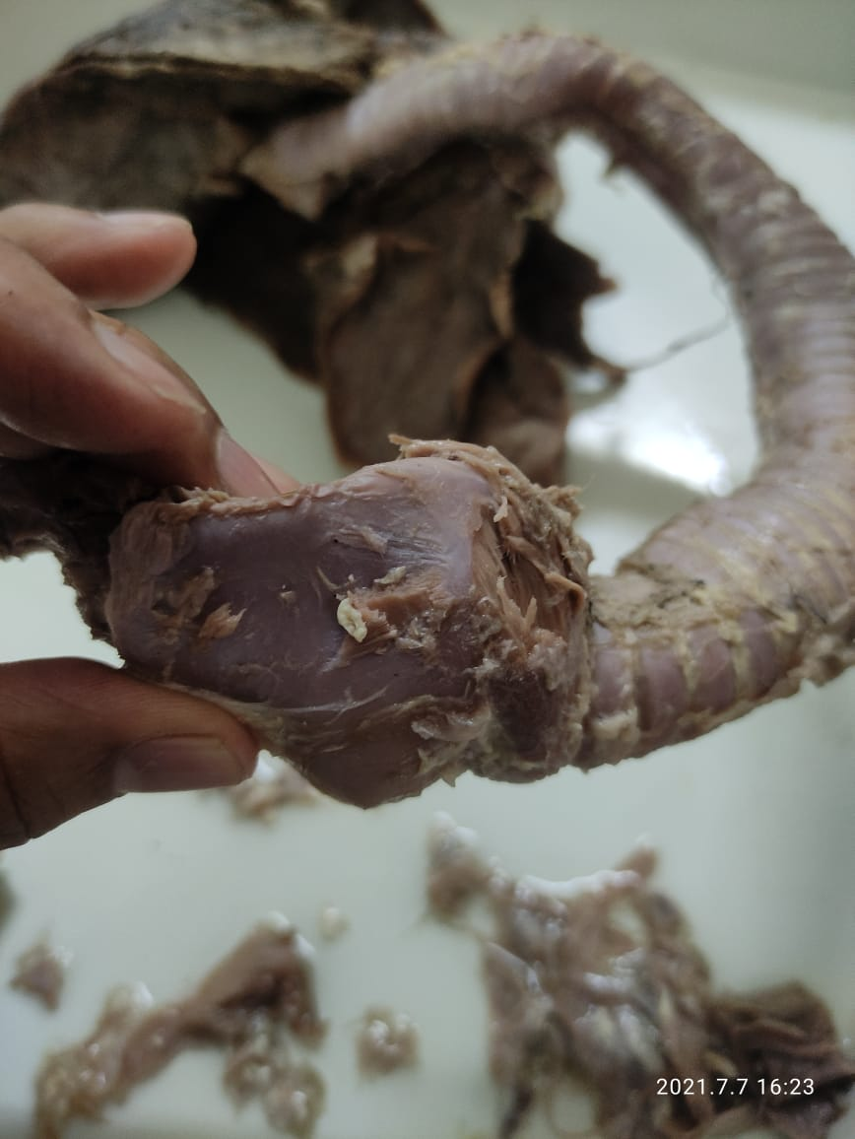

Slide 47
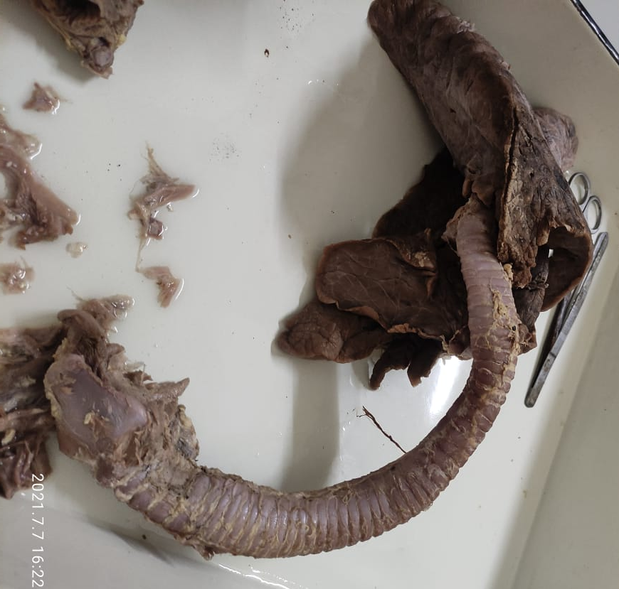

Slide 48
Joints of Larynx
Cricothyroid Joint : It is in between (posterior) caudal cornu of thyroid and cricoid cartilage. Its movement is mainly rotation around the transverse axis.
Crico arytenoid Joint : It is in between the anterior border of cricoid & body of arytendoid cartilage. The movement is rotaion of argtenoid cartilage.
Thyrohyoid Joint : It is between rostral cornu of thyroid cartilage and thyroid cornu of hyoid bone. The movement is rotation along the transverse axis.
Membranes
Thyrohyoid
Crico thyroid
Crico tracheal
Ligaments
Hyo epiglottic lig.
Thyroepiglottic lig.
Transverse arytenoid lig.
Vocal ligaments

Slide 49
Muscles of the larynx
Extrinsic muscles: their attachment lies outside the larynx.
Intrinsic Muscle : both the attachments are confined to laryngeal cartilages.
Extrinsic muscles
Hyothyroideus- hyoid to thyroid cartilage
Hyo-epiglotticus
Sterno-thyrohyoideus
Intrinsic Muscles
Crico-thyroideus
Crico-arytenoiedeus dorsalis and lateralis
Arytenoideus transversus
Epiglotto-arytenoideus
Ventricularis

Slide 50
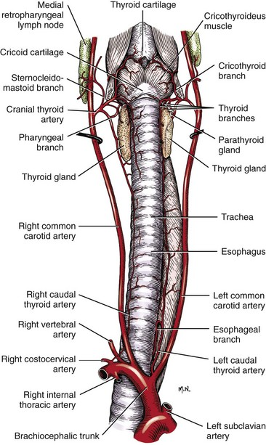
Trachea or Wind Pipe
Is a flexible, cartilaginous and membranous tube of about 65 cm long.
It extends caudal from the larynx at the level of second cervical vertebra to the level of fifth thoracic vertebra where is bifurcates into left and right principal bronchi.
At about the level of 3rd inter costal space the trachea gives off an accessory bronchus from the right side which terminates in the apical lobe of right lung.
trachea is more or less median in position except near its bifurcation where it is pushed to the right side.

Slide 51
For the purpose of description it is divided into
Cervical part- in neck region
Thoracic part
Cervial part : related dorsally with esophagus up to 3rd cervical vertebra and then to longus coli muscle.
Ventrally to thymus gland and sternothyrohyoideus muscle
Laterally to- thyroid gland, jugular contents (common carotid artery, internal jugalar vein, vago-sympathetic trunk and recurrent laryngeal nerve)

Slide 52
Thoracic Part: It lies in the cranial and middle parts of the mediastinum. The esophagus is on the left side for several inches and then passes to the dorsal surface.
Dorsally-
the longus colli muscles, except in the region of its bifurcation where it is related to the oesophagus.
Ventrally-
brachiocephalic trunk, the right common carotid artery, the right pulmonary artery, the left recurrent laryngeal nerve, the right cardio sympathetic nerves and the cranial mediastinal lymph nodes

Slide 53
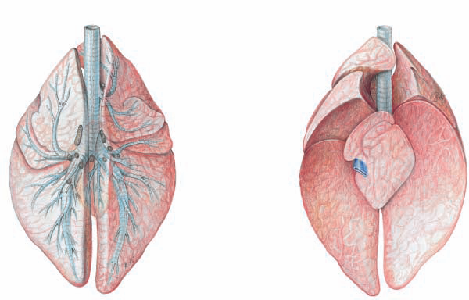
Apical bronchus from trachea for apical lobe of right lung- at opposite to 3rd rib
Trachea terminates into right and left bronchi –opposite to 5th rib

Slide 54
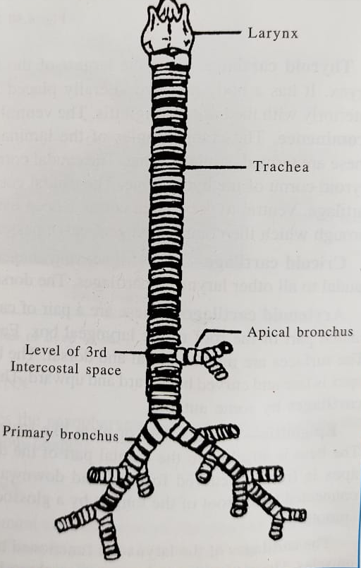
Tracheal rings
C shaped hyaline cartilage
Incomplete dorsally
Fibroelastic membrane encloses and connects the rings
Ventrally are wider and thicker
adjacent rings connected by- tracheal annular ligaments
First ring connect to cricoid cartilage by cricotracheal membrane
Trachea composed of 1. cartilaginous rings 2. fibroelastic membrane 3. muscular layer 4. mucous membrane (tubuloalveolar glands)

Slide 55
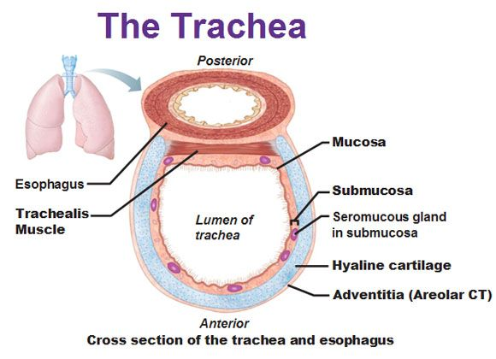
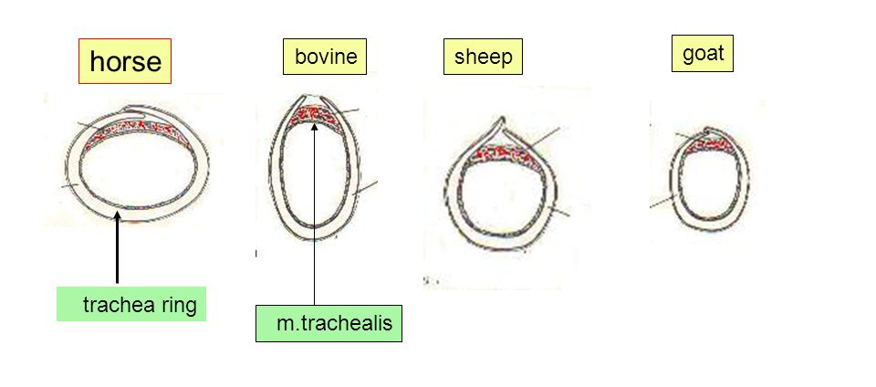

Slide 56
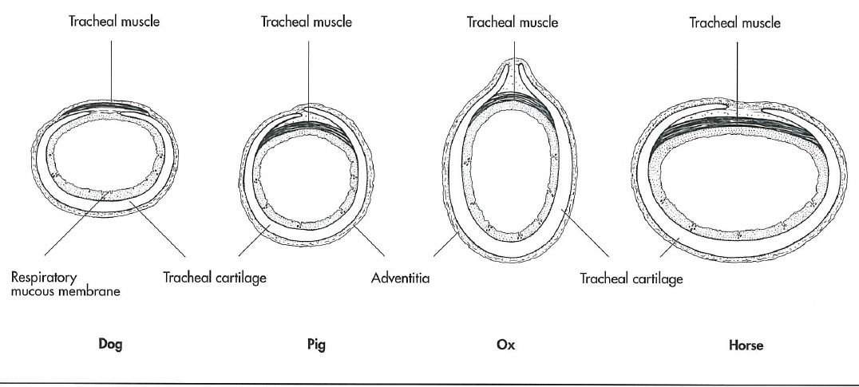
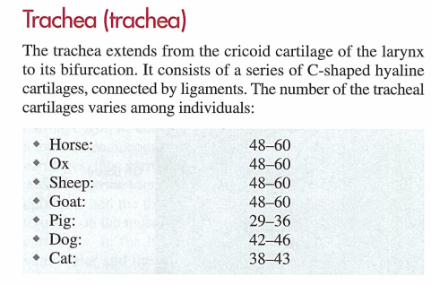

Slide 57
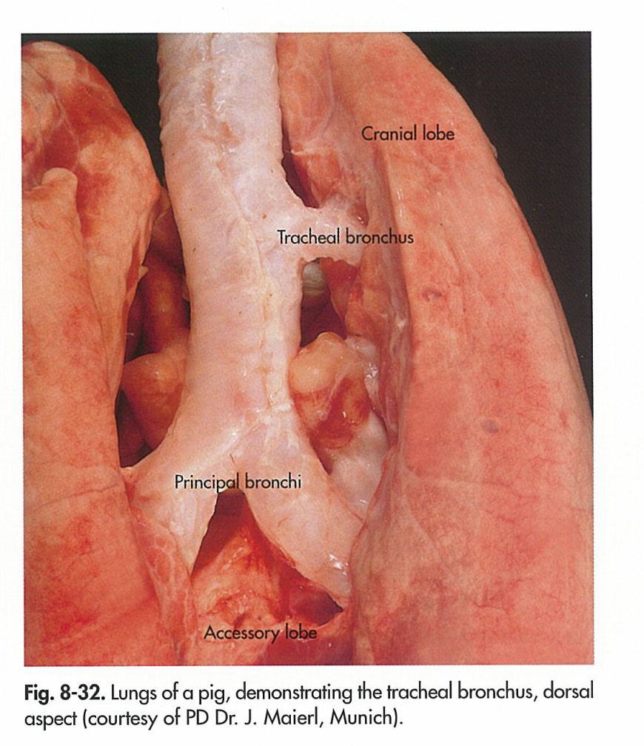
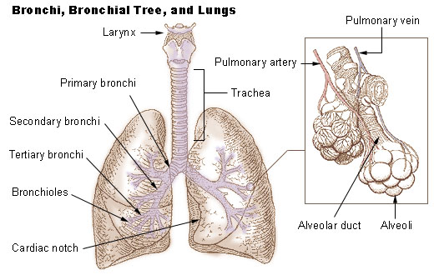
The bronchi
Bronchi are branches of the trachea entering to lungs.
1. Apical bronchus or accessory bronchus arises from the right surface of the trachea opposite the third rib/IC space about 7.5 to 10 cm before bifurcation.
It enters the apical lobe and divides into anterior and posterior branches.
2. Right and left primary bronchi arise from the termination of the trachea.
A. right bronchus divides into secondary or lobar bronchi for cardiac, diaphragmatic and mediastinal lobes.
B. left bronchus gives secondary bronchi to the apical, cardiac and diaphragmatic lobes.
The structure of the bronchi is similar to the trachea but cartilaginous framework consist chiefly of plates instead of rings

Slide 58
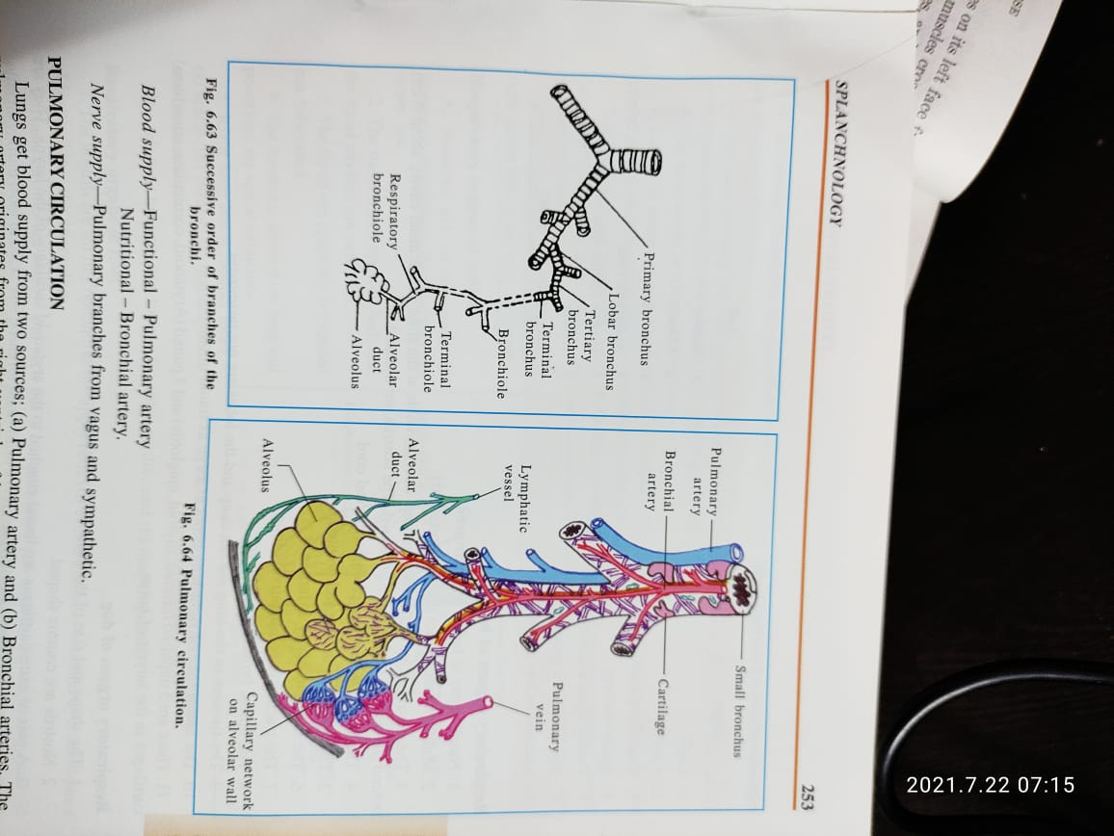
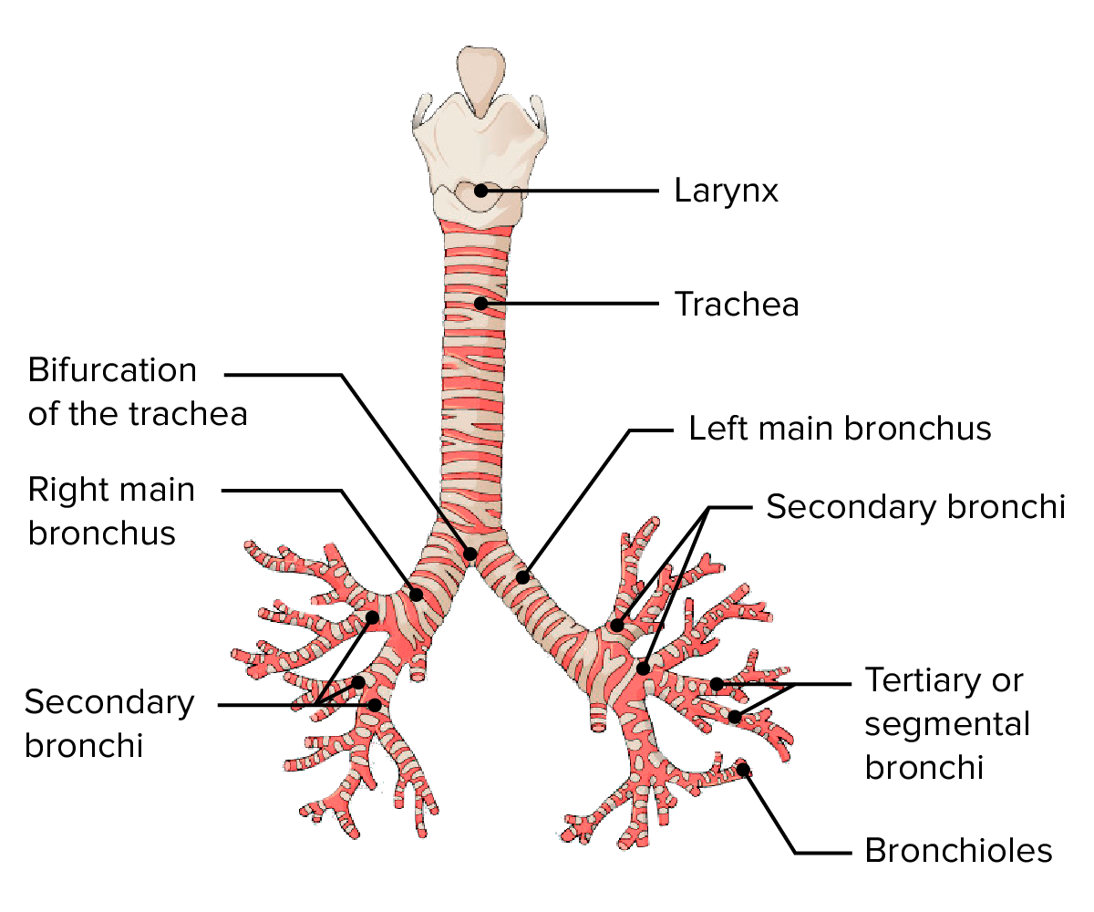
Bronchial tree
this system of division IS pseudodichotomous branching because one daughter branch is larger in cross sectional area than other and because each of these branches exits the parent branch at different angles.
Bronchus-single, Bronchi- many
Tree (branching):trachea-bronchi -bronchiole
Trachea- primary bronchus-lobar bronchus(for each lobe)-tertiary bronchus/segmental(for particular area in each lobe)-terminal bronchus-bronchiol (no glands and no cartilage)-terminal bronchiole-respiratory bronchiole-alveolar duct- alveolus

Slide 59
Lungs (Pulmons) of Ox
Paired organs situated in the thoracic cavity.
Fetal lungs- smaller more firm, grey color, high specific gravity (sink in water)
Adult lungs- Each lung is soft, spongy, highly elastic and pink in color.
Low specific gravity because air (not sink in water)
Fresh unpreserved lungs (pink color)-collaps 1/3 rd of original size
Persevered/embalmed (color varies)- maintain size
Right lung is twice as large as left lung because 1. Heart being further to left side 2. Extra lobe (intermediate)and apical are larger 3. in young animals thymus gland further to left side
Lungs divided by fissures into distinct lobes
Both the lungs have 1.Apical/cranial 2. Cardiac/middle 3. Diaphragmatic lobe/caudal
Right lung have intermediate/mediastinal lobe/accessory also (Total -04 lobe)
Apical lobe of Right lung is often subdivided -02

Slide 60
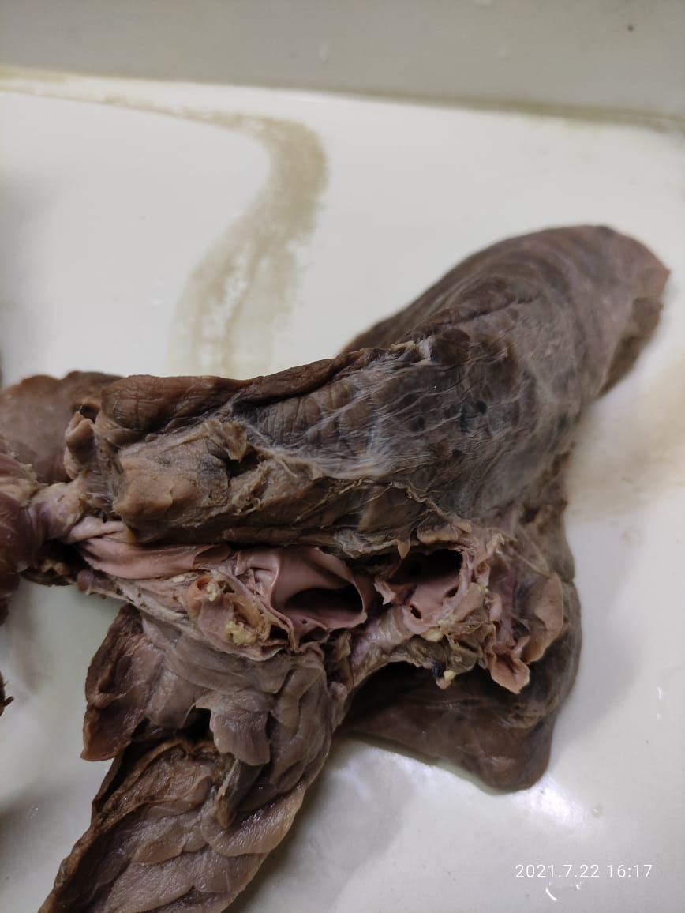
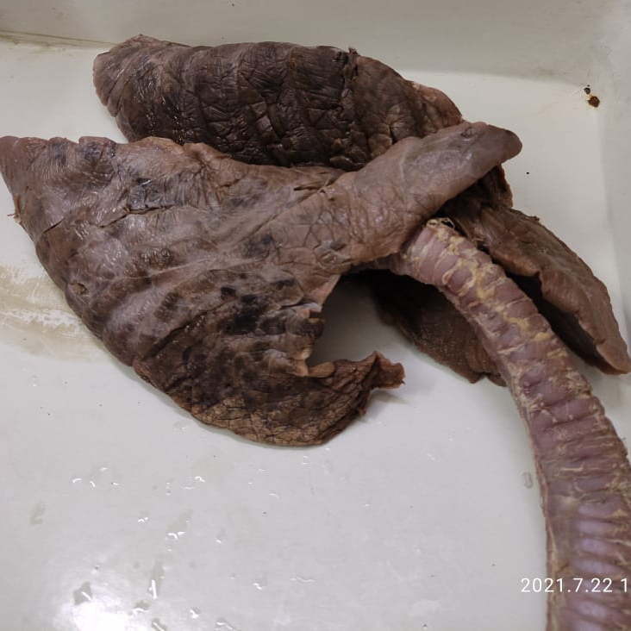
Diaphragmatic
Cardiac
Apical
Hilus
Intermediate

Slide 61
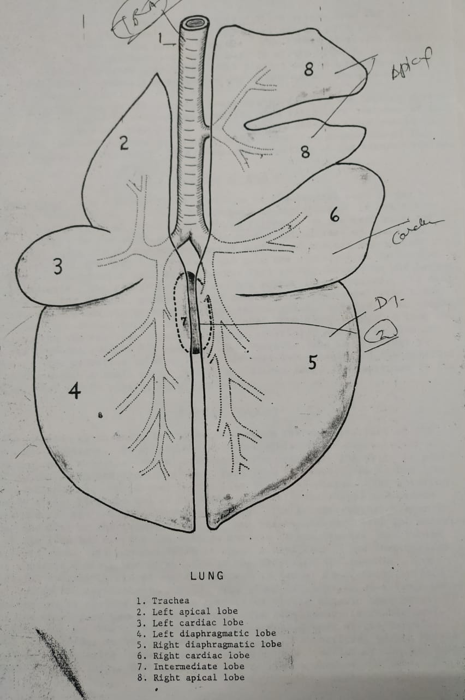

Slide 62
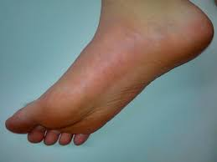
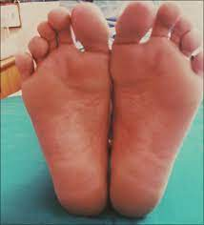
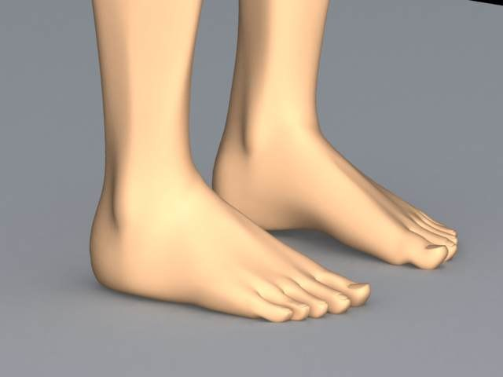

Slide 63
DESCRIPTION- Apex, Base, 3 surfaces (3rd is base)and 3 Borders
Apex :- It is situated interiorly and occupies the cervical pleura. The apex of right lung is larger than left lung.
Base/diaphragmatic surface :- oval,concave ,smooth and related to diaphragm
It is situated posteriorly and related to convex thoracic surface of diaphragm. It is concave elliptical in outline and bounded by basal border.

Slide 64
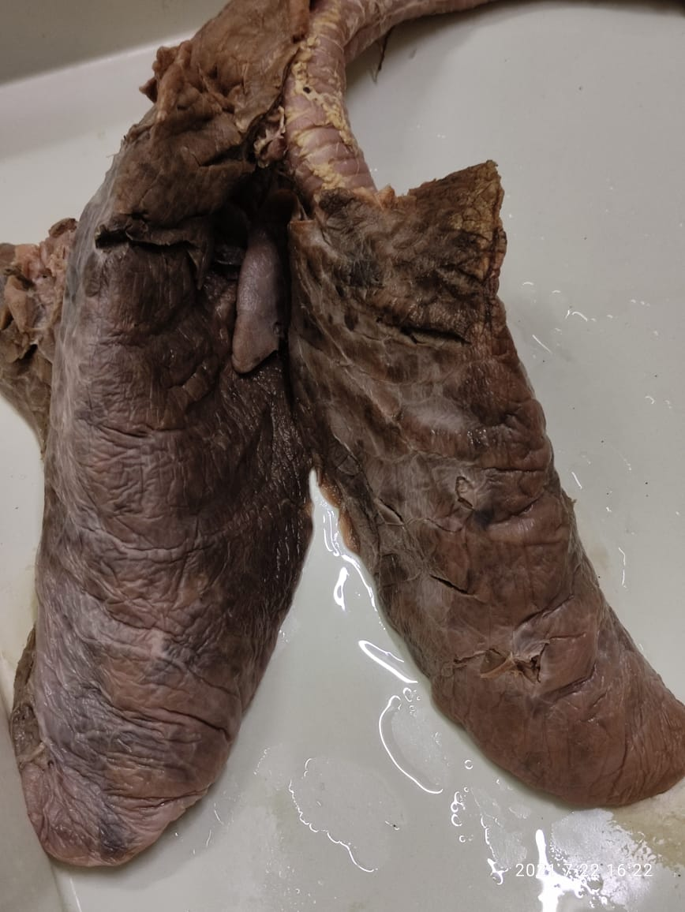
Apex
Coastal surface
Left Cardiac notch
Base

Slide 65
Surfaces :-
1. Costal surface/lateral- largest, smooth and convex. It is related to ribs, costal cartilages and intercostal muscles. Costal impressions present.
2. Mediastinal surface/medial- irregular and molded on organs or mediastinal space. Can be divided into small vertebral part and larger mediastinal part
cardiac impression is large,concave area on apical and cardiac lobes due to contact with heart and pericardium (impression on right lung large because large apical lobe).
Hilus
Esophageal groove
Intermediate lobe appear on Mediastinal surface of right lung.
Diaphragmatic surface- is concave related to diaphragm. Medial surface is less prominent and divided into vertebral and mediastinal parts. Vertebral part is small and related to thoracic vertebrae. Mediastinal part is related to heart and presents cardiac impression which is extensive on right lung. Posterior to hilus of each lung is not covered by pleura and bounded by line of reflection of pleura called as pulmonary ligament.
Right lung presents cardiac impression and grooves formed by trachea, anterior vena cava, azygos vein, and costocervical vein, esophageal and internal thoracic vessels. Left lung presents cardiac impression and grooves formed by left azygos vein, esophagus and aorta.

Slide 66
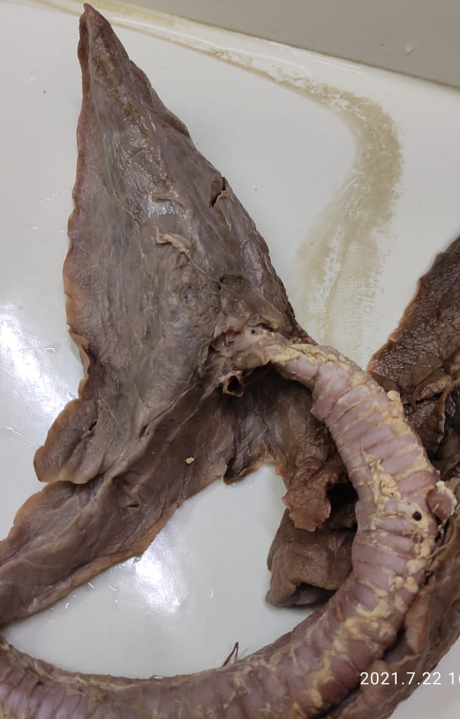
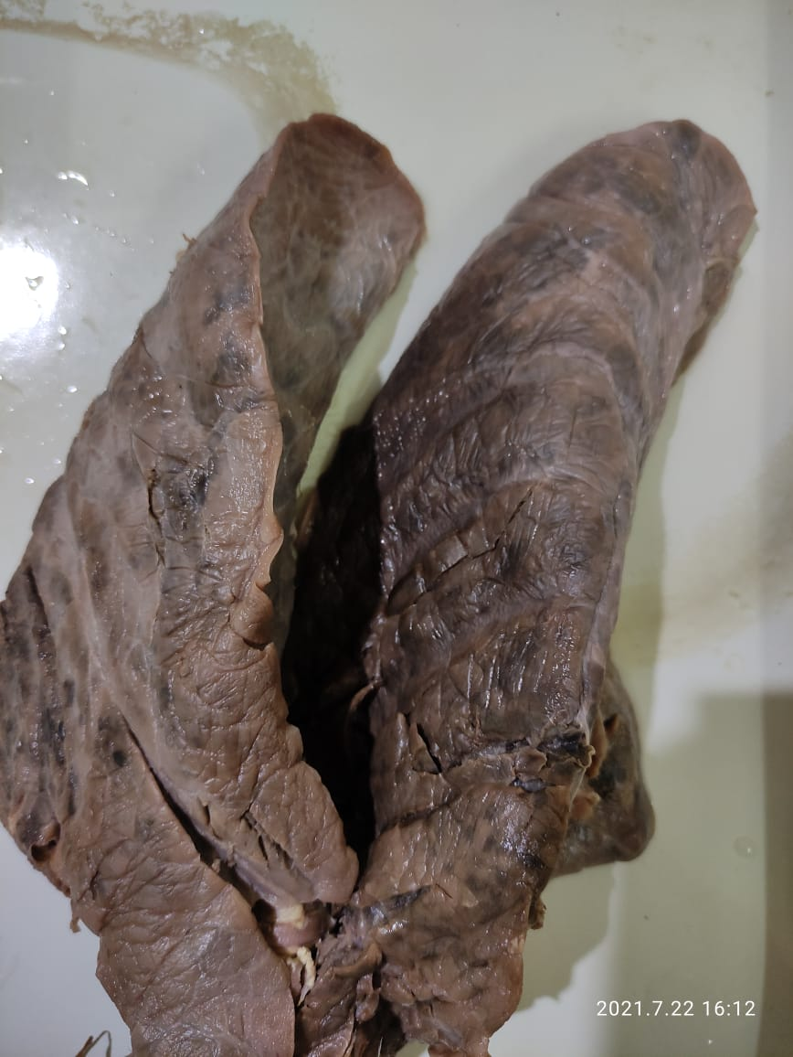
Surface -2, border-3
Base
Mediastinal surface
Mediastinal
surface
B
V
Coastal surface
D

Slide 67
Borders :- 3
1. Dorsal border- thick, rounded and occupy space bounded by bodies of thoracic vertebrae and upper part of ribs.
2. Ventral border is sharp, irregular and lies between thoracic wall and mediastinum.
Right lung- cardiac notch (small) at opposite to ventral part of 4th rib and adjacent costal spaces
Left lung- L shaped cardiac notch (large) heart has extensive contact with lateral thoracic wall as far as 2nd to 4th intercostal space (auscultation)
3. Basal border- thin along the ventral margin of base.

Slide 68
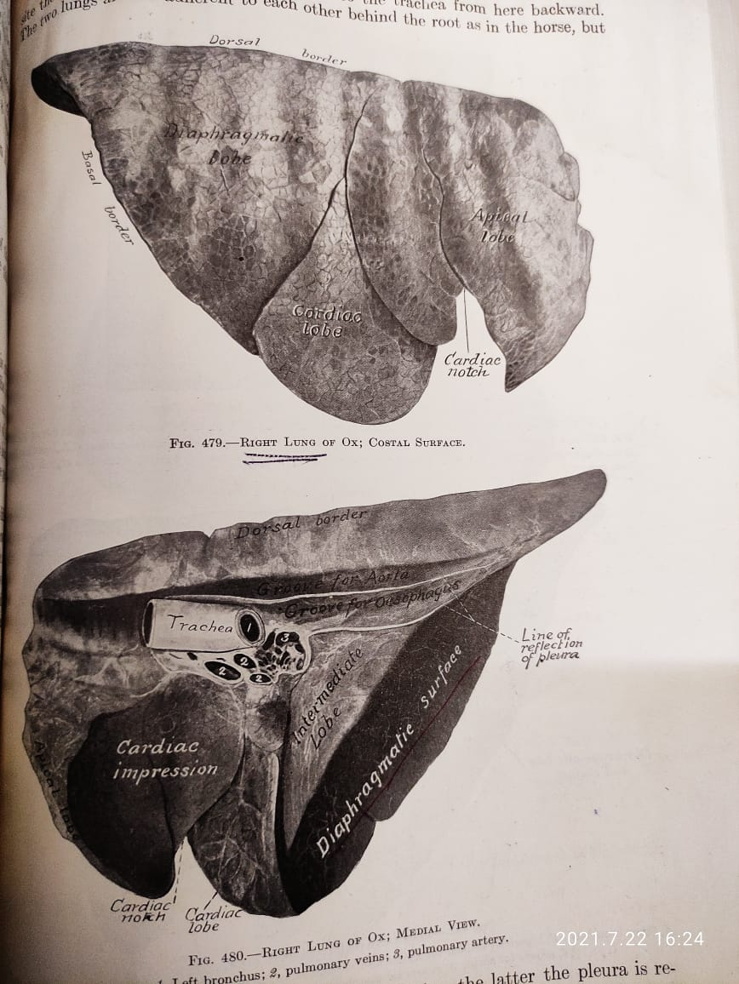
Base

Slide 69
Hilus- area where tubular srtuctures form the root of lungs.
It is on mediastinal surface above the cardiac impression.
Contents:
Bronchus 2.pulmonary artery 3. Pulmonary vein
4. Bronchial artery 5. pulmonary lymph vessel 6. nerves
Right lung has an accessory hilus for apical lobe
Root of lung-composed of structures which enter or leave the lung at hilus on mediastinal surface

Slide 70
Lungs of Horse
Lungs comparatively larger & longer
Not divided into lobes by fissures
There are occasionally external indications of lobar arrangement. However the left lung consist of 02 lobes-apical and diaphragmatic
Right lung- 03 lobes as apical, diaphragmatic and accessory
Surface marking lungs into area is indistinct due to lesser amount of interlobular connective tissue
Ventral border of both lungs present cardiac notches. left is larger than right.
Left cardiac notch quadrilateral 3rd to 6th rib
Right cardiac notch triangular 3rd to 4th I.S.

Slide 71
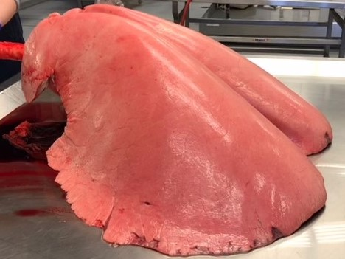
Lungs of horse

Slide 72
Lungs of Dog
-Very deep fissures reach almost to bronchi only left intralobar fissure not quite so deep as other
Left lung- 03 lobes as apical cardiac and
diaphragmatic
Right lung- 04 lobes as ox a. Apical b.cardiac c. Diaphragmatic and accessory
Left cardiac notch very small , ventral part of 5th and 6th interchondral space
Right cardiac notch is triangular and pericardium comes in contact with chest wall between 4th to 5th interchondral space (sight of auscultation)

Slide 73
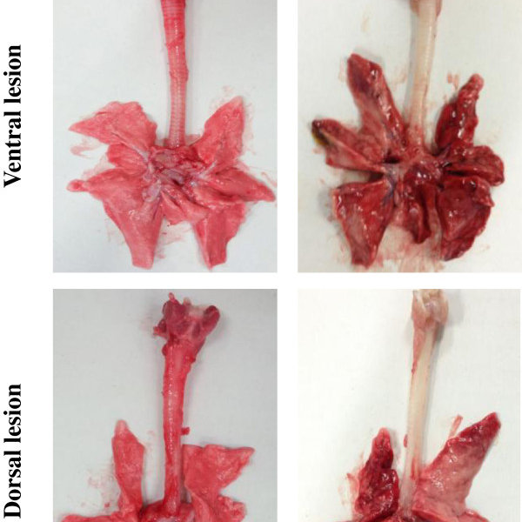
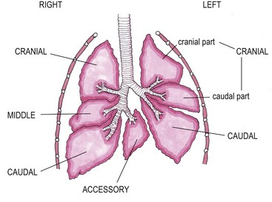

Lungs of Dog

Slide 74
Jugular furrow/groove
Area for search external jugular vein to give intravenous injection I/V
It is space/furrow in neck region which is form by
Dorsally- M.cleidomastoid(part of brachiocephalicus)
Ventrally –M.sternomandibularis (part of sternocephalicus)
Medially - M.sternomastoideous (part of sternocephalicus)
Laterally- Skin only
  Or
  Dorsally- brachiocephalicus
  Ventrally and medially- sternocephalicus

Slide 75
Contents of Jugular furrow/groove
Left side –(6) esophagus, left common carotid artery, external and internal jugular vein, vago-sympathetic trunk and recurrent laryngeal nerve
Right side-(5) right common carotid artery, external and internal jugular vein, vago-sympathetic trunk and recurrent laryngeal nerve

Slide 76
Thoracic cavity
Anterior most body cavity & is also second in size.
a truncated cone shape.
It contains the 2 lungs, invested by pleural sacs, the heart covered by the pericardium and other organs and structures.
Boundaries of the thoracic cavity
1. Lateral walls- flat in anterior part while convex, wider in posterior
formed by the ribs and intercostal muscles.
part of 9,10,11 and 12th ribes and almost all part of 13th /last rib are excluded from thoracic wall or last 4/5 ribs
2. Dorsal wall or roof - thoracic vertebra, ventral longitudinal ligament and portion of longus colli anteriorly and psoas major muscle posteriorly.
3. Ventral wall or floor- sternum, costal cartilages of sternal ribs, muscle transversus thoracis and inter chondral portions of inter costal muscles.

Slide 77
Posterior wall- diaphragm is a musculotendinous,dome shaped structure with convex surface directed towards thoracic cavity when it contract curvature of its dome is reduced and its central part moved caudad, as a result the volume of thoracic cavity increased)
Thoracic inlet – is small narrow and oval in outline. It is bounded dorsally by the 1st thoracic vertebra, laterally by 1st pair of ribs with their costal cartilages and ventrally by the manubrium sterni of sternum.
The thoracic inlet is occupied by oesophagus, Trachea, brachial arteries, bicarotid trunk, origin of anterior vena cava, vagus, phrenic and sympathetic nerves, M. longus colli & lymph glands.

Slide 78

Mediastinum
Literary the word mediastinum means a partition which divides thorax into right and left cavities.
Practically it means the interval between the two pleural sacs.
The mediastinum extends from the thoracic inlet to the diaphragm and bounded dorsally by the vertebral column, ventrally by sternum laterally by the pleural sacs.
With the exception of lungs, caudal vena cava and right phrenic nerve, all structures and organs contained in the thoracic cavity lie in the mediastinum.
It is conventional to divide the mediastinum into 3 parts the imaginary line run vertically to cranial and caudal to the heart.

Slide 79


Slide 80

Caudal
Cranial

Slide 81
Cranial or Precardial mediastinum
Arteries : Brachiocephalic trunk, brachial artery and its branches.
Veins : Cranial vena cava, Jugular vein and its branches.
Nerves : Sympathetic ganglia, vagus and recurrent laryngeal, left phrenic and cardiac nerves.
Muscle : Longus colli.
Organs : Oesophagus & Trachea.
Lymphatics : Thoracic duct, Tracheal ducts & lymph glands.
In young animals thymus gland.

Slide 82
Middle or cardial mediastinum –
Arteries : Thoracic aorta, pulmonary arteries.
Veins : Cranial venacava, pulmonary veins, vena hemiazygus.
Nerve : Sympathetic ganglia, vagus, left phrenic, left recurrent laryngeal nerve
Muscle : Longus colli.
Lymphatics : Thoracic duct and bronchial lymph glands.
Organs : Heart, Oesophagus & Trachea.
Posterior or Post cardial mediastinum :
Arteries : Thoracic aorta, intercostal arteries, bronchial and oesophageal arteries.
Veins : Vena hemiazygus.
Nerve : Sympathatic ganglia, vagus and left phrenic.
Lymphatics : Thoracic duct and oesophageal lymph glands.
Organs : Oesophagus

Slide 83
PLEURA
A thin glistening serous membrane that lines the thoracic cavity (Parietal pleura) and covers the lungs except at the hilus (visceral pleura).
Two pleural sacs divide the thoracic cavity into two halves.
Pleural sacs are always completely separate.
Right pleural sac is larger than the left one, in accordance with the marked difference in the size of lungs

Slide 84
Pleura is of two types
1. Parietal pleura : It lines the thoracic cavity and according to its attachment the parietal pleura is of following types;
a. Costal pleura : Attaches on the medial surface of ribs and internal intercostal muscles.
b. Diaphragmatic pleura : It covers the thoracic surface of the diaphragm.
c. Mediastinal pleura : Forms the chief tissues of the mediastinum.
d. Pericardial pleura : The part of the mediastinal pleura adjacent to the pericardium.
2. Visceral pleura or pulmonary pleura : It covers the lungs except at the hilus and is closely attached to them. It is directly continuous with the mediastinal pleura(parietal) at the hilus.

Slide 85



Cupula plurae

Slide 86


Slide 87
Pulmonary Ligament: It is a fold of pleura strengthened by the elastic tissue posterior to the hilus. Is extends backward to the junction of the mediastinum with the diaphragm and attaches the diaphragmatic lobe of the lung to the mediastinum.
Cupula pleurae : Apex or anterior extremity of the pleural sacs is called cupula pleura.
The right pleural sac extends cranially beyond the first rib on the deep face of muscle scalenus. The left pleural sac does not extend beyond the fist rib.
Pleural cavity: It lies in between the parietal and visceral pleura which contains a film of serous fluid of capillary thinness. This thin film of fluid allows the parietal and visceral pleura to slide easily against each other during inspiration.

Slide 88
Lines of pleural reflections
Parietal pleura reflected (turn) along 3 lines
1. Vertebral line of pleural reflection : along which the costal pleura turns ventrally to form the mediastinal pleura. It extends along the longus colli muscle and bodies of the thoracic vertebra to the vertebral end of the last rib or last intercostal space where it joins the diaphragmatic line of pleural reflection.
2. Sternal line of pleural reflection : along which the costal pleura is reflected dorsally to become the mediastinal pleura. Anteriorly the two lines are close together along the middle of the floor of the thorax but further back they diverge to each side of the sternal attachment of the pericardium.
3. Diaphragmatic line of pleural reflection :
Along which costal plura passes from lateral wall to the diaphragm.
This line clinically important since it is true line of demarcation between thoracic and abdominal cavity.
From Ventral end of 8th rib, extends in a very slight curve upward and backward, so that it reaches 12th rib about 6 inches (15 cm) from its vertebral end. It may reach to 13th rib at lateral border of longissimus dorsi muscle

Slide 89




Slide 90



Slide 91
Plica venacavae : The right pleura forms a special sagittal fold on the right side of the median plane which encloses the posterior venacava.
Costo-phrenico recess/sinus : It is the narrow angular space of pleural cavity between the basal border of the lung and costal attachment of the pleura at the diaphragm. During inspiration the lungs move into this recess.
Costo-mediastinal recess/sinus : It is the narrow space of the pleural cavity within the angle formed by the sternal line of costal pleural reflection.

Slide 92
Comparative respiratory system
Horse
Nasal Cavity :
Nasal cavity is larger and is almost completely divided into similar halves.
middle meatus is relatively wider as compared to ox and not divided into two parts as ox
Ventral nasal meatus is the largest passage & through it the stomach tube is passed in this species.
Nasolacrimal orifice visible when nostrils dilated
Muzzle not keratinized
False nostril/diverticulum nasii- a blind cutaneous pouch in upper commissure or nostrils divided into dorsal and ventral pasages. Dorsal passage leads to False nostril and ventral into the nasal cavity
Cornua of alar cartilage is Comma shaped

Slide 93
Larynx
Cricoid cartilage is more rounded & the lamina is distinctly marked from the arch.
Thyroid cartilage is incomplete ventrally and marked by deep thyroid notch.
Laryngeal prominence is not pronounced & cannot be palp ahead in the living animal.
Arytenoid Cartilage resembles that of ox but the muscular process is not so well developed & the vocal process is not so much narrow & long.
Corniculate Cartilages are paired cartilages of both shape & the base of each is attached to the apex of arytenoid cartilage.
Epiglottis is situated above the body of the thyroid cartilage & is larger/longer. It has a pointed apex which curves ventrally. It may project into the isthmus faucium or lies on the pharyngeal side of the soft palate.
Cuneiform cartilages are paired & attached to each side of the base of epiglottis cartilage. They project caudo-dorsal from their points of attachment

Slide 94
Cavum Laryngis of Horse :
vocal cards are longer & project in the laryngeal cavity from the lateral wall so that the rima glottis is narrow.
False vocal cords
Infront of the lateral ventricles on the lateral walls of the vestibule are the vestibular folds commonly called as the false vocal cords.
Laryngeal saccule
lateral ventricles are deeper and are in the form of pocket like depressions between the vocal cords and vestibular folds. Each of these lead into a cul-de-sac (blind pouch) of mucus membrane formerly called Laryngeal saccule.

Slide 95
Trachea and Bronchi :
It is relatively longer having a length of about 75-80 cm.
It consist of 50-60 cartilagenous rings.
The tracheal bifurcation is opposite the 5th or 6th intercostal space
two principal bronchi going to lungs.

Slide 96
Respiratory System in Dog
Nostrils
Comma shaped
Nostrils are relatively undilated since their cartilaginous support does not permit much movement and the muscles of the nostrils are relatively poorly developed.
Cartilaginous nasal septum continues rostrally beyond the body of their incisive bone and terminates in the snout.
The dorsal edge of the cartilaginous septum is grooved and leads into ventral cleft. The lateral projections thus formed extends into the upper lip .
The skin around and between the nostrils is kiratinous, moist, hairless & is usually pigmented.
Muzzle is marked by a median groove called philtrum or a deep fissure in some breads.

Slide 97
Nasal Cavity
Nasal cavity length is dependent on length of face.
Caudally the nasal cavity is divided into a dorsal fundus and a ventral nasopharyngeal meatus by a transverse plate of bone form by the vomer, palatine, sphenoid & ethmoid bone. Or
Laminal transversalis divides it into upper olfactory and lower respiratory parts.
The middle nasal meatus is short & narrow,divided posteriorly as ox

Slide 98
Larynx
as horse but Is relatively short and wide.
lamina cricoid cartilage is wide or the arch is grooved.
lamina of the thyroid cartilage are in form of more or less rectangular plates. There dorsal angle is extended to form a short hook shaped rostral cornu. Between the rostral cornu & the cranial border of lamina there is a notch, thyroid fissure.
arytenoid cartilage is relatively small & irregularly shaped. It has a base, a rostral apex, 3 surfaces and 3 borders.
corniculate cartilage resembles a horn & is fused by its base to the apex of the arytenoids cartilage. It curves dorsally, caudally and medially.close together resumble like lip of pitcher
cuneiform cartilage is attached to either side of base of epiglottis, are in the form of thin bars and project caudodorsal from their point of attachments.
Vocal cords prominant
Laryngeal saccule extensive

Slide 99
Cavity of Larynx dog:
Vestibular folds (false vocal cards) extend from the cuneiform cartilage to the thyroid cartilage.
vocal cords are large & prominent.
The large lateral ventricles is in the form of a rectangular depression of about 1 cm. long parallel with the margin of the vocal folds.
The laryngeal saccule is extensive

Slide 100
Trachea and Bronchi :
Trachea contains 42 – 46 “c” shaped hyaline cartilaginous incomplete rings.
The trachealis muscle is attached to the outside of the cartilage.
The lumen is circular at the ends but in the middle part the tube is slightly flattened dorsally.
The tracheal bifurcation is opposite to the 5th rib. Bronchi diverge at an obtuse angle.
No apical bronchus

Slide 101
Pig
Nose extended from snout to level of eye
Nostril cannot dilated much b/c embeded with in skeleton of face
Snout formed by apex of nose and upper lip.
Nostrils are situated in snout
Skin covering snout is pigmented and divided by shallow groove, these surface marking helpful in indivisual identification
Larynx elongated
Apical bronchus present as ox at 3rd rib
Right lung-04
Left- 02

Slide 102
Fowl
Nostrils- narrow slit open into beak
Nasal cavities-complete osseo-cartilagenous septum, 03 rudimentary turbinates
Nasal gland- present lies on frontal bone close to internal angle of eye
Larynx –two anterior and posterior
Anterior correspond to mammals
Posterior- Syrynx (sound production-crowing)
Epiglottis- absent (laryngeal opening close by proximation of two lips of larynx)

Slide 103
Cartilages-02 cricoid and arytenoid
Cricoid – main, not as ring but have 04 parts which form ring
Vocal cords- absent
Trachea-
Long, complete hyaline cartilage rings
Last ring forms syrinx
Trachea divided into right and left bronchi
Each bronchus enter lungs
Bronchus dilates after it enter lung continuous further as a duct like channel and terminate in a cartilagenous ring through which it communicate with large abdominal air-sac

Slide 104
Stem bronchus-secondary-tertiary bronchus- dilatations (correspond to alveoli of mammals)
Lungs
Small ,spongy, closely applied against sides of vertebrae and ribs, to which they are attached by cellular tissue.
02 surfaces-diaphragmatic surface (pierced by stem bronchus and present 05 orifices through which air passes to and fro from air sacs)
Costal surface- attached to ribs and imperforate
Inhalation- air leave the lungs
Exhalation- air enter the lungs
Diaphargm – rudimentary

Slide 105
Air Sac
Bladder like membranous receptacles with delicate wall
Air carried into them by branches of the bronchi.
These air sacs are in communication with the bronchus on one side and air spaces in bone cavities on other side.
Confer lightness and buoyancy to body and their position is mainly dorsal thus influence position of centre of gravity.
Not communicate each other
More developed in flying birds than walking
There are 11 air sac
1.Cervical
2.Clavicular – only unpaired
3. Axillary
4.Anterior thoracic
5.Posterior thoracic
6.Abdominal -largest
Posterior air sacs

Slide 106
1.Cervical-lie at base of neck, partly above clavicular and supply air to cervical and dorsal vertebrae and superior ribs
2.Clavicular – only unpaired- placed at anterior part of thoracic cavity above clavicles,surrounds syrynx,bronchi and continue on each side as axillary sac
3. Axillary- receives air by two opening on anterior part of lungs and supplies it to sternum,inferior ribs,and bones of shoulder girdle and the humerus
4.Anterior thoracic- extends from clavicular sac to abdominal sacs. They lies between lungs,heart and abdominal viscera at rudimentary diaphragm and thus help in separating thoracic and abdominal organs.
5.Posterior thoracic- a as anterior
6.Abdominal –largest- extend from lungs to cloaca.
Lies between superior and lateral walls of abdomen on one side and abdominal organs on other side. Each supplies air to sacrum ,oscoxae and femur

Slide 107

1. Cervical air sac
2.
3.
Axillary sac
4.
Thoracic
5.
Thoracic
6.

Slide 108



Slide 109


Slide 110


Slide 111
Applied aspects
Stomach tube passing:
Guttural Pouches:
Viborg’s Triangle:
Roaring:
Ventral laryngeotomy:
Tracheotomy :
Thoracocentesis:
Root of Lungs:
Location of left and right cardiac notch
Significance of right cupula pleura
Area of auscultation of lung in ox,horse and dog
Infection of one lung leads to other in horse

Slide 112
Area of auscultation of lung in ox,horse and dog- on left lateral thoracic wall except in dog right lateral thoracic wall

Slide 113


Slide 115


Slide 116


Slide 118



