Slide 1
Staining techniques

Slide 2
1. Fixation

Slide 3
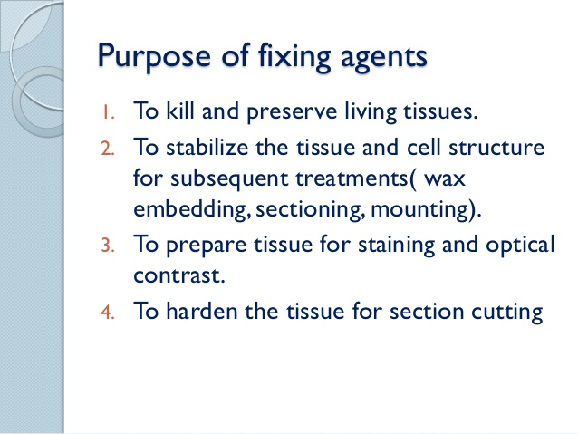

Slide 4
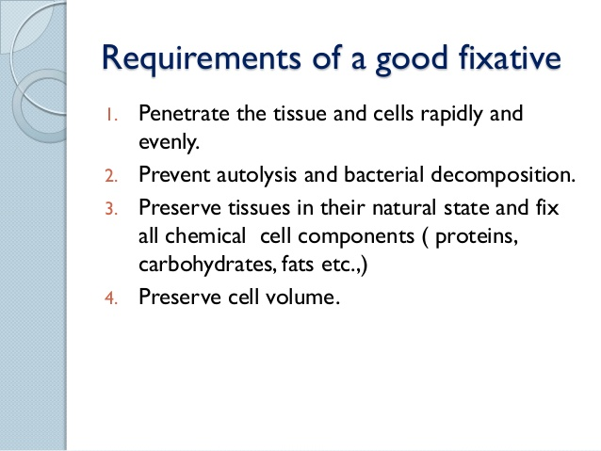

Slide 5
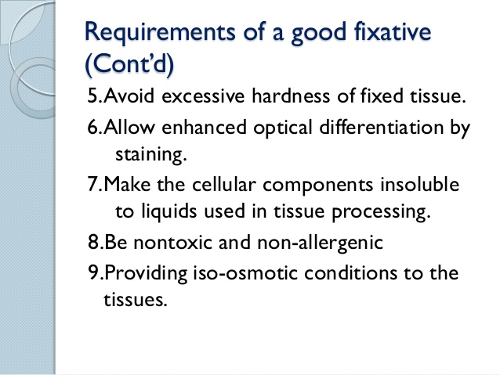

Slide 6
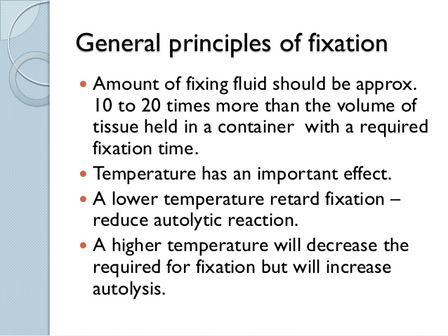

Slide 7
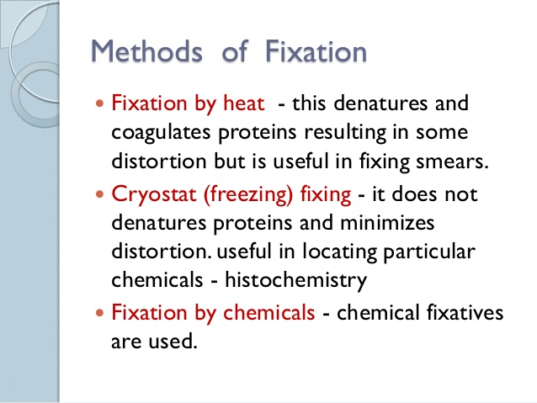

Slide 8
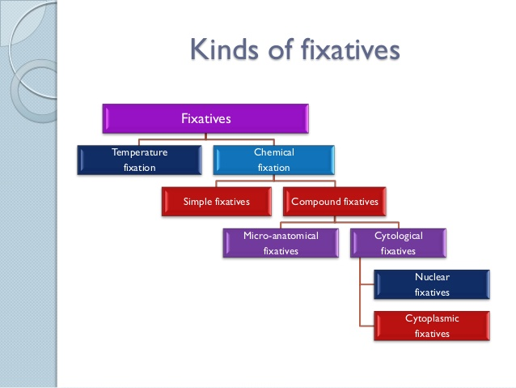

Slide 9
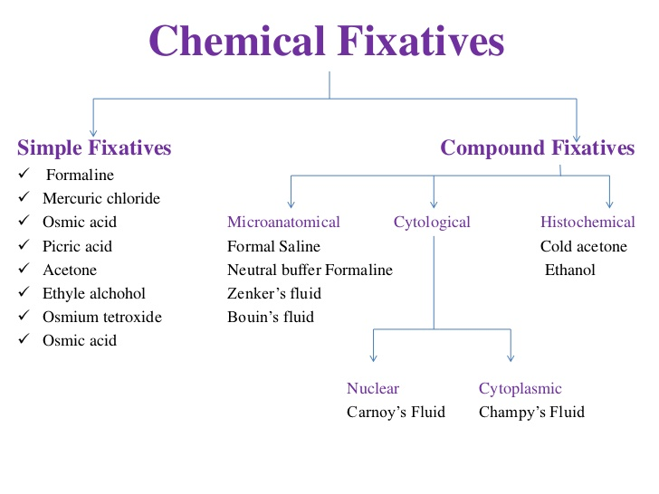
Fixatives used in histopathology

Slide 10
2. Staining

Slide 11
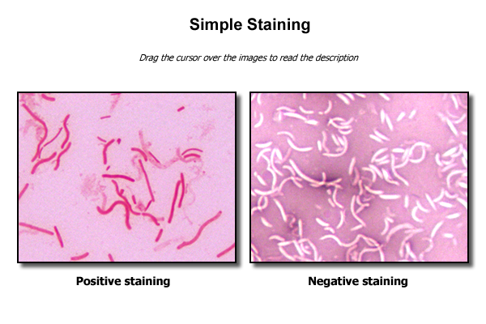

Slide 12
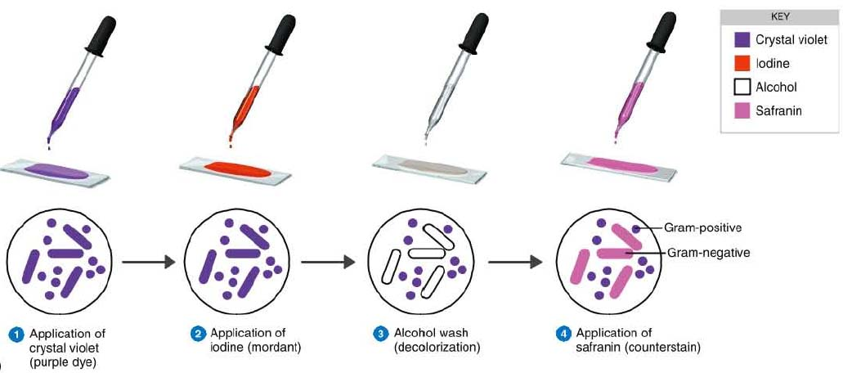
Differential staining

Slide 13
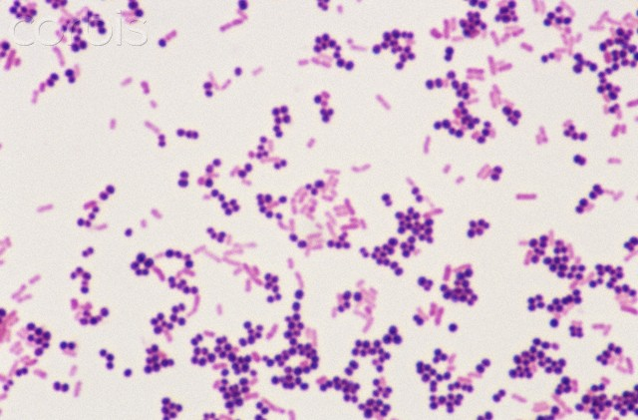
Gram’s staining

Slide 14
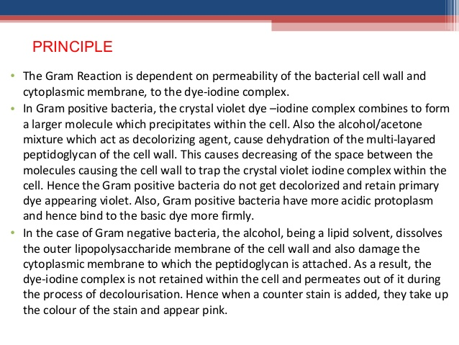
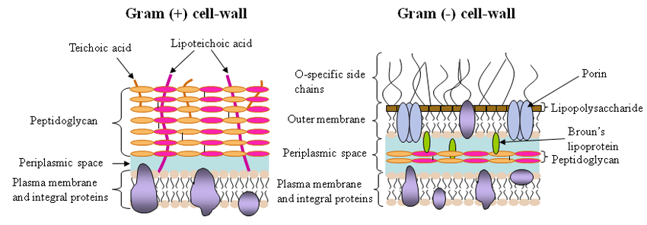

Slide 16
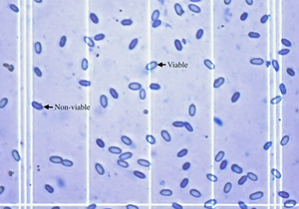
Vital staining
Trypan blue- dead cells take up the stain i.e stain positively and live cells
Exclude the stain or stain negatively

Slide 17
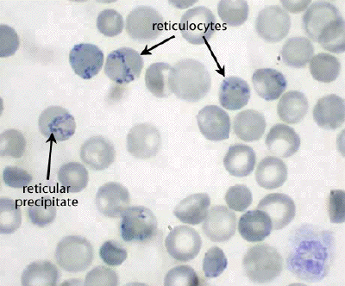
Supra vital stain
To observe the live cells removed from a living organism unlike intravital staining.
Immature red blood cells, called reticulocytes, can be seen in peripheral blood smears stained with a basic dye such as New Methylene Blue as seen here under oil immersion. These dyes bind to residual rRNA elements still present in these cells forming a reticular precipitate. The living cells take up the stain.

Slide 18
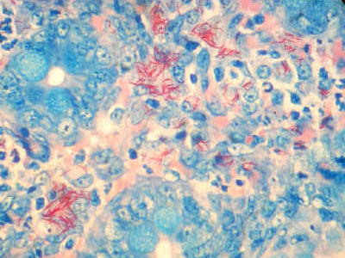
Acid fast staining
Mycobacterium avium subspecies paratuberculosis

Slide 19
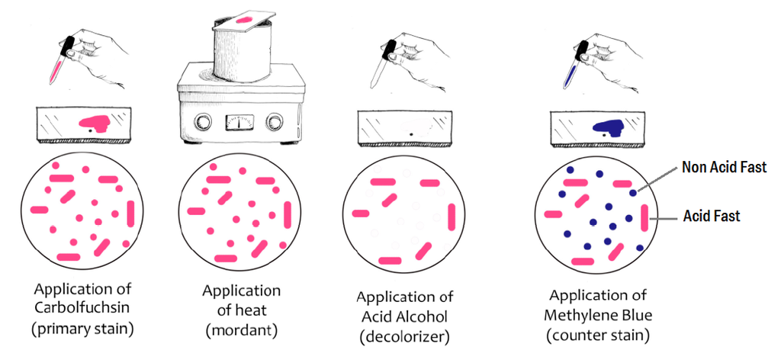

Slide 20
Principle of Acid Fast Stain
Acid-fast mycobacteria contain mycolic acid in their outer membrane, making the cells waxy and resistant to staining with aqueous based stains such as the Gram stain. The primary stain, carbolfuchsin (contain phenol) is applied to the cells, and heat and phenol are used to allow the stain to penetrate into the waxy surface of acid-fast microorganisms. The excess stain is removed with treatment by acid alcohol (ethanol and hydrochloric acid). A secondary stain, methylene blue, is then applied to the cells.

Slide 21
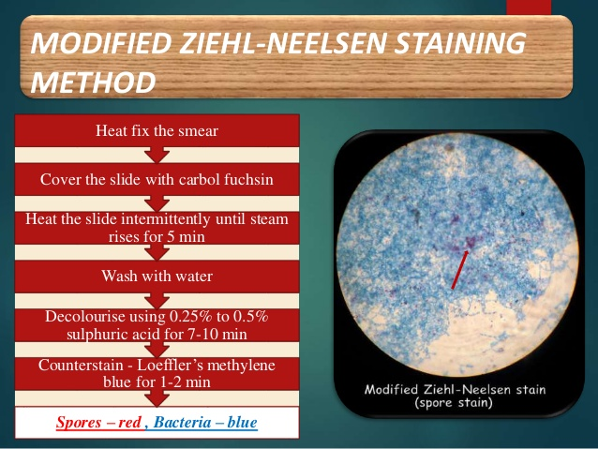

Slide 22
SPECIAL STAINS

Slide 23
These stains are ‘Special’ because they are not routine – simple as that. Therefore, Special Stains refers to any staining technique other than haematoxylin and eosin (H&E). So when we talk about ‘Special Stains’, we are referring to stains that are applied for a single purpose.

Slide 24
However, examination of H&E-stained tissues may raise questions, such as:
What type of tissue is present, and what is its distribution?
Which tissue component is that?
Is that an organism?!
This is where Special Stains come in. They represent a variety of techniques and dyes with a more limited staining range, so they can be used to highlight certain features.

Slide 25
This allows target substances to be identified based on their:
Chemical character: For example – calcium, iron, copper, melanin, lipids, glycosaminoglycans, hemosiderin, DNA and RNA.
Biological character: For example – connective tissues, nerve fibers, and myelin (luxol fast blue -cresyl violet).
Pathological character: For example – bacteria, fungi, and amyloid.

Slide 26
Loeffler’s Alkaline methylene blue stain
Blood/ serum smear
It is a cationic dye which stains the cell a blue color. The presence of negatively charged molecules in the cell causes the staining phenomenon, as the positively charged dye is attracted to negatively charged particles, such as polyphosphates like DNA and RNA

Slide 27
REAGENT FORMULA
Ingredients per liter of deionized water :*
Methylene Blue, Certified- 3.0gm
Potassium Hydroxide, 10%- 1.0ml
Ethanol, 95%- 300.0ml
* Adjusted and/or supplemented as required to meet performance criteria.

Slide 28
Procedure
Prepare and heat or methanol fix a smear of the organism to be examined on a clear glass slide.
Flood the slide with the Methylene Blue, Loefflers stain.
Allow to stand for one to three minutes.
Rinse slide with tap water, and blot dry.
Examine the smear at 1000X, using the oil immersion objective.

Slide 29
Determining bacterial morphology. Staining of bacteria Bacillus anthracis
used in the presumptive identification of Corynebacterium diphtheria
use in the staining of gram-negative bacteria found in spinal fluid, namely Haemophilus influenzae and Neisseria meningitidis.
effective stain for the enumeration of leukocytes in mucus or feces

Slide 30
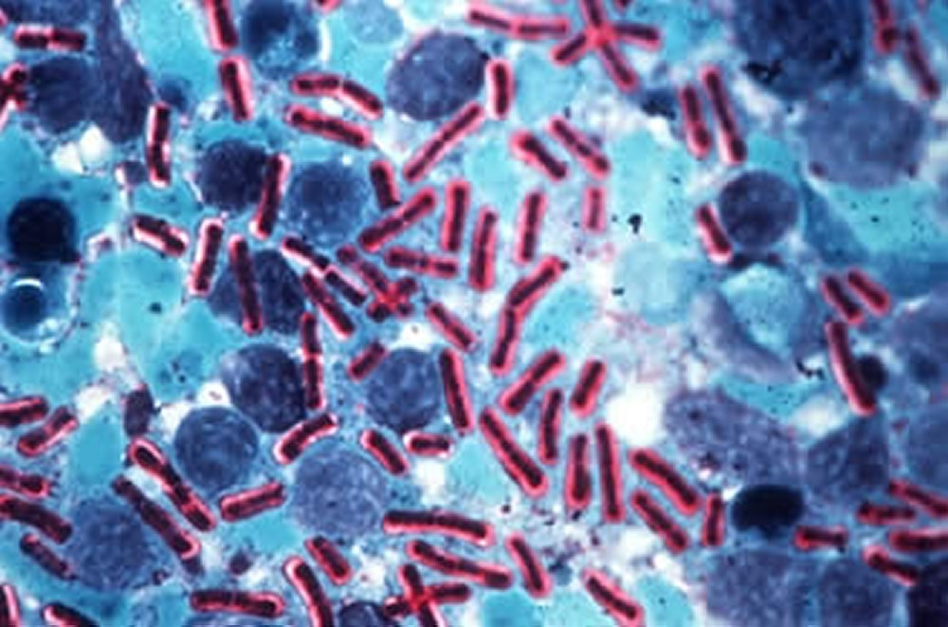
Loeffler’s alkaline methylene blue
Mc Faydean reaction

Slide 31
Romanowsky staining is a Prototypical staining technique that was the forerunner of several distinct but similar methods,Including Giemsa, Jenner, Wright, Field, and Leishman stains, which are used to differentiate cells in pathologic specimens.
It was named after the Russian physician Dmitri Leonidovich Romanowsky (1861–1921), who invented it in 1891.

Slide 32
LEISHMAN’S STAIN -COMPOSITION
Leishman’s stain- 0.3g
Absolute Methyl alcohol- 200ml
Dissolve and filter before use.

Slide 33
LEISHMAN’S STAIN
1. Take an air dried blood smear on and glass slide and cover the smear with the undiluted stain. Take care not to overflow with excess stain. Preferably add just the enough number of drops to cover the smear. To standardize, count the number of drops (usually 7-10) required to cover the film (so that double the number of water can be added) and adjust the incubation time according to the result (usually 1–2 minutes, 3 minutes per WHO). The undiluted stain both acts as a fixative and also partially stains the smear. Still, since the moisture content can vary it is better to fix the slide in Methanol before staining.
2. Add twice the volume of pH 6.8 buffered water (i.e. if e.g. 7 drops of stain was used, then use 14 drops water) to dilute the stain, taking caution that the stain should not overflow (which will make the dilution inaccurate). However, the standard operating procedure published by WHO suggests adding equal (instead of twice) volume of water.^{[4]} Mix the water with the stain underneath by gently blowing with a straw or using a plastic bulb pipette. Allow to stain for 10–12 minutes (time may require adjusting).

Slide 34
"the appearance of a polychromatic 'scum' on the surface of the slide is merely a result of oxidation of the dye components and can be ignored.”
3. Wash off the stain with clean (or filtered) tap water . If the stain is tiped off instead of washing, this will leave a fine deposit covering the film. Wipe the back of the slide clean and stand it in a draining rack to dry. The stained smear should grossly appear neither too pink nor too blue (verify final results microscopically). If the tap water is highly acidic, resulting in smear turning grossly pink too fast or highly alkaline, resulting in the smear remaining too blue, try using boiled cooled water or filtered rain water or pH 6.8 buffered water which can be used as an additional flooding step after washing in running water.
4. The slide should be air dried and can be viewed under microscope either directly or optionally (per WHO) a nonaqueous mounting medium such as DPX (Distrene 80 - a commercial polystyrene, a Plasticizer e.g. dibutyl phthalate and Xylene) may be used.

Slide 35
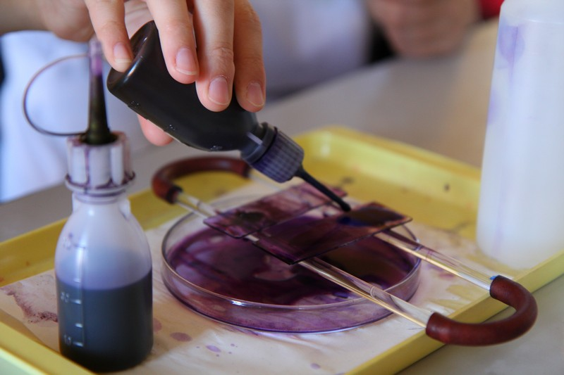

Slide 36
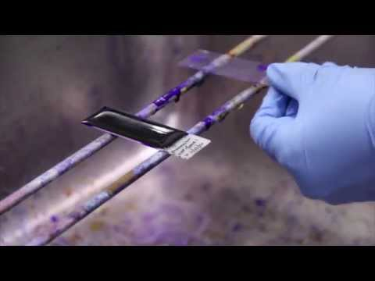

Slide 37
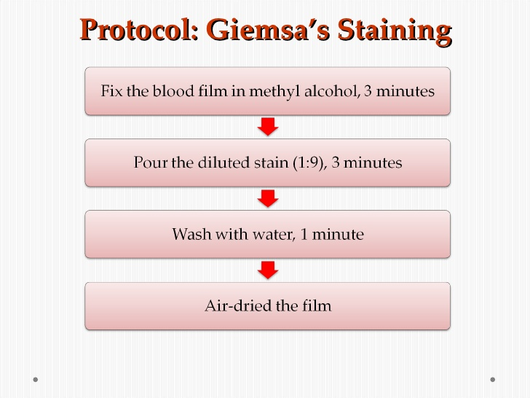
Giemsa stain

Slide 38
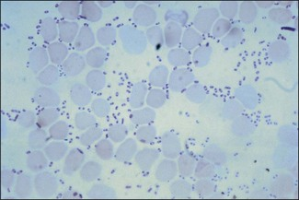
P. multocida- Leishman’s stain blood smear

Slide 39
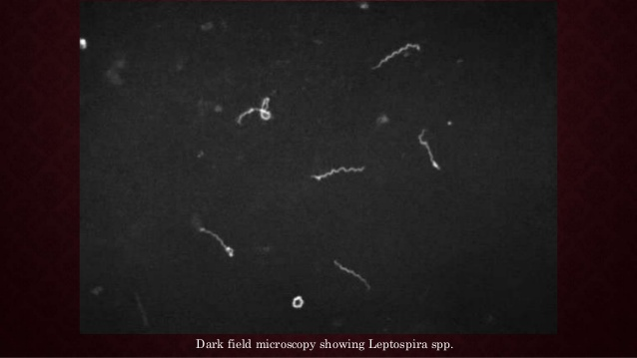

Slide 40
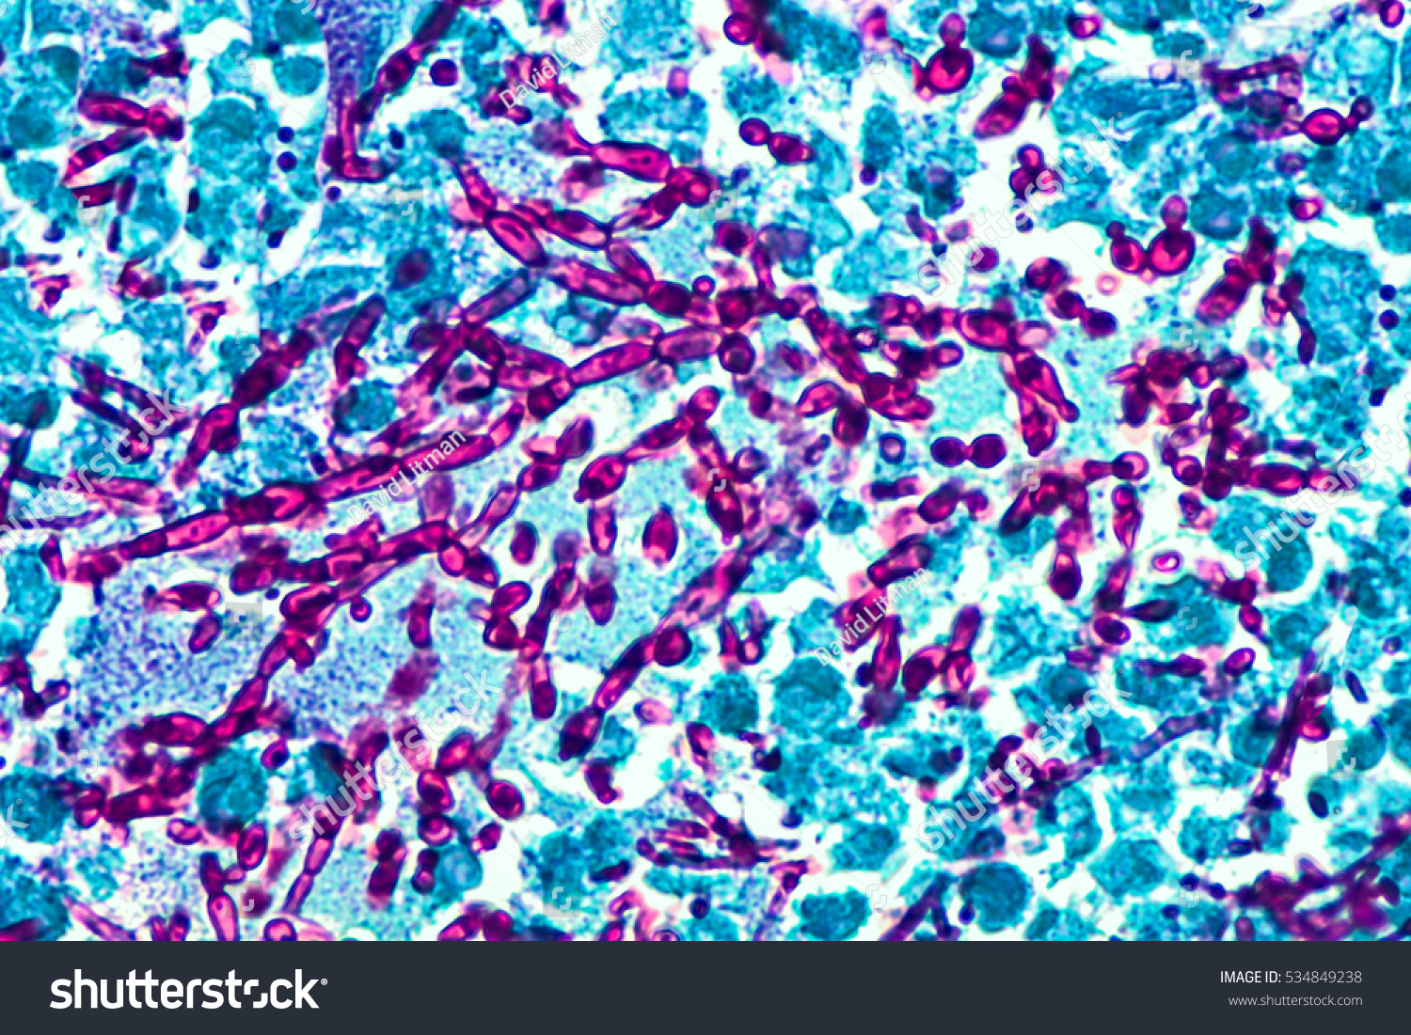
PAS stain
Principle of PAS Stain
Glycol group of carbohydrates are oxidized by periodic acid to release dialdehydes. These dialdehydes on subsequent combination with Schiff’s reagent result in the formation of magenta colored complex, localized at the site of aldehyde formation.

Slide 41
PAS helps to demonstrate glycogen, cellulose and starch.
Basement membrane of various tissues may also be visualized through the PAS stain. The PAS is most commonly used to demonstrate the thickness of glomerular basement membrane when renal disease is being assessed.
Certain fungi in tissue samples such as Cryptococcus neoformans, Histoplasma capsulatum, Aspergillus fumiagtus, Blastomyces etc can be demonstrated by PAS stain because of high carbohydrate content in their cell wall/capsule.
Mucin, particularly acid mucin is demonstrated by PAS.
Russell bodies of plasma cells are stained by PAS.

Slide 42
