Slide 1
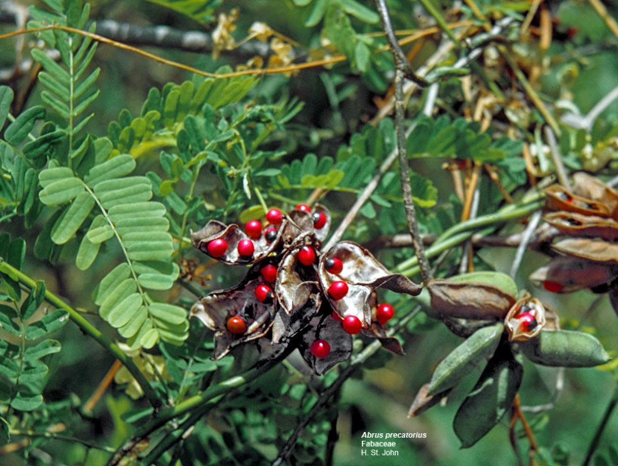
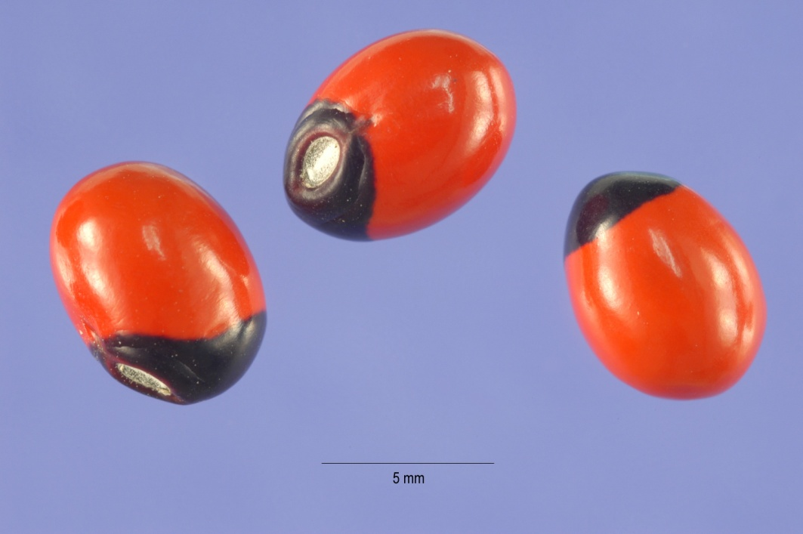
Abrus precatorius
Common Name: jequirity bean or rosary pea
Rati
family Fabaceae

Slide 2
Distribution
Throughout the tropics
Twinning perennial vine with yellow or red flowers
Seeds are used as beads in jewellery and necklace
Toxic part
Seeds: used for malicious poisoning and rarely homicide
Whole seeds have no toxic effects to cattle but toxic to fowls (die with in few days)
Powdered seeds toxic by mouth to all species
Broken seeds are highly toxic (one seed can kill a small child or medium sized dog)

Slide 3
Toxic principle: Abrin is an extremely toxic toxalbumin found in the seeds.
Median lethal dose :
Mice: of 0.7 μg/kg body mass (intravenously)
Approximately 31.4 times more toxic than ricin.
Humans: 10 to 1000 μg/kg body mass (ingested)
3.3 μg/kg body mass (inhaled)
Horses: Sixty gram powdered seeds can kill
Cattle and goat are more resistant by oral administration (Parentral decorticated
seeds i.e. 0.6 mg/kg) fatal to cattle
Ingestion of a single seed, well chewed, can be fatal to both adults and children

Slide 4
Animals affected:
All species of animals.
Cattle are generally poisoned for revenge by leather workers to obtain the
hides cheaply. (Malicious poisoning)
Ecology
Abrus precatorius is a severely invasive plant in warm temperate to tropical regions, so much so that it has become effectively pantropical in distribution

Slide 5
Mechanism of Toxicity
Abrin (Toxalbumin/phytoprotein)
Not affected by gastric juices
Potent cytotoxin
Abrin a type 2 ribosome-inactivating protein
The toxic effect of abrin is due to an intracellular, multi-step process by binding to and penetrating the cells of the body,
inhibiting cell protein synthesis after being transported to the endoplasmic reticulum (ER).
Binds with 28S rRNA of the large ribosomal subunit of a ribosome on or near the ER, inhibiting the regular process of cellular protein synthesis.
Causes agglutination of red blood cells
Abrin probably, because of peculiar binding potential is selectively transported (suicide transport) by the neurons

Slide 6
Clinical Signs
The major symptoms of abrin poisoning depend on the route of exposure and the dose received.
In general, symptoms can appear anywhere between several hours to several days after exposure.
Initial symptoms of abrin poisoning by inhalation may occur within 8 h of exposure but a more typical time course is 18–24 hours;
Fatal within 36–72 hours.
Following ingestion of abrin, initial symptoms usually occur rapidly, but can take up to five days to appear.
The later signs and symptoms of exposure are caused by abrin's cytotoxic effects, killing cells in the kidney, liver, adrenal glands, and central nervous system

Slide 7
Salivation
Nasal discharge
Nausea
Vomition
Profuse hemorrhagic diarrhoea
Watery feces
Ulcerative lesions in mouth and oesophagus
Painful swelling around area of implant
Enlargement of regional lymph nodes
Increased body temperature
Stiffness of muscle
Incoordination
Ataxia
Muscular spasms
Trembling
Convulsions
Paralysis
Coma
Death

Slide 8
Post Mortem Lesions
Acute gastroenteritis with mucosal and serosal gastric hemorrhages
Accumulation of fluid in the lumen of intestine
Petechial hemorrhages throughout body
Hepatic and renal necrosis

Slide 9
Diagnosis
History & circumstantial evidences
Clinical Signs
PM Examination
Treatment
Symptomatic and supportive
Removal of poison from GIT by emesis or lavaging
Followed by activated charcoal, demulscents and saline purgatives
Intravenous infusion of fluids and electrolytes

Slide 10
Ricinus Communis
castor-oil plant, (Ricinus communis), also called castor bean
family (Euphorbiaceae)
Probably native to tropical Africa, the castor-oil plant has become naturalized throughout warm areas of the world
Cultivated in India and other temperate regions
The plants are chiefly cultivated in India, China, and Brazil, largely as the source of castor oil.

Slide 11
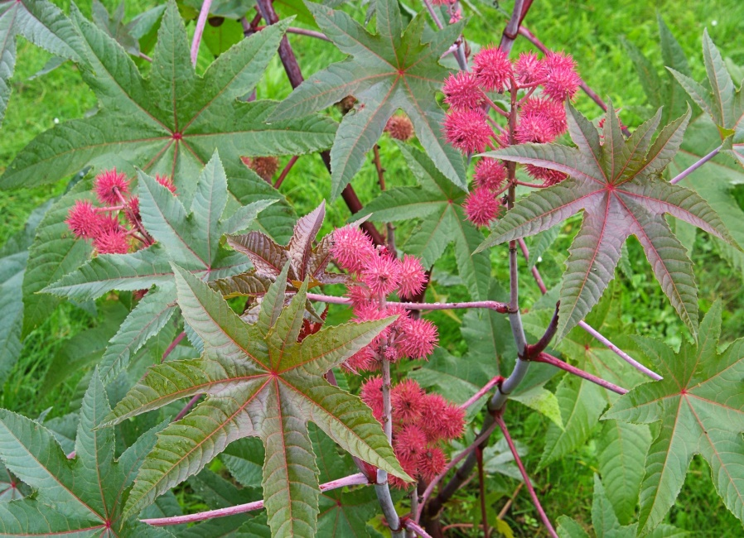
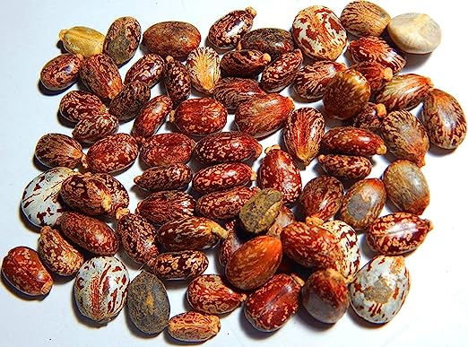
Grown commercially for the pharmaceutical and industrial uses of its oil and for use in landscaping.
Although the plant is the only species in its genus, there are hundreds of natural forms and many horticultural varieties.
The oil-rich seeds contain the poison ricin, one of the most toxic substances known, and consumption of chewed seeds can be lethal.

Slide 12
Ricin, discovered in 1888 by German scientist Peter Hermann Stillmark, is one of the most toxic substances known. It is of special concern because of its potential use as a biological weapon. Accidental exposure to ricin is rare and results primarily from the ingestion of castor seeds.
In the tropics the plants reach about 10 to 13 metres (30 to 40 feet) in height. In temperate climates they are raised as annuals and grow 1.5 to 2.5 metres (4.9 to 8 feet) in a single season. The plants bear handsome giant 12-lobed palmate (fanlike) leaves.
The bristly spined bronze-to-red clusters of fruits are attractive but often are removed before they mature, because of the ricin concentrated in their mottled beanlike seeds.

Slide 13
It is used in the production of synthetic resins, plastics, fibres, paints, varnishes, and various chemicals including drying oils and plasticizers.
Castor oil is viscous, has a clear and colourless to amber or greenish appearance, a faint characteristic odour, and a bland but slightly acrid taste, with a usually nauseating aftertaste.
Castor oil is obtained from castor beans either by pressing or by solvent extraction.
Both beans and oil are produced principally by India and Brazil and consumed primarily in the United States, largely in industry.
Residual cake contains: Ricin-I and Ricin-II (Toxic Principle/phytotoxin)
1g seed gives 1mg pure toxin

Slide 14
In addition to the uses mentioned previously, castor oil and its derivatives are used in cosmetics, hair oils, fungistatic (fungus-growth-inhibiting) compounds, embalming fluid, printing inks, soap, lubricants, greases and hydraulic fluids, dyeing aids, and textile finishing materials.
Turkey-red oil, long used as a dyeing aid, is produced by the reaction of castor oil with sulfuric acid.
Castor oil consists almost entirely of the triglycerides ricinoleic acid; and although castor oil has been taken internally as a cathartic, its use can be harmful.

Slide 15
Susceptible species:
All species of animals
Horses most susceptible (LD50 = 0.007g/kg)
Dogs, sheep, cattle, goats and pigs comparatively resistant
LD50 (g/kg) for other animals
Species Seeds Oil cake
Rabbit 1.00 2.00
Sheep 1.25 2.50
Pig 1.30 5.00-6.00
Piglet 2.40 --
Cattle 2.00 3.00
Calf 0.50 --
Goat 5.50 --
Goose 0.40 --
Hen 14.00 40.00
Dog 0.6-5.00 3.50

Slide 16
Mechanism of Toxicity
Induce hydrolytic fragmentation of ribosomes
Inhibit protein synthesis
Chain A of Ricin inactivates 60s ribosomal subunit – inhibit protein synthesis- endocytosed in cell cytosol after chain B binds to a terminal galactose residue on cell membrane

Slide 17
Signs and Symptoms
Purified ricin can enter the body through ingestion, inhalation, or injection. The early symptoms of poisoning following ingestion include diarrhea and vomiting, which can lead to dehydration. In cases of severe poisoning by ingestion, these symptoms are followed by seizures, hallucinations, and liver and renal failure, usually within 72 hours.
If ricin poisoning occurs by inhalation, symptoms may include difficulty breathing, tightness in the chest, cough, and nausea. Severe poisoning by inhalation causes fluid accumulation in the lungs and respiratory failure, leading to death within 36 to 72 hours.
When ricin is injected, it causes red blood cells to clump together (agglutination), which in turn leads to the destruction of red cells (hemolysis) and produces symptoms similar to poisoning by ingestion. Very small doses of ricin can be lethal if inhaled or injected, since these routes of exposure enable the toxin to immediately enter the bloodstream, resulting in its rapid distribution throughout the body.

Slide 18
Toxicology tests may be used to detect ricin in the blood or urine; however, these tests are generally impractical in an emergency situation, since they require more time than is available to confirm poisoning.
In addition, there is no antidote available for ricin poisoning, and as a result treatment is supportive.
If less than an hour has passed since ingestion, gastric lavage may be performed to remove the poison from the stomach. Intravenous fluids are administered to prevent dehydration, and activated charcoal may be given to absorb the poison from the gastrointestinal tract.
In some cases, poisoned individuals recover.

Slide 19
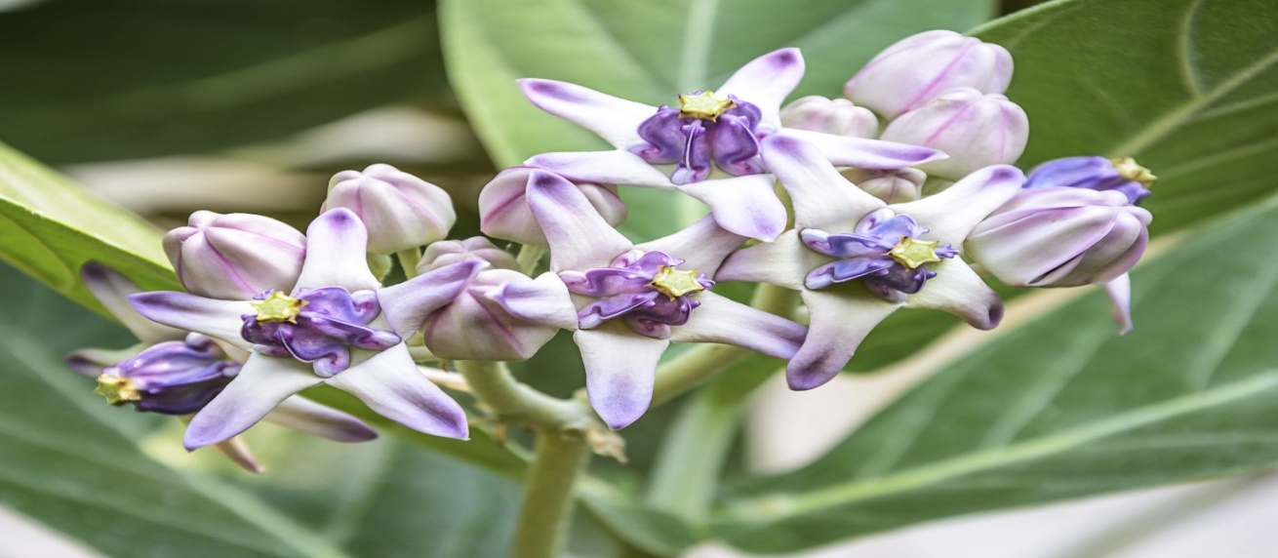
Calotropis gigantea
Calotropis gigantea, the crown flower, is a species of Calotropis native to Cambodia, Vietnam, Bangladesh, Indonesia, Malaysia, Thailand, Sri Lanka, India, China, Pakistan, and Nepal.
It is a large shrub growing to 4 m (13 ft) tall.
The aestivation found in calotropis is valvate i.e. sepals or petals in a whorl just touch one another at the margin, without overlapping. The plant has oval, light green leaves and milky stem. The latex of Calotropis gigantea contains cardiac glycosides, fatty acids, and calcium oxalate. The roots also contain Calotropone

Slide 20
This family includes Calotropis gigantea and the more potent Calotropis procera.
The latex of these plants has been used in Africa as an arrow poison.

Slide 21
Medical uses
Given the potent bioactivity of calotropin, calotropis gigantea has been used as a folk medicine in India for many years, and has been reported to have a variety of uses.
In Ayurveda, Indian practitioners have used the root and leaf of C. procera in asthma and also used in bacterial infection, swelling with redness, boils also and shortness of breath and the bark in liver and spleen diseases.
The plant is reported as effective in treating skin, digestive, respiratory, circulatory and neurological disorders and was used to treat fevers, elephantiasis, nausea, vomiting, and diarrhea.
The milky juice of Calotropis procera was used against arthritis, cancer, and as an antidote for snake bite.
However, these reports are of folk uses and more research is needed to confirm the clinical usefulness of the leaves, latex, and bark. Recent studies have displayed use of calotropin as a contraceptive and as a potential cancer medication.

Slide 22
Calotropis is a poisonous plant.
The active principles are uscharin, calotoxin, calactin, and calotropin.
The leaves and stem when incised yield thick milky juice. It is used as an arrow poison, cattle poison, rarely for suicide and homicide and mostly an accidental poison.
The milky latex sap of Calotropis gigantea is a known cause of toxic keratoconjunctivitis and reversible vision loss.
Crown flower keratitis is a rare condition and is usually the result of accidental ocular exposure to the sap.
The condition is usually self-limited and resolves faster with topical steroids.
The clinical course of this condition suggests that Calotropis is paradoxically relatively nontoxic to corneal epithelium and highly toxic to corneal endothelium.

Slide 23
Signs and symptoms
Applied to the skin, it causes redness and vesication.
When taken orally, the juice produces an acrid, bitter taste and burning pain in throat and stomach, salivation, stomatitis, vomiting, diarrhea, dilated pupils, tetanic convulsions, collapse and death.
The fatal period is 6 to 12 hours.
Treatment includes stomach wash, demulcents, and symptomatic treatment

