Slide 1
Virus-Cell Interaction

Slide 2
Viruses often encode genes that induce, mimic, or shut down host cell functions for their own benefit
Host has elaborate systems to shut down viral functions.
The outcome of infection may vary from essentially benign and undetectable, to tolerated, to lethal.

Slide 3
Viral Factor
Cellular factor
Physiologic, immune, or inflammatory responses of the host
Expression of virulence factors by the virus

Slide 4
Types of Virus-Cell Interactions
CYTOCIDAL
NONCYTOCIDAL
PRODUCTIVE
NON-PRODUCTIVE
PERMISSIVE
NON-PERMISSIVE

Slide 5
Cytocidal Changes in Virus-Infected Cells
Viruses kill the cells in which they replicate. The resulting cell damage is known as a cytopathic effect (CPE).
Cytopathic effect is often characteristic of the particular virus involved and is therefore an important preliminary clue in the dentification of clinical isolates

Slide 6
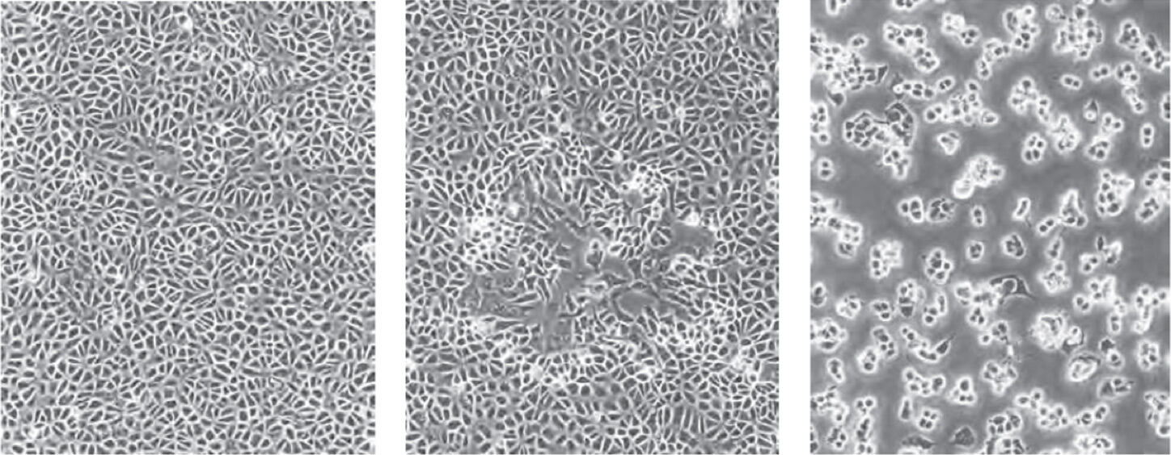

Slide 7
Mechanisms of Cell Damage
DNA
RNA
Protein
Inhibition of host cell nucleic acid synthesis
-depletion of machinery of DNA replication
-produce a DNase that degrades cellular DNA
Inhibition of host cell RNA transcription and processing
-decreases in the availability of transcription factors required for RNA polymerase activity
-Virus encoded factors modulate the expression of cellular genes
Inhibition of host cell protein synthesis
-production of viral enzymes that degrade cellular mRNAs,
-production of factors that bind to ribosomes and inhibit cellular mRNA --alteration of the intracellular ionic environment favoring
the translation of viral mRNAs over cellular mRNAs.

Slide 8
Cytopathic Changes
Effects on cell Physiology
changes in cellular metabolism
alteration in the ATP synthetic pathways
deviation in the ion channel system

Slide 9
Cytopathic Changes
B. Effects on cell morphology
Cell Membrane Fusion and production of “syncytia”
-Syncytia is multinucleated cells result from the fusion of an infected cell with neighboring infected or uninfected cells
-fusion bridges may allow viral entities to spread while escaping the effects of host defenses
-fusion is mediated by viral fusion proteins
Eg. the fusion activity of influenza viruses is carried on hemagglutinin peplomers (spikes), whereas the fusion activity of many paramyxoviruses, is carried on separate peplomers composed of fusion (F) protein.

Slide 10
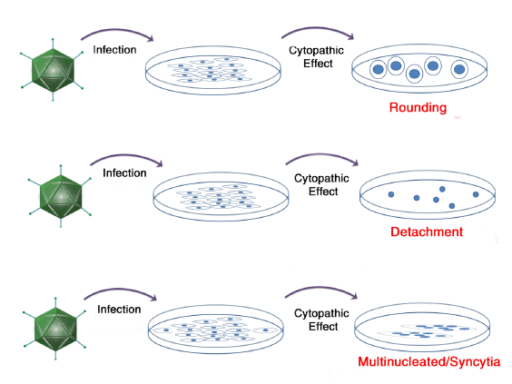

Slide 11
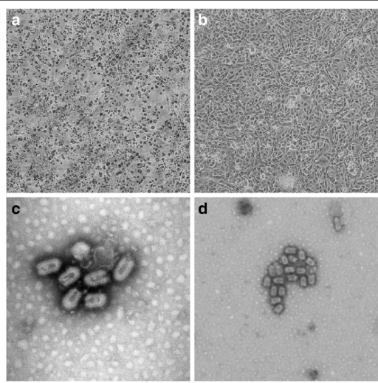

Slide 12
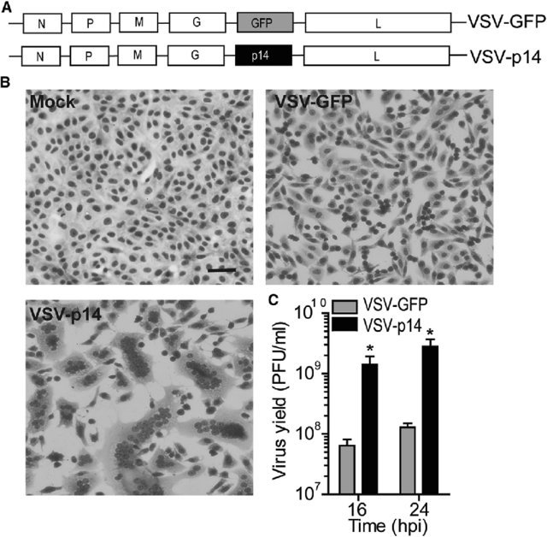
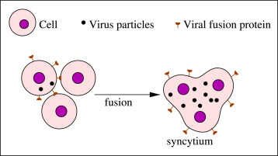

Slide 13
Cytopathic Changes Involving the Cytoskeleton
The cytoskeleton is responsible for the structural integrity of the cell, for the transport of organelles through the cell, and for certain cell motility activities.
virus infected cells exhibit changes in cell shape caused by damage to the cytoskeleton (actin, vimentin and tubulin)

Slide 14
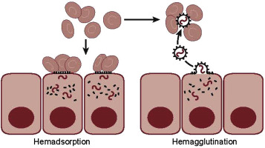
Hemadsorption and Hemagglutination
-virus belonging to family orthomyxoviruses, paramyxoviruses, and togaviruses bud from the plasma membrane
-during budding process they incorporate viral glycoprotein peplomers into the plasma membrane of infected cells
- viral glycoprotein serve as receptors for ligands on the surface of erythrocytes

Slide 15
Noncytocidal Changes
Noncytocidal viruses cause persistent infection, in which infected cells produce and release virions but overall cellular metabolism is little affected.
- regulatory and homeostatic functions of endocrine organs
- digestive and metabolic functions of exocrine organs
- locomotor and circulatory functions of muscles

Slide 16
Inclusion Bodies
formation of inclusion bodies is a characteristic morphological change in cells infected by certain viruses
intranuclear or intracytoplasmic
single or multiple,
large or small,
round or irregular in shape,
acidophilic or basophilic

Slide 17
Inclusion bodies
Intracytoplasmic
Intranuclear

Slide 18
Intracytoplasmic
Negri Bodies in Rabies
Guarnieri bodies in small pox
Intranuclear
Acidophillic: Vericella zooster, Herpes Simplex, Yellow Fever virus
Basophilic: Adenovirus, Cytomegalovirus
Both Intracytoplasmic and Intranuclear
Canine distemper virus

Slide 19
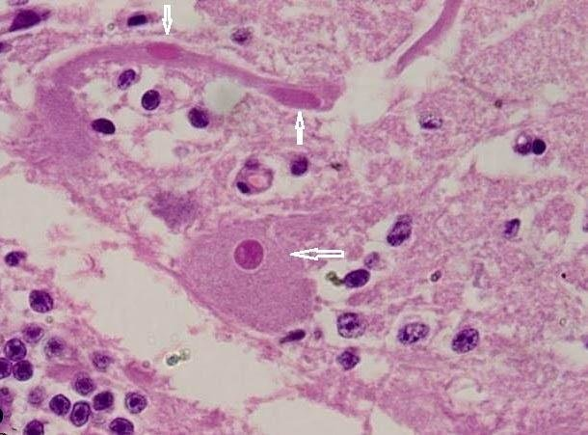
Negri Bodies-Rabies

Slide 20
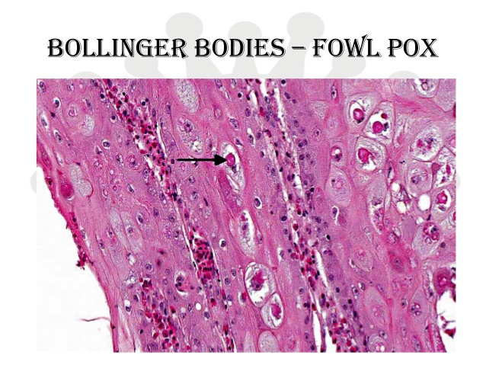
Bollinger Bodies-Fowl Pox

Slide 21
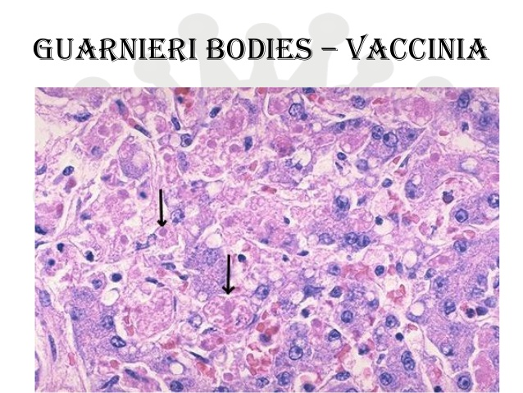
Guarnieri Bodies-Vaccinia Virus

Slide 22
Nature of Inclusion Bodies
Accumulations of viral components: eg. Negri bodies (Rabies) are masses of viral nucleocapsids
Sites of viral synthesis (viroplasm): eg. intracytoplasmic inclusions found in cells infected with poxviruses
Crystalline aggregates of virions: eg. adenovirus inclusions in the nucleus and reovirus inclusions in the cytoplasm of infected cell

Slide 23
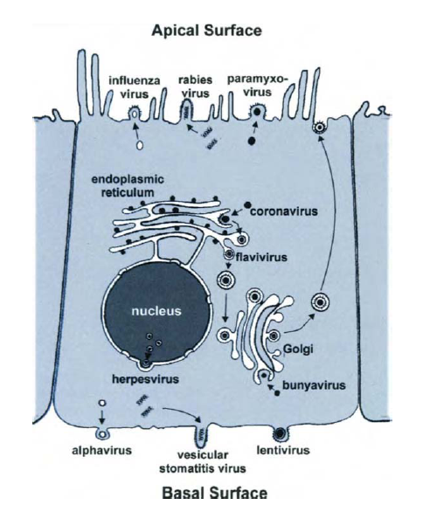
Polarity of Viral Budding

Slide 24
Ultrastructural Changes in Virus-Infected Cells
Increased synthesis of nuclear membranes: eg herpesviruses
Proliferation of the endoplasmic reticulum: flaviviruses
Proliferation of vesicles in the cytoplasm: picornaviruses and caliciviruses
Fusions of cytoplasmic membranes: eg retroviruses
Disruption of cytoskeletal elements
Mitochondrial damage
Changes in the density of the cytosol

Slide 25
Viral infection: establishment of the antiviral state

Slide 26
Viral interference
“When a virus-infected cell resists superinfection with the same or a different virus”
Viral interference
Interferon mediated
Defective interfering mutant

Slide 27
Interferons
Isaacs and Lindenmann (1957)
Cells of the CAM of embryonated hen's eggs infected with influenza virus release into the medium a nonviral protein, "interferon,"
Not synthesized by cells constitutively, but secreted transiently in response viral infections

Slide 28
Definition of Interferons
Naturally occurring proteins
Secreted by eukaryotic cells in response to virus infection, tumour and other inducers
Reacts with uninfected cells so as to render them resistant to infection to virus

Slide 29
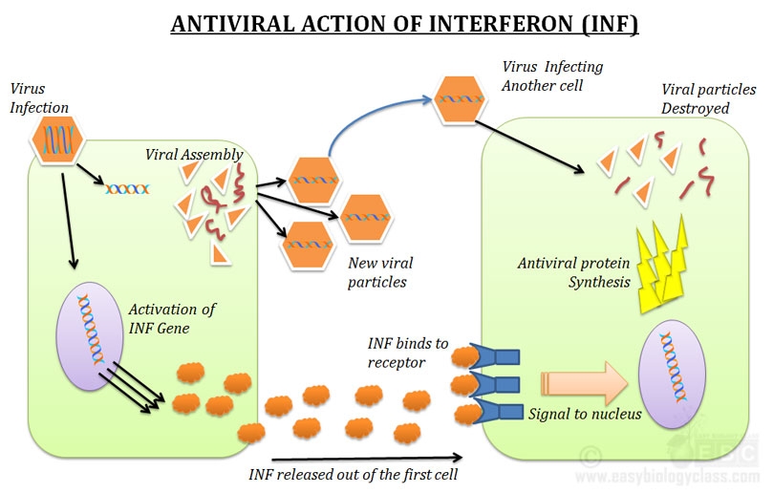
Antiviral Actions of Interferons

Slide 30
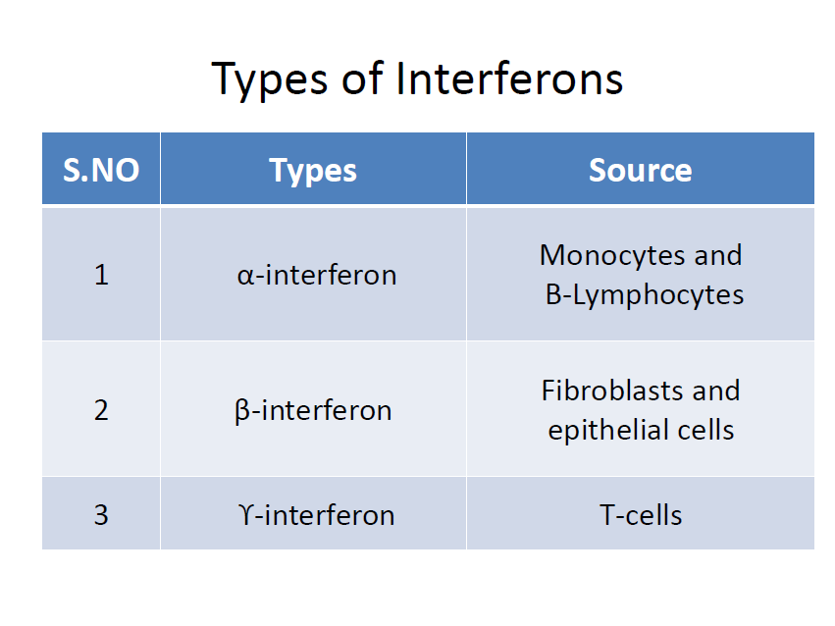

Slide 31
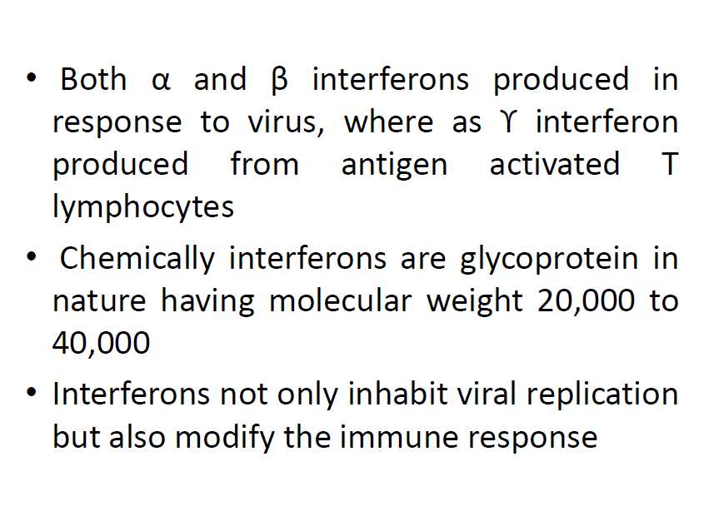

Slide 32
EFFECTS OF INTERFERONS
IMMUNOLOGIC EFFECTS
Cytokines regulate the innate immune system natural killer (NK) cells, macrophages and neutrophils.
They also regulate the adaptive immune system, the T and B cell immune responses.
EFFECTS ON TUMOR CELLS
Increased MHC class I antigen expression
Increased expression of tumor-associated antigens
Increased expression of adhesion molecules

Slide 33
Nonimmunologic effects
Antiangiogenesis effects
cytostatic and cytotoxic effects on tumor cells
Antimetastatic effects on tumor cells

Slide 34
Virus-Induced Cell Death
Necrosis
Apoptosis

Slide 35
Role of the immune system against virus attack
Natural killer cells and cytotoxic T cells are the major type of immune cells involved against virus infection in the host.
NK cells cause the direct cytotoxicity of the virus infected cells
The virus surface antigens are presented over the major histocompatibility antigens class I (MHC-I) molecules and activates the cytotoxic T lymphocytes (CTLs). CTLs exert antiviral state by secreting cytokines and apoptosis.

Slide 36
Viral strategies to escape host immune response
Evasion of interferon system by viruses : blocking the different steps involved in the interferon signaling cascade
Inhibition of protein synthesis : inhibition of cellular protein synthesis and upregulation of viral protein synthesis
Inhibition of interferon production: Many viruses encode dsRNA-binding proteins that inhibit the Many viruses encode dsRNA-binding proteins that inhibit the enzymes protein kinases and 2’-5’ oligoadenylate synthetase

Slide 37
Inhibition of interferon signaling :blocks the downstream signaling pathway

