Slide 1
Cells of Acute Inflammation

Slide 2
INTRODUCTION TO INFLAMMATION
The reaction of vascularized tissue or circulatory system against injurious agent in living body
Reaction can be generalised or localised
Mostly protective mechanism
Few cases- harmful, Ex- hypersensitivity reaction

Slide 3
Etiological Agent
Physical-thermal injury, electric current, x-rays etc.
Chemical-acid, toxic gases etc.
Biological – bacteria, virus, parasite etc.
Nutrition
Immunological- Ag-Ab complexes
Necrotic tissue

Slide 4
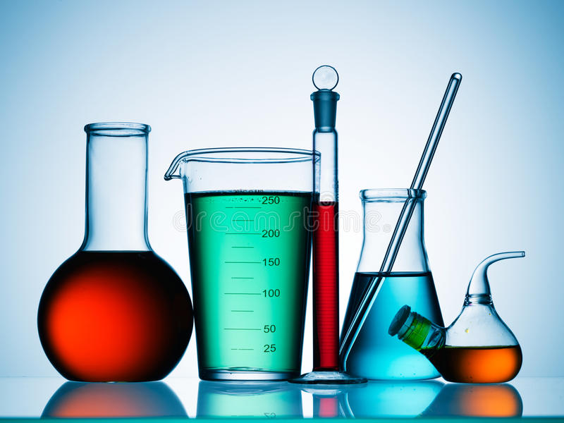
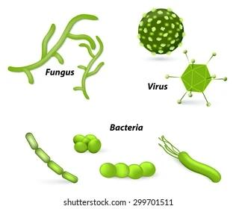
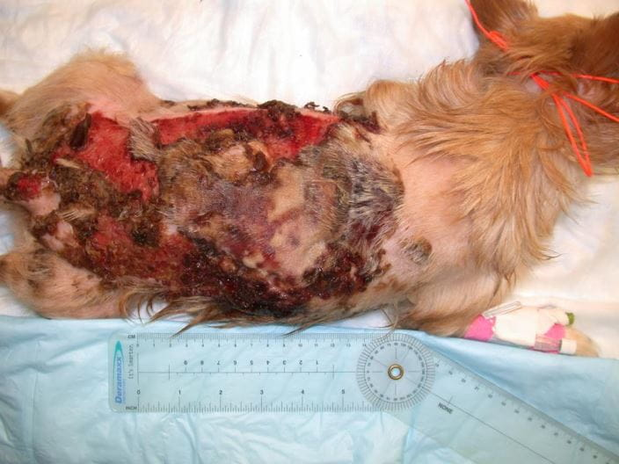
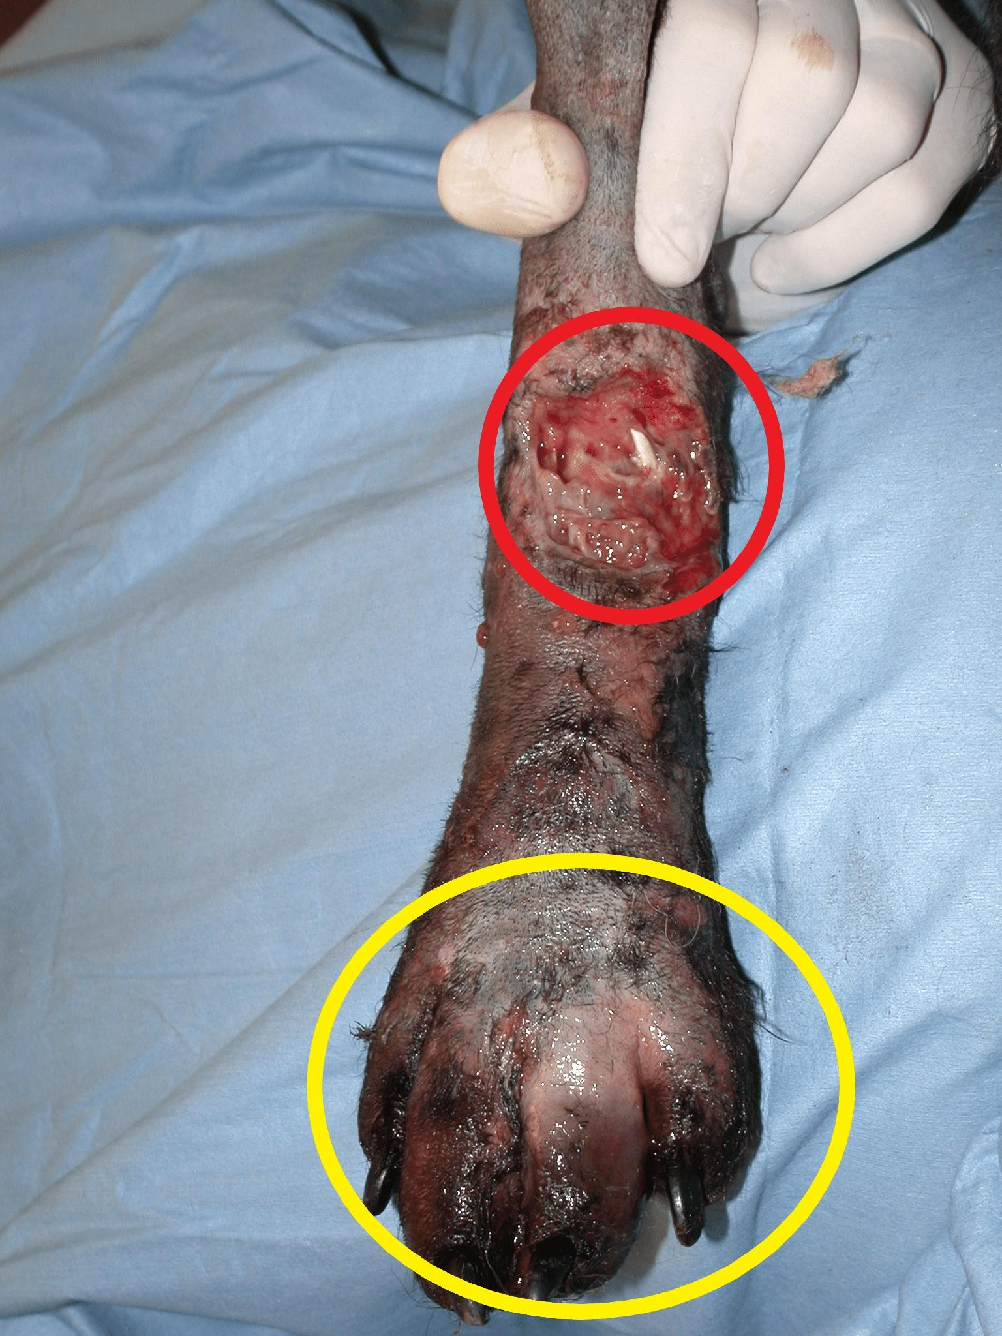

Slide 5
TYPES OF INFLAMMATION
2 types
1.Acute Inflammation
Due to early response by the body
Short duration
2.Chronic Inflammation
Occurs after delay
Longer duration
Characterised by chronic inflammatory cells

Slide 6
Features of Acute & Chronic Inflammation
Acute Inflammation | Chronic Inflammation
Short duration (hr., days) | Long duration(week, month, years)
Irritant is severe | Irritant is of low intensity
Marked vascular changes | Vascular changes are less prominent
Profuse exudation | Exudation scacity
Soft consistency | Firm consistency
No or slight proliferation of CT, BV & epithelium | More proliferation of CT, BV & epithelium
Predominantly neutrophils | Predominantly lymphocytes and macrophages

Slide 7
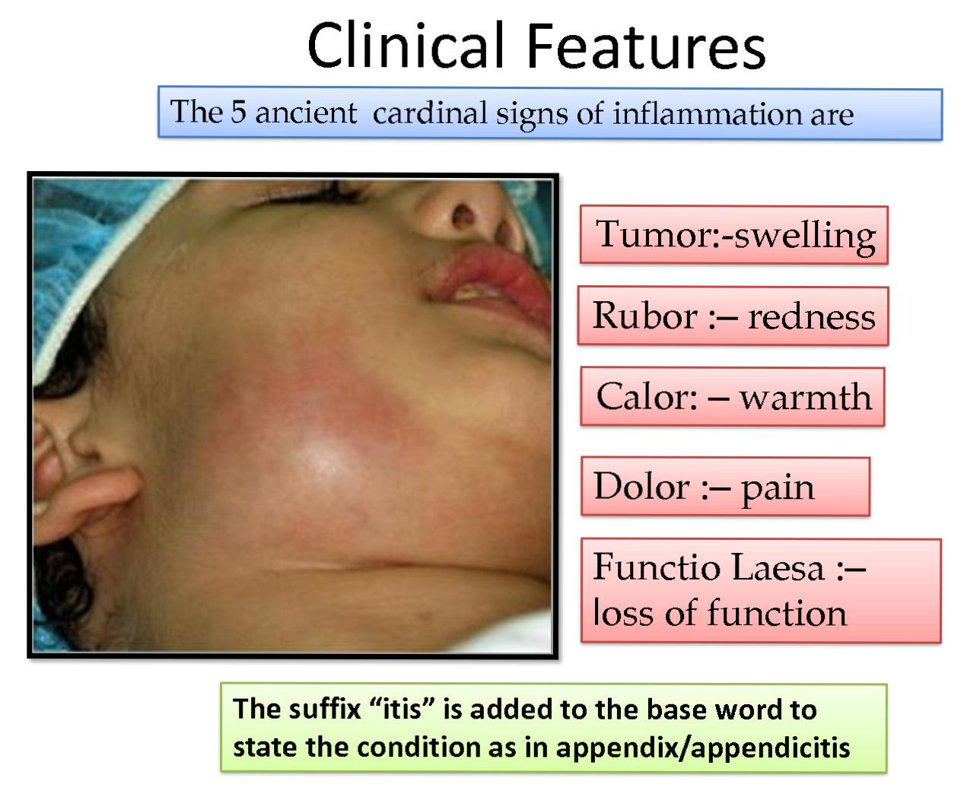
CARDINAL SIGNS OF INFLAMMATION

Slide 8
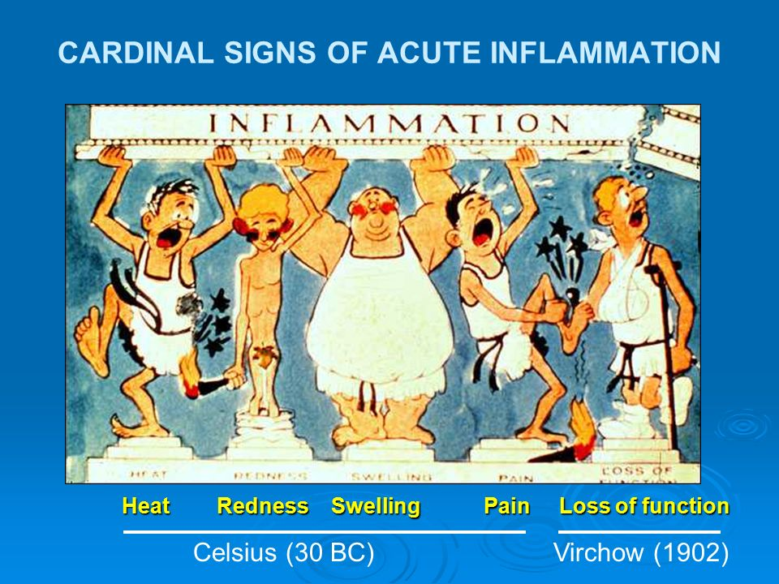

Slide 9
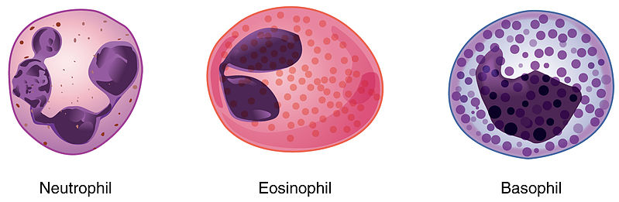
CELLS OF ACUTE INFLAMMATION

Slide 10
1. NEUTROPHIL
Also called as Polymorphs or Polymorphonuclear leukocytes(PMNL)
Range:20-30% of DLC
Size-12-15 micron
Spend <48 hrs in circulation
Heterophil-rabbit, guinea pig, domestic fowl
First line of cellular defence
Neutrophilia -inc. No. Of neutrophils
Neutropenia – dec. No. Of neutrophils

Slide 11
Microphages of Metchnikoff
Fxn : Selective but highly phagocytic
Bacterial infection –more recruitment of neutrophils
Main component of purulent(pus) exudates
Granulocyte Colony-Stimulating Factor(G-CSF) – stimulate growth of neutrophil

Slide 12
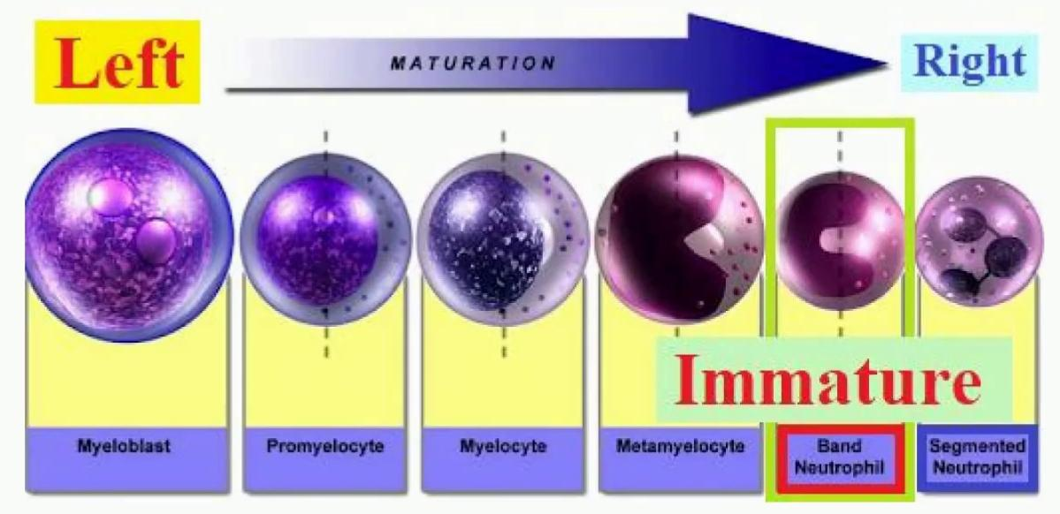
Schilling Index
Helps in determining the immature form of neutrophil in blood
Shift to left- more immature neutrophils
Shift to right- more mature neutrophils

Slide 13
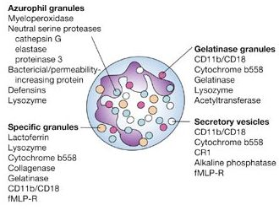
Granules Of Neutrophil

Slide 14
2.Eosinophil
Range- 4-6% of DLC
Bilobed, Very short lived
Parasitic infestation – more recruitment
Allergic rxn – inc. No. Of eosinophil in blood
Size-10-20 micron
Fxn: Killing of foreign body & allergen
Activated eosinophil – rich source of leukotrienes- esp. Leukotriene-C₄ + PAF

Slide 15
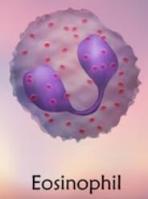
Eosinophil specific granules contain:
i.) Major basic protein- toxic to parasite + lysis of epithelial cells
ii.) Eosinophilic cationic protein(ECP)- directly toxic to epi. Cells
iii.)Eosinophil peroxidase- tissue damage by oxidative stress
Have mild phagocytic property
Eosinophilia-inc. No.
Eosinopenia- dec. No.

Slide 16
3. BASOPHIL/MAST CELL
Range: 0.5-1% of DLC
Nucleus: round, filled with bluish granules, fragmented nucleus
Involved in Type-I hypersensitivity due to histamine secretion from mast cells which have role in allergy
Size: 12-15 micron
Non phagocytic property
Fxn: produces –histamine, serotonin & heparin

Slide 17
Basophil contain a no. Of basophilic membrane bound granules –
Histamine
Eosinophil chemotactic factor(ECF)
Neutrophil Chemotactic factor(NCF)
Granule matrix derieved mediators-heparin
Neutral proteases- Tryptase

Slide 18
Property | Basophil | Mast cell
Produce | B.M. | Mesenchymal cells
Found in | Blood | Around tissues
Size | 12-15 micron | >30 micron
Nucleus | Bilobed | Without lobes
Cytoplasmic granules | Many | Few
Mitosis | Absent | Present

