Slide 1
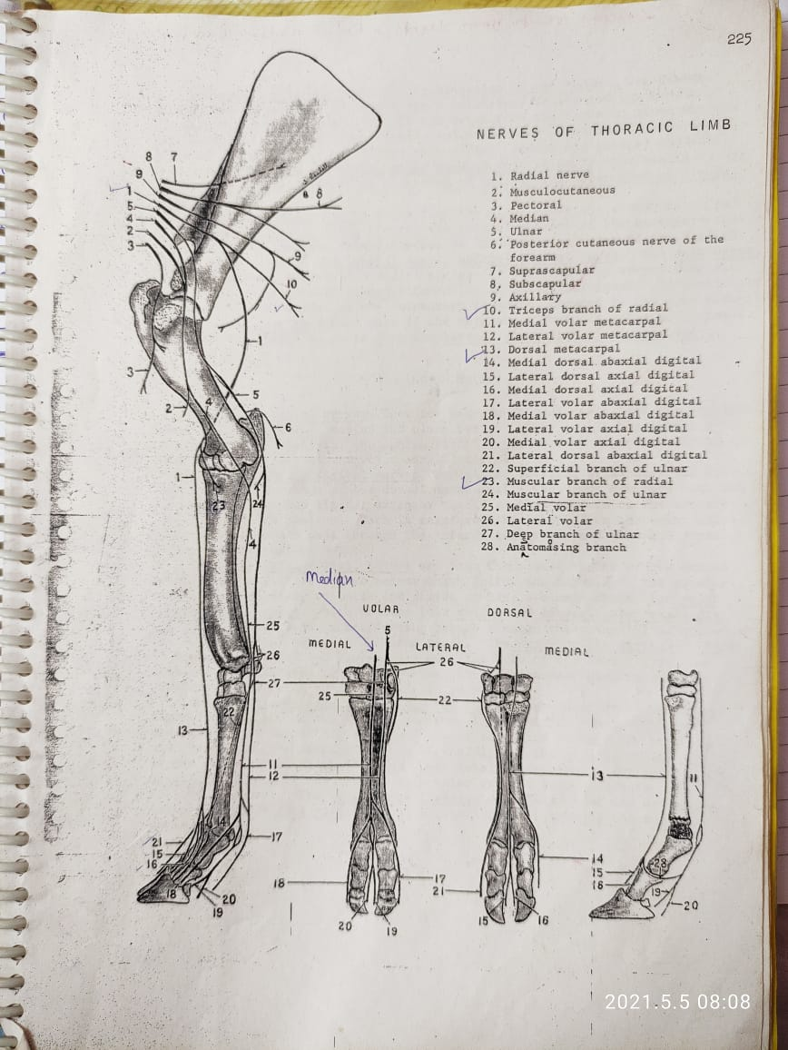
BRACHIAL PLEXUS
(31-01-22)
(23-0-2-23)
By
Dr. Abhinov Verma
Asstt. Professor
Department of Anatomy
DUVASU, Mathura (UP)

Slide 2
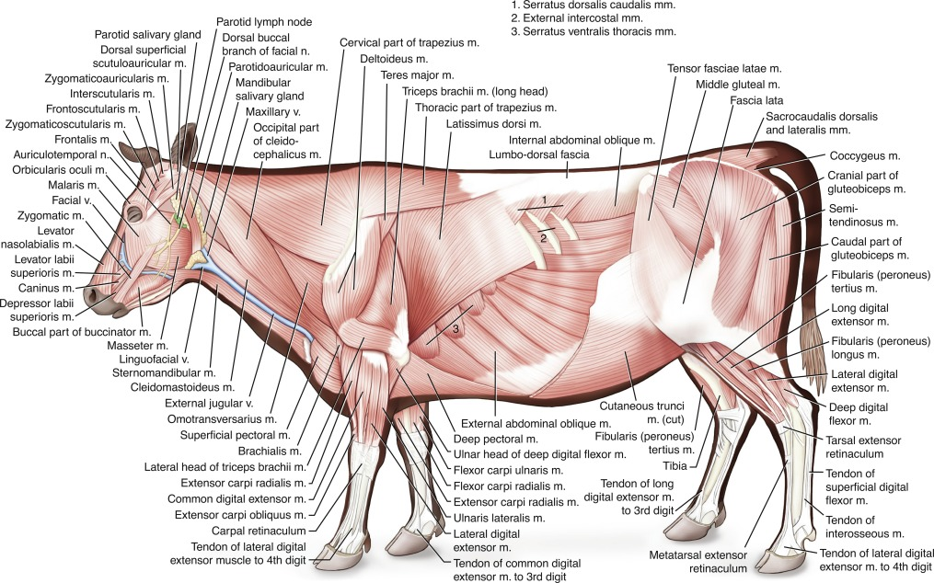

Slide 3
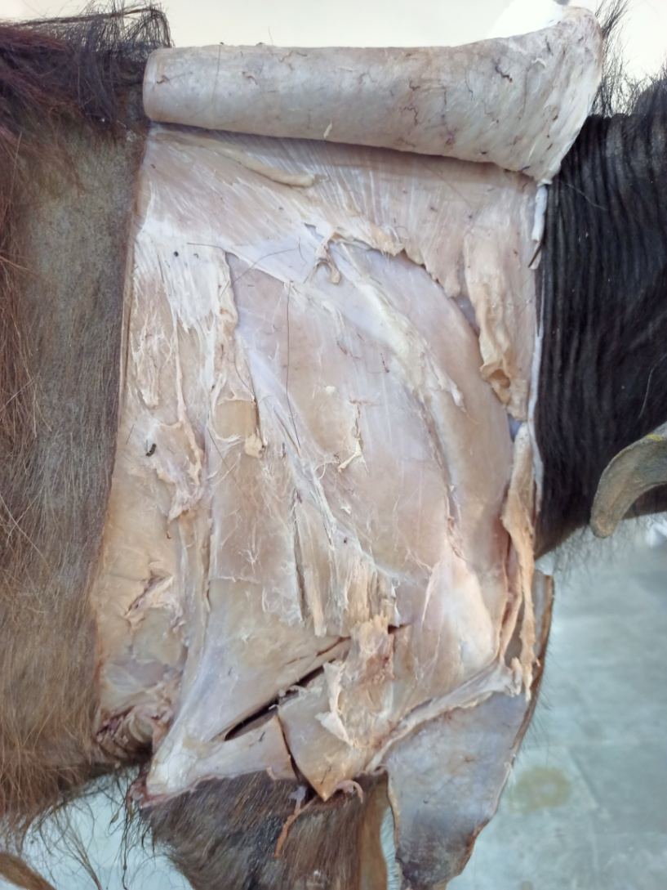
Trapazius
Supraspinatus
Infraspinatus
Tensor facia antibrachii
Deltoideus
Long head of triceps
Lateral head of triceps
Elbow joint
Lateral aspect of shoulder & arm

Slide 4
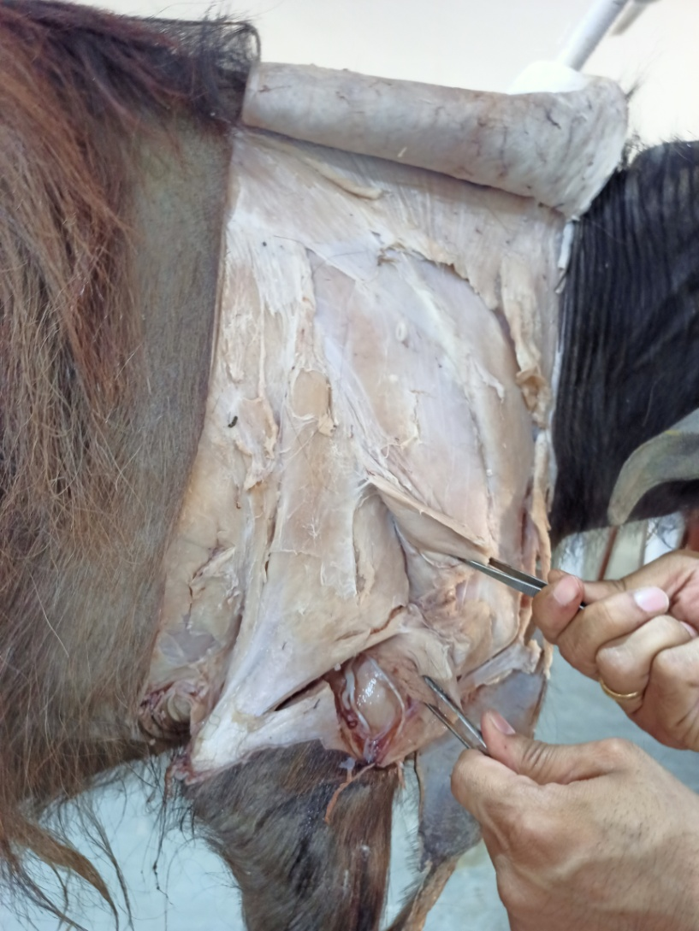
Deltoideus
Teres minor
Lateral head of triceps
Brachialis
Lateral aspect of shoulder & arm

Slide 5
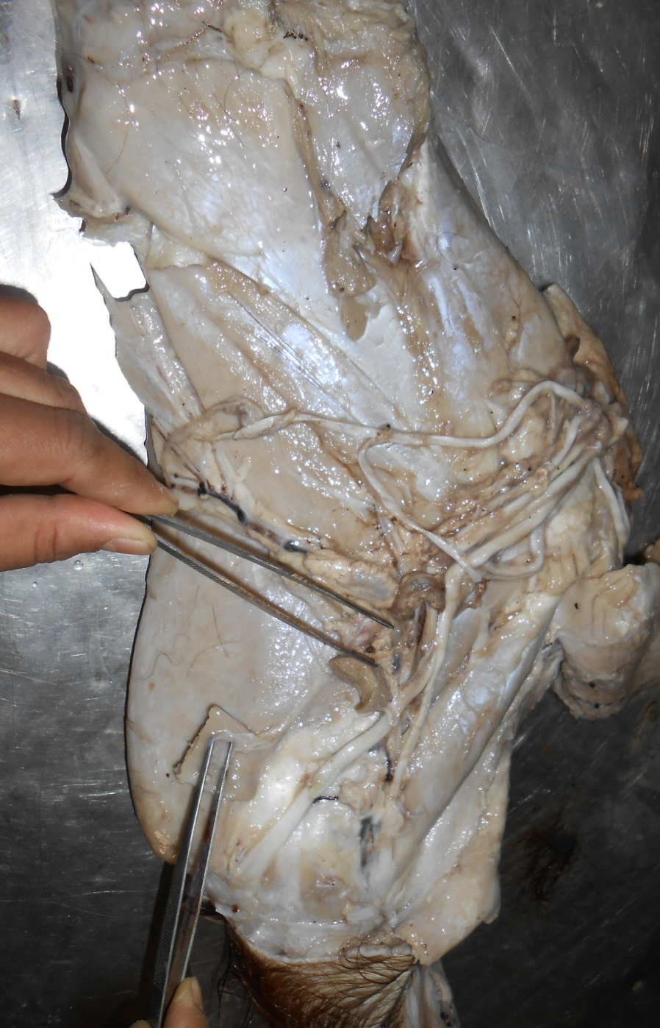
Subscapularis
Teres major
Coracobrachialis
Anconeus
Medial head of triceps
Brachialis
Medial aspect of shoulder & arm

Slide 6
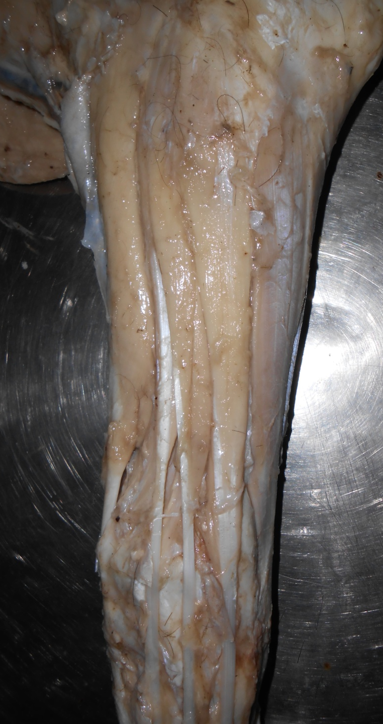
Muscles of Extensor group of fore limb
Extensor carpi radialis
Flexor ulnaris lateralis
Lateral digital extensor
Medial digital extensor
Common digital extensor
Extensor carpi obliquus

Slide 7
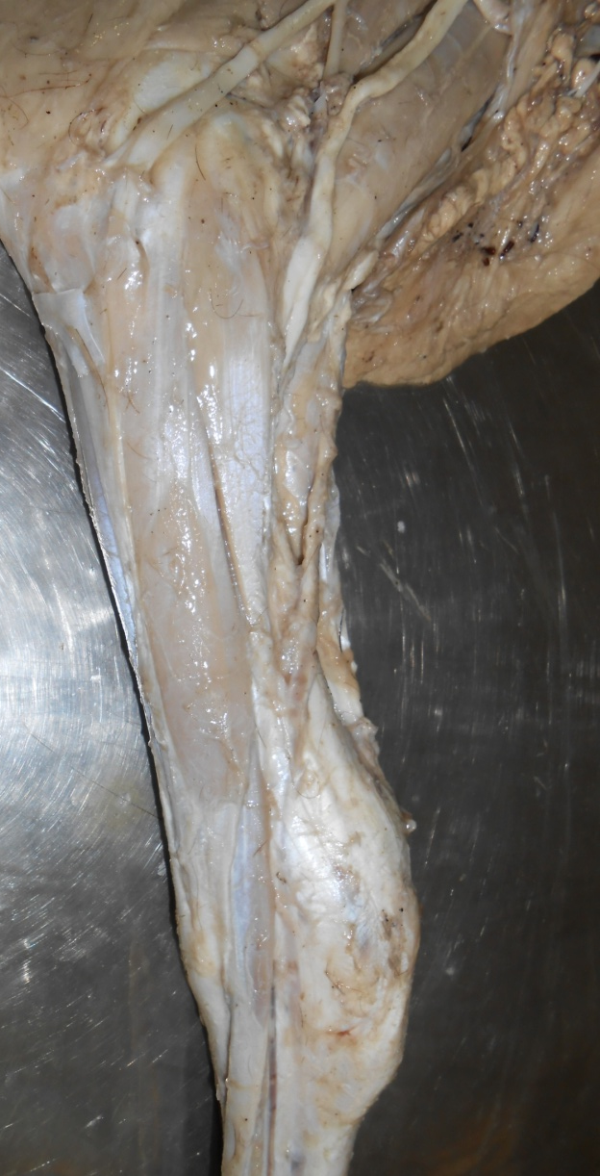
Flexor carpi ulnaris
Flexor carpi radialis

Slide 8
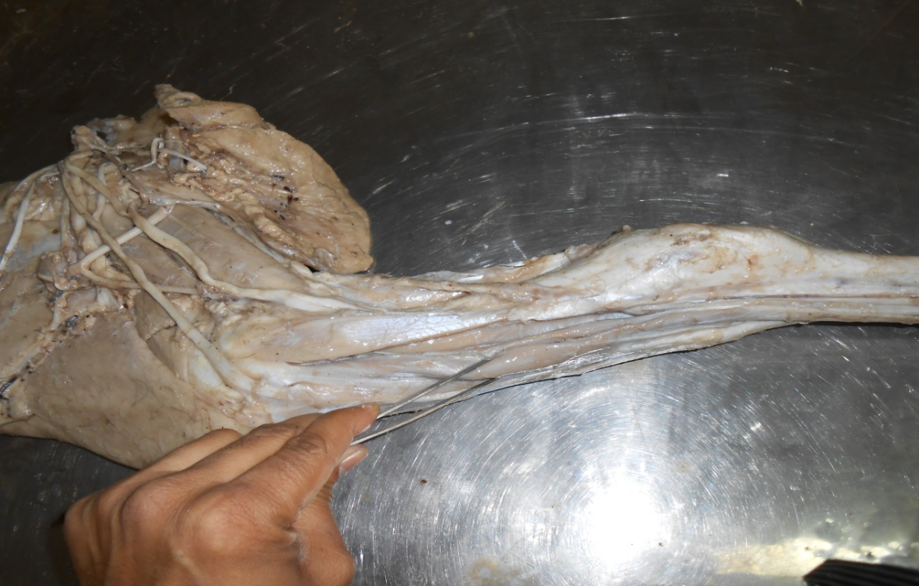
Muscles of Flexor group of fore limb
Ulnar head of
deep digital flexor
Superficial digital flexor
Humeral head of deep digital flexor

Slide 9
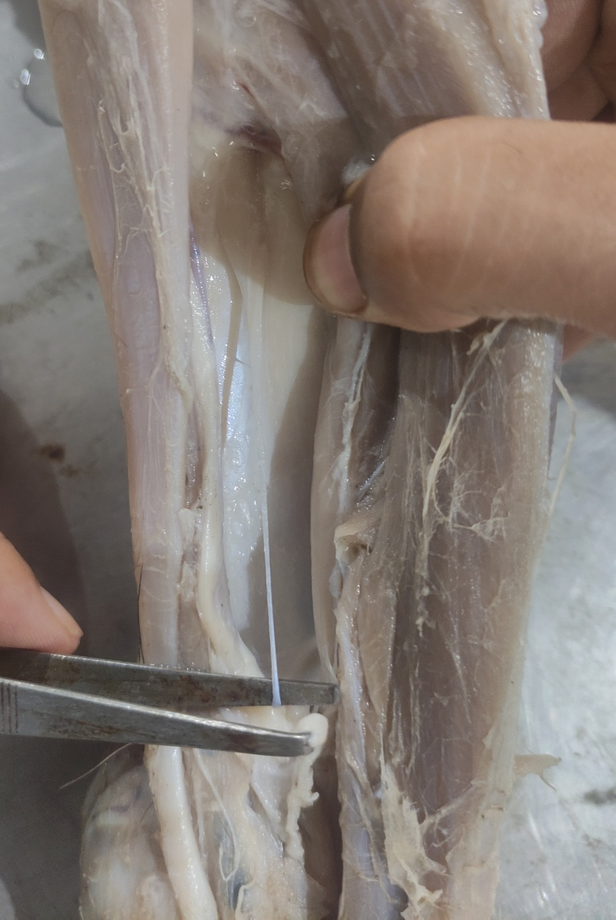
Radial head of
deep digital flexor

Slide 10
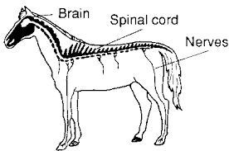
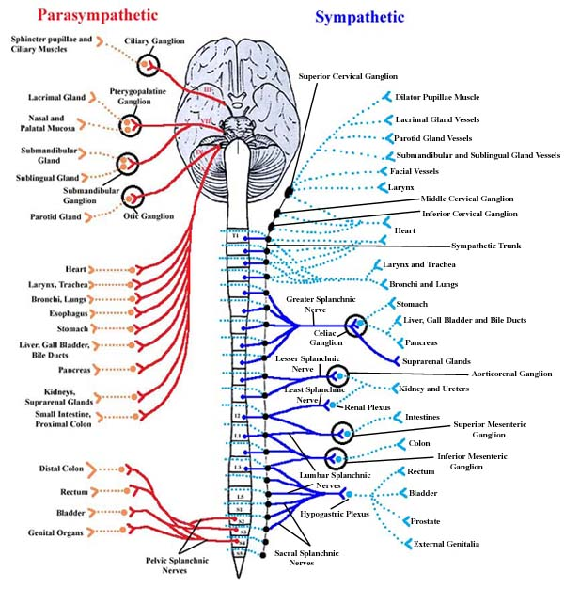
Nerve
Cranial and Spinal nerves:
Cranial nerves- Brain
Spinal nerve- Spinal cord

Slide 11
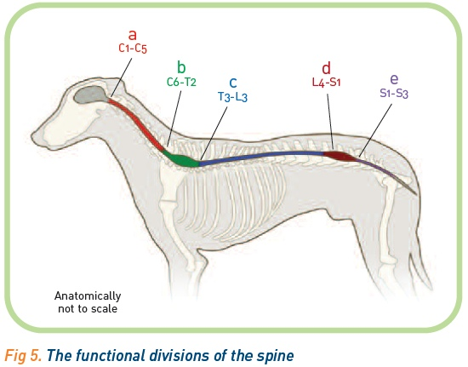
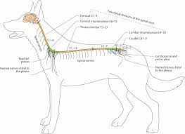

Slide 13
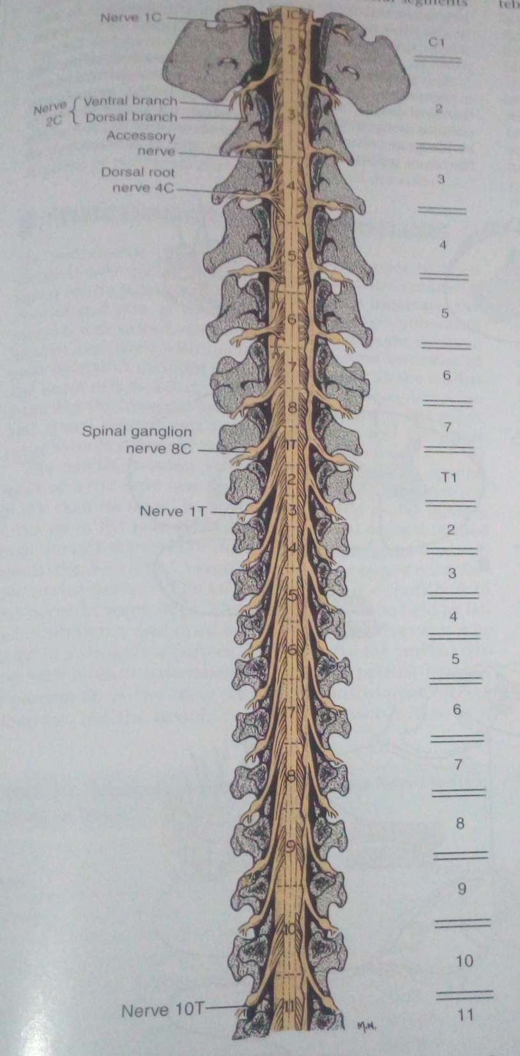
SPINAL NERVES (OX)
Leave the cord in pairs (37)
Cervical : 8(C1-C8)
Thoracic: 13(T1-T13)
Lumbar: 6
Sacral: 5
Coccygeal: 5

Slide 14
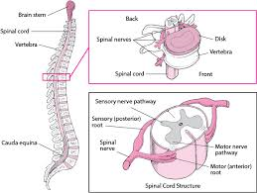

Slide 15
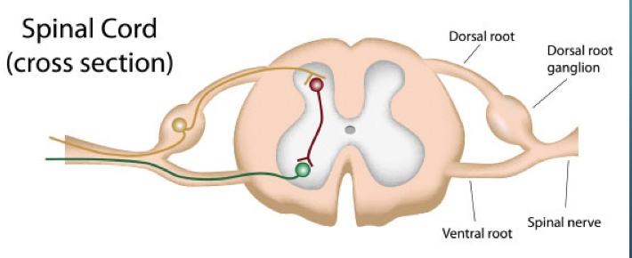
Each nerve is connected to the spinal cord by dorsal and ventral root.
Spinal nerves are formed by union of dorsal and ventral roots and leave the vertebral canal through intervertebral foramina and divide into dorsal and ventral branches.

Slide 16
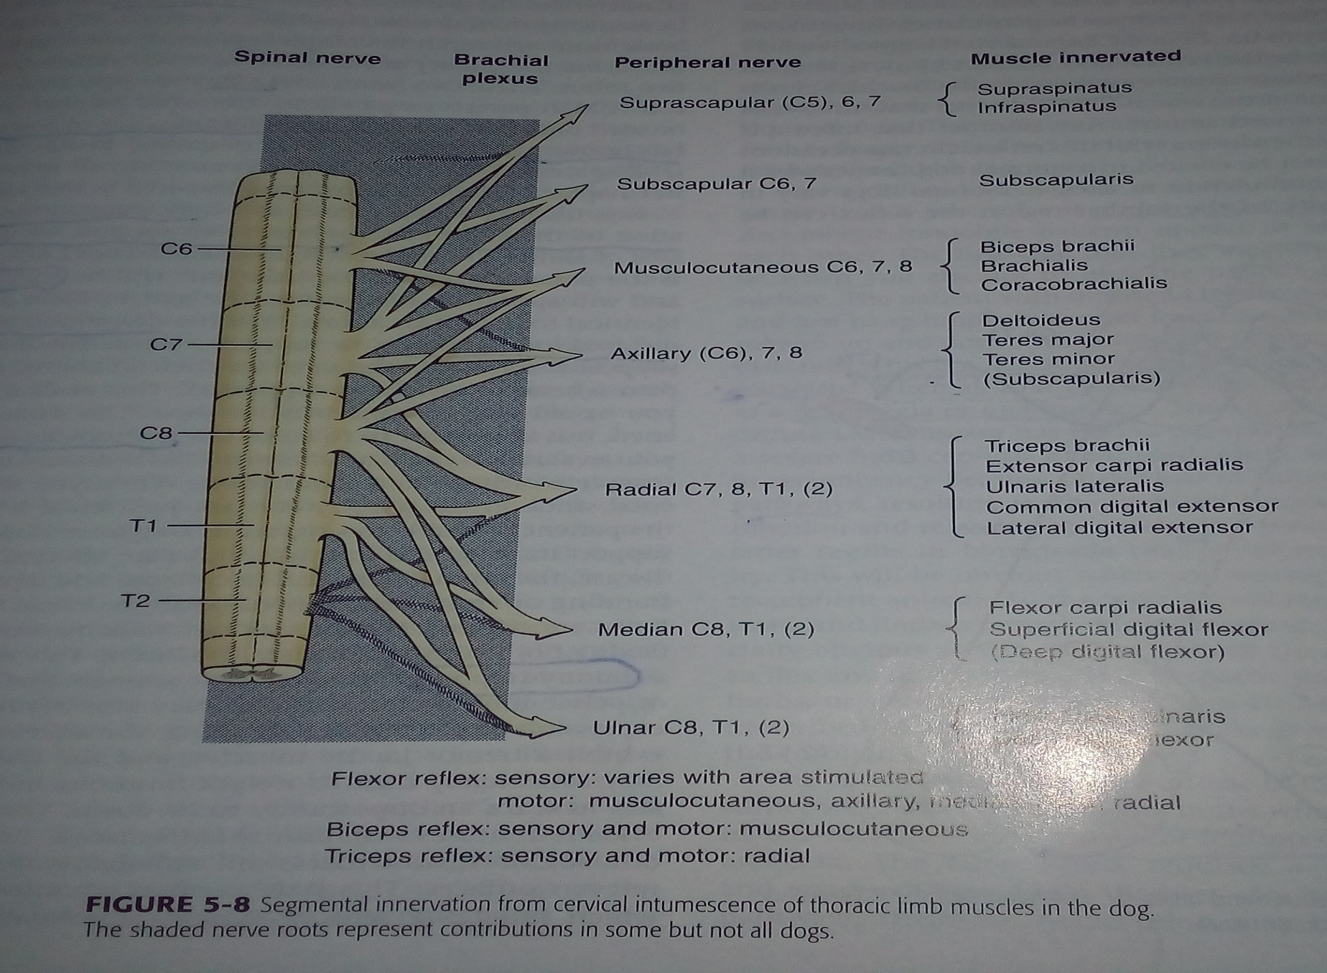
Brachial plexus

Slide 17
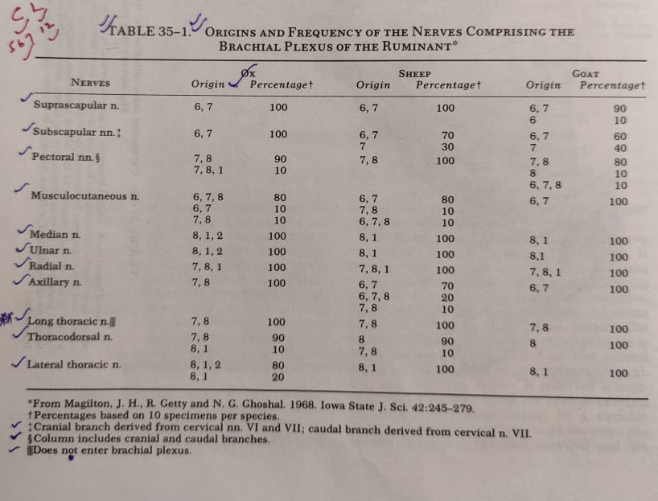
or external thoracic

Slide 18
BRACHIAL PLEXUS
Formed by anastomosis of ventral branches of last three or four cervical(C5,C6,C7 orC8)and first thoracic nerves(T1)spinal nerves. The second thoracic (T2)nerve may or may not contribute.
Appear as thick wide band between two parts of scalenus muscle and is covered by anterior deep pectoral and subscapularis
Branches-11
Distributed mainly to thoracic limb and muscles of pectoral girdle with exception of the trapazius and rhomboideus muscles.
The Median,ulnar &radial extends into digits

Slide 19
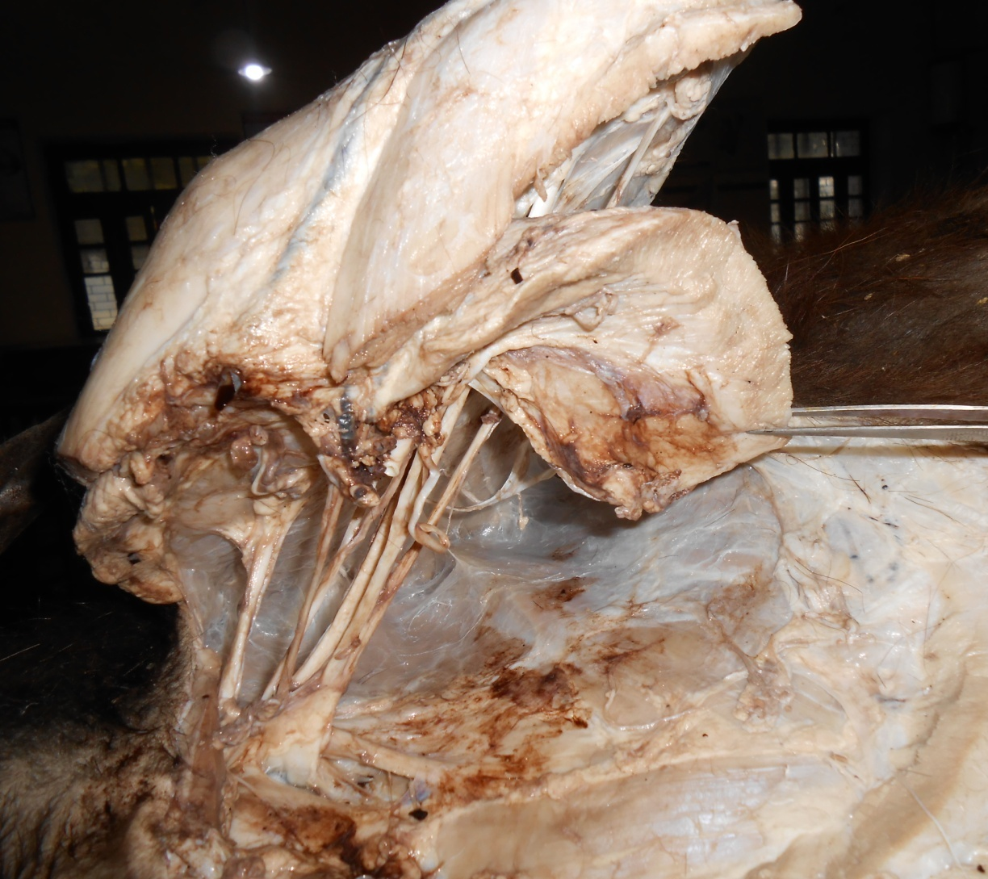

Slide 20
11 branches
Suprascapular
Subscapular
Axillary
Pectoral
External thoracic
Long thoracic
Thoracodorsal
8. Radial
9. Musculocutaneous
10. Ulnar
11. Median

Slide 21
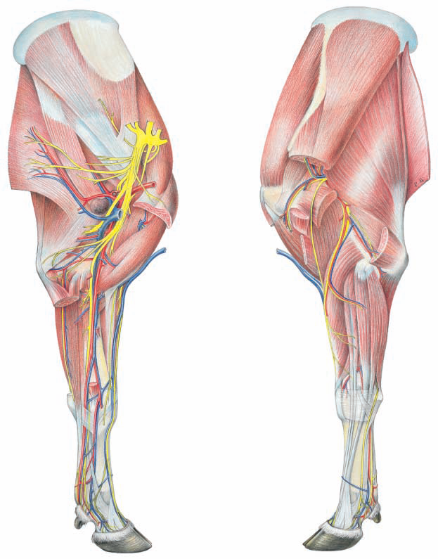
Suprascapular nerve
Subscapular
Thoracodorsal
Axillary
Radial
Musculocutaneous
Median
Ulnar
Pectorals
External thoracic
Long thoracic
RAT
MUM

Slide 22
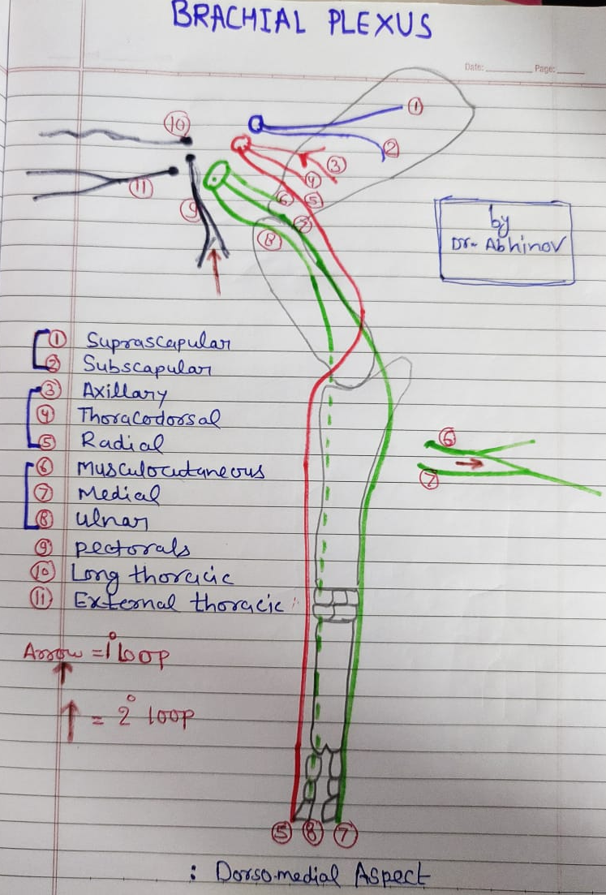

Slide 23
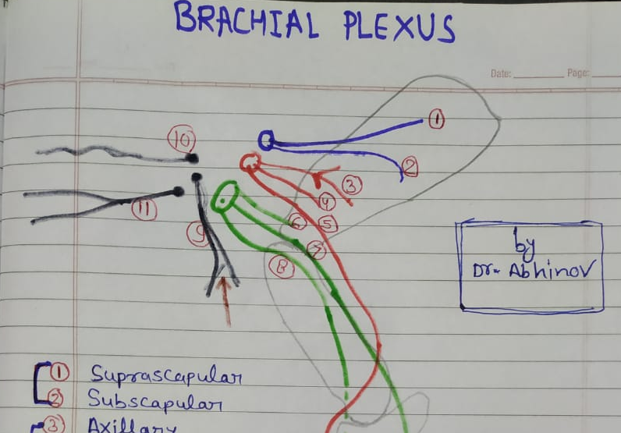

Slide 24
Muscles of Pectoral region
SN | Name of muscle
1. | Superficial pectoral
2. | Deep pectoral/ Pectoralis profundus

Slide 25
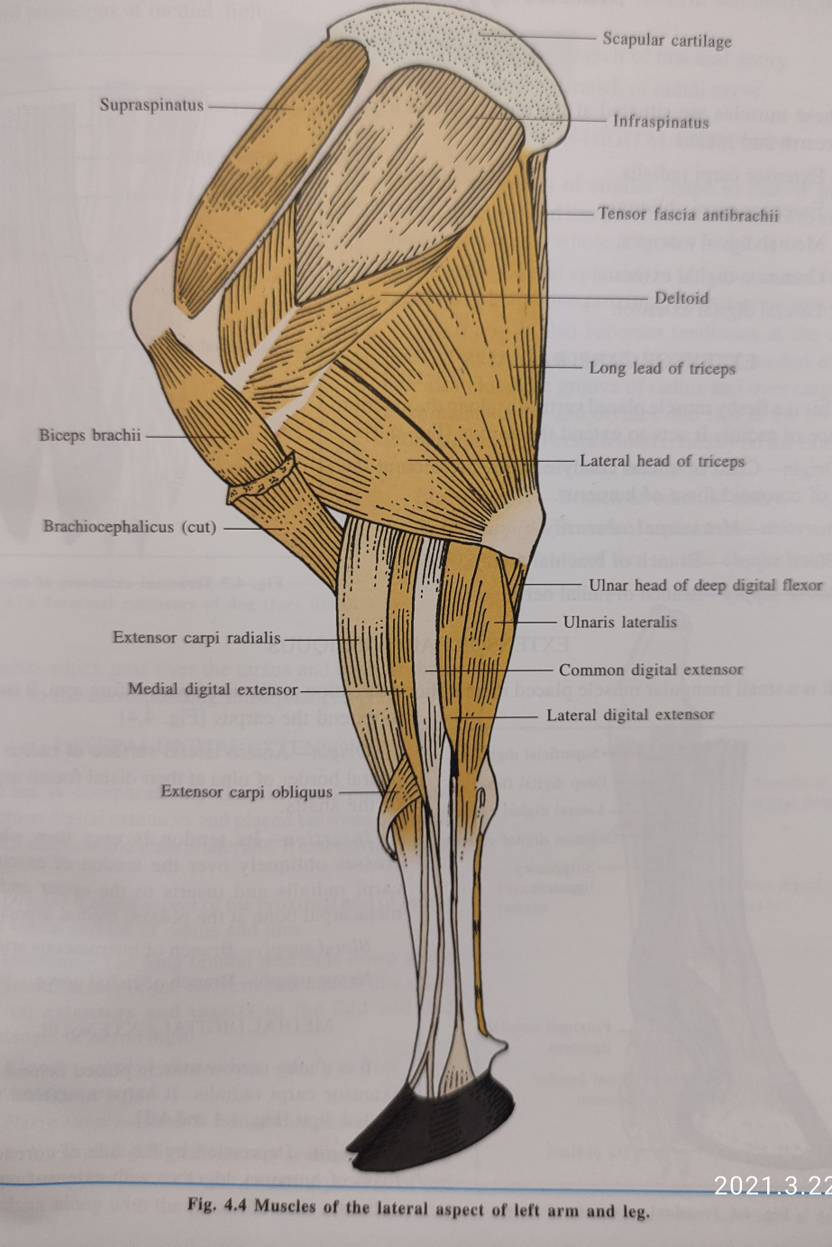
Muscles of Lateral aspect of Shoulder and arm
Trapazius
Supra spinatus
Infraspinatus
Deltoideus
Teres minor
Tensor fascia antibrachii
Long head of triceps
Lateral head of triceps
Brachialis

Slide 26
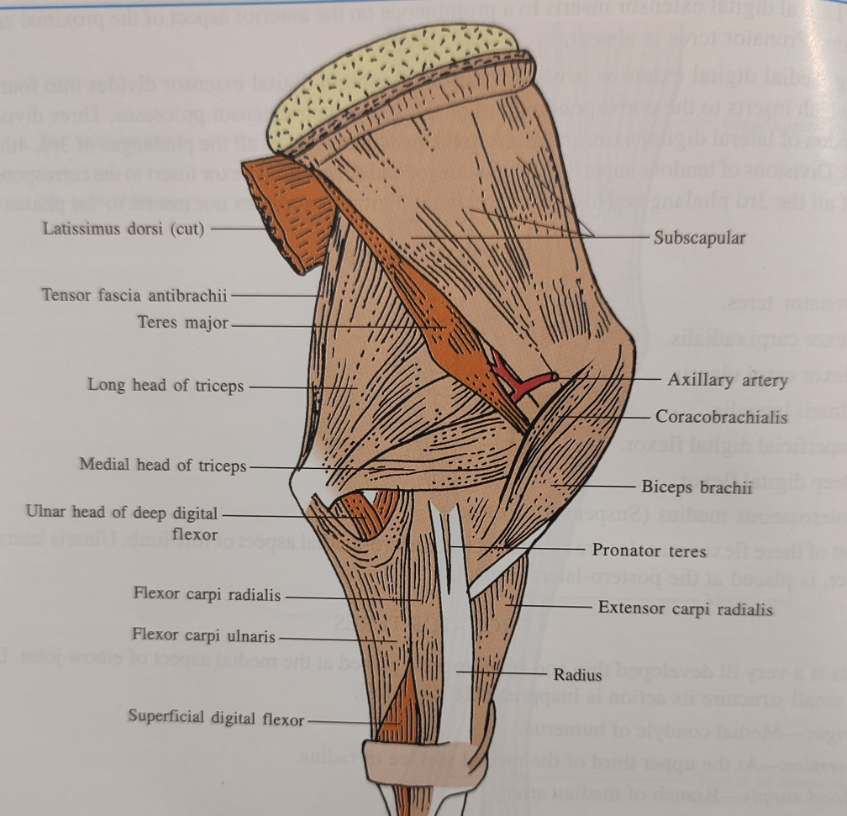
To attach with thoracic wall
Pectoral muscles,Serratus ventralis,Latissimus dorsi
Muscles of Medial aspect of Shoulder and arm
Subscapularis
Teres major
Biceps brachii
Coracobrachialis
Medial head of triceps
Anconeus

Slide 27
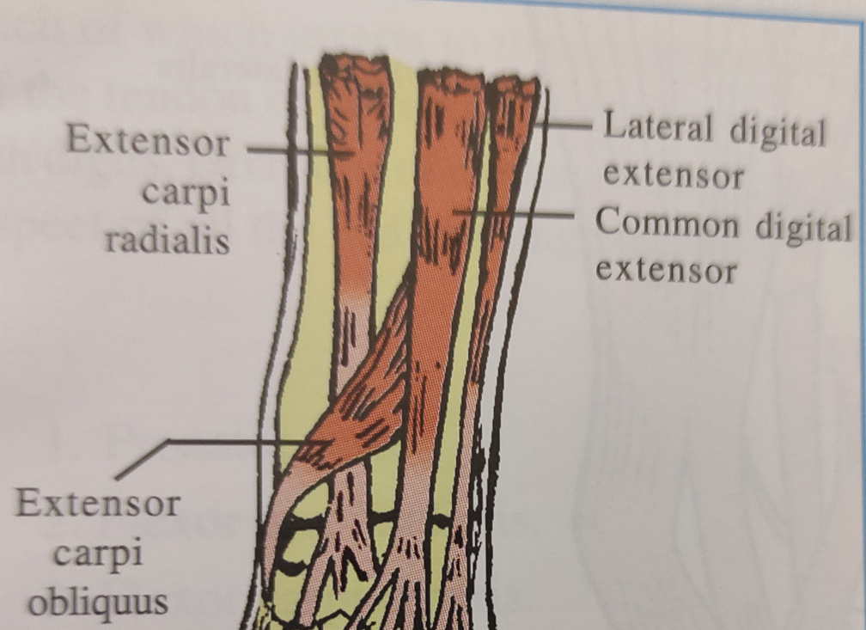
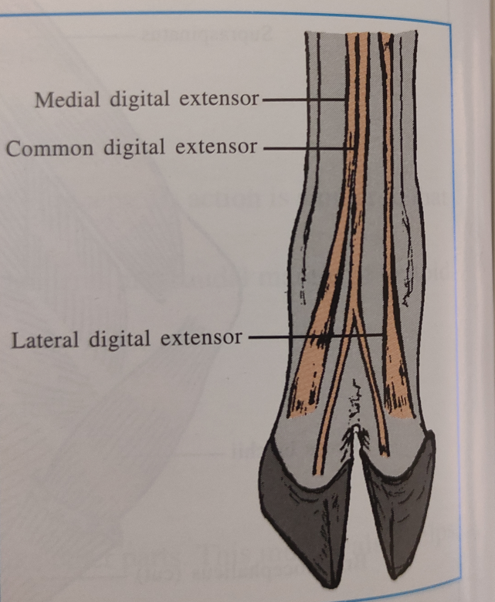
Muscles of Forearm and Manus:
A. Extensor division
Extensor carpi radialis
Extensor carpi obliquus
Lateral digital extensor
Medial digital extensor
Common digital extensor
Flexor ulnaris lateralis

Slide 28
Muscles of Forearm and Manus:
A. Flexor division
Flexor carpi radialis
Flexor carpi ulnaris
Pronator teres
Superficial digital flexor
Deep digital flexor
a. Humeral head
b. Radial head
c. Ulnar head

Slide 29
1. Suprascapular nerve:
Supplying supraspinatus and infraspinatus muscle
Suprascapular Nerve Paralysis- Shoulder Sweeny/Shoulder Slip:
It occurs due to injury/compression in suprascapular nerve resulting in atrophy of supraspinatus and infraspinatus muscles. It results in instability to weight bearing on shoulder. To treat the condition surgically decompression of suprascapular nerve is required.
2. Subscapular nerve:
Subscapularis muscles
3. Axillary nerve:
-Soon divides into 2-3 branches
Supplying posterior part of subscapularis and teres major muscles, teres minor, deltoideus and brachiocephalic muscle

Slide 30
4. Pectoral nerve:
Atleast 2 in number
Forming secondary loop below axillary artery
Deep pectoral Muscle (Superficial and anterior part)
5. External Thoracic Nerve
Dorsal branch- cutaneous trunchi muscle
Ventral branch- deep pectoral muscles (deep surface)
6. Long thoracic nerve
M. serratus ventralis
7. Thoracodorsal
M.Latissimus dorsi

Slide 31
8. Musculocutaneous
it give off a large branch that joins the median nerve forming a primary loop from which axillary artery passes.
Supply- coracobrachialis and biceps brachii muscle
9.Radial – on dorsomedial
10. Ulnar- posteriolateral
11. Median - posterior
Up to Digits

Slide 32
Frequently asked questions
Q.1 Nerves reach up to digits of forelimb?
Q.2 Nerve for extensors of forelimb?
Q.3 Nerves for flexors of forelimb?
Q.4 Which muscles are innervate by radial nerve?
Q.5 Which muscles are innervate by ulnar nerve?
Q.6 Which muscles are innervate by median nerve?

Slide 33
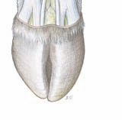
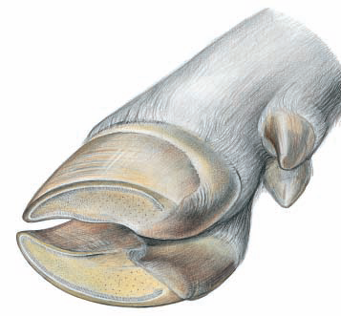
Complicated mode are digits innervation?
Total digits in one limb- 02 (lateral & medial)
Total surfaces- 08 to which we innervate by 03 nerve
Surfaces in 02 digits
1.medial (III digit )dorsal abaxial- radial
2.lateral (IV digit)dorsal abaxial- ulnar
3.medial dorsal axial-radial
4.lateral dorsal axial-radial
5.medial volar abaxial -median
6.lateral volar abaxial-ulnar + median
7.medial volar axial- median
8.lateral volar axial- median

Slide 34
As Radial nerve innervate- dorsomedial aspect of digit,
Ulnar- dorsal and posteriolateral aspect of digit,
Median- posterior aspect
Or
1. Dorsal aspect of digits- radial nerve except one(lateral dorsal abaxial- ulnar)
2. Volar/palmer aspect of digits- median nerve except one(lateral volar abaxial-ulnar + median)

Slide 35
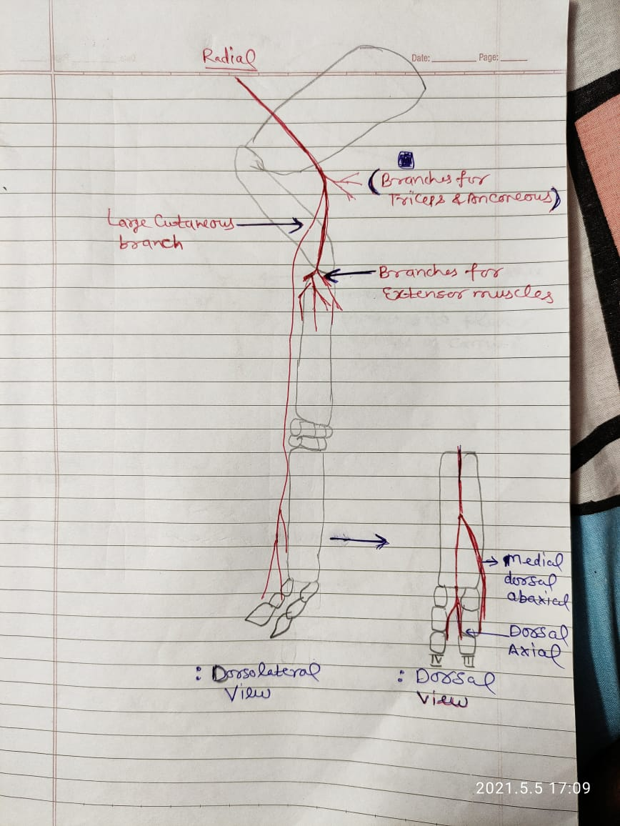
Radial nerve
Derived from posterior part of plexus.
It is thickest nerve of brachial plexus.
Descend down between long head of triceps and brachialis muscle.
Branches given to
1. To Lateral and medial head of triceps
2. To Muscle anconeus
3. Large cutaneous branch- crosses muscle brachialis and descends on dorsal surface of forearm, carpus and continue as dorsal metacarpal nerve

Slide 36
Parent trunk passes downward in musculospiral groove,crosses flexure surface of elbow joint and supply extensor muscles of fore limb and flexor ulnaris lateralis.
Dorsal metacarpal nerve:
Divided into 2 branches
Medial dorsal abaxial digital nerve: arise near middle of metacarpus
Dorsal axial digital nerve: near fetlock further divided into
A. Medial dorsal axial digital nerve
B. Lateral dorsal axial digital nerve

Slide 38
Radial Nerve Paralysis or Dropped elbow:
The condition caused due to trauma to the nerve by any reason. In this condition elbow seems dropped. For treating the condition the nerve stimulation by physical medicine is recommended.

Slide 39
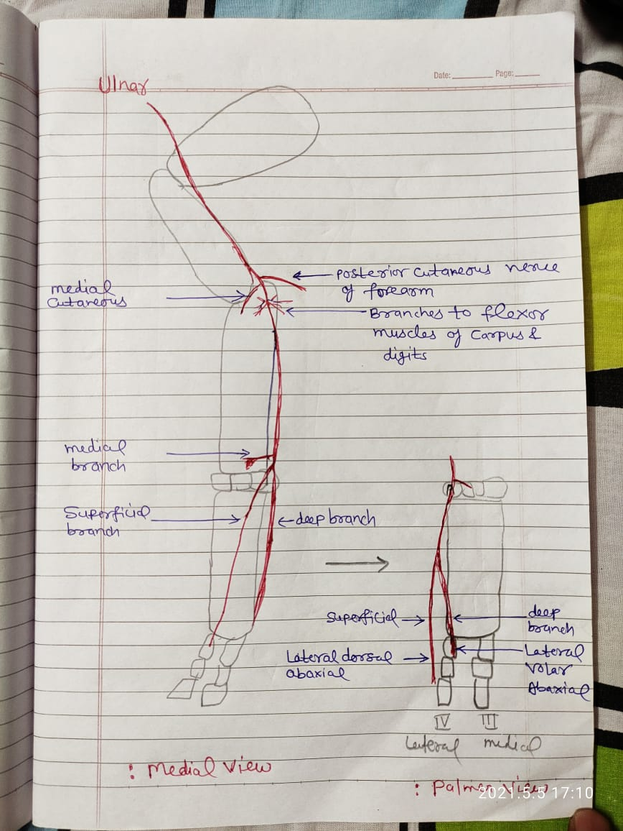

Slide 40
Ulnar nerve
Arise with median nerve in a common sheath under deep pectoral muscle.
Separate from median near middle of arm
Runs over medial epicondyle of humerus under ulnar head of muscle flexor carpi ulnaris to which it innervate.
Branches
Posterior cutaneous nerve of forearm
Medial cutaneous nerve of forearm

Slide 41
Parent trunk- give muscular branch as it crosses medial epicondyle of humerus and branches supply to flexor muscles as flexor carpi radialis, flexor carpi ulnaris, superficial digital flexor and ulnar head of deep digital flexor.
Divided into 3 branches a little above accessory carpal bone
1.Medial branch
2. Superficial branch
3. Deep branch

Slide 42
1.Medial branch: skin on volar surface of carpus
2. Superficial branch: passes downward on lateral surface of accessory carpal bone and follow lateral border of metacarpal bone up to fetlock joint and continue as lateral dorsal abaxial digital nerve
3. Deep branch: passes downward on medial surface of accessory carpal bone and continue as deep lateral metacarpal nerve and at distal part of metacarpal it joins median nerve to form lateral volar abaxial digital nerve

Slide 44
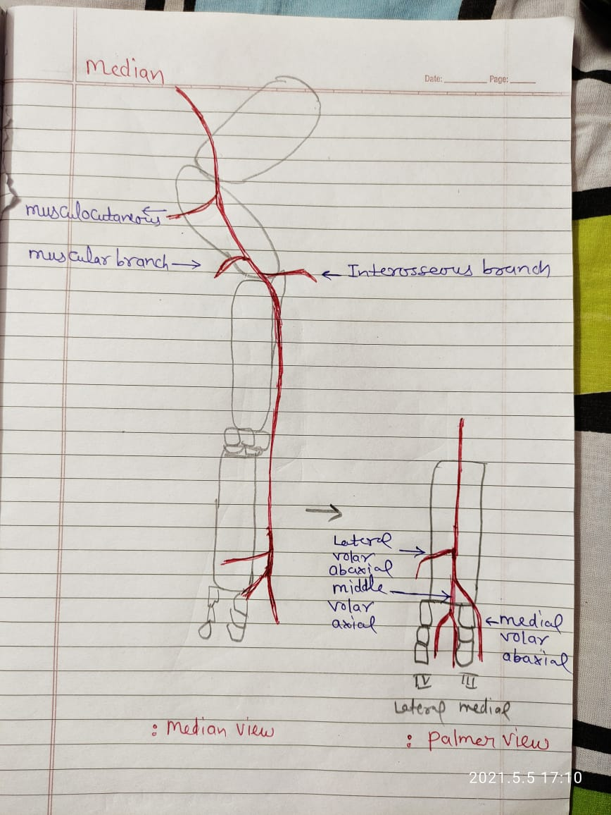
Median nerve
After separation from ulnar passes under M. pronator teres and goes to posterior surface of forearm and on metarpal as medial volar nerve
Before this gives following branches:
Musculocutaneous branch- at middle of arm to M.brachialis and continue as dorsal cutaneous nerve of forearm
Muscular branch- at between pronator teres and radius bone and supply to humeral head of deep digital flexor
Interosseous branch- enter in proximal interosseous space and supply radial head of deep digital flexor

Slide 45
Medial volar nerve:
It is continuation of median nerve.
At distal third of metacarpal divide into 3 branches
Medial branch: continue as medial volar abaxial digital nerve
Middle branch: as middle volar axial which further divided into medail and lateral branch
Lateral branch: as lateral volar abaxial with ulnar

Slide 47
See through comparison
Radial
Ulnar
Median

Slide 48
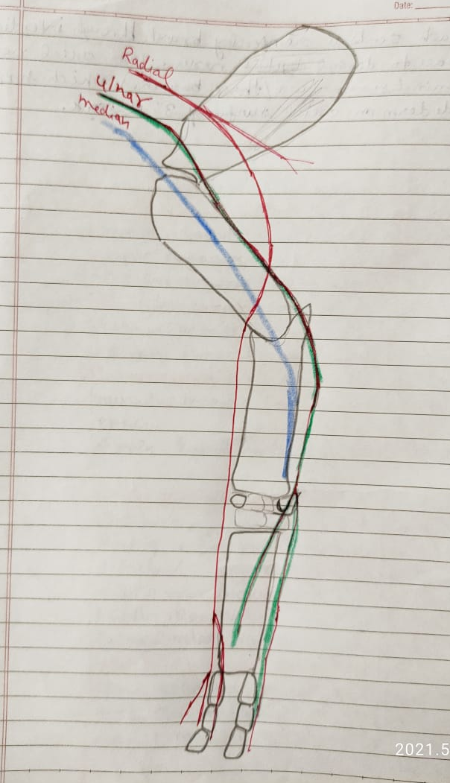
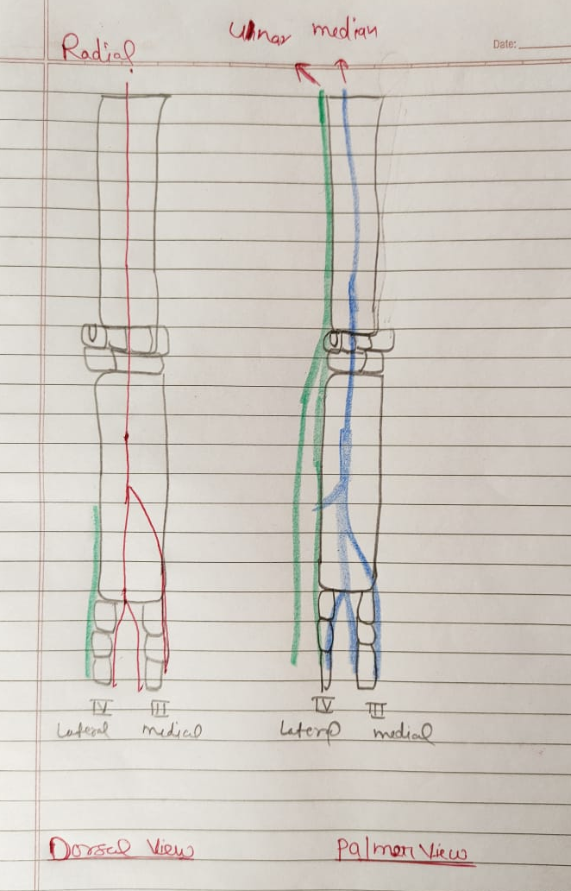
R-Dorsal
U-Posteriolateral
M-posterior

Slide 49
Radial – all extersor muscles and flexor ulnaris lateralis
Ulnar – to all flexor muscles except flexor ulnaris lateralis, radial and humeral head of deep digital flexor
Median - to certain flexors as radial and humeral head of deep digital flexor muscles

Slide 50
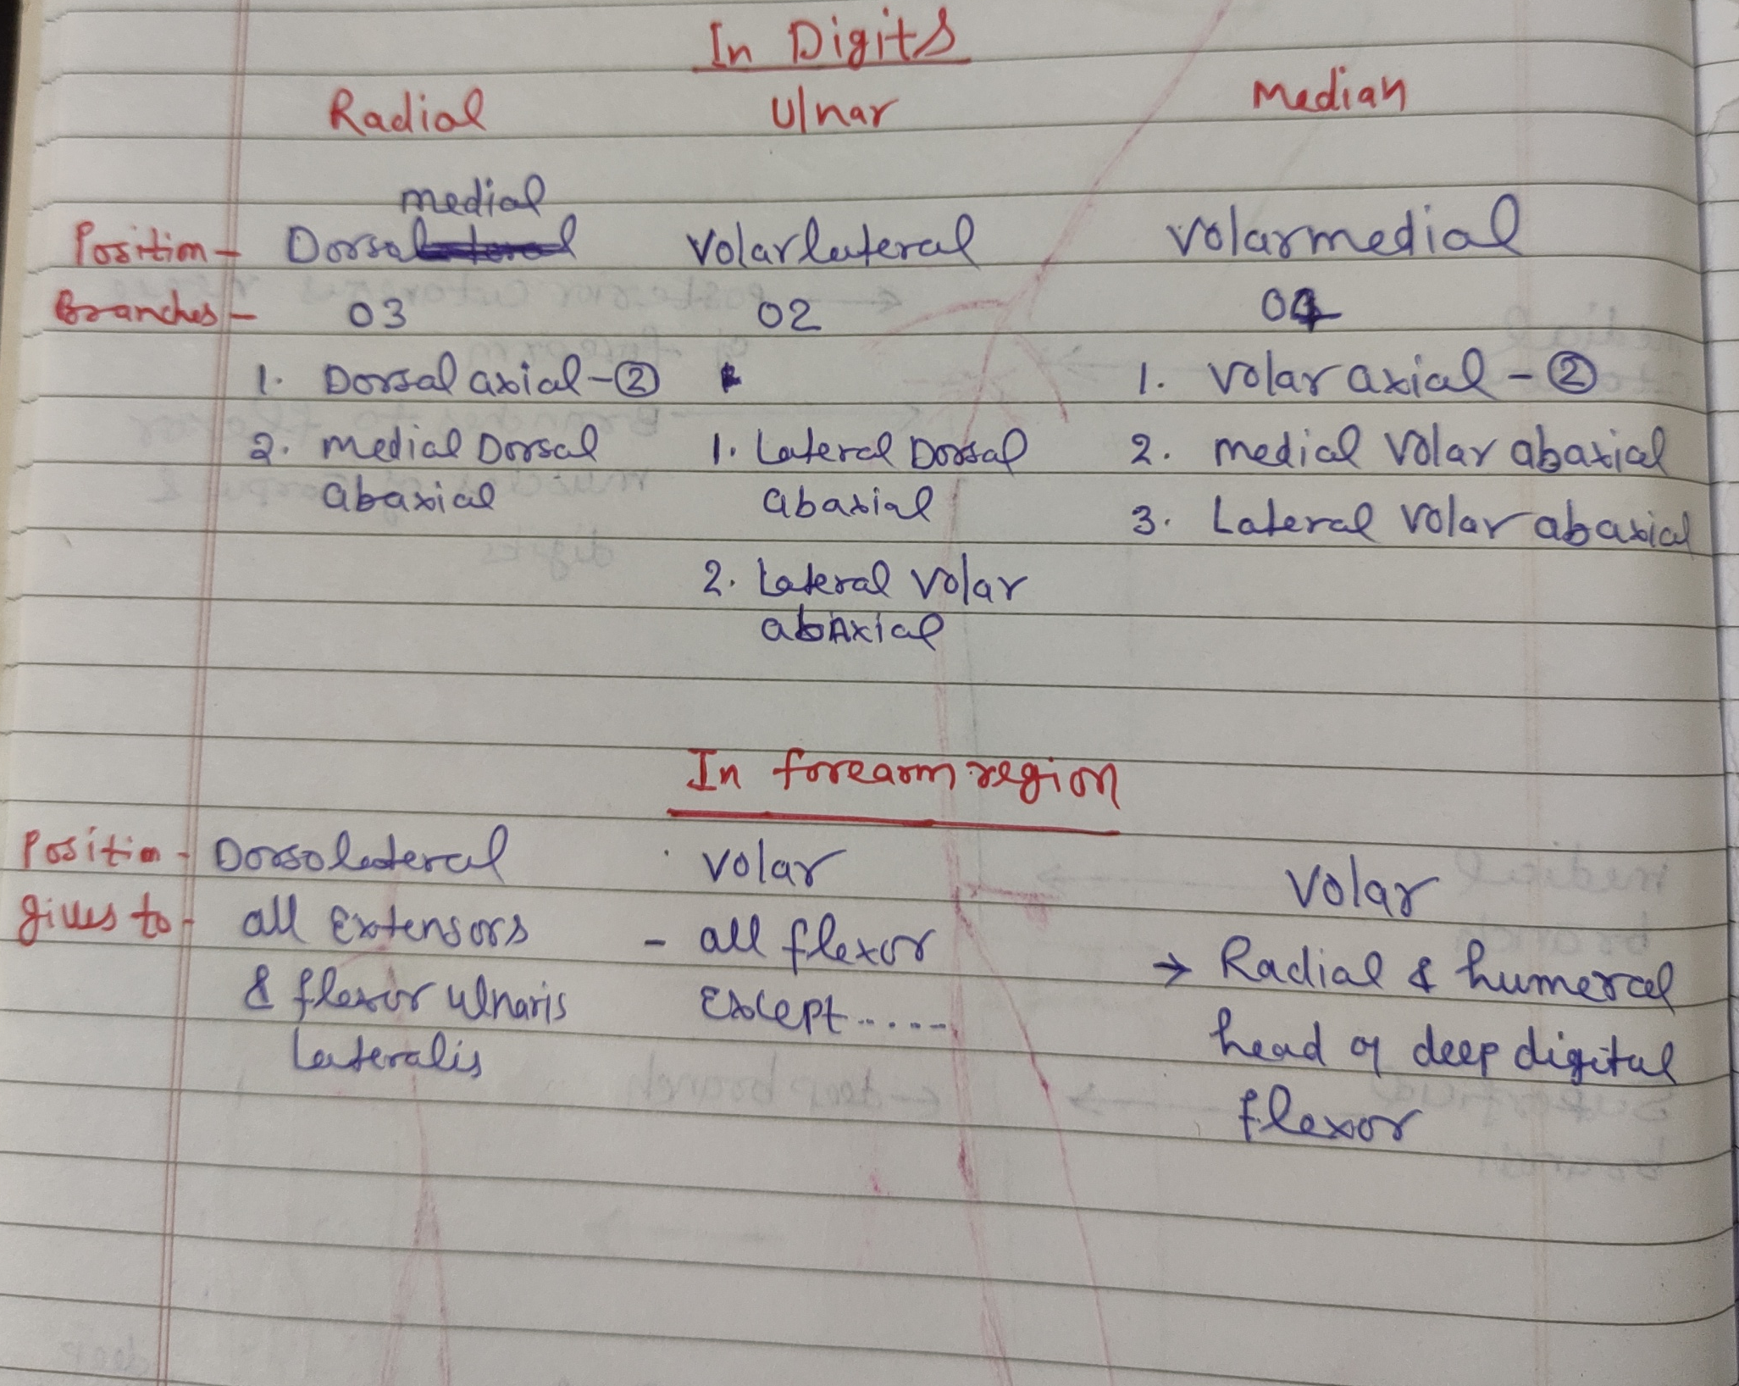

Slide 51
Thanks

Slide 52
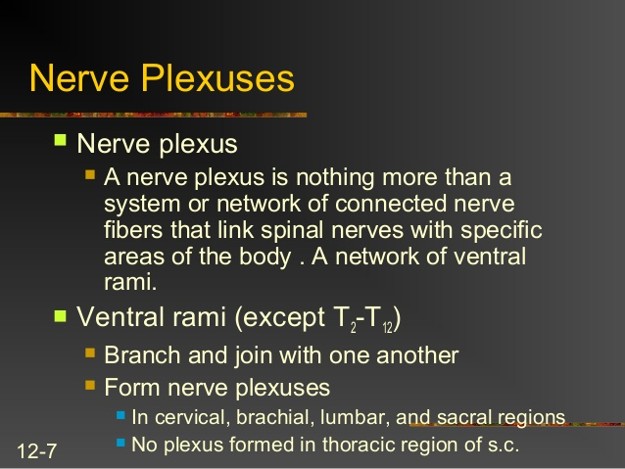

Slide 53
BRACHIAL PLEXUS
This is a flat fasciculus of nerves placed between the medial face of the shoulder and the thoracic wall.
It is formed by the convergence of ventral primary branches of 6th ,7th and 8th cervical and 1st and 2nd thoracic spinal nerves. The plexus appears as a wide, white band at first between the scalenus and longus coli and then between the two divisions of the scalenus. The subscapularis and deep pectoral muscles cover it.
Branches from the brachial plexus supply the muscles and integument of the forelimb and some of the muscles of shoulder girdle and chest wall.
Brachial plexus block: the fore limb may be drawn backward then the needle is inserted in the triangular depression bounded by the supraspinatus muscle, thoracic wall to the spine of the scapula.

Slide 54
Dorsal branches (smaller) Ventral branches (larger)
Dorsal region of the body Ventral region of the body
Spinal nerves
Dorsal root intervertebral foramen Ventral root
(afferent: cell process) (efferent: cell axons)
Spinal cord

Slide 55
SPINAL NERVES (OX)
Leave the cord in pairs (37)
Cervical : 8
Thoracic: 13
Lumbar: 6
Sacral: 5
Coccygeal: 5

Slide 56
Brachial plexus

Slide 57
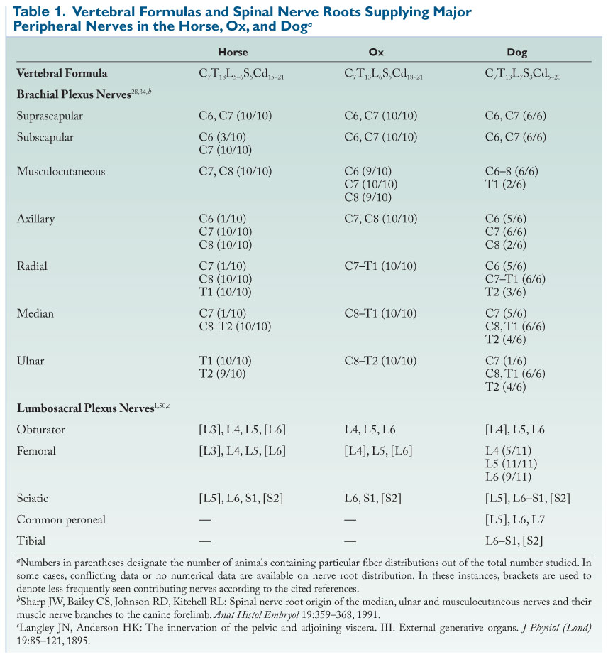

Slide 58
NANE OF NERVE | ORIGIN | COURSE | DISTRIBUTION
Suprascapular | Anaterior band 6C+7C | Passes forward on medial aspect of scapula and disappears between subscapularis and supraspinatus, then crosses anterior border of scapula and turns backwards and enters the infraspinatus muscle. | Supra & infra spinatus muscles
Subscapular | Anaterior band 6C+7C | Its two branches enter the medial surface of subscapularis muscle | Subscapularis muscle
Suprascapular Nerve Paralysis- Shoulder Sweeny/Shoulder Slip:
It occurs due to injury in suprascapular nerve resulting in atrophy of supraspinatus and infraspinatus muscles. It results in instability to weight bearing on shoulder. To treat the condition surgically decompression of suprascapular nerve is required.

Slide 59
 | Radial | Posterior part 7C+8C+1T | Passes downward lateral to subscapular vein and thoracodorsal vessel and nerve and disappears between triceps brachi muscle and humerus. Then continues downward between long head of triceps and brachialis muscle near the upper part of lateral supracondyloid crest. It is accompanied by muscular branch of subscapular artery. A large cutaneous branch crosses the brachialis muscle adjacent to the origin of extensor carpi radialis and under the lateral head of triceps. It descends under the deep fascia on dorsal surface of forearm and crosses the carpus and metacarpus. Above the fetlock it divides in to three dorsal digital nerves. | Triceps brachi, anconeus, brachialis extensor muscles of carpus and digits, ulnaris lateralis
Radial Nerve Paralysis or Dropped elbow:
It is thickest nerve of brachial plexus, innervating AII the extensor muscles of forelimb and ulnaris lateralis (flexor). The condition caused due to trauma to the nerve by any reason. In this condition elbow seems dropped. For treating the condition the nerve stimulation by physical medicine is recommended.

Slide 60
 | Axillary nerve | Anaterior and posterior band 7C+8C | It crosses the insertion of subscapularis muscle then passes laterally between subscapularis muscle and vessel posterior to shoulder joint. Then in deep face of deltoideus muscle divides in to several branches. Cutaneous branch immerges below the deltoideus and anastmoses with similar branch of radial nerve. | Deltoideus, teres minor, brachio-cephalicus, skin on anterior surface of fore arm
 | Thoracodorsal | Anaterior and posterior bands 7C+8C | It passes backward to the deep surface of lattissimus dorsi muscle and ramifies; the terminal branches follow the thoracodorsal vessel on muscle. | lattissimus dorsi muscle
Axillary nerve
Cutaneous branch of axillary
Cutaneous branch of radial
anastomoses

Slide 61
 | Musculocutaneous | Anterior part 6C+7C+8C | It crosses the lateral surface of brachial artery, gives off large branch which joins with median nerve forming a loop below the artery. Then it continues forward to the Coracobrachialis and then enters to the posteromedial surface of biceps brachi muscle. | Coracobrachialis biceps brachii, brachialis

Slide 62
 | Ulnar | 8C+1T+2T | It arises and follows the posterior border of median nerve, enclosed in a common sheath, under the deep pectoral muscle. At the middle of arm it is separated from the median nerve and passes downward and backward to the medial epicondyle of the humerus where it turns downwards under the ulnar head of deep digital flexor. The posterior cutaneous nerve of the fore arm arises from ulnar above the elbow joint. It follows the parent trunk over the medial epicondyle and divides into several branches which supply skin on the posterior and adjacent parts of the medial and lateral surface of the fore arm. A second branch, the medial cutaneous nerve of the forearm, arises from the distal border of ulnar nerve. It passes downward under the superficial pectoral muscle with a cutaneous branch of the ulnar artery and crosses the medial surface of the elbow joint. The ulnar nerve continues downward at first in a groove formed by the superficial digital flexor and ulnar head of the deep digital flexor muscle and then on the posterior surface of superficial digital flexor muscle to the distal fourth of the region under the antibrachial fascia. Passes downward under the flexor carpi ulnaris and terminates above the accessory carpal bone by dividing into three branches. Volar cutaneous carpal nerve: pierces the volar carpal ligament and ramifies in the skin. The superficial branch passes laterally between the flexor carpi radialis and ulnaris muscles and turns downward on the lateral surface of the carpus as Superficial lateral volar nerve: the deep branch passes downward on the medial surface of the accessory carpal bone in the carpal canal as deep lateral metacarpal nerve. A single muscular branch arises from the posterior border of nerve as it crosses the medial epicondyle of the humerus. | Skin of the fore arm,, flexor carpi ulnaris. Skin of volar surface of carpus Ulnar head of deep digital flexor and superficial digital flexor

Slide 63
 | Median | Posterior part 8C+1T+2T | Arises with ulnar nerve in a common sheath, musculocutaneous nerve joins the median below the artery forming a loop for the vessel. Ulnar nerve separates from median near the middle of the fore arm and inclines backward and downward. The median crosses the anterior border of the brachial artery and continues in this position to the elbow. Here it crosses the artery, passes under the pronator teres and continues along the postrerior surface of radius, covered by flexor carpi radialis, to the distal part of forearm, where it continues as medial volar nerve. Musculocutaneous branch: it arises at the middle of forearm and disappears between the humerus and biceps muscle, and continues as dorsal cutaneous nerve of forearm in accompany with cephalic vein for some distance. Muscular branch: arises when median nerve passes between the pronator teres and radius. It is directed downward and backward with muscular branch of median artery. Interosseous branch: arises little below the muscular branch, passes laterally between the humeral head of deep digital flexor muscle and radius and enters the proximal interosseous space. | Pronator teres, flexor carpi radialis, deep digital flexor and superficial digital flexor Biceps brachii, brachialis Flexor carpi radialis, flexor carpi ulnaris, humeral and radial heads of deep digital flexor

Slide 64
Radial nerve
Median nerve
Ulnar nerve
Cutaneous
Deep
Superficial
Volar cutaneous carpal
Medial
Lateral
Extensors of fore arm
Superficial lateral volar
Medial
Lateral
Abaxial
Axial
Abaxial
Axial
Abaxial
Axial
Dorsal lateral abaxial digital
Dorsal medial abaxial digital
Dorsal common axial digital
Medial volar abaxial digital
Volar common axial digital (suspensory ligament,flexor tendon & skin)
Lateral volar abaxial digital

Slide 65
 | Pectoral | Posterior band 7C+8C | Two branches immerge from medial to the musculocutaneous and median nerve, pass downward on either side and anastomose ventral to the brachial artery forming a 2nd loop below brachial artery. | Superficial and anterior part of deep pectoral muscle.
 | Lateral thoracic/ external thoracic | Posterior part of posterior band 8C+1T+2T | Divides in to dorsal and ventral branches near brachial vein. Dorsal branch passes backwards along dorsal border of deep pectoral muscle and ramifies in cutaneous trunci muscle. Ventral branch passes posterior on the deep surface of the deep pectoral muscle and ramifies in it. | deep pectoral, cutaneous trunci
 | Long thoracic | Anaterior band 7C+8C | After giving branches to serratus ventralis muscle, it passes backward to the superficial surface of muscle, gives off several branches dorsally and ventrally. | Serratus ventralis muscle

Slide 66
NERVE BLOCKS
Median nerve block:
Median nerve block is done for the diagnosis of lameness. The neurectomy is resorted to as a last measure to prolong the utility of draft animals in incurable disease conditions of limb.
The median nerve is a large nerve of the brachial plexus. In the forearm region the nerve is seen in the posteromedial aspect, beneath the pronator teres muscle.
Site of injection: Most superficial point, immediately below the medial tuberosity at the groove between the caudal border of radius and the flexor carpi radialis.
Ulnar nerve block:
The ulnar nerve arises with the median nerve from the thoracic component of the brachial plexus. In the forearm region, it descends down between the flexor carpi unlaris and ulnaris lateralis muscles.
Site of injection: About 4” above the upper border of the accessory carpal bone along a line joining the point of elbow with the accessory carpal bone. A hand breadth above the accessory carpal the nerve is situated between the flexor carpi ulnaris and ulanris lateralis just under the fascia of forearm. Desensitisation of the skin laterally above the carpus is an indication of a successful block.

Slide 67
Suprascapular Nerve Paralysis- Shoulder Sweeny/Shoulder Slip:
It occurs due to injury in suprascapular nerve resulting in atrophy of supraspinatus and infraspinatus muscles. It results in instability to weight bearing on shoulder. To treat the condition surgically decompression of suprascapular nerve is required.
Radial Nerve Paralysis or Dropped elbow:
It is thickest nerve of brachial plexus, innervating extensor muscles of forelimb and ulnaris lateralis. The condition caused due to trauma to the nerve by any reason. In this condition elbow seems dropped. For treating the condition the nerve stimulation by physical medicine is recommended.
Capped Elbow or hygroma or elbow seroma or olecranon bursitis:
It is a fluid filled cavity surrounded by a dense fibrous connective tissue due to inflammation over the olecranon bursa. Growth become harder with lesser amount of fluid if not removed.
Canine elbow is entirely surrounded by olecranon bursa just beneath the skin for smooth gliding of skin over the olecranon.

