Slide 1
CALCIFICATION
Department of Veterinary Pathology

Slide 2
What is Physiological Calcification ?
Calcification in Bones and Enamel.
Pathological Calcification
Definition
Deposition of calcium salts in tissues other than osteoid or enamel is called Pathological calcification.

Slide 3
Types of Pathological Calcification
1.Dystrophic Calcification
If calcification occurs in dead degenerative tissues
2.Metastatic Calcification
If calcification occurs in apparently normal tissues

Slide 4
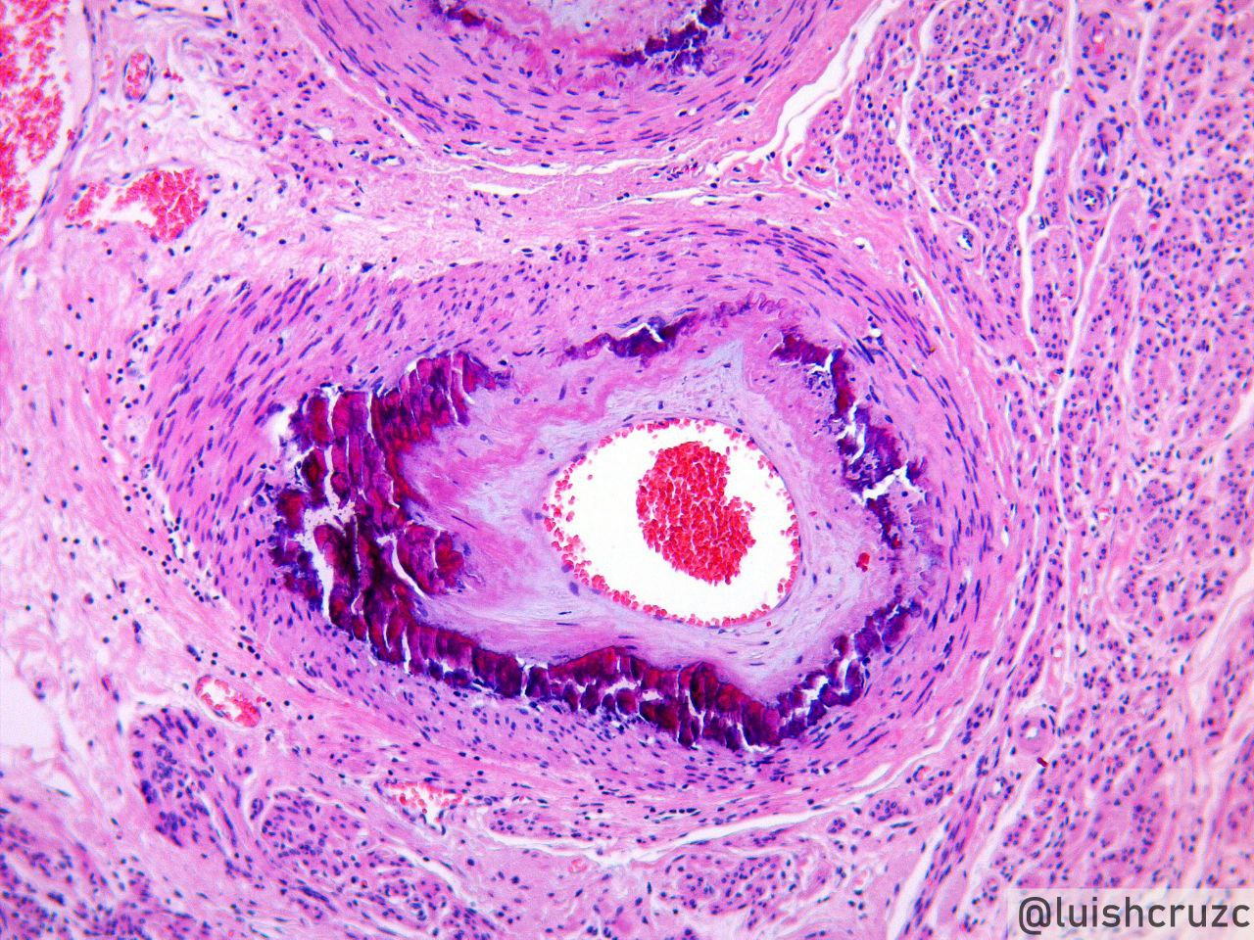
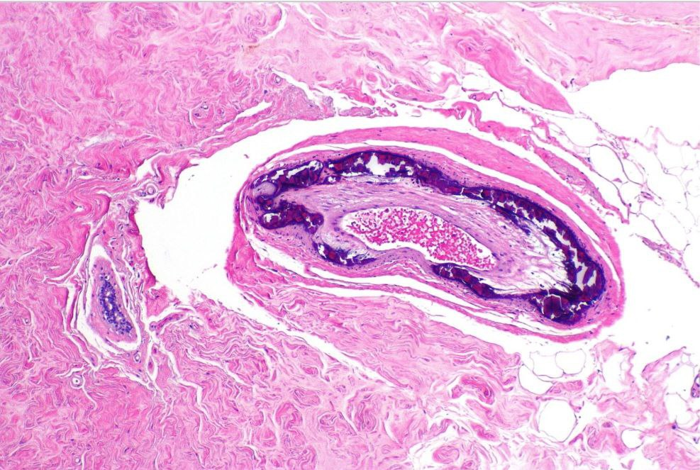
H & E Staining of Calcification
Calcium salts appears as Deeply basophilic, irregular and granular clumps.
Medial Calcification (Arteriosclerosis)
Medial (blood capillary) Calcification

Slide 5
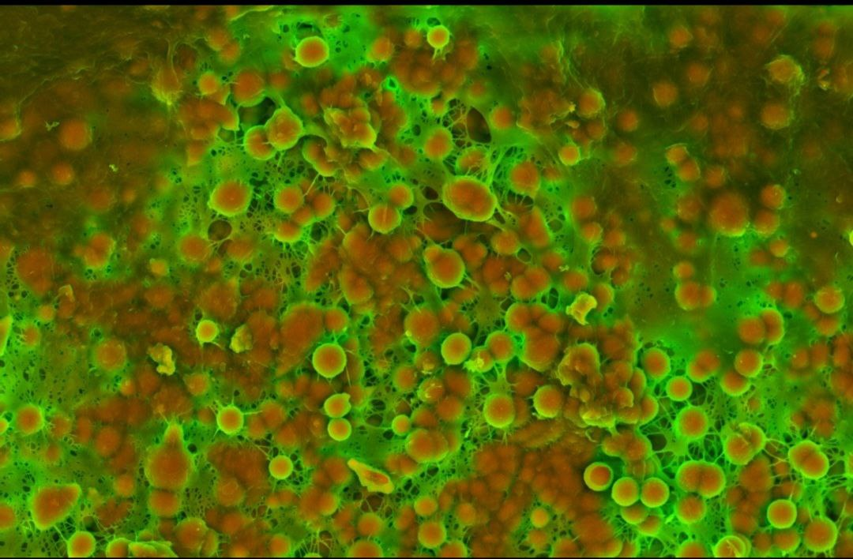
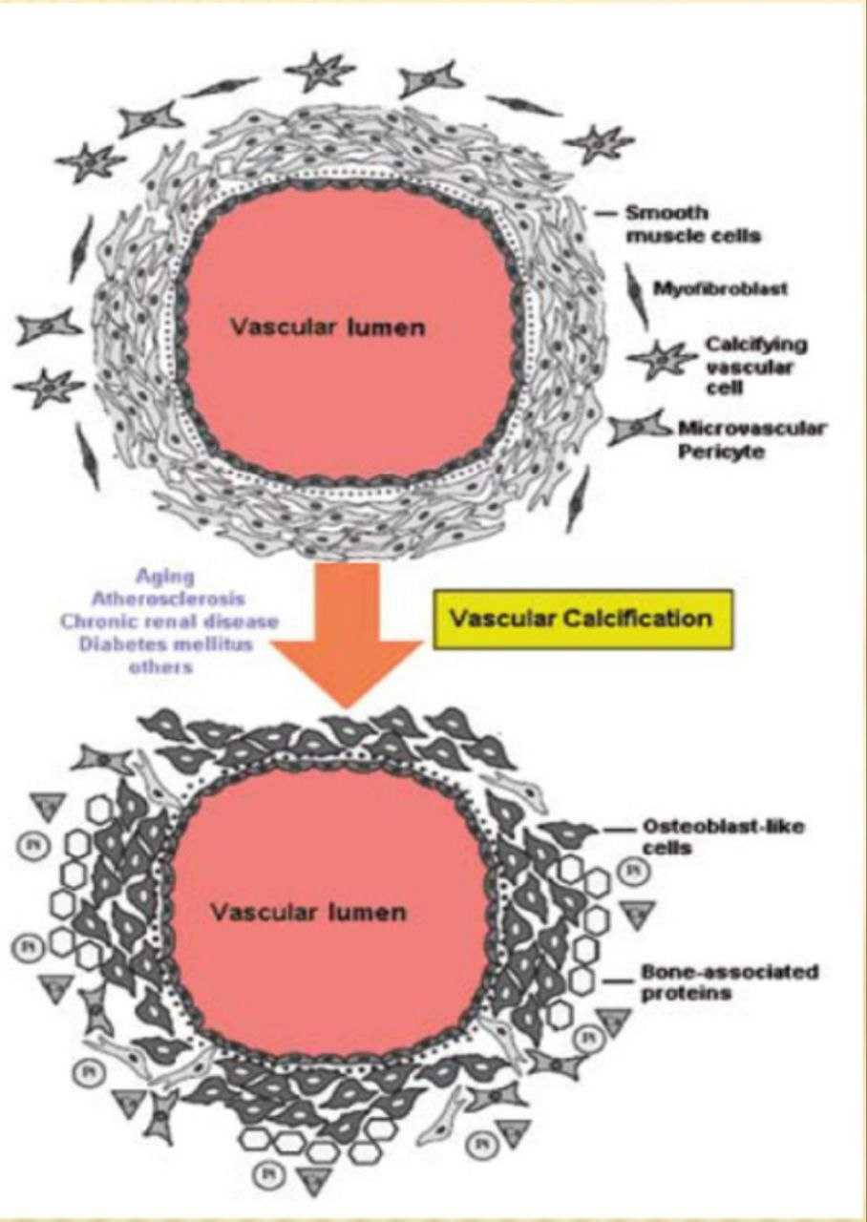
Density-Dependent Colour Scanning
Electron Micrograph SEM (DDC-SEM)
of cardiovascular calcification,
showing in orange calcium phosphate
spherical particles (denser material)
and, in green, the extracellular matrix
(less dense material).

Slide 6
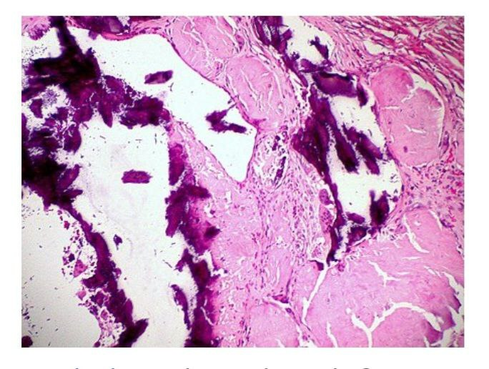
Sites for Dystrophic Calcification
Calcification in dead tissue
1. Caseous necrosis in tuberculosis is the mostcommon site for dystrophic calcification.
Calcified tuberculous lesions
Hilar lymph nodes
lung alveoli

Slide 7
Sites for Dystrophic Calcification
2. chronic abscesses - Liquefaction necrosis, it
may get calcifed.
3. Fat necrosis following acute pancreatitis or
traumatic fat necrosis.
deposition of calcium soaps
4. Gamna-Gandy bodies in chronic venous congestion (CVC)

Slide 8
Sites for Dystrophic Calcification
5. Infarcts may sometimes undergo
dystrophic calcification
6. Thrombi, especially in the veins, may produce
phleboliths.

Slide 9
Sites for Dystrophic Calcification
In Degenerated Tissue
1. Dense old scars may undergo hyaline
degeneration and subsequent calcification
2. Atheromas in the aorta undergo calcification
3. Mönckeberg's sclerosis shows calcification in the
tunica media of muscular arteries

Slide 10
Pathogenesis of dystrophic Calcification
Occurs by formation of crystalline calcium phosphate.
It occurs in 2 phases . (A) Initiation [or nucleation] (B) Propagation [extension]
Initiation – occurs intracellularly in mitochondria of dead cells
occurs extracellularly in membrane bound vesicles [matrix vesicles in normal tissues]
Propagation- it occurs after Initiation. Propagation of crystal occurs.
It depends on – (a) Ca & phosphate concentration in extracellular spaces.
(b) Presence of mineral inhibitors
(c) Degree of collagenization

Slide 11
METASTATIC CALCIFICATION
1. Hyperparathyroidism which may be primary such as
due to parathyroid adenoma which leads to Hypercalcemia.
2. Bony destructive lesions such as multiple myeloma
3. Prolonged immobilisation of a patient results in
disuse atrophy of the bones and hypercalcaemia.
4. Vitamin D related disorders
5. Renal failure in which phosphate retention leads to secondary hyperparathyroidism

Slide 12
METASTATIC CALCIFICATION SITE
1. Kidneys - especially at the basement membrane of
tubular epithelium causing nephro-calcinosis (Renal stone).
2. Lungs, especially in the alveolar walls.
3. Stomach, on the acid-secreting fundal glands.
4. Blood vessels, especially on the internal elastic lamina.
5. Cornea is another site affected by metastatic calcification.
6. Synovium of the joint causing pain and dysfunction.

Slide 13
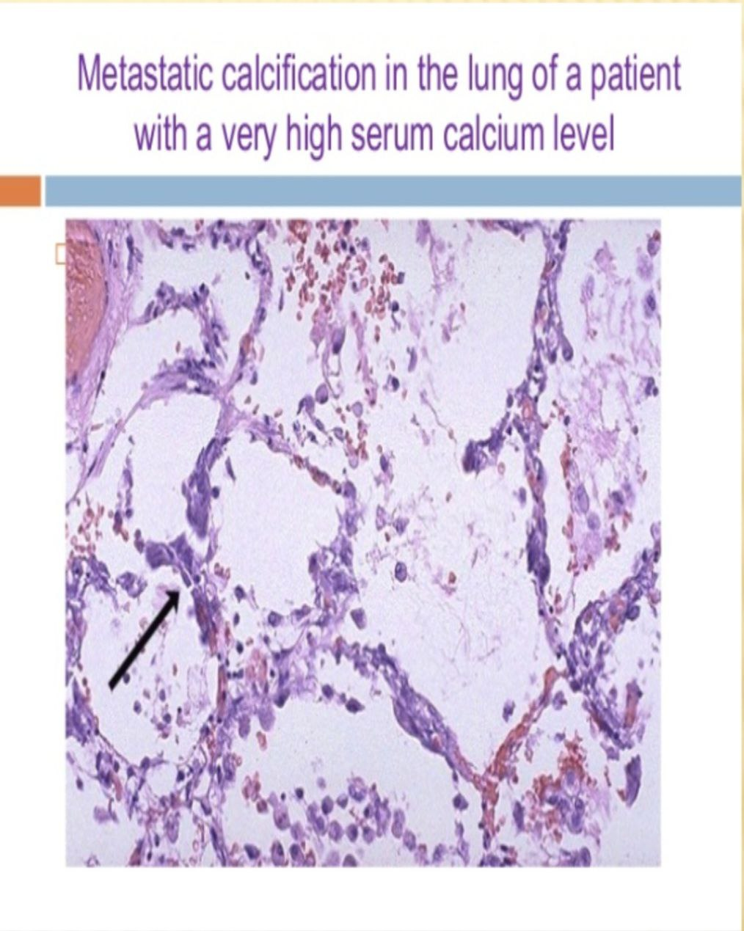

Slide 14


