Slide 1
Host–pathogen interaction

Slide 2
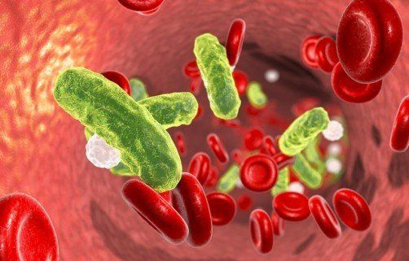
Bacteremia
Bacteremia is defined as the presence of viable bacteria in the bloodstream and can occur in daily activities like tooth brushing and some minor medical procedures like dental work but also during infection.
Transient Bacteremia :
Intermitant bacterimeia:
Persistant bacterimeia:
Bacteremia develops when bacteria manage to escape the host immune mechanisms or when the otherwise well-orchestrated immune response fails to control bacterial spread due to inherent or acquired immune defects that are associated with susceptibility to infection.

Slide 3
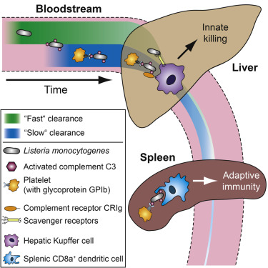

Slide 4
Septicemia
Septicemia is a clinically significant form of bacteremia complicated by toxemia, fever, malaise, and often shock
Septicemia is characterized by the multiplication of microorganisms within the bloodstream and “seeding” into blood from fixed microcolonies present in one or more tissues.
In septicemia, mediators of inflammation are generated systemically, leading to diffuse “leakage” of plasma into the interstitial and sequestration of leukocytes in the microvasculature.
Generation of cytokines, kinins, vasoactive amines, and lipid mediators of inflammation, combined with widespread endothelial damage, leads to profound circulatory disturbances.

Slide 5
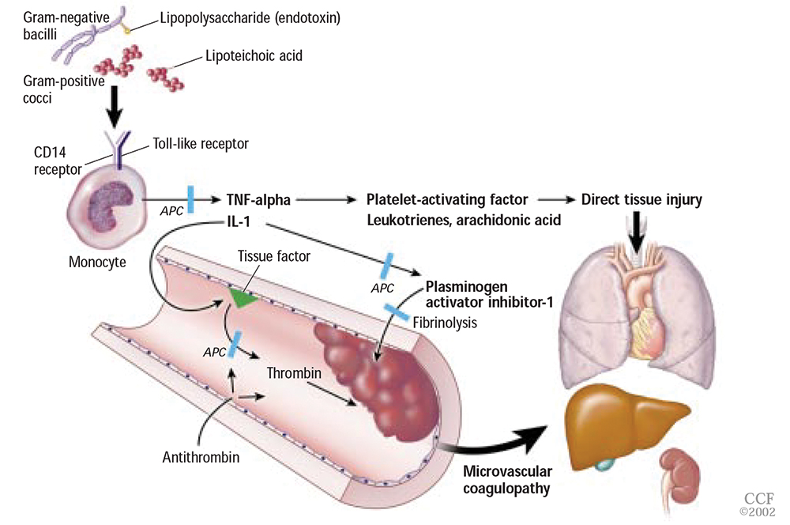

Slide 6
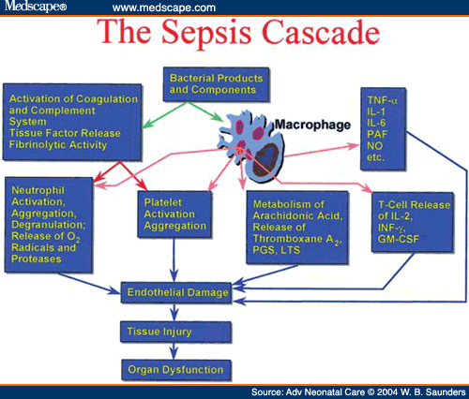

Slide 7
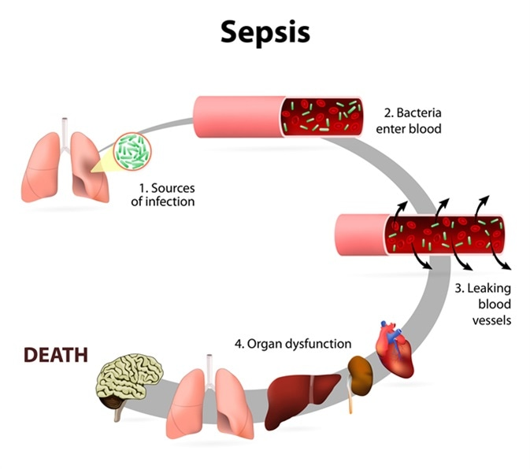

Slide 8
Bacteremia | Septicemia
Bacteremia is the simple presence of bacteria in the blood. | Septicemia is the presence and multiplication of bacteria in the blood.
Bacteremia is not as dangerous as Septicemia. | Septicemia is a potentially life-threatening infection.
Less amount of bacteria are present in blood. | Large amounts of bacteria are present in the blood
This may occur through a wound or infection, or through a surgical procedure or injection. | It can arise from infections throughout the body, including infections in the lungs, abdomen, and urinary tract.
Toxins are not produced. | Toxins may be produced by bacteria.
Bacteremia usually causes no symptoms or it may produce mild fever. | It shows symptoms like chills, fever, prostration, very fast respiration and/or heart rate.
It can resolve without treatment. | Untreated septicemia can quickly progress to sepsis.
Rapidly removed from the bloodstream by the immune system. | Antibiotics will be used to treat the bacterial infection that is causing septicemia.

Slide 9
Toxins
Many bacteria are able to produce poisonous substances called toxins.
Toxins act on the body's cells, tissues, and organs and interfere with important body processes, thereby interrupting normal body functions.
Those microorganisms that produce toxins are said to be toxigenic.
Toxemia- The condition in which toxins are produced is called toxemia.

Slide 10
Toxins
Exotoxins
Endotoxins

Slide 11
Exotoxins
Exotoxins are proteins produced by bacteria during their growth and liberated into their surrounding environment.
Exotoxins are produced chiefly by Gram‐positive bacteria, and the genes for this production are carried primarily on the plasmids.
exotoxins are not heat stable
  destroyed rapidly at 60°C
    except Staphylococcal enterotoxin

Slide 12
Enterotoxins: -act on the GI tract to cause diarrhea
Cholera toxin-Vibrio cholera,
Neurotoxin-act on the nerves or NMJ to cause paralysis tetanus toxin- Clostridium tetani,
botulinum toxin- Clostridium botulinum
Pyrogenic exotoxins- stimulate release of cytokines
cause rash, fever, toxic shock syndrome toxin –staphylococcus species
Tissue invasive exotoxins-enzymes that destroy tissue to allow bacteria to invade the host alpha toxin- Clostridium perfringens

Slide 13
Immunity against toxin
Toxoids are preparations of exotoxins chemically treated to destroy their toxigenicity but retain their ability to elicit antibody formation in the body. Toxoids are currently available to protect against diphtheria and tetanus (the DT injection).
Toxoidation: the process of converting toxin to toxoid
It is possible to immunize against the effects of exotoxins by injecting toxoids into individuals.
Antitoxins: In response to toxins, the body produces special antibodies called antitoxins, which unite with and neutralize the toxins, providing defense against disease.

Slide 14
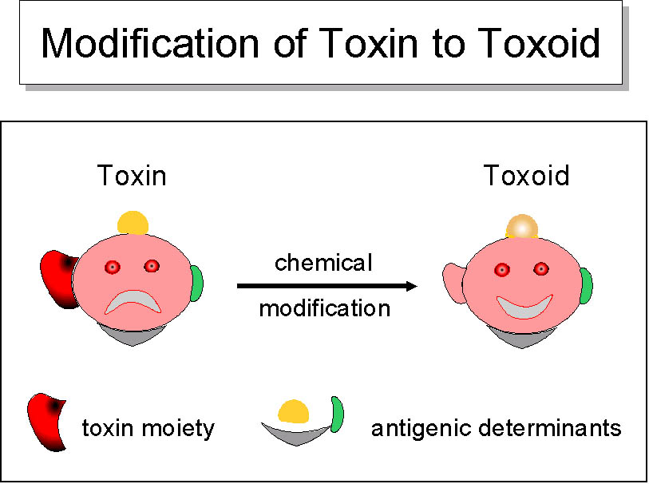

Slide 15
Endotoxins
Endotoxins are portions of the cell wall of Gram‐negative bacteria.
They consist primarily of lipopolysaccharides and are released when bacteria break apart during the process of lysis.
Since lysis occurs during antibiotic therapy, the effects of endotoxins can bring about a worsening of symptoms during the recovery period. This condition is called endotoxin shock. It is accompanied by fever, chills, aches, and cardiovascular collapse.

Slide 16
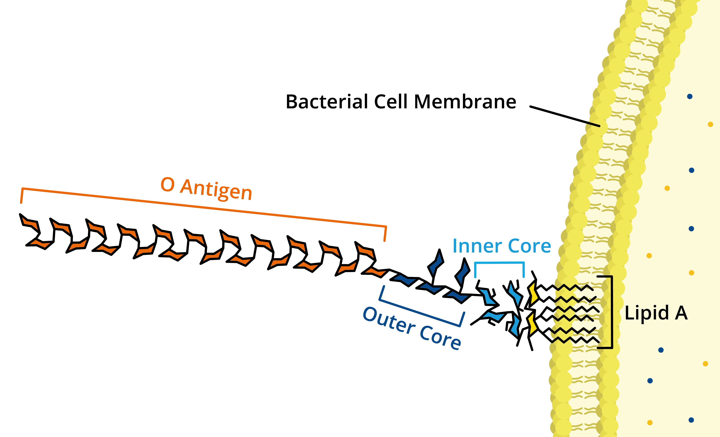

Slide 17
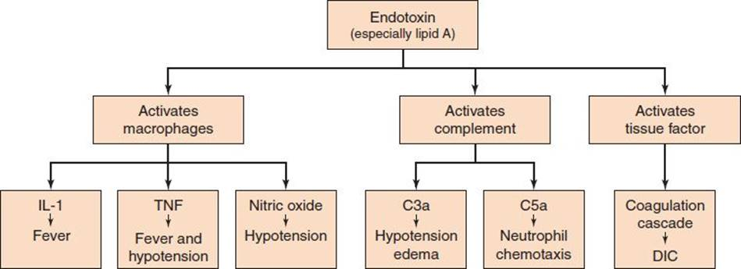

Slide 18
 | Exotoxin | Endotoxin
Type of organism | Produced by both Gram +ve and –ve bacteria | Found in Gram –ve bacteria only
Location | Synthesized in cytoplasm and secreted out by live bacteria | Part of outer membrane of bacterial cell. Released only by dead bacteria
Chemical nature | protein | lipopolysaccharide
Heat stability | Relatively unstable | Relatively stable
toxicity | Highly toxic | Moderately toxic
toxoid | Can be converted to toxoid | Not converted to toxoid
immunogenicity | Highly immunogenic | Weakly immunogenic
Gene location | Either in chromosome or plasmid | Bacterial chromosomes
specificity | Exotoxins are enzymes; this makes them highly specific in their mechanism and for their host cells. | Endotoxins are comparatively not very specific in nature

